Slide 1

AQA English Language Paper 1 Section – Q3: Structure
“We’ll do it today, son, I know we will.” That’s what my father said to me on that fateful day ten years ago. Before his coughing and spluttering, when he wasn’t pierced with medical serpent wires, when the nurse looked at me with those pitiful blue eyes that had done the same thing countless times before. Different people, different rooms, same fate.
We are now going to focus on structure and structural analysis.
Look again at paragraphs 4 and 7 from the text.
Draw an emoji next to each of the two paragraphs to describe the mood or tone or each paragraph.
How does the writer make each paragraph have a different mood or tone?
Why is the end of each paragraph here so powerful? Explain your interpretations.
Paragraph 4
You did the same with James, named after your father, holding his hand as his journey through the vicissitudes of life was just beginning. Just as you had done years ago, just as your father and his father had done the same. The same people, the same place, the same destiny.
Paragraph 7

Slide 2

“We’ll do it today, son, I know we will.” That’s what my father said to me on that fateful day ten years ago. Before his coughing and spluttering, when he wasn’t pierced with medical serpent wires, when the nurse looked at me with those pitiful blue eyes that had done the same thing countless times before. Different people, different rooms, same fate.
This paragraph has a very different tone to most of the text. It is sad because the narrator recalls the death of his father and how he was dying in hospital. He ends the paragraph with a powerful but tragic sentence: “Different people, different rooms, same fate.” This implies that death is something we will all experience, but in different places. Much of the text is hopeful and reveals the narrator’s joy, but this part changes tone and reveals to us the narrator’s tragedies, too.
Paragraph 4
You did the same with James, named after your father, holding his hand as his journey through the vicissitudes of life was just beginning. Just as you had done years ago, just as your father and his father had done the same. The same people, the same place, the same destiny.
This paragraph connects to the paragraph 4 because it mentions the narrator’s father again, but this time the mood is one of joy. The narrator’s son has taken the place of the narrator when he was at the football with his father. He is beginning his life’s journey. The paragraph ends with a similar sentence to the other one, but now it is positive. People will experience the same footballing destiny and experiences.
Paragraph 7

Slide 3
Learning outcomes
To describe how the writer uses tone and place throughout the extract
To explain how the writer alters tone and place throughout the extract
To evaluate why the structure affects us as readers

Slide 4

Beginning
Place
Tone
Character
Perspective
Mood
Middle
Time
Topic
Ending
Structure can be difficult to understand and analyse, but one way of exploring it is through changes in tone and mood.
It is rare for a text to have the same tone throughout. Changes in tone and mood reflect a change in perspective for the characters or the narrator.
Much of the text we are exploring today is positive and joyful, but there are moments where the mood and tone radically alter and this changes the narrator’s perspective, which in turns alters how we think and feel about the story.

Slide 5

Let’s explore the rest of the text and its structure
Next to each paragraph, draw an emoji or write down a word (such as ‘joy’) to reflect the mood of each section of the story.
For each paragraph, explain how each mood is shown. Example: The narrator explains his awe at how the whole town unites for the football match.
Evaluate how the changes in mood affect the reader. The ending of the text focuses us on the tension of the match and its importance to the narrator.

Slide 6


This cavern of echoes means everything to you. It’s where you came with your dad every weekend with thousands of others just like you: ordinary families, ordinary lives, ordinary houses and mundane days of schooling, working, being a dad, a mum, a brother or sister. But this isn’t an ordinary day or an ordinary place, this is where hopes and dreams are built, where anxious murmurs mix with raucous roars of delight in a cacophony of passion, doubt and ecstasy.
The opening is mostly positive. The narrator explains the importance of the stadium and the football for him but also explains how thousands of ordinary people experience the extraordinary when they go to the stadium. It is a place filled with sheer delight but also doubt.
Paragraph 1
Amongst the masses you find your seat – your seat – the one your father’s blood and toil bought for you, the one green plastic folding mass-produced product that is just like the tens of thousands that surround it in a sea of regularity. But its yours. It’s the place where you sat with your hands over your pallid face as the eternal doom of relegation threatened, the place where you leapt as close to the sun as you could when that tiny sparkle of silver reflected onto the faces of wide smiles and piercing evocations of a glorious past rekindled. A symbol of your ancestors, your people, your future.
We’ve already explored this section for Q2, but it highlights the power of the stadium on a personal level for the narrator, including the significance of having their own seat and place, and how key moments from his past at the stadium mean the football is an important part of his identity.
Paragraph 2

Slide 7

You’re here again. It’s January and it’s cold, to the point where scarves, gloves, padded coats and scalding coffee desperately battle with the elements that hit and kick and thump you for hours. That’s irrelevant though, all you care about is those 23 people on the pitch – 11 heroes, 11 enemies and the judge who chooses your fate.
This paragraph describes a cold day in January at the stadium – a specific date. It describes how the weather attacks the spectators, but all that matters to the narrator is the football. This is a serious tone.
Paragraph 3
“We’ll do it today, son, I know we will.” That’s what my father said to me on that fateful day ten years ago. Before his coughing and spluttering, when he wasn’t pierced with medical serpent wires, when the nurse looked at me with those pitiful blue eyes that had done the same thing countless times before. Different people, different rooms, same fate.
We’ve already explored this section, but it has a very sad and tragic tone as the narrator switches to their past and what happened to their father.
Paragraph 4

Slide 8
And as you turn to the seat next to you and you see the ghost of your father, who carried out his rituals, who wore the crest proudly above his heart and switched his gaze between the game and you, holding you as tight as he could when the ball shuddered into the back of their net, precious tears dripping along the crags of his ageing cheeks – the only time you’d seen him cry – you see he is still there as you look down to your own child. Just a boy, but his heart and soul is with you, with him, with all of us.
This section links to the previous as it mentions the narrator’s father, but it is far more positive as the narrator remembers a joyful memory they had with their father, as he cried tears at the football. The narrator describes how there is a communal spirit at the football as his father is still there with him in spirit and everyone there has their heart and soul in the game and the stadium.
Paragraph 5
All roads of the town twist and turn towards the turrets and the colossal walls of your colosseum. That morning the town had moved en masse: little doors opened in synchronicity as the soldiers of fortune said goodbye to those they left behind and marched towards another day, another battle, another victory, stalemate or defeat.
This section zooms out and we are outside the stadium and looking at the roads that wind towards the stadium. The outside of the stadium is described using powerful imagery such as “turrets” and “colosseum”. This military imagery is continued as the fans are described as “soldiers of fortune” and leaving those left behind.”
Paragraph 6

Slide 9
You did the same with James, named after your father, holding his hand as his journey through the vicissitudes of life was just beginning. Just as you had done years ago, just as your father and his father had done the same. The same people, the same place, the same destiny.
We have explored this section before, but we know it has a joyful tone as the narrator explains how everyone is part of a larger football community and will experience the same things, including the narrator’s son who takes the place of narrator had when with his own father.
Paragraph 7
Now the referee has initiated the match and the ball is kicked for the first time. The swaying songs switch to an almighty cheer and you watch. Watch and wait. Fingers clutching plastic cups, wrapped around mighty flags that fight the chilly breeze, and fingers that nervously twitch and flick as you stare at every pass, every movement, every tackle.
The focus switches to the game that the narrator previously mentioned. The narrator zooms in on key imagery from the spectators, particularly the spectators’ hands and what they hold and do as the game begins.
Paragraph 8

Slide 10



Ten minutes in and your striker is in the box. He’s going to score! He’s going to do it! The crowds crescendo into an unbelievable wall of sound. But he’s felled. He’s taken down. The roars of anticipation instantly transform into intense anger, expectant judgement. Referee!
This section is increasingly tense. Look at how the writer employs lots of short sentences to increase the tension, so we can feel how the spectators feel as the game continues. The narrator’s sense of outrage as shown in the final sentence.
Paragraph 9
He agrees. There is a penalty. He steps up to the spot. Their keeper bounces and bounds like a jester in a court desperate for approval. The whistle goes. Your striker runs up and down briefly, all the eyes are on him. Every single one of them.
The tension continues to increase as the referee gives the team a penalty. The narrator zooms in on key images: the referee, his whistle, the striker running, the eyes of the fans watching.
Paragraph 10
He moves towards the ball. You turn to the seat next to you. There is your child, your father, his father and an endless line of spectres of time past and present. You turn back to the field, the sphere moves towards the rectangle that makes or breaks you that day.
The final paragraph ends on a cliff-hanger as we don’t know whether the ball goes in or not. More and more sentence sentences are used. The narrator reflects back to his father and how the football transcends generations and time.
Paragraph 11

Slide 11


Let’s explore the use of place in the text
You have been given 11 pictures.
Cut these out and put them in order based on the focus of each paragraph in the text.
Explain how the change in places in the text make us think and feel about the story.
Evaluate how the writer has used place to change how the reader thinks and feels. Provide examples.

Slide 12
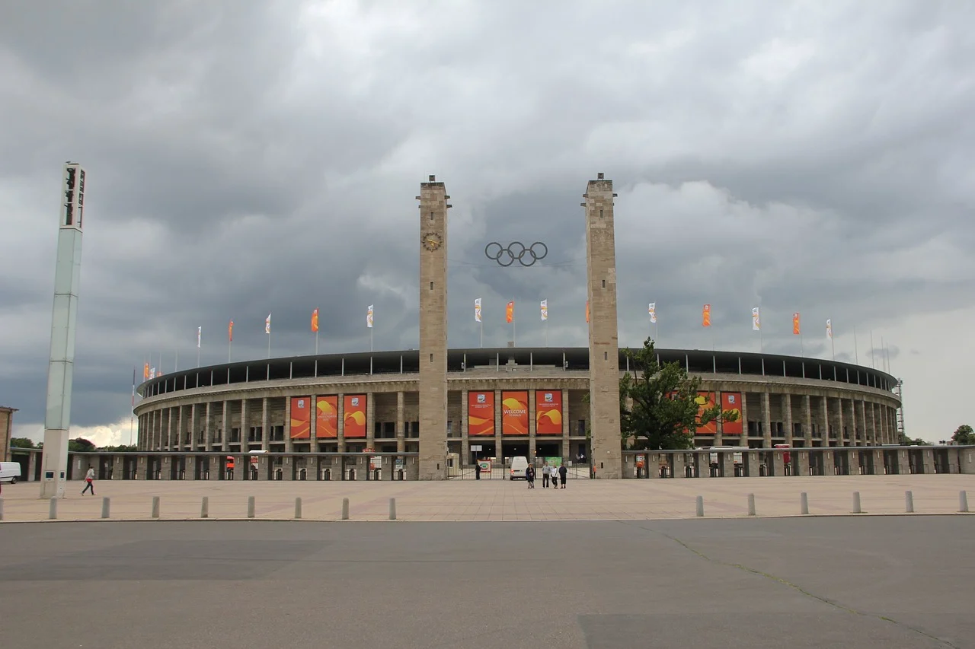


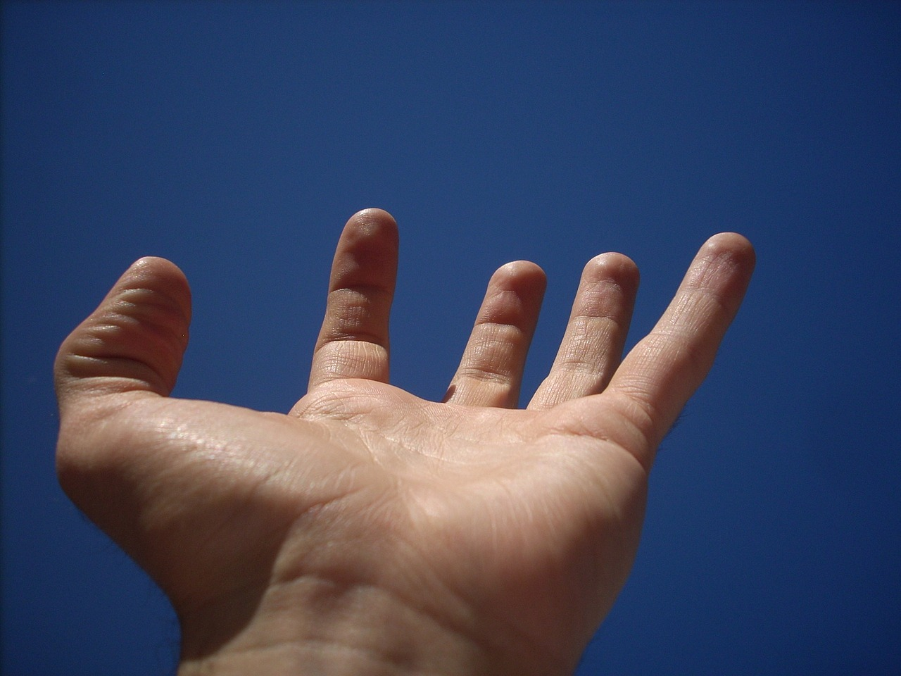






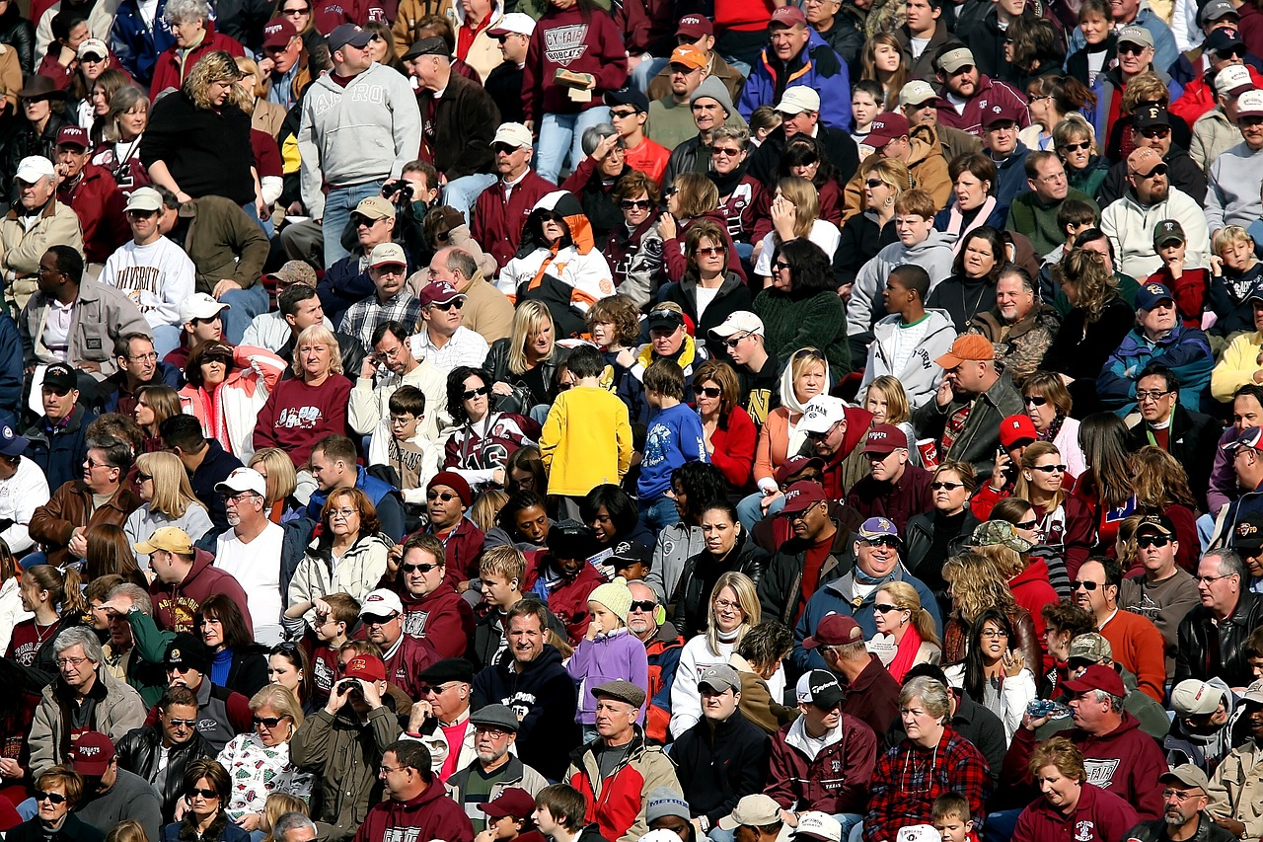

Slide 13
The narrator describes all the ordinary people who experience the extraordinary at the stadium.
The narrator focuses in on their own seat to explain how personal this massive place is to him.
The narrator focuses in on one specific day at the stadium and how cold it is, but also how people only care about the game.
Now the narrator changes time to focus on the narrator’s father in hospital and the tragedy in the narrator’s past.
Then the narrator switches to the time when his father was at the game with him and the narrator saw him cry.
The narrator zooms out to the outside of the stadium and describes the roads filled with fans as they leave home for the game.

Slide 14





Then we switch back to the time when the narrator took his son to his first game.
The narrator changes focus to the present day and the game mentioned before. He focuses in on images of the spectator’s hands to show their emotions.
Now we focus on the events of the game and the uproar as the home crowd think their player has been fouled in the box.
The narrator describes the actions in slow motion as the striker attempts to take the penalty.
The extract ends with the ball flying through the air. We are not told whether the goal is scored or not, so we feel the tension of the crowd.

Slide 15


Plenary: Three Things
Speak to the person next to you and find out three things the person has learnt from today’s lesson. Be prepared to share your ideas.
To describe how the writer uses tone and place throughout the extract
To explain how the writer alters tone and place throughout the extract
To evaluate why the structure affects us as readers

