Slide 1
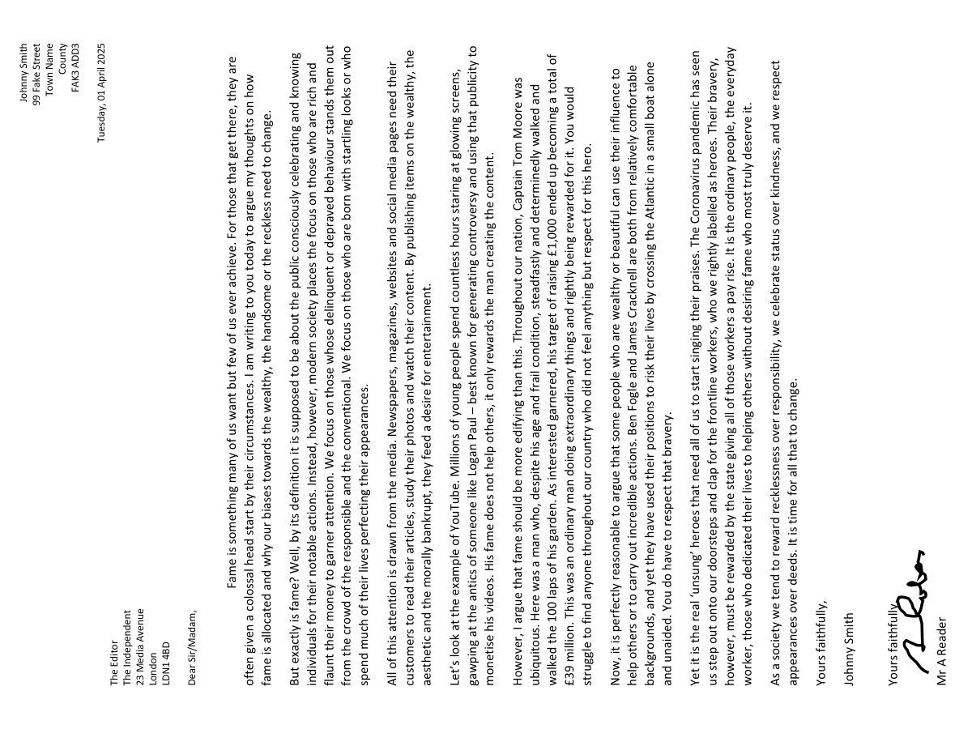
Letter Writing
In magazines and newspapers, readers can write in to the editor to express their opinions on a previously published article.
When they write in to the magazine, they write in the form of a letter.
Look at the example letter given to you.
How is it different to others pieces of non-fiction writing we have studied?
How is the relationship between writer and reader different to a speech or article?
Evaluate which language features are included in the letter and for what effects.

Slide 2
Johnny Smith
99 Fake Street
Town Name
County
FAK3 ADD3
Tuesday, 01 April 2025
The Editor
The Independent
23 Media Avenue
London
LDN1 4BD
Dear Sir/Madam,
Fame is something many of us want but few of us ever achieve. For those that get there, they are often given a colossal head start by their circumstances. I am writing to you today to argue my thoughts on how fame is allocated and why our biases towards the wealthy, the handsome or the reckless need to change.
But what exactly is fame? Well, by its definition it is supposed to be about the public consciously celebrating and knowing individuals for their notable actions. Instead, however, modern society places the focus on those who are rich and flaunt their money to garner attention. We focus on those whose delinquent or depraved behaviour stands them out from the crowd of the responsible and the conventional. We focus on those who are born with startling looks or who spend much of their lives perfecting their appearances.
All of this attention is drawn from the media. Newspapers, magazines, websites and social media pages need their customers to read their articles, study their photos and watch their content. By publishing items on the wealthy, the aesthetic and the morally bankrupt, they feed a desire for entertainment.
Let’s look at the example of YouTube. Millions of young people spend countless hours staring at glowing screens, gawping at the antics of someone like Logan Paul – best known for generating controversy and using that publicity to monetise his videos. His fame does not help others, it only rewards the man creating the content.
However, I argue that fame should be more edifying than this. Throughout our nation, Captain Tom Moore was ubiquitous. Here was a man who, despite his age and frail condition, steadfastly and determinedly walked and walked the 100 laps of his garden. As interested garnered, his target of raising £1,000 ended up becoming a total of £39 million. This was an ordinary man doing extraordinary things and rightly being rewarded for it. You would struggle to find anyone throughout our country who did not feel anything but respect for this hero.
Now, it is perfectly reasonable to argue that some people who are wealthy or beautiful can use their influence to help others or to carry out incredible actions. Ben Fogle and James Cracknell are both from relatively comfortable backgrounds, and yet they have used their positions to risk their lives by crossing the Atlantic in a small boat alone and unaided. You do have to respect that bravery.
Yet it is the real ‘unsung’ heroes that need all of us to start singing their praises. The Coronavirus pandemic has seen us step out onto our doorsteps and clap for the frontline workers, who we rightly labelled as heroes. Their bravery, however, must be rewarded by the state giving all of those workers a pay rise. It is the ordinary people, the everyday worker, those who dedicated their lives to helping others without desiring fame who most truly deserve it.
As a society we tend to reward recklessness over responsibility, we celebrate status over kindness, and we respect appearances over deeds. It is time for all that to change.
Yours faithfully,
Johnny Smith

Slide 3

Letters
Letters are either for very personal purposes (between family members) or for very formal reasons (businesses contacting customers or councils contacting people, for instance).
We tend to use social media, phone apps and email for most written communication now, but letters are still used by many businesses to relay important information to people.
They have very specific features that aren’t seen in other types of non-fiction writing.

Slide 4
Learning outcomes
To describe the key features of letters
To explain how we set out a letter to make it effective
To evaluate the effectiveness of the beginning of our letter using success criteria

Slide 5

Let’s look at the letter again and explores the format of writing
Glue the letter into the centre of a page of your exercise book.
Around the letter annotate (label) all the key features you can see being used.
Look carefully at the layout of the letter. What do you notice? Annotate these features.
This is a writing to argue piece. Why is the use of language convincing for the reader? Provide examples.

Slide 6
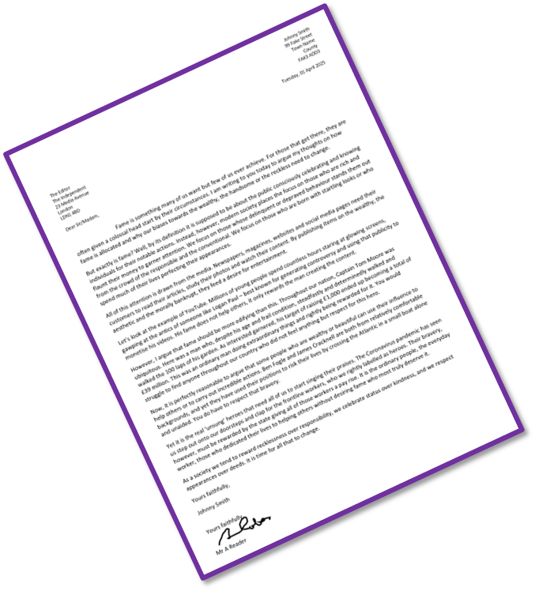
The address of the receiver This is included on the left below the writer’s address.
Writer’s address at the top right and the date written below.
Directly addressing the receiver: If you know the name of the person you are writing it, you write it down formally (Mr A Name, Mrs A Name). However, if you don’t know their name you would put ‘Dear Sir/Madam’.
The date is usually included so the reader knows when it was sent.
Introductory paragraph: This sets out why you are writing to the receiver and what you hope to achieve through the letter.
Paragraphs linked with connectives: This is to ensure your writing flows well for the reader and links your ideas together. It provides a clear structure to your letter and writing.
The language used is very formal, so extensive vocabulary is employed and a serious tone is established.
However, the writer also uses writing to argue techniques like rhetorical questions and emotive language to attempt to make their argument convincing.
Signed off with ‘Yours sincerely’ or ‘Yours faithfully’. If you were writing to someone whose name you don’t know, you would sign off with ‘Yours faithfully’. A signature shows the letter is genuine and authentic. If you know their name then you put ‘Yours sincerely’.

Slide 7
Letters
Letters are either for very personal purposes (between family members) or for very formal reasons (businesses contacting customers or councils contacting people, for instance).
Letters to the editor are a little different in that whilst the writer contacts the editor, they know their letter may be published in the magazine or newspaper for all readers to see. Therefore, whilst it is directed at the editor, the writer knows their ideas are being read by a much wider audience.

Slide 8
Fame is something many of us want but few of us ever achieve. For those that get there, they are often given a colossal head start by their circumstances. I am writing to you today to argue my thoughts on how fame is allocated and why our biases towards the wealthy, the handsome or the reckless need to change.
The introductory paragraph sets out why the writer has contacted the editor: to show their anger and frustration at modern attitudes towards fame and how we should be celebrating people for their achievements rather than their looks or wealth. The hyperbole help to emphasise the writer’s opinion to the editor.
But what exactly is fame? Well, by its definition it is supposed to be about the public consciously celebrating and knowing individuals for their notable actions. Instead, however, modern society places the focus on those who are rich and flaunt their money to garner attention. We focus on those whose delinquent or depraved behaviour stands them out from the crowd of the responsible and the conventional. We focus on those who are born with startling looks or who spend much of their lives perfecting their appearances.
The writer then moves on to giving a definition of fame because it helps support their argument.
The writer argues that fame is given to people who have money or carry out dangerous stunts to gain fame.
They begin by using a rhetorical question to ask the editor (and the newspaper readers) to consider what they think ‘fame’ means.
The writer uses emotive language such as “delinquent or depraved behaviour”.

Slide 9
However, I argue that fame should be more edifying than this. Throughout our nation, Captain Tom Moore was ubiquitous. Here was a man who, despite his age and frail condition, steadfastly and determinedly walked and walked the 100 laps of his garden. As interested garnered, his target of raising £1,000 ended up becoming a total of £39 million. This was an ordinary man doing extraordinary things and rightly being rewarded for it. You would struggle to find anyone throughout our country who did not feel anything but respect for this hero.
The writer later focuses in on an example of someone who has achieved fame because of their actions by raising money for charity.
Previously, the writer had provided an example of an ‘influencer’ they feel carries out dangerous or questionable stunts to gain fame and therefore money.
They use powerful adjectives like “ubiquitous”, adverbs like “steadfastly” and “determinedly” to argue that Captain Tom deserved the fame he garnered.
The writer included statistics to support their argument and used direct address to focus on the editor and the newspaper’s readers.
Yet it is the real ‘unsung’ heroes that need all of us to start singing their praises. The Coronavirus pandemic has seen us step out onto our doorsteps and clap for the frontline workers, who we rightly labelled as heroes. Their bravery, however, must be rewarded by the state giving all of those workers a pay rise. It is the ordinary people, the everyday worker, those who dedicated their lives to helping others without desiring fame who most truly deserve it.
As a society we tend to reward recklessness over responsibility, we celebrate status over kindness, and we respect appearances over deeds. It is time for all that to change.
The writer provides another example to argue that the public workers during the pandemic deserve recognition and fame for their actions, and this needs to go beyond clapping in public to more tangible rewards such as better pay.
The conclusion of the letter sums up the writer’s argument and it ends with a short and powerful sentence to leave the readers thinking about their argument.

Slide 10
Let’s focus on the exam task
‘It is people who have extraordinary skill, courage and determination who deserve to be famous, not those who have good looks or lots of money or behave badly.’
Write a letter to the editor of a newspaper in which you argue your point of view in response to this statement.
Discuss: What is your view on this statement? Do you agree or disagree with it?
Bonus Challenge: What ideas would you use to support your perspectives?

Slide 11
Write out the start of your letter now
Key feature | I have included this (Tick):
Address at the top-right (you can make this up)
Today’s date underneath
Reader’s address on left below (you can make this up)
Dear Sir/Madam/Dear Editor,
Indented first paragraph
Introductory paragraph that sets out the purpose of my letter
My tone is appropriately formal.
Set out your page as if you were writing a formal letter.
Write out your introductory paragraph setting out your argument on the statement.
Not sure how to start?
Fame is a controversial, divisive but also fascinating topic because…
‘It is people who have extraordinary skill, courage and determination who deserve to be famous, not those who have good looks or lots of money or behave badly.’

Slide 12

Self-assessment
Key feature | I have included this (Tick):
Address at the top-right (you can make this up)
Today’s date underneath
Reader’s address on left below (you can make this up)
Dear Sir/Madam/Dear Editor,
Indented first paragraph
Introductory paragraph that sets out the purpose of my letter
My tone is appropriately formal.
Use the checklist you have been given to self-assess the quality and accuracy of the start of your formal letter.
Once you can see your strengths and your areas to improve, go back and make your changes.

Slide 13
Key feature | I have included this
Address at the top-right (you can make this up)
Today’s date underneath
Reader’s address on left below (you can make this up)
Dear Sir/Madam/Dear Editor,
Indented first paragraph
Introductory paragraph that sets out the purpose of my letter
My tone is appropriately formal.
Key feature | I have included this
Address at the top-right (you can make this up)
Today’s date underneath
Reader’s address on left below (you can make this up)
Dear Sir/Madam/Dear Editor,
Indented first paragraph
Introductory paragraph that sets out the purpose of my letter
My tone is appropriately formal.
Key feature | I have included this
Address at the top-right (you can make this up)
Today’s date underneath
Reader’s address on left below (you can make this up)
Dear Sir/Madam/Dear Editor,
Indented first paragraph
Introductory paragraph that sets out the purpose of my letter
My tone is appropriately formal.
Key feature | I have included this
Address at the top-right (you can make this up)
Today’s date underneath
Reader’s address on left below (you can make this up)
Dear Sir/Madam/Dear Editor,
Indented first paragraph
Introductory paragraph that sets out the purpose of my letter
My tone is appropriately formal.

Slide 14

Plenary: Learning Pyramid
To describe the key features of letters
To explain how we set out a letter to make it effective
To evaluate the effectiveness of the beginning of our letter using success criteria
Most important element learnt
Second most important element learnt
Third most important element learnt
Fourth most important element learnt
Fill in your pyramid with the five most important elements you have learnt from the lesson.
Fifth most important element learnt

