Slide 1
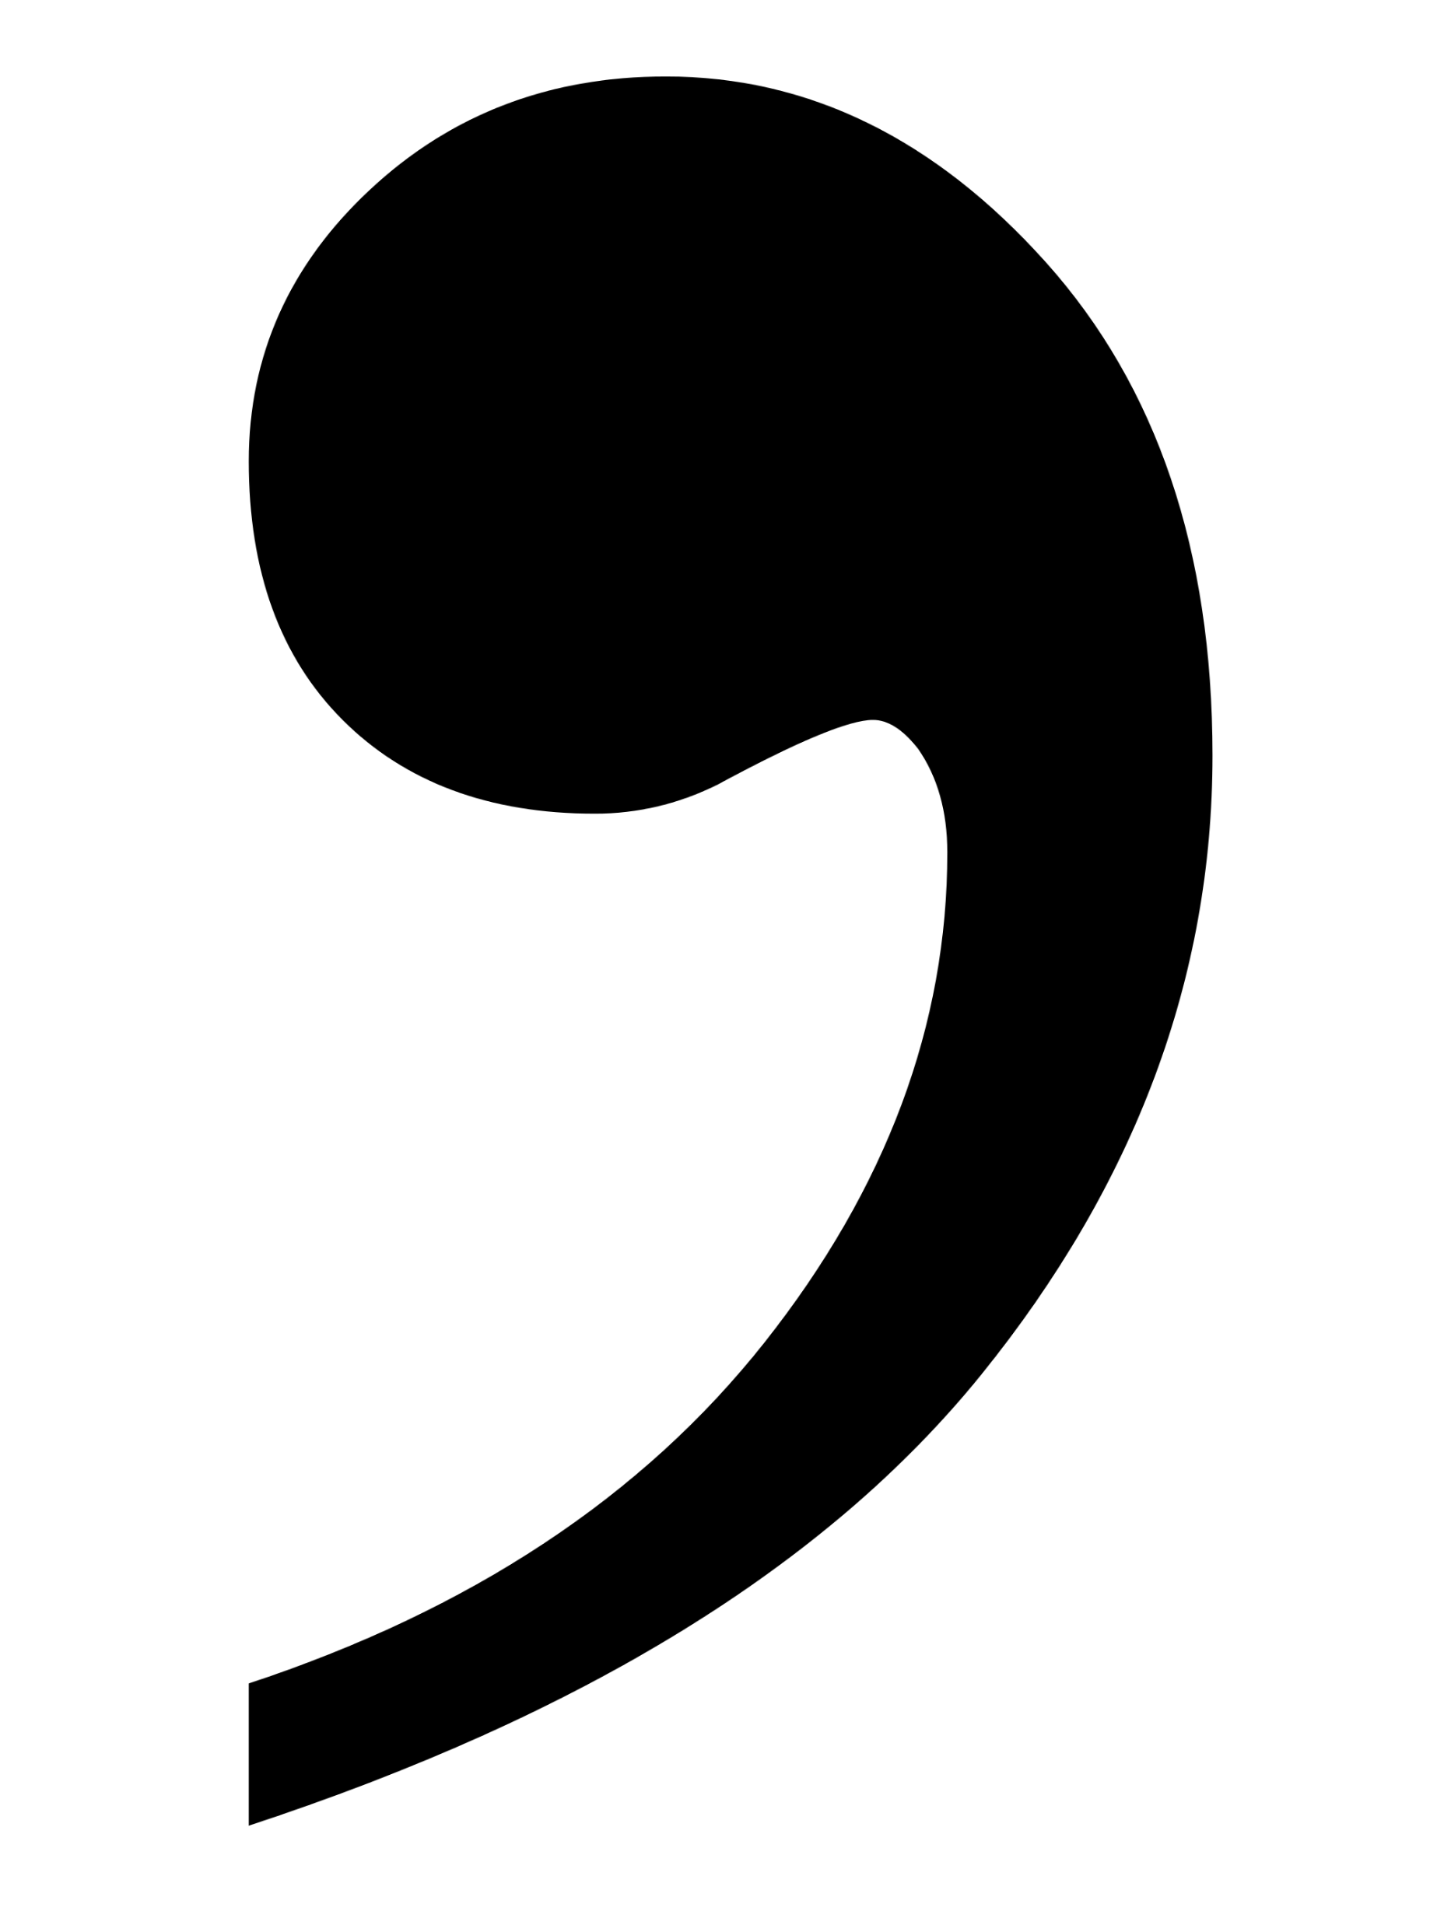
Commas
He looked me dead in the eyes with a piercing, menacing stare and said, “You think this is over, Steven, but it isn’t.” He spoke through a cold, calculating and callous smile.
He looked me dead in the eyes with a piercing menacing stare and said “You think this is over Steven but it isn’t.” He spoke through a cold calculating and callous smile.
What are the differences between these two short quotations? Circle or highlight them on your sheet.
How has the use of punctuation helped the reader to understand the text better in the first example?
What are the benefits of using commas in your own writing and how can they aid your readers? Provide examples.

Slide 2
He looked me dead in the eyes with a piercing, menacing stare and said, “You think this is over, Steven, but it isn’t.” He spoke through a cold, calculating and callous smile.
He looked me dead in the eyes with a piercing menacing stare and said “You think this is over Steven but it isn’t.” He spoke through a cold calculating and callous smile.
He looked me dead in the eyes with a piercing, menacing stare and said, “You think this is over, Steven, but it isn’t.” He spoke through a cold, calculating and callous smile.
He looked me dead in the eyes with a piercing menacing stare and said “You think this is over Steven but it isn’t.” He spoke through a cold calculating and callous smile.
He looked me dead in the eyes with a piercing, menacing stare and said, “You think this is over, Steven, but it isn’t.” He spoke through a cold, calculating and callous smile.
He looked me dead in the eyes with a piercing menacing stare and said “You think this is over Steven but it isn’t.” He spoke through a cold calculating and callous smile.
He looked me dead in the eyes with a piercing, menacing stare and said, “You think this is over, Steven, but it isn’t.” He spoke through a cold, calculating and callous smile.
He looked me dead in the eyes with a piercing menacing stare and said “You think this is over Steven but it isn’t.” He spoke through a cold calculating and callous smile.
He looked me dead in the eyes with a piercing, menacing stare and said, “You think this is over, Steven, but it isn’t.” He spoke through a cold, calculating and callous smile.
He looked me dead in the eyes with a piercing menacing stare and said “You think this is over Steven but it isn’t.” He spoke through a cold calculating and callous smile.
He looked me dead in the eyes with a piercing, menacing stare and said, “You think this is over, Steven, but it isn’t.” He spoke through a cold, calculating and callous smile.
He looked me dead in the eyes with a piercing menacing stare and said “You think this is over Steven but it isn’t.” He spoke through a cold calculating and callous smile.
He looked me dead in the eyes with a piercing, menacing stare and said, “You think this is over, Steven, but it isn’t.” He spoke through a cold, calculating and callous smile.
He looked me dead in the eyes with a piercing menacing stare and said “You think this is over Steven but it isn’t.” He spoke through a cold calculating and callous smile.
He looked me dead in the eyes with a piercing, menacing stare and said, “You think this is over, Steven, but it isn’t.” He spoke through a cold, calculating and callous smile.
He looked me dead in the eyes with a piercing menacing stare and said “You think this is over Steven but it isn’t.” He spoke through a cold calculating and callous smile.
Notes:
To print out and copy for all students

Slide 3
Learning outcomes
To describe different ways of using commas effectively
To assess how I can improve my writing using commas
To evaluate how I have used commas previously and how I can make improvements to my work

Slide 4

Progress Line – The Beginning
On the board use your Post-it note to give yourself a score out of 10 in terms of your understanding of using commas effectively.
3
Know they go in lists
1
10
Notes:
Draw a line on your whiteboard or have a poster on display where students can use post-its or white tack paper onto the line

Slide 5

Why do we need commas?
Commas are used to help readers break down sentences. They act as mini pauses for the reader, but they also help to separate smaller ideas down as well.
Moreover, they can help us avoid confusion:
“Let’s eat, Grandma!”
“Let’s eat Grandma!”
Commas can save lives!

Slide 6
We will begin a new narrative piece now
Write the opening to a story about a life-saving rescue.
In this unit we will focus on narrative writing.
You have been asked to write the opening to a story about a life-saving rescue.
Plan out an idea for a narrative about this. If you’re not sure, plan a narrative about someone saving someone else from drowning.
Bonus Challenge: Plan a clear beginning, middle and end to your narrative.

Slide 7






A life-saving rescue is a brilliant idea to work with!
Rescuing an animal
Rescuing someone hurt during sport or exercise
Space rescue
Rescue on another planet
Rescuing an alien!
A rescue at sea.
A rescue on a mountain.
A rescue underground.
A story from the perspective of a firefighter, police officer or paramedic
Rescue during a conflict
Rescuing an enemy or foe
You can choose any ‘life-saving rescue’ you want! Like Sci-Fi? Write a Sci-Fi story. Like romance stories? Write about rescuing someone and falling in love!

Slide 8
There are many different ways of using commas
We will explore some of the most important ways today.
Look at your information sheet and choose one of the following challenges:
Write out three sentences using the red options.
Write out three sentences using the amber options.
Write out three sentences using the green options.

Slide 9






Link together two independent clauses for longer sentences (for and nor but or yet so - FANBOYS):
Steven was frightened by the monster, but he did not show his fear.
He knew he had to win, and he was determined to make it happen.
Using commas for embedded sentences.
Embedded sentences include a dependent clause in the middle of a sentence.
Steve, who was brave and smart, managed to outwit the monster.
The monster, who was known throughout the land, was hated by all the people.
Using commas in lists:
The vampire was hungry, tired, upset and couldn’t see.
Using commas for speech punctuation:
The Sheriff shouted, “Get back here, Robin Hood!”
Robin laughed and replied, “Not a chance!”
“You will regret this,” retorted the Sheriff.
“Unlikely,” replied Robin, “I’m already three steps ahead of you!”
Using commas for dependent clauses:
Although he was scared, Steve produced a plan.
A dependent clause cannot exist on its own, it is dependent on another clause to make sense.
Steve came up with a plan – (Independent)
Although he was scared, … (Dependent)
Using commas for transition words such as connectives and adverbial starters:
Consequently, the gold was given to the poor of Sherwood.
However, the Sheriff could do nothing.

Slide 10

Now let’s peer assess our use of commas!
Swap work with the person nearest to you.
When you have the other student’s work, carefully analyse their sentences and ensure they have used commas accurately.
If they have made any mistakes, go back and make corrections for them in a red pen.
Additionally, provide them with feedback on how they can further improve their use of commas.
Although you have used commas in lists accurately, now try using them for dependent clauses.

Slide 11

Using the feedback provided by your partner, go back over one of your older pieces of writing
Try to push your use of commas on to the next level. For instance, you could include embedded clauses in your writing or use commas to indicate connectives at the beginning of sentences.
Revisiting, revising and improving your writing is an important skill in English.

Slide 12
Let’s recap how to use commas effectively!
Around the room are six posters, each with a key symbol on.
Move to one poster and write down the rule for using commas in this way.
Move to one poster and write down an example of using commas in this way.
Move to one poster and explain how using commas in this way aids the reader.
You will have 3 minutes on each poster. You must complete all six posters.
Notes:
Print posters on A3 if possible

Slide 19
Plenary: Progress Line
3
Know they go in lists
9
Understand how to use commas in lists, embedded clauses and speech punctuation.
On the board use your Post-it note to give yourself a score out of 10 in terms of your understanding of how to use commas effectively.
Write down on the Post-it note how you feel about the learning outcomes now. What else would you like to know?
To describe different ways of using commas effectively
To assess how I can improve my writing using commas
To evaluate how I have used commas previously and how I can make improvements to my work
1
10

