Slide 1

English Language Paper 1 – Q2: Language Analysis
In the previous lesson we began to explore Paper 1 Section A.
What skills are you asked to show off for Q2?
How can you ensure you answer Q2 effectively?
Why is it more important to explain the effects of devices than just mention the devices themselves?

Slide 2

Q1 (4 marks)
Identifying
Question 1 will ask you to focus on a specific section of the text.
In the case of the football text, the question asks you to focus on lines 1 to 6.
There are four sections to this question which are all multiple choice.
Success criteria for Q1
Read this part of the text carefully
Identify the information that best fits the three options for each question

Slide 3
Learning outcomes
To describe the use of language in the extract
To explain how we can improve our language analysis in Q2
To apply our understanding of Q2 skills to our own answers

Slide 4


Today we will focus on language analysis
Q2 will always ask you to analyse the language in a specific part of the text, for a specific reason.
In this paper, the exam task asks: “How does the writer use language here to describe the stadium experience?
We know the narrator wants to show us that he thinks the stadium is incredibly important and personal, but he uses his language to convey his sense of respect and love for it.
The stadium is amazing
A symbol of your ancestors, your people, your future.

Slide 5
Let’s explore language devices in the extract
Amongst the masses you find your seat – your seat – the one your father’s blood and toil bought for you, the one green plastic folding mass-produced product that is just like the tens of thousands that surround it in a sea of regularity. But its yours. It’s the place where you sat with your hands over your pallid face as the eternal doom of relegation threatened, the place where you leapt as close to the sun as you could when that tiny sparkle of silver reflected onto the faces of wide smiles and piercing evocations of a glorious past rekindled. A symbol of your ancestors, your people, your future.
Device | Meaning
Metaphor | Transforming one thing into another, into something that is not literally applicable. The sea is a blue carpet.
Pronouns | Words that replace names, such as you, he, she, they.
Short sentence | A sentence that is short in length, used to emphasise or amplify a specific idea.
Repetition | Repeating words or ideas again and again for emphasis.
Anaphora | Repeating the same words at the start of different clauses
Sibilance | Repeating an ‘s’ sound in different words to create a hissing sound that creates powerful imagery. The strange sinister snake.
Adjectives | Words that describe nouns (people, places, objects). Adjectives can build up tone and mood in description.
Hyperbole | A form of exaggeration used to highlight key ideas or points. The endless expanse.
Go through the extract and annotate all the language devices you can find.
Explain how each one affects the reader and their understanding of the stadium.
Evaluate how the devices convey the narrator’s sense of joy for the stadium and its experiences.

Slide 6
There is so much language you can analyse in this short extract
Amongst the masses you find your seat – your seat
The writer describes the stadium as both impersonal and personal. Although there are masses of seats, the narrator has their own personal one.
the one your father’s blood and toil bought for you,
The seat is so important to the narrator because his father got it for him through “blood and toil”. This metaphor amplifies how much the narrator respects their father and the work he put in to get that seat at the stadium.
the one green plastic folding mass-produced product that is just like the tens of thousands that surround it in a sea of regularity.
The seat is just one “in a sea of regularity” and its just “mass produced” and “green plastic”, all of these adjectives and metaphors combine to emphasise this to the reader,

Slide 7
But its yours.
The narrator repeats the possessive pronoun “yours” to highlight how important the stadium and its experiences are to him.
It’s the place where you sat with your hands over your pallid face as the eternal doom of relegation threatened, the place where you leapt as close to the sun as you could
The narrator remembers memories at the stadium, including the threat of relegation and the glory of winning a trophy. The hyberbole of “eternal doom” and “leapt as close to the sun as you could” reiterate how important this place is to the narrator.
when that tiny sparkle of silver reflected onto the faces of wide smiles and piercing evocations of a glorious past rekindled.
The narrator recalls the moment his team won a trophy and how it affected the spectators. The stadium is a magical place at times, as conveyed through the “wide smiles” and “piercing evocations”.
A symbol of your ancestors, your people, your future.
The stadium is a “symbol of your ancestors, your people, your future”, the repetition of the pronoun and the use of anaphora working together to reiterate just how important the stadium is to the people who go there.

Slide 8

Q2: Language analysis
This question asks you to explore another short section of the extract, this time focusing on how the writer uses language to describe the stadium experience.
You are asked to look at these areas in your analysis:
  • words and phrases
  • language features and techniques
  • sentence forms. [8 marks]
Possible sentence starters to use:
The description of the stadium as… helps the reader to understand that the narrator sees it as…
When we are told: “…” [quotation]
This helps the reader to… because…
The use of [technique] emphasises to the reader…
In particular, the word(s) “…” show us that…
Therefore, the writer makes the reader see…
In this question you will always be given a short extract from the chapter or text you are provided with. You must only write about this extract and not the rest of the chapter.
Plan and write out your answer to this question.
Timed conditions: 12 minutes

Slide 9
It is far more important to explain your interpretations than find language devices
It is good to know a range of devices when you head into the exam, but the most important thing for Q2 is to be able to explain your interpretations.
That shows you understand how the language affects the reader’s thoughts and feelings.
We will explore improving our analyses now.

Slide 10
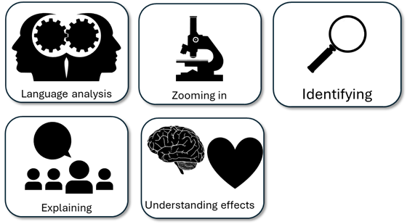
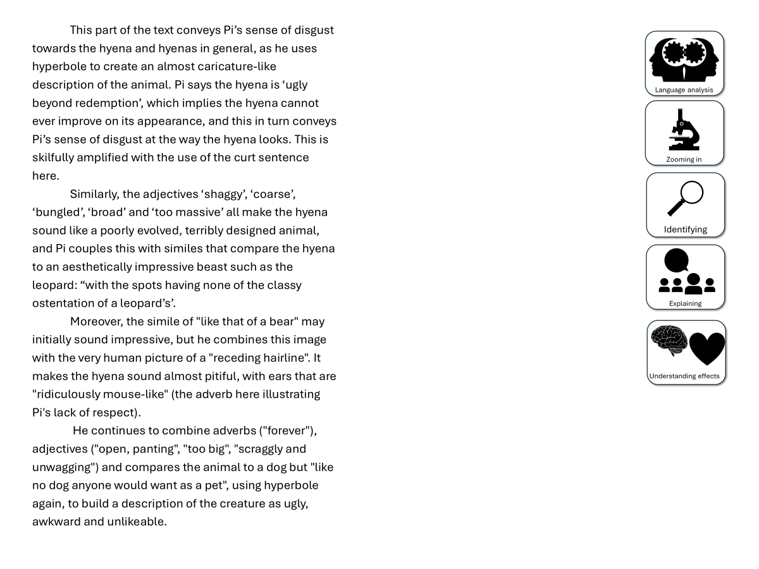
You have been given a good answer for Q2
Go through the answer and find one good example for each of the five skills shown. You could this through arrows, annotations or highlighting.
Bonus Challenge: The student has avoided using words like “shows” too often. What other analytical verbs have they used instead?

Slide 11





The writer presents the stadium experience as one of sheer joy for the narrator, as well as being very personal to him. “Amongst the masses you find your seat – your seat”. The writer describes the stadium as both impersonal and personal. Although there are masses of seats, the narrator has their own personal one.
Additionally, we are told, “the one your father’s blood and toil bought for you”. The seat is so important to the narrator because his father got it for him through “blood and toil”. This metaphor amplifies how much the narrator respects their father and the work he put in to get that seat at the stadium, as well as the importance of the seat to him in terms of what the stadium means to him personally.
Moreover, the narrator uses juxtaposition by describing the seat as “the one green plastic folding mass-produced product that is just like the tens of thousands that surround it in a sea of regularity. “The seat is just one “in a sea of regularity” and its just “mass produced” and “green plastic”, all of these adjectives and metaphors combine to emphasise this to the reader. They they combine this with “But its yours.” The narrator repeats the possessive pronoun “yours” to highlight how important the stadium and its experiences are to him.
Furthmore, the narrator uses anecdotes to reiterate the significance of the stadium to his own personal experiences: “It’s the place where you sat with your hands over your pallid face as the eternal doom of relegation threatened”. The narrator remembers memories at the stadium, including the threat of relegation” and “the place where you leapt as close to the sun as you could” and the glory of winning a trophy. The hyberbole of “eternal doom” and “leapt as close to the sun as you could” reiterate how important this place is to the narrator.
Finally, the extract ends with “A symbol of your ancestors, your people, your future.” The stadium is an symbol of the timelessness of the stadium and its impact on the narrator. The repetition of the pronoun and the use of anaphora working together to reiterate just how important the stadium is to the people who go there.
Notes:
Print for students

Slide 12
Plenary: We will now peer assess our own answers
Swap your answers with another student.
1) What skills did the student use well in their answer?
Example: They found two really good examples like “eternal doom” that showed how the narrator thinks the stadium is important to them.
2) What skills could the student improve on in their answer?
Example: They need to explain why describing relegation as “eternal doom” shows the importance of the stadium.

