Slide 1
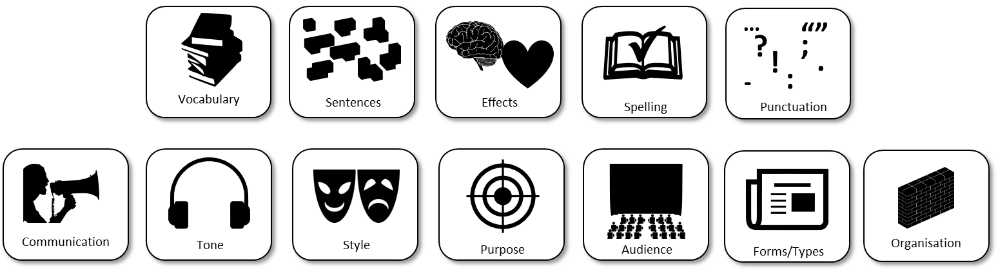
AQA English Language Paper 2 Section B: Article Writing Lesson
‘People protest about the cruelty of keeping animals in captivity, but they seem happy enough to eat meat, keep pets and visit zoos. All animals should be free!’
Write an article for a magazine in which you explain your point of view on this statement.
Write a list of success criteria for getting a top mark for this question.
Bonus Challenge: Which areas will you need to focus on today to make sure you have made improvements for your article?

Slide 2
Learning outcomes
To describe how to gain a top mark in Paper 2 Section B (non-fiction writing)
To explain how you can improve your article based on your previous learning
To evaluate the effectiveness of your learning based on success criteria

Slide 3
Use vocabulary that is ambitious, impressive and professional to add weight to your perspectives.
Use sentence structures for effect to ensure you engage with your audience and meet the purpose of the text.
Ensure your writing affects how the audience feels about the topic you are addressing, including through the use of language (DAFORREST)
Double check your spelling, punctuation and grammar to make sure it is accurate and effective.
Convey your perspectives to the audience clearly and effectively so that the audience understands your perspectives clearly.
Provide a consistent tone to your writing so you come across as knowledgeable, professional and convincing.
Use all of the conventions of article writing and writing to argue to make sure you address the purpose and audience of the text.
Ensure your writing addresses the purpose (why you are writing), the audience (who you are writing to and the form/type (what you are writing).
Think about how you are starting and ending your article and how you have organised your ideas into clear paragraphs with links to make them flow well, as well as subheadings and sections.

Slide 4

This is what you need to achieve for top marks for AO5 (24 marks)
Content
• Communication is convincing and compelling and directly relevant to focus and task
• Tone, style and register are assuredly matched to purpose and audience
• Extensive and ambitious vocabulary with sustained crafting of linguistic devices
You need to communicate your ideas well, so you need to think about what effects your article is having on your audience. Do you convincingly explain your perspectives?
We’ve spent lots of time exploring tone. It is crucial to create a professional and authoritative tone so your audience will take your ideas seriously.
Use the conventions of article writing to engage your audience and explain your ideas
Consider your use of vocabulary and language and how these can interest and engage your audience.

Slide 5






This is what you need to achieve for top marks for AO5 (24 marks)
Organisation
• Varied and inventive use of structural features
• Writing is compelling, incorporating a range of convincing and complex ideas
• Fluently linked paragraphs with seamlessly integrated discourse markers
We have spent some time exploring how we can use connectives to link ideas, as well as using linking sentencnes. Don’t forget –ispaced!
Consider how you are using language and structure to engage your audience.
Remember ToPTiPs and how you can link paragraphs together using connectives and linking sentences.
…
“”
?
;
!
.
-
:
Vocabulary
Sentences
Effects
Spelling
Punctuation

Slide 6




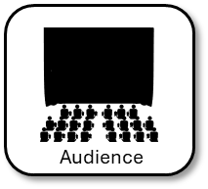


Examiners are given this list of success criteria to help them mark your speech
Convincing explanations
• Conceptualised focus on task.
• Detailed/complex ideas.
• Fluid sequencing of ideas/
argument.
• Judicious choice of register.
• Confident and varied tone.
• Convincing and impressive
vocabulary.
• Deliberate crafting of language
and use of rhetorical devices.
• Subtle variation of pace.
The examiner wants your explanations to be convincing. That means your ideas need to be set out in detail and you show a deep understanding of the topic in the exam task.
Remember to make your paragraphs flow well together with the use of connectives and linked sentences between the endings and beginnings of paragraphs.
You will need to make your tone and register match the purpose and audience, so for our article they need to sound professional, authoritative and convincing.
Don’t forget to upgrade your vocabulary and use technical terms to show your explanations are engaging.
Remember to use your DAFORREST techniques to engage your audience with your ideas.

Slide 7
This is what you need to achieve for top marks for AO6 (16 marks)
Sentence demarcation is consistently secure and consistently accurate
Wide range of punctuation is used with a high level of accuracy
Uses a full range of appropriate sentence forms for effect
Uses Standard English consistently and appropriately with secure control of complex grammatical structures
High level of accuracy in spelling, including ambitious vocabulary
Extensive and ambitious use of vocabulary
Make sure you’ve put your full stops and commas in the right places.
Use other types of punctuation such as: colons, semicolons, speech marks, dashes, hyphens, exclamation marks, question marks and so on.
Check your grammar and sentence structures to make sure they read well.
Check your spelling of difficult words to make sure you haven’t made any mistakes.
Try to impress with your vocabulary, but don’t sacrifice your style by putting too many impressive words just for the sake of it!
…
?
;
!
.
-
:
Vocabulary
Sentences
Effects
Spelling
Punctuation

Slide 8
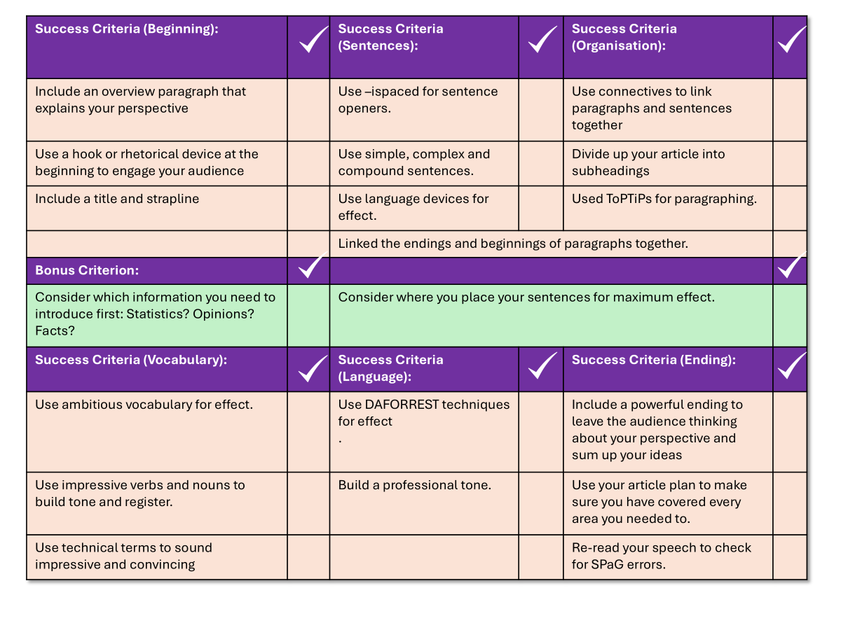
You now have one hour to write your article
‘People protest about the cruelty of keeping animals in captivity, but they seem happy enough to eat meat, keep pets and visit zoos. All animals should be free!’
Write an article for a magazine in which you explain your point of view on this statement.
Use your checklist to help you write out your article.
You may refer to your notes from this term if you wish.
You have one hour to complete your article.
Good luck!

Slide 9

Success Criteria (Beginning): |  | Success Criteria (Sentences): |  | Success Criteria (Organisation):
Include an overview paragraph that explains your perspective |  | Use –ispaced for sentence openers. |  | Use connectives to link paragraphs and sentences together
Use a hook or rhetorical device at the beginning to engage your audience |  | Use simple, complex and compound sentences. |  | Divide up your article into subheadings
Include a title and strapline |  | Use language devices for effect. |  | Used ToPTiPs for paragraphing.
 |  | Linked the endings and beginnings of paragraphs together.
Bonus Criterion:
Consider which information you need to introduce first: Statistics? Opinions? Facts? |  | Consider where you place your sentences for maximum effect.
Success Criteria (Vocabulary): |  | Success Criteria (Language): |  | Success Criteria (Ending):
Use ambitious vocabulary for effect. |  | Use DAFORREST techniques for effect . |  | Include a powerful ending to leave the audience thinking about your perspective and sum up your ideas
Use impressive verbs and nouns to build tone and register. |  | Build a professional tone. |  | Use your article plan to make sure you have covered every area you needed to.
Use technical terms to sound impressive and convincing |  |  |  | Re-read your speech to check for SPaG errors.

Slide 10




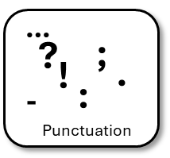
Plenary: Self-assessment reflection sheet
How confident do you feel about this area?
Not confident
Very confident
Which areas do you feel you need to spend more time on?
1) ______________________________________________________________________________________
2)
______________________________________________________________________________________

