Slide 1

Magazine Article Subheadings
We explored some of the basic features of articles in the previous lesson, but one area we still need to focus on is subheadings.
What is a subheading?
How might subheadings be useful to the reader of an article?
Why are subheadings different to titles and straplines?
Here are the basic features to include:
a clear/apt/original title
a strapline (heading beneath the main headline)
subheadings
an introductory (overview) paragraph
effectively/fluently sequenced paragraphs.
Article

Slide 2
Learning outcomes
To describe the importance of subheadings
To explain how these features can help engage an audience
To evaluate the effectiveness of our own subheadings using success criteria

Slide 3
A subheading is a short title for one section of an article
They are used to support the title and strapline of the article and help to break up the text of the article into different sections.
They are useful to include in your article writing because they show a good understanding of structure and organisation.

Slide 4

You are marked out of 24 marks for AO5
AO5 Content and organisation
Communicate clearly, effectively and imaginatively, selecting and adapting tone, style and register for different forms, purposes and audiences.
Organise information and ideas, using structural and grammatical features to support coherence and cohesion of texts.

Slide 5
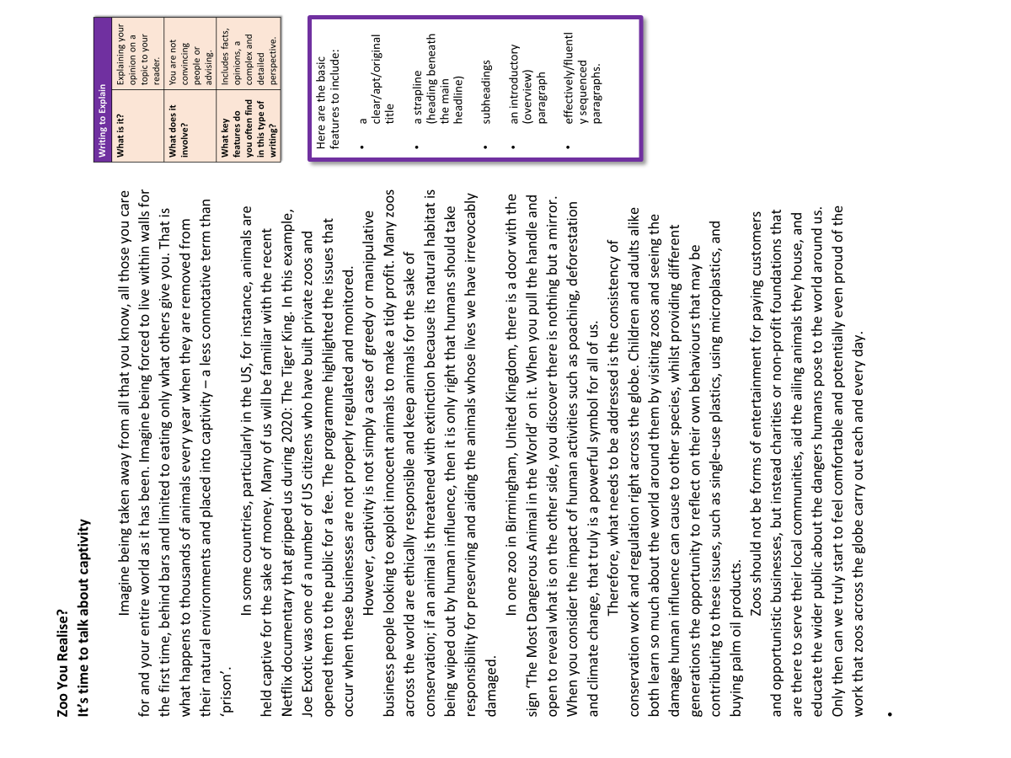
The article we previously explored did not include subheadings, but we’re going to look at how they could be added.
Discuss: Where could the writer add in subheadings to their article?
Bonus Challenge: Why did you choose to break down the article into those sections?

Slide 6
Zoo You Realise?
It’s time to talk about captivity
Imagine being taken away from all that you know, all those you care for and your entire world as it has been. Imagine being forced to live within walls for the first time, behind bars and limited to eating only what others give you. That is what happens to thousands of animals every year when they are removed from their natural environments and placed into captivity – a less connotative term than ‘prison’.
In some countries, particularly in the US, for instance, animals are held captive for the sake of money. Many of us will be familiar with the recent Netflix documentary that gripped us during 2020: The Tiger King. In this example, Joe Exotic was one of a number of US citizens who have built private zoos and opened them to the public for a fee. The programme highlighted the issues that occur when these businesses are not properly regulated and monitored.
Headline
Strapline
We could use the first two paragraphs of the article as the first section as it includes our introductory paragraph and one specific example that supports the introductory paragraph.

Slide 7
Conservation over profit
However, captivity is not simply a case of greedy or manipulative business people looking to exploit innocent animals to make a tidy profit. Many zoos across the world are ethically responsible and keep animals for the sake of conservation; if an animal is threatened with extinction because its natural habitat is being wiped out by human influence, then it is only right that humans should take responsibility for preserving and aiding the animals whose lives we have irrevocably damaged.
In one zoo in Birmingham, United Kingdom, there is a door with the sign ‘The Most Dangerous Animal in the World’ on it. When you pull the handle and open to reveal what is on the other side, you discover there is nothing but a mirror. When you consider the impact of human activities such as poaching, deforestation and climate change, that truly is a powerful symbol for all of us.
Subheading
We could then add a subheading in for the section that explores how conservation is arguably a more legitimate form of captivity than private business owners looking to make a profit.
The writer has chosen a short subheading that sums up what the next section is about.

Slide 8
A way forward
Therefore, what needs to be addressed is the consistency of conservation work and regulation right across the globe. Children and adults alike both learn so much about the world around them by visiting zoos and seeing the damage human influence can cause to other species, whilst providing different generations the opportunity to reflect on their own behaviours that may be contributing to these issues, such as single-use plastics, using microplastics, and buying palm oil products.
Zoos should not be forms of entertainment for paying customers and opportunistic businesses, but instead charities or non-profit foundations that are there to serve their local communities, aid the ailing animals they house, and educate the wider public about the dangers humans pose to the world around us. Only then can we truly start to feel comfortable and potentially even proud of the work that zoos across the globe carry out each and every day.
Subheading
We could then add a subheading in for the section that provides a way forward for conservation and for how people perceive it.
This final section of the article outlines the writer’s perspective that conservation to help endangered species is far more useful than for the sake of making money.

Slide 9

‘People protest about the cruelty of keeping animals in captivity, but they seem happy enough to eat meat, keep pets and visit zoos. All animals should be free!’
Write an article for a magazine in which you explain your point of view on this
statement.
Writing to Explain
What is it? | Explaining your opinion on a topic to your reader.
What does it involve? | You are not convincing people or advising. You are explaining your perspective on a topic.
What key features do you often find in this type of writing? | Includes facts, opinions, a complex and detailed perspective.
Here are the basic features to include:
a clear/apt/original title
a strapline (heading beneath the main headline)
subheadings
an introductory (overview) paragraph
effectively/fluently sequenced paragraphs.
Article
When you are writing to explain, it is different to writing to argue.
You are explaining your view on a topic, you are not trying to persuade people to agree with you or convince someone about an argument you have.

Slide 10
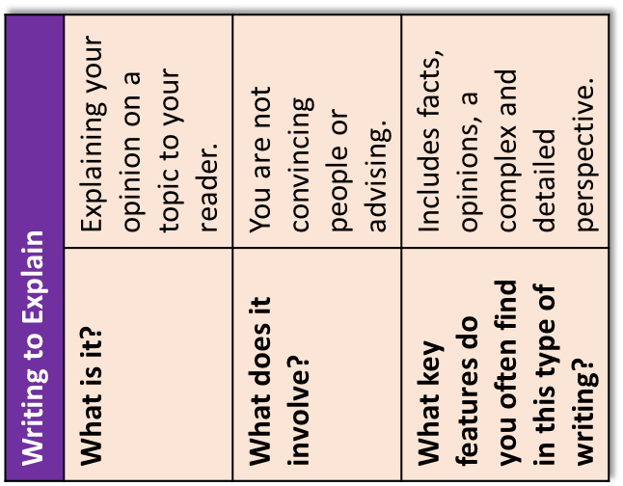
Here are the basic features to include:
a clear/apt/original title
a strapline (heading beneath the main headline)
subheadings
an introductory (overview) paragraph
effectively/fluently sequenced paragraphs.
Zoo You Realise?
It’s time to talk about captivity
Imagine being taken away from all that you know, all those you care for and your entire world as it has been. Imagine being forced to live within walls for the first time, behind bars and limited to eating only what others give you. That is what happens to thousands of animals every year when they are removed from their natural environments and placed into captivity – a less connotative term than ‘prison’.
In some countries, particularly in the US, for instance, animals are held captive for the sake of money. Many of us will be familiar with the recent Netflix documentary that gripped us during 2020: The Tiger King. In this example, Joe Exotic was one of a number of US citizens who have built private zoos and opened them to the public for a fee. The programme highlighted the issues that occur when these businesses are not properly regulated and monitored.
However, captivity is not simply a case of greedy or manipulative business people looking to exploit innocent animals to make a tidy profit. Many zoos across the world are ethically responsible and keep animals for the sake of conservation; if an animal is threatened with extinction because its natural habitat is being wiped out by human influence, then it is only right that humans should take responsibility for preserving and aiding the animals whose lives we have irrevocably damaged.
In one zoo in Birmingham, United Kingdom, there is a door with the sign ‘The Most Dangerous Animal in the World’ on it. When you pull the handle and open to reveal what is on the other side, you discover there is nothing but a mirror. When you consider the impact of human activities such as poaching, deforestation and climate change, that truly is a powerful symbol for all of us.
Therefore, what needs to be addressed is the consistency of conservation work and regulation right across the globe. Children and adults alike both learn so much about the world around them by visiting zoos and seeing the damage human influence can cause to other species, whilst providing different generations the opportunity to reflect on their own behaviours that may be contributing to these issues, such as single-use plastics, using microplastics, and buying palm oil products.
Zoos should not be forms of entertainment for paying customers and opportunistic businesses, but instead charities or non-profit foundations that are there to serve their local communities, aid the ailing animals they house, and educate the wider public about the dangers humans pose to the world around us. Only then can we truly start to feel comfortable and potentially even proud of the work that zoos across the globe carry out each and every day.

Slide 11
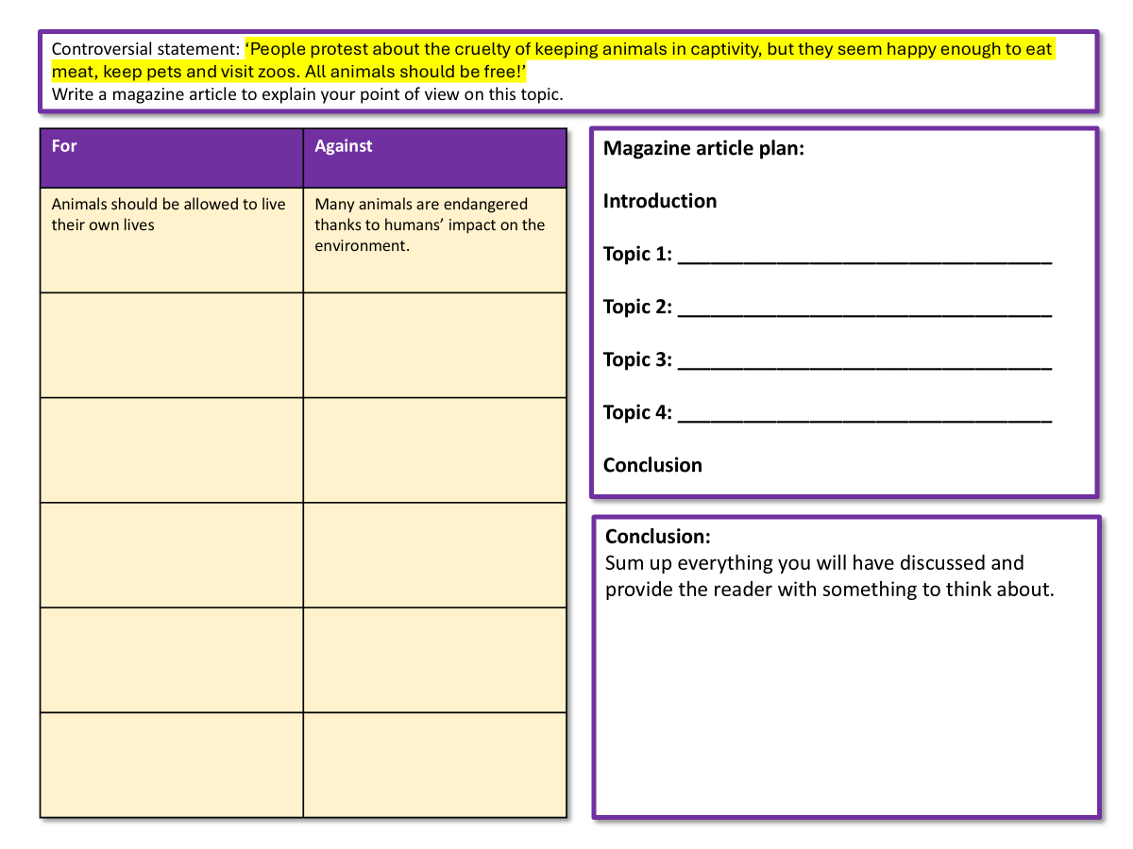
Creating effective subheadings
Alliteration: Callous Captivity
Repetition/Anaphora: Change for Good, Change for Animals
Making a huge statement: How we can save the planet
Asking a rhetorical question: What can we do to help our animals?
Using pronouns to engage the reader: Animal welfare is a responsibility for all of us
Emotive language: Our last chance to change
Use your planning sheet from the previous lessons to add in potential subheadings for your article.
Aim to write 2-3 subheadings for your article.

Slide 12
Controversial statement: ‘People protest about the cruelty of keeping animals in captivity, but they seem happy enough to eat meat, keep pets and visit zoos. All animals should be free!’
Write a magazine article to explain your point of view on this topic.
For | Against
Animals should be allowed to live their own lives | Many animals are endangered thanks to humans’ impact on the environment.
Magazine article plan:
Introduction
Topic 1: __________________________________
Topic 2: __________________________________
Topic 3: __________________________________
Topic 4: __________________________________
Conclusion
Conclusion:
Sum up everything you will have discussed and provide the reader with something to think about.

Slide 13

Swap books with another student
Success criteria
Subheadings
Short and to-the-point
Uses language techniques to engage the reader
Look at the subheadings they had added to their planning sheet.
What did they do well? Use the success criteria to help you assess this
How could they improve their subheadings? Provide examples based on the success criteria

Slide 14
Re-read your notes from the previous lessons
Communication
Write down three targets for yourself to improve your non-fiction writing when you come to write your magazine article.
Here are a few examples:
Include a headline, strapline and subheadings
Use ToPTiPs for paragraphing
Replace simple vocabulary like good with more impressive synonyms
Tone, style, register
Vocabulary
Structure
Ideas
Paragraphs
Sentences
Punctuation
Grammar
Spelling

Slide 15

Plenary: Adjective Tennis
One person in the classroom will come up with a word to describe their learning today (for instance: important). They then explain why they chose that adjective.
They then choose someone else to come up with a new adjective and explanation. We keep going until we run out of ideas!
We may stop at certain points to discuss our adjectives!
To describe the importance of subheadings
To explain how these features can help engage an audience
To evaluate the effectiveness of our own subheadings using success criteria

