Slide 1

English Language Paper 1 Section A: Q1 and Q2
We are going to explore a new extract today.
This text is from the beginning of a novel about a football supporter.
What does football mean to some people?
How important can sport be to some people?
Why do some people see football as a very important part of their identity? Provide examples.

Slide 2
Learning outcomes
To describe the key skills required for Paper 1 Section A
To explain how to answer Q1
To evaluate what skills are needed for Q2

Slide 3


Paper 1 skills
Identifying
Choosing evidence
Identifying information is important because you need to read through texts and find the information you need to answer questions successfully.
Choosing evidence ensures you can back up your interpretations and support your ideas with examples from the text.

Slide 4



Read through the extract from It’s Only a Game by Adrian Jones
It was published in 2015, and it is an extract from the beginning of the novel. It is set at a football ground where the narrator describes their feelings about the game and the sport.
This is important information to keep in mind when answering the questions.
Timed conditions: 10 minutes

Slide 5
Q1 (4 marks)
Identifying
Question 1 will ask you to focus on a specific section of the text.
In the case of the It’s Only a Game text, the question asks you to focus on lines 1 to 6.
There are four sections to this question which are all multiple choice.

Slide 6
Read lines 1-6 again and put a tick in the right box for each of the four questions
Q1.1: What is the narrator describing?
Q1.2: Where do the people live?
A stadium
Travelling to work
Visiting the park
Houses
Flats
Tower blocks
Q1.3: What sort of people are they?
Q1.4: What do the people do during the week?
Unusual
Ordinary
Old-fashioned
Stay at home
Play football
Go to work and school

Slide 7

Let’s look at the answers for Q1
Q1.1: What is the narrator describing?
Q1.2: Where do the people live?
A stadium
Travelling to work
Visiting the park
Houses
Flats
Tower blocks
Q1.3: What sort of people are they?
Q1.4: What do the people do during the week?
Unusual
Ordinary
Old-fashioned
Stay at home
Play football
Go to work and school

Slide 8
Why were these the answers?
Q1.1: What is the narrator describing?
“This cavern of echoes means everything to you.”
A stadium
Travelling to work
Visiting the park
Q1.2: Where do the people live?
“ordinary houses”
Houses
Flats
Tower blocks

Slide 9
Why were these the answers?
Q1.3: What sort of people are they?
“ordinary families, ordinary lives, ordinary houses and mundane days”
Unusual
Ordinary
Old-fashioned
Q1.4: What do the people do during the week?
“mundane days of schooling, working, being a dad, a mum, a brother or sister”
Stay at home
Play football
Go to work and school

Slide 10


Paper 1 skills: Q2
Language analysis
Zooming in
Language analysis shows you can see the effects a text has on a reader and why.
Zooming in on key parts of the text improves your ability to analyse that text and master your analytical skills.

Slide 11
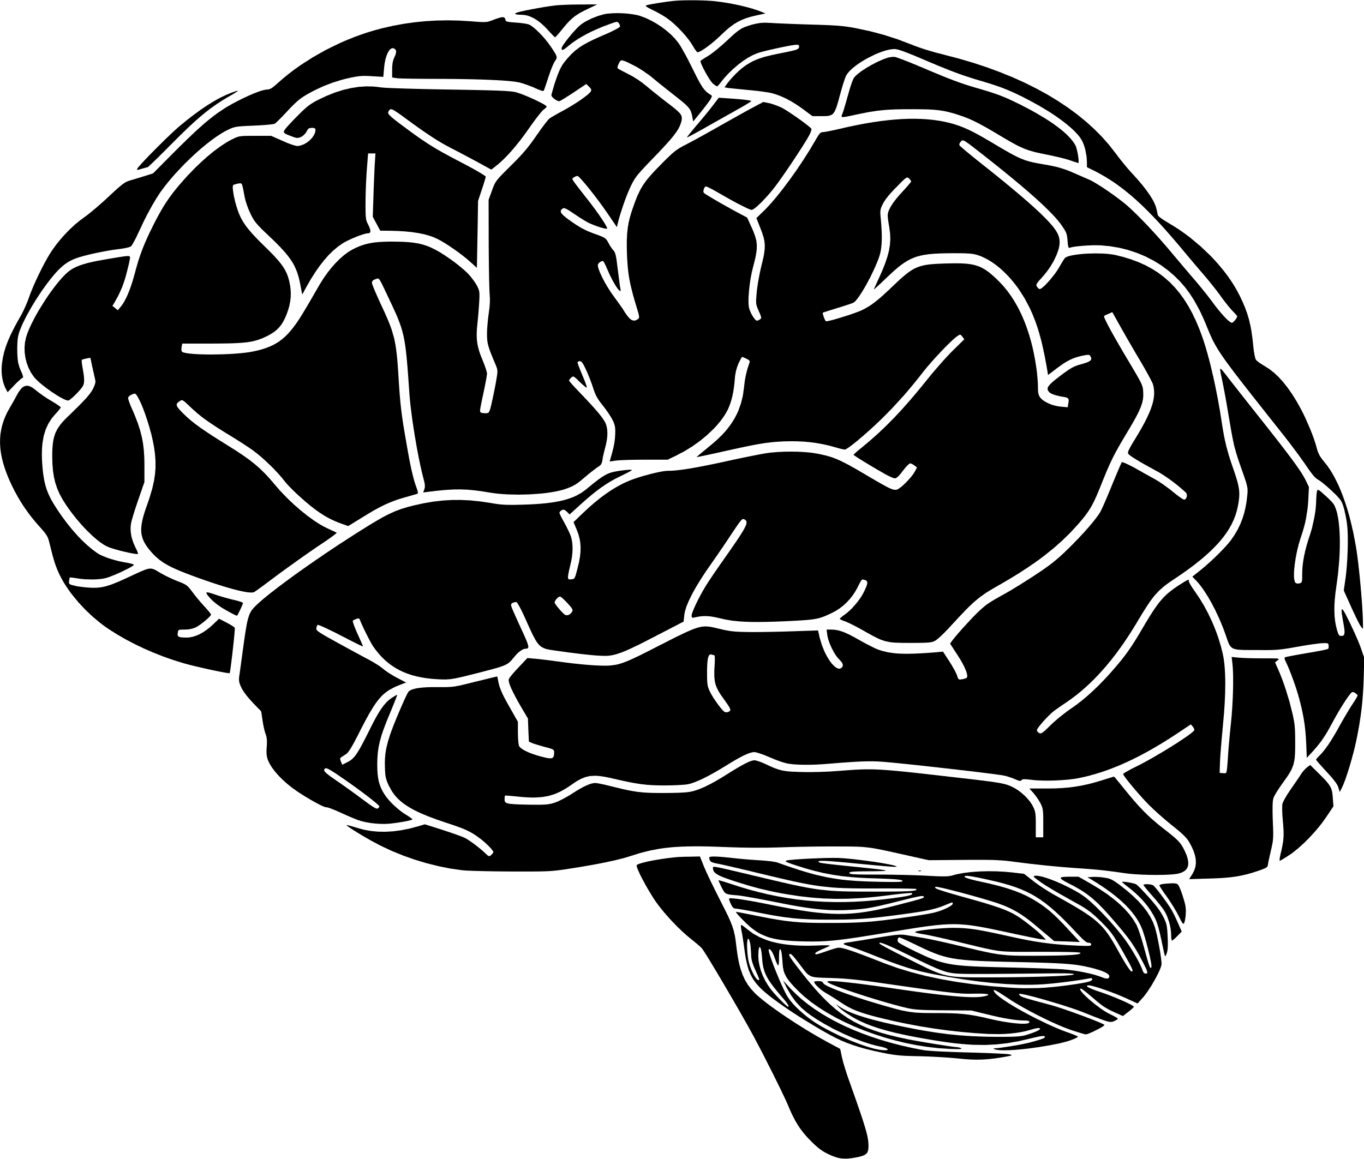




Understanding effects
Writer
Text
Reader
A writer will choose every single word carefully when creating a text. Every adjective, every sentence, every paragraph – each will be designed to have specific effects on the reader.
We need to explore how the text has effects on the reader: how it makes them think and feel. If we can do that successfully, we will master Paper 1 Section A.

Slide 12
Q2 focuses on language analysis
It asks you to focus on specific lines. In this example, we are asked to explore lines 7 to 13.
Here is the question:
How does the writer use language here to describe the stadium experience?

Slide 13
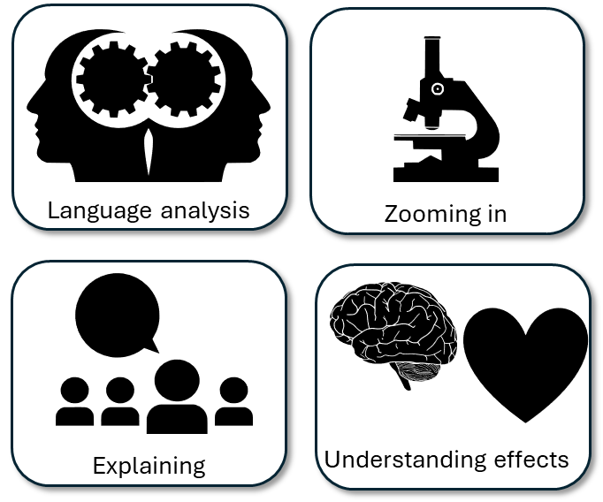

Re-read lines 7 to 13
Around your stadium picture:
Write down examples of how the experience is described
How the writer has employed language techniques
Why this example affects how the reader understands the stadium experience.
“But its yours”
Possessive pronoun of yours, the use of italics and the short sentence
amplify the importance of the stadium and the place for the narrator. He feels a sense of ownership because of the seat he has.

Slide 15
The writer describes the stadium as both impersonal and personal. Although there are masses of seats, the narrator has their own personal one.
The seat is so important to the narrator because his father got it for him through “blood and toil”. This metaphor amplifies how much the narrator respects their father and the work he put in to get that seat at the stadium,
The seat is just one “in a sea of regularity” and its just “mass produced” and “green plastic”, all of these adjectives and metaphors combine to emphasise this to the reader, but again the narrator repeats the possessive pronoun “yours” to highlight how important the stadium and its experiences are to him.
The narrator remembers past memories at the stadium, including the threat of relegation and the glory of winning a trophy. The hyberbole of “eternal doom” and “leapt as close to the sun as you could” reiterate how important this place is to the narrator.
Amongst the masses you find your seat – your seat – the one your father’s blood and toil bought for you, the one green plastic folding mass-produced product that is just like the tens of thousands that surround it in a sea of regularity. But its yours. It’s the place where you sat with your hands over your pallid face as the eternal doom of relegation threatened, the place where you leapt as close to the sun as you could when that tiny sparkle of silver reflected onto the faces of wide smiles and piercing evocations of a glorious past rekindled. A symbol of your ancestors, your people, your future.
The narrator recalls the moment his team won a trophy and how it affected the spectators. The stadium is a magical place at times, as conveyed through the “wide smiles” and “piercing evocations”.
The stadium is a “symbol of your ancestors, your people, your future”, the repetition of the pronoun and the use of anaphora working together to reiterate just how important the stadium is to the people who go there.

Slide 16
Next lesson we will explore turning our notes into proper answers for Q2

Slide 17




Plenary: Key Symbols
Which of these symbols best sums up your new knowledge and understanding from today’s lesson? Why?
To describe the key skills required for Paper 1 Section A
To explain how to answer Q1
To evaluate what skills are needed for Q2

