Slide 1







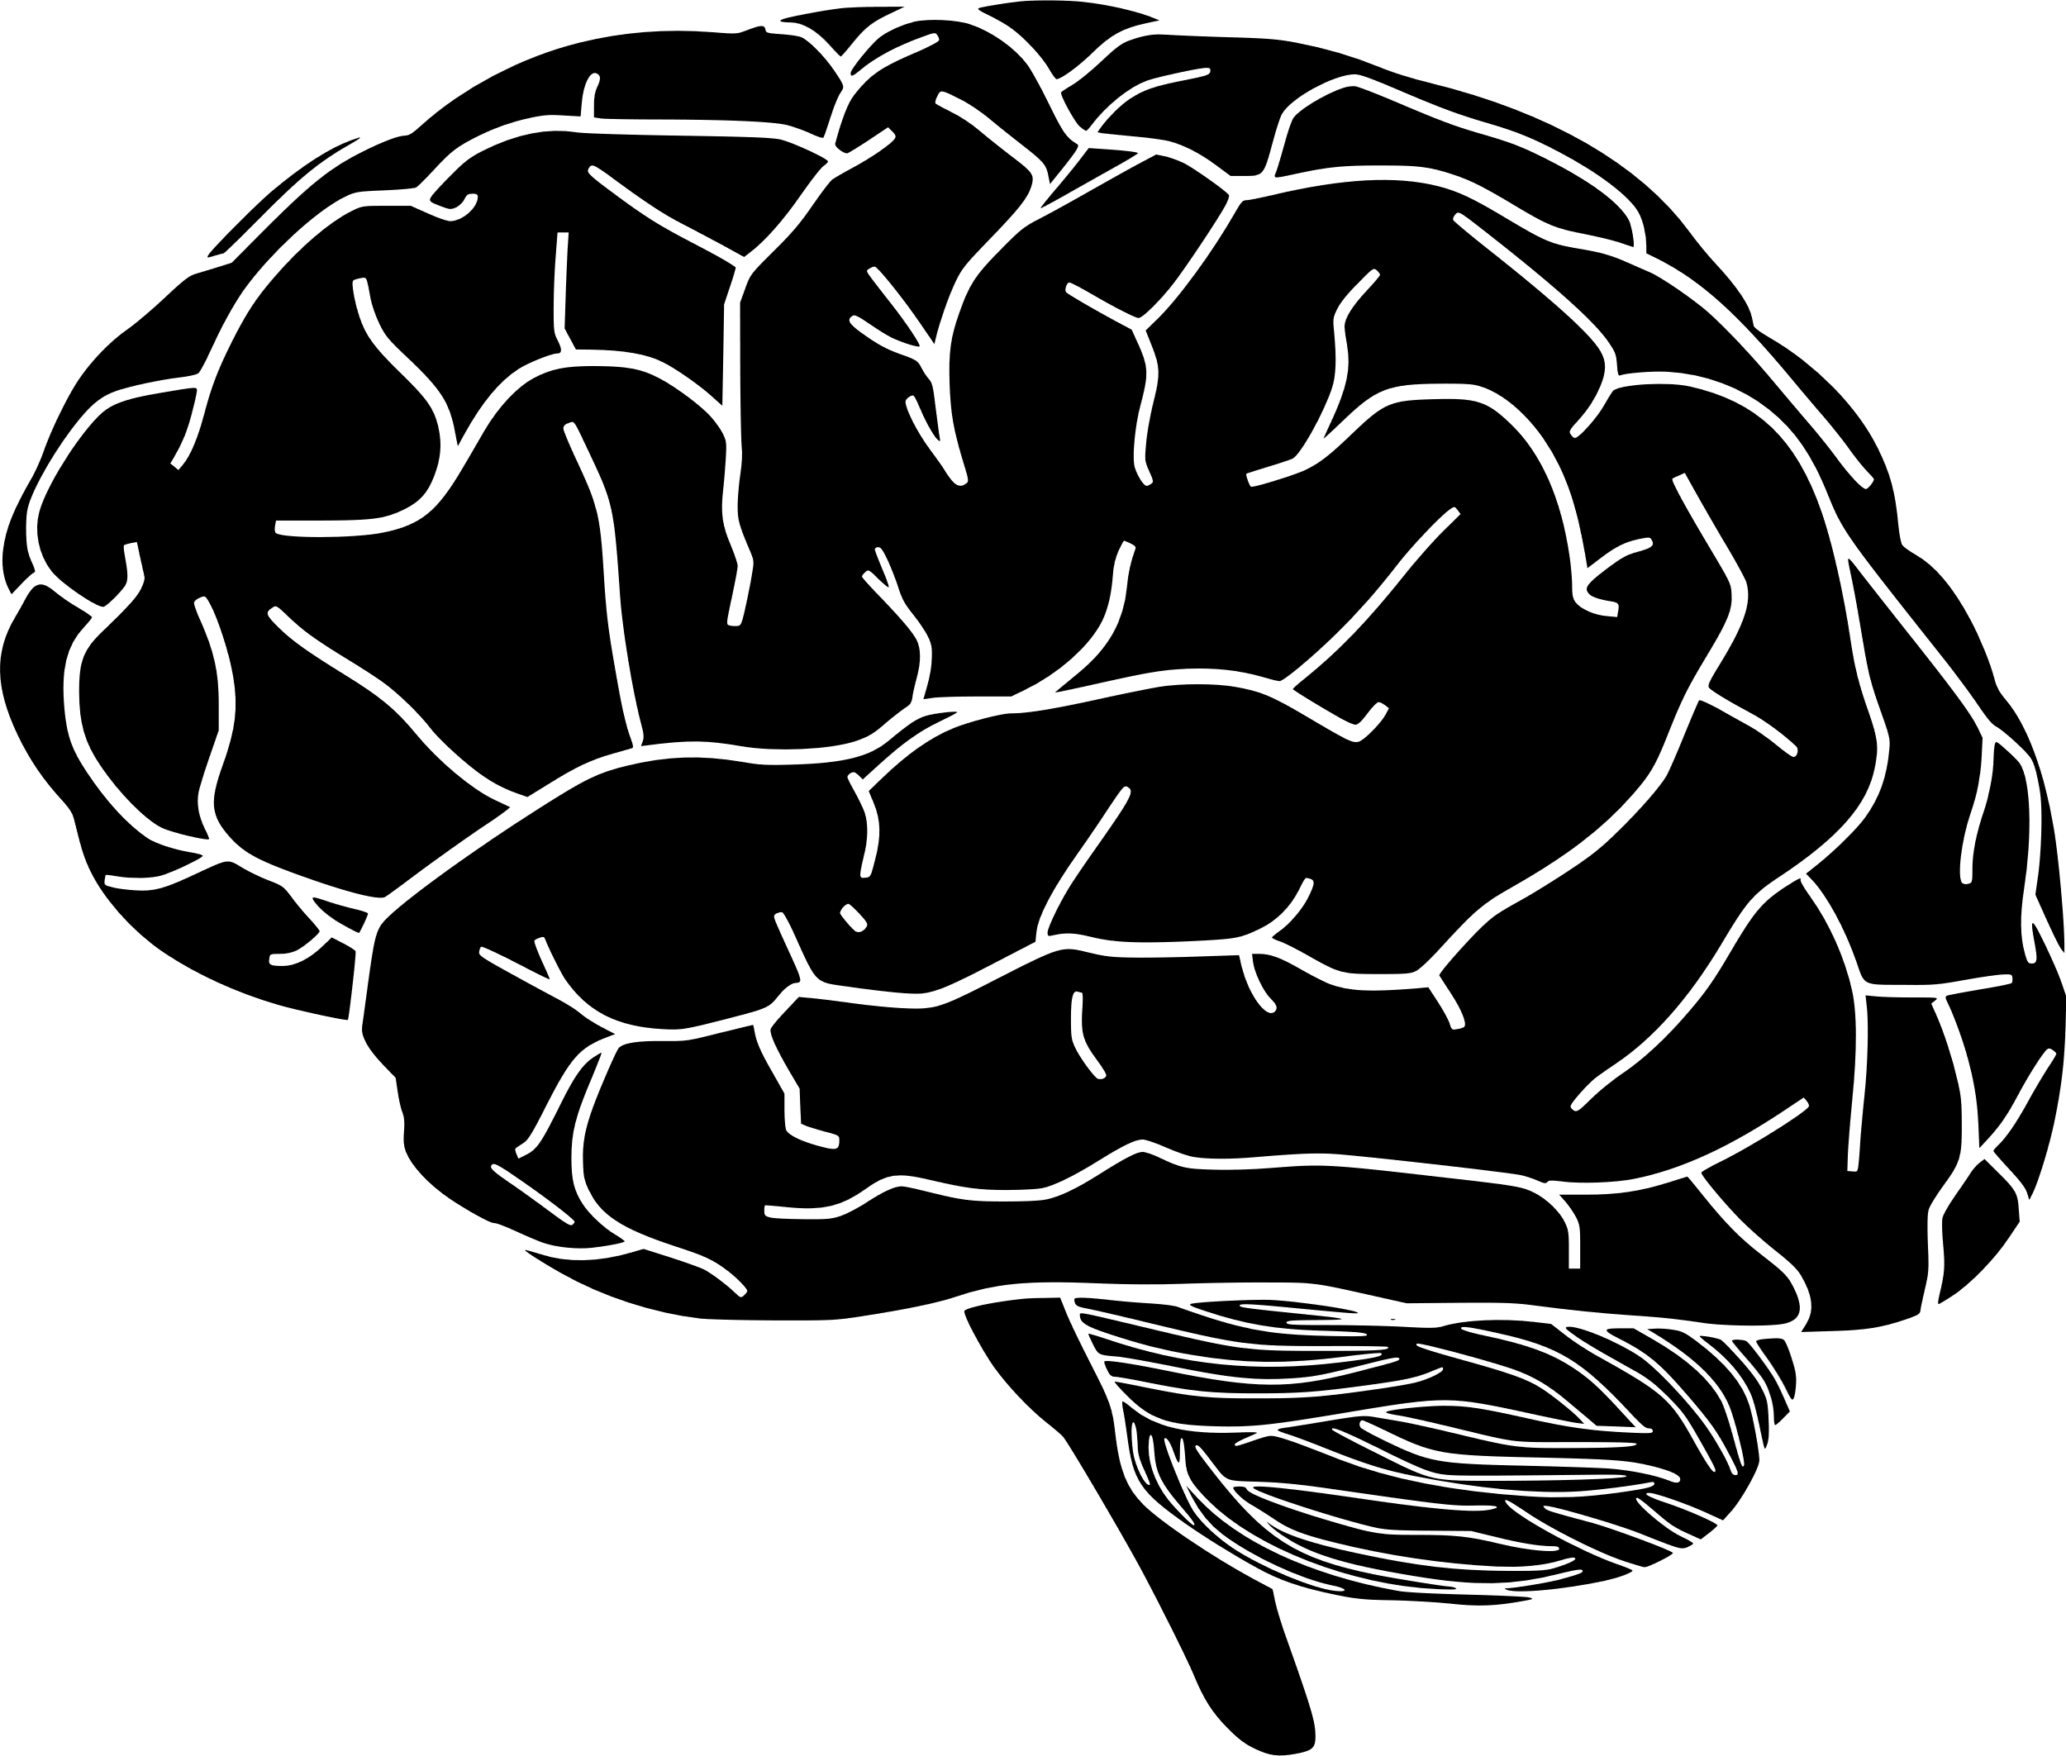


Introduction to English Language Paper 1 Section A
Identifying
Choosing evidence
Language analysis
Zooming in
Structural analysis
Evaluating
Explaining
Understanding effects
These are some of the main skills you will need to master the Paper 1 Section A exam.
What does each of these skills mean?
How is language analysis different to structural analysis?
Why is evaluating a very different skill to explaining?

Slide 2
Learning outcomes
To describe the key skills required for Paper 1 Section A
To explain how to answer Q1
To evaluate what skills are needed for Q2

Slide 3
Paper 1 skills
Identifying
Choosing evidence
Identifying information is important because you need to read through texts and find the information you need to answer questions successfully.
Choosing evidence ensures you can back up your interpretations and support your ideas with examples from the text.

Slide 4
Paper 1 skills
Language analysis
Zooming in
Language analysis shows you can see the effects a text has on a reader and why.
Zooming in on key parts of the text improves your ability to analyse that text and master your analytical skills.

Slide 5
Paper 1 skills
Structural analysis
Structural analysis is different to language analysis because we explore how a text is put together and how it changes from beginning to end.
We look at how a text is divided up into different sections what effects these sections can have on a reader.

Slide 6
Paper 1 skills
Structural analysis
Structural analysis is different to language analysis because we explore how a text is put together and how it changes from beginning to end.
We look at how a text is divided up into different sections what effects these sections can have on a reader.

Slide 7
Paper 1 skills
Evaluating
Explaining
Evaluating a text is very important in Paper 1. It means to consider one interpretation of a text and judge whether you agree or disagree with that interpretation.
That is different to explaining because you will need to explain your own interpretations for most of Paper 1.

Slide 8



Understanding effects
Writer
Text
Reader
A writer will choose every single word carefully when creating a text. Every adjective, every sentence, every paragraph – each will be designed to have specific effects on the reader.
We need to explore how the text has effects on the reader: how it makes them think and feel. If we can do that successfully, we will master Paper 1 Section A.

Slide 9
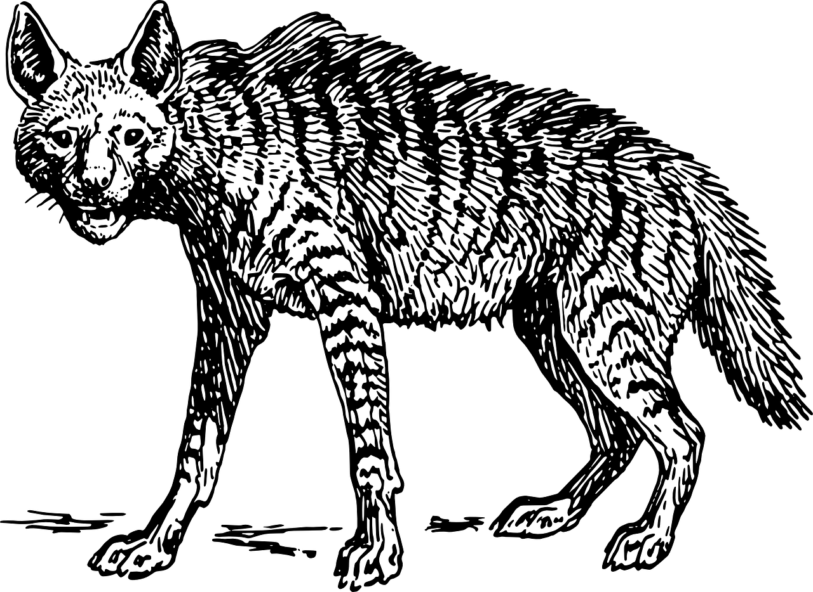

Read through the extract from Life of Pi by Yann Martel.
Yip
Yip
Yip
Yip
It was published in 2001 and it is an extract from the middle of the novel. It is set on a lifeboat in the middle of the Pacific Ocean, where a teenage boy called Pi is on a lifeboat with a tiger, an orangutan and a hyena, but there are no other people.
This is important information to keep in mind when answering the questions.
Timed conditions: 10 minutes

Slide 10
Q1 (4 marks)
Identifying
Question 1 will ask you to focus on a specific section of the text.
In the case of the Life of Pi text, the question asks you to focus on lines 1 to 9.
There are four sections to this question which are all multiple choice.

Slide 11
Read lines 1-9 again and put a tick in the right box for each of the four questions
Q1.1: What worries Pi about the hyena?
Q1.2: How does hyenas usually attack?
Its appearance
Remembering what Pi’s father told him about hyenas
The noise it is making
On their own
In a pair
As a group
Q1.3: What sort of attackers are hyenas?
Q1.4: What does Pi hope will distract the hyena away from him?
Tough
Vulnerable
Reluctant
Its mother
The other animals on the boat
The horizon

Slide 12

Let’s look at the answers for Q1
Q1.1: What worries Pi about the hyena?
Q1.2: How does hyenas usually attack?
Its appearance
Remembering what Pi’s father told him about hyenas
The noise it is making
On their own
In a pair
As a group
Q1.3: What sort of attackers are hyenas?
Q1.4: What does Pi hope will distract the hyena away from him?
Tough
Vulnerable
Reluctant
Its mother
The other animals on the boat
The horizon

Slide 13
Why were these the answers?
Q1.1: What worries Pi about the hyena?
“It was the hyena that worried me. I had not forgotten Father’s words.”
Its appearance
Remembering what Pi’s father told him about hyenas
The noise it is making
Q1.2: How does hyenas usually attack?
Hyenas attack in packs whatever animal can be run down
On their own
In a pair
As a group

Slide 14
Why were these the answers?
Q1.3: What sort of attackers are hyenas?
“They are hardy attackers, rising up from buttings and kickings immediately,”
Tough
Vulnerable
Reluctant
Q1.4: What does Pi hope will distract the hyena away from him?
“I clung to the hope that a zebra, a familiar prey,
and an orang-utan, an unfamiliar one, would distract it from thoughts of me”
Its mother
The other animals on the boat
The horizon

Slide 15
Q2 focuses on language analysis
It asks you to focus on specific lines. In this example, we are asked to explore lines 10 to 19.
Here is the question:
How does the writer use language here to describe the hyena’s appearance?

Slide 16
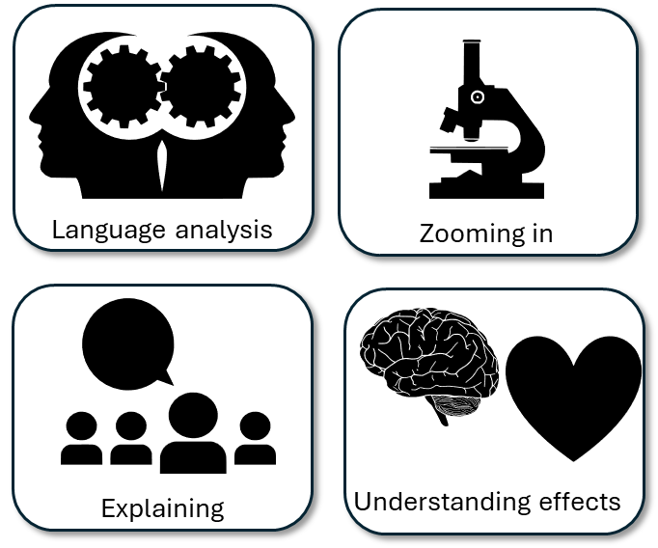

Re-read lines 10 to 19
Around your hyena picture:
Write down examples of how the hyena is described
How the writer has employed language techniques
Why this example affects how the reader understands the hyena’s appearance
“ugly beyond redemption”
Adjective of ugly and hyperbole of beyond redemption to amplify how disgusted Pi is by the animal’s appearance

Slide 18
Next lesson we will explore turning our notes in to proper answers for Q2

Slide 19

Plenary: Blind Vote
Put your heads on the table and close your eyes.
I will read out the learning outcomes and you need to put your thumbs up or down to judge how far you think you have progressed. Do not look up!
To describe the key skills required for Paper 1 Section A
To explain how to answer Q1
To evaluate what skills are needed for Q2

