Slide 1
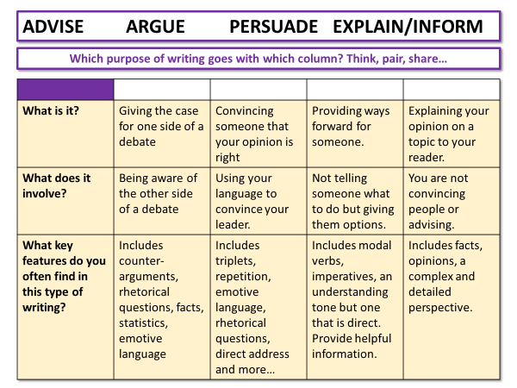
AQA English Language Paper 2 Section B:
Non-Fiction Writing
This term we are going to focus on non-fiction writing.
Match up the purposes to their definitions in your table.
How can changing the purpose of a non-fiction change how it is written? Make notes.
Why is it absolutely essential to assess purpose and audience before planning out a non-fiction text?

Slide 2
ADVISE ARGUE PERSUADE EXPLAIN/INFORM
Which purpose of writing goes with which column? Think, pair, share…
What is it? | Giving the case for one side of a debate | Convincing someone that your opinion is right | Providing ways forward for someone. | Explaining your opinion on a topic to your reader.
What does it involve? | Being aware of the other side of a debate | Using your language to convince your leader. | Not telling someone what to do but giving them options. | You are not convincing people or advising.
What key features do you often find in this type of writing? | Includes counter-arguments, rhetorical questions, facts, statistics, emotive language | Includes triplets, repetition, emotive language, rhetorical questions, direct address and more… | Includes modal verbs, imperatives, an understanding tone but one that is direct. Provide helpful information. | Includes facts, opinions, a complex and detailed perspective.

Slide 3
ADVISE ARGUE PERSUADE EXPLAIN/INFORM
 | WRITING TO ARGUE | WRITING TO PERSUADE | WRITING TO ADVISE | WRITING TO EXPLAIN/INFORM
What is it? | Giving the case for one side of a debate | Convincing someone that your opinion is right | Providing ways forward for someone. | Explaining your opinion on a topic to your reader.
What does it involve? | Being aware of the other side of a debate | Using your language to convince your leader. | Not telling someone what to do but giving them options. | You are not convincing people or advising.
What key features do you often find in this type of writing? | Includes counter-arguments, rhetorical questions, facts, statistics, emotive language | Includes triplets, repetition, emotive language, rhetorical questions, direct address and more… | Includes modal verbs, imperatives, an understanding tone but one that is direct. Provide helpful information. | Includes facts, opinions, a complex and detailed perspective.

Slide 4
Learning outcomes
To describe purposes and audiences of non-fiction texts
To explain the key features of different types of text
To evaluate the effectiveness of an example speech in meeting the requirements of an exam task

Slide 5

What are purpose, audience and key features?
Purpose is the reason why you have created a piece of writing. For instance, the purpose of your notes in your exercise book are to help you to be able to describe and explain your ideas.
Audience is the people or groups of people you are targeting when you are creating your writing. Example: Football match programmes are designed for football fans of a particular team.
Key features are the elements you expect to find in a particular type of writing. For instance, in a persuasive piece of writing you will be looking for persuasive language techniques like rhetorical questions.

Slide 6
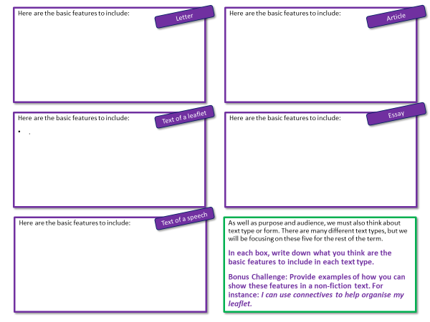
We must also consider ‘text types’ carefully
As well as purpose and audience, we must also think about text type or form. There are many different text types, but we will be focusing on the five key types for the rest of the term.
On your worksheet, write down what you think are the basic features to include in each text type.
Bonus Challenge: Provide examples of how you can show these features in a non-fiction text. For instance: I can use connectives to help organise my leaflet.

Slide 7
Here are the basic features to include:
Here are the basic features to include:
Letter
Article
Text of a leaflet
Essay
Here are the basic features to include:
.
Here are the basic features to include:
Text of a speech
Here are the basic features to include:
As well as purpose and audience, we must also think about text type or form. There are many different text types, but we will be focusing on these five for the rest of the term.
In each box, write down what you think are the basic features to include in each text type.
Bonus Challenge: Provide examples of how you can show these features in a non-fiction text. For instance: I can use connectives to help organise my leaflet.

Slide 8
Here are the basic features to include:
the use of addresses
a date
a formal mode of address if required e.g. Dear Sir/Madam or a named recipient effectively/fluently sequenced paragraphs
an appropriate mode of signing off: Yours sincerely/faithfully.
Here are the basic features to include:
a clear/apt/original title
a strapline (heading beneath the main headline)
subheadings
an introductory (overview) paragraph
effectively/fluently sequenced paragraphs.
Letter
Article
Text of a leaflet
Essay
Here are the basic features to include:
A title that is fitting for the purpose and audience
Using organisational devices to assist with structure and layout. This could include subheadings, boxes or bullet points.
Paragraphs that are effectively and sequenced carefully.
Here are the basic features to include:
An introduction that sets out the purpose, structure and organisation of the essay.
A conclusion that carefully sums up the essay's ideas.
Paragraphs that are effectively and sequenced carefully.
Text of a speech
Here are the basic features to include:
It has the purpose and audience at its heart and addresses the audience clearly
Paragraphs are linked and show sequence
Uses rhetorical devices to show the audience is at the heart of the speech
A sign off at the end of the speech, such as: "Thank you for listening."
As well as purpose and audience, we must also think about text type or form. There are many different text types, but we will be focusing on these five for the rest of the term.
In each box, write down what you think are the basic features to include in each text type.
Bonus Challenge: Provide examples of how you can show these features in a non-fiction text. For instance: I can use connectives to help organise my leaflet.

Slide 9

The examiner’s template in a nutshell
The statement will be related to whatever topic you’ve been looking at in Section A. You are allowed to use ideas from Section A in your Section B writing.
‘In a nutshell’ means to sum up something complex into something small. William Shakespeare may have been the first person to write this phrase down!
‘Controversial statement that can be argued a number of ways.’
Write a letter/speech/article/essay/text of a leaflet to [audience] explaining/informing/advising/persuading/arguing your opinion on this statement.
(24 marks for content and organisation 16 marks for technical accuracy) [40 marks]
You are advised to plan your answer to Question 5 before you start to write.
Purpose – Why?
Audience- Who?
Form – What?
Oh! Planning! We’ll come on to that.

Slide 10
In Paper 2 Section B you will be given a task like this
'Cars are convenient, comfortable and save time. However, we need to use them less by making public transport such as trains, trams, and buses cheaper, more reliable and easier to access.'
Write a speech to be given at a meeting of your local council in which you are to argue your point of view on this statement.
Discuss: What are the text type, purpose and audience for this task?
Bonus Challenge: Which key features would you need to include in your writing piece?

Slide 11

'Cars are convenient, comfortable and save time. However, we need to use them less by making public transport such as trains, trams, and buses cheaper, more reliable and easier to access.'
Write a speech to be given at a meeting of your local council in which you are to argue your point of view on this statement.
Writing to Argue
What is it? | Giving the case for one side of a debate
What does it involve? | Being aware of the other side of a debate
What key features do you often find in this type of writing? | Includes counter-arguments, rhetorical questions, facts, statistics, emotive language
Text of a speech
Here are the basic features to include:
It has the purpose and audience at its heart and addresses the audience clearly
Paragraphs are linked and show sequence
Uses rhetorical devices to show the audience is at the heart of the speech
A sign off at the end of the speech, such as: "Thank you for listening."
When you are writing to argue, you are showing you understand what this purpose of writing involves.
It means you are presenting your opinions around a topic, but you are also showing an awareness of other arguments and conveying how these ideas are wrong in comparison to your own.
Writing to argue is different to writing to persuade, as arguing involves showing an awareness of others’ ideas but arguing why they are wrong, whereas persuading means you talk about your own opinions and convince the audience you are right.

Slide 12
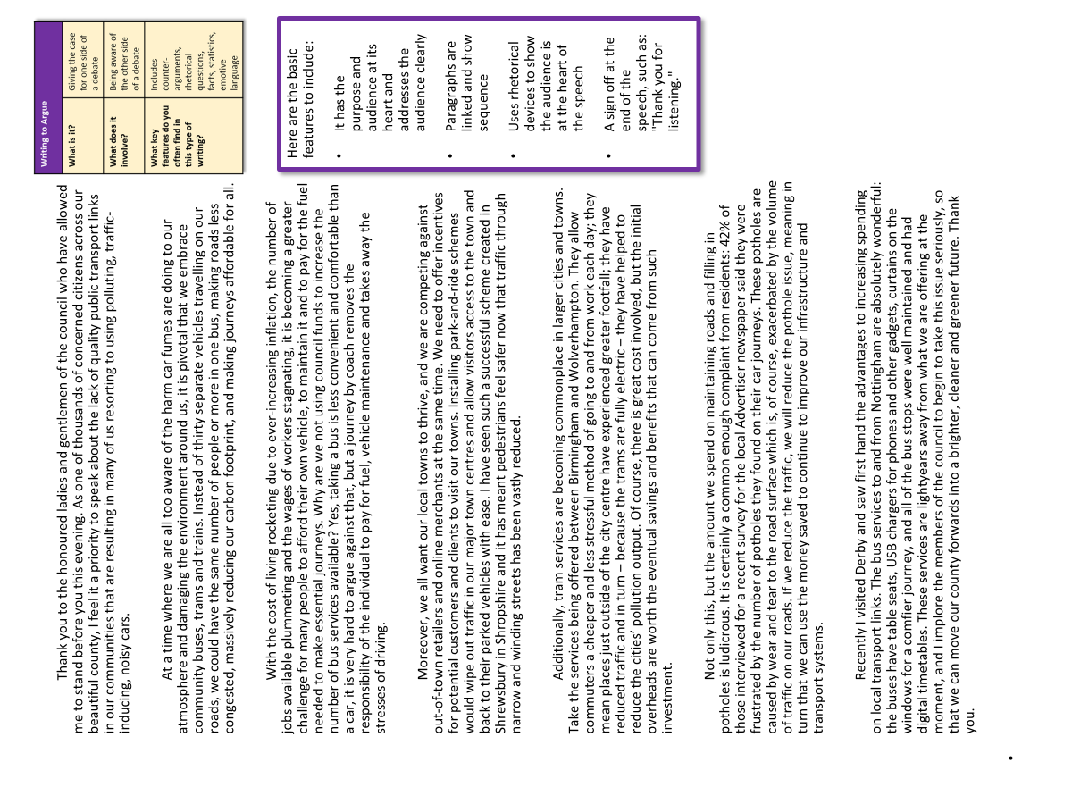
Now, let’s use our learning to analyse an example speech
Using your table and your new learning from today’s lesson, work with the person nearest to you to decide:
What makes this a good speech?
How does the writer make this a writing to argue piece?
Why does this speech meet the requirements of the exam task? Provide examples.

Slide 13
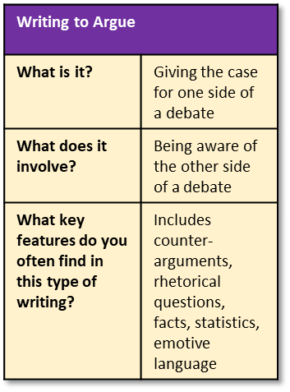
Here are the basic features to include:
It has the purpose and audience at its heart and addresses the audience clearly
Paragraphs are linked and show sequence
Uses rhetorical devices to show the audience is at the heart of the speech
A sign off at the end of the speech, such as: "Thank you for listening."
Thank you to the honoured ladies and gentlemen of the council who have allowed me to stand before you this evening. As one of thousands of concerned citizens across our beautiful county, I feel it a priority to speak about the lack of quality public transport links in our communities that are resulting in many of us resorting to using polluting, traffic-inducing, noisy cars.
At a time where we are all too aware of the harm car fumes are doing to our atmosphere and damaging the environment around us, it is pivotal that we embrace community buses, trams and trains. Instead of thirty separate vehicles travelling on our roads, we could have the same number of people or more in one bus, making roads less congested, massively reducing our carbon footprint, and making journeys affordable for all.
With the cost of living rocketing due to ever-increasing inflation, the number of jobs available plummeting and the wages of workers stagnating, it is becoming a greater challenge for many people to afford their own vehicle, to maintain it and to pay for the fuel needed to make essential journeys. Why are we not using council funds to increase the number of bus services available? Yes, taking a bus is less convenient and comfortable than a car, it is very hard to argue against that, but a journey by coach removes the responsibility of the individual to pay for fuel, vehicle maintenance and takes away the stresses of driving.
Moreover, we all want our local towns to thrive, and we are competing against out-of-town retailers and online merchants at the same time. We need to offer incentives for potential customers and clients to visit our towns. Installing park-and-ride schemes would wipe out traffic in our major town centres and allow visitors access to the town and back to their parked vehicles with ease. I have seen such a successful scheme created in Shrewsbury in Shropshire and it has meant pedestrians feel safer now that traffic through narrow and winding streets has been vastly reduced.
Additionally, tram services are becoming commonplace in larger cities and towns. Take the services being offered between Birmingham and Wolverhampton. They allow commuters a cheaper and less stressful method of going to and from work each day; they mean places just outside of the city centre have experienced greater footfall; they have reduced traffic and in turn – because the trams are fully electric – they have helped to reduce the cities’ pollution output. Of course, there is great cost involved, but the initial overheads are worth the eventual savings and benefits that can come from such investment.
Not only this, but the amount we spend on maintaining roads and filling in potholes is ludicrous. It is certainly a common enough complaint from residents: 42% of those interviewed for a recent survey for the local Advertiser newspaper said they were frustrated by the number of potholes they found on their car journeys. These potholes are caused by wear and tear to the road surface which is, of course, exacerbated by the volume of traffic on our roads. If we reduce the traffic, we will reduce the pothole issue, meaning in turn that we can use the money saved to continue to improve our infrastructure and transport systems.
Recently I visited Derby and saw first hand the advantages to increasing spending on local transport links. The bus services to and from Nottingham are absolutely wonderful: the buses have table seats, USB chargers for phones and other gadgets, curtains on the windows for a comfier journey, and all of the bus stops were well maintained and had digital timetables. These services are lightyears away from what we are offering at the moment, and I implore the members of the council to begin to take this issue seriously, so that we can move our county forwards into a brighter, cleaner and greener future. Thank you.

Slide 14
Thank you to the honoured ladies and gentlemen of the council who have allowed me to stand before you this evening. As one of thousands of concerned citizens across our beautiful county, I feel it a priority to speak about the lack of quality public transport links in our communities that are resulting in many of us resorting to using polluting, traffic-inducing, noisy cars.
At a time where we are all too aware of the harm car fumes are doing to our atmosphere and damaging the environment around us, it is pivotal that we embrace community buses, trams and trains. Instead of thirty separate vehicles travelling on our roads, we could have the same number of people or more in one bus, making roads less congested, massively reducing our carbon footprint, and making journeys affordable for all.
Here are the basic features to include:
It has the purpose and audience at its heart and addresses the audience clearly
Paragraphs are linked and show sequence
Uses rhetorical devices to show the audience is at the heart of the speech
A sign off at the end of the speech, such as: "Thank you for listening."
Text of a speech
The speech is directed at a local council, which means it has to address local issues that are of concern to people in the area and to the council.
The writer effectively combines arguments directed at the council but also appeals to them by highlighting how important it is for local people to have good local transport services.
As well as this, the writer links their paragraphs together effectively so each one flows into the other.
With the cost of living rocketing due to ever-increasing inflation, the number of jobs available plummeting and the wages of workers stagnating, it is becoming a greater challenge for many people to afford their own vehicle, to maintain it and to pay for the fuel needed to make essential journeys. Why are we not using council funds to increase the number of bus services available? Yes, taking a bus is less convenient and comfortable than a car, it is very hard to argue against that, but a journey by coach removes the responsibility of the individual to pay for fuel, vehicle maintenance and takes away the stresses of driving.

Slide 15
Moreover, we all want our local towns to thrive, and we are competing against out-of-town retailers and online merchants at the same time. We need to offer incentives for potential customers and clients to visit our towns. Installing park-and-ride schemes would wipe out traffic in our major town centres and allow visitors access to the town and back to their parked vehicles with ease. I have seen such a successful scheme created in Shrewsbury in Shropshire and it has meant pedestrians feel safer now that traffic through narrow and winding streets has been vastly reduced.
Additionally, tram services are becoming commonplace in larger cities and towns. Take the services being offered between Birmingham and Wolverhampton. They allow commuters a cheaper and less stressful method of going to and from work each day; they mean places just outside of the city centre have experienced greater footfall; they have reduced traffic and in turn – because the trams are fully electric – they have helped to reduce the cities’ pollution output. Of course, there is great cost involved, but the initial overheads are worth the eventual savings and benefits that can come from such investment.
Here are the basic features to include:
It has the purpose and audience at its heart and addresses the audience clearly
Paragraphs are linked and show sequence
Uses rhetorical devices to show the audience is at the heart of the speech
A sign off at the end of the speech, such as: "Thank you for listening."
Text of a speech
The writer has used examples, anecdotes, rhetorical questions, statistics, rule of three and many other rhetorical devices and language features to put across their argument.
They also make sure they consider counter-arguments and other points of view and respond to these to show they are aware of them and why they disagree.
Finally, they include a sign off at the end of the speech.
Not only this, but the amount we spend on maintaining roads and filling in potholes is ludicrous. It is certainly a common enough complaint from residents: 42% of those interviewed for a recent survey for the local Advertiser newspaper said they were frustrated by the number of potholes they found on their car journeys. These potholes are caused by wear and tear to the road surface which is, of course, exacerbated by the volume of traffic on our roads. If we reduce the traffic, we will reduce the pothole issue, meaning in turn that we can use the money saved to continue to improve our infrastructure and transport systems.
Recently I visited Derby and saw first hand the advantages to increasing spending on local transport links. The bus services to and from Nottingham are absolutely wonderful: the buses have table seats, USB chargers for phones and other gadgets, curtains on the windows for a comfier journey, and all of the bus stops were well maintained and had digital timetables. These services are lightyears away from what we are offering at the moment, and I implore the members of the council to begin to take this issue seriously, so that we can move our county forwards into a brighter, cleaner and greener future. Thank you.

Slide 16

Plenary: Roll the dice
Each person has been given a number between 1-6.
You are now part of a team, either 1, 2, 3, 4, 5 or 6.
Once one team member has answered a question, they cannot answer another.
We will roll the dice to see who will get to answer the questions.
The team with the highest score at the end wins the game.
To describe purposes and audiences of non-fiction texts
To explain the key features of different types of text
To evaluate the effectiveness of an example speech in meeting the requirements of an exam task
Notes:
If you don’t have dice you can use a generator like this one: https://www.random.org/dice/

