Slide 1

AQA English Language Paper 1 Section B: Narrative Writing
Section B of Paper 1 is the creative writing section.
You choose ONE question from a choice of two.
There is usually a choice between narrative writing (story) and descriptive writing.
In this unit we will focus on narrative writing.
You have been asked to write the opening to a story about a human meeting an animal.
Plan out an idea for a narrative about this. If you’re not sure, plan a narrative about someone getting a new pet.
Bonus Challenge: Plan a clear beginning, middle and end to your narrative.

Slide 2
Learning outcomes
To describe ways of opening stories
To analyse how one writer begins their story
To evaluate the impact of our own story beginnings

Slide 3
These are the types of questions you will see in the exam
Here are the kinds of questions you’ll get:
Write a description of… using your imagination. You may choose to use
the picture provided for ideas.
Write a story about…
Write a story that begins with the sentence…
Write the opening to a story about…
Describe… using your imagination.
Write a story about… using your imagination. You may choose to use
the picture provided for ideas.
The questions highlighted are the types we will be focusing on in this unit.
The exam task will usually include a central idea or theme for you to work around, but it still gives you lots of flexibility in terms of what you could write about…

Slide 4

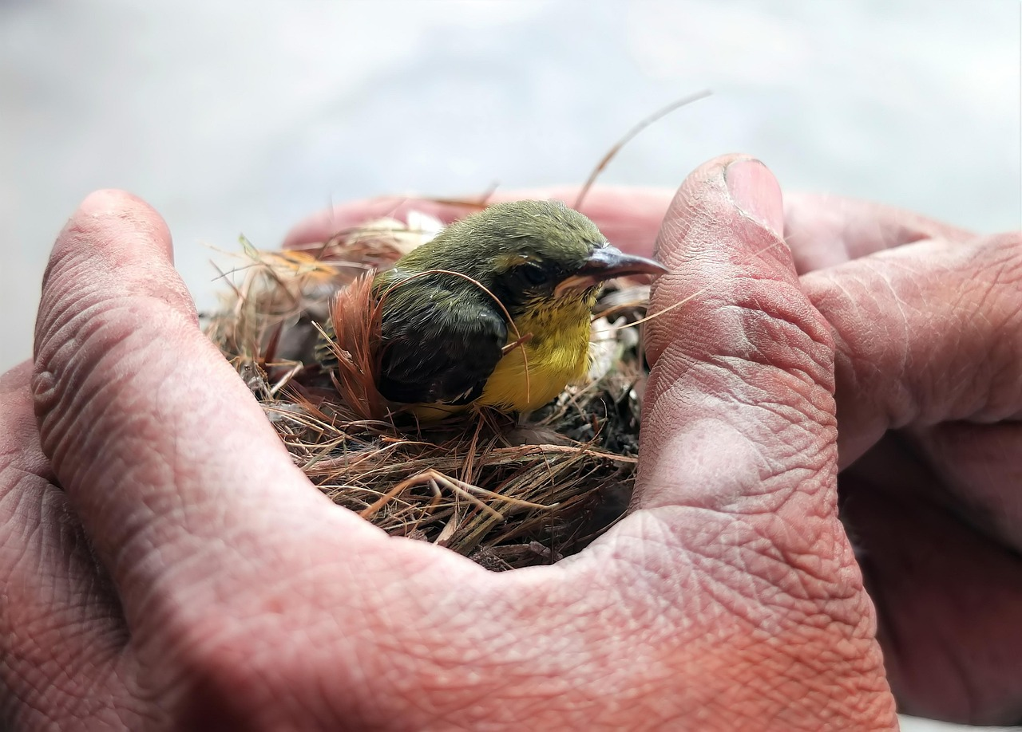

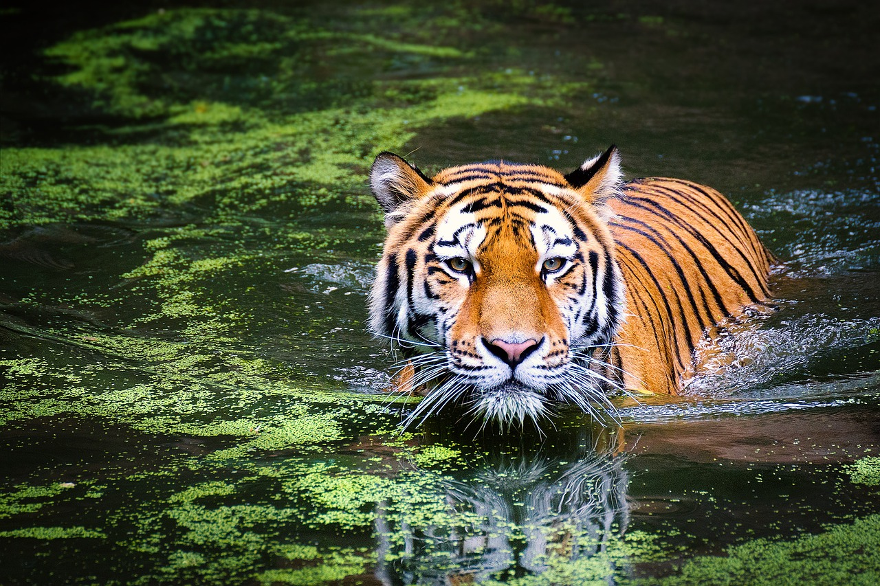

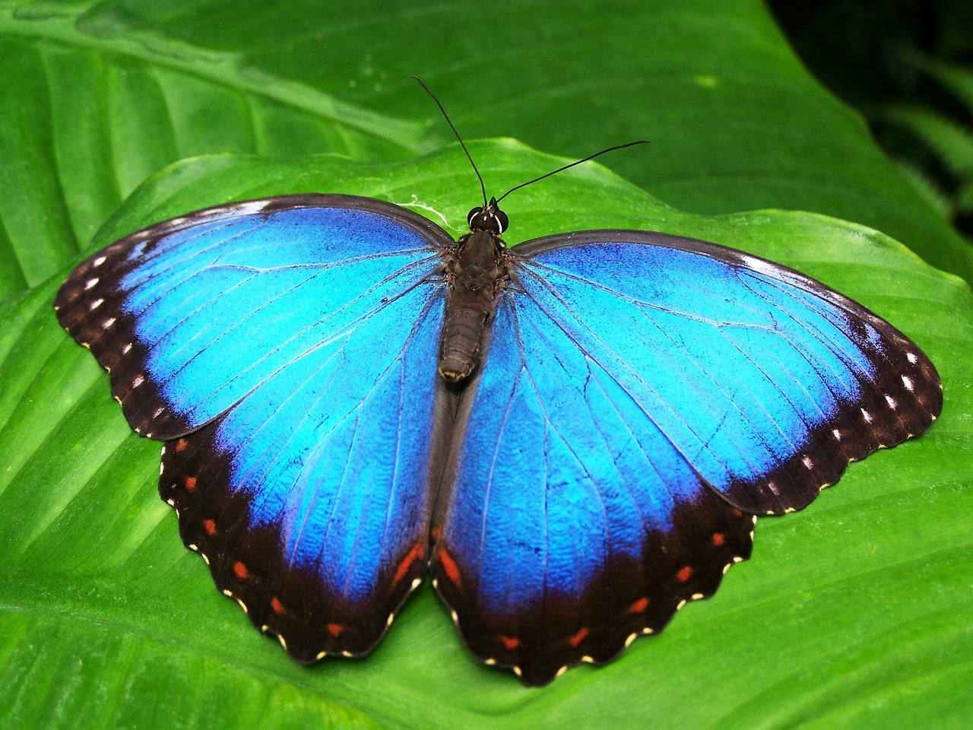
A human meeting an animal is a brilliant idea to work with!
Rescuing a hurt or baby animal
Meeting a new pet for the first time
Saving a rare or endangered animal from deforestation/loggers.
Escaping from a dangerous animal
A story about a war horse, pigeon, etc.
A story about butterfly spotting
You can choose any ‘a human meeting an animal story’ you want! Like Sci-Fi? Write a Sci-Fi story. Like romance stories? Write about someone meeting a new partner who loves animals!

Slide 5
Your narrative needs to have a clear structure
Beginning
Middle
Ending
How will you hook the reader into your story?
What will you introduce first? A character? A setting? Plot?
How will you keep the reader interested?
Will the story build to a climax or will it change direction?
How will you leave the reader at the end?
Will they be left on a cliff-hanger? Will you bring it to a climax or an anticlimax?
Plan out a clear beginning, middle and end for your story.
Bonus Challenge: How will you hook the reader into your story? How will you ensure you keep the reader engaged for the entire story?

Slide 6
Let’s look at two potential beginnings to a story
Student 1
I was really lonely, so I decided to get a dog to make my life more fun.
Student 2
It felt like there was something missing. Life was great for me: a decent flat, a job that I enjoyed, I was living in a town full of friendly folk and with my family nearby. I should have been happy, but I’d had this nagging feeling at the back of my mind for a while now. Ultimately, the flat was wonderful but often too quiet.
What are the differences between the two beginnings?
How do the two beginnings make you feel? Why?
Why is ‘show not tell’ so important when planning stories?

Slide 7
Student 1
Student 2
I was really lonely, so I decided to get a dog to make my life more fun.
It felt like there was something missing. Life was great for me: a decent flat, a job that I enjoyed, I was living in a town full of friendly folk and with my family nearby. I should have been happy, but I’d had this nagging feeling at the back of my mind for a while now. Ultimately, the flat was wonderful but often too quiet.
This student has chosen to tell us what happens straight away. We know they get a dog to help them with their loneliness.
However, one of the most exciting parts of the story has already been revealed.
Great story writers will build up to important plot events. They will show not tell.
This student hasn’t even mentioned about getting a dog, but instead focuses on character development.
We learn lots about how the character feels, and they show us why the character is not happy.
They are pacing their story well before they go on to introduce the new dog.

Slide 8








A puzzle! Hook your reader in with something that isn’t clear at the beginning, perhaps something unusual has happened?
Subtle hook. Hint at what is going to happen in the rest of the text/chapter.
Direct address. Talk directly to your readers as a way of engaging them.
Visual hook. Use a powerful image or description to engage the reader at the start.
It felt like there was something missing.
Amusing hook. Use a joke to establish a comedic tone at the beginning of your text.
Dialogue. Have characters talking to each other right from the beginning to establish characters and relationships.
Write out the opening sentence of your story using a subtle hook.
Bonus Challenge: Write a different opening using one of the other hooks. Which one works better for your story? Why?
Subtle hook. Hint at what is going to happen in the rest of the text/chapter.
Atmospheric hook. Use your descriptive language to build up a particular tone and atmosphere right at the very beginning.
Mid-action: Start a narrative right in the middle of action and hook the reader in straight away. No need for long-winded introductions or descriptions.

Slide 9

Switch opening sentences with another student
It felt like there was something missing.
Use your success criteria table to assess the effectiveness of their opening sentence.
Explain why their opening sentence was effective.
Success criteria
Did they use show not tell?
Does it use a subtle hook?
Why did this opening hook you into the story? | I know the character doesn’t feel right or happy, but I don’t know why.

Slide 10
Success criteria
Did they use show not tell?
Does it use a subtle hook?
Why did this opening hook you into the story?
Success criteria
Did they use show not tell?
Does it use a subtle hook?
Why did this opening hook you into the story?
Success criteria
Did they use show not tell?
Does it use a subtle hook?
Why did this opening hook you into the story?
Success criteria
Did they use show not tell?
Does it use a subtle hook?
Why did this opening hook you into the story?
Success criteria
Did they use show not tell?
Does it use a subtle hook?
Why did this opening hook you into the story?
Success criteria
Did they use show not tell?
Does it use a subtle hook?
Why did this opening hook you into the story?

Slide 11


Every story is a journey, and you need to plan your destination
Beginning
It felt like there was something missing.
Ending
Smiling at Lethe, we drove off, both on our way to our new lives.

Slide 12
Next lesson we will focus on our endings and planning out our middles
Beginning
It felt like there was something missing.
Ending
Smiling at Lethe, we drove off, both on our way to our new lives.

Slide 13

Plenary: Feelings
How you felt about the learning outcomes at the start of the lesson:
How you feel at the end of the lesson:
What you want to feel like next lesson:
To describe ways of opening stories
To analyse how one writer begins their story
To evaluate the impact of our own story beginnings

