Slide 1
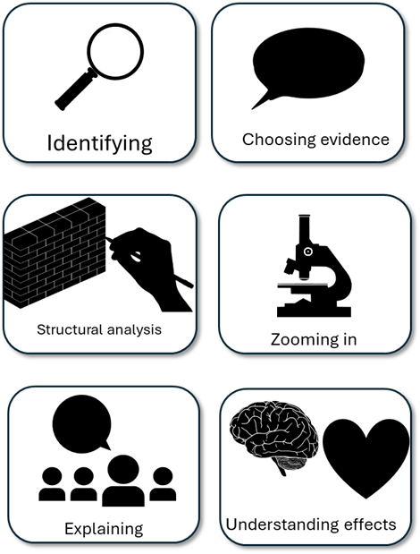
English Language Paper 1 – Q3: Improving Structure Analyses
The narrator talks about the stadium and the people and then moves on to talking about his seat in the stadium. Then the narrator talks about his father passing away.
Read the student answer to Q3 above.
What skills did they use in their answer?
How could they improve this answer?
Why does this answer not address AO2 effectively? Provide examples.
AO2
Explain, comment on and analyse how writers use structure to achieve effects and influence readers, using relevant subject terminology to support their views

Slide 2
Learning outcomes
To describe ways of improving our Q3 answers
To explain how student answers can better meet the requirements of the mark scheme
To evaluate the effectiveness of our improved Q3 answers

Slide 3


AO2
Explain, comment on and analyse how writers use structure to achieve effects and influence readers, using relevant subject terminology to support their views
This is the mark scheme that examiners use to mark Q3:
Shows perceptive and detailed understanding of structural features:
• Analyses the effects of the writer’s choices of structural features
• Selects a range of judicious examples
• Makes sophisticated and accurate use of subject terminology
Student’s answer
Analysed the effects of the structure
Included examples to support ideas
Included subject terminology to support ideas

Slide 4
The student did include examples, but…
The narrator talks about the stadium and the people and then moves on to talking about his seat in the stadium. Then the narrator talks about his father passing away.
• Selects a range of judicious examples
Judicious means showing good judgement and sense.
… They didn’t explain the effects of structure on the reader, and one good way to do this is by using a range of examples that back up your interpretations.

Slide 5
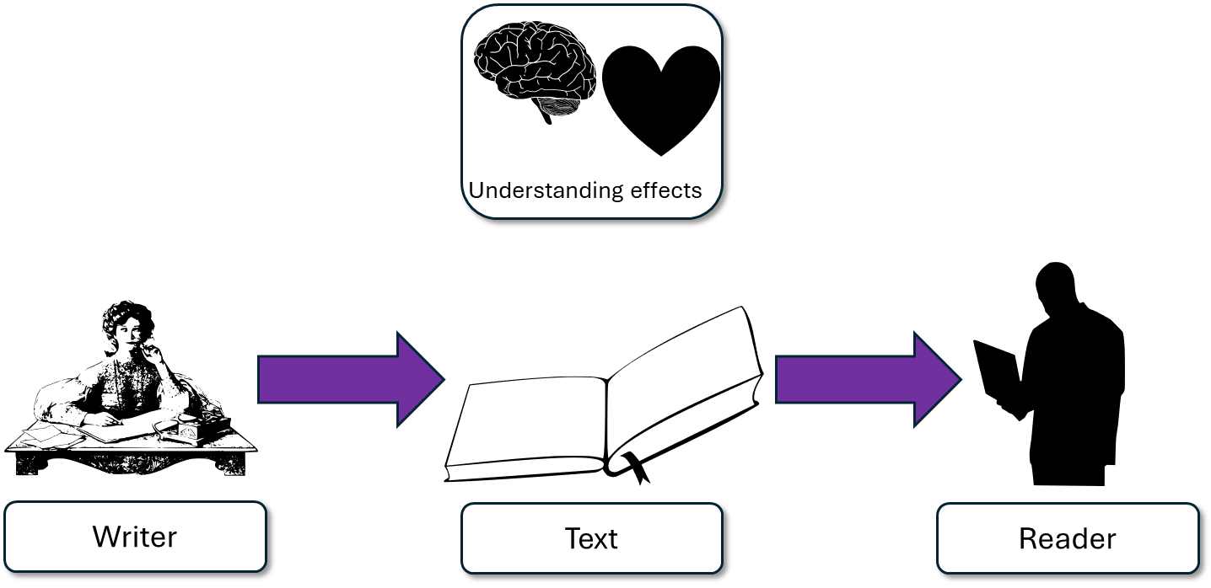
The extract begins with an abrupt short sentence: “This cavern of echoes means everything to you.” It doesn’t explicitly state what this cavern is, but the following description of ordinary people going to an extraordinary place provides us with clues before clarifying the power of the stadium through the description of the seat. This is both an impersonal and personal place for the narrator.
This student’s answer uses the same example but look at how they’ve zoomed in on that example and explained the effects on the reader.
The extract begins with the narrator describing the sentence, but it is the short sentence at the start that amplifies his sense of admiration and respect for the stadium that enables us to appreciate the atmosphere inside the stadium.
It is a place where ordinary people experience extraordinary things.

Slide 6
“I want the reader to experience the powerful atmosphere inside the stadium.”
Wow, that’s a powerful beginning. What is this ‘cavern of echoes’?
The text begins with the short sentence, “This cavern of echoes means everything to you.”

Slide 7
Let’s help this student to improve part of their answer
Next, he talks about how the switch of focus to the father’s death.
“Before his coughing and spluttering, when he wasn’t pierced with medical serpent wires”
Student’s answer
Analysed the effects of the structure
Included examples to support ideas
Included subject terminology to support ideas
Using your understanding of the Q3 mark scheme, transform this into a more effective answer.

Slide 8
Let’s look at another student’s answer
Previously, the writer focused on describing the stadium and the people in it and how they were wrapped up in the joy and excitement of being at the game, but now the focus is switched from the present to the past and the tragedy of the narrator losing their father. The narrator never explicitly states their father died, but alludes to it through “medical serpent wires” and “coughing and spluttering”. This radically alters the atmosphere and brings tragedy juxtaposed next to beautiful and joyful description.
This student’s answer includes the same example as before, but now they explain how the juxtaposition of the father’s death scene next to the beautiful description of the stadium and its people changes the atmosphere. The student explains that this has the effect of making the reader a sense of sadness and this is amplified with the juxtaposition of the glorious with the tragic.

Slide 9
We should also include some structural devices…
Previously, the writer focused on describing the stadium and the people in it and how they were wrapped up in the joy and excitement of being at the game, but now the focus is switched from the present to the past and the tragedy of the narrator losing their father. The narrator never explicitly states their father died, but alludes to it through “medical serpent wires” and “coughing and spluttering”. This radically alters the atmosphere and brings tragedy juxtaposed next to beautiful and joyful description.
Previously, the writer focused on describing the stadium and the people in it and how they were wrapped up in the joy and excitement of being at the game, but we see the narrator losing their father. The narrator never explicitly states their father died, but alludes to it through “medical serpent wires” and “coughing and spluttering”. This radically alters the atmosphere and brings tragedy right next to the beautiful and joyful game.
Student 1
Student 2
Discuss: What has the Student 1 included that Student 2 has not?

Slide 10
You must explain your interpretations
Remember that it is crucial that you include explanations as to why the examples and devices have effects on the reader.
How do those examples and changes in structure make the reader think and feel?

Slide 11
Last lesson we wrote our own Q3 answers
Drafting and redrafting is an important activity in English because it helps you to become a more effective English analyst.
Using your learning from today and the success criteria, rewrite your answer.
Your answer for Q3
Analysed the effects of the structure
Included examples to support ideas
Included subject terminology (devices) to support ideas
Bonus criteria:
Included analytical verbs
Used a range of examples to support your ideas

Slide 12
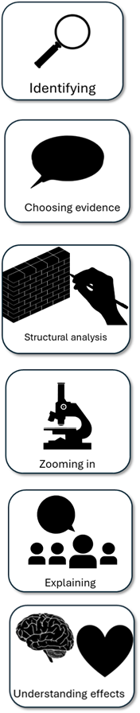
We will now peer assess our new answers
Swap your answers with another student.
Student’s Q2 answer |  | What could they add or change to improve their answer?
Analysed the effects of the language
Included quotes to support ideas
Included subject terminology (devices) to support ideas
Bonus criteria:
Included analytical verbs
Used a range of quotes to support your ideas

Slide 13
Student’s Q3 answer: |  | What could they add or change to improve their answer?
Analysed the effects of the structure
Included examples to support ideas
Included subject terminology (devices) to support ideas
Bonus criteria:
Included analytical verbs
Used a range of examples to support your ideas
Notes:
To print out for students

Slide 14
Let’s recap Paper 1 Section A so far
Close your exercise books and cover up your notes.
What skills do you need to show for Q1? (4 marks)
What skills do you need to show for Q2? (8 marks)
What skills do you need to show for Q3? (8 marks)

Slide 15

Q1 Recap
Q1: You are given a short extract from the beginning of the text.
You are given four multiple choice questions: three options in each one.
Put a tick next to the correct answer for each question.
Do not put more than one tick per question.
Identifying

Slide 16



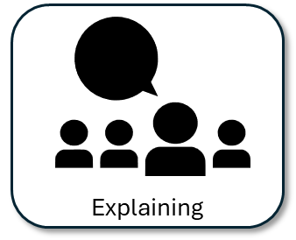

Q2 Recap
Q2: You are given a short extract from the text.
You are asked to explain how the writer describes something in that part of the text.
You must include quotes or evidence to support your ideas.
You should include some language devices.
You must explain how those quotes and devices support your ideas.

Slide 17
Q3 Recap
Q3: You must explore the whole extract
You are asked to explain how the writer uses structure to build a particular area (such as atmosphere).
You must include examples to support your ideas.
You should include some structural devices.
You must explain how those examples and devices support your ideas.

Slide 18




Plenary: Head, Heart, Heave, Hold
Head: Write down one thing that has made you think in this lesson.
Heart: Write down what you have felt this lesson.
Heave: Write down one thing that you disagreed with in this lesson.
Hold: Write down one thing you will remember from this lesson.
To describe ways of improving our Q3 answers
To explain how student answers can better meet the requirements of the mark scheme
To evaluate the effectiveness of our improved Q3 answers

