Slide 1


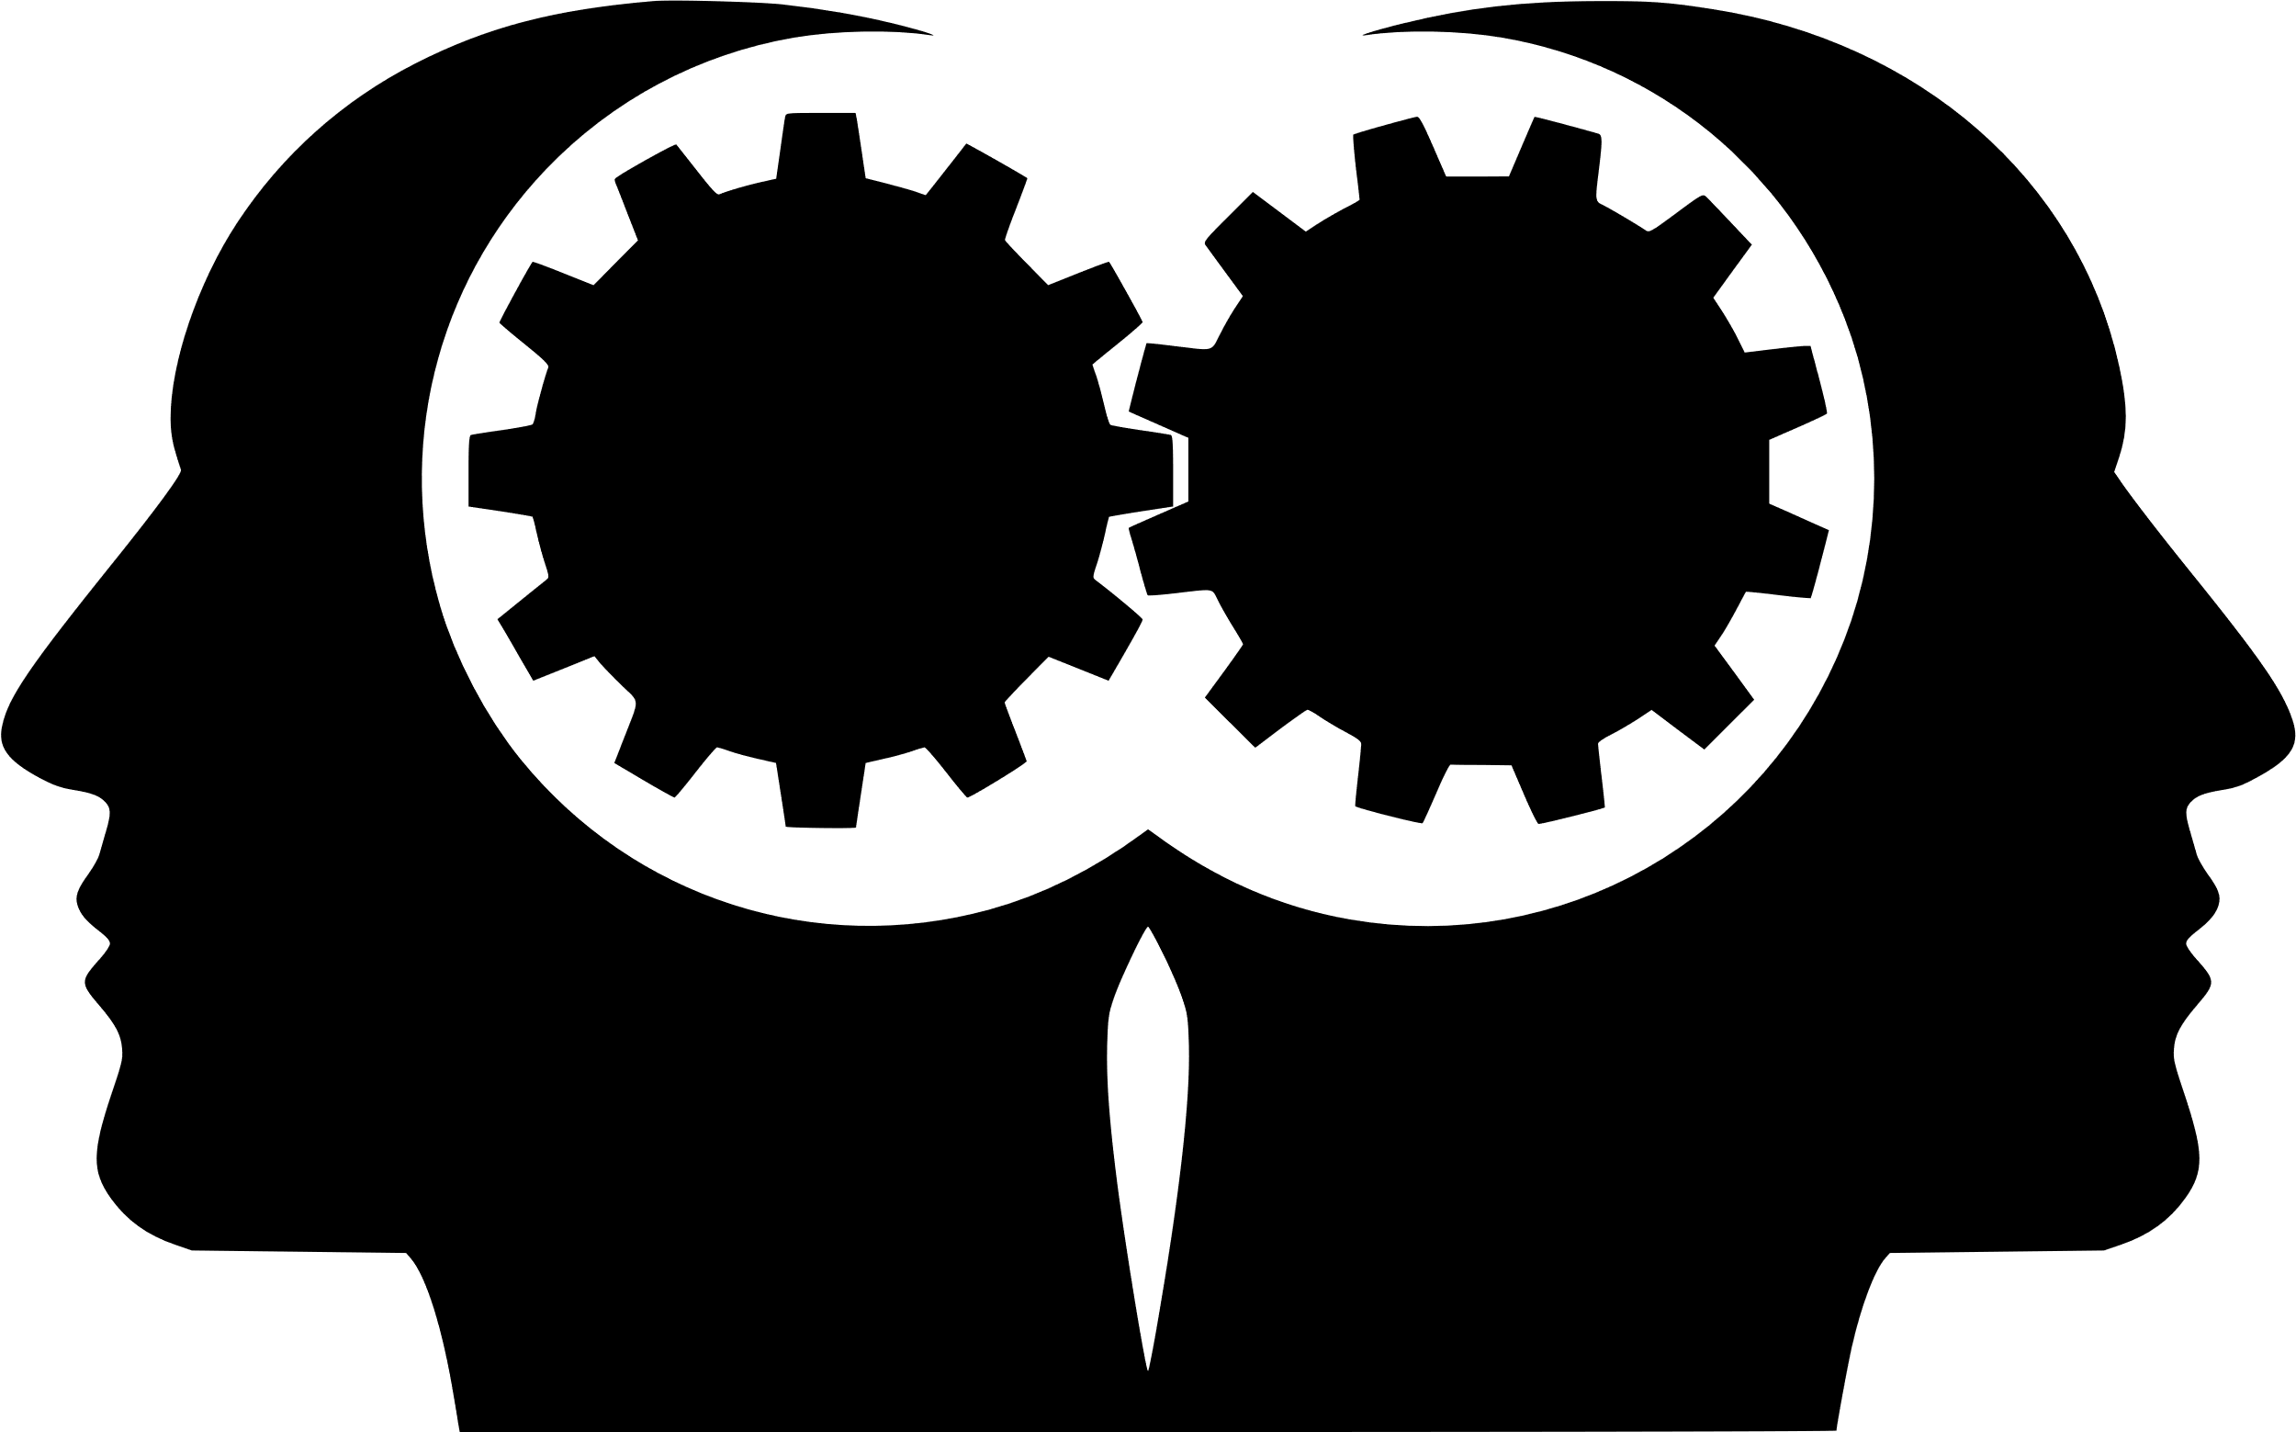

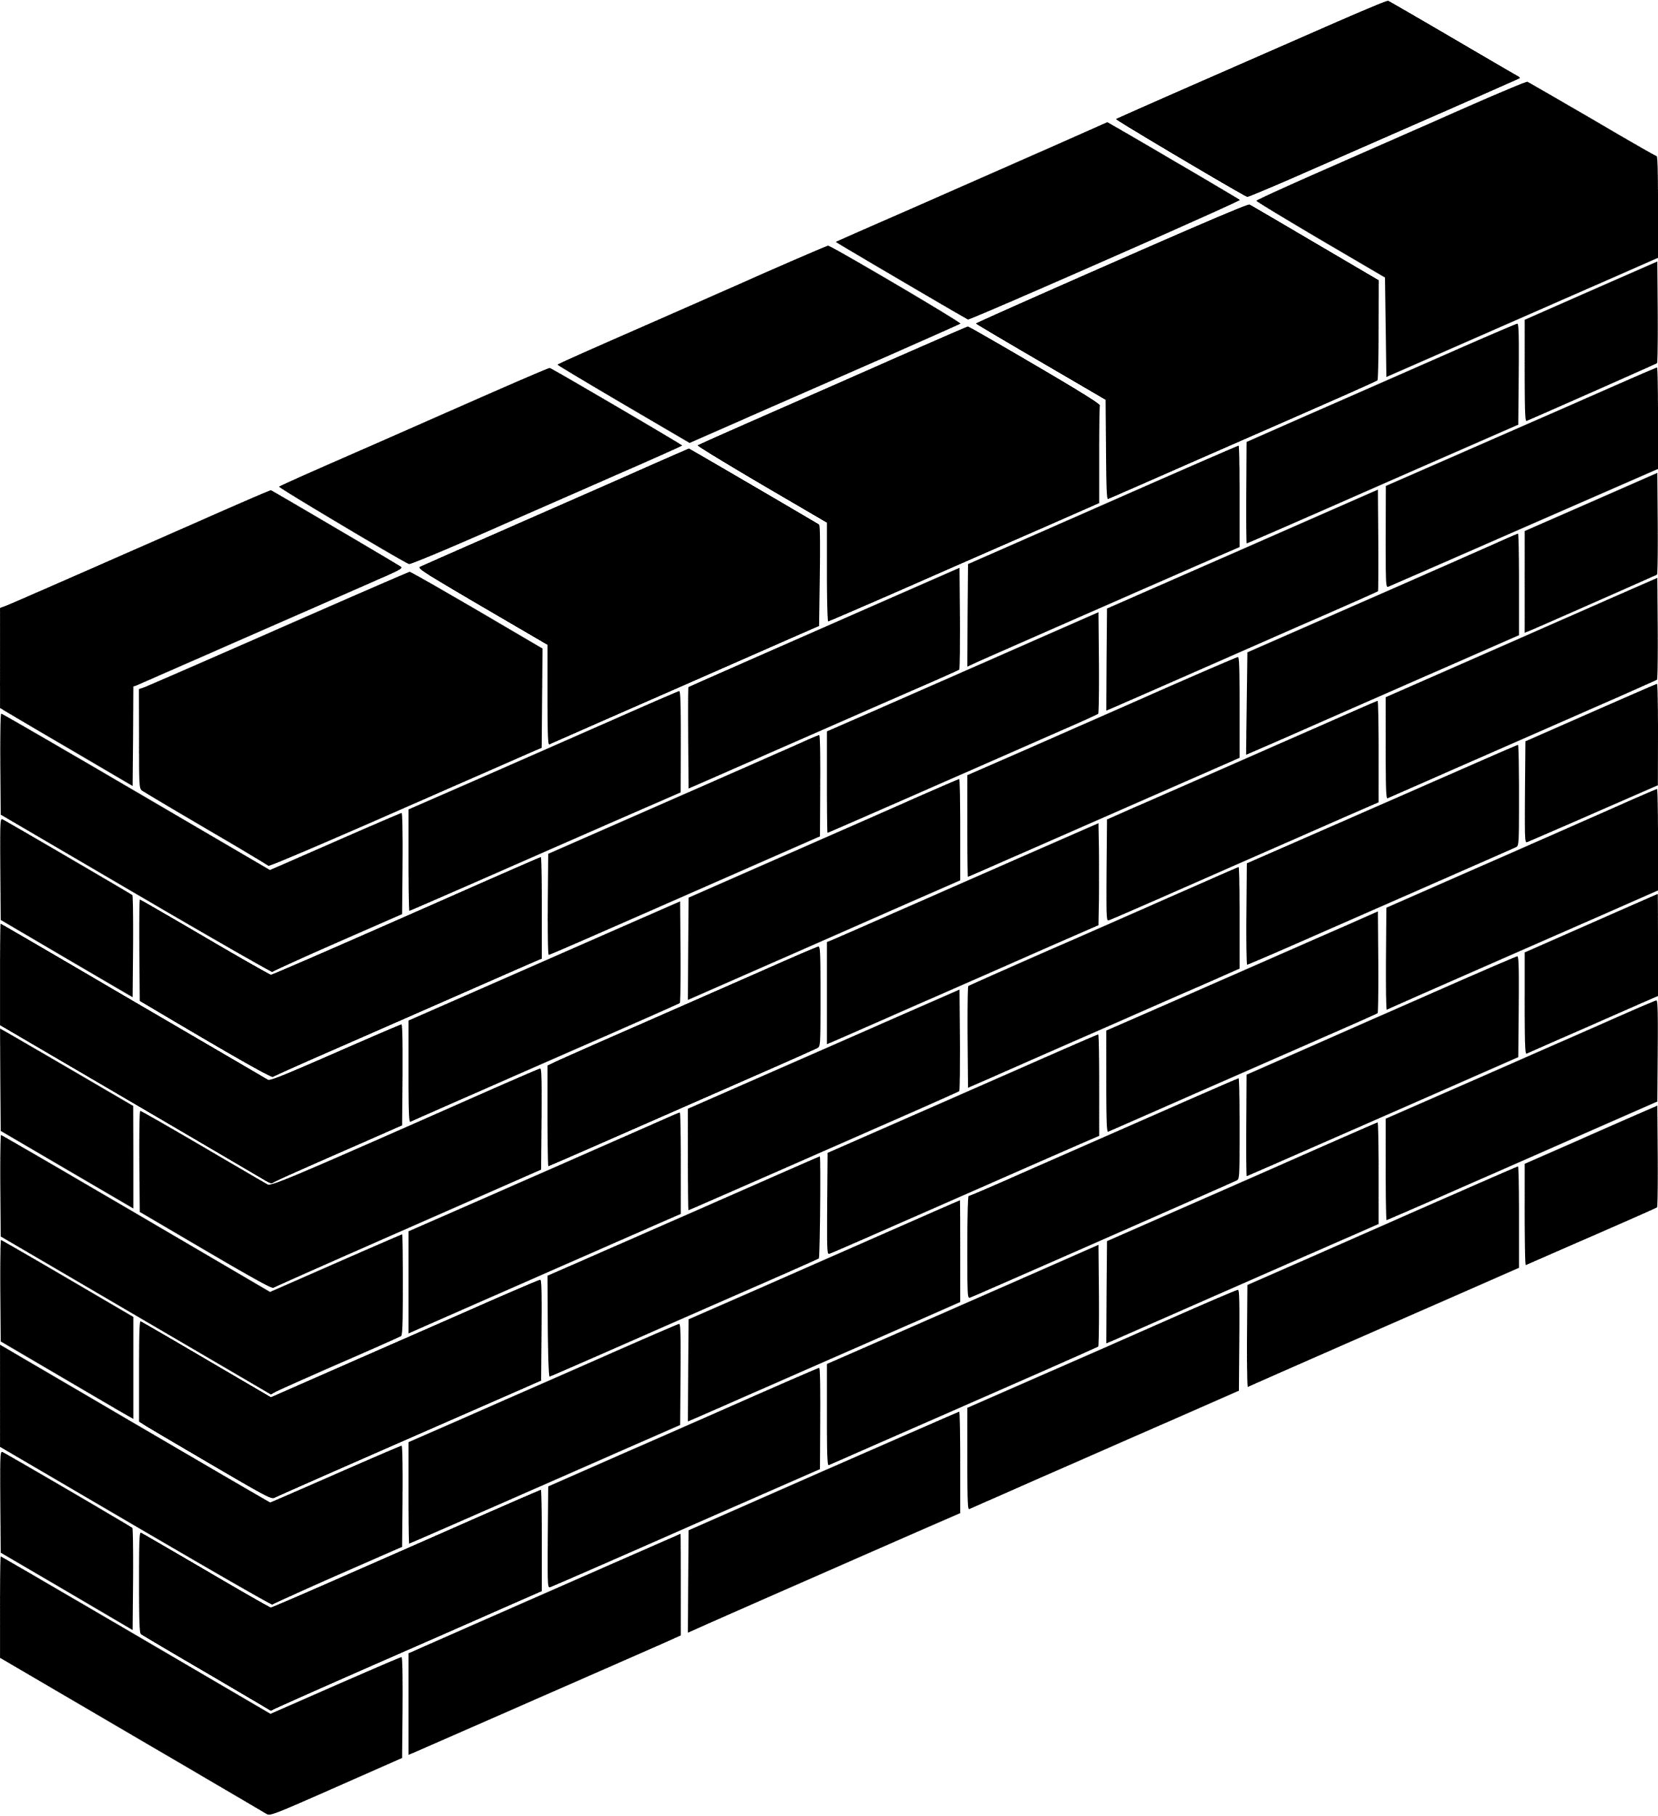


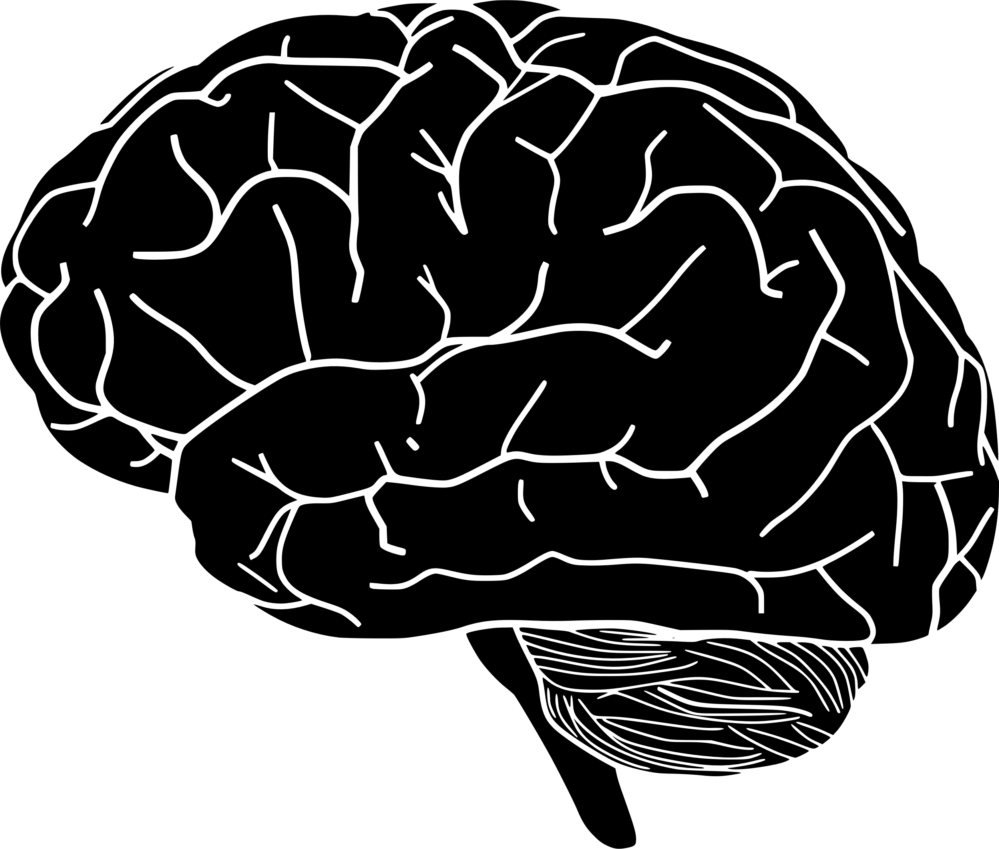


AQA English Language Paper 1 Section A – Q4: Critical Evaluation
Identifying
Choosing evidence
Language analysis
Zooming in
Structural analysis
Evaluating
Explaining
Understanding effects
Last lesson we began to explore Q4, which is all about critical evaluation skills.
Which of the above skills do we need to include in Q4?
How is Q4 different to Q2 (language analysis) and Q3 (structural analysis)?
Why is evaluating a different skill to analysis? Provide examples.

Slide 2
Learning outcomes
To describe how a student has evaluated the text in a model answer
To explain how we can improve our critical evaluations for Q4
To apply our understanding of Q4 skills to our own answers

Slide 3
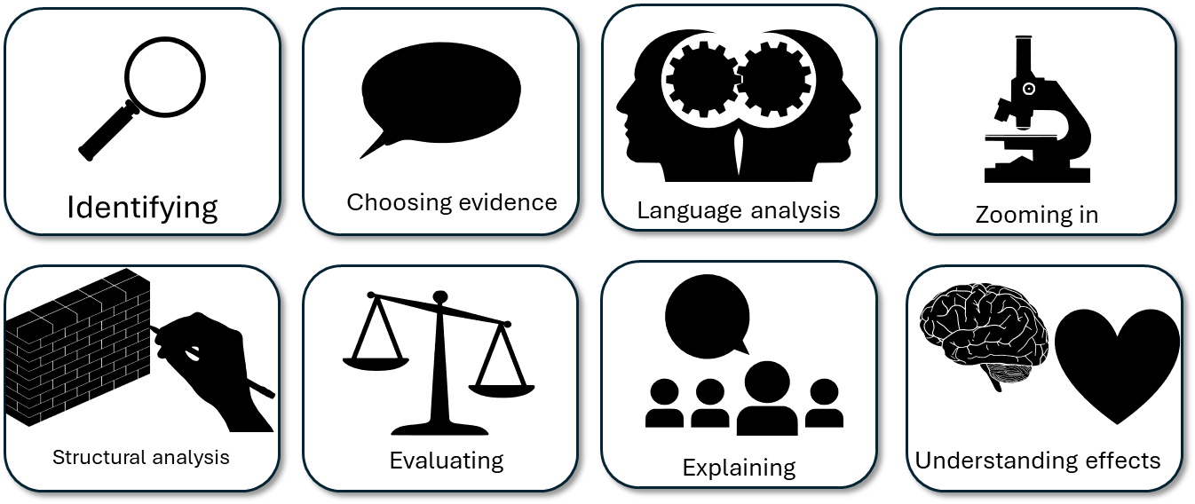
Ideally, we need to use all these skills in our answers for Q4
As well as giving our opinions on a statement provided, we also need to include some analysis of how the language and structure impacts on the reader.
We looked at how a text was funny or threatening for a reader previously, and we need to explain how the language and structure help the reader to think and feel this.

Slide 4
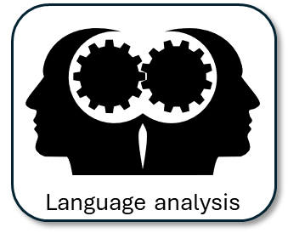
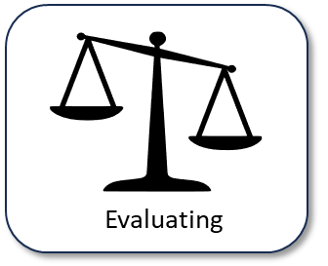
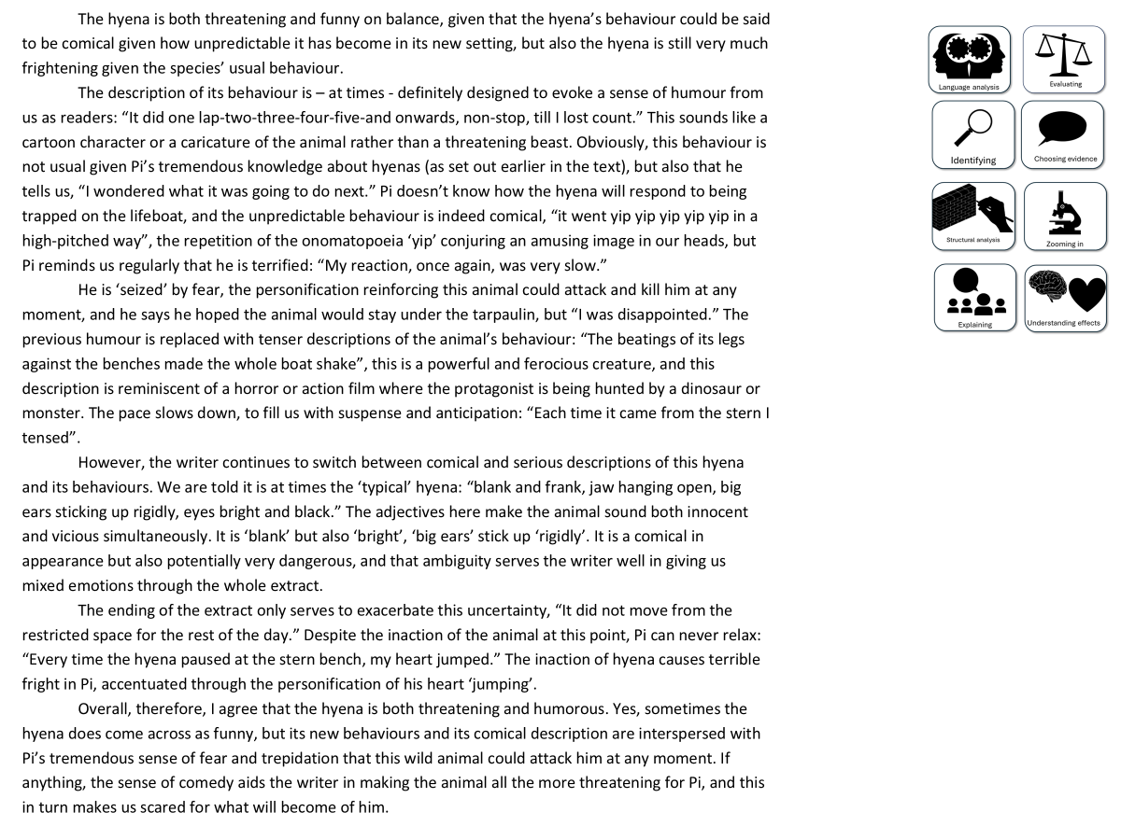
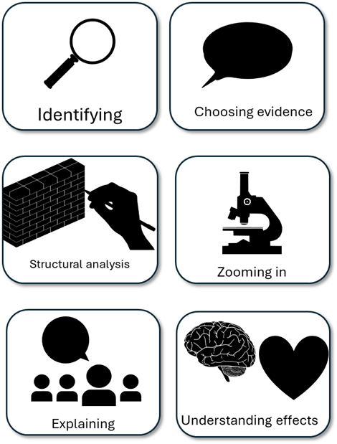
You have been given a good answer for Q4
Go through the answer and find good examples of how the student has evaluated. You could do this through arrows, annotations or highlighting.
Bonus Challenge: Find examples of language or structure analysis.

Slide 5
The hyena is both threatening and funny on balance, given that the hyena’s behaviour could be said to be comical given how unpredictable it has become in its new setting, but also the hyena is still very much frightening given the species’ usual behaviour.
The description of its behaviour is – at times - definitely designed to evoke a sense of humour from us as readers: “It did one lap-two-three-four-five-and onwards, non-stop, till I lost count.” This sounds like a cartoon character or a caricature of the animal rather than a threatening beast. Obviously, this behaviour is not usual given Pi’s tremendous knowledge about hyenas (as set out earlier in the text), but also that he tells us, “I wondered what it was going to do next.” Pi doesn’t know how the hyena will respond to being trapped on the lifeboat, and the unpredictable behaviour is indeed comical, “it went yip yip yip yip yip in a high-pitched way”, the repetition of the onomatopoeia ‘yip’ conjuring an amusing image in our heads, but Pi reminds us regularly that he is terrified: “My reaction, once again, was very slow.”
He is ‘seized’ by fear, the personification reinforcing this animal could attack and kill him at any moment, and he says he hoped the animal would stay under the tarpaulin, but “I was disappointed.” The previous humour is replaced with tenser descriptions of the animal’s behaviour: “The beatings of its legs against the benches made the whole boat shake”, this is a powerful and ferocious creature, and this description is reminiscent of a horror or action film where the protagonist is being hunted by a dinosaur or monster. The pace slows down, to fill us with suspense and anticipation: “Each time it came from the stern I tensed”.
However, the writer continues to switch between comical and serious descriptions of this hyena and its behaviours. We are told it is at times the ‘typical’ hyena: “blank and frank, jaw hanging open, big ears sticking up rigidly, eyes bright and black.” The adjectives here make the animal sound both innocent and vicious simultaneously. It is ‘blank’ but also ‘bright’, ‘big ears’ stick up ‘rigidly’. It is a comical in appearance but also potentially very dangerous, and that ambiguity serves the writer well in giving us mixed emotions through the whole extract.
The ending of the extract only serves to exacerbate this uncertainty, “It did not move from the restricted space for the rest of the day.” Despite the inaction of the animal at this point, Pi can never relax: “Every time the hyena paused at the stern bench, my heart jumped.” The inaction of hyena causes terrible fright in Pi, accentuated through the personification of his heart ‘jumping’.
Overall, therefore, I agree that the hyena is both threatening and humorous. Yes, sometimes the hyena does come across as funny, but its new behaviours and its comical description are interspersed with Pi’s tremendous sense of fear and trepidation that this wild animal could attack him at any moment. If anything, the sense of comedy aids the writer in making the animal all the more threatening for Pi, and this in turn makes us scared for what will become of him.

Slide 6
The hyena is both threatening and funny on balance, given that the hyena’s behaviour could be said to be comical given how unpredictable it has become in its new setting, but also the hyena is still very much frightening given the species’ usual behaviour.
The description of its behaviour is – at times - definitely designed to evoke a sense of humour from us as readers: “It did one lap-two-three-four-five-and onwards, non-stop, till I lost count.” This sounds like a cartoon character or a caricature of the animal rather than a threatening beast. Obviously, this behaviour is not usual given Pi’s tremendous knowledge about hyenas (as set out earlier in the text), but also that he tells us, “I wondered what it was going to do next.” Pi doesn’t know how the hyena will respond to being trapped on the lifeboat, and the unpredictable behaviour is indeed comical, “it went yip yip yip yip yip in a high-pitched way”, the repetition of the onomatopoeia ‘yip’ conjuring an amusing image in our heads, but Pi reminds us regularly that he is terrified: “My reaction, once again, was very slow.”
He is ‘seized’ by fear, the personification reinforcing this animal could attack and kill him at any moment, and he says he hoped the animal would stay under the tarpaulin, but “I was disappointed.” The previous humour is replaced with tenser descriptions of the animal’s behaviour: “The beatings of its legs against the benches made the whole boat shake”, this is a powerful and ferocious creature, and this description is reminiscent of a horror or action film where the protagonist is being hunted by a dinosaur or monster. The pace slows down, to fill us with suspense and anticipation: “Each time it came from the stern I tensed”.
However, the writer continues to switch between comical and serious descriptions of this hyena and its behaviours. We are told it is at times the ‘typical’ hyena: “blank and frank, jaw hanging open, big ears sticking up rigidly, eyes bright and black.” The adjectives here make the animal sound both innocent and vicious simultaneously. It is ‘blank’ but also ‘bright’, ‘big ears’ stick up ‘rigidly’. It is a comical in appearance but also potentially very dangerous, and that ambiguity serves the writer well in giving us mixed emotions through the whole extract.
The ending of the extract only serves to exacerbate this uncertainty, “It did not move from the restricted space for the rest of the day.” Despite the inaction of the animal at this point, Pi can never relax: “Every time the hyena paused at the stern bench, my heart jumped.” The inaction of hyena causes terrible fright in Pi, accentuated through the personification of his heart ‘jumping’.
Overall, therefore, I agree that the hyena is both threatening and humorous. Yes, sometimes the hyena does come across as funny, but its new behaviours and its comical description are interspersed with Pi’s tremendous sense of fear and trepidation that this wild animal could attack him at any moment. If anything, the sense of comedy aids the writer in making the animal all the more threatening for Pi, and this in turn makes us scared for what will become of him.
In each of the highlighted sections the student evaluates whether they think the hyena is funny or threatening.

Slide 7
This student has decided that the hyena is both threatening and funny in equal measure
The hyena is both threatening and funny on balance, given that the hyena’s behaviour could be said to be comical given how unpredictable it has become in its new setting, but also the hyena is still very much frightening given the species’ usual behaviour.
Straight away they answer the task and evaluate the text.
However, they go on to provide examples and explain their evaluation.
The hyena is funny because it is unpredictable in its new setting, but it is also threatening because of the behaviour we know from Pi the animal is expected to show.

Slide 8
This student has decided that the hyena is both threatening and funny in equal measure
The description of its behaviour is – at times - definitely designed to evoke a sense of humour from us as readers: “It did one lap-two-three-four-five-and onwards, non-stop, till I lost count.” This sounds like a cartoon character or a caricature of the animal rather than a threatening beast. Obviously, this behaviour is not usual given Pi’s tremendous knowledge about hyenas (as set out earlier in the text), but also that he tells us, “I wondered what it was going to do next.” Pi doesn’t know how the hyena will respond to being trapped on the lifeboat, and the unpredictable behaviour is indeed comical, “it went yip yip yip yip yip in a high-pitched way”, the repetition of the onomatopoeia ‘yip’ conjuring an amusing image in our heads, but Pi reminds us regularly that he is terrified: “My reaction, once again, was very slow.”
Again, they evaluate the text and answer the task.
They provide a number of examples that show the hyena is comical, but also threatening.
They also explain how each example supports their evaluation of the text.

Slide 9
Let’s look at the mark scheme for Q4
AO4
Evaluate texts critically and support this with appropriate textual references
To get 20/20:
Shows perceptive and detailed evaluation:
• Develops a convincing and critical understanding of ideas
• Shows perceptive understanding of writer’s methods
• Evaluates critically and in detail the impact of the writer’s ideas and
methods on the reader
• Selects a range of judicious textual detail
Student’s answer
Evaluated the text based on the statement provided
Included examples to support ideas
Evaluated the writer’s use of methods (language and structure)
This is what we need to focus on next

Slide 10
Look at this specific section of the student’s answer
He is ‘seized’ by fear, the personification reinforcing this animal could attack and kill him at any moment, and he says he hoped the animal would stay under the tarpaulin, but “I was disappointed.” The previous humour is replaced with tenser descriptions of the animal’s behaviour: “The beatings of its legs against the benches made the whole boat shake”, this is a powerful and ferocious creature, and this description is reminiscent of a horror or action film where the protagonist is being hunted by a dinosaur or monster. The pace slows down, to fill us with suspense and anticipation: “Each time it came from the stern I tensed”.
Go through this and find where the student has explored the use of language or structure.
Discuss: How do these analyses help support the students’ evaluation of the text?

Slide 11
Look at this specific section of the student’s answer
He is ‘seized’ by fear, the personification reinforcing this animal could attack and kill him at any moment, and he says he hoped the animal would stay under the tarpaulin, but “I was disappointed.” The previous humour is replaced with tenser descriptions of the animal’s behaviour: “The beatings of its legs against the benches made the whole boat shake”, this is a powerful and ferocious creature, and this description is reminiscent of a horror or action film where the protagonist is being hunted by a dinosaur or monster. The pace slows down, to fill us with suspense and anticipation: “Each time it came from the stern I tensed”.
This contains both language analysis and structural analysis.
The explanations help the student to explain their evaluation of the text because they are successfully arguing that the hyena is both funny and threatening.
As well as this, they are showing they understand the writer’s methods and the effects they have on the reader.

Slide 12

Q4: Critical evaluation
This question asks you to explore the second half of the extract only – from line 20 to the end.
In this part of the source, the hyena could be seen as funny or threatening.
To what extent do you agree or disagree with this statement?
In your response, you could:
• consider your impressions of how the hyena behaves
• comment on the methods the writer uses to present the hyena as funny or threatening
• support your response with references to the text.[20 marks]
Possible sentence starters to use:
I think the writer shows the hyena is very much a threat because…
When we are told that: “…” this reinforces… because…
The use of [technique] reiterates that... because...
Additionally, the hyena can be said to appear comical because…
By describing the hyena as…, we learn that it is not a threat because…
This helps us to develop an understanding of Pi’s thoughts and feelings because… particularly his use of [technique] which…
Plan and write out your answer to this question.
Timed conditions: 30 minutes

Slide 13
Plenary: We will now peer assess our own answers
Swap your answers with another student.
1) What skills did the student use well in their answer?
Example: They explain how they think the hyena is more funny than threatening.
2) What skills could the student improve on in their answer?
Example: They need to explain why the writer’s methods make the reader think the hyena is more funny than threatening.

