Slide 1
Speed questioning
Ask the questions to the person opposite
Explain any incorrect answers
Two minutes at each station
When you hear the buzzer move left
Leave the card!

Slide 2
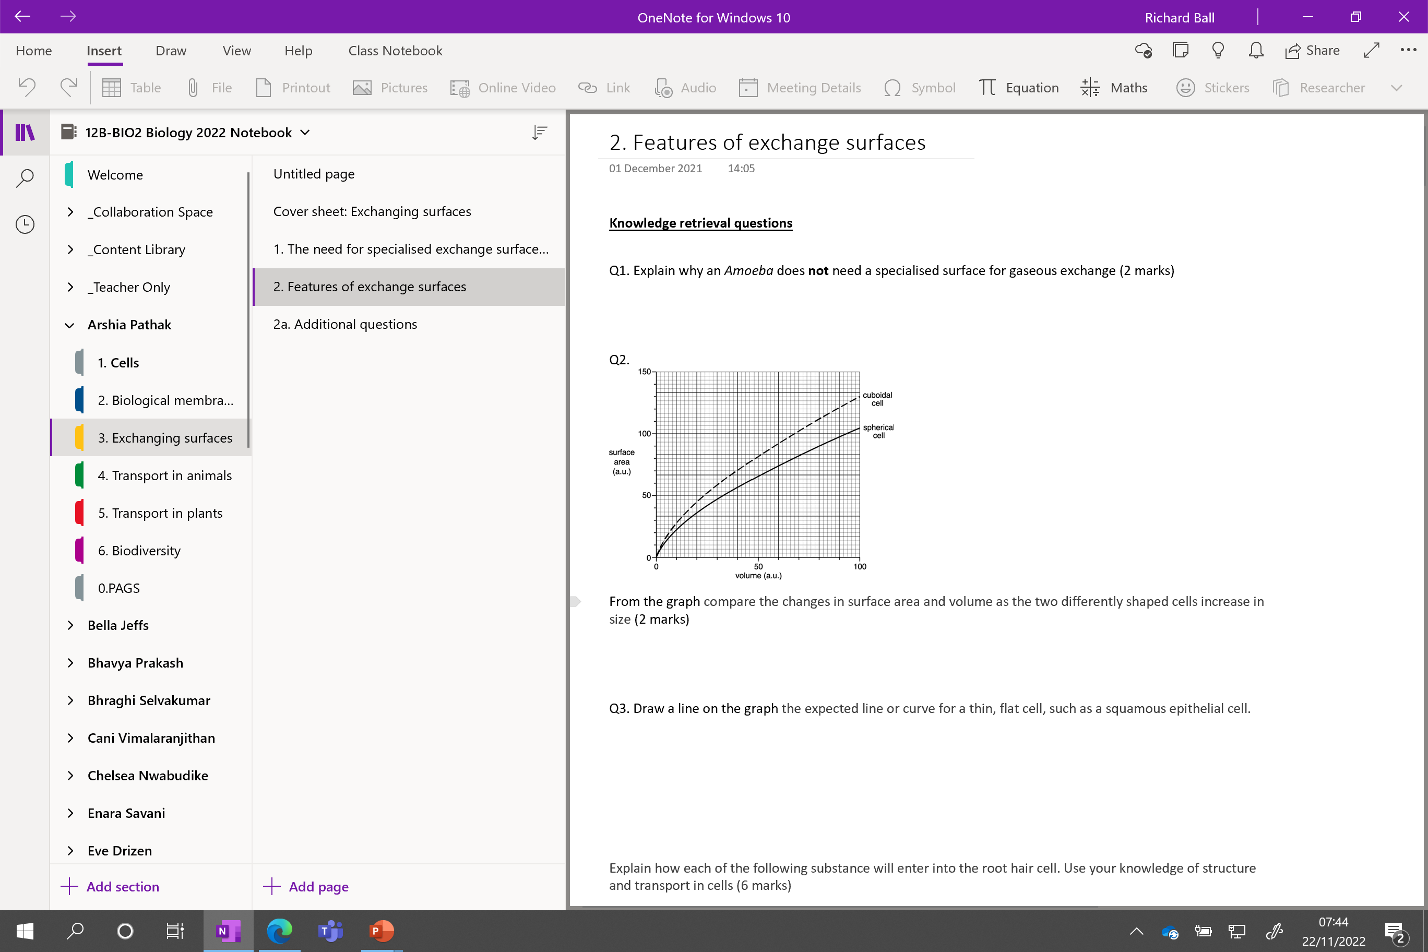

Slide 3
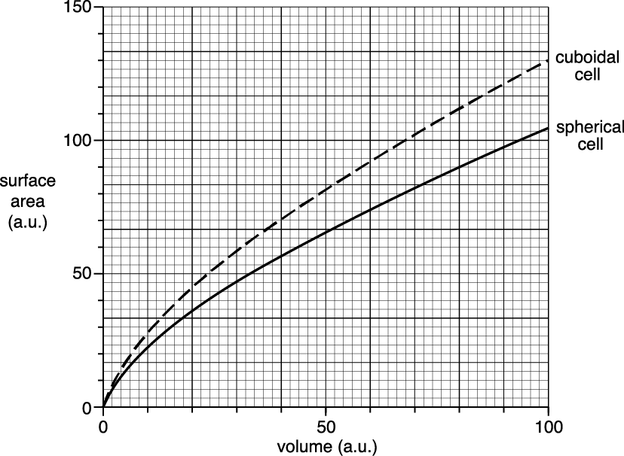
Knowledge retrieval questions Exchanges surfaces lesson1
Q1. Explain why an Amoeba does not need a specialised surface for gaseous exchange (2 marks)
Q2. From the graph compare the changes in surface area and volume as the two differently shaped cells increase in size (2 marks)
Q3. Draw a line on the graph the expected line or curve for a thin, flat cell, such as a squamous epithelial cell.
large surface area to volume ratio;
short diffusion pathway;
idea that diffusion sufficient / fast enough, to supply (all) needs
Similarities - As volume increases, surface area increases / surface area to volume ratio decreases
Differences - idea that the spherical cell always has a lower surface area than the cuboidal cell

Slide 4
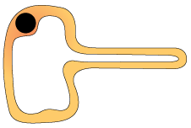

BONUS QUESTION!
Explain how each of the following substance will enter into the root hair cell. Use your knowledge of structure and transport in cells (6 marks)
Key
Water molecule
Magnesium ion
Nitrate ion
Water moves in via osmosis
moving from an area of higher water potential to an area of lower water potential
Magnesium ions - facilitated diffusion
via protein channels from high to low concentration
Nitrate ions active transport
from low to high concentration via protein carriers using ATP
Why do plants need nitrate and magnesium ions?

Slide 5
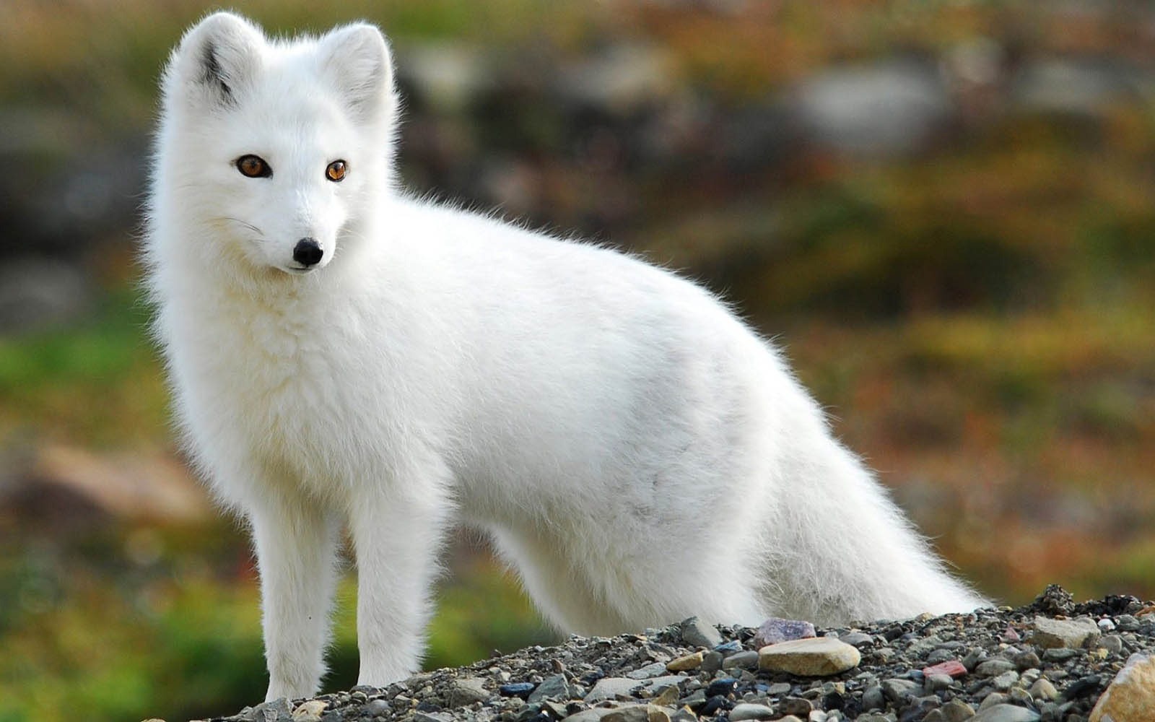
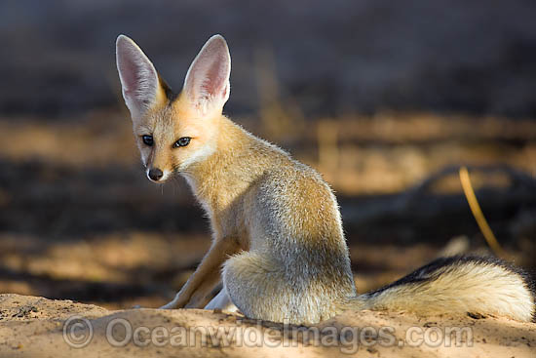

Which one has a larger surface area to volume ratio?
WHY?
STARTER
Arctic fox
Desert fox

Slide 6
What three physical factors would influence the speed a substance is able to cross the cell surface membrane?

Slide 7
Is there a calculation to work out the rate of transport across a surface?

Slide 8
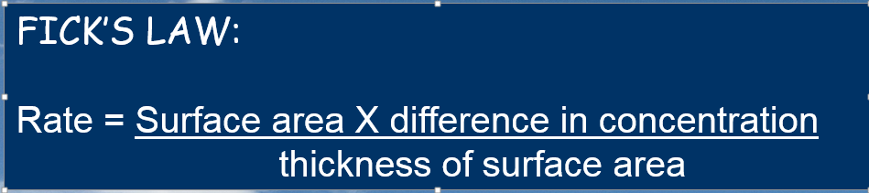
Fick’s Law (factors affecting speed of transport across a surface)
Size of the concentration gradient
Size of surface the substance can come into contact with
Diffusion pathway width

Slide 9
The rate of diffusion is proportional to both the surface area and concentration difference and is inversely proportional to the thickness of the membrane.

Slide 10
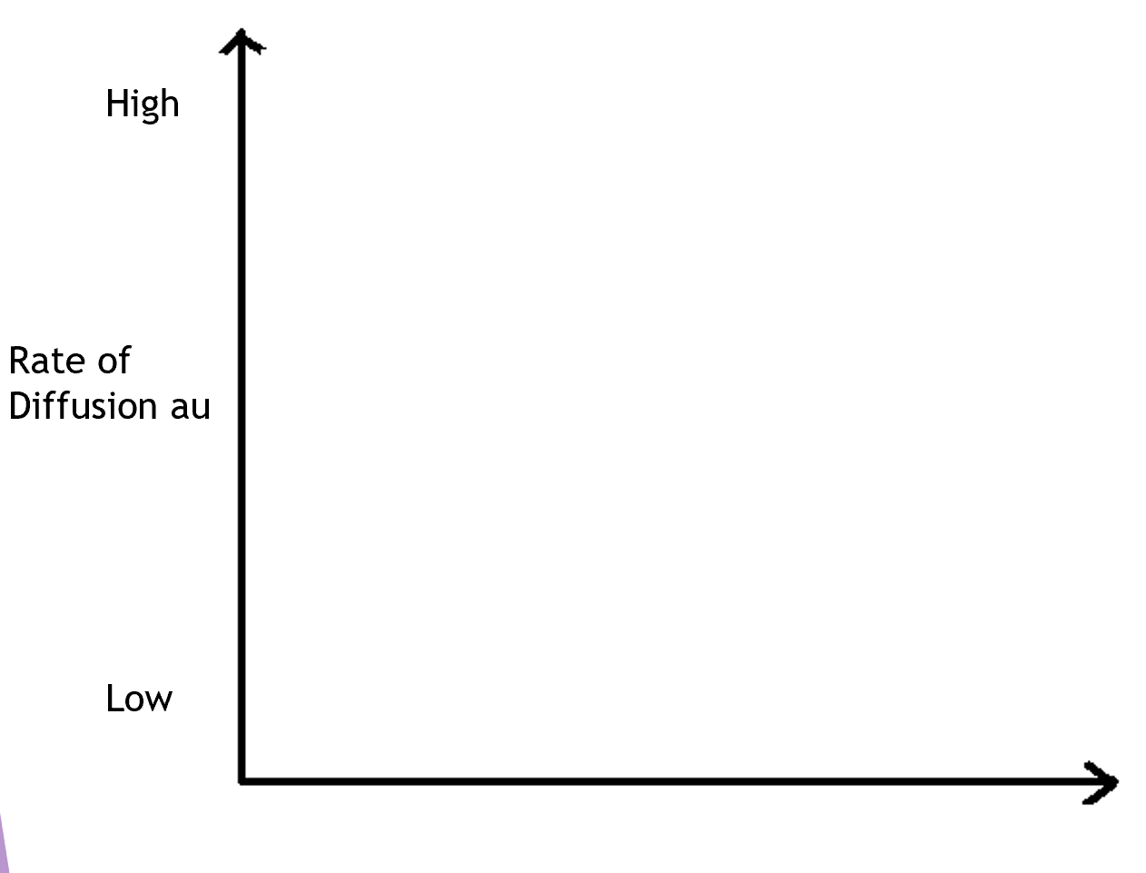
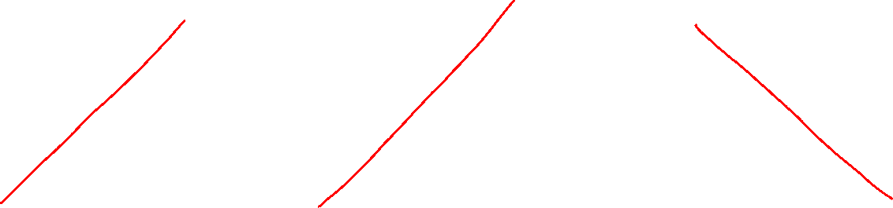
The rate of diffusion is proportional to both the surface area and concentration difference and is inversely proportional to the thickness of the membrane.
L Surface area H
L Thickness of membrane H
L Con grad H

Slide 11


Fick's law of diffusion can be used to calculate a value for the effectiveness of the uptake of water by the root hair cells.
This value can be calculated using the equation
The mean surface area of a root hair cell 30m²
The diffusion distance in the root hair cell is 0.2 μm.
The mean water concentration in soli is 3.5kPa and in the root hair cell is 0.5kPa
Calculate the rate of osmosis.
(30 x 3) = 450 au
0.2

Slide 12
Features of Exchange Surfaces
Wednesday, 23 July 2025

Slide 13
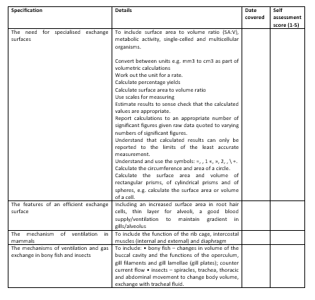
Learning Outcomes
Describe the features that all gas exchange surfaces have in common
Explain how specific examples are adapted for exchanging materials

Slide 14
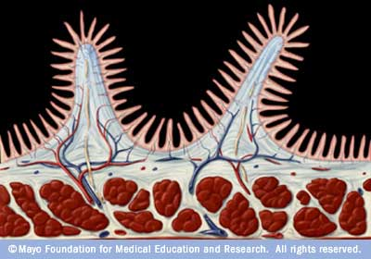
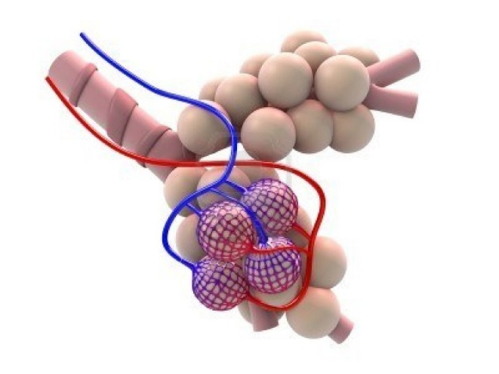
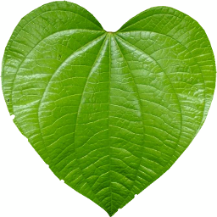
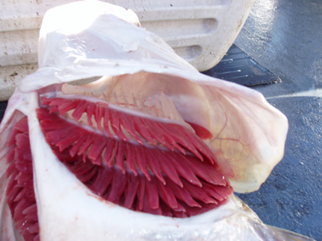
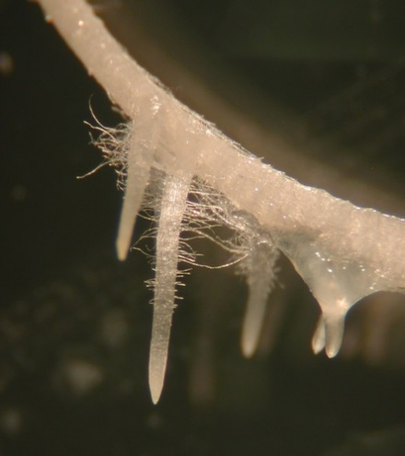
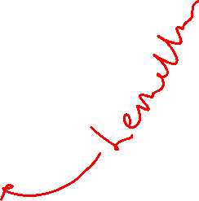
What features make
these exchange
surfaces successful?

Slide 15
Specialised exchange surfaces
The effectiveness of an exchange surface is improved by:
  Having a _____ surface area
  A ____ membrane which ensures a _____ diffusion distance
  (in animals) an efficient ______ supply
  (in animals for gas exchange) being ventilated (good circulation of ___).
  In complex organisms, an efficient _________ system

Slide 16
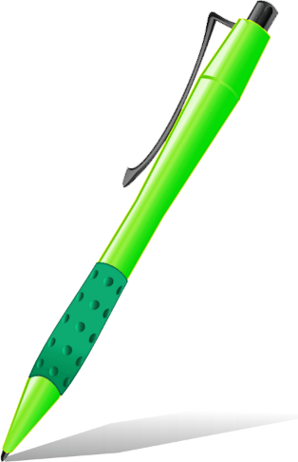
Specialised exchange surfaces
The effectiveness of an exchange surface is improved by:
Having a large surface area
A thin membrane which ensures a short diffusion distance
(in animals) an efficient blood supply
(in animals for gas exchange) being ventilated (good circulation of air).
In complex organisms an efficient transport system

Slide 17
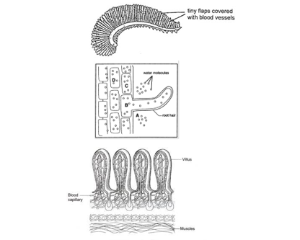
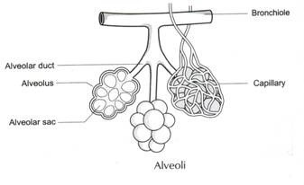
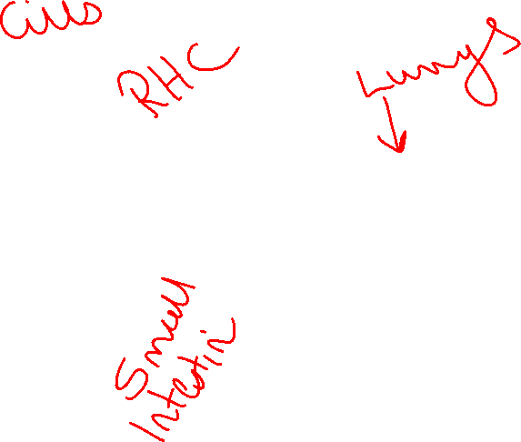
Now apply your knowledge:
add labels to explain how each different exchange surface is adapted to be efficient.

Slide 18
Answers:
1.Fish gills – many lamellae increase surface area. Covered in capillaries to maintain blood flow and concentration gradient. Thin membrane reduces diffusion distance.
2. Plant roots – many root hairs (cilia) increase surface area for uptake of water and ions. Thin membrane to reduce diffusion distance.
3. Small intestine – folded and covered in villi to increase surface area and diffusion of nutrients. Many capillaries to increase blood supply. Thin membrane to reduce diffusion distance.
4. Lungs – alveoli increase surface area. Covered in capillaries for efficient blood supply. Thin membrane to reduce diffusion distance. Air circulates freely so they are well ventilated.

Slide 19
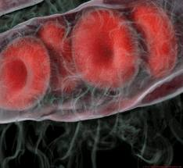
Apply your knowledge:
How is a red blood cell adapted for efficient gas exchange? 4 marks

Slide 20
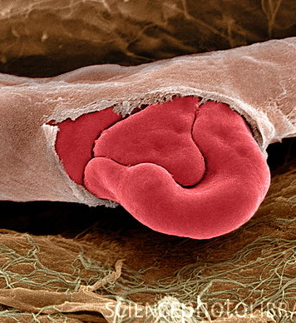
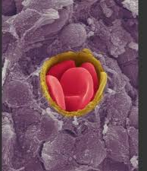
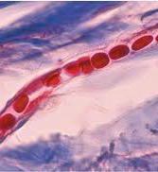
1. No nucleus, increases volume to transport gases
2. Biconcave shape increases surface area.
3. Contains haemoglobin which bonds with O₂ and CO₂
4. Malleable shape to fit through small spaces.

Slide 22
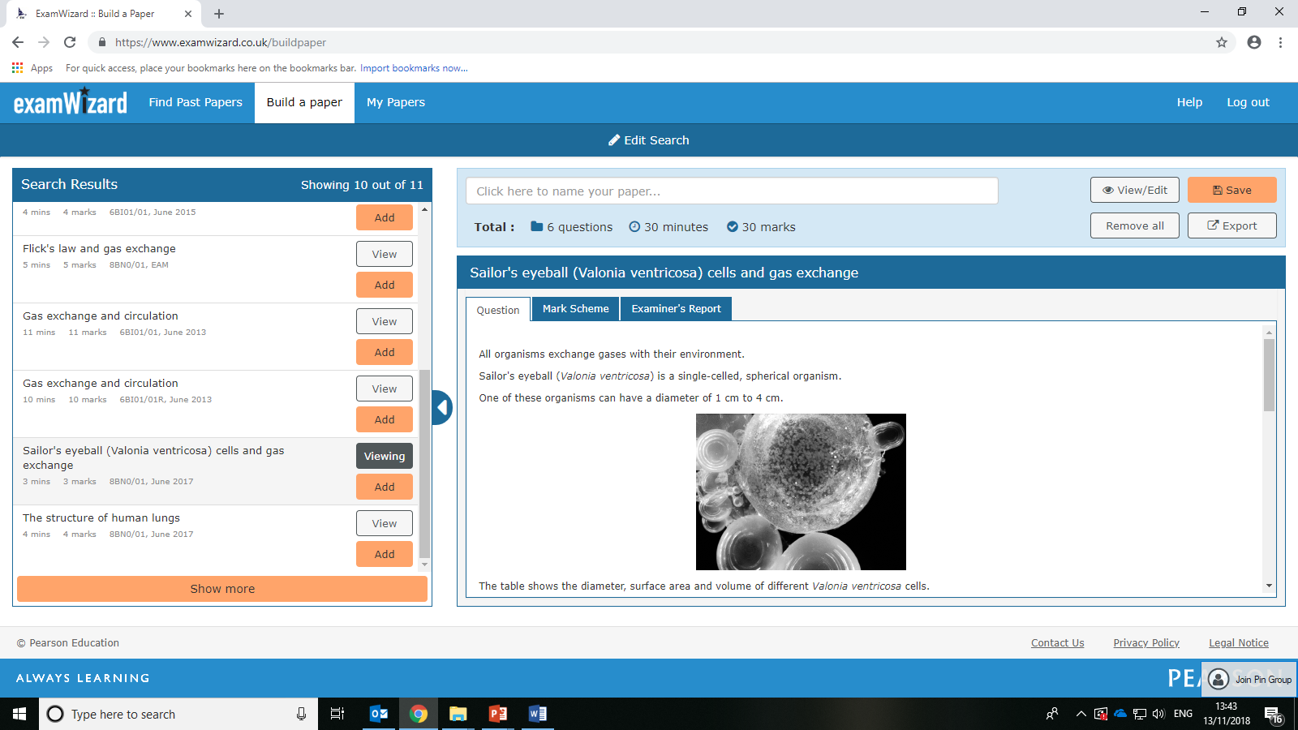
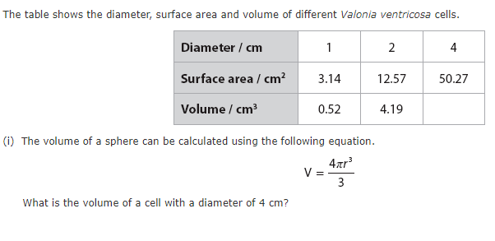
Check your understanding
(ii) Describe why single-celled organisms, such as Valonia ventricosa, do not need a specialised gas exchange surface.
(2)

Slide 23
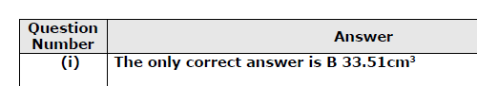
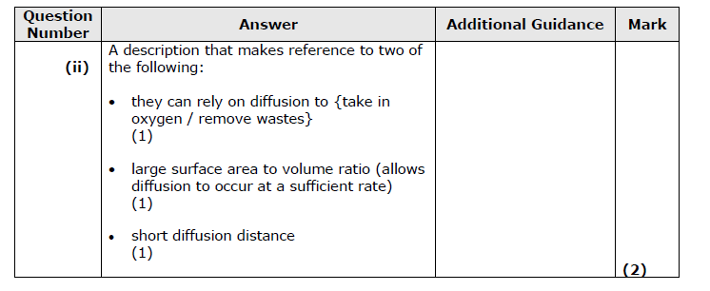
Self-Assess

Slide 24
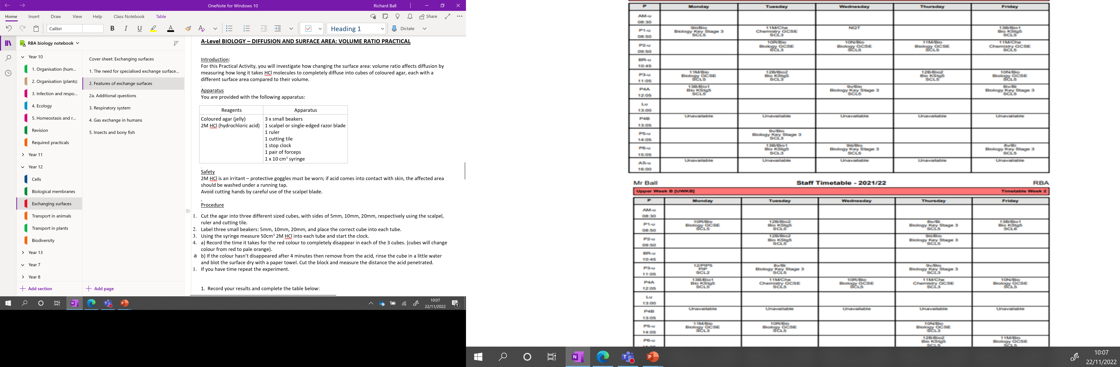

Slide 25
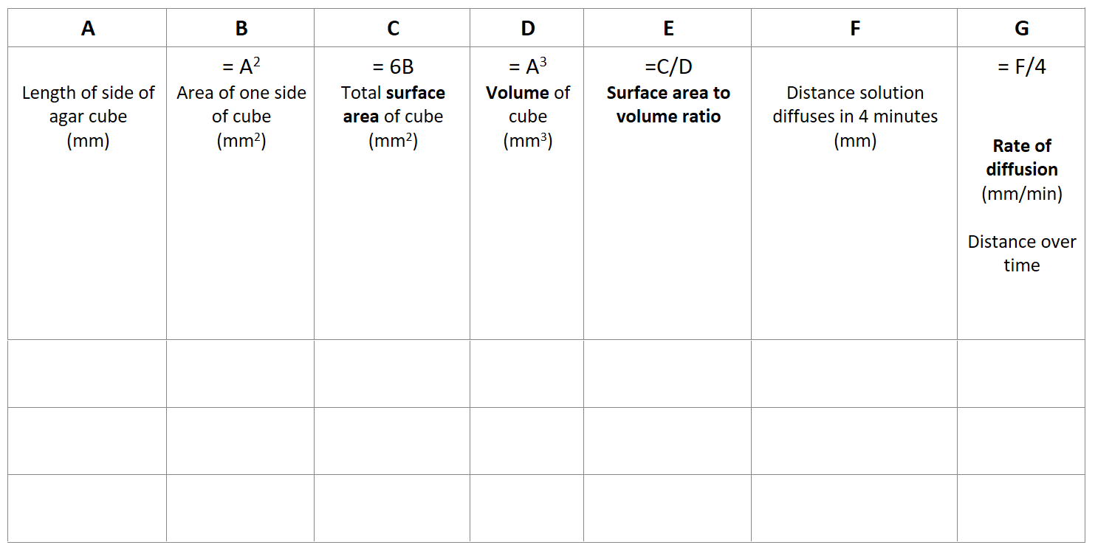
Investigating diffusion in different sized cubes

Slide 26
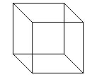
5
10
20

Slide 27
DISCUSS
Did the dependent variable measure the independent variable for this experiment?
Did measuring the distance the HCl diffuse in from one side investigate the SA:V ratio between each cube?
What calculation would we needed to have make?

Slide 28
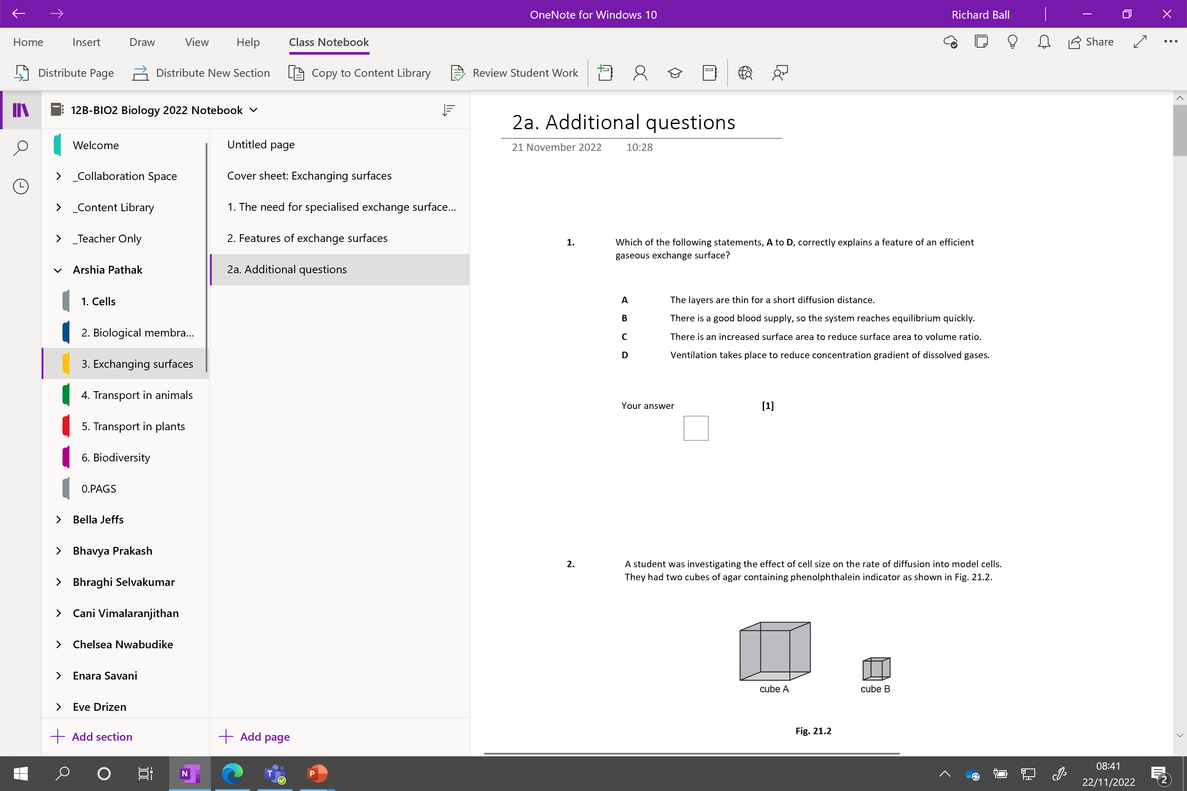

Slide 29
Problems with practical
Larger cube diffuses further because its bigger.....
Larger cube also diffuses more into it
You would need the equivalent number of smaller cubes to that make up the larger cube for this be fair
How can you change the practical to make it relevant?
3 shapes and time taken to completely diffuse through
Very thin / long rectangle = fastest
10mm x 10mm cube - slowest
Sphere can we make a sphere diameter 10mm?

Slide 30


