Slide 1
(e) the factors that can affect the evolution of a species
Keywords: stabilising, directional
Lesson objectives:
Recall examples of continuous and discontinuous variation
Describe stabilising selection and directional selection

Slide 2
Evolution – 3 key terms to know:
Gene Pool The sum of all the genes in a population at any given time
Allele Frequency The relative frequency of a particular allele in the population
Evolution A change in allele frequency within a population that occurs over time
- Allele frequencies change in response to changing conditions

Slide 3
  Evolution by natural selection, what can you remember?
Selection pressure affects an organisms ability to survive
(disease, predation, competition).
Population is a group of organisms of the same species living in a particular area.
Selection pressures create a struggle for survival.
Individuals within a population vary because they have different alleles.
Selection pressures create a struggle for survival.
Individuals within a population vary because they have different alleles.
They, in turn, are more likely to survive, reproduce and pass on their genes. So the frequency of the beneficial allele increases from generation to generation.
They, in turn, are more likely to survive, reproduce and pass on their genes. So the frequency of the beneficial allele increases from generation to generation.
Some organisms are better able to survive the selection pressures than others.
Some organisms are better able to survive the selection pressures than others.
Generated by meiosis or mutation
This means that a greater proportion of the next generation will inherit the beneficial characteristic.
This means that a greater proportion of the next generation will inherit the beneficial characteristic.
Individuals that have an allele that increases their chance of survival are more likely to survive, reproduce and pass on the beneficial allele, than others with different alleles.
Individuals that have an allele that increases their chance of survival are more likely to survive, reproduce and pass on the beneficial allele, than others with different alleles.
Number the boxes on your worksheet

Slide 4
Types of selection pressures
Stabilising
Disruptive
average individuals favoured
Directional
individuals favoured at both extremes
individuals favoured in one direction (one extreme)

Slide 5

Directional selection
‘Individuals favoured in one direction’

Slide 6
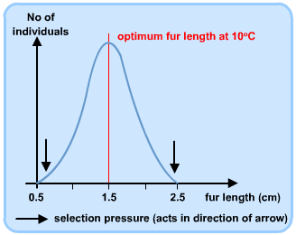
What will happen if it gets colder?

Slide 7
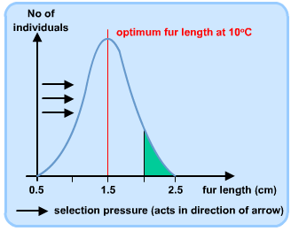
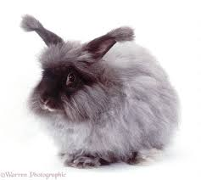
If the temperature falls, the individuals with longer fur length are at an advantage as they have better insulation against the cold.
There is a selection pressure favouring the animals with longer fur, so these animals are more likely to survive and thus reproduce.

Slide 8
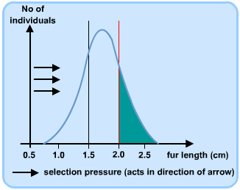
Over several generations, the average fur length increases as more young have inherited the genes for long fur.

Slide 9
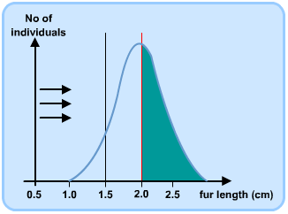
When the mean fur length has reached the most advantageous length, the selection pressure ceases.

Slide 10
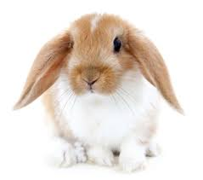
Stabilising selection

Slide 11
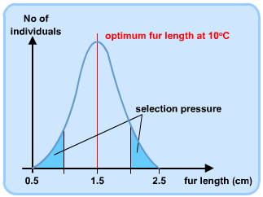
In years when it is hot, short fur is favoured.
In years when it is cold, long fur is favoured.
When temperature remains constant, individuals at the extremes will never be at an advantage. The mean fur length will be favoured.
How will this change the shape of the graph?

Slide 12
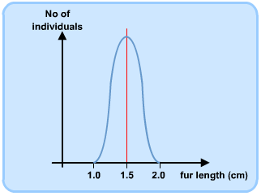
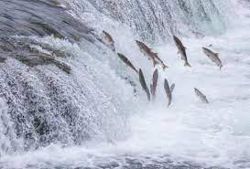
The mean will remain the same but there will be fewer individuals at the extremes
CH – can you think of an example of disruptive selection?

Slide 13
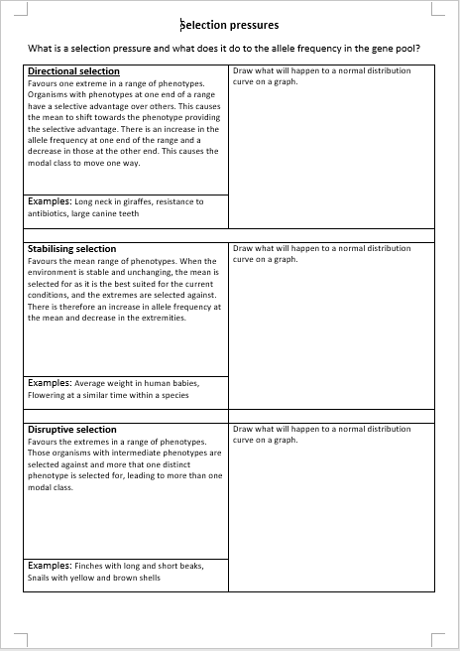
Complete the worksheet
Draw a graph next to each description to show the effect that the selection pressure has

Slide 14
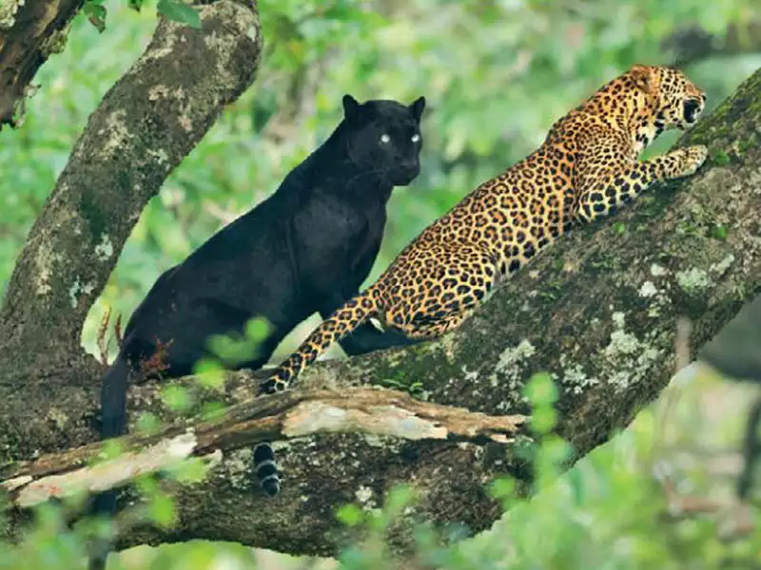
Practice Question:

Slide 15
Check your answer:

Slide 16
Genetic drift
Evolution can also occur by genetic drift
Genetic drift says that characteristics are passed on by chance rather than due to factors that affect the individual's ability to survive and reproduce.
e.g. A neutral mutation occurs giving no benefit or disadvantage.

Slide 17
  Evolution via genetic drift
  Individuals within a population show variation in their genotypes (A and B).
  By chance, the allele for genotype B gets passed on to offspring more than others.
  If this repeats again and again, it can lead to evolution as the allele becomes more common in the population.

Slide 18
Genetic drift and population size
Natural selection and genetic drift work alongside each other to drive evolution.
However, evolution by genetic drift usually has a greater effect in smaller populations.
This is because in smaller populations, chance has a bigger influence.
In bigger populations, chance tends to even out, making natural selection the dominant driver of evolution.

Slide 19
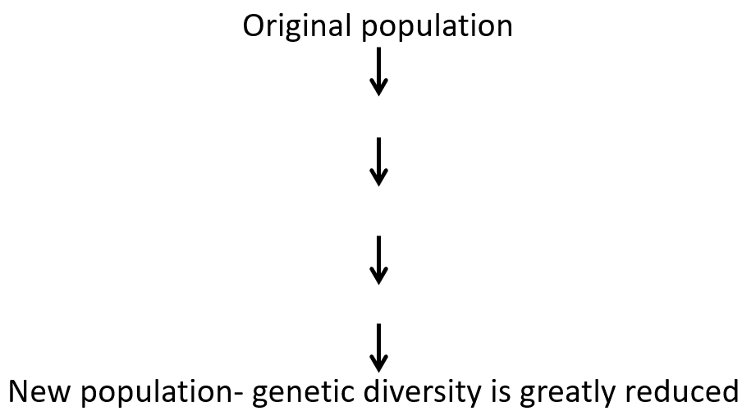
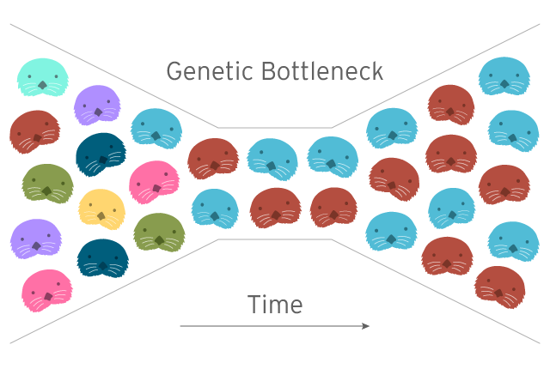
Genetic bottle necks
This is where a few individuals within a population survive an event or change (e.g. disease, environmental change or habitat destruction)
The gene pool is massively reduced
Only the alleles of the survivors are available to be passed on to offspring
Complete the flow diagram to show this process

Slide 20
Genetic bottleneck summary
Original population
Large numbers of the population die
Reduced population – some alleles are lost from the original population
Reproduction
New population- genetic diversity is greatly reduced
Notes:
2 bottle necks are thought to have shaped modern human genetics

Slide 21
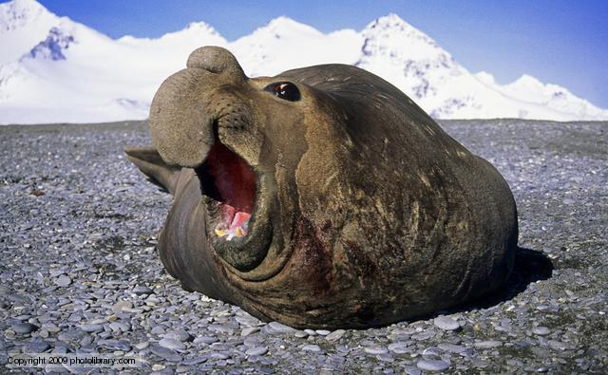
The Elephant seal
Northern elephant seals have reduced genetic variation probably because of a population bottleneck humans inflicted on them in the 1890s. Hunting reduced their population size to as few as 20 individuals at the end of the 19th century. Their population has since rebounded to over 30,000 — but their genes still carry the marks of this bottleneck: they have much less genetic variation than a population of southern elephant seals that was not so intensely hunted.
Notes:
Hunted until there were only 20 left. Now the genetic diversity is drastically reduced and a disease could easily wipe them al
l out

Slide 22
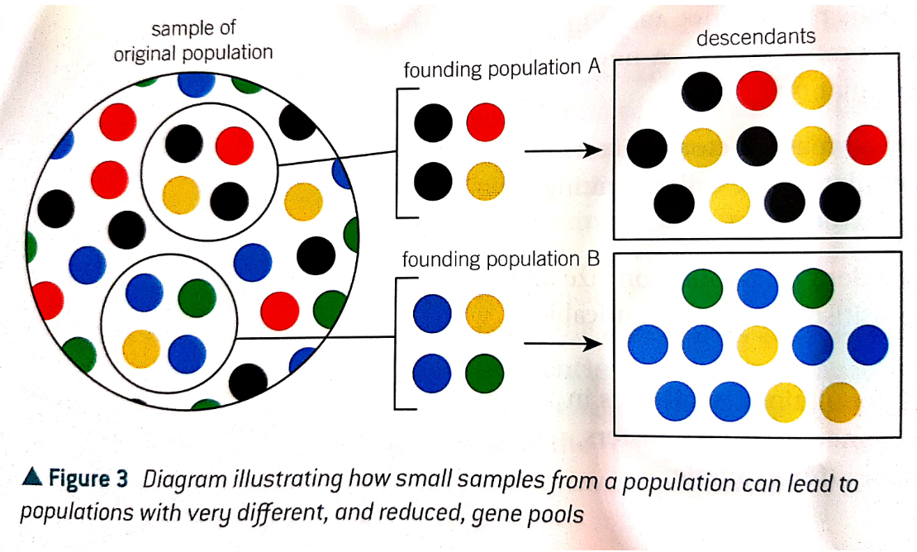
The founder effect
Small populations can arise due to the establishment of new colonies by a few, isolated individuals

Slide 23
Fast recall questions
Define the term gene pool
Define the term allele frequency
How are allele frequency and evolution related?
Explain why variation is needed for evolution to take place
Explain why the founder effect can lead to an increased incidence of genetic disease.
1. The complete range of alleles in a population
2. How often an allele appears in a population
3. Evolution is the change in the frequency of an allele in a population over time
4. Individuals vary, some are better adapted to selection pressures than others. Survive, reproduce and pass on alleles
5. Allele frequency is higher than in original population. If one of these alleles represents a genetic disorder this would mean that it has an increased incidence in the population.

