Slide 1
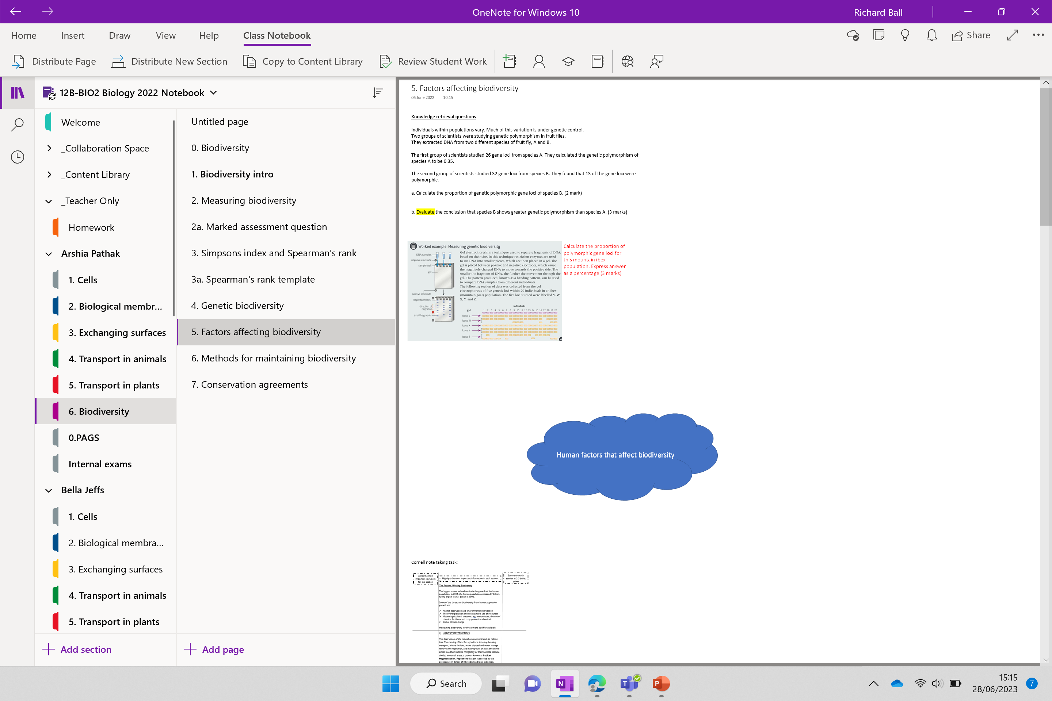

Slide 2

Knowledge retrieval questions
Individuals within populations vary. Much of this variation is under genetic control.
Two groups of scientists were studying genetic polymorphism in fruit flies.
They extracted DNA from two different species of fruit fly, A and B.
The first group of scientists studied 26 gene loci from species A. They calculated the genetic polymorphism of species A to be 0.35.
The second group of scientists studied 32 gene loci from species B. They found that 13 of the gene loci were polymorphic.
a. Calculate the proportion of genetic polymorphic gene loci of species B. (2 mark)
b. Evaluate the conclusion that species B shows greater genetic polymorphism than species A. (3 marks)
13/32 = 0.41 (must be 2sf to match species A)
Species B has greater (calculated genetic) polymorphism (than species A)
numbers / polymorphisms are similar
might not have sampled same loci
no indication of (fruit flies) sample size
For
Against

Slide 3
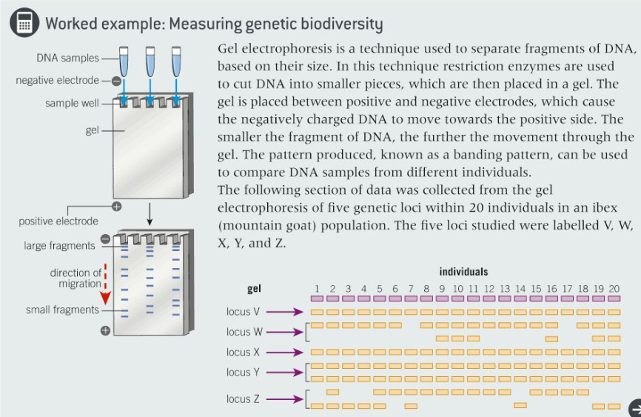
Calculate the proportion of polymorphic gene loci for this mountain ibex population. Express answer as a percentage (3 marks)
WYZ were polymorphic
VX were not polymorphic
Total loci: 5
3/5 = 0.6
0.6 x 100 = 60%

Slide 4
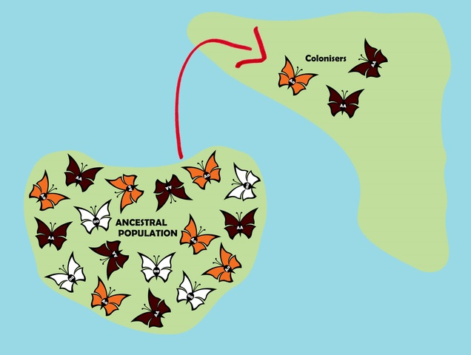
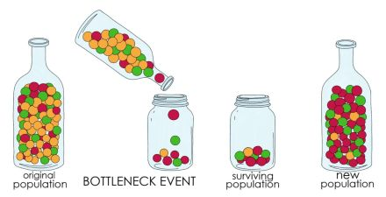
Recap

Slide 5
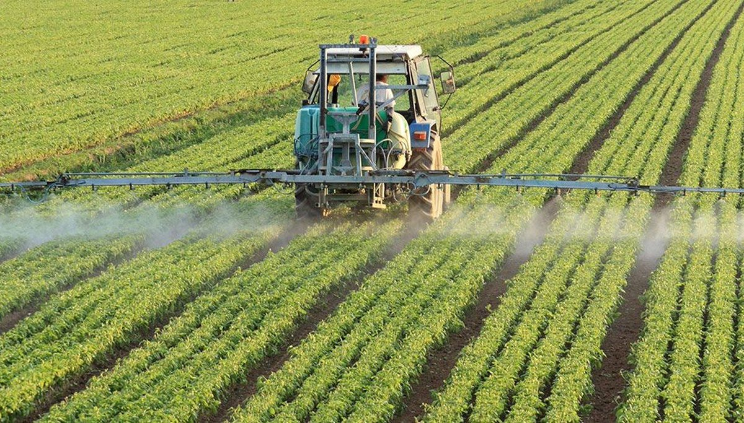
Factors affecting biodiversity

Slide 6
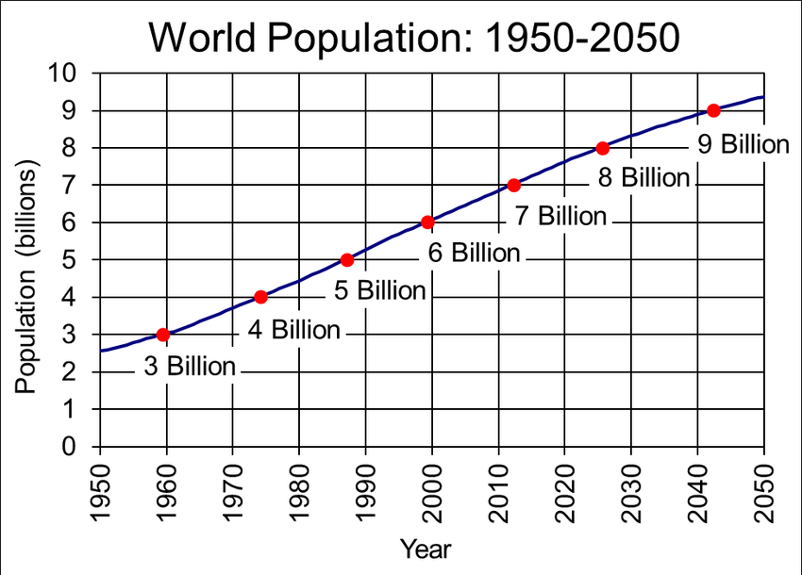

Slide 7
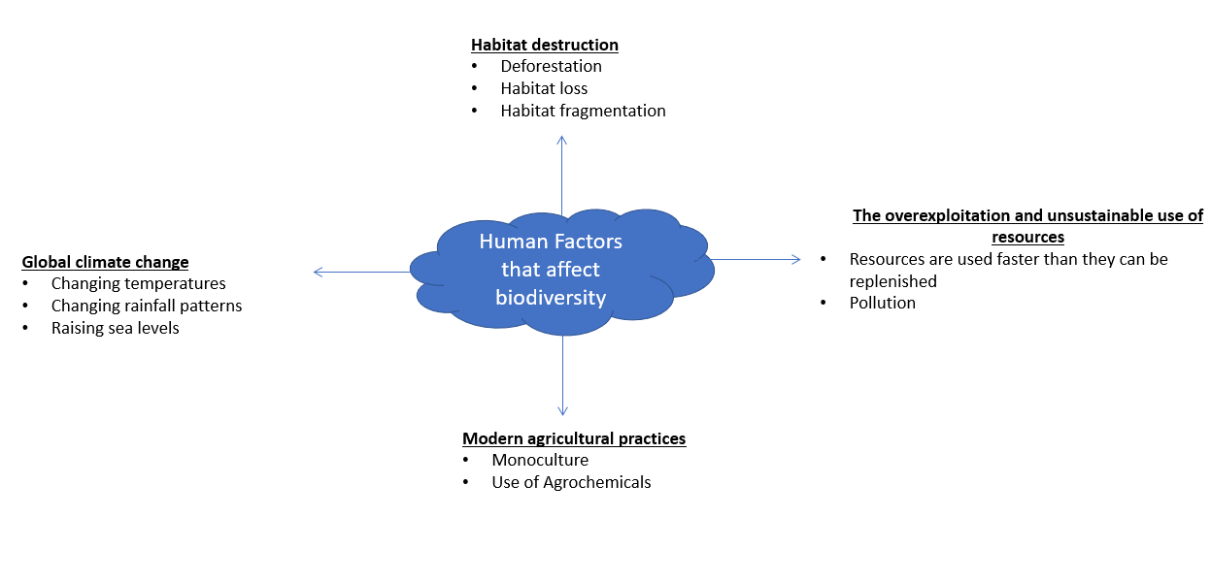
Threats to biodiversity from human population growth

Slide 8
Threats to biodiversity from human population growth

Slide 9
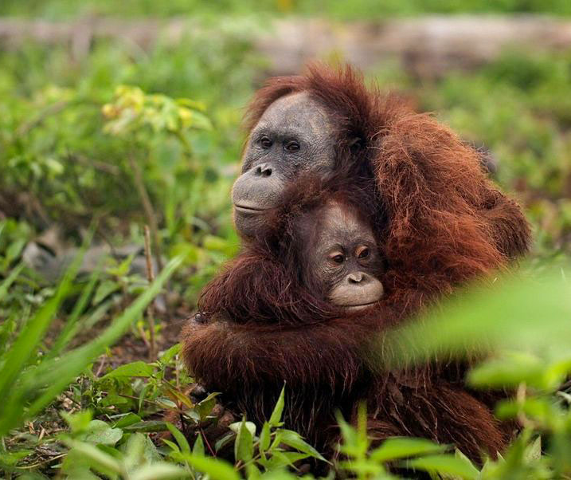
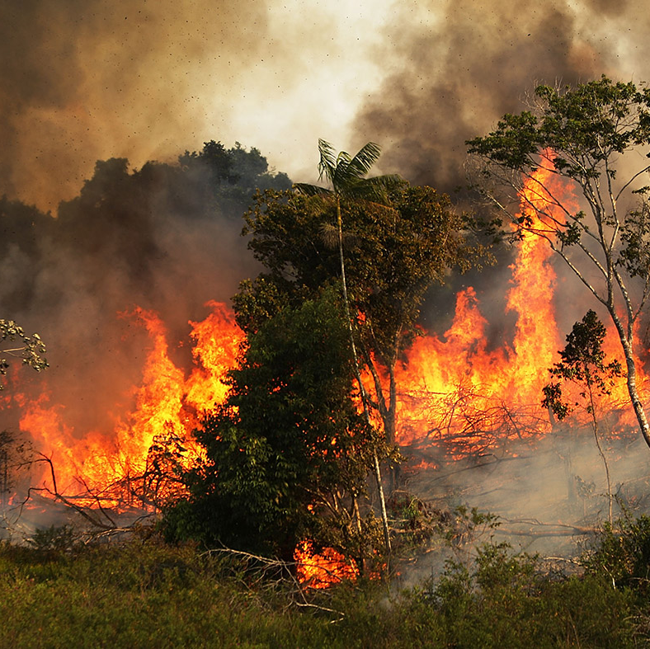
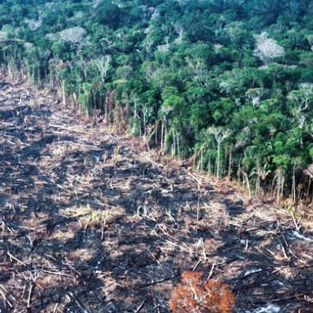
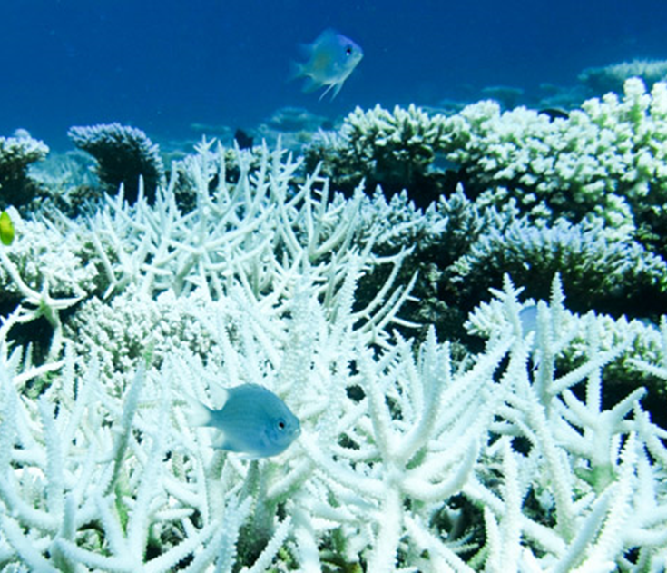
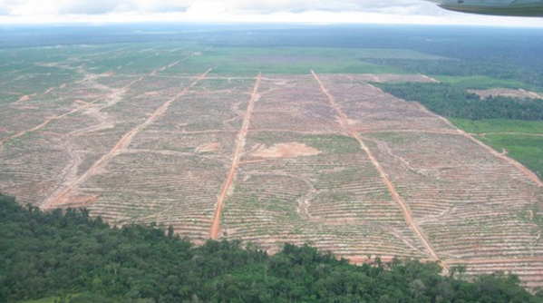
How do these activities impact on biodiversity?

Slide 10
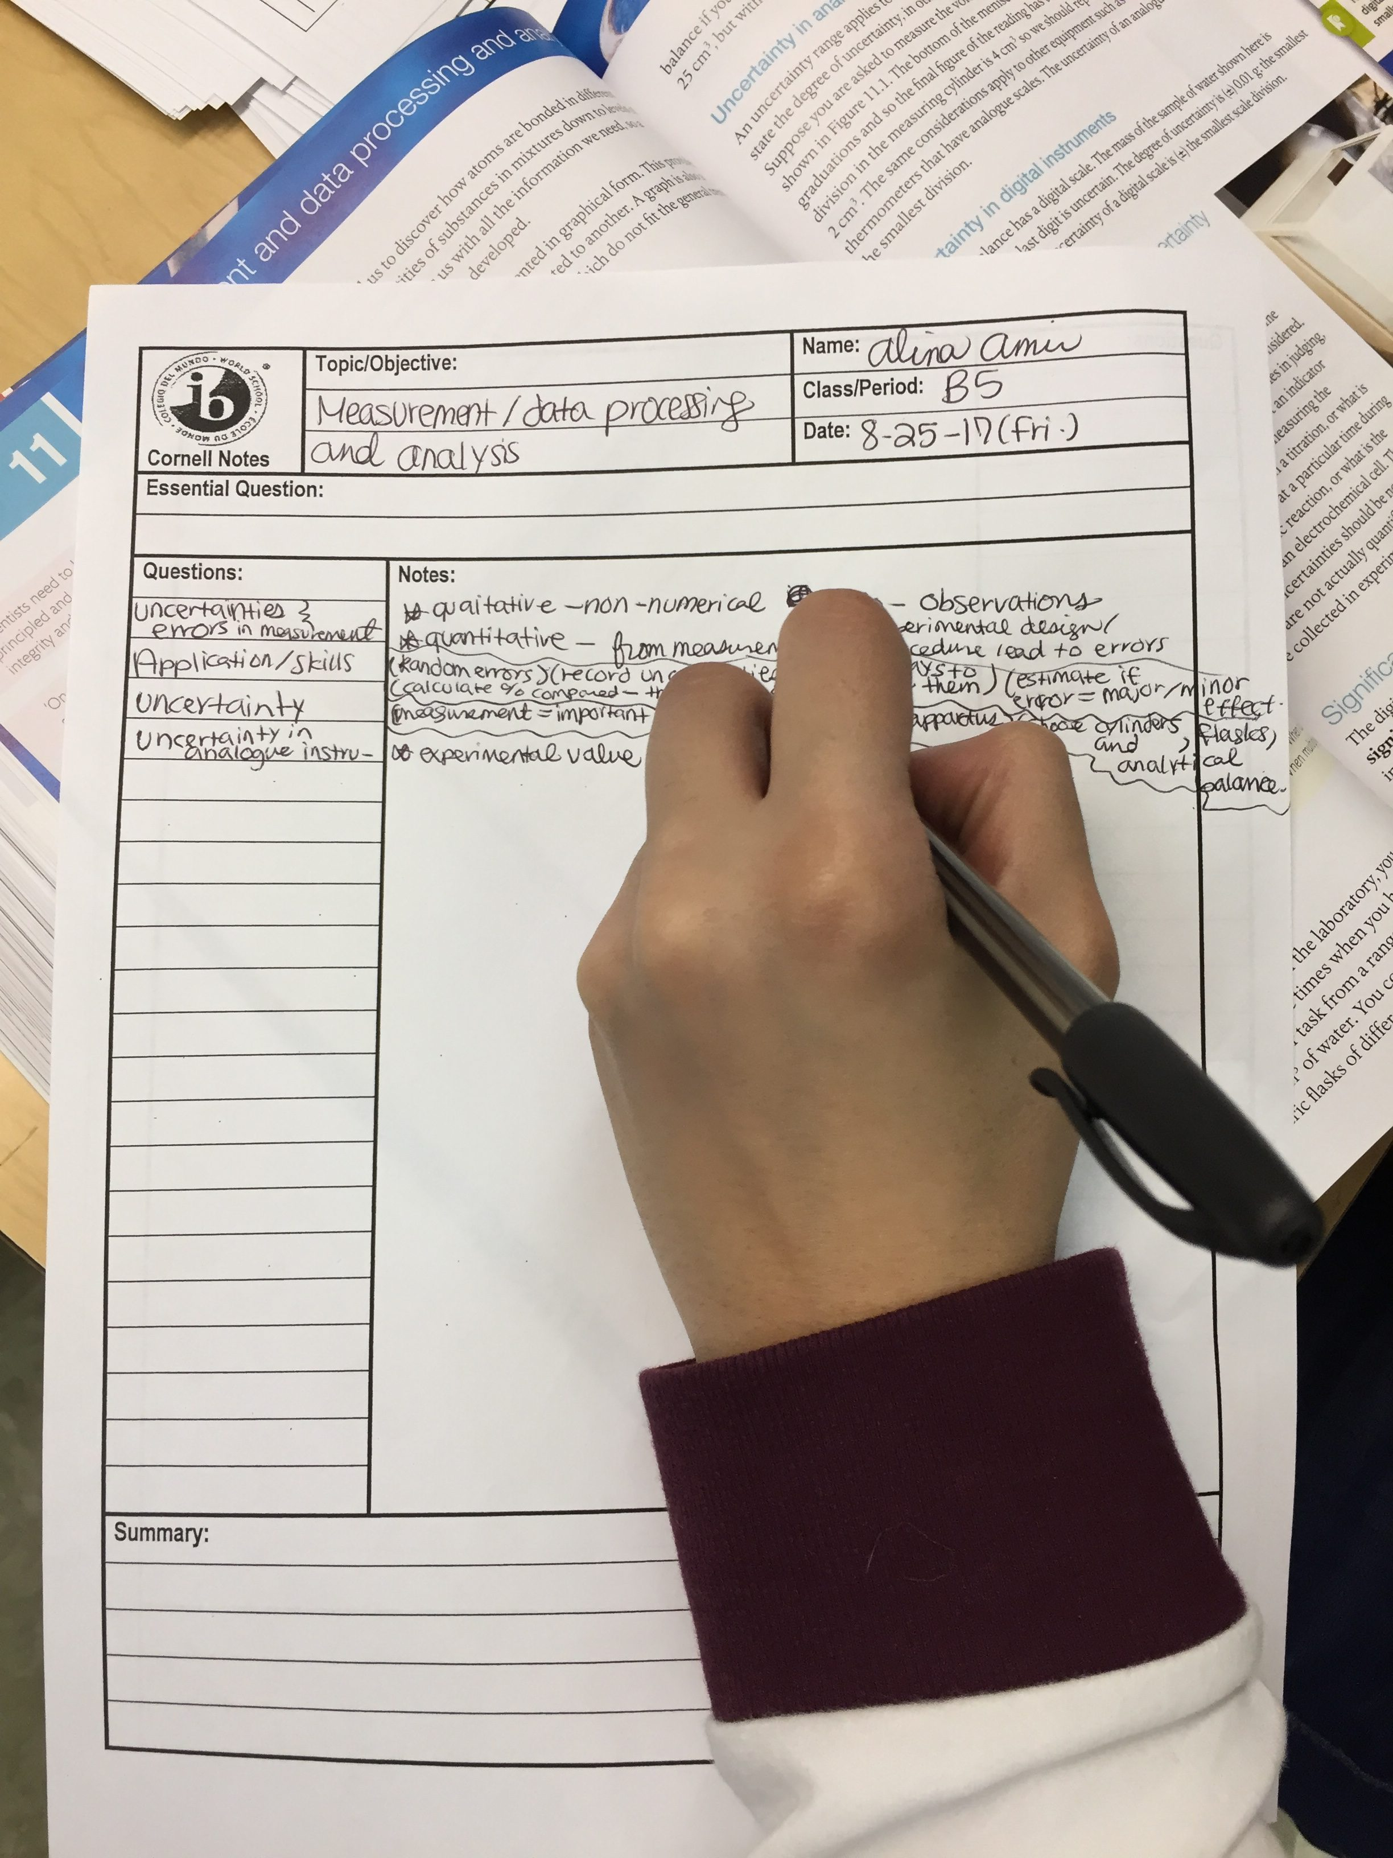
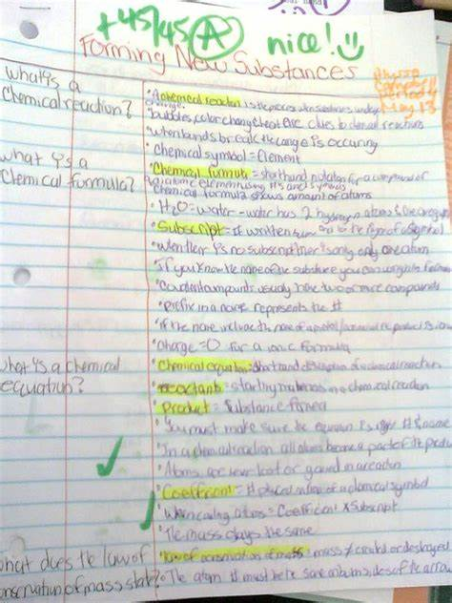
Cornell notes

Slide 11
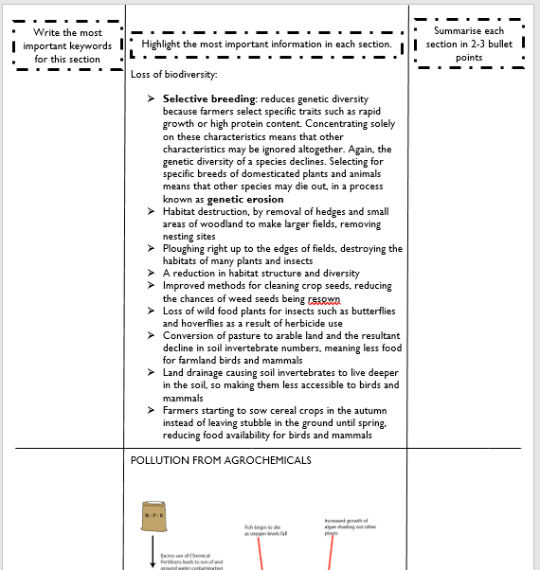






Cornell notes
Your task is to complete notes using a technique called ‘Cornell note taking’
Read the information provided
Identify key terms
Summarise the key points

Slide 12
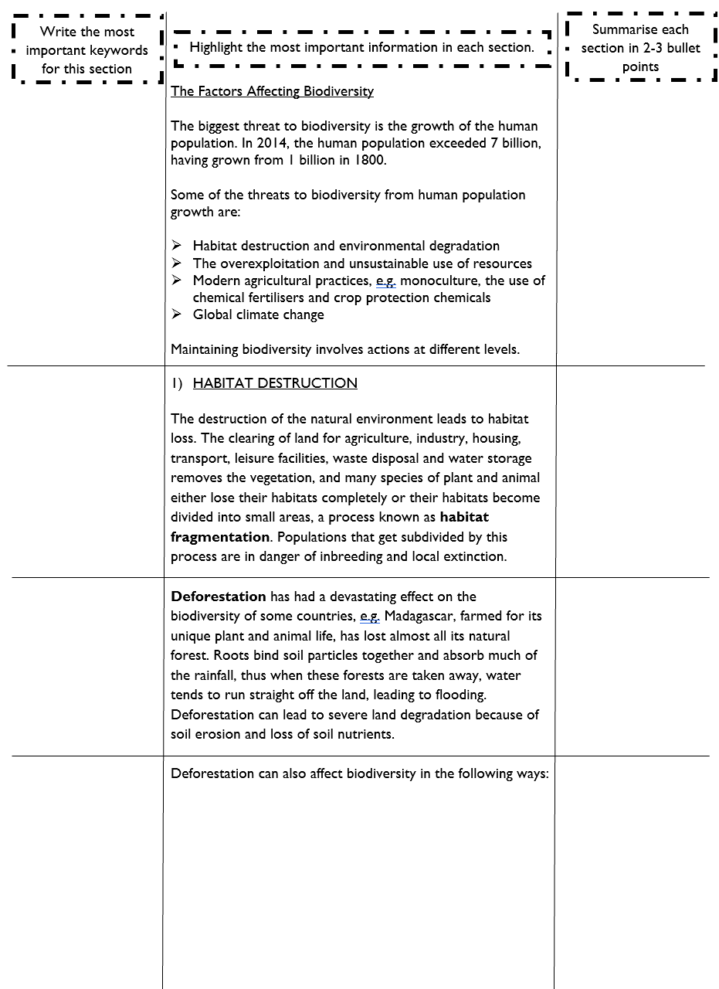
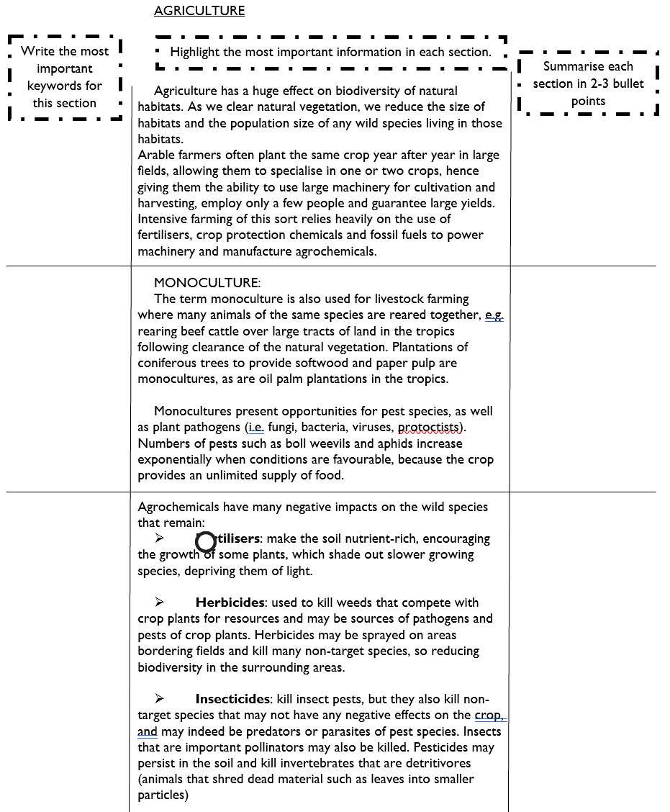
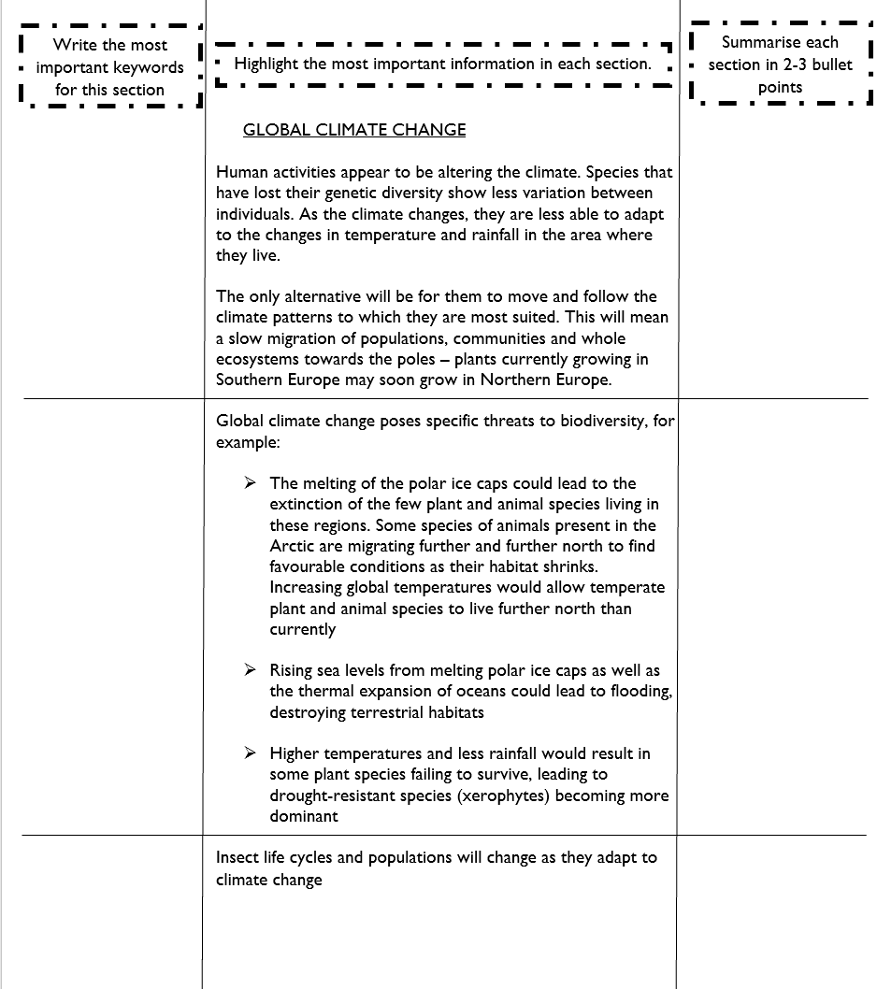
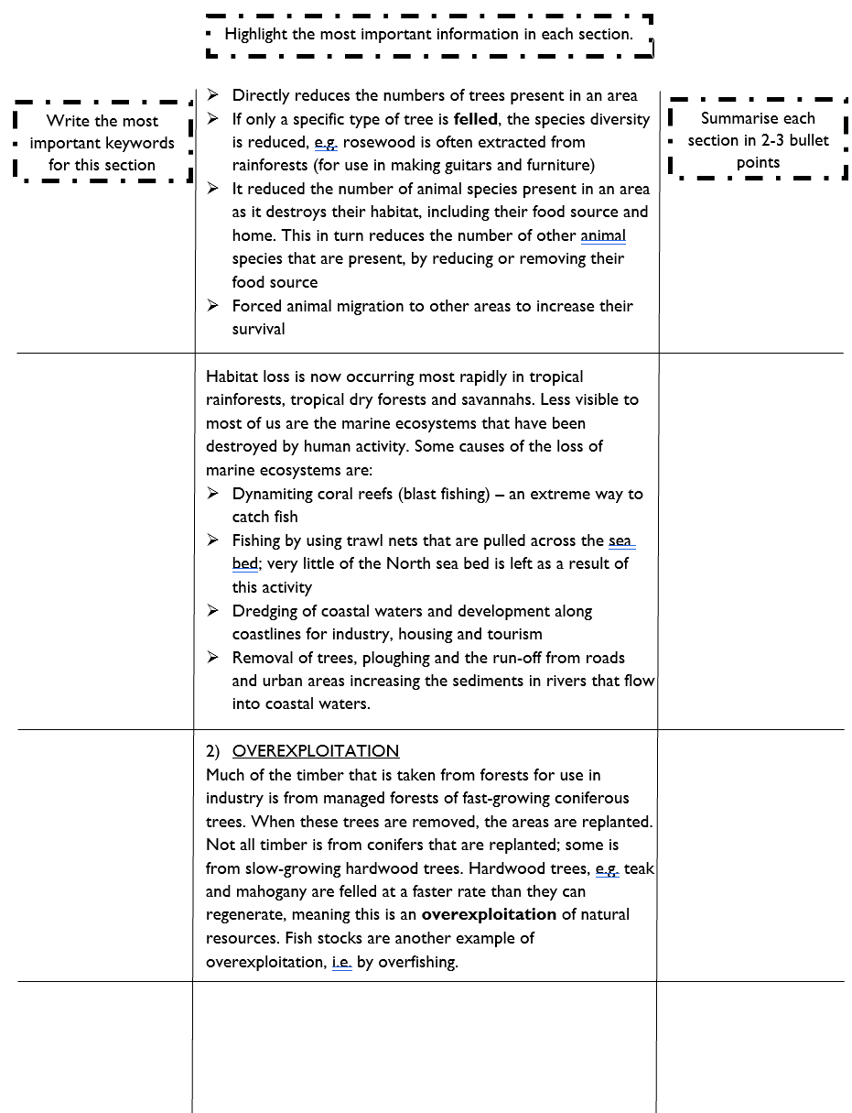
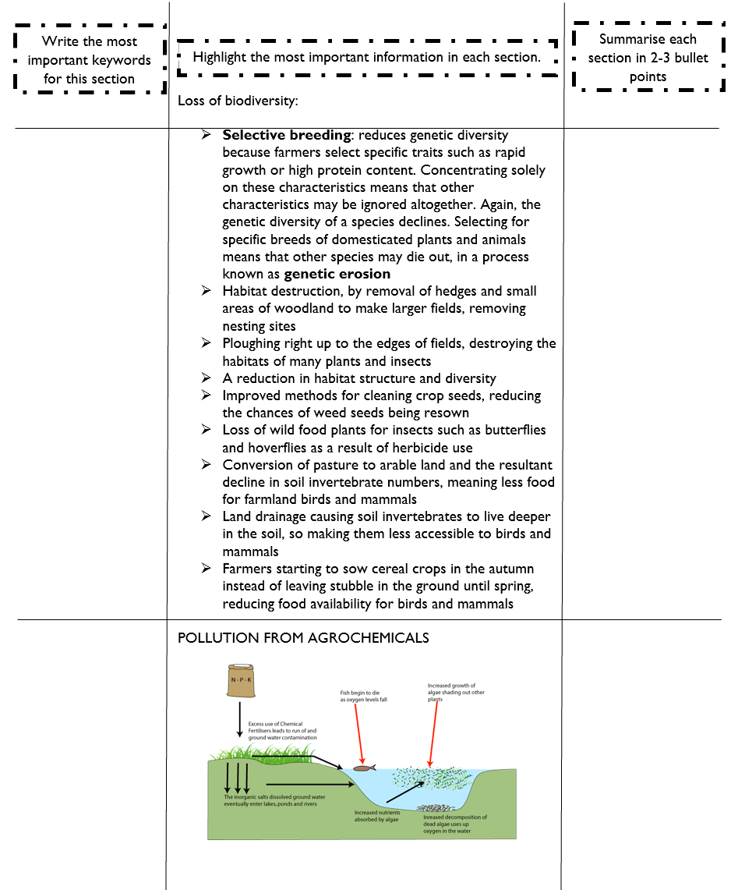
Set as an assignment to completed by next lesson
PAG: 30-45min
This: 20-30min

Slide 13
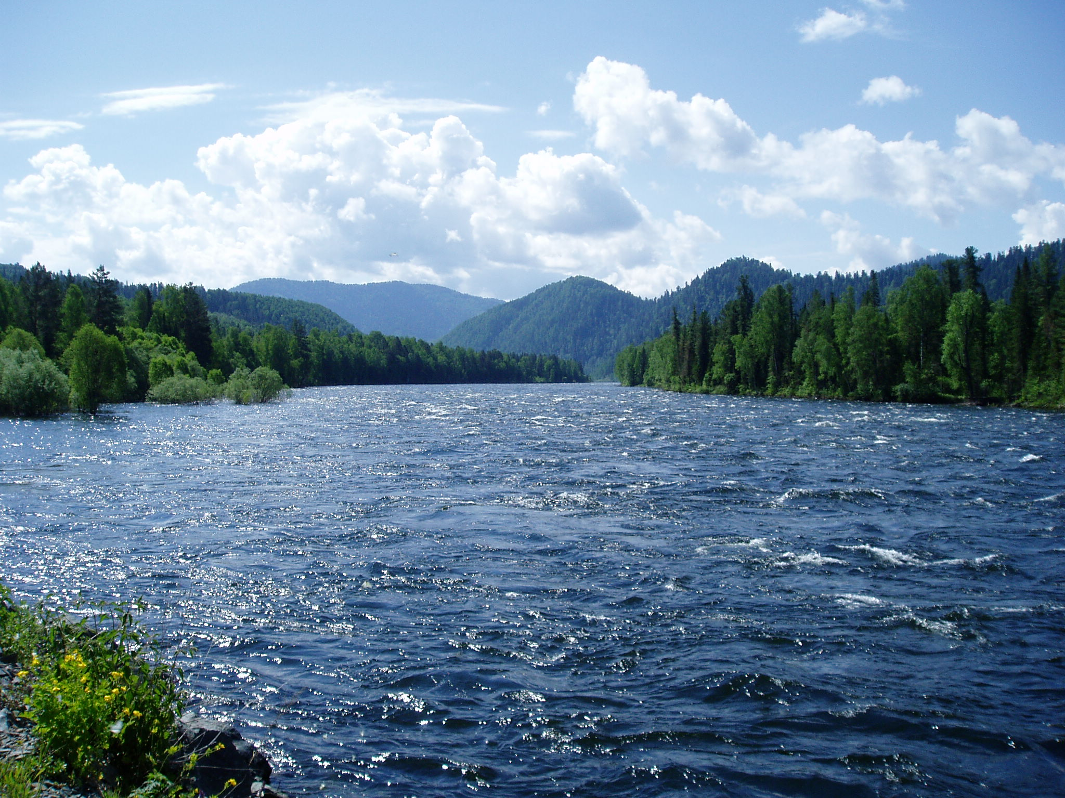
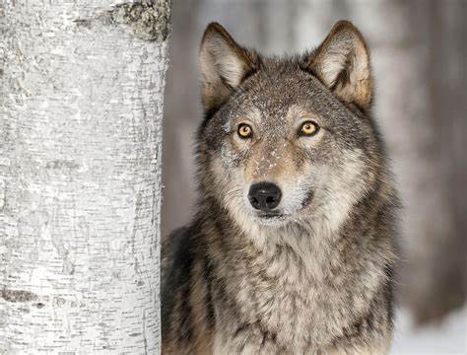
How did introducing wolves into Yellowstone National Park improve the rivers?
  Ecological
  Social and aesthetic

Slide 14
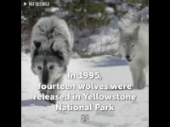

Slide 15
CLIP
(91) What Happened When A Pack Of Wolves Were Released In Yellowstone National Park - YouTube

Slide 16
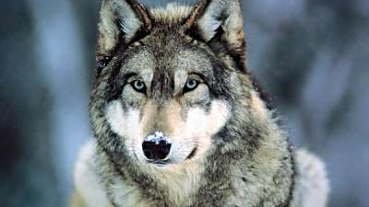
The wolf is a keystone species in America - what does this mean?
A keystone species is a species which has a disproportionately large effect on its natural environment

Slide 17
Practical components failed
Arshia: 8.1 not completed / 3.1 graph not done by hand
Bella: 3.1 not completed
Bhavya: 3.1 not completed / Cornell notes not complete
Bhraghi: 3.1 not completed / Cornell notes not complete
Cani: 3.1 graph not done by hand
Chelsea: 3.1 not completed / Cornell notes incomplete
Enara: 3.1 not completed
Eve: 3.1 No graph
Kiera: 3.1 no graph / Cornell notes incomplete
Neeka: 2.1 not completed / 3.1 not complete / Cornell notes incomplete
Pearl: 5.1 no graph / 3.1 not completed / Cornell notes incomplete
Phoebe : 3.1 not completed
Ria: 3.1 not completed / 5.1 missing answers on extension questions / 8.1 missing work / Cornell notes not completed
Saran: 3.1 not complete

Slide 18
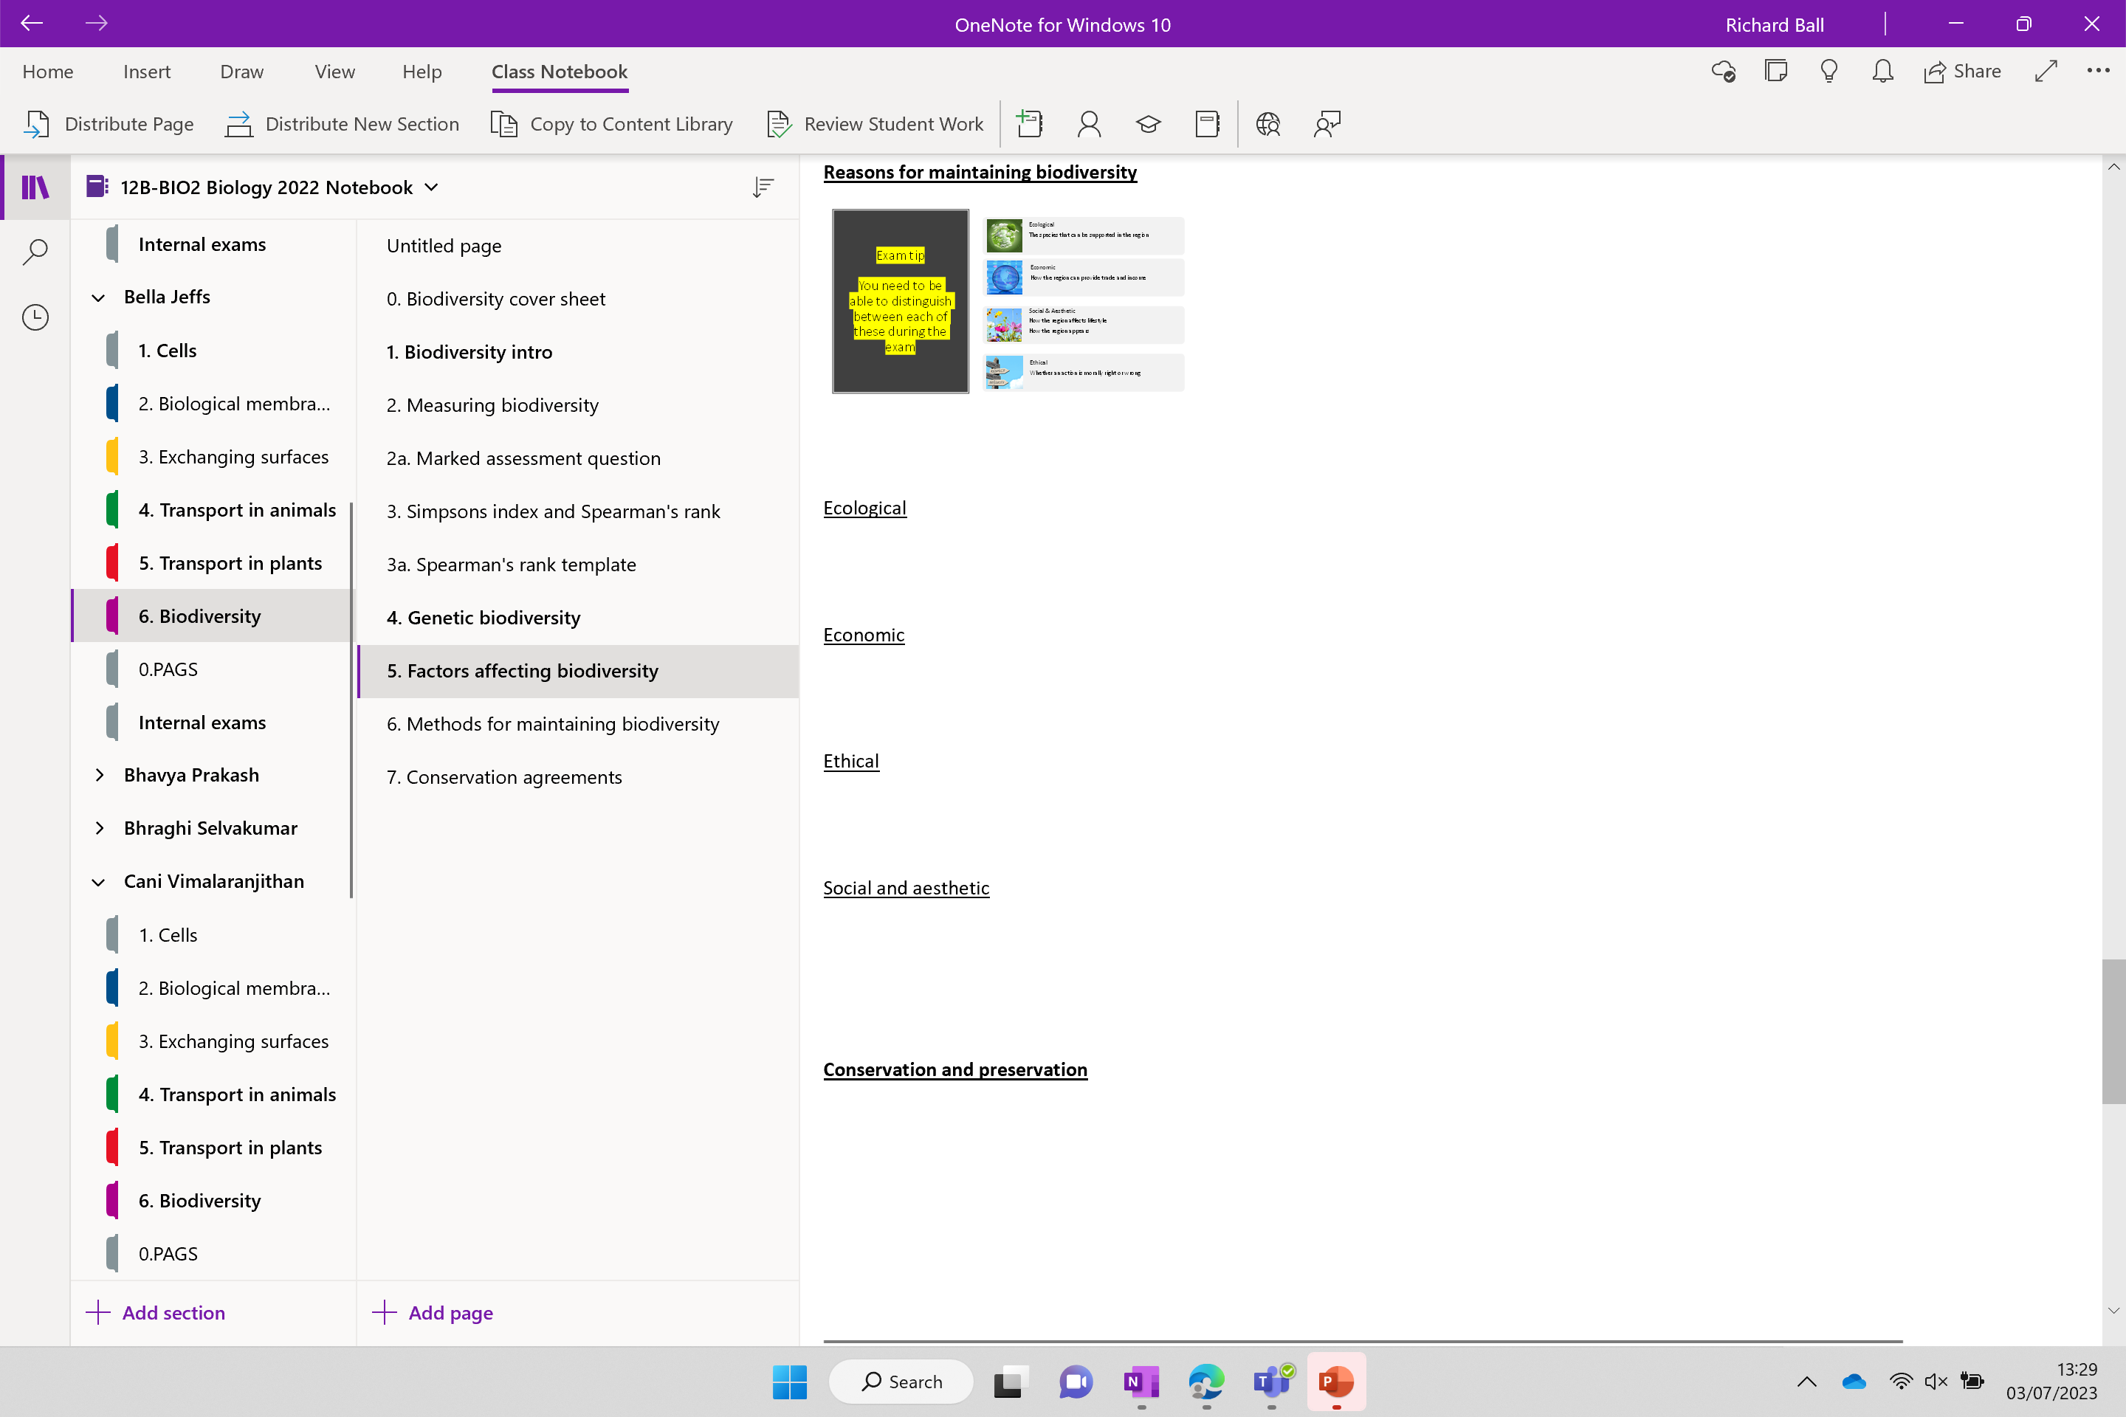

Slide 19

Reasons to Maintain Biodiversity
  Ecological
  Economic
  Ethical
  Social and aesthetic

Slide 20
Exam tip
You need to be able to distinguish between each of these during the exam
Ecological
The species that can be supported in the region
Economic
How the region can provide trade and income
Social & Aesthetic
How the region affects lifestyle
How the region appears
Ethical
Whether an action is morally right or wrong

Slide 21

Use your knowledge and the images to make your notes

Slide 22
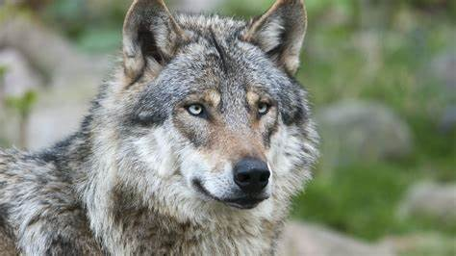
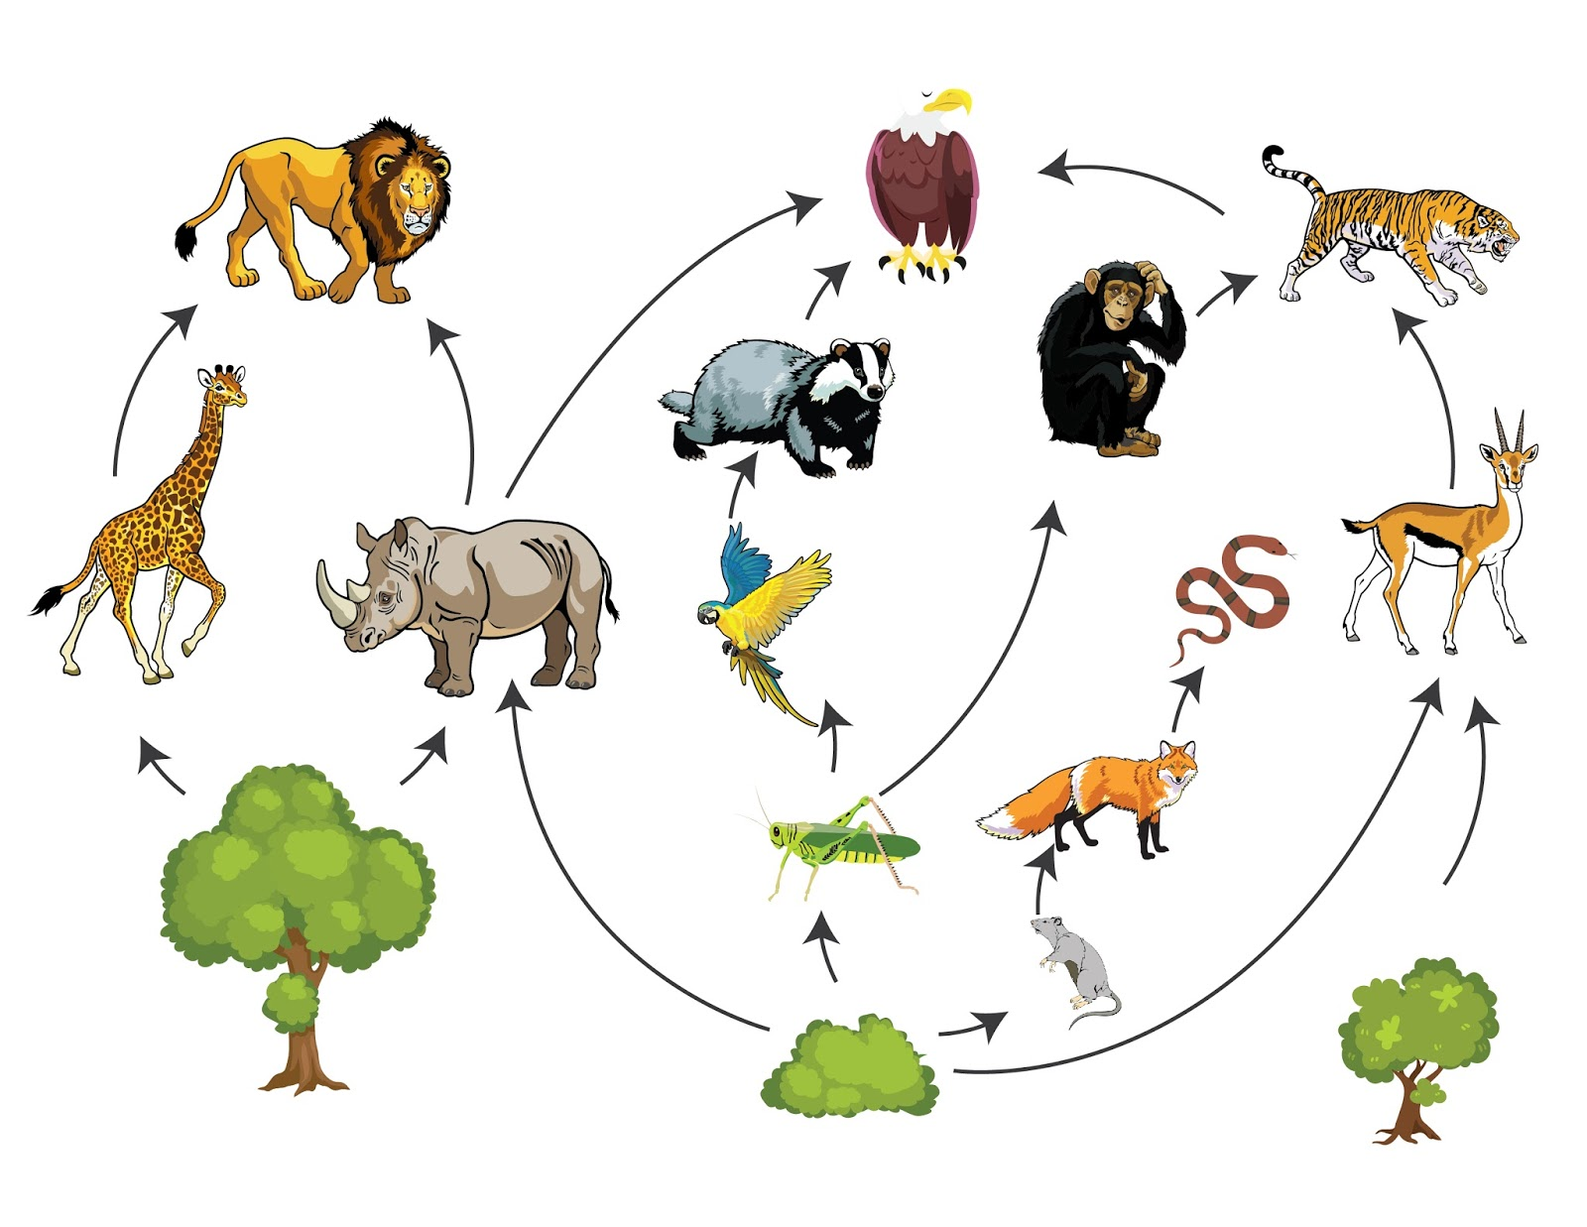
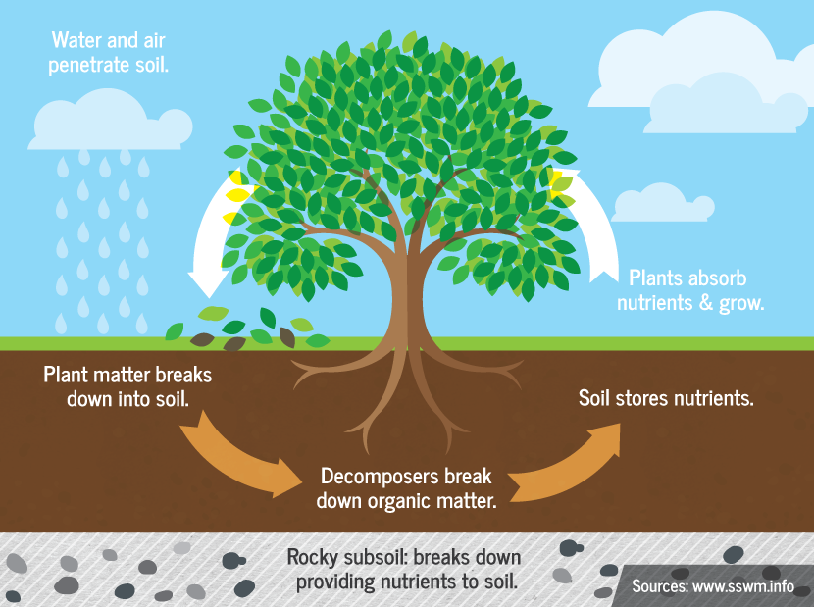
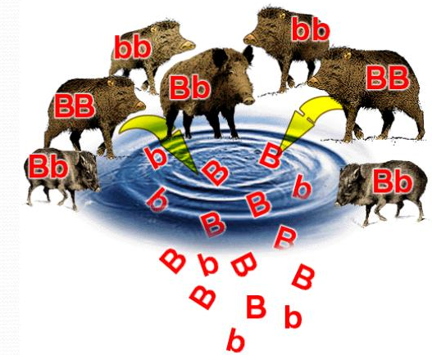
Ecological reasons to maintain biodiversity

Slide 23
Ecological reasons to maintain biodiversity
Minimises disruption to f…… c………..
Minimises disruption to n…………. cycles (worms are very important!)
Protect k………….. species (usually a small population which has a huge impact on the ecosystem)
Genetic resource – plants and animals are the source of virtually all food, clothing, drugs and fuels.

Slide 24
Ecological reasons to maintain biodiversity
Minimises disruption to food chains
Minimises disruption to nutrient cycles (worms are very important!)
Protect keystone species (usually a small population which has a huge impact on the ecosystem)
Genetic resource – plants and animals are the source of virtually all food, clothing, drugs and fuels.

Slide 25
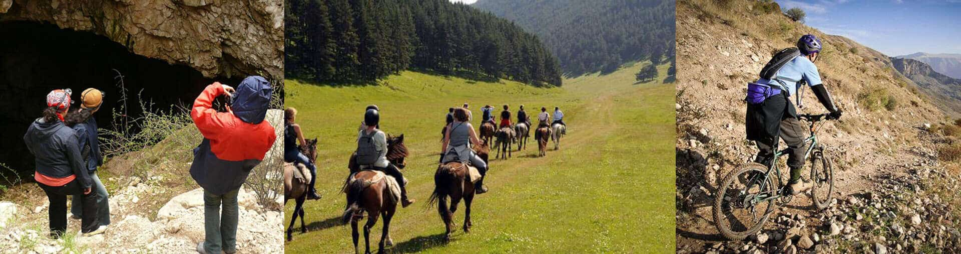
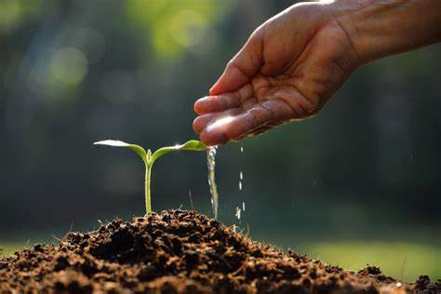
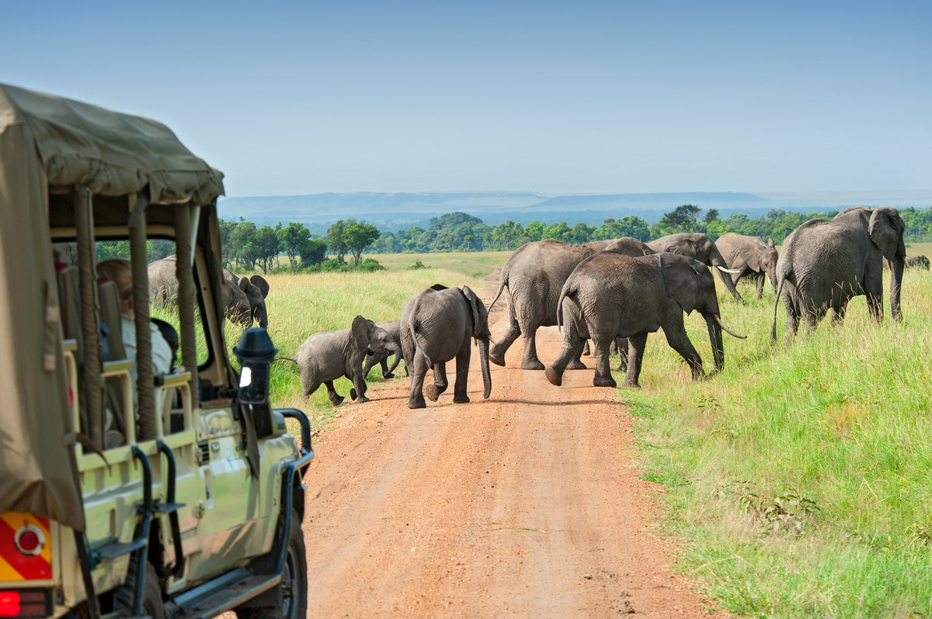
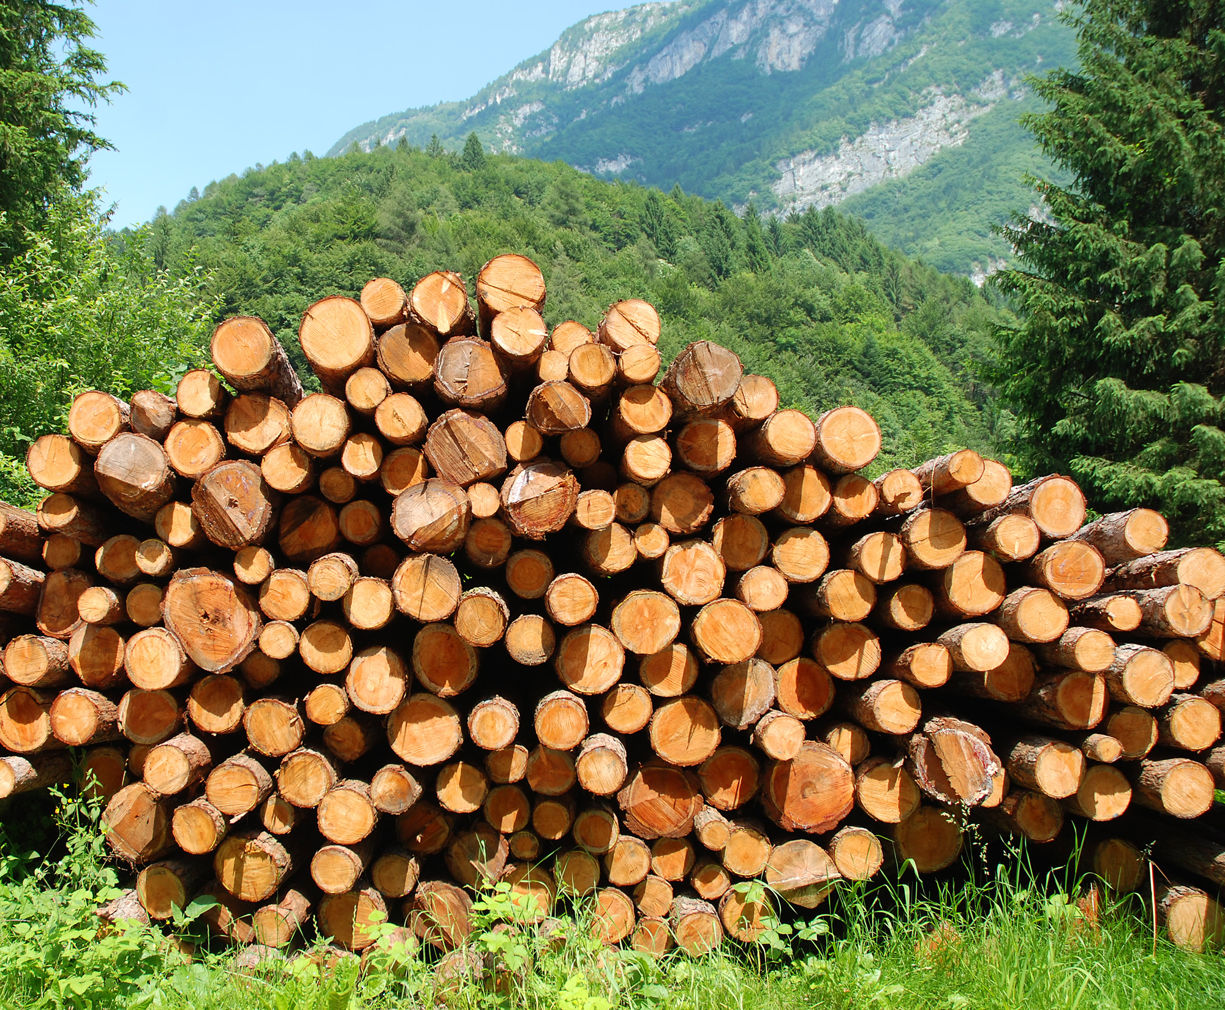
Economic reasons to maintain biodiversity

Slide 26
Economic reasons to maintain biodiversity
Natural ecosystems provide services
    Fertilisation of soil (reduces need for artificial fertilisers)
    Recycling of nutrients
    Growth of timber, food and fuel
Ecotourism
    Local economy stimulated (places of outstanding natural beauty)

Slide 27
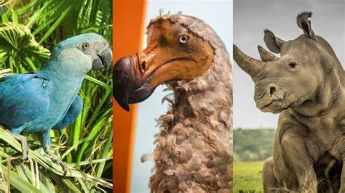
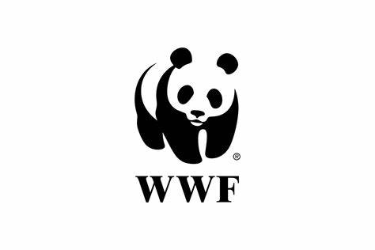
Ethical

Slide 28
Ethical
Species become extinct as a result of human action
Humans have a responsibility to maintain species, ecosystems and habitats for future generations
Species need to be saved for future generations
All organisms have a right to survive and live in the way to which they have become adapted.

Slide 29
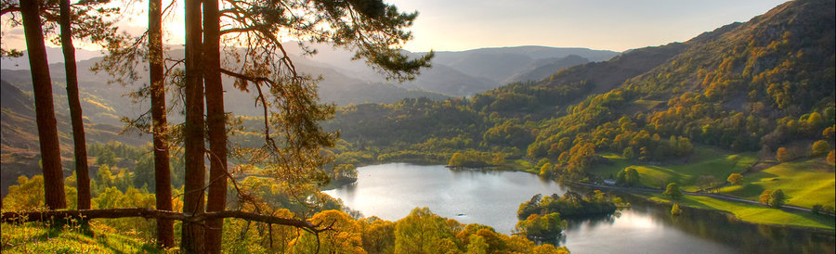
Social and Aesthetic
People enjoy :
  Beautiful landscapes
  visiting wild places
  Observing wildlife
  The large animals are sustained by an interdependent web which includes a huge number of species
  Wellbeing – physical, intellectual and emotional health

Slide 30
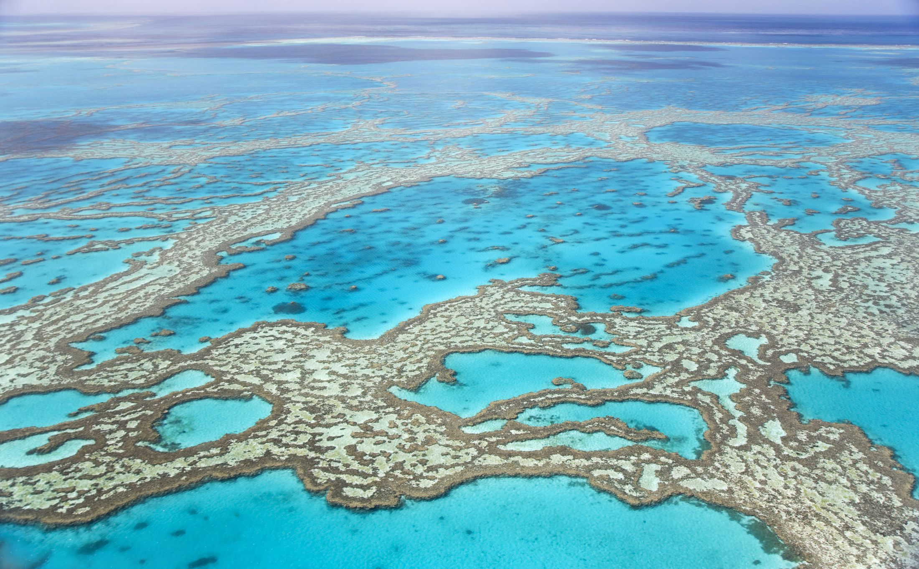
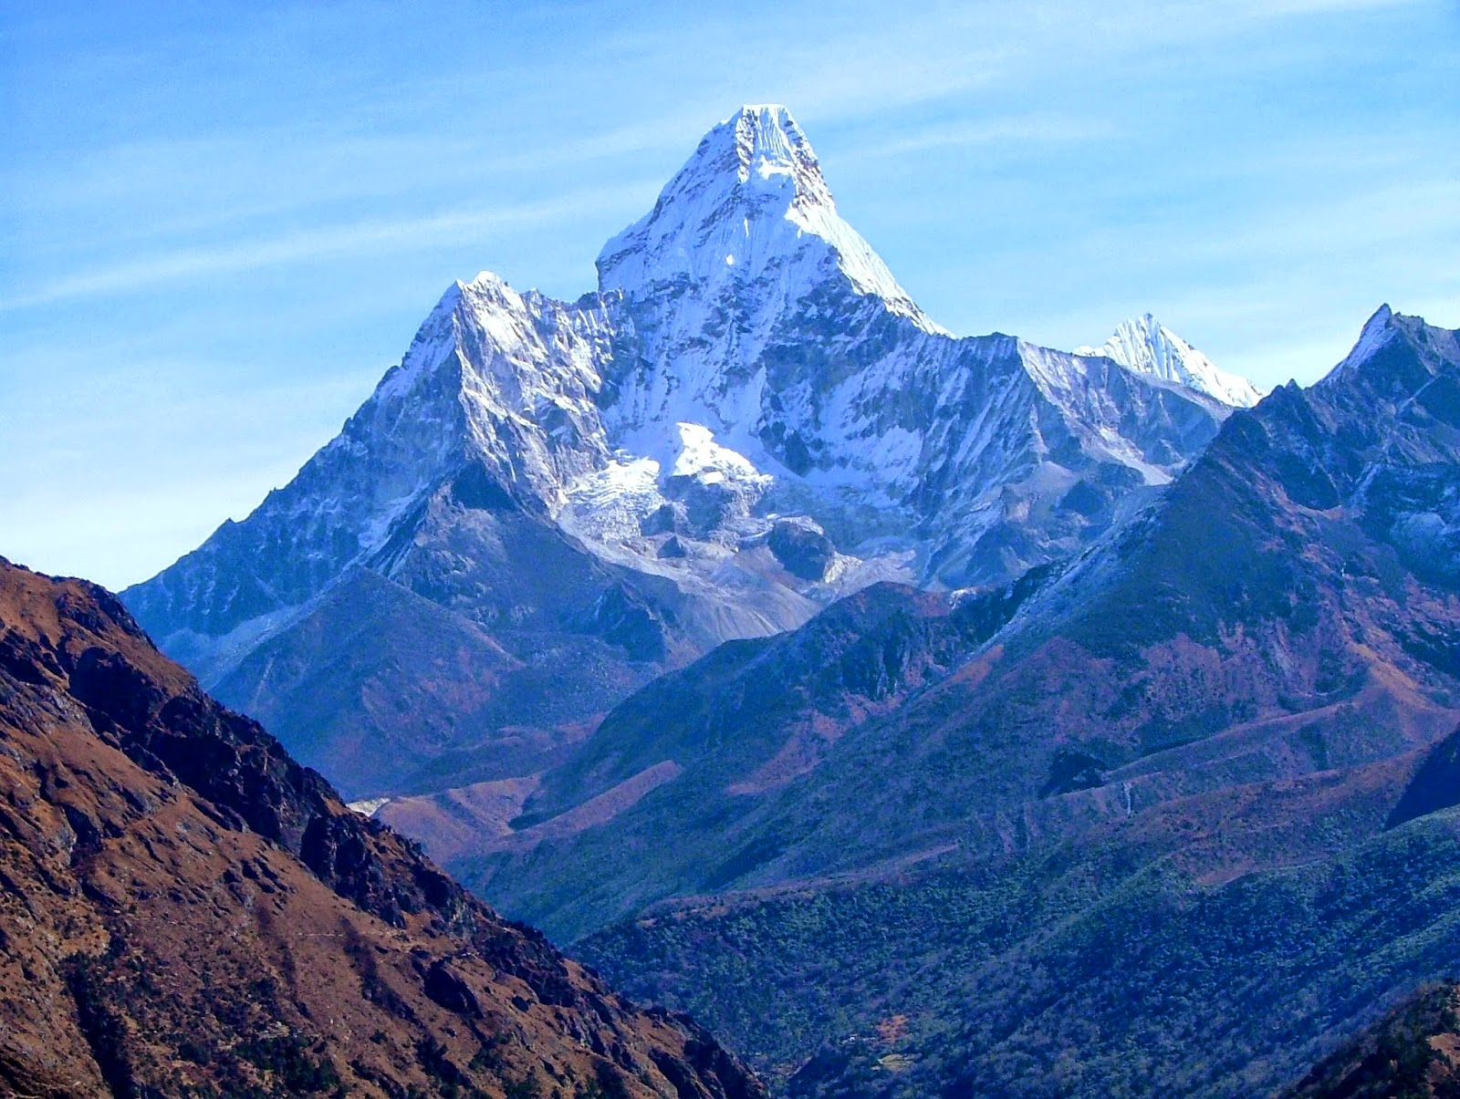
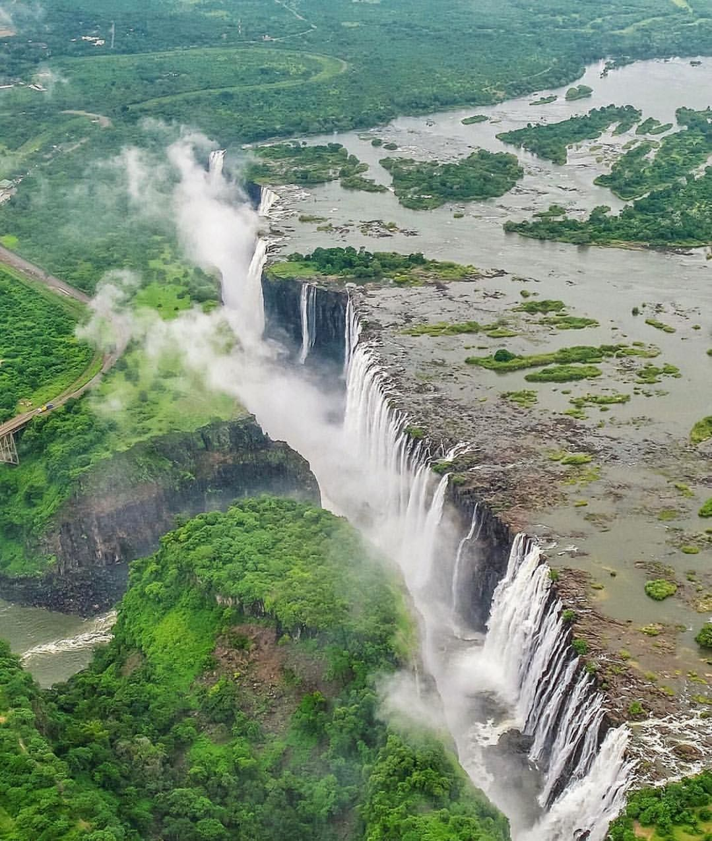
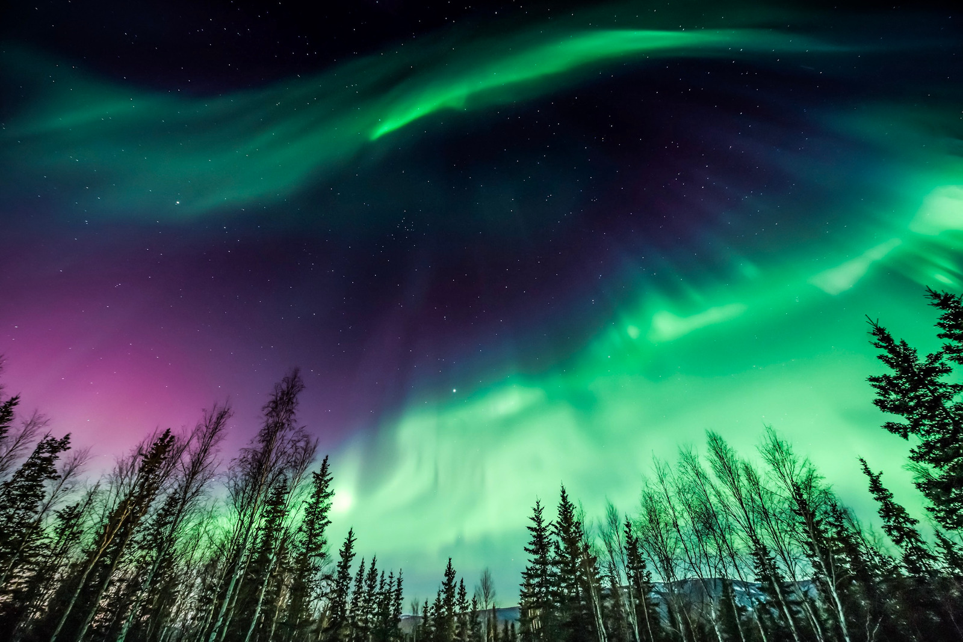
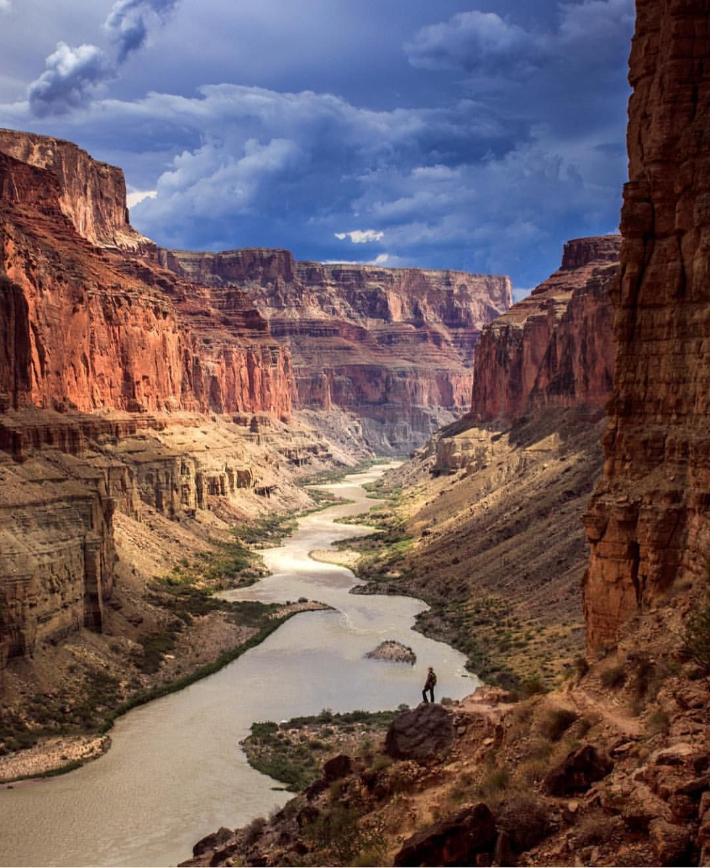
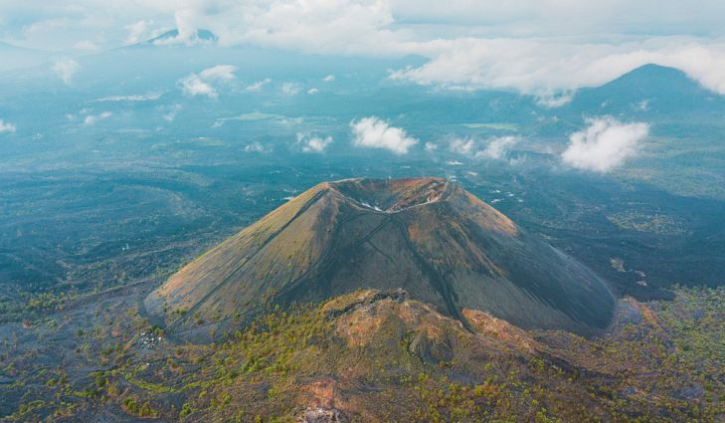
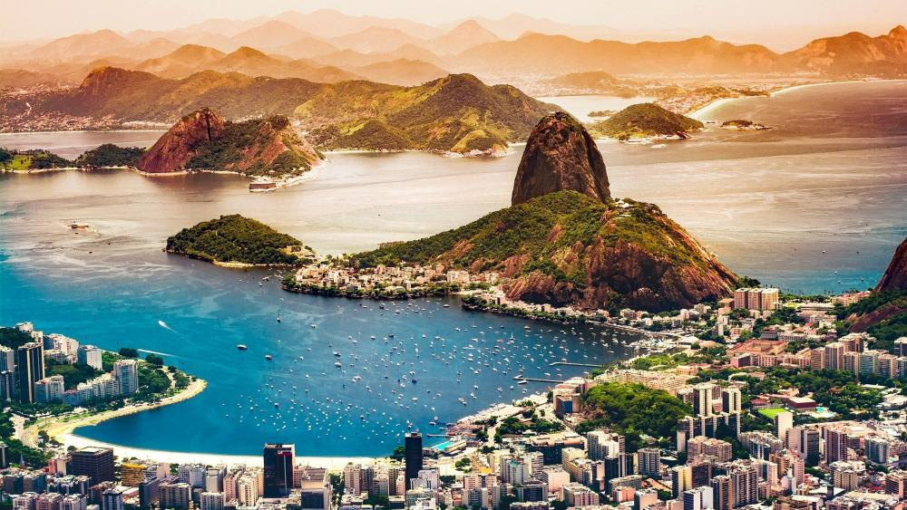
Can you name the seven natural wonders of the world?
Mt Everest – China/Nepal
Victoria falls - Zambia
Great Barrier Reef – Australia
Aurora Borealis – Arctic circle
Grand Canyon - Arizona
Paricutin volcano - Mexico
Guanabara bay - Brazil

Slide 31
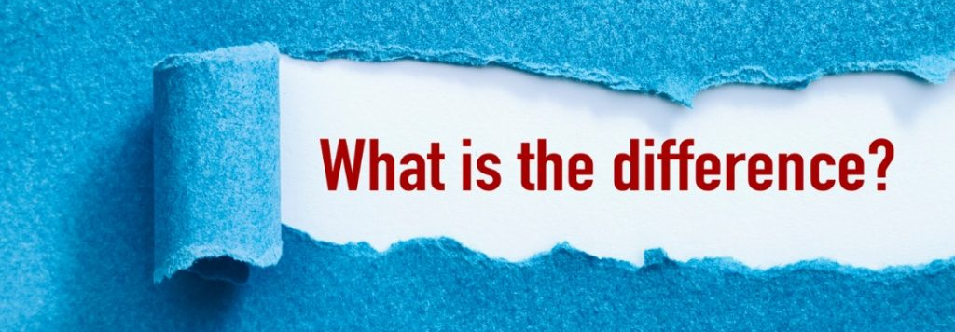
Conservation & Preservation
Exam tip
Do not use these words interchangeable

Slide 32
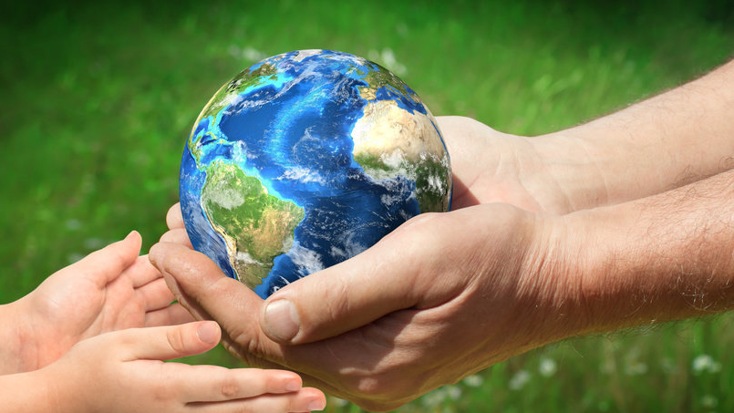
Preservation & Conservation
Conservation: Maintaining biodiversity through human action or management
Preservation: Restricting or banning human interference (must remain pristine)
Preservation vs conservation – what is the difference?
Conservation is an active process that involves active/ sustainable management of habitats and species in them.
Preservation leaves ecosystems/habitats undisturbed

Slide 33
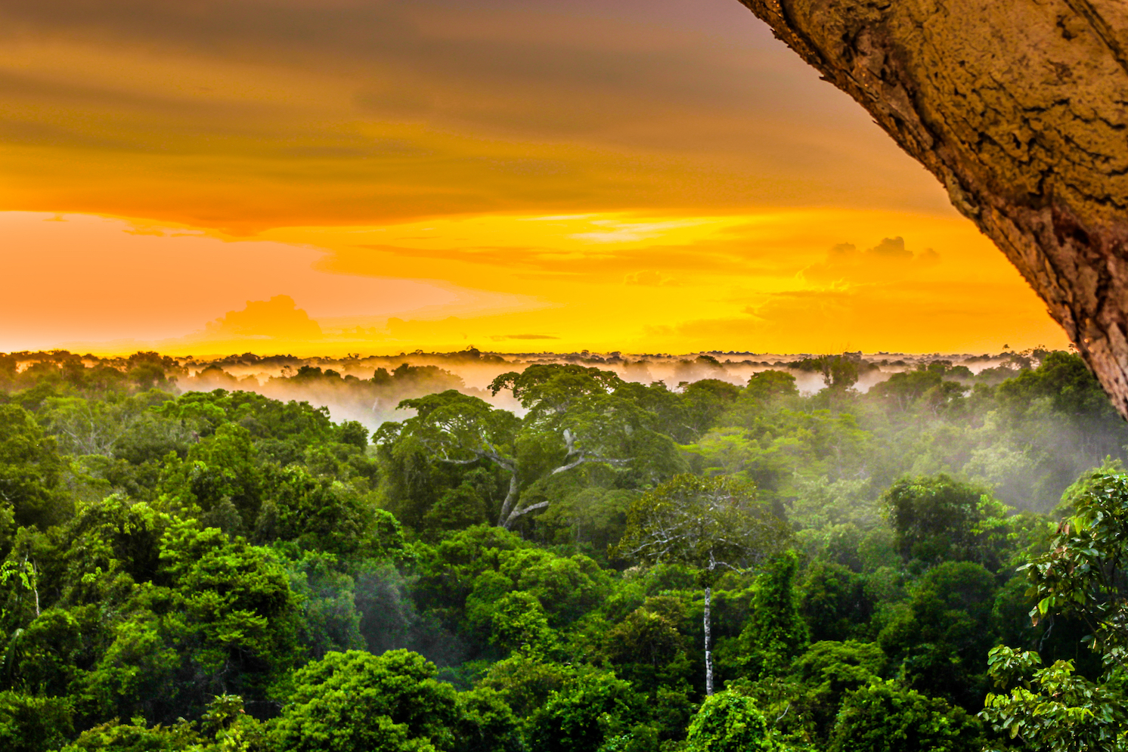
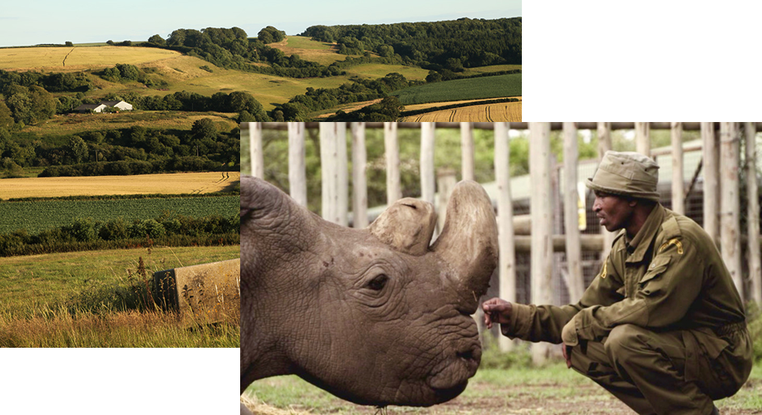

Conservation
Preservation

Slide 34
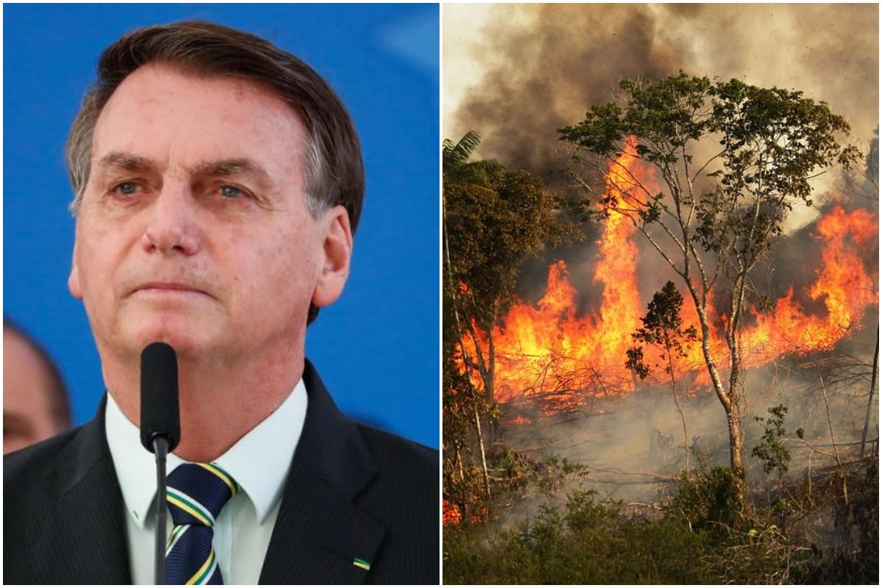
(96) Deforestation in Brazil's rainforest hits new record in January - YouTube

Slide 35
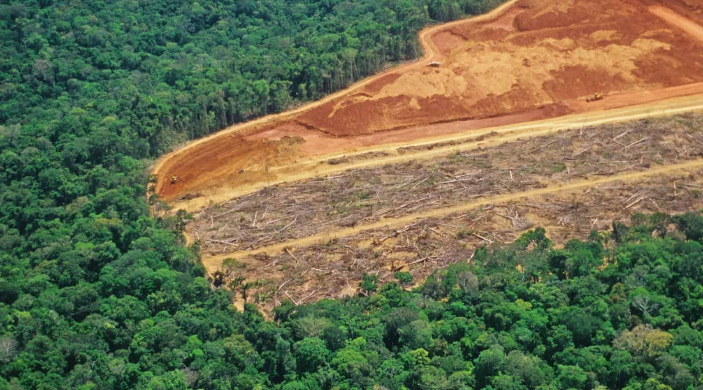
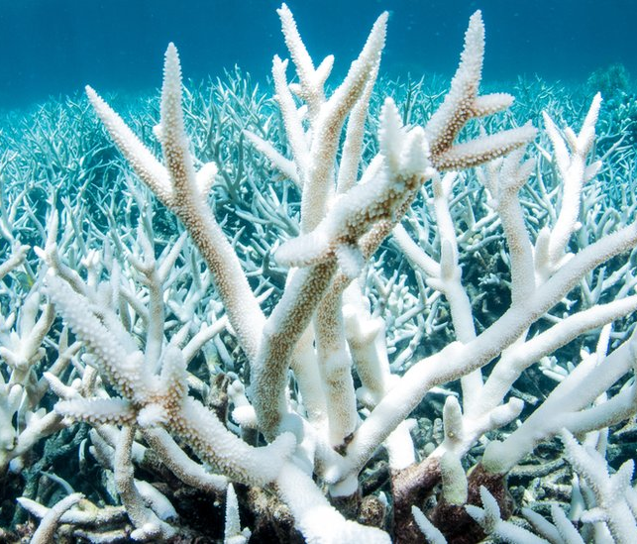

Getting conservation wrong

Slide 36

Social & aesthetic
Ethical
Economical

Slide 37
Economic? Social? Ethical?
Identify how each of the following statements should be classified (some statements can be classified in more than one way)
Sustainable use of resource
Save species for future generations
Maintain the gene pool
Responsibility to save species that we have endangered
Agricultural purposes
Ecotourism
Medicinal Uses
Aesthetic reasons
Support Forest Communities
To enable indigenous people to retain their way of life
Resources may be of use in the future

Slide 38
Social & aesthetic
Ethical
Save species for future generations
Aesthetic reasons
To enable indigenous people to retain their way of life
Ecotourism
Responsibility to save species that we have endangered
Maintain the gene pool
Resources may be of use in the future
Support Forest Communities
Sustainable use of resource
Do you agree?
Medicinal Uses
Agricultural purposes
Economical

Slide 39
Begin Cornell notes task – due Friday
Next lesson
Assignment question – set for everyone to complete
Consolidation questions for those in lesson for remainder / found in folder for those away

