Slide 1
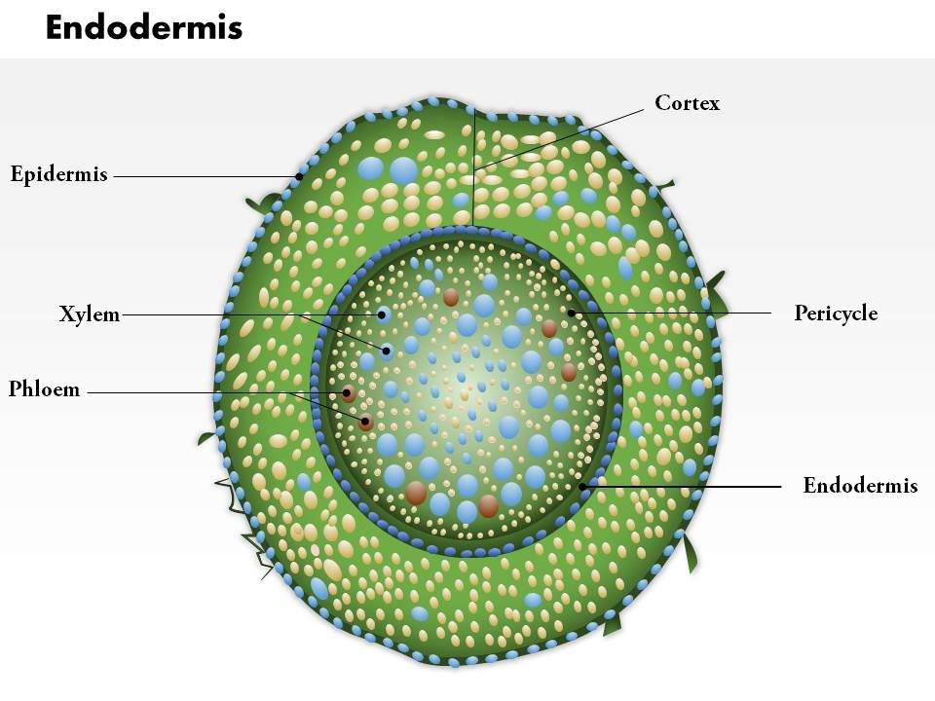
Knowledge retrieval questions
https://pollev.com/science1s478
Q1. Explain, in terms of water potential how water moves from the soil to the endodermis in a root (5 marks)
Water is absorbed from the soil by the root hairs via osmosis
The water potential is higher in the epidermal cells than in the xylem in the root centre
Water moves from cell to cell through the cytoplasm down the water potential gradient (symplast pathway)
Water also moves through the fibres of the cell wall and intercellular spaces (apoplast pathway)
But must go through the cytoplasm in the endodermal cells due to the Casparian strip
Q2. Explain why, in summer, the diameter of a branch is smaller at noon than at midnight (4 marks)
Temperature higher at noon so transpiration rate higher
More water evaporates from the surface of the mesophyll cells reducing the water potential
Water moves from the xylem in the leaves into the cells creating a tension pulling the water up the xylem
This pulls the xylem vessels in - so reducing the diameter of the trunk/branch
Q3. Explain the root pressure hypothesis for water movement in the xylem (3 marks)
Mineral ions are actively transported out of the endodermal cells into the xylem vessels
Lowering the water potential in the xylem
So water moves in from the surrounding cells by osmosis / down the water potential gradient
Raising the root pressure (hydrostatic pressure)

Slide 2
https://pollev.com/science1s478

Slide 3
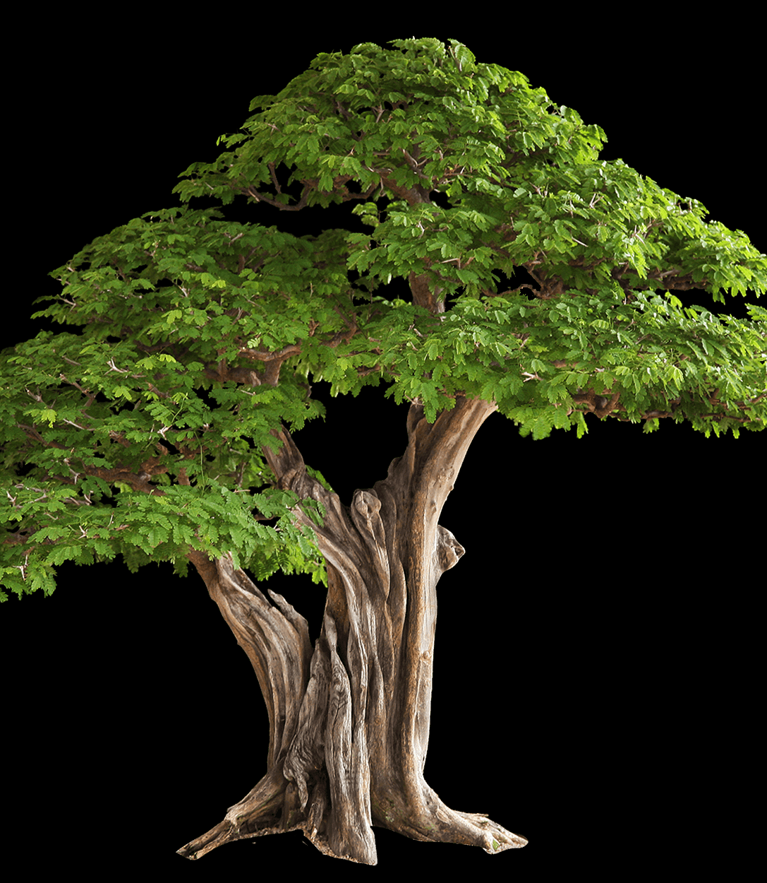
Quick Check: Name the different pressures that move water through a plant.
Turgor
………..……. pressure as a result of osmosis in plants cells provides a hydrostatic skeleton to support the plant
Actively pumping ions into the xylem creates …………… pressure at the bottom of the xylem
Evaporation of water from the leaf, causes ……………….. pressure at the top of the xylem
root
negative

Slide 4
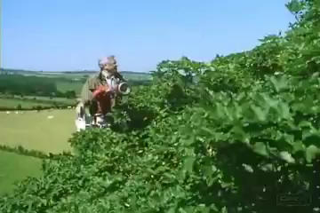
Transpiration
Notes:
https://www.youtube.com/watch?v=tk5IwL2iNgU

Slide 5
Investigating transpiration
More than 95% of water taken up by the plant passes through the transpiration stream.
  What happens to the other 5%?
  It is used in photosynthesis and other metabolic processes
  RECAP: If only 5% of the water is used why do plants have a transpiration stream?
  Turgid cells provide structure and support to the plant
  Transport of minerals and ions from the soil to the cells
  Maintaining a constant temperature. Evaporation allows the plant to cool.

Slide 6
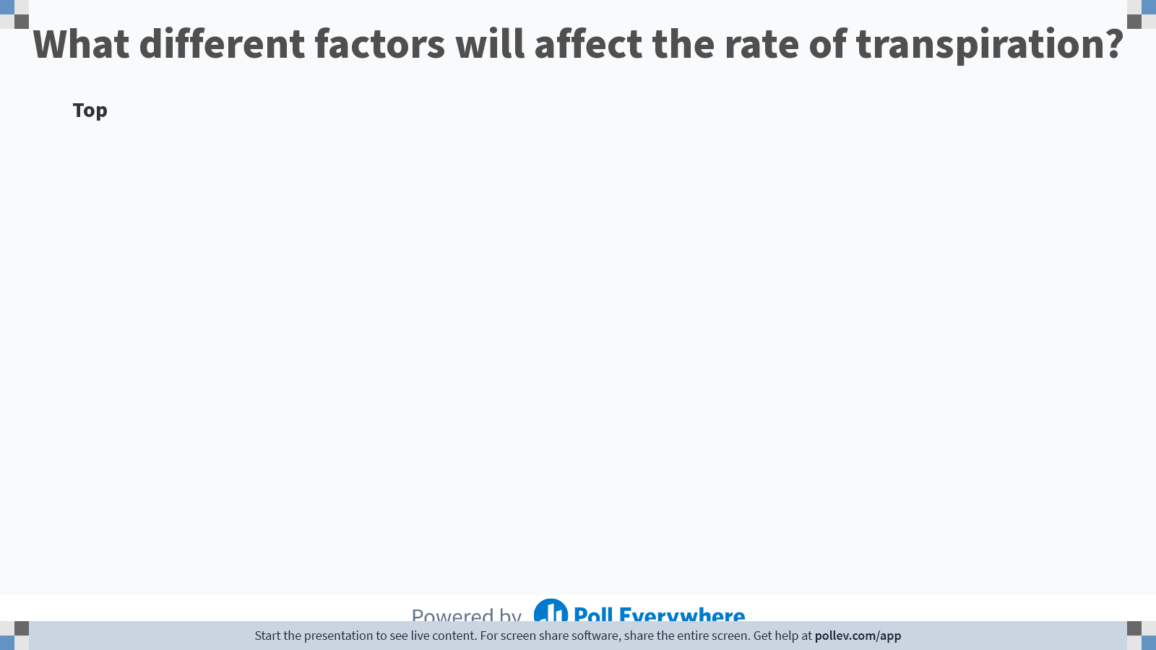
Notes:
Poll Title: Do not modify the notes in this section to avoid tampering with the Poll Everywhere activity.
More info at polleverywhere.com/support
What different factors will affect the rate of transpiration?
https://www.polleverywhere.com/discourses/oCZF8q8Z1nurIMVEOxQPp

Slide 7
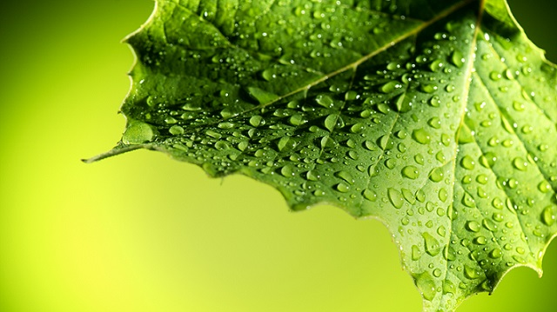
Explain why the following factors will affect the rate of transpiration
Light:
Temperature:
Humidity:
Air movement:
Soil-water availability:

Slide 8
Explain why the following factors will affect the rate of transpiration
Light: Photosynthesis occurs in light, opening the stomata to allow CO₂ to diffuse into leaf. This allows H₂O to be lost to the atmosphere.
Temperature: high temperatures increase the KE of H₂O molecules, increasing rate of evaporation. It also decreases H₂O potential of air, increasing H₂O potential gradient.
Humidity: high humidity = smaller H₂O potential gradient = low transpiration rate.
Air movement: high air movement maintains H₂O potential gradient.
Soil-water availability: Low level of water in the soil places the plant under “water stress” and the rate of transpiration reduces

Slide 9
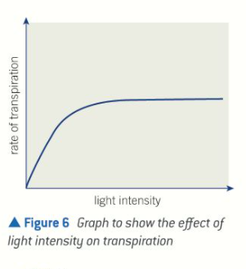
Explain the trend in the graph (3 marks)

Slide 10
Explain the trend in the graph (3 marks)
As light intensity increases the rate of transpiration increases
The increase rate of transpiration begins to slow and then level off
Light no longer the limiting factor for transpiration

Slide 11

Notes:
The shape of the leaf and sometimes small hairs creates a layers of moist air around the plant reducing transpiration. Windy conditions will remove this and increase the water concentration gradient speeding up transpiration

Slide 12
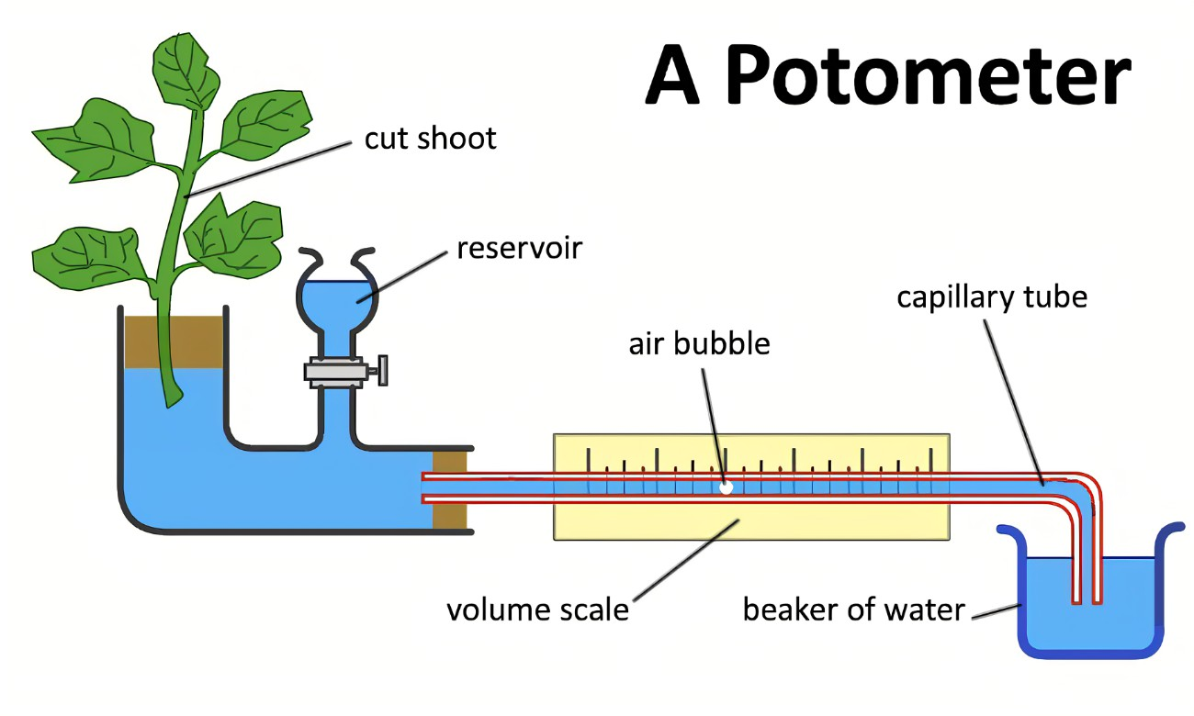
How Transpiration is Measured
A potometer is used to measure the rate of transpiration
Water is pulled up through the plant
The volume of water taken up is measured in a given time to calculate the rate in mm³ / per min

Slide 13
Describe how to set up a potometer to measure water uptake, explaining the precautions that need to be taken, Explain why a potometer measures water uptake rather than transpiration rate, and be able to interpret and explain data obtained using a potometer.
Ruler
Capillary tube
Air bubble
Beaker of water
Cutting
Reservoir
Potometer

Slide 14
Setting up the potometer
https://youtu.be/EGFD-l1-krI?feature=shared

Slide 15
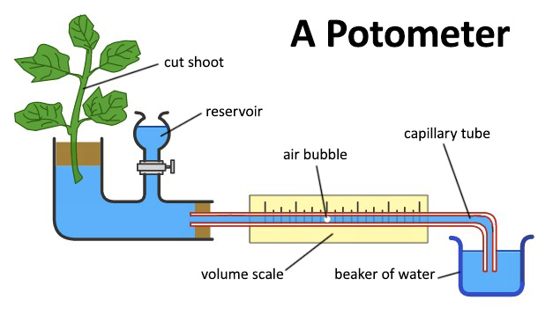
Describe how to set up a potometer to measure water uptake, explaining the precautions that need to be taken, Explain why a potometer measures water uptake rather than transpiration rate, and be able to interpret and explain data obtained using a potometer.
Leaf shoot is cut under water.
Potometer filled with water.
Rubber tube connected to leafy shoot and potometer.
Joints sealed with water proof substance.
Air bubble introduced into capillary tube.
Measure distance air bubble travelled.
Volume or distance against time is plotted.
https://youtu.be/EGFD-l1-krI?feature=shared
The conditions can be varied to look at the effect on water uptake...
- Light intensity, temperature, humidity, stomata availability - cover underside of leaves with vaseline
You could be asked to calculate the volume of water that was released via the transpiration stream! πr²h
Notes:
πr²h

Slide 16
Lesson after exams below
Recap potometer first (above written down already) – but needs recapping

Slide 17
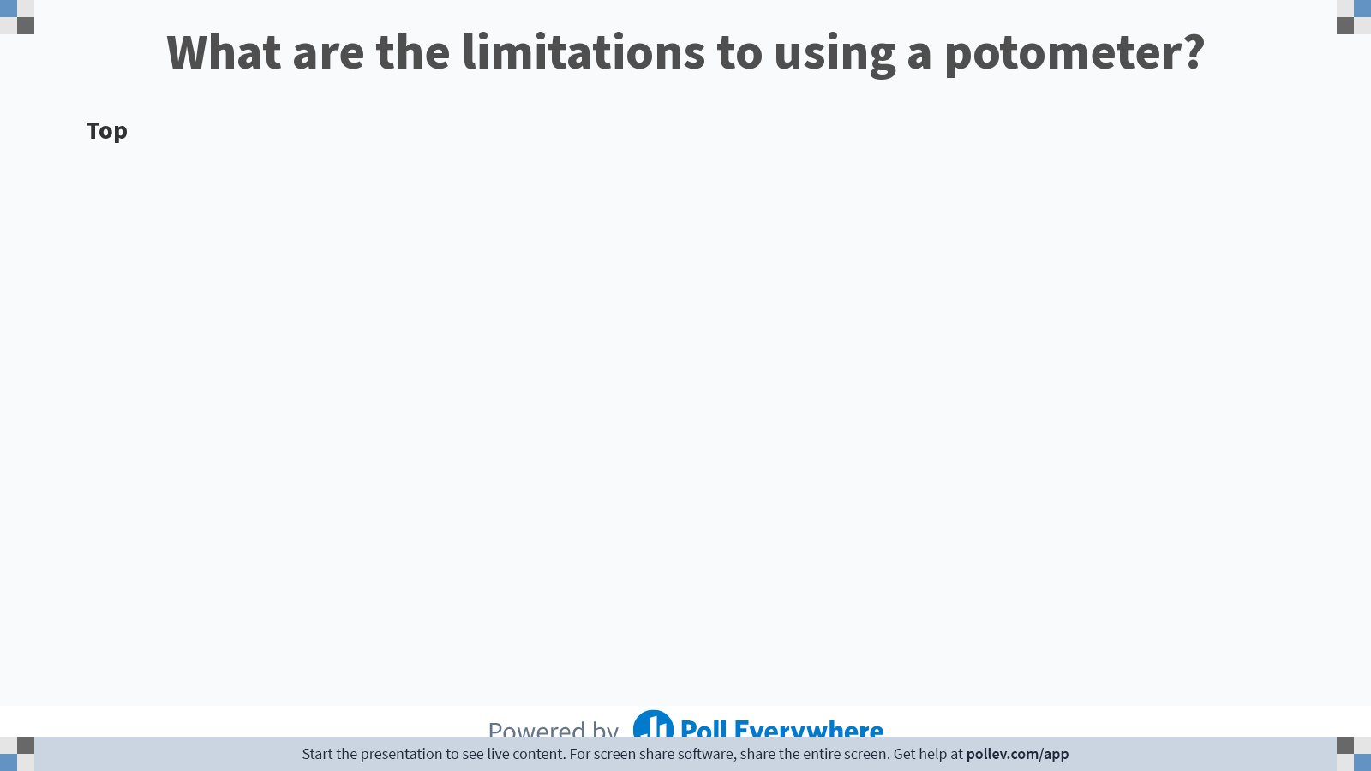
Notes:
Poll Title: Do not modify the notes in this section to avoid tampering with the Poll Everywhere activity.
More info at polleverywhere.com/support
What are the limitations to using a potometer?
https://www.polleverywhere.com/discourses/iXwLuoATKYhR8OSxerLWd

Slide 18
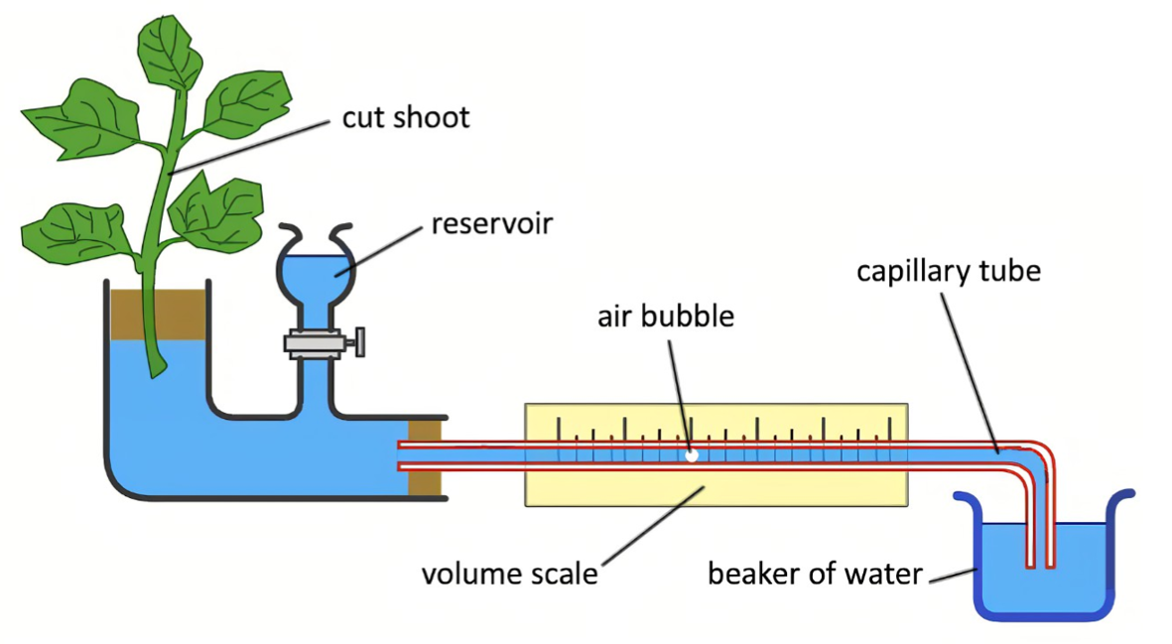
Potometer limitations
Measures water uptake, not water loss (some water is does not evaporate)
Cutting plant shoot may damage plant, effecting transport of water into the plant
Plant has no roots so no resistance to water being pulled up

Slide 19
Practical
Measure the rate of transpiration for 5 minutes when changing the following environmental conditions:
Light
Temperature
Wind
Make a table to record your results
Rate of transpiration
Distance moved or volume lost = ………. mm/min or ml/min
time
Create a suitable to record your results
Leaf shoot is cut under water.
Potometer filled with water - underwater
Rubber tube connected to leafy shoot and potometer - underwater
Joints sealed with water proof substance.
Air bubble introduced into capillary tube.
Introduce first independent variable
Measure distance air bubble travelled after three minutes
Volume or distance against time is plotted.

Slide 20
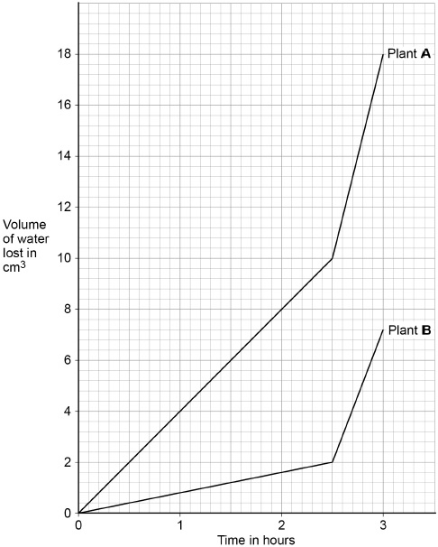
Rate of transpiration calculation
Calculate the rate of water loss per hour in plant B from 2.5 hours to 3 hours.
Give your answer to 2 significant figures.

Slide 21
Rate of transpiration calculation
Calculate the rate of water loss per hour in plant B from 2.5 hours to 3 hours.
Give your answer to 2 significant figures.
5.2 lost in 30 minutes
(5.2 × 2 =) 10.4
10 (cm3/hour)

Slide 22
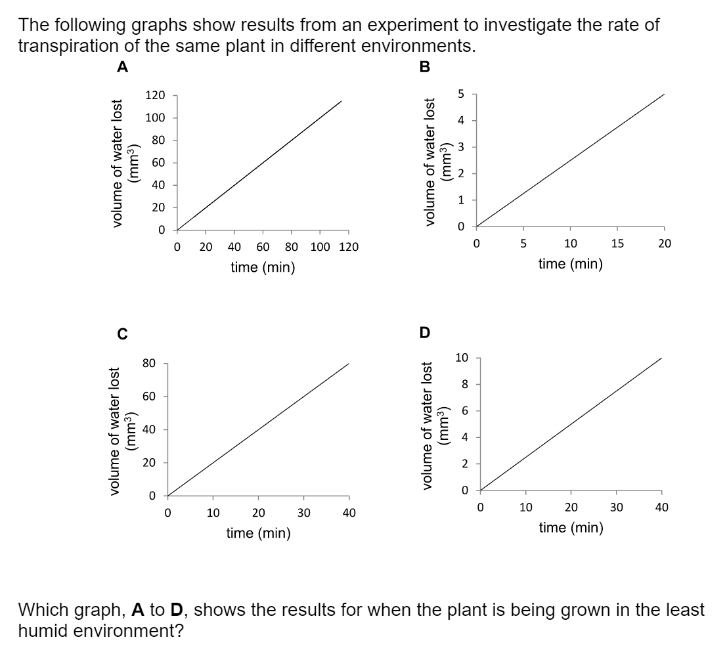
C
2mm³ min⁻¹

Slide 23
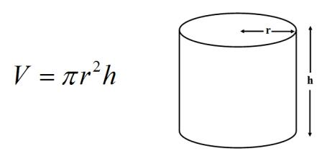
Measuring volume and transpiration rate
Measuring the volume of water taken up by the shoot involves calculating the volume of a cylinder (the length of capillary tube). The volume of a cylinder is given by the formula:
(where r is the radius of the capillary tube and h is the length of the capillary tube).
h = the distance moved by the bubble – could be expressed as l for length
The rate of transpiration is the volume calculated, divided by the time taken.
Rate =volume/time

Slide 24
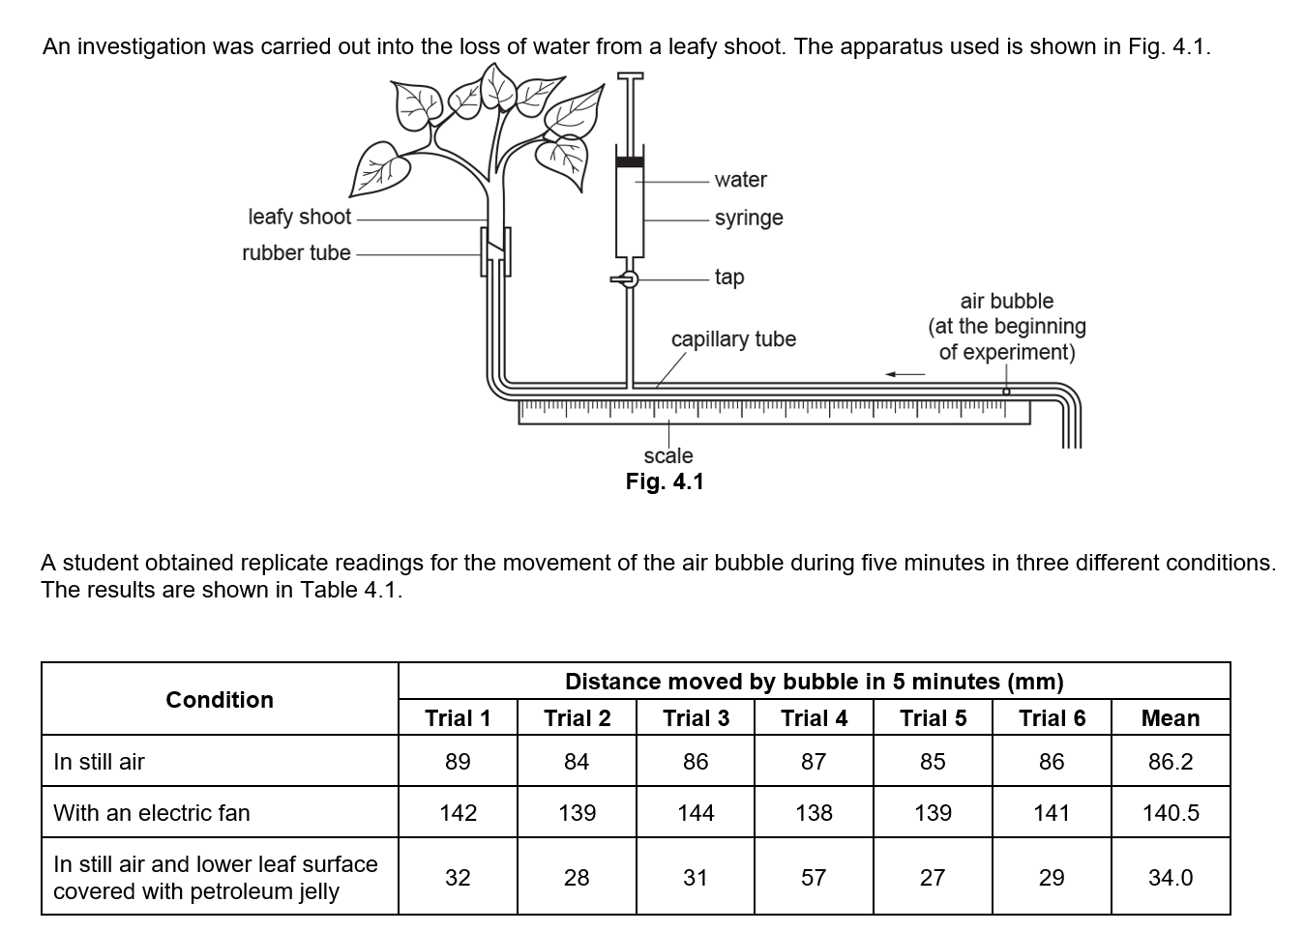
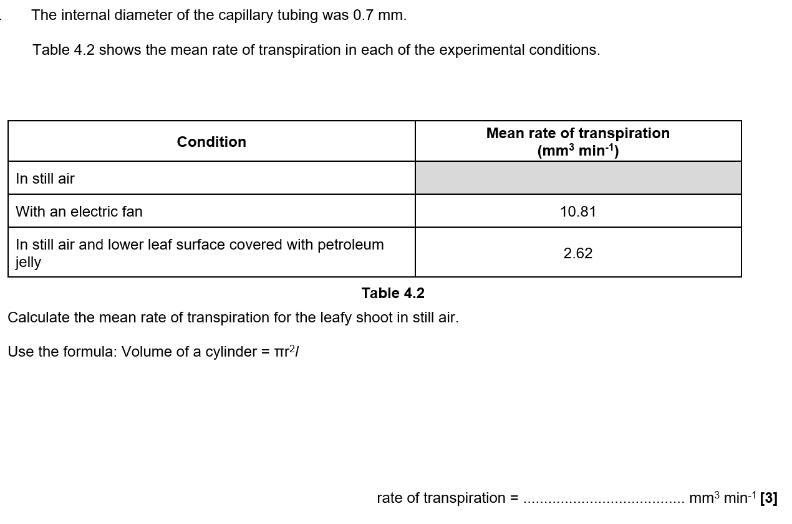
6.63
Convert the distance moved in 5 minutes to 1 minute first
86.2 / 5 = 17.24mm
π x 0.352 x 17.24 = 6.6347
Match the decimal places in the table = 6.63mm³ min⁻¹

Slide 25
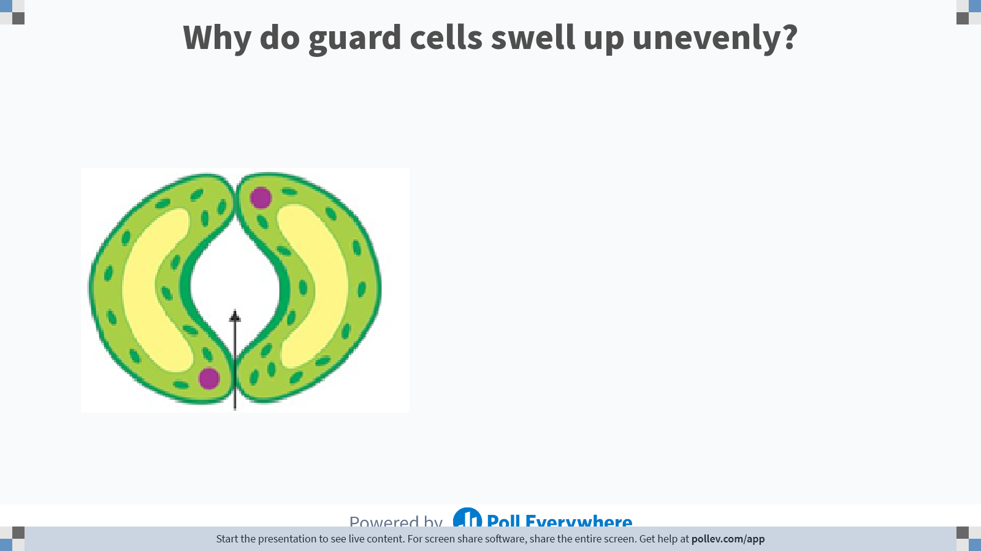
Notes:
Poll Title: Do not modify the notes in this section to avoid tampering with the Poll Everywhere activity.
More info at polleverywhere.com/support
Why do guard cells swell up unevenly?
https://www.polleverywhere.com/free_text_polls/Lz3BiRuYQQzaPdFZvN61T

Slide 26
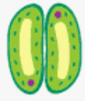
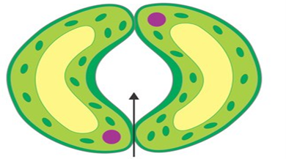
Guard cells
The main way the rate of transpiration is controlled in plants is the opening and closing of the guard cells
Diagram:
Ions are actively pumped into the guard cells
Inner wall is less flexible
Stomata open

Slide 27
Guard cells
The main way the rate of transpiration is controlled in plants is the opening and closing of the guard cells
Diagram:
This is a turgor-driven process
When turgidity is low, the asymmetry of the guard cells closes the stomata
When environmental conditions are favourable, solutes (ions) are pumped into the guard cells, via active transport, increasing their turgor
Cellulose hoops prevent any widthway swelling
A inflexible inner wall and flexible outer wall causes the cell to swell into a bean shape, opening the stomata pore
Ions are actively pumped into the guard cells
Inner wall is less flexible
Stomata open
When water becomes scarce, hormones (ABA) trigger turgor loss in the guard cells, closing them to conserve water

Slide 28
Plant species | Estimated number of stomata
 | Upper leaf | Lower leaf
X | 4000 | 32000
Y | 0 | 600
Z | 9000 | 42000
Q1. Which species is likely to live in a dry environment. Explain why you have chosen this species (3 marks)
Q2. Explain why all three have the higher majority of stomata under the leaf. How does this improve the chances of survival? (2 marks)

Slide 29
Q1. Which species is likely to live in a dry environment. Explain why you have chosen this species (3 marks)
Q2. Explain why all three have the higher majority of stomata under the leaf. How does this improve the chances of survival? (2 marks)
Species Y / fewer stomata on upper surface of leaf / reducing water loss via transpiration
Reduces water loss via stomata / easier to evaporate from the top of a leaf

