Slide 1
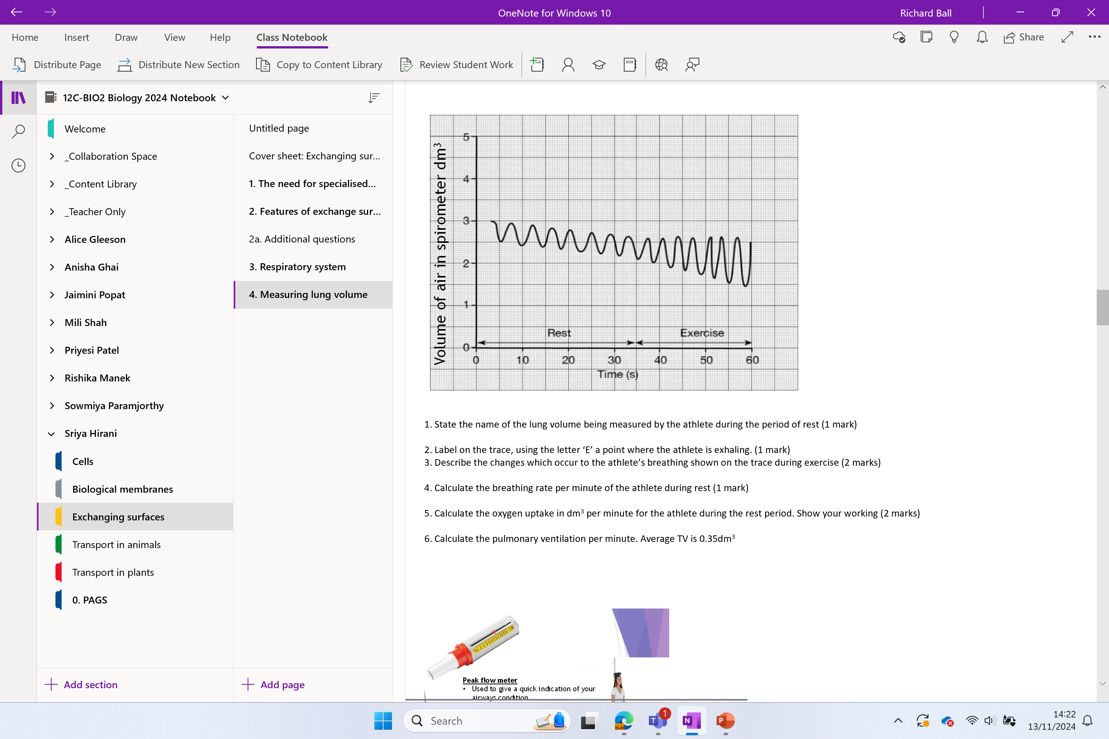

Slide 2
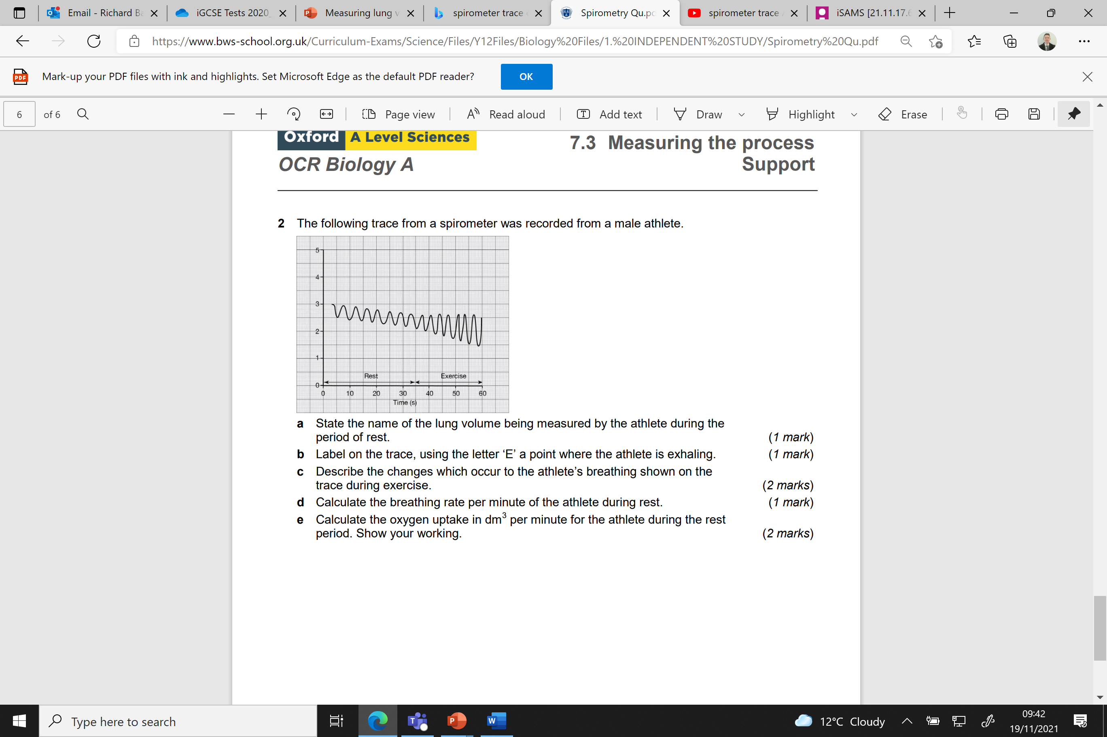
Try this
Each square is 0.05dm3
1. State the name of the lung volume being measured by the athlete during the period of rest. (1 mark)
Tidal volume
2. Label on the trace, using the letter ‘E’ a point where the athlete is exhaling. (1 mark)
3. Describe the changes which occur to the athlete’s breathing shown on the trace during exercise. (2 marks)
Breathing rate increases
Depth of breathing increases
4. Calculate the breathing rate per minute of the athlete during rest (1 mark)
6x2 = 12 breaths per minute
OR
7x2 = 14 breaths per minutes
5. Calculate the oxygen uptake in dm³ per minute for the athlete during the rest period. Show your working. (2 marks)
0.3 x 2 = 0.6dm³ per minute
E
Volume of air in spirometer dm³
6. Calculate the pulmonary ventilation per minute. Average TV is 0.35dm³
PV = TV x BR
PV = 0.35 x 12 = 4.2dm³ per minute
Or = 0.35 x 14 = 4.9dm³ per minute

Slide 3
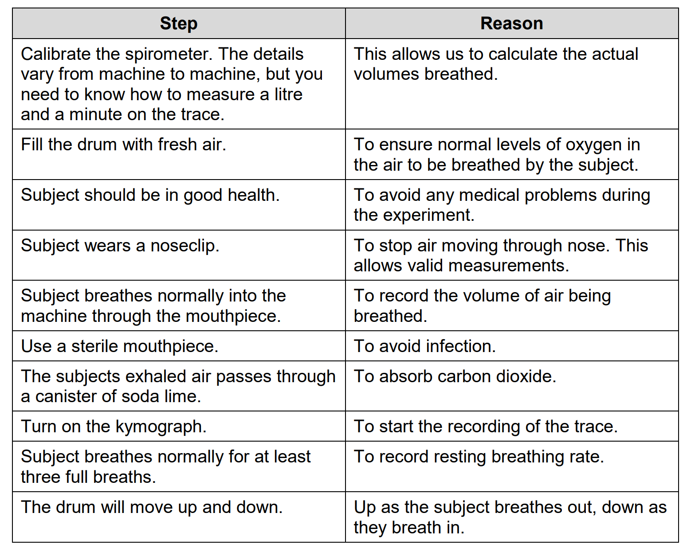
Recap

Slide 4
RECAP
Why does the trace decrease diagonally?
CO_{2(g)} has to be removed during exhalation otherwise it will rise to a dangerously high level.
CO_{2(g)} is absorbed by soda lime present in the spirometer.

Slide 5
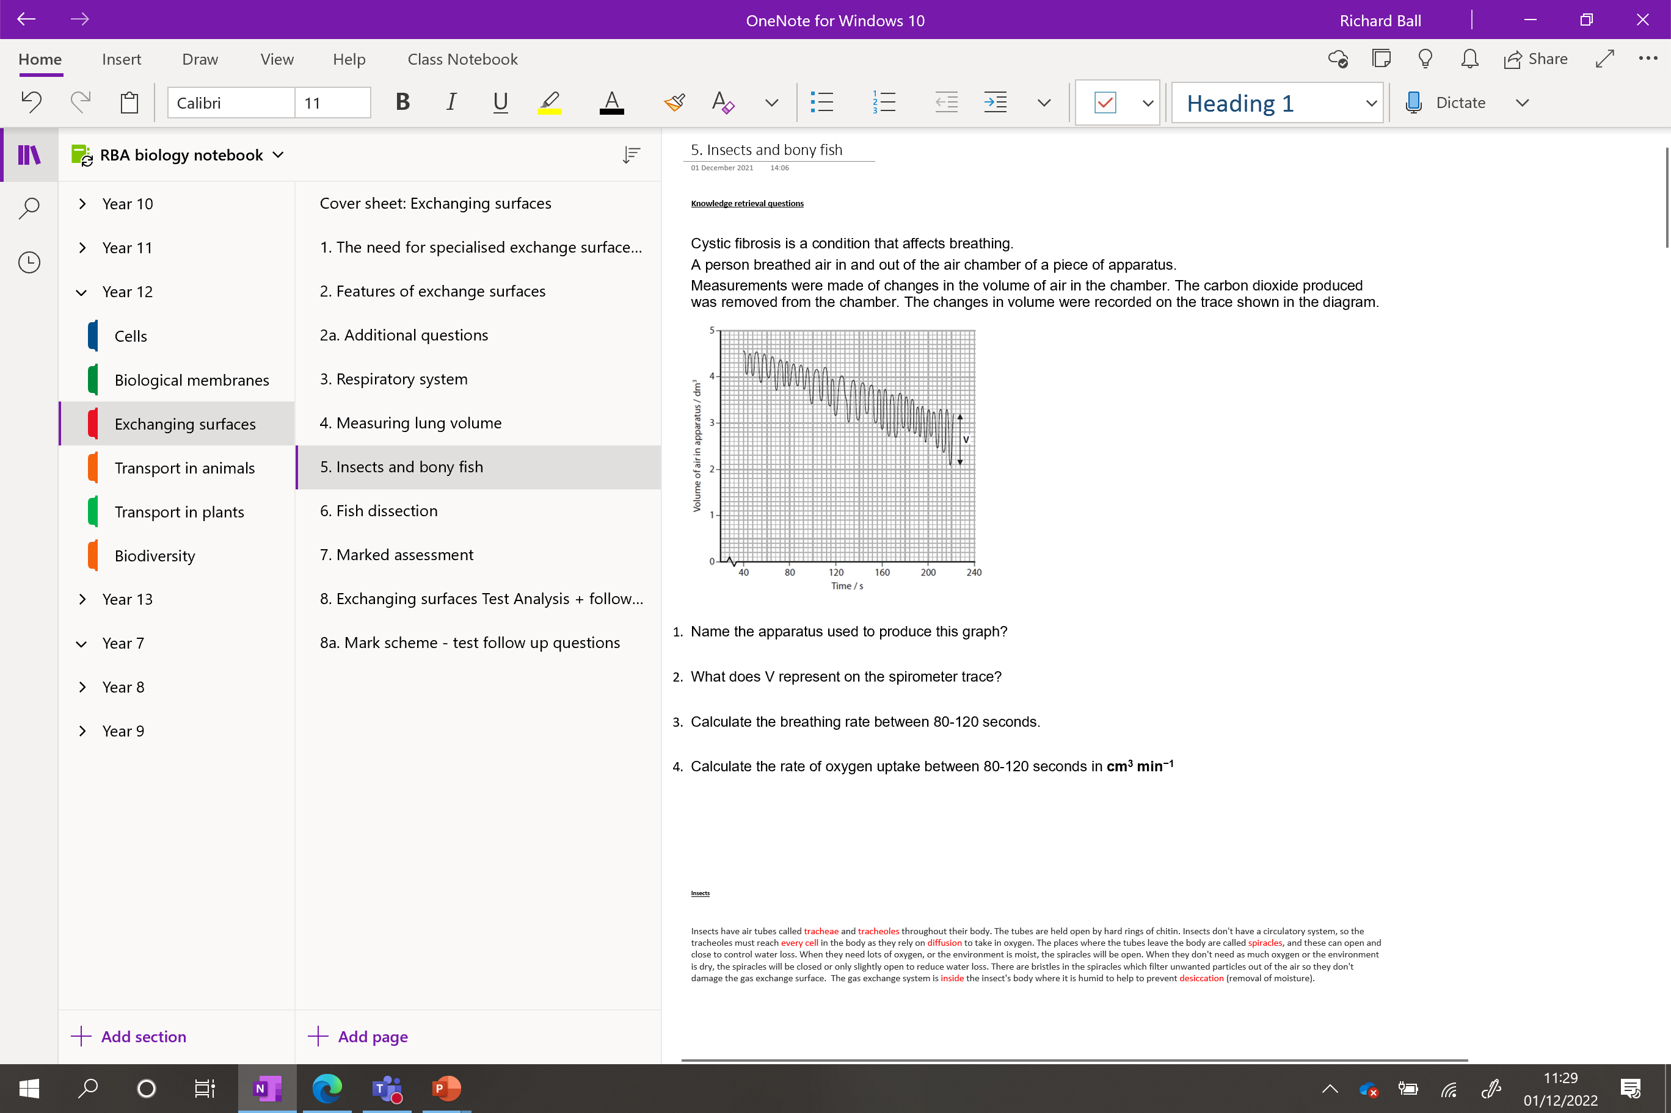

Slide 6
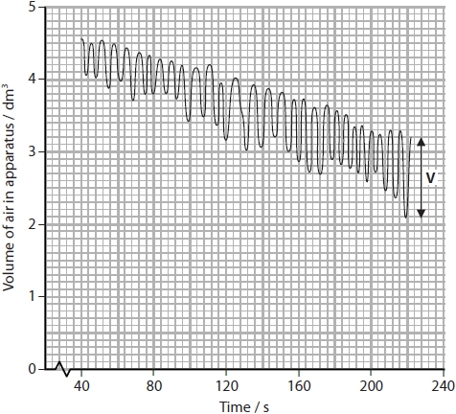
Knowledge retrieval question
Worksheet: Exchanging surfaces / insects and bony fish
Cystic fibrosis is a condition that affects breathing.
A person breathed air in and out of the air chamber of a piece of apparatus.
Measurements were made of changes in the volume of air in the chamber. The carbon dioxide produced was removed from the chamber. The changes in volume were recorded on the trace shown in the diagram.
Name the apparatus used to produce this graph?
What does V represent on the spirometer trace?
Calculate the breathing rate between 80-120 seconds.
Calculate the rate of oxygen uptake between 80-120 seconds in cm³ min⁻¹
Spirometer
Tidal volume
6 in 40s / so 9 breaths per minute
Volume consumed: 0.65dm³
0.65 x 1000 = 650cm³
Time: 40s
650/40 = 16.25cm³ sec⁻¹
16.25 x 60 = 975cm³ min⁻¹

Slide 7
Answers to h/w found in last lessons folder

Slide 8
Exchange of gasses in bony fish and insects
Wednesday, 23 July 2025

Slide 9
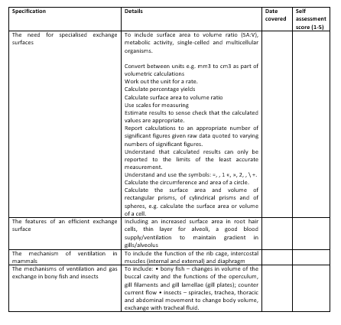
Learning Outcomes
Identify the organs in an insect and a bony fish that control gas exchange.
Apply your knowledge of gas exchange to fish and insects.

Slide 10
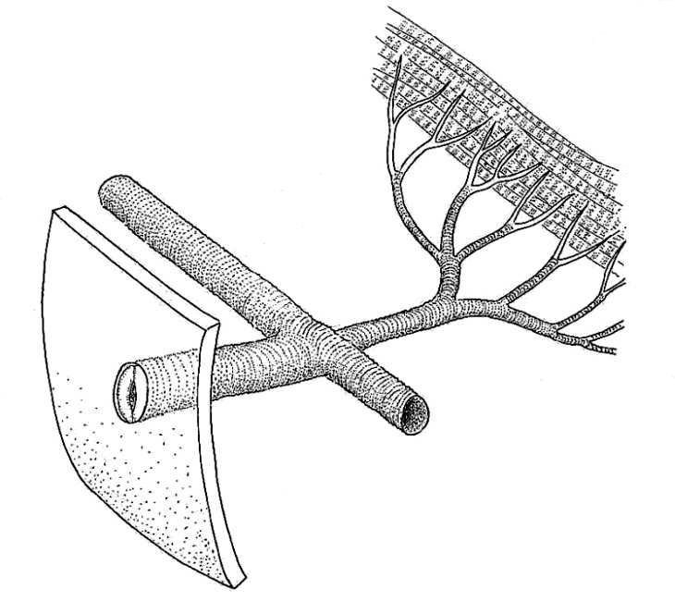
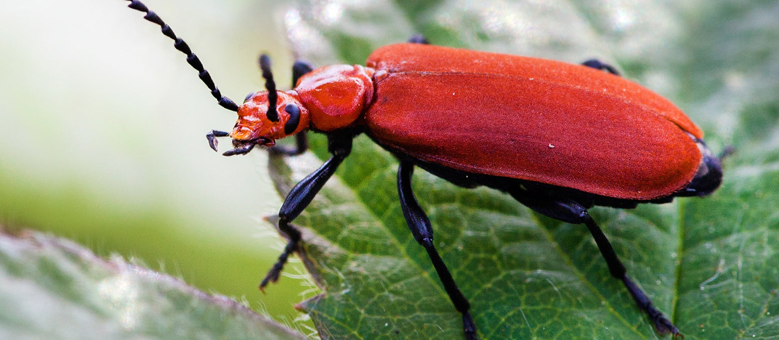
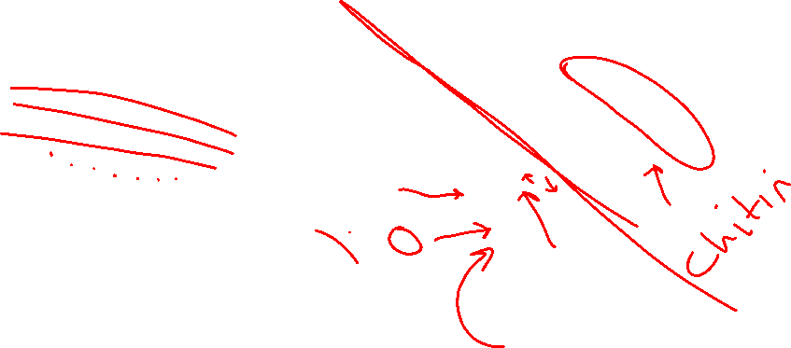
How does an insect deliver substances to cells?
Like an amoeba or multicellular organism?

Slide 11
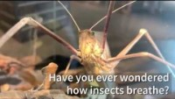

Slide 12
Insects – use this information to label and annotate your diagrams.
Insects have air tubes called tracheae and tracheoles throughout their body.
The tubes are held open by hard rings of chitin. Insects don't have a circulatory system, so the tracheoles must reach every cell in the body as they rely on diffusion to take in oxygen.
The places where the tubes leave the body are called spiracles, and these can open and close to control water loss.
When they need lots of oxygen, or the environment is moist, the spiracles will be open.
When they don't need as much oxygen or the environment is dry, the spiracles will be closed or only slightly open to reduce water loss.
There are bristles in the spiracles which filter unwanted particles out of the air so they don't damage the gas exchange surface.
The gas exchange system is inside the insect's body where it is humid to help to prevent desiccation (removal of moisture).

Slide 13
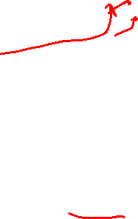
Tracheoles – branch off the tracheae
Elongated cells
No chitin
Freely permeable to gas
Run between the cells of the insect.
This is where most gaseous exchange occurs
Exoskeleton – too thick for gas exchange
Respiring cells
Tracheae – tubes leading from the spiracles, these are the largest tubes in an insects respiratory system (1mm diameter).
They carry air into and along the body.
Lined with chitin (prevent them collapsing)
Chitin is impermeable to gas, so little gas exchange takes place in the tracheae
Contain tracheal fluid
Spiracles – air can enter and leave here. Water is also lost from these.
Small bristles prevent unwanted particles from entering.

Slide 14
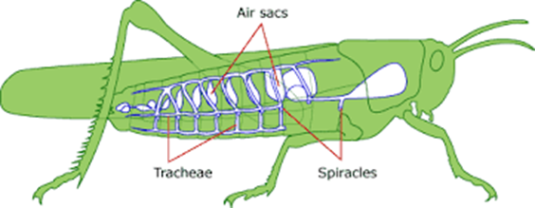
Now try the gap fill!
In the majority of insects a....... moves along the tracheae/tracheoles via diffusion
Vast number of tracheae/tracheoles give a l………. s…………. a………… for efficient gaseous exchange
Oxygen dissolves in moisture on the walls of the tracheoles then …………….. into the cells
Towards the end of the tracheoles there is …………….. fluid – this limits the oxygen diffusing at rest / and is removed when more …………….
However, when the oxygen demands are high (e.g when flying), …………… acid builds up in the tissues, which results in a higher rate of ………………. (to remove lactic acid), resulting in more water moving out of the cells via …….……………. – this exposes more surface area for gas exchange
Notes:
build up of lactic acid causes tracheal fluid to move out and expose more area for gaseous exchange,

Slide 15
In the majority of insects air moves along the tracheae/tracheoles via diffusion
Vast number of tracheae/tracheoles give a large surface area for efficient gaseous exchange
Oxygen dissolves in moisture on the walls of the tracheoles then diffuses into the cells
Towards the end of the tracheoles there is tracheal fluid – this limits the oxygen diffusing at rest / and is removed when more active
However, when the oxygen demands are high (e.g when flying), lactic acid builds up in the tissues, which results in a higher rate of respiration (to remove lactic acid), resulting in more water moving out of the cells via osmosis – this exposes more surface area for gas exchange
Notes:
build up of lactic acid causes tracheal fluid to move out and expose more area for gaseous exchange,

Slide 16
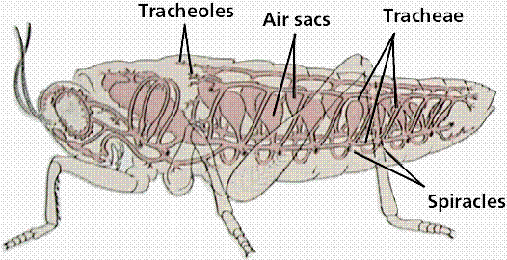
Air sacs in insects
These are attached to the trachea
They store extra air (oxygen) until it is needed for respiration.
Give two occasions when having a storage of air would be beneficial to the insect (2 marks)
Keeping its spiracles closed in a dry environment and use the oxygen it has stored inside. Reduce water loss.
The air sacs are also used when the insect has a high energy demand (flying).

Slide 17
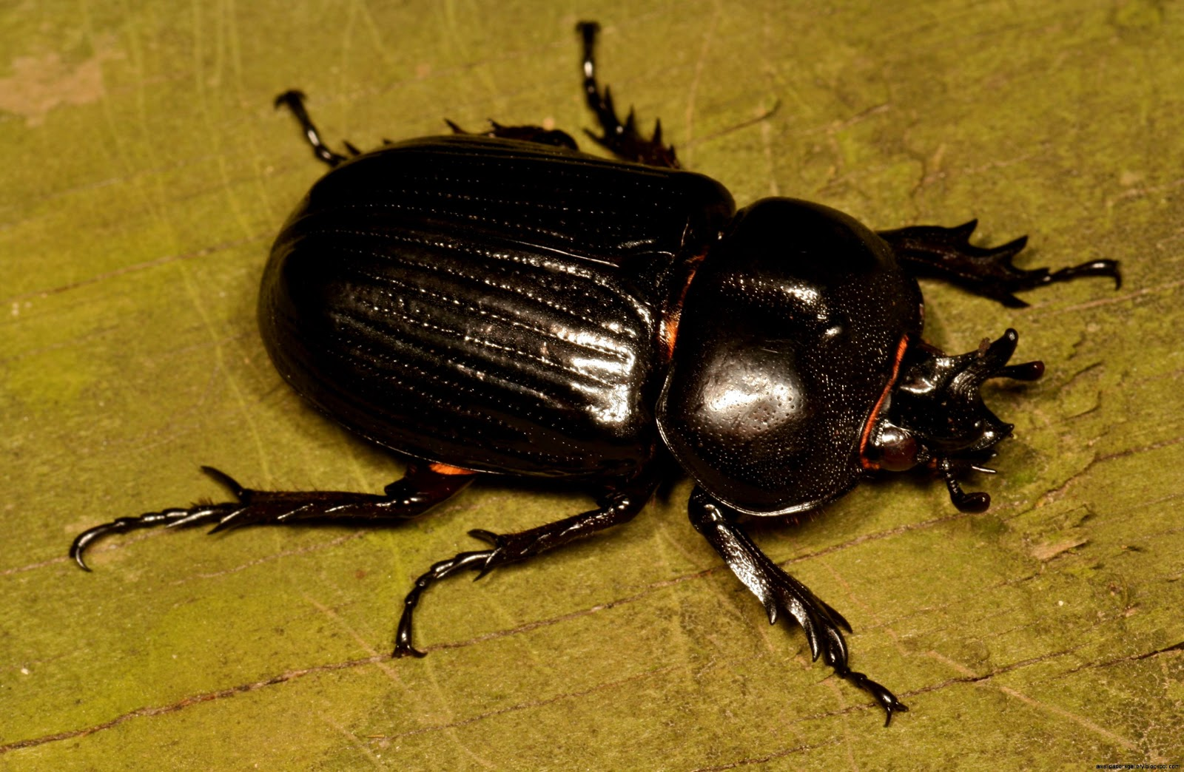
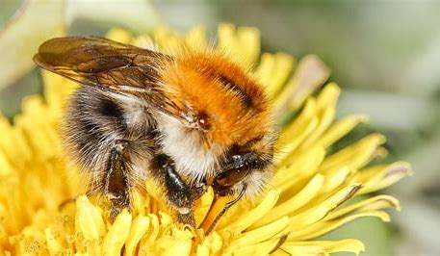
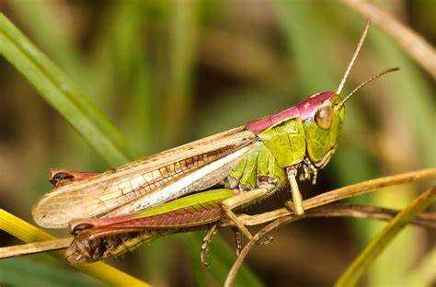
High energy demand insects

Slide 18
High energy demand insect adaptations
Mechanical ventilation – air is actively pumped into the system by muscular pumping movements of the thorax and abdomen
Additional air sacs

Slide 19
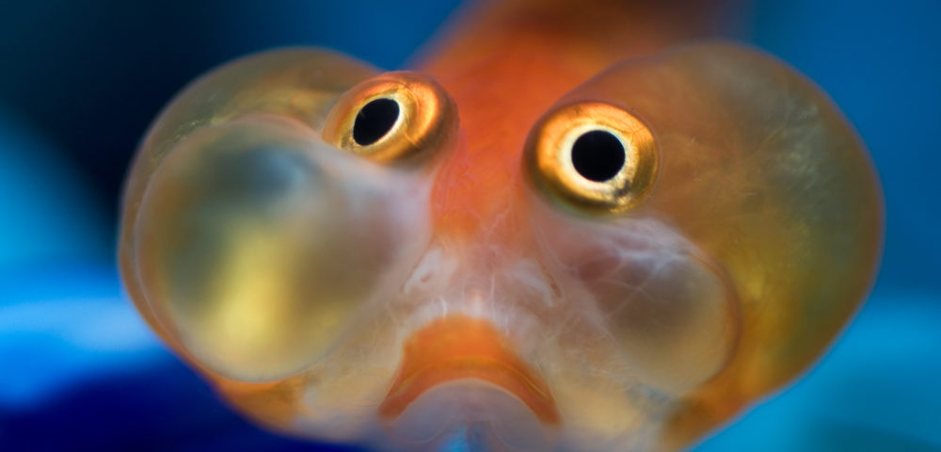
What are the advantages and disadvantages to respiration underwater?

Slide 20
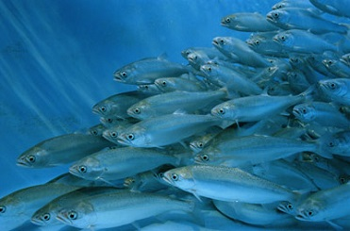
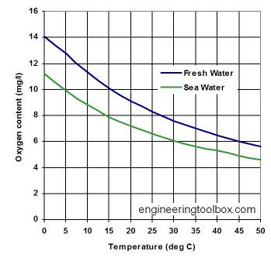
Water as gas exchange medium
1. What advantage is there to have a gas exchange system always exposed to an aquatic environment?
Cell membranes of gas exchange surface kept moist due to contact with water
No need to prevent water loss from gas exchange surfaces
2. What are the disadvantages of having a gas exchange system exposed to water, especially for organisms living in the oceans?
Oxygen concentration in water is low, especially in warmer and/or saltier water.
Gas exchange system must therefore be very efficient to absorb enough oxygen for aerobic respiration.
Notes:
Why does o2 level drop when its gets hotter? AND also in salt water its lower… next two slides

Slide 21

Hot vs Cold water solubility
Why does cold water contain more oxygen?
Hot water, is less soluble. Oxygen molecules move around more, and have the required energy to break away from the water.

Slide 22
Salt vs fresh water
Why does fresh water contain more oxygen?
Freshwater can hold more dissolved oxygen than saltwater because saltwater has less space for oxygen molecules due to the sodium and chloride ions it contains. Therefore the warmer and saltier the water, the less dissolved oxygen it will contain.

Slide 23
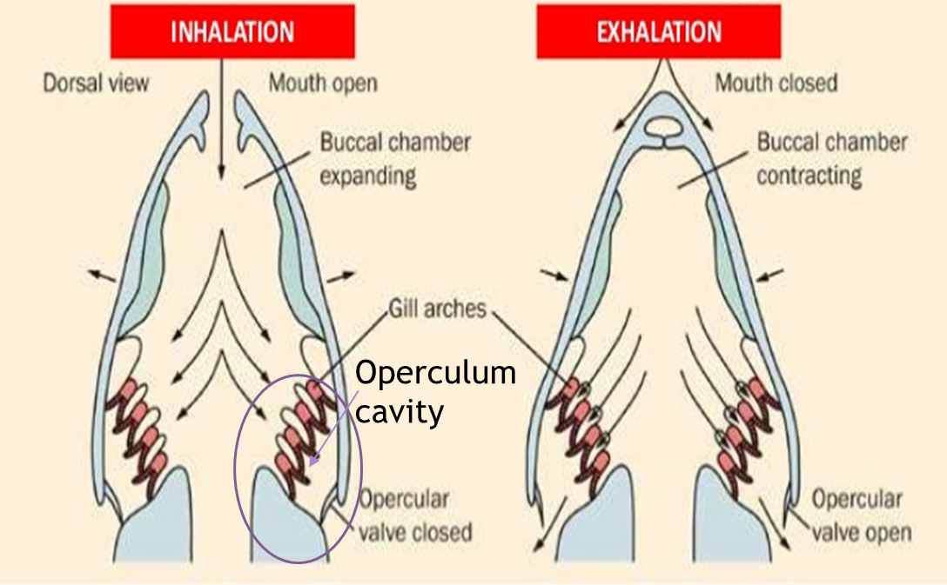
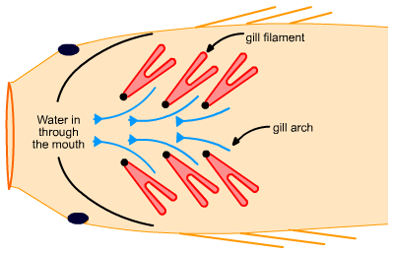
Notes:
The mouth is opened and the floor of the buccal cavity drops (increasing volume).
Pressure drops and water moves in
At the same time the operculum valve is closed
The operculum cavity (containing the gills) then begin to expand lowering the pressure inside
The floor of the buccal cavity begins to move up increasing pressure there
Causing the water to move over the gills
The opercular valve then opens to release the water

Slide 24

Bony fish
The mouth is opened and the floor of the …………. cavity drops (increasing volume).
Pressure ………… and water moves in
At the same time the operculum valve is closed
The operculum cavity (containing the gills) then begin to …………… lowering the pressure inside
The floor of the buccal cavity begins to move up increasing ………….. there
Causing the water to move over the …………
The opercular valve then opens to …………… the water
Release
Drops
Expand
buccal
Pressure
Gills

Slide 25

Bony fish
The mouth is opened and the floor of the buccal cavity drops (increasing volume).
Pressure drops and water moves in
At the same time the operculum valve is closed
The operculum cavity (containing the gills) then begin to expand lowering the pressure inside
The floor of the buccal cavity begins to move up increasing pressure there
Causing the water to move over the gills
The opercular valve then opens to release the water
Release
Drops
Expand
buccal
Pressure
Gills

Slide 26
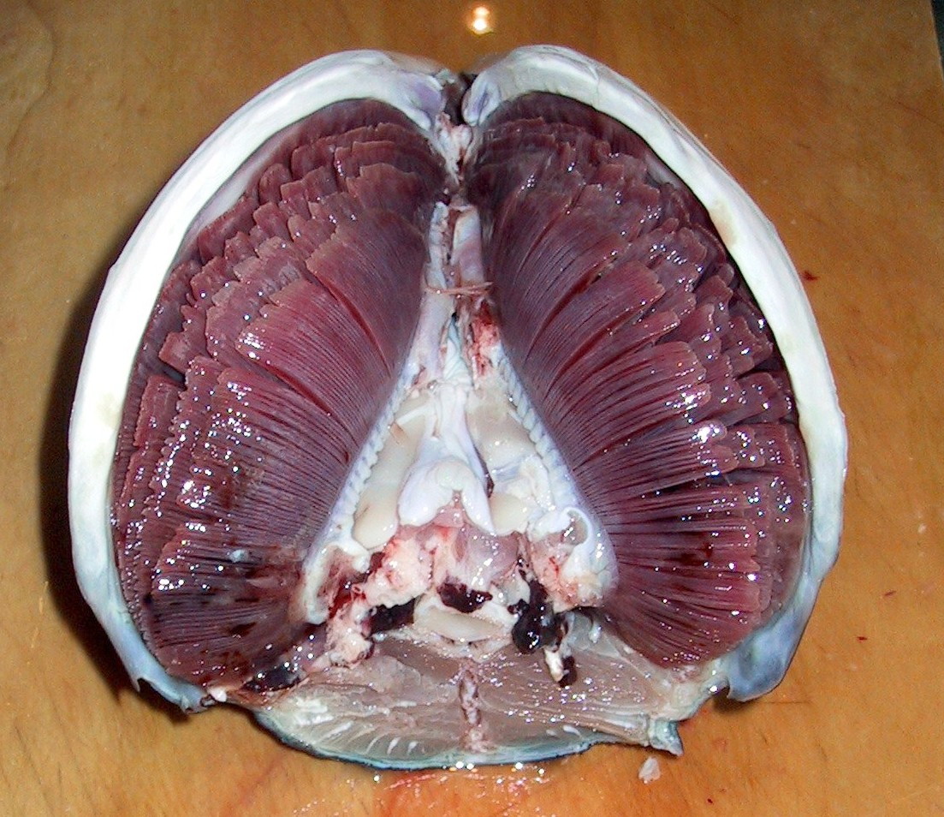
Gas Exchange in Fish - adaptations
Fish exchange materials using their gills. Similarly to the cases we have discussed previously:
They are ………. to allow gases to diffuse through easily
Presence of lamellae and secondary lamellae give a ………… …..….. ……....
Good ……….. supply to maintain a high concentration gradient
The constant flow of ……… transports carbon dioxide away and a fresh supply of oxygen to the gills
The membranes which the gases diffuse across are very …….. – short diffusion pathway
Constant flow
of water across gills
Gill stacks
Tuna gills – source Wikipedia.
Blood vessels carry CO₂ away
from gills and O₂ to gills.
Notes:
26

Slide 27
Gas Exchange in Fish - adaptations
Fish exchange materials using their gills. Similarly to the cases we have discussed previously:
They are moist to allow gases to diffuse through easily
Presence of lamellae and secondary lamellae give a large surface area
Good blood supply to maintain a high concentration gradient
The constant flow of water transports carbon dioxide away and a fresh supply of oxygen to the gills
The membranes which the gases diffuse across are very thin.
Constant flow
of water across gills
Gill stacks
Tuna gills – source Wikipedia.
Blood vessels carry CO₂ away
from gills and O₂ to gills.
Notes:
27

Slide 28
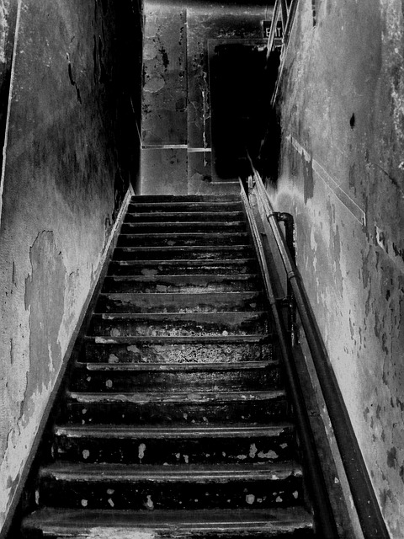
STEPS OF DOOM!!

Slide 29
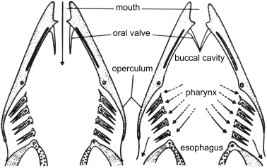
Annotate your diagram to explain how a fish extracts oxygen from the water

Slide 30
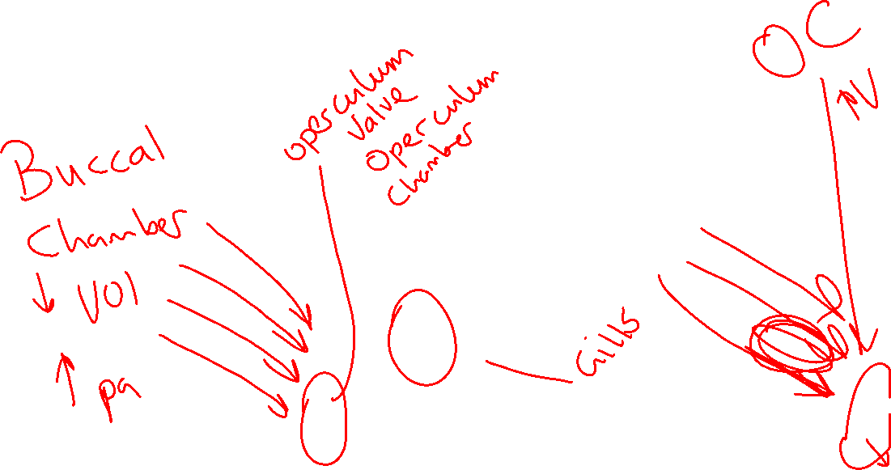

Slide 31
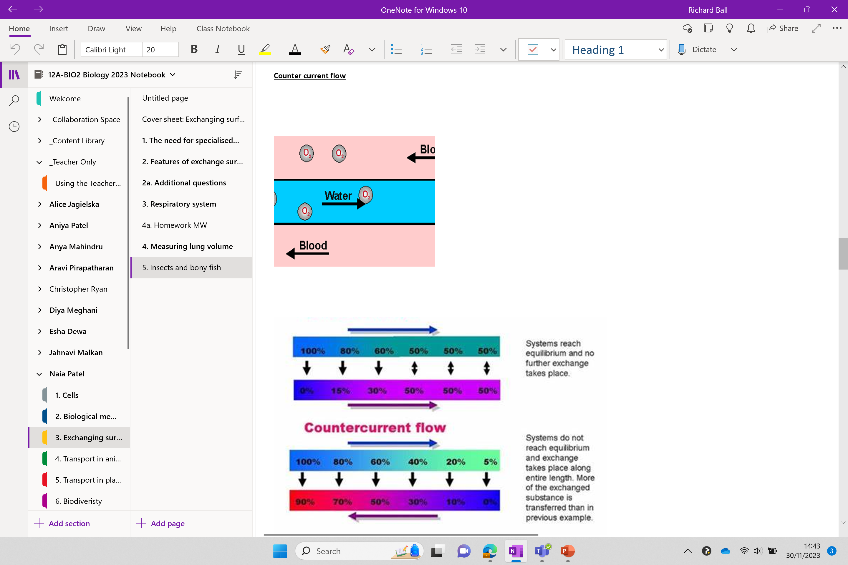
Starter try the exam style question on your desk
Now open to here →

Slide 32
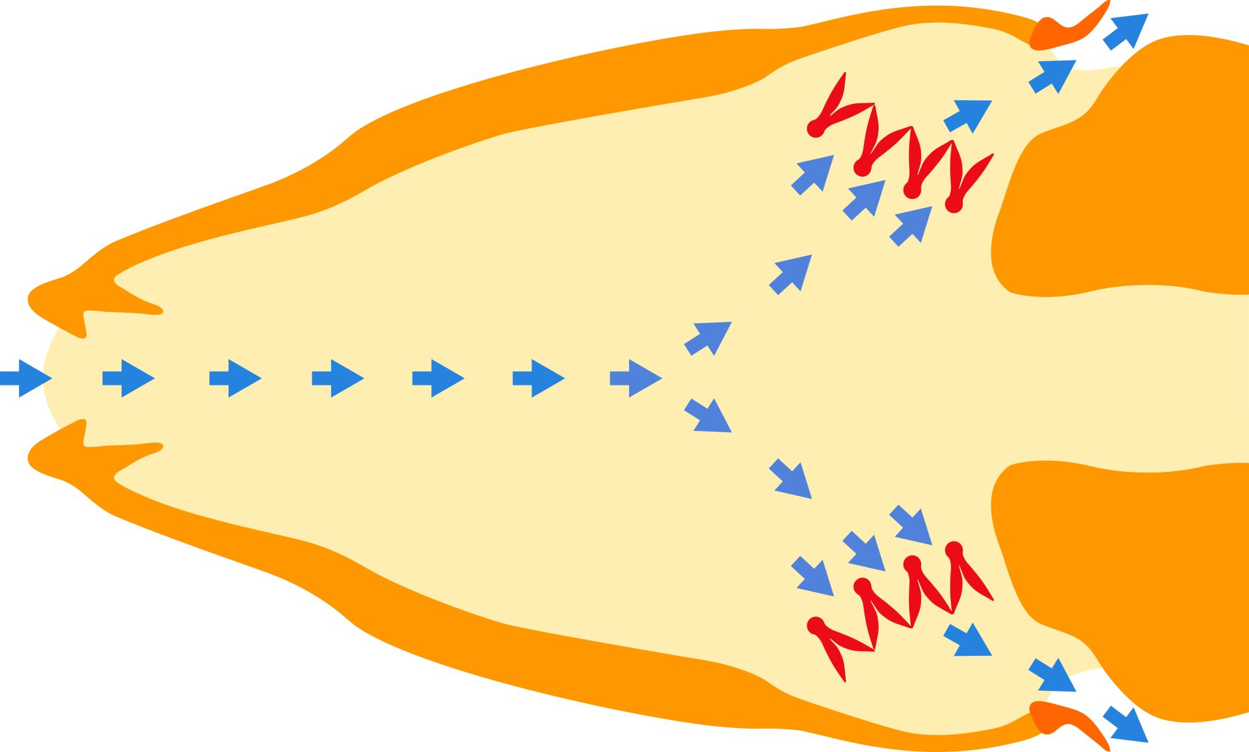
RECAP

Slide 33
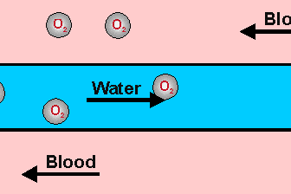
How do fish maintain a concentration gradient with the water?
Countercurrent flow
Water moving through the gills and in the blood flow in different directions.
This maintains a steep concentration gradient
Allows bony fish to remove up to 80% of the oxygen flowing over the gills

Slide 34
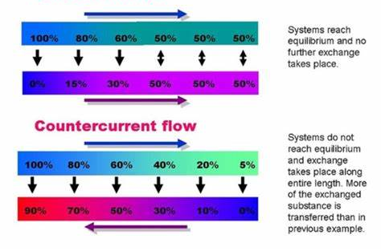
Parallel system

Slide 35
What happens to a shark if it stops swimming?
MYTH!!.....Kind of!

Slide 36
How Do Sharks Breathe? | SHARK ACADEMY - YouTube

Slide 37
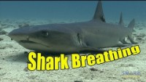

Slide 38
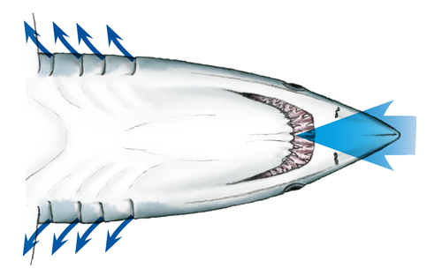
Primitive cartilaginous fish
Do not contain a sophisticated gas exchange system
They simply keep moving to force the water through the gills
This is called ram ventilation
They also use a parallel system so only utilise around 50% of the oxygen from the water – concentration gradient is not as steep

Slide 39
OPEN REVISION PPt
Pass out the card – quick quiz

Slide 42
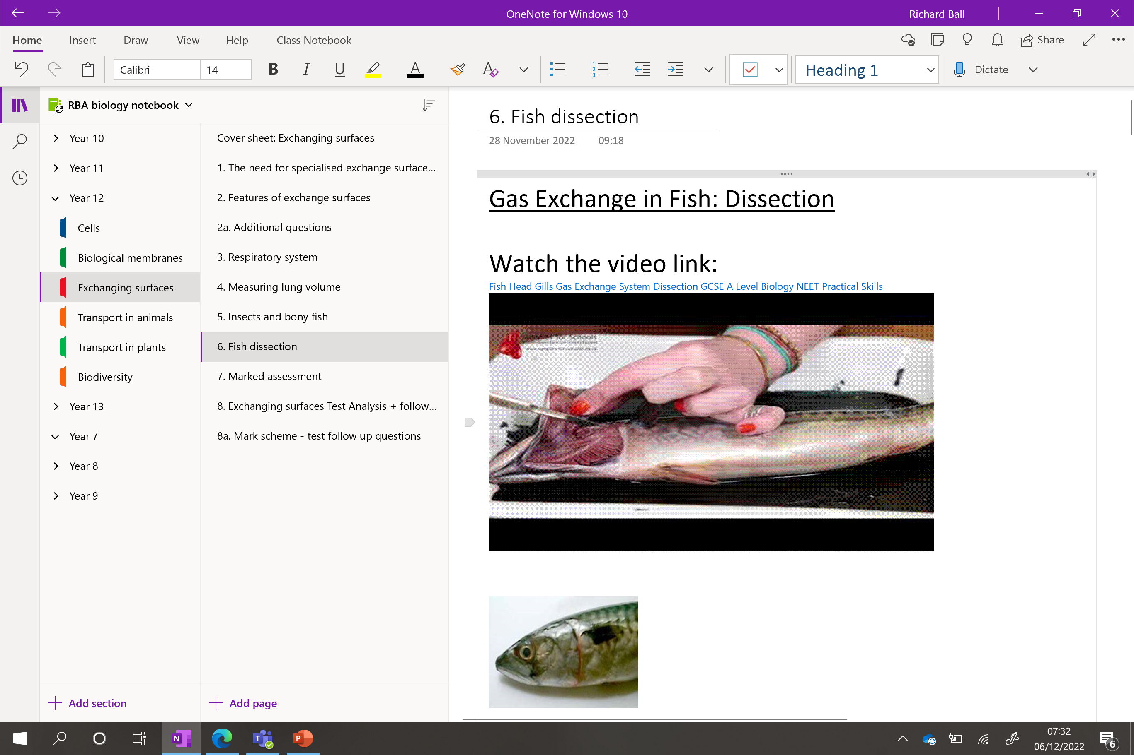

Slide 43
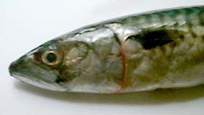
Fish dissection
Uh Oh
Watch video next slide
Follow method on fish dissection notebook page

Slide 44
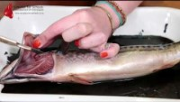

Slide 45
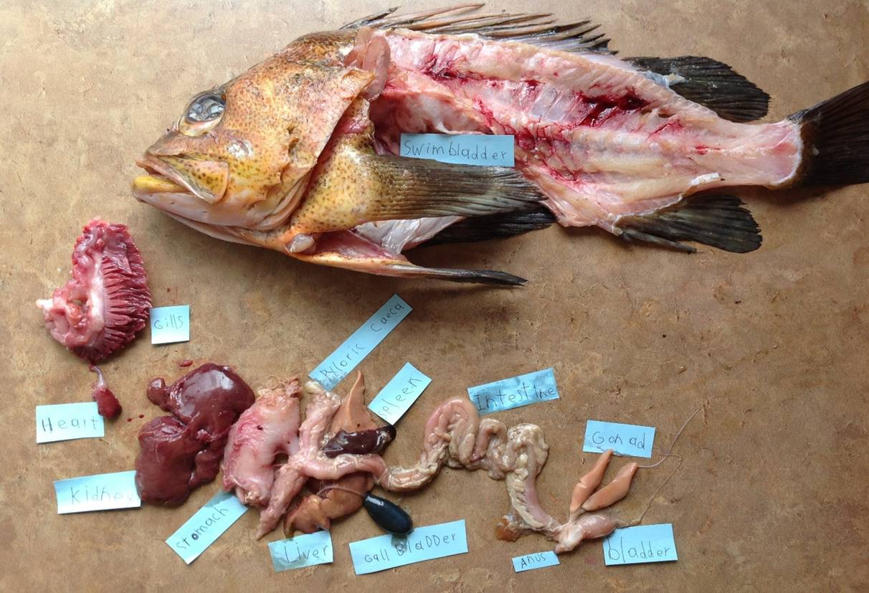

Slide 46
When done
Complete the insect and bony fish additional questions
Any of the additional questions from the end of any lesson in the unit

Slide 47
Learning Outcomes
Identify the organs in an insect and a bony fish that control gas exchange.
Apply your knowledge of gas exchange to fish and insects.

Slide 48
Questioning your thinking…
Fish cannot survive out of water because their gills collapse. Explain why they cannot survive in these conditions.
Explain why there are many filaments and lamellae in fish gills.
Sharks do not have an operculum and some have lost their ability to pump water through the buccal cavity. Explain why these sharks will drown if they stop moving.
Why do insects have a separate tracheal system instead of relying on blood to transport oxygen around the body?
Explain why the tracheal fluid is withdrawn into the body when the tissue is very active.

Slide 49
ANSWERS
Gill collapses out of water, so surface area exposed to air is small – insufficient to allow enough gaseous exchange. Eventually the gills will dry out.
To increase the surface area for gaseous exchange.
Buccal pump and operculum flap pump water over the gills. If the fish is unable to pump water, then the flow will stop if fish stops moving. All the oxygen in the water in the gills will be used up.
4. With an open circulation, an insect cannot easily direct the flow of blood to the tissues that need it most; the flow is also affected by body movements. Using separate air-filled tubes allows development of a system that can bring more air to the tissues that need it. If the insect relies on diffusion to some extent, the oxygen can diffuse more quickly through air than through blood fluid.
Oxygen can diffuse through the walls at the end of the tracheoles into the tissue fluid, withdrawing fluid from the end of the tube increases the surface area over which exchange can occur.

Slide 50
