Slide 1
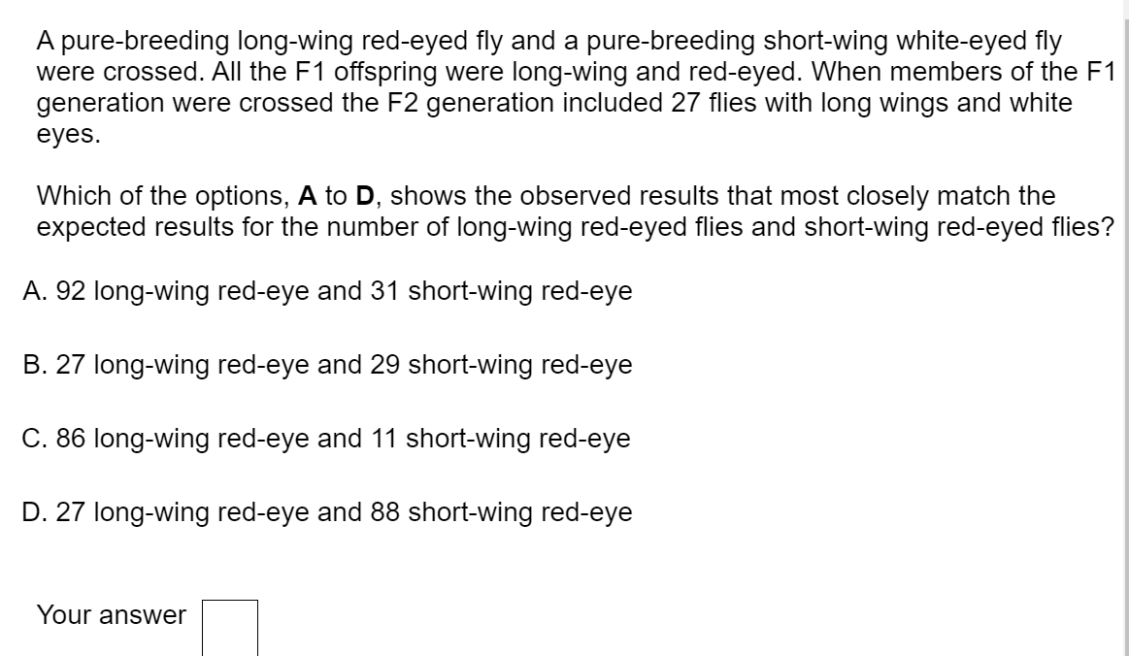
Prove to me that you've cracked it!
A

Slide 2

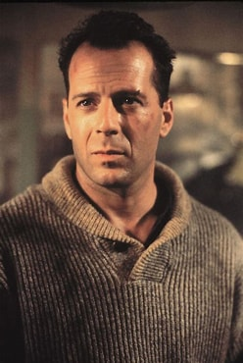
Epistasis
Epistasis – when one gene masks or supresses the expression of another
Classic example –Widow’s peak
Widow’s peak is a V shaped hair growth.
In humans, gene 1 controls Widow’s peak, gene 2 controls baldness.
If you have the gene for baldness, then it doesn’t matter if you have the gene for Widow’s peak as you have no hair!
The baldness gene ‘masks’ the Widow’s peak gene

Slide 3
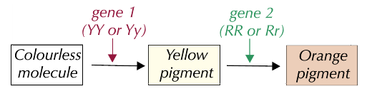
Recessive epistatic alleles example – flower colour
Gene 1 codes for a yellow pigment (Y) and gene 2 codes for an enzyme that turns the yellow pigment orange (R)
If you don’t have the dominant Y it doesn’t matter if you have the R allele as the flower will be white. Gene 1 is epistatic to gene 2 as it can mask the expression of gene 2.
Crossing homozygous parents will give a 9:3:4 (orange: yellow: white) phenotypic ratio in the F₂ generation

Slide 4
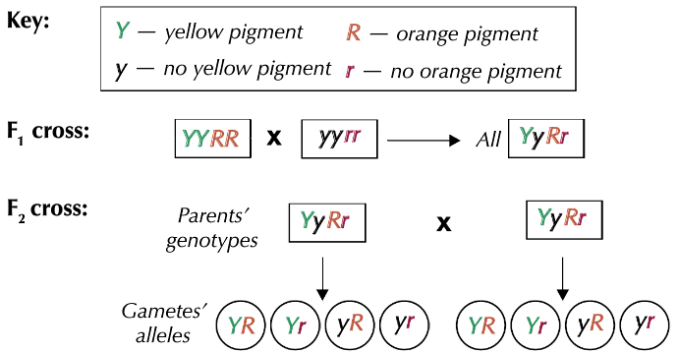
Work out the gamete alleles

Slide 5
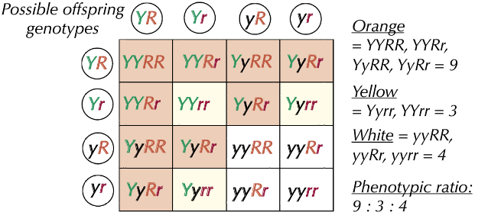
Possible offspring

Slide 6
Dominant epistatic alleles
If the epistatic allele is dominant, then having one copy of it will mask the expression of the other gene.
Crossing homozygous parents will result in a 12:3:1 phenotypic ratio in the F₂ generation

Slide 7
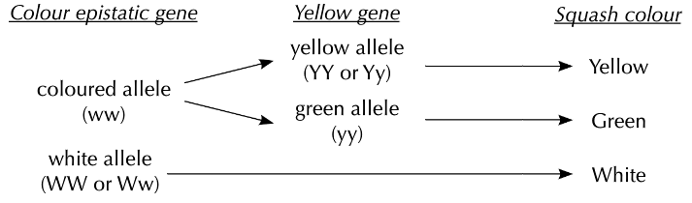
Squash colour
The no-colour white allele (W) is dominant over the colour allele (w)
The yellow allele (Y) is dominant over the green allele (y)
If the plant has at least one W it will be white

Slide 8
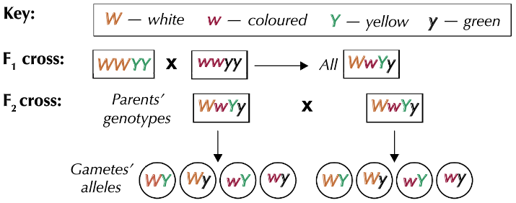
Complete the cross.

Slide 9
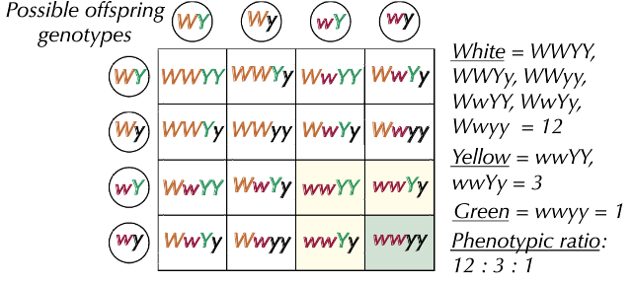
Possible offspring

Slide 10
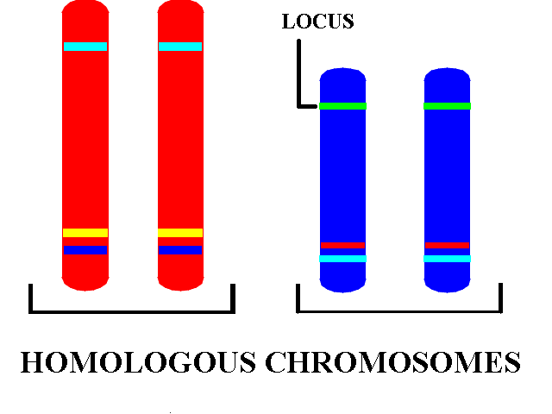
The locus
The locus of a gene is its position on the chromosome. If you look at homologous chromosomes, they will have the same gene at the same locus. They may have different alleles for the gene at the same locus.
Genetic linkage is the tendency of alleles that are located close together on a chromosome to be inherited together during meiosis (the production of gametes) phase of sexual reproduction.
The closer genes loci are to each other the less likely crossing over is to have happened between the loci and therefore the more likely those genes are to be inherited together and there fore we say these genes are linked.

Slide 11
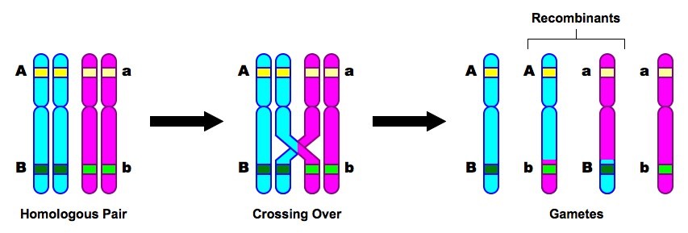
Linked genes can only be separated if crossing over occurs (chiasmata) during meiosis.
The chromosomes which crossed over and no longer have the original genes ‘linked’ and have a new combination of alleles are now called recombinants.

Slide 12
Fast recall questions
What is the probability of having a female child?
Some characteristics are sex- linked, what does this mean?
Why are X linked disorders more common in males than females?
What is an autosome?
Why are genes on the same autosome said to be linked?
50%
Allele for the characteristic is on a sex chromosome (X or Y)
Males only have one X chromosome and express the characteristic on that chromosome whether it is dominant or recessive
A chromosome that is not a sex chromosome
Stay together during independent assortment of chromosomes during meiosis I (unless crossing over splints them up first)

Slide 13
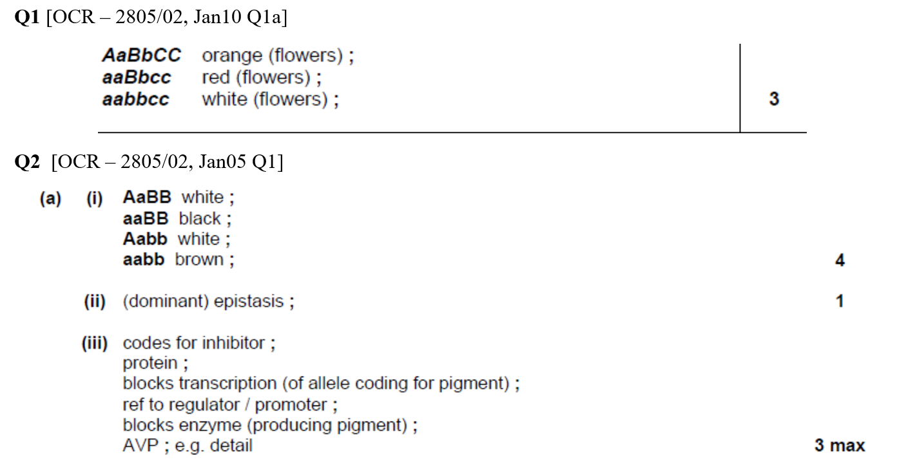
Complete practice questions

Slide 14
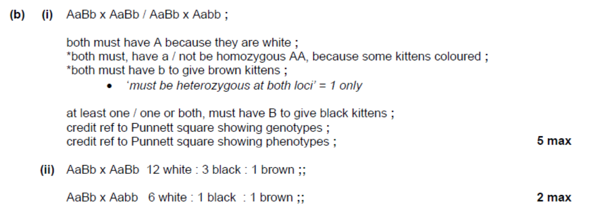

Slide 15
