Slide 1
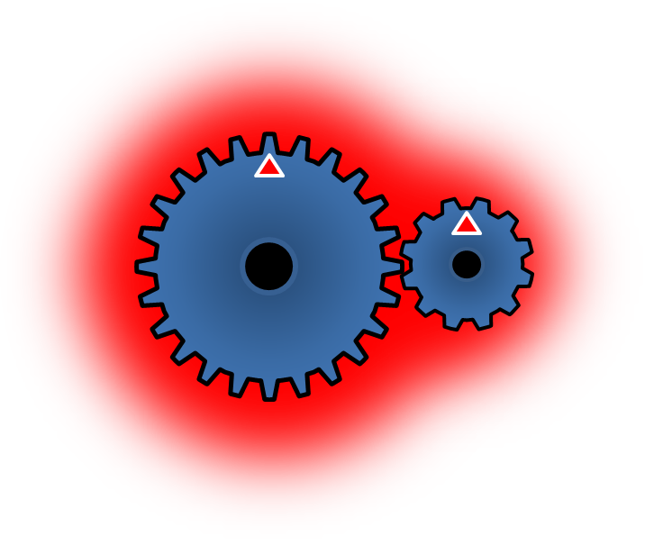
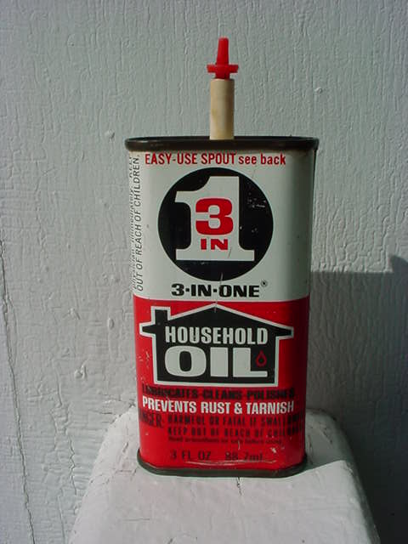
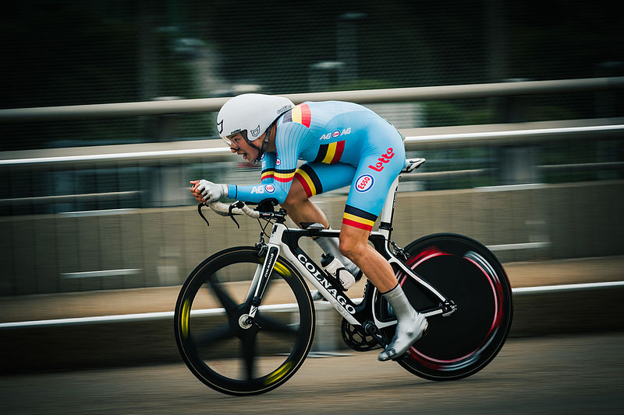
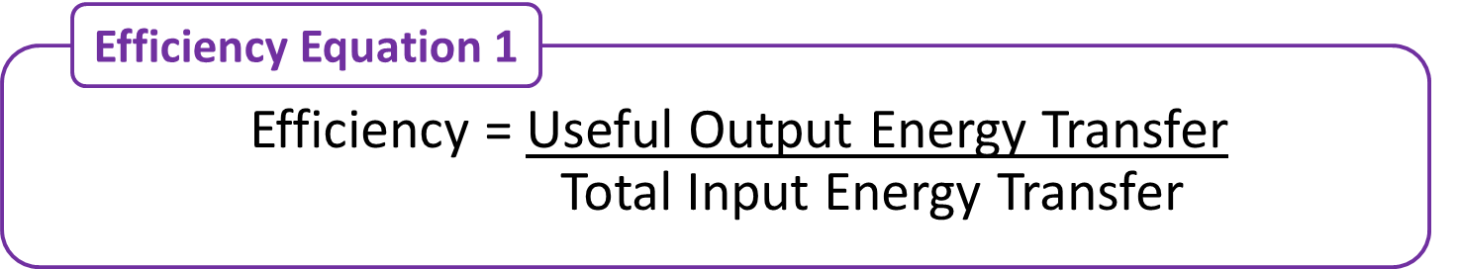
No-Prep Complete Lesson
GCSE Science / Physics
Efficiency (Energy Topic)
35+ Slides No-Prep Lesson
Ideal for non-Physicists
Worked Examples.
Exam Style Questions
Answers
Animated Diagrams

Slide 2
Teacher Notes
This lesson covers all of AQA GCSE Physics 4.1.2.2 (Combined Science 6.1.2.2).
The second section of the lesson is higher tier only, however I think it very much reinforces learning from the “useful and wasted energy” lesson and the from the first section of this lesson, and so I would recommend you teach this to all students regardless of tier.
The final exam style question (Q3) relates to the higher tier portion of the lesson.

Slide 3
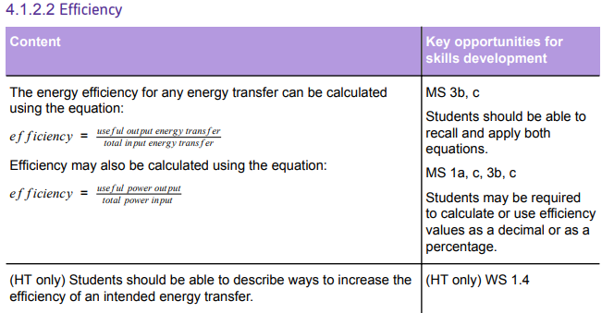
Key: Items in a green box are covered in this lesson.

Slide 4
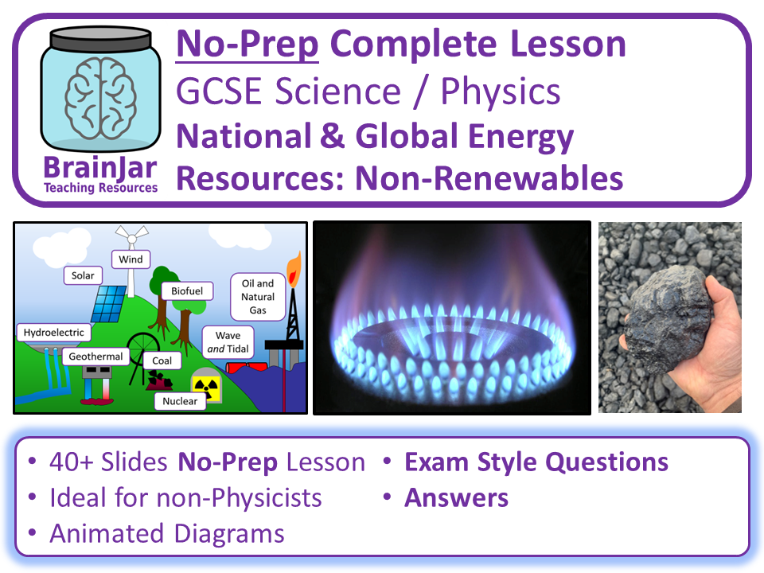
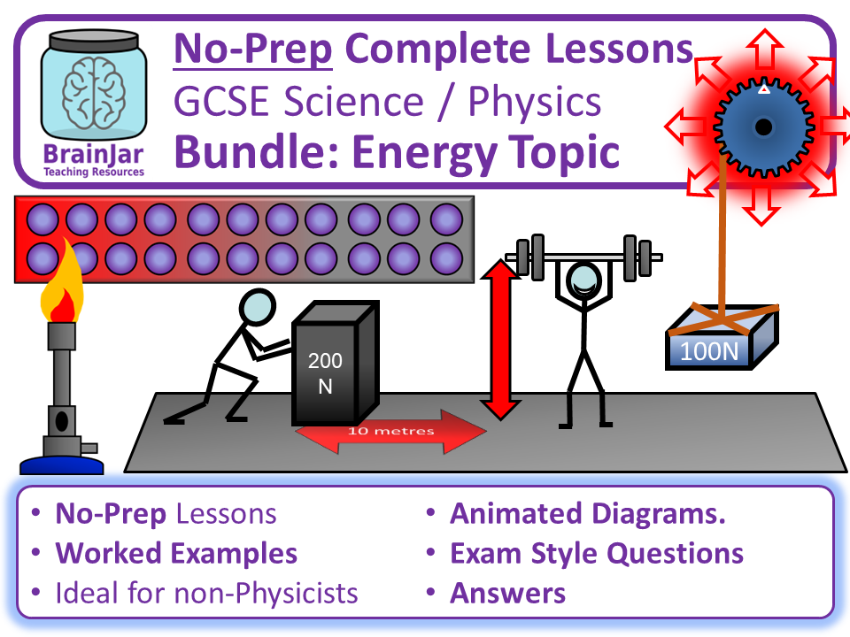
If you enjoyed this resource please leave a review and check out the other resources in my TES shop!
Click here for more: BrainJar's Shop - Teaching Resources – TES
Next Lesson
Discounted Topic Bundle
Twitter: @brainjarscience Facebook: @brainjarscience Email: brainjardovey@gmail.com

Slide 5
30 September 2025
Energy Efficiency
What word would you use for the following descriptions?
  Energy that is transferred to the object and energy store we want it to be.
  Energy that is not transferred usefully.
  Energy that has spread out into the surroundings and is therefore wasted.
Think about the gears in a cars gearbox. Not all of the energy in the kinetic energy store of the gears will be usefully transferred to the wheels. Explain why this happens and what happens to the rest of the energy.
Suggest how we could increase the proportion of energy supplied to the gears that is transferred usefully.
In some houses water is heated and stored in a hot water tank. Suggest how we could reduce the amount of energy wasted in this situation.
Starter

Slide 6
Answers
What word would you use for the following descriptions?
  Energy that is transferred to the object and energy store we want it to be. Useful.
  Energy that is not transferred usefully. Wasted.
  Energy that has spread out into the surroundings and is therefore wasted. Dissipated.
Think about the gears in a cars gearbox. Not all of the energy in the kinetic energy store of the gears will be usefully transferred to the wheels. Explain why this happens and what happens to the rest of the energy. Friction as the gears rub against each other causes them to get hot because kinetic energy is being transferred to the thermal energy store. This will be dissipated / transferred to the thermal store of the surroundings.
Suggest how we could increase the proportion of energy supplied to the gears that is transferred usefully. Use lubrication.
In some houses water is heated and stored in a hot water tank. Suggest how we could reduce the amount of energy wasted in this situation. Insulate the tank.

Slide 7
Lesson Focus and Learning Objectives
Lesson Focus:
How can we compare different machines to see which transfers more energy usefully?
Learning Objectives (To Be Able To…):
Calculate the efficiency of an energy transfer presenting your answer as a decimal or percentage.
Explain how we can reduce unwanted energy transfers and therefore increase efficiency.

Slide 8
What We Already Know
So far we have learned:
Energy can be transferred usefully, stored or dissipated, but cannot be created or destroyed.
Useful energy: Energy that is transferred to the object and energy store we want it to be.
Wasted energy: Energy that is not transferred usefully.
Dissipated: Energy that has spread out into the surroundings (usually into the thermal energy store). When this happens energy is wasted.

Slide 9
What We Will Learn Today
In this lesson we will focus on how good different devices (e.g. a car engine) are at transferring energy usefully and wasting as little as possible.
This is called efficiency.

Slide 10

Our lifting machine has 250 J of energy transferred to it.
The machine lifts the box, increasing its GPE store by 200 J.
The machine gets hot.
How much energy has been wasted?
Where has the wasted energy gone?

Slide 11
Useful and Wasted Energy
Because we know that energy cannot be created or destroyed, we can tell that:
In the case of the lifting machine, the total energy input was 250 J and 200 J of that was transferred usefully:
250 J = 200 J + Wasted Energy
Therefore 50 J must have been wasted.
The wasted energy was dissipated and ended up in the thermal energy store of the surroundings.
Total Input Energy Transfer
=
Useful Output Energy Transfer
+
Wasted Output Energy Transfer
This is not an equation that the exam specification says you need to learn but it is very useful so I suggest that you do!

Slide 12
This machine has 250 J of energy transferred to it.
It uses 200 J of the energy to lift the box, increasing the GPE store of the box by 200 J.
We now know that 50 J of energy is wasted as the machine gets hot because of friction.
How could we express how good this machine is at its job?

Slide 13
Efficiency Equation 1
Efficiency Equation 1
Efficiency = Useful Output Energy Transfer
Total Input Energy Transfer
Efficiency has no units.
Both useful output energy transfer and total input energy transfer are measured in joules (J)
You need to memorise this equation!

Slide 14
Efficiency Equation 2
Efficiency Equation 2
Efficiency = Useful Power Output
Total Power Input
Efficiency has no units.
Both useful power output and total power input are measured in watts (W)
You need to memorise this equation!

Slide 15
Efficiency Equations
Both equations will give you an answer that is a decimal e.g. 0.5.
You might also need to calculate efficiency as a percentage.
To do this multiply your decimal by 100.
For example: 0.5 x 100 = 50%
The efficiency equations tell you what proportion (or percentage) of the energy transferred to a machine is transferred usefully.
So if you calculate efficiency to be 75% then you know that 75% of the input energy to a machine is being usefully transferred.
Of course the other 25% must be being wasted.

Slide 16
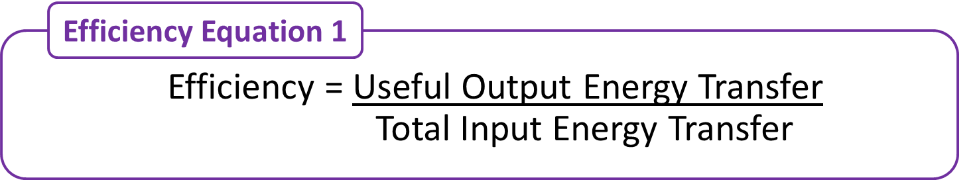
Worked Example
We decide to buy a new lifting machine. When 300 J of energy is transferred to the machine it can be used to increase the GPE store of an object it lifts by 240 J. Calculate its efficiency, giving it as a decimal and as a percentage.
Step 1: Write out the equation:
Efficiency = Useful Output Energy Transfer
Total Input Energy Transfer
Step 2: Insert the numbers we have:
Efficiency = 240 J
300 J
Step 3: Calculate:
Efficiency = 0.8
As a percentage: 0.8 x 100 = 80%
Conclusion:
Our new machine has an efficiency of 0.8 or 80%
This means it transfers 80% of the energy supplied to it (the input energy) usefully.
The other 20% is wasted because it is dissipated to the surroundings.

Slide 17
Efficiency Limits
Efficiency can never be greater than 1 (as a decimal) or 100% (as a percentage).
An efficiency of more than 1 or 100% would mean that useful output energy was greater than total input energy so you had somehow created energy. As we know, it is not possible to create (or destroy) energy.
Top Tip: If you get an answer greater than 1 or 100% then you’ve done it wrong so try again!
Example Incorrect answer:
Efficiency = Useful Output Energy Transfer
Total Input Energy Transfer
Efficiency = 110 J
100 J
Efficiency = 1.1 or 110% Remember this is an incorrect answer!

Slide 18
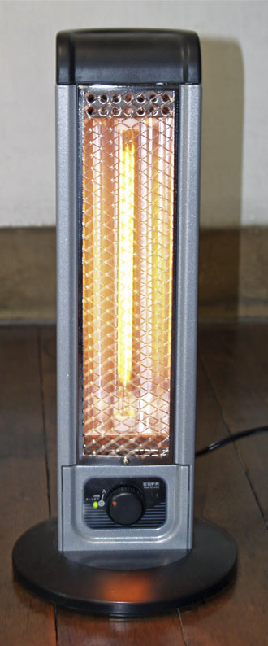
Efficiency Limits
An efficiency of more than 1 or 100% is always impossible.
However an efficiency of exactly 1 or 100% is also very unlikely.
An efficiency of exactly 1 or 100% would mean that all of the input energy had been transferred usefully.
No energy transfer is perfect – some energy is always wasted and dissipated to the surroundings.
The only situation where we might get an efficiency of 1 or 100% would be a heater. Because its job is to heat up the surroundings it’s not really possible for any of the energy supplied to it to be wasted in the thermal energy store of the surroundings!

Slide 19

Worked Example 2
Now we’ve lifted all our heavy boxes we need to gift wrap them, so we buy a special wrapping machine. It has an efficiency of 0.20 The total power input to the machine is 2.6 W. Calculate the useful power output of the machine.
Step 1: Write out the equation:
I’ve skipped this step to save space, the equation is top right!
Step 2: Insert the numbers we have:
0.20 = Useful Power Output
2.6 W
Step 3: Re-arrange:
0.20 x 2.6 = Useful Power Output
Step 4: Calculate:
Useful Power Output = 0.52 W

Slide 20
Learning Check: Quick Questions
1 minute to discuss with the person next to you, before I choose people at random.
The total amount of input energy must equal…
…useful energy + wasted energy.
State the equation to calculate efficiency using energy transferred.
Efficiency = Useful Output Energy Transfer
Total Input Energy Transfer
State the equation to calculate efficiency using power.
You have calculated the efficiency of an appliance to be 0.75. What is this as a percentage?
Efficiency = Useful Power Output
Total Power Input
75%
You have calculated the efficiency of an appliance to be 1.2. What is this as a percentage?
Trick question! Efficiency cannot be >1 or >100%
You have calculated the efficiency of an appliance to be 60%. What percentage of energy is wasted?
40%

Slide 21
Efficiency
Learning Check: In-Depth Questions
Tasks:
The motor of a toy car is supplied with 200 J of energy which is transferred to 120 J of kinetic energy as it moves across the floor. The motor gets warmer.
  What is the useful energy transfer?
  What is the wasted energy transfer?
  What is the efficiency of the motor? Give your answer as a percentage.
The total power input to a lawn mower is 375 W and the useful power output is 180 W. Calculate the efficiency of the lawn mower.
A hairdryer has an efficiency of 0.82. Calculate the useful output energy transfer when the total input energy transfer is 150 J
A student calculates the efficiency of a machine to be 1.1. Explain why this answer must be wrong.
Extension: We are thinking of buying two brand new lifting machines.
Machine A: Total input power 50 W, wasted output power 5 W
Machine B: Useful output power 95 W, wasted output power 5 W
Which is more efficient?

Slide 22
Answers
The motor of a toy car is supplied with 200 J of energy which is transferred to 120 J of kinetic energy as it moves across the floor. The motor gets warmer.
  What is the useful energy transfer? To the kinetic energy store of the toy.
  What is the wasted energy transfer? To the thermal energy store of the motor / the surroundings.
  What is the efficiency of the motor? Give your answer as a percentage. 60%
The total power input to a lawn mower is 375 W and the useful power output is 180 W. Calculate the efficiency of the lawn mower. 0.48 or 48%
A hairdryer has an efficiency of 0.82. Calculate the useful output energy transfer when the total input energy transfer is 150 J 123 J
A student calculates the efficiency of a machine to be 1.1. Explain why this answer must be wrong. Efficiency cannot be greater than 1 (or 100%) because this would mean that useful output energy was greater than input energy (1). It is impossible to create energy (1).
Extension: Machine A efficiency is 0.9. Machine B efficiency is 0.95. Machine B is more efficient.

Slide 23
Extension Task Answers
Extension: We are thinking of buying two brand new lifting machines.
Machine A: Input power 50 W, wasted output power 5 W
Machine B: Useful output power 95 W, wasted output power 5 W
Which is more efficient?
Machine A efficiency is 0.9 (because Useful Output Power 45 W)
Machine B efficiency is 0.95 (because total input power is 100 W)
Machine B is more efficient.

Slide 24
Increasing Efficiency
Higher Tier Only

Slide 25
Increasing Efficiency
Let’s go back to the first equation we saw today.
If we want to increase efficiency we need to reduce the wasted output energy transfer.
This will automatically increase the useful output energy transfer.
Total Input Energy Transfer
=
Useful Output Energy Transfer
+
Wasted Output Energy Transfer

Slide 26
Increasing Efficiency
So to increase efficiency we need to increase the useful output energy by reducing the amount of energy that is wasted.
Usually this means reducing the amount of energy transferred to the thermal energy store of the surroundings (i.e. wasted as heat).
Increasing efficiency means making this number bigger!
Efficiency Equation 1
Efficiency = Useful Output Energy Transfer
Total Input Energy Transfer

Slide 27
Increasing Efficiency
For higher tier you need to be able to describe ways to increase the efficiency of an energy transfer.
As we have shown, this means reducing wasted energy transfers and therefore increasing useful energy transfers.
But how exactly do we do that?
You could be given a number of scenarios and asked to describe how efficiency could be increased.

Slide 28
Increasing Efficiency
Solution: Lubrication such as oil can be used to reduce friction.
Problem: Friction between moving parts wastes energy.
This is because energy is transferred to the thermal energy store of the machinery (and eventually dissipated to the surroundings).

Slide 29
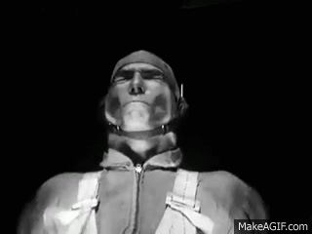
Increasing Efficiency
Solution: Streamlining can reduce air resistance.
This cyclist’s posture, helmet, and even the design of his wheels are designed to reduce air resistance by being streamlined.
Problem: Air resistance (a type of friction) wastes energy by transferring it to the surroundings.
This man is in a wind tunnel where the effect of air resistance can be tested.

Slide 30
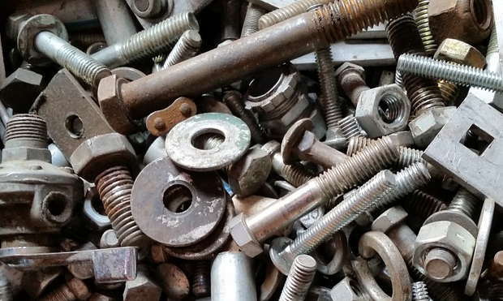
Increasing Efficiency
Solution: Tighten loose parts!
Problem: Sound from loose parts moving transfers energy to the surroundings through sound waves (the radiation pathway).

Slide 31
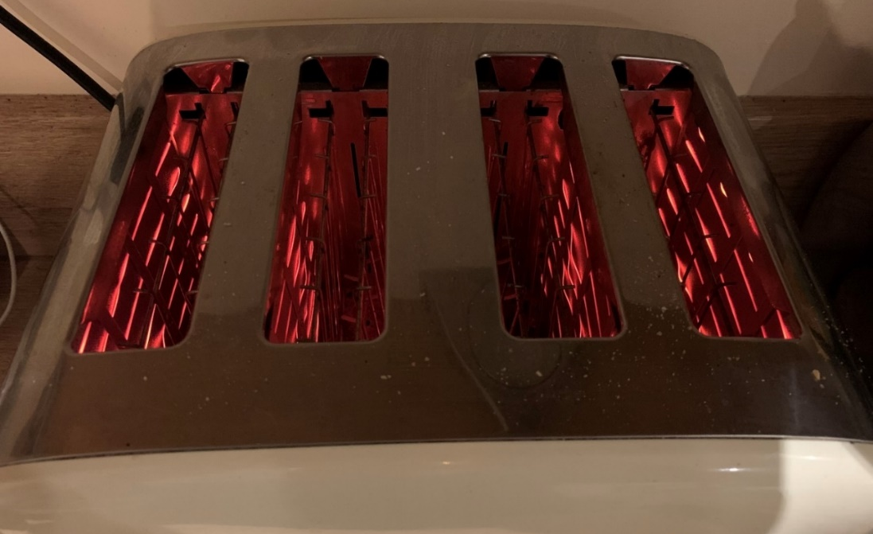
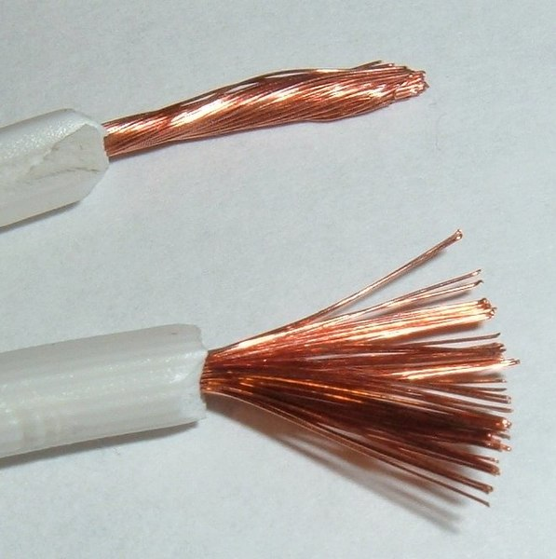
Increasing Efficiency
Solution: Use wires with low resistance or reduce the current.
You will learn more about this in the electricity topic.
Problem: Electrical resistance causes wires to heat up, transferring energy to the thermal energy stores of the surroundings.
OK, in this picture of a toaster this is useful – because we want a toaster to get hot. However in most situations we do not want wires to get hot!

Slide 32
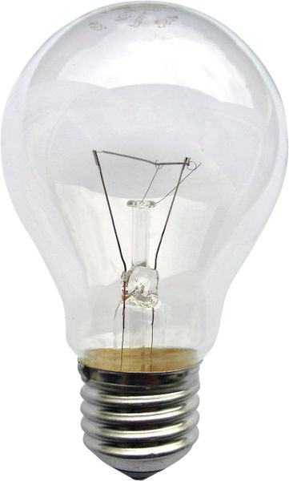
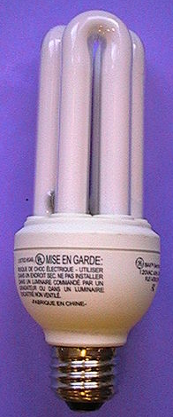
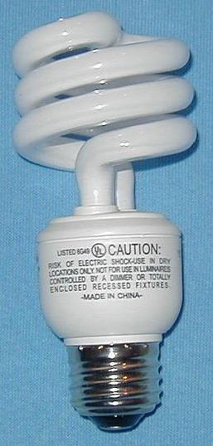
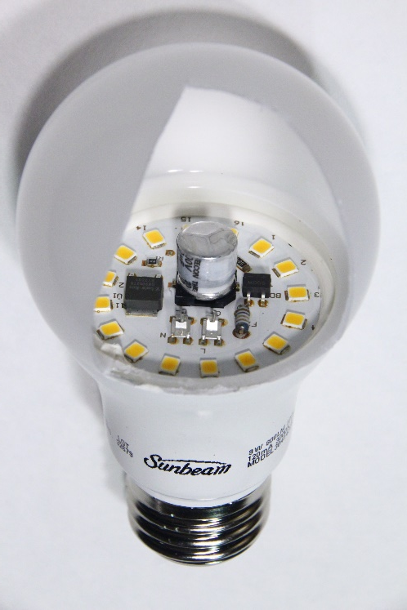
Light Bulb Efficiency
A filament lamp is an “old fashioned” lamp with a thin wire (the filament) that gets hot because of electrical resistance and glows in order to emit light.
This transfers energy to thermal energy store of the surroundings.
These were phased out for more efficient compact fluorescent lamps and now LED lamps which both work in totally different ways and so do not transfer as much thermal energy to the surroundings.
The Filament
Filament Lamp
5% efficient
Compact Fluorescent Lamps
LED Lamp
70% efficient

Slide 33
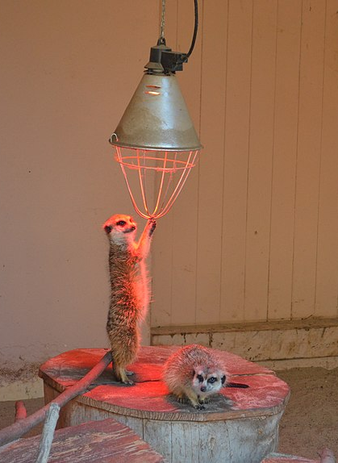
Useful or Wasted?
But remember, whether an energy transfer is useful or wasted depends on what we want to do.
In this case a filament lamp is being used to keep these meerkats warm. Here we want the filament lamp to transfer energy to the thermal store of the surroundings.
So when a filament lamp is used as a light bulb it is not efficient, but when used to warm things up it is efficient! It all depends on whether the energy transfer is useful or not in the specific situation.

Slide 34
Learning Check: Quick Questions
1 minute to discuss with the person next to you, before I choose people at random.
We can increase the efficiency of an energy transfer by reducing…
…the amount of energy that is wasted.
Most energy is wasted because it is transferred to…
…the thermal energy store of the surroundings.
Lubrication is used to reduce…
Air resistance can be reduced through…
…friction between moving parts.
…streamlining.
Energy wasted because of electrical resistance can be reduced by…
…using wires with a low resistance or reducing current.
Tightening loose parts can reduce energy that is wasted because of…
…sound transferring energy to the surroundings.

Slide 35
Increasing Efficiency
Learning Check: In-Depth Questions
Tasks:
A machine has a total energy input of 100 J of which 20 J is wasted. Explain why reducing the amount of energy wasted would increase its efficiency.
Explain why energy is being wasted and how efficiency could be increased for each of the following situations.
  A car engine rattles alarmingly as you drive along.
  When you open the bonnet to find out what is causing the alarming rattle you notice that the gearbox* is very hot.
  A lorry driving along has a completely flat front.
  The back of your TV is warm when you touch it.
Challenge: A machine has an efficiency of less than 0.9. In order to save money we would like it to have an efficiency of 0.9. The useful output energy transfer is 420 J and the total input energy transfer is 525 J.
What is the current efficiency?
How much would we need to reduce the wasted energy by in order to reach 90% efficiency?
* I know, you wouldn’t really be able to see the gearbox if you opened the bonnet.

Slide 36
Answers
A machine has a total energy input of 100 J of which 20 J is wasted. Explain why reducing the amount of energy wasted would increase its efficiency.
If we reduce the wasted energy output then the useful energy output will increase because Total Energy Input = Useful + Wasted Energy
This would increase the useful output energy transfer in the equation:
Efficiency = Useful Output Energy Transfer / Total Input Energy Transfer.
While the total input energy transfer would not change. Therefore efficiency would be greater.
Explain why energy is being wasted and how efficiency could be increased for each of the following situations.
  A car engine rattles alarmingly as you drive along. Sound transfers energy to the surroundings. Tighten the loose parts.
  When you open the bonnet to find out what is causing the alarming rattle you notice that the gearbox is very hot. Friction between moving parts transfers energy to the thermal energy store of an object and so to the surroundings. Use lubrication.
  A lorry driving along has a completely flat front. Air resistance transfers energy to the surroundings. Streamline the lorry.
  The back of your TV is warm when you touch it. Electrical resistance causes wires to heat up which eventually transfers energy to the surroundings. Use wires with a lower resistance (or reduce the current).

Slide 37
Answers
Challenge: A machine has an efficiency of less than 0.9.
In order to save money we would like it to have an efficiency of 0.9.
The useful output energy transfer is 446.25 J and the total input energy transfer is 525 J.
How much would we need to reduce the amount of wasted energy by in order to reach an efficiency of 0.9
Current amount of energy wasted (525 – 446.25) = 78.75 J
To reach 0.9 efficiency:
  0.9 = Useful Output Energy Transfer / 525
  0.9 x 525 = Useful Output Energy Transfer
  472.5 J = Useful Output Energy Transfer
  Therefore we would need Useful Output Energy Transfer to be 472.5 J
This means that wasted energy would need to be (525 – 472.5 =) 52.5
Therefore we would need to reduce wasted energy transfer by (78.75 – 52.5 =) 26.5 J

Slide 38
Exam Style Questions
Please mark this in your book as
“exam questions”

Slide 39
1
An athlete is making a smoothie using a smoothie maker. The total power input to the motor is 250 W. The useful power output is 150 W.
Calculate the percentage efficiency of the motor in the smoothie maker. [3 marks]
Calculate how much power is wasted by the motor in the smoothie maker [1 mark]
How does energy wasted by the smoothie maker affect the temperature of the surroundings? [1 mark]
Efficiency = 150 ÷ 250 (1)
Efficiency = 0.6 (1)
0.6 x 100 = 60% (1)
100 W
Increased

Slide 40
2
A student is comparing two motors used to lift weights using a system of gears and pulleys.
The efficiency of the first motor was 12%. The useful output energy transfer was 1.80 J. Calculate the total input energy transfer. [4 marks]
The second motor has an efficiency of 0.15. The total input energy transfer to it is 20 J. Calculate the useful output energy transfer. [3 marks]
12% = 0.12 (1)
0.12 = 1.80 ÷ total input energy transfer (1)
Total input energy transfer = 1.80 ÷ 0.12 (1)
Total input energy transfer = 15.0 J (accept 15) (1)
4 marks for correct answer no working
0.15 = useful output energy transfer ÷ 20 (1)
0.15 x 20 = useful output energy transfer (1)
Useful output energy transfer = 3 J (1)

Slide 41
3
A group of students have entered a competition to make the most efficient toy car. Each car will be powered by a small battery connected to a motor which drives the wheels of the vehicle through a series of gears. Each toy car will travel along a track. The toy car that travels the furthest will win the competition.
Describe what is meant by “efficient” [1 mark]
Suggest three ways that the team of students could improve the efficiency of their toy car [3 marks].
A larger / higher percentage / proportion of of the (total) energy / power input is usefully transferred
Reduce friction / use lubrication on the gears.
Reduce air resistance / streamline the shape of the car.
Reduce electrical resistance / use low resistance wires between the battery and the motor.
Reduce energy transfers due to sound / ensure there are no loose parts

Slide 42
Self-Evaluation

Slide 43
Lesson Focus and Learning Objectives
Lesson Focus:
How can we compare different machines to see which transfers more energy usefully?
Learning Objectives (To Be Able To…):
Calculate the efficiency of an energy transfer presenting your answer as a decimal or percentage.
Explain how we can reduce unwanted energy transfers and therefore increase efficiency.

Slide 44
Self-Evaluation
Lesson Focus: How can we compare different machines to see which transfers more energy usefully?
Calculate the efficiency of an energy transfer presenting your answer as a decimal or percentage.
Explain how we can reduce unwanted energy transfers and therefore increase efficiency.
For each of the learning objectives, rate your progress towards completing them using Red, Amber or Green.
If you are green in every area then what has helped you / what have you done to make you successful?
If you are Amber or Red what do you need to know, do, or be helped with, in order to make you green?

