Slide 1


AS Economics
Supply
For more help, please visit www.exampaperspractice.co.uk
© 2025 Exams Papers Practice. All Rights Reserved

Slide 2
Theory of Supply
Supply is the quantity of a good or service that producers are willing and able to supply at a given price.
For more help, please visit www.exampaperspractice.co.uk
© 2025 Exams Papers Practice. All Rights Reserved

Slide 3
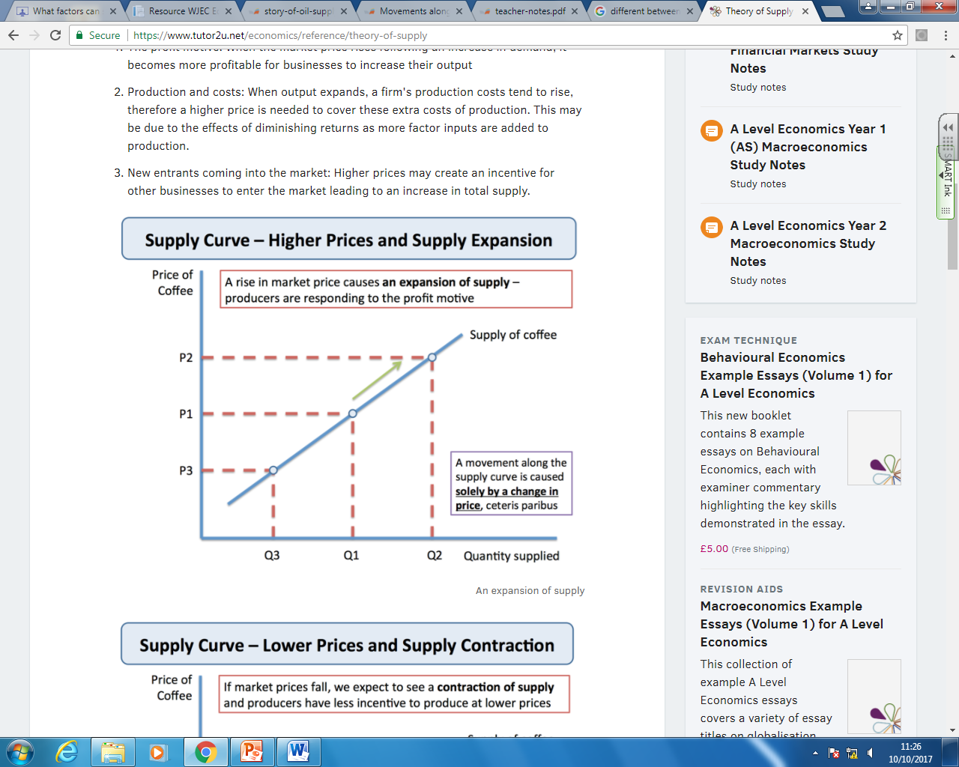
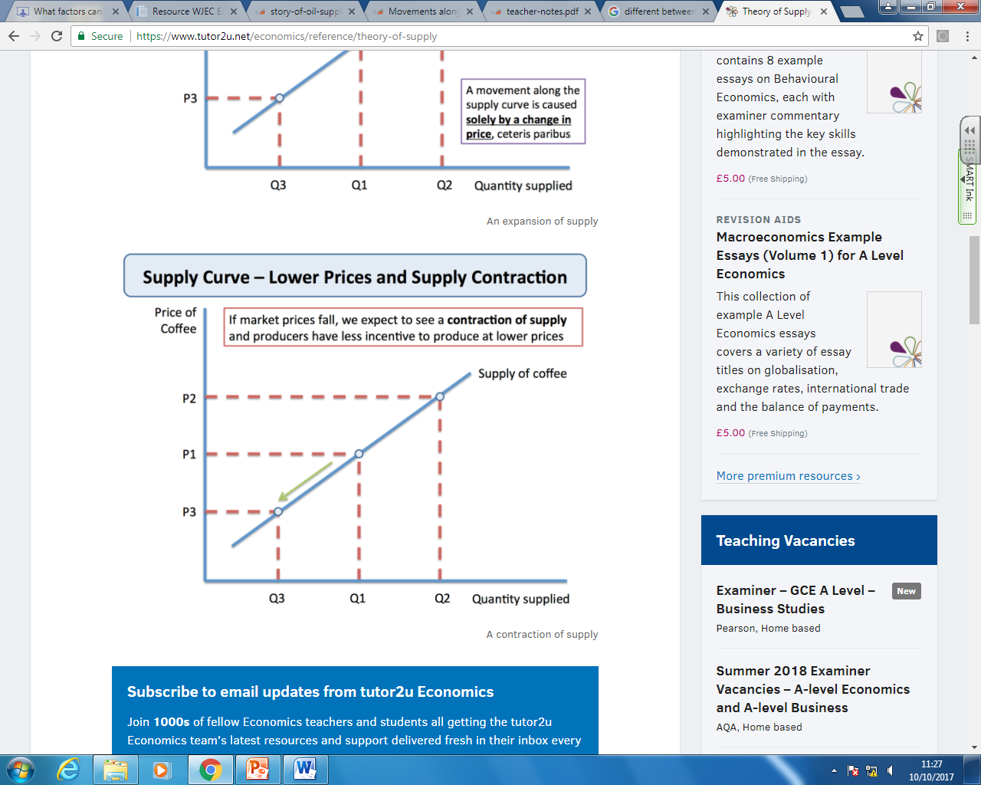
Theory of Supply
For more help, please visit www.exampaperspractice.co.uk
© 2025 Exams Papers Practice. All Rights Reserved

Slide 4
Theory of Supply
The supply curve is upward sloping from left to right –
When the price is higher, producers will expand their production.
When the price is lower, producers will contract their production.
For more help, please visit www.exampaperspractice.co.uk
© 2025 Exams Papers Practice. All Rights Reserved

Slide 5
Theory of Supply
A change in price will cause a movement either up or down the same supply curve.
However the following factors may cause the curve to shift:
For more help, please visit www.exampaperspractice.co.uk
© 2025 Exams Papers Practice. All Rights Reserved

Slide 6

Shifts in the supply curve
1. Changes in the cost of production
A rise in the cost of production will shift the supply curve to the left. This could occur due to a rise in the price of raw materials, or a firm having to pay higher wages to its workers.
A fall in the costs of production will shift the supply curve to the right. The business is willing and able to supply more at every price level.
For more help, please visit www.exampaperspractice.co.uk
© 2025 Exams Papers Practice. All Rights Reserved

Slide 7

Shifts in the supply curve
2. Changes in the productivity of factors of production
Increased productivity of a factor of production means that a company will get more output from a unit of factor input.
Improvements in technology can improve productivity and reduce costs of production.
As a result the supply curve will shift right.
For more help, please visit www.exampaperspractice.co.uk
© 2025 Exams Papers Practice. All Rights Reserved

Slide 8

Shifts in the supply curve
3. Taxes
A tax is a charged placed on the production of a good or service by the government.
A tax will effectively increase in the cost of production for the producer. This will reduce the quantity the firm is willing and able to supply at any given price.
For more help, please visit www.exampaperspractice.co.uk
© 2025 Exams Papers Practice. All Rights Reserved

Slide 9

Shifts in the supply curve
4. Subsidies
A subsidy is a payment of money by the government to a producer in order to encourage them to produce or supply a certain good or service.
A subsidy will effectively reduce costs of production for the producer, and so will increase supply.
For more help, please visit www.exampaperspractice.co.uk
© 2025 Exams Papers Practice. All Rights Reserved

Slide 10
Shifts in the supply curve
5. Changes to the price of other goods
If the price of Good A increases, then a firm may switch production from Good B to increase production of Good A.
This will lead to a fall in supply of Good B, as the firm tries to take advantage of the higher price level for Good A.
For more help, please visit www.exampaperspractice.co.uk
© 2025 Exams Papers Practice. All Rights Reserved

Slide 11
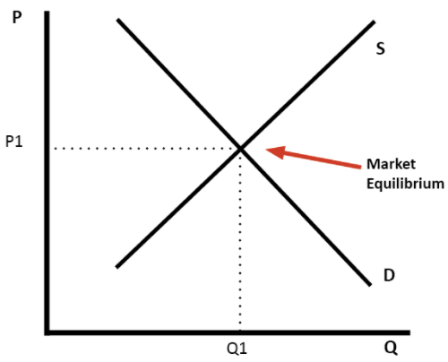
Market Equilibrium
Market: Any place where buyers and and sellers come together to exchange goods/services.
Equilibrium: When Demand = Supply in a market
For more help, please visit www.exampaperspractice.co.uk
© 2025 Exams Papers Practice. All Rights Reserved

Slide 12
Market Equilibrium
If the price if £10, buyers will not buy any goods. Sellers will wish to supply 10 million units.
Supply is greater than demand and therefore there will be excess supply.
If the price if £2, demand will be 12 million units, but only 2 million units will be supplied.
Demand is greater than supply and therefore there is excess demand.
For more help, please visit www.exampaperspractice.co.uk
© 2025 Exams Papers Practice. All Rights Reserved

Slide 13
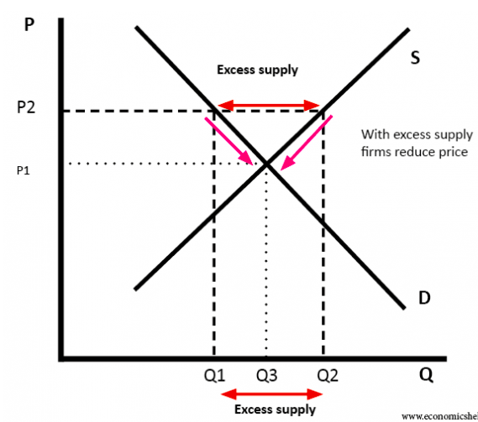
In a free market, disequilibrium will never last. The invisible hand of the price mechanism will guide us to equilibrium.
If there is excess supply:
A signal is sent to producers that the price is too high
This acts as an incentive for producers to lower the price (so they can make profit)
There will be a contraction along supply and an extension of demand
We are back at equilibrium – excess supply has been rationed away
For more help, please visit www.exampaperspractice.co.uk
© 2025 Exams Papers Practice. All Rights Reserved
Notes:
A signal is excess stock or excess resources

Slide 14
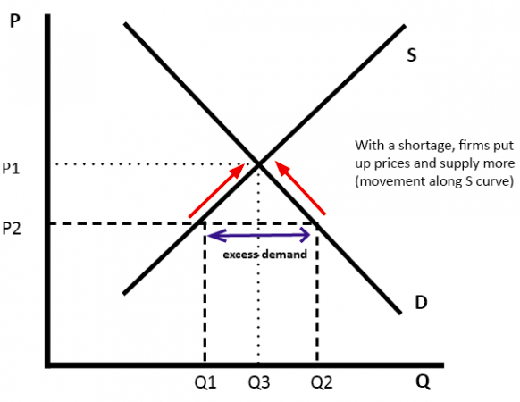
In a free market, disequilibrium will never last. The invisible hand of the price mechanism will guide us to equilibrium.
If there is excess demand:
A signal is sent to producers that the price is too low
This acts as an incentive for producers to increase the price (so they can make profit)
There will be an extension along supply and a contraction of demand
We are back at equilibrium – excess demand has been rationed away
For more help, please visit www.exampaperspractice.co.uk
© 2025 Exams Papers Practice. All Rights Reserved
Notes:
Signal – huge queues or waiting lists

Slide 15
Changes in Market Equilibrium
Shifts in demand or supply curves will change the market equilibrium;
Demand Shifts to the Right
Demand Shifts to the Left
For more help, please visit www.exampaperspractice.co.uk
© 2025 Exams Papers Practice. All Rights Reserved

Slide 16
Changes in Market Equilibrium
Shifts in demand or supply curves will change the market equilibrium;
Supply Shifts to the Right
Supply Shifts to the Left
For more help, please visit www.exampaperspractice.co.uk
© 2025 Exams Papers Practice. All Rights Reserved

Slide 17
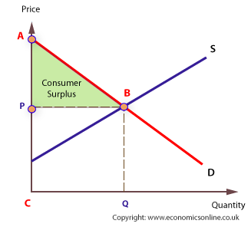
Consumer and Producer Surplus
Consumer surplus is a measure of the welfare that people gain from consuming goods and services.
Consumer surplus is defined as the difference between the amount that consumers are willing and able to pay for a product (indicated by the demand curve) and the total amount that they actually do pay (i.e. the market price).
Consumer surplus is shown by the area under the demand curve and above the price.
For more help, please visit www.exampaperspractice.co.uk
© 2025 Exams Papers Practice. All Rights Reserved

Slide 18
Consumer and Producer Surplus
There are consumers who are willing and able to demand the product at a higher price.
The triangle measures the consumer welfare gain.
For more help, please visit www.exampaperspractice.co.uk
© 2025 Exams Papers Practice. All Rights Reserved

Slide 19
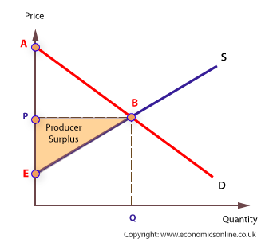
Consumer and Producer Surplus
Producer surplus is a measure of the welfare that firms gain from supplying goods and services.
Producer surplus is the difference between what producers are willing and able to supply a product for
(indicated by the supply curve), and the price they actually receive (i.e. the market price)
Producer surplus is shown by the area above the supply curve and below the market price.
For more help, please visit www.exampaperspractice.co.uk
© 2025 Exams Papers Practice. All Rights Reserved

Slide 20
Consumer and Producer Surplus
There are firms who are willing and able to supply the product at a lower price.
The triangle measures the consumer welfare gain.
For more help, please visit www.exampaperspractice.co.uk
© 2025 Exams Papers Practice. All Rights Reserved

