Slide 1


Demand
Theme 2 Economics
For more help, please visit www.exampaperspractice.co.uk
© 2025 Exams Papers Practice. All Rights Reserved

Slide 2
Expectations
General
No Homework = No lesson
Late = Gated
Behaviour = Gated
Your work
Exercise Books are neat
Assessments uploaded
For more help, please visit www.exampaperspractice.co.uk
© 2025 Exams Papers Practice. All Rights Reserved

Slide 3
Starter
Why are you studying Economics?
What do you know about Economics?
Think of one question you have about the Economy that you want answering!
For more help, please visit www.exampaperspractice.co.uk
© 2025 Exams Papers Practice. All Rights Reserved

Slide 4
Economics
Economics is the study of scarcity and its implications for the use of resources, production of goods and services, growth of production and welfare over time, and a great variety of other complex issues of vital concern to society.
For more help, please visit www.exampaperspractice.co.uk
© 2025 Exams Papers Practice. All Rights Reserved

Slide 5
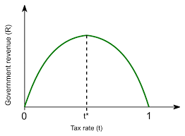
To Tax or not To Tax?
Income Tax
For more help, please visit www.exampaperspractice.co.uk
© 2025 Exams Papers Practice. All Rights Reserved

Slide 6
The Course
Pearson Edexcel B Economics
Four Units
Three Exams
https://qualifications.pearson.com/en/qualifications/edexcel-a-levels/economics-b-2015.html
For more help, please visit www.exampaperspractice.co.uk
© 2025 Exams Papers Practice. All Rights Reserved

Slide 7
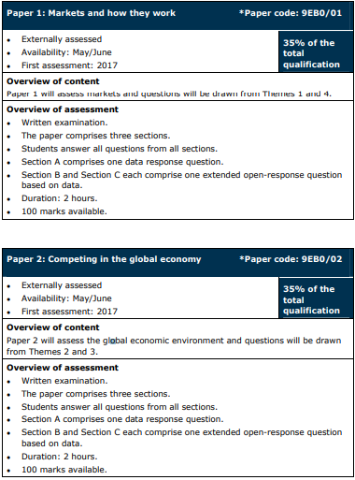
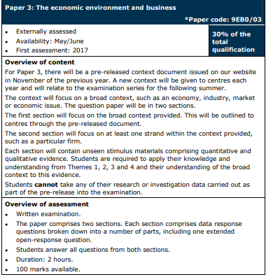
For more help, please visit www.exampaperspractice.co.uk
© 2025 Exams Papers Practice. All Rights Reserved

Slide 8

Home learning
Research Adam Smith the Economist and create a fact sheet on him.
  One A4 submitted in your homework exercise book.
For more help, please visit www.exampaperspractice.co.uk
© 2025 Exams Papers Practice. All Rights Reserved

Slide 9
What is a Market?
A market is any place or process that brings together buyers and sellers to facilitate an exchange.
Markets can be physical, or virtual locations where buyers and sellers come together to engage in a transaction.
For more help, please visit www.exampaperspractice.co.uk
© 2025 Exams Papers Practice. All Rights Reserved

Slide 10



Economic Agents
Economic agents will come together in a market to engage in a transaction.
An Economic Agent is simply a person, company, or organisation, that has an influence on the economy.
Different economic agents will have varying objectives.
For more help, please visit www.exampaperspractice.co.uk
© 2025 Exams Papers Practice. All Rights Reserved

Slide 11

Economic Agents
Consumers
Consumers are traditionally assumed to want to maximise their utility (while living within their means).
When faced with a decision about how to spend limited income, consumers will opt for the good/service that gives them the most satisfaction.
For more help, please visit www.exampaperspractice.co.uk
© 2025 Exams Papers Practice. All Rights Reserved

Slide 12
Economic Agents
Firms
We assume the objective of any firm is to maximise profit.
A firms profit is their total revenue minus their total costs.
Profit means the firm can survive, and reinvest in the business in the hope of making more profits in the future.
For more help, please visit www.exampaperspractice.co.uk
© 2025 Exams Papers Practice. All Rights Reserved

Slide 13
Economic Agents
Governments
Governments try to balance the resources of a country with the needs and wants of the population, i.e. economists assume governments try to maximise public interest.
This is likely to include the following:
Economic Growth
Full employment
Low inflation
For more help, please visit www.exampaperspractice.co.uk
© 2025 Exams Papers Practice. All Rights Reserved

Slide 14
Theory of Demand
Demand is the quantity of a good or service that consumers are willing and able to buy at a given price.
They have enough money to be able to buy the good or service
They voluntarily want to consume the good or service.
For more help, please visit www.exampaperspractice.co.uk
© 2025 Exams Papers Practice. All Rights Reserved

Slide 15
Individual Demand
Each of us has an individual demand for particular goods and services– our level of demand at each price reflects the value that we place on a product.
Market Demand
Market Demand is the sum of individual demand for a good/service, at a particular price.
For more help, please visit www.exampaperspractice.co.uk
© 2025 Exams Papers Practice. All Rights Reserved

Slide 16
Theory of Demand
A demand curve shows us the relationship between price and quantity demanded.
At any given point along the curve, it shows us the quantity of the good or service that would be bought at a particular price.
Price of a chocolate bar | Class Demand
30p | 18
60p | 15
90p | 8
£1.20 | 4
£1.50 | 0
For more help, please visit www.exampaperspractice.co.uk
© 2025 Exams Papers Practice. All Rights Reserved

Slide 17
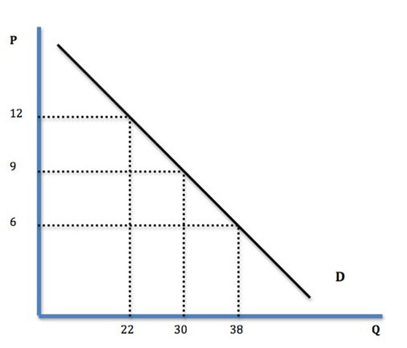

Ceteris paribus, there is an inverse relationship between price and quantity demanded.
As price falls, we see an extension in quantity demanded.
As price rises, we see a contraction in quantity demanded.
For more help, please visit www.exampaperspractice.co.uk
© 2025 Exams Papers Practice. All Rights Reserved

Slide 18
Why do demand curves slope down from left to right?
Demand curves slope downwards from left to right.
The higher the price charged for a good, the lower the quantity demanded.
There are 3 explanations for this:
Diminishing marginal utility
The income effect
The substitution effect
For more help, please visit www.exampaperspractice.co.uk
© 2025 Exams Papers Practice. All Rights Reserved

Slide 19
Why do demand curves slope down from left to right?
1. Diminishing marginal utility
Total Utility: Total Satisfaction from a given level of consumption.
Marginal Utility: The change in satisfaction from consuming one extra unit.
For more help, please visit www.exampaperspractice.co.uk
© 2025 Exams Papers Practice. All Rights Reserved
Notes:
Total utility is the total satisfaction from a given level of consumption.
Marginal utility is the change in satisfaction from consuming one extra unit.
Most benefit is generated by the first unit of a good consumed because it satisfies all or a large part of the immediate need or desire.
A second unit consumed would generate less utility – perhaps even zero, given that the consumer now has less need or desire.
With less benefit derived, the rational consumer is prepared to pay less for the second unit, because the marginal utility falls.

Slide 20
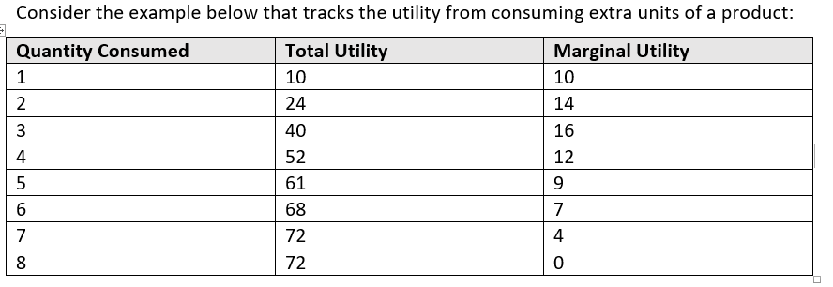
Why do demand curves slope down from left to right?
1. Diminishing marginal utility
Marginal Utility: The change in satisfaction from consuming one extra unit.
For more help, please visit www.exampaperspractice.co.uk
© 2025 Exams Papers Practice. All Rights Reserved
Notes:
Total utility is the total satisfaction from a given level of consumption.
Marginal utility is the change in satisfaction from consuming one extra unit.
Most benefit is generated by the first unit of a good consumed because it satisfies all or a large part of the immediate need or desire.
A second unit consumed would generate less utility – perhaps even zero, given that the consumer now has less need or desire.
With less benefit derived, the rational consumer is prepared to pay less for the second unit, because the marginal utility falls.

Slide 21
Why do demand curves slope down from left to right?
Total Utility: Total Satisfaction from a given level of consumption.
Marginal Utility: The change in satisfaction from consuming one extra unit.
As a person increases consumption of a product, the marginal utility to the consumer falls (i.e. diminishes).
As a result, consumers are willing to pay less & less as consumption increases.
For more help, please visit www.exampaperspractice.co.uk
© 2025 Exams Papers Practice. All Rights Reserved
Notes:
Total utility is the total satisfaction from a given level of consumption.
Marginal utility is the change in satisfaction from consuming one extra unit.
Most benefit is generated by the first unit of a good consumed because it satisfies all or a large part of the immediate need or desire.
A second unit consumed would generate less utility – perhaps even zero, given that the consumer now has less need or desire.
With less benefit derived, the rational consumer is prepared to pay less for the second unit, because the marginal utility falls.

Slide 22
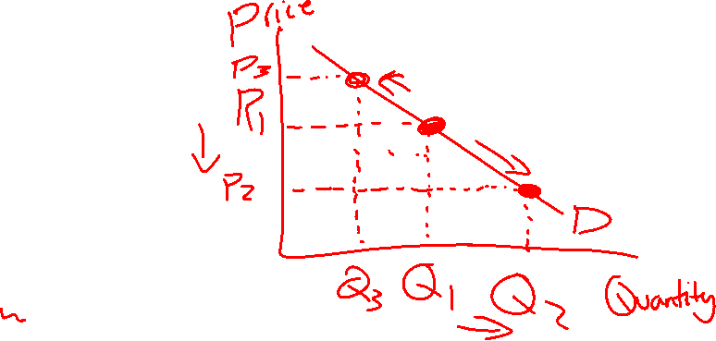
Recall
Show the impact on a demand curve of chocolate becoming cheaper.
For more help, please visit www.exampaperspractice.co.uk
© 2025 Exams Papers Practice. All Rights Reserved

Slide 23

Why do demand curves slope down from left to right?
2. The Income effect
Assuming a fixed level of income, the income effect means that as the price of a product falls, the amount of the product that consumers can buy with their income increases, and so demand increases.
For more help, please visit www.exampaperspractice.co.uk
© 2025 Exams Papers Practice. All Rights Reserved

Slide 24
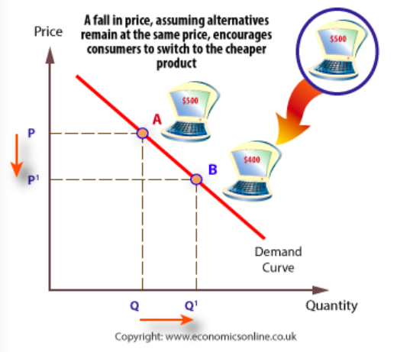


Why do demand curves slope down from left to right?
3. The Substitution effect
A fall in the price of a good makes that good appear relatively cheaper than alternative goods, ceteris paribus.
Consumers will therefore increase demand for the relatively cheaper good.
For more help, please visit www.exampaperspractice.co.uk
© 2025 Exams Papers Practice. All Rights Reserved

Slide 25

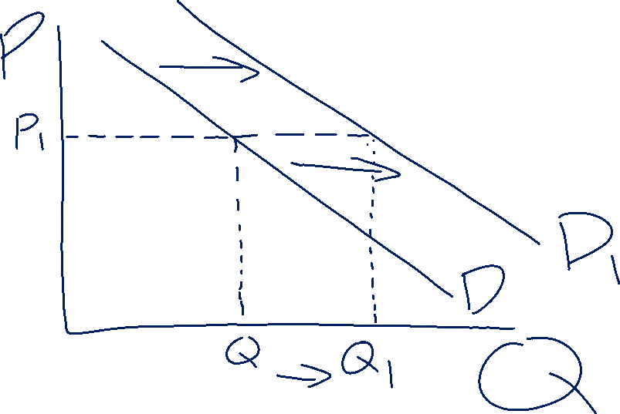
For more help, please visit www.exampaperspractice.co.uk
© 2025 Exams Papers Practice. All Rights Reserved

Slide 26
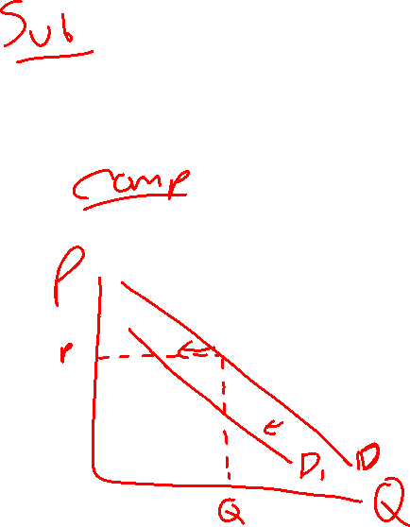
Activity
Show the impact on a diagram of an increase in price of Coke
Show the impact on a diagram of a increase in the price of tea bags on the demand for milk.
For more help, please visit www.exampaperspractice.co.uk
© 2025 Exams Papers Practice. All Rights Reserved

Slide 27
For more help, please visit www.exampaperspractice.co.uk
© 2025 Exams Papers Practice. All Rights Reserved

Slide 28
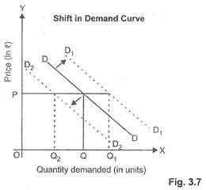
Shifts in the Demand Curve
The demand curve can shift up or down.
This occurs when consumers are willing to by a higher (or lower) quantity of goods (even when the good remains at the same price).
A demand curve shifts to the right (D1) when there is an increase in the amount demanded at every price.
A demand curves shifts to the left (D2) when there is an decrease in the amount demanded at every price.
For more help, please visit www.exampaperspractice.co.uk
© 2025 Exams Papers Practice. All Rights Reserved

Slide 29
Shifts in the Demand Curve
There are lots of factors that can cause a shift in the demand curve:
Changes in consumer income
Changes in the price of substitute goods
Changes in the price of complement goods
Changes in tastes and fashions
Advertising
Interest rates
For more help, please visit www.exampaperspractice.co.uk
© 2025 Exams Papers Practice. All Rights Reserved

Slide 30
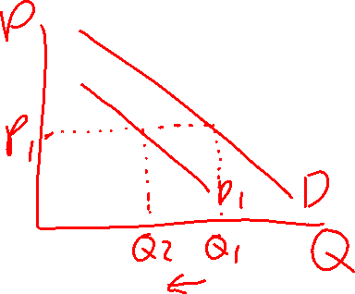
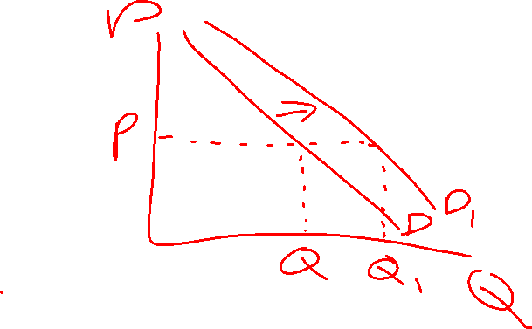
Activity
Demand diagram for Crocs
Demand for a pencil with advertising campaign
For more help, please visit www.exampaperspractice.co.uk
© 2025 Exams Papers Practice. All Rights Reserved

Slide 31
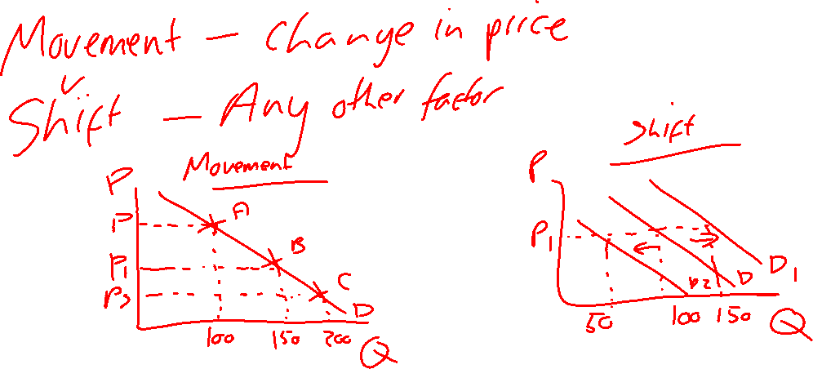
What is the difference between a movement and a shift in the demand curve
For more help, please visit www.exampaperspractice.co.uk
© 2025 Exams Papers Practice. All Rights Reserved

Slide 32
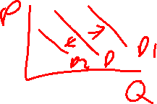
Shifts in the Demand Curve
1. Changes in Consumer Income
When an individual’s income goes up, their ability to purchase goods and services increases.
Economists say that a rise in income will lead to an increase in demand.
For more help, please visit www.exampaperspractice.co.uk
© 2025 Exams Papers Practice. All Rights Reserved

Slide 33
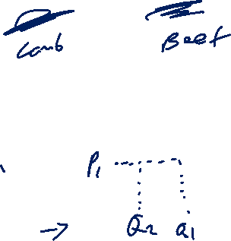
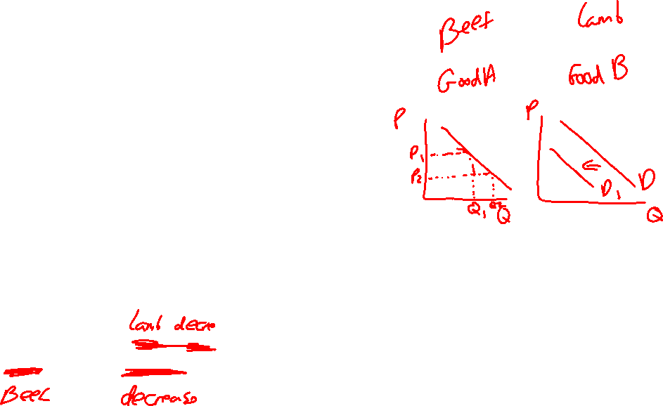
Shifts in the Demand Curve
2. Changes in the price of substitute goods
Substitute goods are in competitive demand and act as replacements for each other e.g. beef and lamb.
If the price of beef rises the demand for lamb would increase, ceteris paribus.
For more help, please visit www.exampaperspractice.co.uk
© 2025 Exams Papers Practice. All Rights Reserved

Slide 34
Shifts in the Demand Curve
Substitute goods are in competitive demand and act as replacements for each other e.g. beef and lamb.
If the price of beef rises the demand for lamb would increase, ceteris paribus.
Complementary goods are goods that are often used together, so they are in joint demand e.g. strawberries and cream.
If the price of strawberries fell, the demand for cream would increase, ceteris paribus.
For more help, please visit www.exampaperspractice.co.uk
© 2025 Exams Papers Practice. All Rights Reserved

Slide 35
Shifts in the Demand Curve
4. Advertising campaigns and Changes in tastes and fashions
Advertising can be a very powerful influence on consumer demand which seeks to influence consumer choice.
Changing consumer tastes and preferences over time and through different seasons will also have a large effect on demand.
For more help, please visit www.exampaperspractice.co.uk
© 2025 Exams Papers Practice. All Rights Reserved

Slide 36
Shifts in the Demand Curve
5. Interest Rates
Many durable goods are bought on credit using borrowed money, thus the demand for them may be sensitive to the rate of interest charged by the lender.
Lower interest rate will increase demand.
For more help, please visit www.exampaperspractice.co.uk
© 2025 Exams Papers Practice. All Rights Reserved

