Slide 1



4.4.3 Supply-side policies
For more help, please visit www.exampaperspractice.co.uk
© 2025 Exams Papers Practice. All Rights Reserved

Slide 2
Recall
What is meant by the term supply-side policy.
Write down 3 different supply-side policies.
Research recent supply-side policies implemented by the UK Government.
For more help, please visit www.exampaperspractice.co.uk
© 2025 Exams Papers Practice. All Rights Reserved

Slide 3
Learning Objectives
What is the difference between market-based and interventionist methods?
Are you able to explain the impact of Market-based and interventionist policies?
Can you use AD/AS diagrams to illustrate supply-side policies?
Can you explain the strengths and weaknesses of supply-side policies?
Are you able to explain the potential policy conflicts and trade-offs facing policy-makers when applying policies?
For more help, please visit www.exampaperspractice.co.uk
© 2025 Exams Papers Practice. All Rights Reserved

Slide 4

Supply-side Policy: A Definition
“Policies that seek to improve the long run productive potential of the economy.”
For more help, please visit www.exampaperspractice.co.uk
© 2025 Exams Papers Practice. All Rights Reserved

Slide 5
Supply-Side Policy Goals
These are policies to increase the country’s long term growth potential
A successful supply side policy will shift a country’s production possibility frontier to the right
Consumer Goods
X2
X1
Y1
Y2
Capital Goods
For more help, please visit www.exampaperspractice.co.uk
© 2025 Exams Papers Practice. All Rights Reserved

Slide 6
Market-based v interventionist supply side policy options
Supply side policies can be broadly split into two categories:
Market-based or free market supply-side policies
  are those which aim to make labour and product markets more flexible and efficient by reducing government involvement and interference
Interventionist supply-side policies
  are supported by those who believe the government has a key role to play in the efficient operation of markets
For more help, please visit www.exampaperspractice.co.uk
© 2025 Exams Papers Practice. All Rights Reserved
Notes:
http://www.bbc.co.uk/news/business-24058989

Slide 7
Supply side policy options
Cutting Income Tax
This should create incentives to work and expand the labour force
This may influence the economically inactive to enter labour force and boost output
Cutting Corporation Tax
Increases profit motive of firms which can be re-invested in capital
Modification of Welfare Payments
Widen gap between benefits and wages to boost work incentives
Investment Grants
Offers incentives to invest in capital
Regional Policy
Provides incentives for firms to set up in depressed regions
Subsidies
Creating incentives for firms to produce more
For more help, please visit www.exampaperspractice.co.uk
© 2025 Exams Papers Practice. All Rights Reserved
Notes:
http://www.bbc.co.uk/news/business-24058989

Slide 8
Reducing marginal tax rates
Band | Taxable income | Tax rate
Personal Allowance | Up to £12,570 | 0%
Basic rate | £12,571 - £50,270 | 20%
Higher rate | £50,271 - £150,000 | 40%
Additional rate | Over £150,000 | 45%
Marginal tax is the percentage of tax paid on an additional £1 of earnings
In a progressive tax regime, the marginal tax rate will increase as income increases
For more help, please visit www.exampaperspractice.co.uk
© 2025 Exams Papers Practice. All Rights Reserved

Slide 9
Supply-side policy options
To promote competition
Deregulation
Opening markets to freer competition and removing barriers to entry should help to drive productivity gains and boost supply
Privatisation
Minimisation of state control which can often be inefficient
This has been pursued by a number of (mainly Conservative) governments to privatise key areas of the economy in order to drive efficiency
For more help, please visit www.exampaperspractice.co.uk
© 2025 Exams Papers Practice. All Rights Reserved

Slide 10
Supply-side policy options
  To improve skills, quality and quantity of the labour force
Training and Education
  Improves productivity, mobility and flexibility of the workforce
Immigration
  Improves the quality of workforce as skilled workers can be used to improve the skills base of the economy
  Improves the quantity of the workforce as increased numbers can be used to fill vacancies in the economy or to help cut costs through lower wages
For more help, please visit www.exampaperspractice.co.uk
© 2025 Exams Papers Practice. All Rights Reserved
Notes:
http://www.bbc.co.uk/news/business-23730015
http://www.bbc.co.uk/news/uk-31748422

Slide 11
Supply-side policy options
To reform the labour market
Reformation of Trade Unions
  A reduction in trade union power and influence may give rise to lower wage rises, feeding through to lower inflation, and more labour market flexibility
  Providing incentives to work such as lower marginal tax rates and supplying accommodation in areas such as London with high housing costs
For more help, please visit www.exampaperspractice.co.uk
© 2025 Exams Papers Practice. All Rights Reserved
Notes:
http://www.bbc.co.uk/news/business-23730015
http://www.bbc.co.uk/news/uk-31748422

Slide 12
Task: Income Tax Cuts
What impact do you think the increase in the personal tax allowance and the increase in salary band on the 20% and 40% rate will have on the labour market?
To what extent would this improve the functioning of the labour market and supply-side of the economy? What would you change, and why? What impact might your decisions have?
Band | Taxable income | Tax rate
Personal Allowance | Up to £12,570 | 0%
Basic rate | £12,571 to £50,270 | 20%
Higher rate | £50,271 to £150,000 | 40%
Additional rate | over £150,000 | 45%
For more help, please visit www.exampaperspractice.co.uk
© 2025 Exams Papers Practice. All Rights Reserved

Slide 13
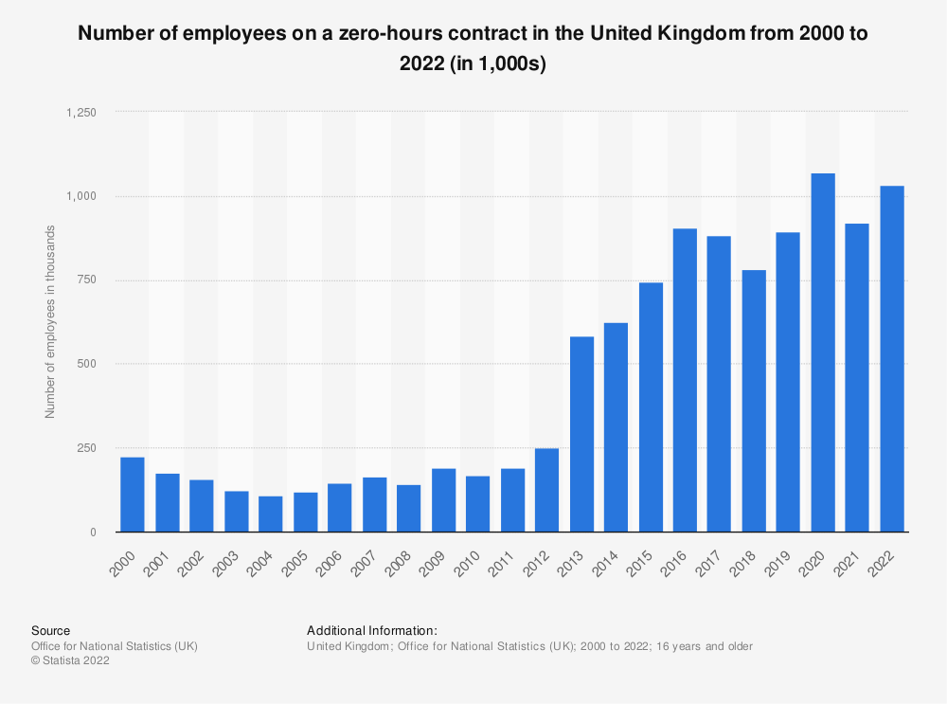
Zero Hours Contracts
Task 1: What impact do you think the rise in zero hour contracts will have on the supply-side of the economy?
Task 2: Will it make it more flexible?
Task 3: What are the consequences of this change in the labor market?
For more help, please visit www.exampaperspractice.co.uk
© 2025 Exams Papers Practice. All Rights Reserved
Notes:
http://www.bbc.co.uk/news/business-37305581

Slide 14
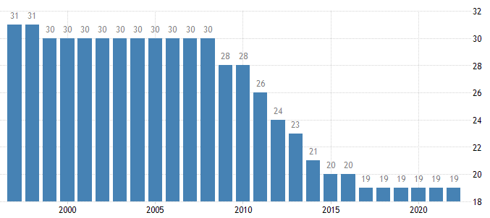
UK Corporation Tax Rates
The long term trend for corporation tax rates is downwards.
What are the impacts of this type of government policy? Are there any drawbacks?
For more help, please visit www.exampaperspractice.co.uk
© 2025 Exams Papers Practice. All Rights Reserved

Slide 15
Microeconomic effects of supply-side policies
If supply-side policies are effective, they can have a number of microeconomic benefits, such as:
Improved flexibility and strength of the labour market
Improved competitiveness within product markets
Higher levels of innovation within product markets
Greater efficiency and productivity of firms
For more help, please visit www.exampaperspractice.co.uk
© 2025 Exams Papers Practice. All Rights Reserved

Slide 16
Macroeconomic effects of supply-side policies
If supply-side policies are effective, they can have several macroeconomic benefits, such as:
Lower rates of unemployment and a lower natural rate of unemployment
Improved international competitiveness
Higher rates of long-run economic growth leading to improved living standards
Greater flexibility within the economy to withstand economic shocks
Softer inflationary pressures as long-run aggregate supply reduces capacity constraints
For more help, please visit www.exampaperspractice.co.uk
© 2025 Exams Papers Practice. All Rights Reserved

Slide 17
The supply-side effects of monetary policy
1) Whilst monetary policy has numerous effects on AD, it can also influence LRAS.
2) A cut in interest rates might stimulate businesses investment into capital process to improve their productivity and efficiency, which will shift LRAS to LRAS1.
3) As Investment is a component of AD, AD will shift to AD1.
4) Productive capacity has now increased to FE1 and increases in AD can feed through to higher growth and employment. In this example, there has been no change in the price level.
LRAS
LRAS1
Price Level
P
AD
AD1
Y
Y1
FE
FE1
Real National Output
For more help, please visit www.exampaperspractice.co.uk
© 2025 Exams Papers Practice. All Rights Reserved

Slide 18
Expansionary Supply-Side Policy
If the economy is running up against capacity constraints, the government might implement a supply-side policy.
Investment, for example into training and education, should boost LRAS to LRAS1.
This has a positive effect on inflation as the price level moves from P to P1.
Economic growth has been enhanced to Y1, also creating employment. Productive potential has also increased to FE1.
With a more highly skilled workforce, this may improve the competitiveness of UK exports in terms of both quantity and quality, which, all other things being equal, may improve the balance of payments on current account.
LRAS
LRAS1
Price Level
P
AD
AD1
Y
Y1
FE
FE1
Real National Output
For more help, please visit www.exampaperspractice.co.uk
© 2025 Exams Papers Practice. All Rights Reserved

Slide 19
Strengths and weaknesses: is supply-side policy effective?
Time Lags
  Many policies have significant time lags in terms of effectiveness
  Training and education may take several years for its full effects to be felt
Cost
  May be expensive to implement e.g. HS2 is estimated to cost at least £42bn
Policies of competing nations
  Our main competitors e.g. Germany, USA, China will also be introducing their own supply-side policies
  If their policies are more effective than ours, then the anticipated gains in international trade may not occur
Likelihood of government failure?
  Do governments spend wisely and efficiently on projects?
  There are a number of cases of poorly administered government supply-side polices which have not had the desired outcome
For more help, please visit www.exampaperspractice.co.uk
© 2025 Exams Papers Practice. All Rights Reserved

Slide 20
Macroeconomic policy conflicts
1) Consider a government wishes to lower unemployment.
2) It may increase Government spending to achieve this, so AD shifts to the right to AD1.
3) This has the effect of increasing real national output and creating jobs as the economy moves along the SRAS curve.
4) However, this has been at the expense of a rise in the price level from P to P1.
Price Level
SRAS
P1
P
AD1
AD
Q
Q1
Real National Output
For more help, please visit www.exampaperspractice.co.uk
© 2025 Exams Papers Practice. All Rights Reserved

Slide 21
Macroeconomic policy conflicts
1) Imagine the economy is in equilibrium at PQ, and the government is concerned about inflation.
2) It may increase taxes in order to reduce consumption.
3) As a result, AD will shift to the left.
4) This will be effective in reducing inflationary pressure as the price level falls from P to P1.
6) However, as AD falls so does real national output and economic growth. It is also likely that with lower AD, unemployment would rise.
5) As consumers have reduced disposable income, they may spend less on imports, so improving the balance of payments.
LRAS
Price Level
P
P1
AD
AD1
Q1
Real National Output
Q
FE
For more help, please visit www.exampaperspractice.co.uk
© 2025 Exams Papers Practice. All Rights Reserved

Slide 22
So, which objective?
The achievement of one objective may also help to meet additional objectives
However, the objectives also inherently conflict, so progress towards one, may hamper the progress towards others
As a consequence, governments have to prioritise which objective they consider to be the most important
For more help, please visit www.exampaperspractice.co.uk
© 2025 Exams Papers Practice. All Rights Reserved
Notes:
http://www.bbc.co.uk/news/business-23588958

Slide 23
Policy conflicts and trade offs: economic growth and negative externalities
Negative externalities
the costs and benefits to a third party created by economic agents when undertaking their activities e.g. pollution
Long term impact on the environment e.g. global warming
Overuse of scarce resources
Potential increase in the consumption of demerit goods
Income and wealth inequality
Work life balance
What is the opportunity cost of growth?
For more help, please visit www.exampaperspractice.co.uk
© 2025 Exams Papers Practice. All Rights Reserved

Slide 24
Policy conflicts and trade offs: conflicts between fiscal and supply-side policies
The Government can increase government spending in order to pay for merit goods in areas such as education and health. This can impact on private sector supply
The crowding-out of the private sector as:
Public sector spending takes the place of the private sector
Public sector borrowing reduces the supply of funds available to the private sector, pushing up interest rates
Bottlenecks occur in the production process as firms cannot cope with the increased demand brought about by government expenditure, effectively slowing down supply
Nevertheless, spending in areas such as education are likely to boost the productive potential of the economy in the long run as the LRAS curve shifts to the right
For more help, please visit www.exampaperspractice.co.uk
© 2025 Exams Papers Practice. All Rights Reserved

Slide 25
Plenary
Which one of the following is most likely to be an example of a supply-side improvement in the economy? An increase in
business innovation
consumer expenditure
exports
factor immobility
For more help, please visit www.exampaperspractice.co.uk
© 2025 Exams Papers Practice. All Rights Reserved
Notes:
A

Slide 26
Multiple Choice 2
The government wishes to increase the trend rate of growth of national output through the use of supply-side policies. To achieve its objective, the government would be most likely to increase its spending on
wages for public sector employees
welfare benefits
subsidies to failing firms
education and training
For more help, please visit www.exampaperspractice.co.uk
© 2025 Exams Papers Practice. All Rights Reserved
Notes:
D

Slide 27
Multiple Choice 3
An economy has introduced a series of successful supply side policies. All other things being equal, which combination of macroeconomic indicators is the most likely outcome?
 | Employment | Inflation | Deficit on the Current Account
A | Increasing | Decreasing | Decreasing
B | Decreasing | Increasing | Increasing
C | Increasing | Increasing | Decreasing
D | Decreasing | Decreasing | Increasing
For more help, please visit www.exampaperspractice.co.uk
© 2025 Exams Papers Practice. All Rights Reserved
Notes:
A

Slide 28
Multiple Choice 4
A cut in income tax could be considered
both a monetary policy and a fiscal policy
both a monetary policy and a supply-side policy
both a fiscal policy and a supply-side policy
neither a monetary policy nor a fiscal policy
For more help, please visit www.exampaperspractice.co.uk
© 2025 Exams Papers Practice. All Rights Reserved
Notes:
C

