Slide 1



4.4.2 Demand-side policies
For more help, please visit www.exampaperspractice.co.uk
© 2025 Exams Papers Practice. All Rights Reserved

Slide 2
Learning Objectives
Are you able to explain how monetary policy works?
Are you able to explain how fiscal policy works?
Are you able to evaluate different policies and give their benefits/drawbacks in different situations?
For more help, please visit www.exampaperspractice.co.uk
© 2025 Exams Papers Practice. All Rights Reserved

Slide 3
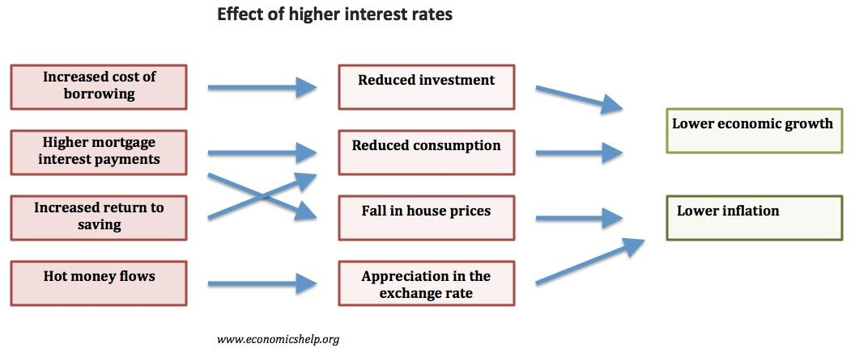
Interest rates
For more help, please visit www.exampaperspractice.co.uk
© 2025 Exams Papers Practice. All Rights Reserved

Slide 4
Discuss the impact of higher interest rates on dealing with high inflation?
Incentivise saving, Marginal Propensity Save rises, Consumption falls, AD components © (greatest component 65%) falls and thus AD falls. AD shift to left diagram. Leads to fall in inflation. This is dependent on it being demand pull and not cost push inflation? We are a heavy importer on Price inelastic goods such as gas?
DIAGRAM – Left shift in AD
Increase cost of borrowing, lower investment AD Component (I), less firms investing into the economy, less growth, LRAS/AD shifting potentially? FDI may actually increase and not reduce inflation due to hot money flows.
For more help, please visit www.exampaperspractice.co.uk
© 2025 Exams Papers Practice. All Rights Reserved

Slide 5
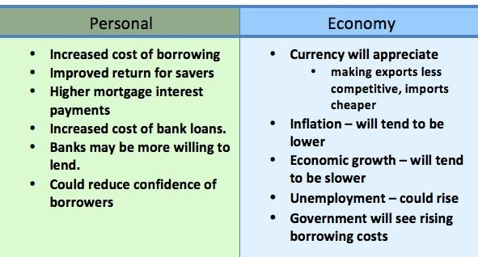
Effects of increase in interest rates
For more help, please visit www.exampaperspractice.co.uk
© 2025 Exams Papers Practice. All Rights Reserved

Slide 6

Task
Discuss the impact of higher interest rates on dealing with high inflation?
For more help, please visit www.exampaperspractice.co.uk
© 2025 Exams Papers Practice. All Rights Reserved

Slide 7
Discuss the impact of higher interest rates on dealing with high inflation?
Incentivise saving, Marginal Propensity Save rises, Consumption falls, AD components © (greatest component 65%) falls and thus AD falls. AD shift to left diagram. Leads to fall in inflation. This is dependent on it being demand pull and not cost push inflation? We are a heavy importer on Price inelastic goods such as gas?
DIAGRAM – Left shift in AD
Increase cost of borrowing, lower investment AD Component (I), less firms investing into the economy, less growth, LRAS/AD shifting potentially? FDI may actually increase and not reduce inflation due to hot money flows.
For more help, please visit www.exampaperspractice.co.uk
© 2025 Exams Papers Practice. All Rights Reserved

Slide 8
Effect of higher interest rates
Increases the cost of borrowing.
Increase in mortgage interest payments.
Increased incentive to save rather than spend.
Higher interest rates increase the value of a currency (Due to hot money flows, investors are more likely to save in British banks if UK rates are higher than other countries) A stronger Pound makes UK exports less competitive – reducing exports and increasing imports. This has the effect of reducing aggregate demand in the economy.
Rising interest rates affect both consumers and firms.
Government debt interest payments increase.
Reduced confidence. Interest rates affect consumer and business confidence. A rise in interest rates discourages investment; it makes firms and consumers less willing to take out risky investments and purchases.
For more help, please visit www.exampaperspractice.co.uk
© 2025 Exams Papers Practice. All Rights Reserved

Slide 9
Discuss the most effective policy to reduce inflation.
For more help, please visit www.exampaperspractice.co.uk
© 2025 Exams Papers Practice. All Rights Reserved

Slide 10
Discuss the most effective policy to reduce inflation.
Increase interest rates
  Saving more attractive
  MPS increases
  Consumption falls © 65%
  AD shifts to the left (Diagram)
Fiscal policy
  Increase taxes on individuals
    Less disposable income → Reduce consumption → lay workers off → higher unemployment → Less tax income→ AD falls
For more help, please visit www.exampaperspractice.co.uk
© 2025 Exams Papers Practice. All Rights Reserved

Slide 11
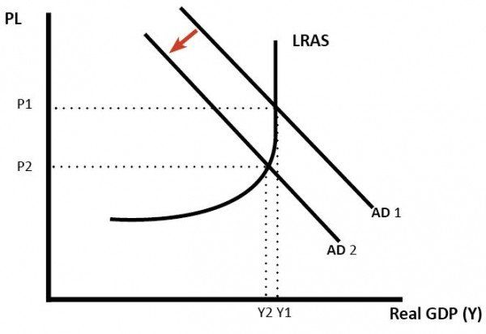
Task
Task 1: What is this diagram showing?
Task 2: How may this occur?
For more help, please visit www.exampaperspractice.co.uk
© 2025 Exams Papers Practice. All Rights Reserved

Slide 12
Task 3: Discuss whether this Is this a bad thing for an economy?
For more help, please visit www.exampaperspractice.co.uk
© 2025 Exams Papers Practice. All Rights Reserved

Slide 13
Task 3: Discuss whether this Is this a bad thing for an economy?
Bad thing → interest rates are higher → appreciation in the exchange rate→ SPICED → Leads to less exports → Net exports reduced → Continued low economic growth.
Good thing → ATM high rate of inflation → Needs to be controlled → Reduce disposable income → IR rise or fiscal policy (higher taxes) → less consumption → more businesses laying off staff → higher unemployment → Lower wages → inflation reduces → Over time we recover and demand starts to rise.
For more help, please visit www.exampaperspractice.co.uk
© 2025 Exams Papers Practice. All Rights Reserved

Slide 14
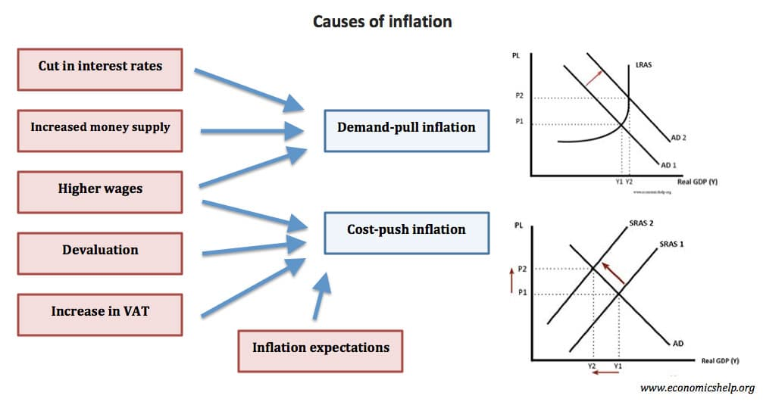
Inflation
For more help, please visit www.exampaperspractice.co.uk
© 2025 Exams Papers Practice. All Rights Reserved

Slide 15

Summary of Main causes of inflation
Demand-pull inflation – aggregate demand growing faster than aggregate supply (growth too rapid)
Cost-push inflation – For example, higher oil prices feeding through into higher costs.
Devaluation – increasing cost of imported goods, and also the boost to domestic demand.
Rising wages – higher wages increase firms costs and increase consumers’ disposable income to spend more.
Expectations of inflation – causes workers to demand wage increases and firms to push up prices.
For more help, please visit www.exampaperspractice.co.uk
© 2025 Exams Papers Practice. All Rights Reserved

Slide 16
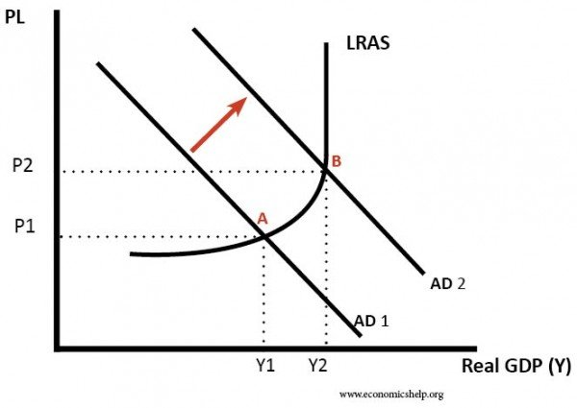
Demand Pull Inflation
If the economy is at or close to full employment, then an increase in aggregate demand (AD) leads to an increase in the price level (PL). As firms reach full capacity, they respond by putting up prices leading to inflation. Also, near full employment with labour shortages, workers can get higher wages which increase their spending power.
For more help, please visit www.exampaperspractice.co.uk
© 2025 Exams Papers Practice. All Rights Reserved

Slide 17
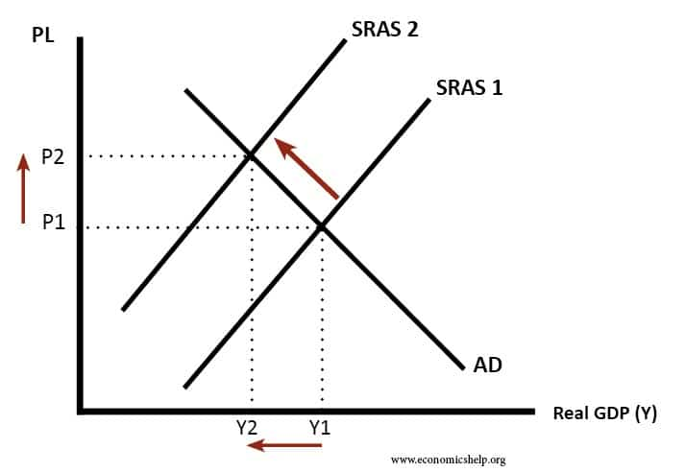
Cost-push inflation
If there is an increase in the costs of firms, then businesses will pass this on to consumers. There will be a shift to the left in the AS.
For more help, please visit www.exampaperspractice.co.uk
© 2025 Exams Papers Practice. All Rights Reserved

Slide 18
Task
Discuss which type of inflation is most damaging to an economy?
Cost push → Need for certain goods such as gas → finite resources leads to higher prices → excess demand of these goods → firms set higher prices → inelastic goods still need to be bought → increased costs to firms → higher prices for consumers/employ less staff → generate less government tax revenue.
Demand pull → High prices need to be dealt with by fiscal or monetary policy → Discourages consumption → reducing consumer confidence → long time to recover and encourage people to spend again.
For more help, please visit www.exampaperspractice.co.uk
© 2025 Exams Papers Practice. All Rights Reserved

Slide 19
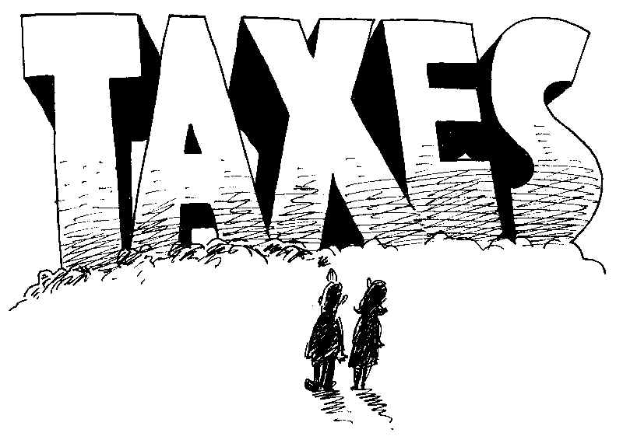
Fiscal Policy
“The manipulation of government spending, taxation and government borrowing to influence the level of economic activity.”
For more help, please visit www.exampaperspractice.co.uk
© 2025 Exams Papers Practice. All Rights Reserved
Notes:
http://www.bbc.co.uk/learningzone/clips/government-spending-cuts-causes-and-effects/11909.html

Slide 20
Fiscal policy goals
Fiscal policy is used to achieve a wide variety of objectives
  Keep inflation on target (2%)
  Stimulate economic growth and employment during times of recession
  Maintain a stable economic cycle that minimises boom and bust
Note however, that fiscal policy can have supply side effects too
Any change in the balance between government spending and taxation, will impact upon the 4 macroeconomic targets
However, fiscal policy has a wide variety of goals and may have microeconomic targets in addition to this, which can include improving education, health and the redistribution of income
For more help, please visit www.exampaperspractice.co.uk
© 2025 Exams Papers Practice. All Rights Reserved

Slide 21
Fiscal policy instruments
Fiscal policy is said to be “expansionary” if the government is trying to positively stimulate economic activity.
Possible methods include:
Cutting taxes
  A cut in income tax may give consumers more disposable income, thus raising consumption
  A cut in corporation tax may increase available profits for firms which may stimulate investment
Raising government spending
  The government may increase its spending on core infrastructure projects or increase the pay of public sector workers
Increasing the budget deficit
  Another way of increasing spending if the government do not wish to raise taxation is to increase borrowing
  This can be spent on a variety of projects nationally
  However, this adds to the national debt, and must be repaid with interest
For more help, please visit www.exampaperspractice.co.uk
© 2025 Exams Papers Practice. All Rights Reserved

Slide 22
Fiscal policy instruments
Fiscal policy is said to be “contractionary” if the government is trying to constrain aggregate demand, reduce debt or control inflation.
Possible methods include:
Increasing taxes
  If income tax is raised this may discourage spending and reduce consumption
  This will reduce aggregate demand and may help to bring inflation under control
Cutting government spending
  The government may decide to reduce expenditure on public projects or cut key government budgets if it considers excessive government spending to be unaffordable or perhaps inflationary
Cutting the budget deficit
  The UK budget deficit is large and thus must be repaid with interest
  Cutting the governments long term borrowing commitments may help to stabilise economic growth as reduced debt repayments in future can be reinvested back into the economy
The following diagrams serve to illustrate how fiscal policy can be used to control inflation and unemployment
For more help, please visit www.exampaperspractice.co.uk
© 2025 Exams Papers Practice. All Rights Reserved

Slide 23
Task: Cutting corporation tax will create economic growth. Discuss.
For more help, please visit www.exampaperspractice.co.uk
© 2025 Exams Papers Practice. All Rights Reserved

Slide 24
Increase in AD
LRAS
Price Level
1) Assume the government would like to stimulate economic growth.
2) It may decide to cut taxation, which will boost AD to AD1, as consumption rises.
P1
P
3) This has the effect of increasing real national output from Y to Y1.
AD1
AD
4) There will also be the added benefit of creating employment.
Y
Real National Output
Y1
FE
6) In addition, if additional consumption is spent on imports, then this will worsen the balance of payments on current account.
5) However, this has come at the expense of an increase in the price level to P1, which may hamper the inflation target.
For more help, please visit www.exampaperspractice.co.uk
© 2025 Exams Papers Practice. All Rights Reserved

Slide 25
Increase in LRAS
LRAS
LRAS1
Price Level
1) Imagine the government would like to stimulate the supply-side of the economy.
2) They may cut corporation tax in order to boost firms’ profits, which can then be reinvested in capital projects.
P
P1
AD
3) LRAS will shift to the right to LRAS1.
Y
Y1
FE1
FE
Real National Output
5) However, if AD remains unchanged, spare capacity has now increased in size from Y-FE to Y1-FE1, indicating a waste of economic resources.
4) Productive capacity has now increased to FE1 and there has been a fall in the price level from P to P1, helping to soften inflationary pressure.
For more help, please visit www.exampaperspractice.co.uk
© 2025 Exams Papers Practice. All Rights Reserved

Slide 26
Decrease in AD
1) Assume the government would like to use fiscal policy to maintain its inflationary target of 2%, because the economy is running up against capacity constraints.
Price Level
LRAS
2) It may decide to increase taxation, which will cut AD to AD1, as consumption falls.
P
3) This has the effect of reducing inflationary pressure as the price level falls from P to P1.
P1
AD
4) There will also be the added benefit of improving the balance of payments on current account as less income is spent on imports.
AD1
Y
Real National Output
Y1
FE
6) In addition, falling consumption and lower aggregate demand is likely to increase cyclical unemployment.
5) However, this has come at the expense of a reduction in real national output from Y to Y1, which damages economic growth.
For more help, please visit www.exampaperspractice.co.uk
© 2025 Exams Papers Practice. All Rights Reserved

Slide 27
Strengths and weaknesses of fiscal policy
Economic Growth
  Expansionary policy alone won’t increase the long-run growth rate, but will act as a short-run stimulus to economic growth
  However, fiscal stimulus through tax cuts and increasing government spending may be employed to help lift a country out of recession, therefore smoothing out fluctuations in the economic cycle
  Keynesian economists favour this approach and might consider increasing the governments budget deficit in the short-run - a necessary requirement to put an economy back on target in terms of economic growth
Unemployment
  Higher government spending should lead to higher levels of employment if there are good polices to support training programmes and back to work schemes
  The use of fiscal policy to improve employment statistics is a vital part of economic policy
  Tax credit and welfare changes are on-going – keep up to date with these!
For more help, please visit www.exampaperspractice.co.uk
© 2025 Exams Papers Practice. All Rights Reserved

Slide 28
Strengths and weaknesses of fiscal policy
Inflation
  Fiscal policy is a fairly blunt instrument with which to seek to control the price level
  In theory, expansionary policy will boost AD and create inflationary pressure, whilst contractionary policy will do the opposite
  In reality, it is very difficult to ‘fine tune’ the economy towards a 2% inflation target using broad instruments such as taxation and government spending
  In any case, the causes of inflation are varied and come from many sources which fiscal policy cannot control e.g. increasing raw material costs from abroad
Balance of Payments on Current Account
  The UK has a high propensity to import, so expansionary policy tends to limit our ability to achieve this target
  However, the government could employ expenditure-switching policies by e.g. taxing foreign imports to make domestic goods more attractive
For more help, please visit www.exampaperspractice.co.uk
© 2025 Exams Papers Practice. All Rights Reserved
Notes:
http://www.bbc.co.uk/news/business-21933720

Slide 29
Direct and indirect taxation
Direct tax is imposed on the income of individuals or profits of businesses
This type of tax is paid directly to the government
Examples include:
  Income tax
  Corporation tax
  Inheritance tax
  National Insurance contributions
Indirect tax is imposed on goods or services
This increases the price of that good or service
Examples include:
  Value Added Tax
  Excise duty
  Customs duty
For more help, please visit www.exampaperspractice.co.uk
© 2025 Exams Papers Practice. All Rights Reserved
Notes:
http://www.bbc.co.uk/news/business-32194031
http://www.bbc.co.uk/news/business-32897770
http://www.bbc.co.uk/news/business-12099638

Slide 30
Strengths and weaknesses – is fiscal policy effective?
It depends!
The size of the change in government spending and/or taxation will vary the impact it has
The effectiveness, efficiency and timing of changes will also influence policy effectiveness
The size of the multiplier will influence the size of changes in AD
How close to full employment the economy is
  Expansionary policy will have different effects if there is significant spare capacity compared to if it is close to full employment
Time – It takes time for the full effect of tax cuts or spending increases to have the desired effect on the economy
For more help, please visit www.exampaperspractice.co.uk
© 2025 Exams Papers Practice. All Rights Reserved
For more help, please visit www.exampaperspractice.co.uk
© 2025 Exams Papers Practice. All Rights Reserved

Slide 31
Task: Discuss whether indirect taxes are the most effective way of reducing smoking.

Slide 32
Multiple choice 1
Fiscal policy involves changes in both
the budget balance and the balance of payments
interest rates and the supply of credit
the money supply and the exchange rate
government spending and tax revenue
For more help, please visit www.exampaperspractice.co.uk
© 2025 Exams Papers Practice. All Rights Reserved
Notes:
D

Slide 33
Multiple choice 2
Which one of the following is an example of expansionary fiscal policy?
A reduction in interest rates
An increase in the budget deficit
An increase in the money supply
An increase in tax rates
For more help, please visit www.exampaperspractice.co.uk
© 2025 Exams Papers Practice. All Rights Reserved
Notes:
B

Slide 34
Multiple choice 3
All other things being equal, a substantial cut in the rate of income tax in the short run is most likely to reduce
inflation
unemployment
spending on imports
the government budget deficit
For more help, please visit www.exampaperspractice.co.uk
© 2025 Exams Papers Practice. All Rights Reserved
Notes:
B

Slide 35
Multiple choice 4
Which one of the following is the best example of fiscal policy having a direct supply-side effect?
An increase in the money supply leading to greater output
A reduction in income tax boosting consumption and the supply of consumer credit from banks
A reduction in interest rates boosting investment and the productive potential of the economy
Government expenditure on retraining schemes increasing factor mobility
For more help, please visit www.exampaperspractice.co.uk
© 2025 Exams Papers Practice. All Rights Reserved
Notes:
D

Slide 36
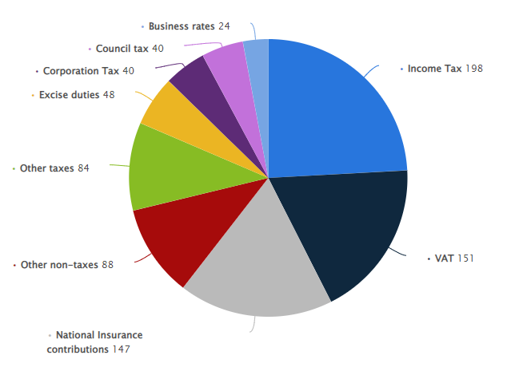
Sources of Tax Revenue
Task 1: What will be the impact of changes in the levels and types of tax revenue?
Task 2: What changes would you make?
Task 3: What would the impact be?
For more help, please visit www.exampaperspractice.co.uk
© 2025 Exams Papers Practice. All Rights Reserved

Slide 37
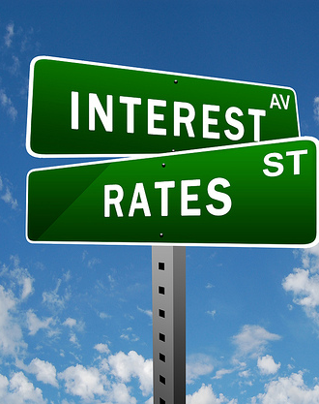
Monetary policy: a definition
“The manipulation of the rate of interest, the money supply and exchange rates to influence the level of economic activity.”
For more help, please visit www.exampaperspractice.co.uk
© 2025 Exams Papers Practice. All Rights Reserved

Slide 38
Monetary policy goals
The primary target of monetary policy is to maintain a low rate of inflation
Target = 2% (CPI) +/- 1%
Monetary policy in the UK has been delegated to the Bank of England (BoE), who have responsibility for setting interest rates (also known as the base rate) and controlling the money supply
In recent times the Bank has also assumed a degree of responsibility for assisting in stimulating economic growth and employment
For more help, please visit www.exampaperspractice.co.uk
© 2025 Exams Papers Practice. All Rights Reserved
Notes:
http://www.youtube.com/watch?v=ZwFLddDB8jw

Slide 39
How does monetary policy work?
The Bank, via the Monetary Policy Committee (MPC), meet every month to decide the level of interest rates and any other changes to policy strategy
In order to make their decision the MPC consider a wide range of macroeconomic variables including GDP, unemployment, exchange rates, house prices, the level of investment by firms and GDP growth in other countries
The main tool they have at their disposal is interest rates, although they may also use other tools to influence the money supply, such as quantitative easing
In theory, if inflation remains around the target level of 2%, then this will give confidence to
Consumers – as regards to spending decisions
Firms – as regards to investment decisions
Workers – as regards to wage demands
For more help, please visit www.exampaperspractice.co.uk
© 2025 Exams Papers Practice. All Rights Reserved
Notes:
http://www.bankofengland.co.uk/monetarypolicy/Pages/how.aspx

Slide 40

The Monetary Policy Committee (MPC)
Setting interest rates is the responsibility of the MPC
MPC: 9 members (4 independent, 5 from within bank)
Chaired by the Governor of the Bank of England Andrew Bailey
The MPC meet monthly to assess the state of the economy and decide whether it is appropriate to increase, decrease or hold interest rates from their existing level
It is independent from government, which should give it more credibility (free from political influence)
For more help, please visit www.exampaperspractice.co.uk
© 2025 Exams Papers Practice. All Rights Reserved
Notes:
http://www.bbc.co.uk/news/business-23093989
http://www.bankofengland.co.uk/monetarypolicy/Pages/overview.aspx

Slide 41
Interest rates
Interest rates are best described as the “price of money”
Interest rates are the cost of borrowing and the reward for saving
Task 1: Complete the table.
Task 2: Explain your answers.
 | Likely impact on consumer saving | Likely impact on consumer borrowing | Likely impact on investment | Likely impact on house prices
High Interest Rates | Increase/Decrease | Increase/Decrease | Increase/Decrease | Increase/Decrease
Low Interest Rates | Increase/Decrease | Increase/Decrease | Increase/Decrease | Increase/Decrease
For more help, please visit www.exampaperspractice.co.uk
© 2025 Exams Papers Practice. All Rights Reserved

Slide 42
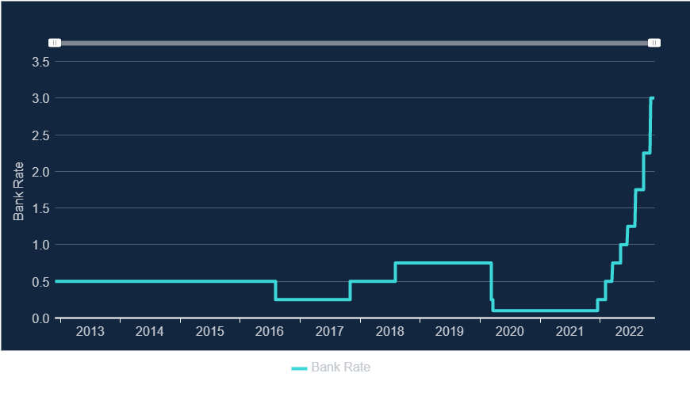
Interest rates in the UK
Task 1: What impact do you think this might have on aggregate demand?
Task 2: Why do you think rates have remained so low for so long?
Task 3: Why have interest rates increased so rapidly?
For more help, please visit www.exampaperspractice.co.uk
© 2025 Exams Papers Practice. All Rights Reserved

Slide 43
Task
Discuss the impact when interest rates increase, what happens to exchange rates?
For more help, please visit www.exampaperspractice.co.uk
© 2025 Exams Papers Practice. All Rights Reserved

Slide 44
Interest rates and the exchange rate
It is important to understand the link between interest rates and exchange rates
Global investors who have significant sums of money to deposit in banks will seek to place it in the country where they get the best return i.e. where the interest rate is highest
If we assume that the UK has the same interest rates as the USA, then for that investor, the return is the same whether they deposit it in the UK or USA
If the UK raises interest rates, then investors will move their money to the UK in order to get the best return
This means they will have to sell their $s and buy £s to deposit in the UK
This increased demand for UK pounds increases the exchange rate
This then feeds through to exports, making them relatively less price competitive, and making imports more attractive
This will have the effect of worsening the balance of payments on current account
This process is sometimes referred to as Hot Money, as international funds move around the world chasing the best interest rates
For more help, please visit www.exampaperspractice.co.uk
© 2025 Exams Papers Practice. All Rights Reserved

Slide 45
Asset purchases to increase the money supply (quantitative easing)
  Quantitative Easing (QE)
    When the recession began in the UK in 2008, the BoE would have been expected to cut interest rates in order to help stimulate economic activity
    However, with interest rates at 0.5%, they had very little downwards movement to manipulate the economy with
    In addition, banks were nervous about lending money to firms and individuals, so the BoE sought to boost the funds available for lending to businesses and firms
    In total, £375bn has been raised in QE
    How effective this has been is a matter of debate, but it could be argued that the recession may have been worse had the BoE not intervened in this manner
For more help, please visit www.exampaperspractice.co.uk
© 2025 Exams Papers Practice. All Rights Reserved
Notes:
http://www.bbc.co.uk/news/business-15198789

Slide 46
The impact of changing the level of AD on the economy as a whole
Consumption
  Low interest rates = less incentive to save, more incentive to borrow and therefore higher consumption
  This affects general spending and consumer durables especially
  Higher interest rates = vice versa
Investment
  Low interest rates = investment projects become less costly/more profitable thus more attractive, so investment should rise
  High interest rates = vice versa
Net Exports
  Low interest rates = weaker £ as less attractive to currency investors
  Weak £ = Stronger Exports, fewer Imports
  High rates = vice versa
The following diagrams serve to illustrate how monetary policy can be used to control inflation and unemployment
For more help, please visit www.exampaperspractice.co.uk
© 2025 Exams Papers Practice. All Rights Reserved

Slide 47
Expansionary monetary policy
LRAS
Price Level
1) If the Bank of England is concerned that slow economic growth is likely to feed through to lower inflation, they may cut interest rates.
2) This reduces the savings ratio and makes borrowing more attractive, so consumption rises.
P1
P
3) This has the effect of increasing real national output from Y to Y1.
AD1
AD
4) There will also be the added benefit of creating employment.
Y
Y1
FE
Real National Output
For more help, please visit www.exampaperspractice.co.uk
© 2025 Exams Papers Practice. All Rights Reserved

Slide 48
Contractionary monetary policy
1) If the Bank of England is concerned that inflation is running above the 2% target they may increase interest rates to reduce inflationary pressure.
LRAS
Price Level
2) This makes saving more attractive and will reduce consumption in addition to reducing investment from firms.
P
3) This has the effect of reducing inflationary pressure as the price level falls from P to P1.
P1
AD
4) However, this has come at the expense of a reduction in real national output to Y1, which damages economic growth and employment.
AD1
Y1
FE
Real National Output
For more help, please visit www.exampaperspractice.co.uk
© 2025 Exams Papers Practice. All Rights Reserved

Slide 49
Strengths and weaknesses – is monetary policy effective?
It depends on:
The size of the change in interest rates will vary the impact
Timing of rate changes
The size of the multiplier
The stage of the economic cycle the economy is at
Time – How long rate changes take to work
Primary target is control of inflation, but may conflict with other objectives
BoE might be hampered by poor/inaccurate data
Interest rates helps to solve demand-pull, but may be less effective with cost-push causes
For more help, please visit www.exampaperspractice.co.uk
© 2025 Exams Papers Practice. All Rights Reserved

Slide 50
Plenary
Which one of the following is most likely to be classified as an instrument of monetary policy?
Taxation
The inflation rate
The exchange rate
Government spending
For more help, please visit www.exampaperspractice.co.uk
© 2025 Exams Papers Practice. All Rights Reserved
Notes:
C

Slide 51
Multiple choice 2
All other things being equal, a large increase in an economy's rate of interest will cause
Both its aggregate demand curve and its short-run aggregate supply curve to shift to the right
Its aggregate demand curve to shift to the right and its short-run aggregate supply curve to shift to the left
Both its aggregate demand curve and its short-run aggregate supply curve to shift to the left
Its aggregate demand curve to shift to the left and its short-run aggregate supply curve to shift to the right
For more help, please visit www.exampaperspractice.co.uk
© 2025 Exams Papers Practice. All Rights Reserved
Notes:
C

Slide 52
Multiple choice 3
All other things being equal, a large rise in interest rates is most likely to lead to an increase in
economic growth
investment
unemployment
aggregate supply
For more help, please visit www.exampaperspractice.co.uk
© 2025 Exams Papers Practice. All Rights Reserved
Notes:
C

Slide 53
Multiple choice 4
If an economy is operating with a negative output gap, which is expected to worsen, what combination of fiscal and monetary policies is the government most likely to implement?
Higher taxes with lower interest rates
Higher taxes with higher interest rates
Lower taxes with lower interest rates
Lower taxes with higher interest rates
For more help, please visit www.exampaperspractice.co.uk
© 2025 Exams Papers Practice. All Rights Reserved
Notes:
C

Slide 54
Multiple choice 5
The consequence of increasing the interest rate when the exchange rate is rising is likely to be an increase in
aggregate demand
aggregate supply
the current account surplus
the level of unemployment
For more help, please visit www.exampaperspractice.co.uk
© 2025 Exams Papers Practice. All Rights Reserved
Notes:
D

Slide 55
How investment, job creation and economic growth can be encouraged
Demand-side policies encourage investment, job creation and economic growth:
  Lower interest rates make it cheaper to borrow money and therefore finance expansion
  At the same time firms interest payments are lower, making them more profitable. More retained profit is available for reinvestment
  Government spending and lower taxes will lead to an increase in demand and greater confidence in the economy
  This will lead to more firms investing for the future
For more help, please visit www.exampaperspractice.co.uk
© 2025 Exams Papers Practice. All Rights Reserved

Slide 56
How investment, job creation and economic growth can be encouraged
Demand-side policies encourage investment, job creation and economic growth:
  As confidence in an economy grows firms prepare for the future, taking on more workers, thus creating jobs
  In the long-run firms are more prepared to invest in projects
  This leads to an increase in the productive capacity of the economy e.g. new factories and machinery
  Therefore, we have economic growth
For more help, please visit www.exampaperspractice.co.uk
© 2025 Exams Papers Practice. All Rights Reserved

Slide 57
Time lags involved
Time lags occur where there is a delay between when a policy is implemented and its outcomes
Policy decisions may take some time to have an effect for a number of reasons e.g. firms will wait to see the impact of government policy on the economy
The Chancellor only announces policy decisions, through the budget, annually and the full effects of these might not be felt for several months or even years into the future
For more help, please visit www.exampaperspractice.co.uk
© 2025 Exams Papers Practice. All Rights Reserved
Notes:
http://www.bbc.co.uk/news/uk-politics-37309834

Slide 58
Trade-offs
Demand-side policies have some built in trade-offs
  E.g. 1
    Expansionary policy → higher output + lower U
    BUT at expense of high inflation
  E.g. 2
    Tight fiscal policy control inflation
    BUT may increase U and damage GDP
For more help, please visit www.exampaperspractice.co.uk
© 2025 Exams Papers Practice. All Rights Reserved

Slide 59
Links between objectives
The achievement of one objective can often lead to other objectives being met.
Example 1
If the government invests in education and training, this may result in more skilled workers who can be more productive and produce higher quality goods and services. These can then be exported potentially at more competitive prices, which may improve the balance of payments. As this is a component of aggregate demand, greater economic growth will occur, which may in turn create more jobs and lower unemployment.
Example 2
If the Bank of England consistently meet its inflation target, this may give firms more confidence to invest. Higher capital spending will boost long term productive potential, again assisting unemployment and enhancing the competitiveness of UK exports and the balance of payments as a consequence.
For more help, please visit www.exampaperspractice.co.uk
© 2025 Exams Papers Practice. All Rights Reserved

Slide 60
Possible conflicts
In summary, there are a number of possible conflicts that arise through economic decision-making:
  Unemployment v inflation – by creating unemployment e.g. through less government spending demand will fall leading to lower inflation
  Economic growth v the balance of payments – a policy of growth e.g. expansionary fiscal policy will lead to higher employment and greater demand. Higher income will increase consumption, part of which will be spent on exports. This will lead to a deterioration in the balance of payments
  Economic growth v inflation - a positive output gap will lead to increased demand and resultant inflationary pressures
Therefore, policy decision- makers will have to bear in mind the side effects of any policy choices
For more help, please visit www.exampaperspractice.co.uk
© 2025 Exams Papers Practice. All Rights Reserved
Notes:
http://www.theguardian.com/commentisfree/2011/nov/25/george-osborne-unemployment-norman-lamont

Slide 61
Negative output gaps: inflation and unemployment
  A negative output gap occurs when actual output is below the trend rate. This indicates low demand so there will be a reduction in inflationary pressures. As a result of lower demand cyclical unemployment will occur.
GDP
Actual GDP
Trend line
If the economy is in a recession and operating at Point X, firms do not need to employ as many workers because they do not need to produce as many goods because demand has fallen.
As the economy recovers and moves towards a positive output gap, cyclical unemployment will reduce.
Negative Output Gap
X
Time
For more help, please visit www.exampaperspractice.co.uk
© 2025 Exams Papers Practice. All Rights Reserved

Slide 62
Positive output gaps: inflation and unemployment
  A positive output gap occurs when actual output is above the trend rate. This indicates high demand so there will be an increase in inflationary pressures. As a result of higher demand cyclical unemployment will fall.
Actual GDP
GDP
Trend line
Positive Output Gap
If the economy is in a boom and operating at Point Y, firms employ more workers to meet the increased demand.
Cyclical unemployment will have fallen and inflationary pressures will impact on the economy.
Y
Time
For more help, please visit www.exampaperspractice.co.uk
© 2025 Exams Papers Practice. All Rights Reserved

Slide 63
conflicts between fiscal policy and inflation targets
The Government can increase government taxation in order to reduce demand in the economy, therefore reducing inflationary pressure
In the short run this might have the opposite impact e.g. raising VAT on goods and services will see an initial increase in prices and therefore inflation
However, in the long-run price rises will mean that there is likely to be a fall in demand for goods and services in general
Hopefully, this will see a fall in the rate of inflation to justify the government’s policy
It will be difficult to measure the exact impact in the short-run and long-run as information is based on forecasts
The government would be expected to prioritise the good of the economy in the long-run. However, short term decision-making might occur due to political pressures e.g. an upcoming general election
For more help, please visit www.exampaperspractice.co.uk
© 2025 Exams Papers Practice. All Rights Reserved

Slide 64
Consider how policy instruments affect
other variables
  Using your understanding of economics consider the consequences for AD and AS under the following:
    How a rise in the interest rate impacts on:
      The exchange rate
      Competitiveness
      Inflation
      Unemployment
      The supply-side of the economy
    An increase in the level of government spending impacts on:
      The amount of money in the economy
      The interest rate
      Competitiveness
      Inflation
      Unemployment
For more help, please visit www.exampaperspractice.co.uk
© 2025 Exams Papers Practice. All Rights Reserved

