Slide 1


4.3.3 policies to deal with market failure
4.3 market failure across the economy
For more help, please visit www.exampaperspractice.co.uk
© 2025 Exams Papers Practice. All Rights Reserved

Slide 2
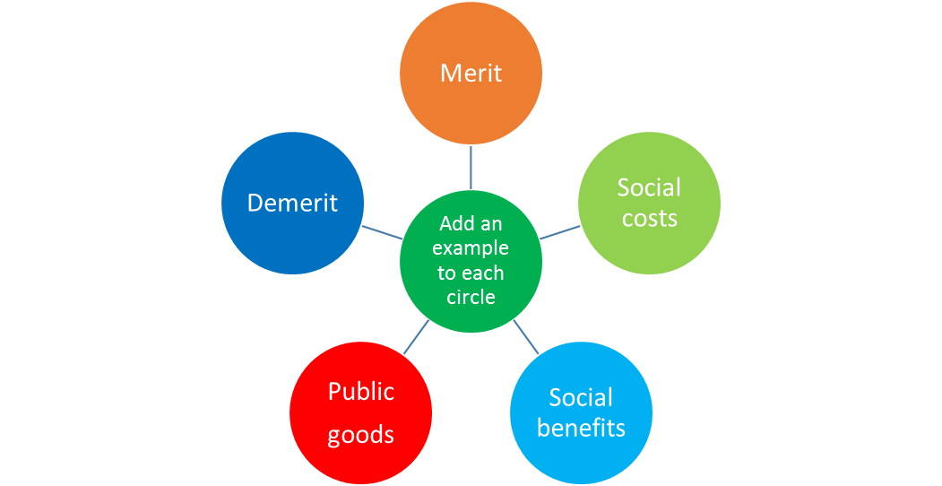
Recall
Add an example of each type and explain what is meant by each term.
For more help, please visit www.exampaperspractice.co.uk
© 2025 Exams Papers Practice. All Rights Reserved

Slide 3

Starter
What impact does vaccines have on society?
What are the benefits and drawbacks of vaccines?
For more help, please visit www.exampaperspractice.co.uk
© 2025 Exams Papers Practice. All Rights Reserved

Slide 4
Learning Objectives
Are you able to explain the policies of public and merit goods, indirect taxation of demerit goods, tradable pollution permits, provision of information, legislation and regulation
Are you able to analyse the impact of these policies on the economy and society, long- and short-term
For more help, please visit www.exampaperspractice.co.uk
© 2025 Exams Papers Practice. All Rights Reserved

Slide 5
Task - The Power is in your hands
Produce a plan for reducing the negative externalities caused by anti vaccinators.
How will you ensure they get vaccinated?
How will you reduce the impact on NHS hospitals?
What measures?
Economic Policy
Diagrams
Detail
For more help, please visit www.exampaperspractice.co.uk
© 2025 Exams Papers Practice. All Rights Reserved

Slide 6
Government provision
Governments intervene in order to reduce market failure to:
  Reduce or eliminate negative externalities
  Increase or maximise positive externalities
  Increase the supply of merit goods
  Reduce the supply of demerit goods
  Supply public goods that would be undersupplied by the market
  https://www.bbc.co.uk/news/av/world-asia-23011189
  Why are public goods undersupplied by the market?
For more help, please visit www.exampaperspractice.co.uk
© 2025 Exams Papers Practice. All Rights Reserved
Notes:
http://www.bbc.co.uk/news/world-asia-23011189

Slide 7
The reasons for government intervention in markets
Governments intervene in order to support UK industry:
  Full employment is a government target
  Certain industries are more important than others as they employ large amounts of labour
  Infrastructure is essential if business are to provide quality services
For more help, please visit www.exampaperspractice.co.uk
© 2025 Exams Papers Practice. All Rights Reserved
Notes:
http://www.theguardian.com/environment/2015/mar/10/ministers-cars-to-be-swapped-for-electric-versions-in-green-drive
http://www.telegraph.co.uk/finance/newsbysector/industry/10878582/Government-announces-45m-investment-in-low-carbon-aircraft.html
http://www.telegraph.co.uk/finance/economics/11112639/UK-in-top-10-nations-for-infrastructure-investing.html
http://www.bbc.co.uk/news/uk-33033682

Slide 8
The reasons for government intervention in markets
To reduce inequalities in the distribution of income and wealth:
  Unequal distribution can lead to poverty
  Tensions in society can be created
  A breakdown in society can cause further market failure
For more help, please visit www.exampaperspractice.co.uk
© 2025 Exams Papers Practice. All Rights Reserved
Notes:
http://www.bbc.co.uk/news/uk-politics-29686628
http://www.bbc.co.uk/news/education-32181848

Slide 9
Looking ahead
How do you think the Government might intervene in the future?
For more help, please visit www.exampaperspractice.co.uk
© 2025 Exams Papers Practice. All Rights Reserved

Slide 10
The impact of these policies on the economy and society
Economic growth as a key objective
Job creation
Rising incomes
Improved standards of living
Improved international competitiveness of UK economy
Improved confidence of:
          consumers to spend
          business to invest
Lower government spending on job seeker’s allowance and associated benefits
Tax revenues are likely to increase allowing the government to re-invest in infrastructure or spend on public services
For more help, please visit www.exampaperspractice.co.uk
© 2025 Exams Papers Practice. All Rights Reserved

Slide 11
The ways in which governments intervene to correct market failure
There are a number of ways in which governments can intervene to correct market failure
These include:
The provision of public and merit goods
Indirect taxation of demerit goods
Tradable pollution permits
Provision of information
Legislation
Regulation
For more help, please visit www.exampaperspractice.co.uk
© 2025 Exams Papers Practice. All Rights Reserved

Slide 12
Provision of public and merit goods
State provision occurs when goods and services are either merit goods or public goods. The government will intervene to ensure that an adequate supply of these products is available to the market.
State provision occurs when the government (or state) intervenes in the market in order to supply a good or a service
This will occur if the government believes that the product is:
A merit good
The government supplies goods and services such as state education and health e.g. NHS as society believes that these are under provided by the market mechanism
A public good
The government supplies goods and services such as defence and infrastructure e.g. roads as these would be under provided by the public sector due to the free rider problem
For more help, please visit www.exampaperspractice.co.uk
© 2025 Exams Papers Practice. All Rights Reserved
Notes:
http://www.bbc.co.uk/news/business-32397212

Slide 13
Taxation
Taxation is the medium through which governments finance their spending and control the economy. It is a charge imposed on products, individuals and businesses.
An indirect tax is a tax on a good or a service.
A direct tax is a tax on an individual or an organisation.
The incidence (or burden) of tax is the amount that the consumer (or producer) will pay for the tax.
The imposition of an indirect tax on demerit goods will lead to an increase in the cost of supply for a firm. This will lead to a shift in the supply curve up and to the left. Quantity supplied will decrease by Q-Q1. P will increase from P to P1.
The increase in tax has caused the price to rise by the vertical distance between the supply curves. The incidence (amount) of the tax paid for by the producer is shown by the blue line (equivalent to P-P0). The incidence of the tax paid for by the consumer is shown by the green line (P1-P).
S with tax
Price
S
Tax
P1
P
P0
D
Q1
Q
Quantity
For more help, please visit www.exampaperspractice.co.uk
© 2025 Exams Papers Practice. All Rights Reserved
Notes:
http://www.telegraph.co.uk/news/science/11164195/Smoking-bans-and-alcohol-taxes-do-they-work.html
http://www.independent.co.uk/life-style/health-and-families/health-news/minister-warns-food-industry-could-face-sugar-tax-10268698.html

Slide 14
Taxation
Specific tax is a set amount per unit. For example, a tax of 50p per fizzy drink.
A specific tax will lead to a parallel shift in the supply curve.
An ad valorem tax is a percentage of the price of the good or service. Therefore, the more expensive the product the greater the tax levied on it.
An ad valorem tax will shift the supply curve upwards whilst also tilting it. As price increases the tax increases.
S with tax
S with tax
Price
Price
S
S
Tax
P1
Tax
P1
P
P
P0
P0
D
D
Q1
Q
Quantity
Q1
Q
Quantity
For more help, please visit www.exampaperspractice.co.uk
© 2025 Exams Papers Practice. All Rights Reserved
Notes:
http://www.bbc.co.uk/news/uk-politics-17455660
http://www.bbc.co.uk/news/uk-politics-17755788

Slide 15
Tradable pollution permits
Pollution permits seek to provide an incentive to businesses on a global scale to reduce CO2 emissions.
Due to the recession EU production has fallen so there have been an excess of pollution permits on the market.
This increase in supply of pollution permits has been coupled with a fall in demand as firms produce less.
This has led to a fall in their price making the scheme less effective.
Pollution permits allow firms to produce a legal level of pollution every year
Permits are tradable on the market
If a firm does not use all of its permits it can sell them to other firms that pollute above their allowance
This provides a financial incentive for firms to reduce pollution
Trading schemes seek to reduce CO2 emissions globally
It is difficult to assess the amount and level of permits to provide to firms
For more help, please visit www.exampaperspractice.co.uk
© 2025 Exams Papers Practice. All Rights Reserved
Notes:
http://www.theguardian.com/environment/2013/jul/03/emissions-trading-reforms-pollution-permits

Slide 16
Tradable pollution permits
The government issue a fixed amount of pollution rights in the economy. Therefore, supply is perfectly inelastic as it cannot change.
If there is an increase in demand for pollution permits (the legal right to pollute) demand will shift from D to D1 and the price of these tradable permits will increase.
Firms will either pay more for the right to pollute, or they will be incentivised to reduce pollution. Those who do not need their permits can sell them on the market.
S1
S (legal right to pollute)
Price
(pollution rights)
P1
P
D1
D
Q1
Q
Quantity
(pollution rights)
Governments can enforce stricter pollution control by reducing the number of tradable permits to Q1. This will lead to a shift in the supply curve to S1 leading to higher prices and a higher cost to firms of creating pollution.
For more help, please visit www.exampaperspractice.co.uk
© 2025 Exams Papers Practice. All Rights Reserved

Slide 17
The provision of information
Through the provision of information governments seek to redress the problems caused by a lack of information.
The greater the information available to consumers the more likely they are to buy goods and services with confidence.
Provision of information ensures that economic units can maximise decisions when consuming and producing goods and services
The government will provide information where the private sector fails to do so
The government provides information in a variety of areas e.g.
The job market
Dangerous products e.g. cigarettes
Economic data to help firms plan for the future
For more help, please visit www.exampaperspractice.co.uk
© 2025 Exams Papers Practice. All Rights Reserved
Notes:
http://www.bbc.co.uk/news/uk-30374732

Slide 18
Legislation
Legislation involves creating and enacting laws in order to protect individuals, firms and society as a whole
The legal environment describes the collection of legislations that impact on the activities of organisations
Should Sunday trading hours be dictated by the Law?
For more help, please visit www.exampaperspractice.co.uk
© 2025 Exams Papers Practice. All Rights Reserved
Notes:
http://www.bbc.co.uk/news/uk-33421842
Sunday trading hours could be extended

Slide 19
Regulation
Regulation occurs when the government seeks to provide effective competition within markets.
Regulation is undertaken by government to create competitive markets
The government believes that this will protect the interests of consumers so that they are not exploited by firms
Effective regulation will lead to greater choice and lower prices
Regulation takes place in a number of industries such as telecoms, water and energy
A key reason for regulation is to create conditions for continued investment in infrastructure in important areas of the economy
Do e-cigarettes need regulation?
For more help, please visit www.exampaperspractice.co.uk
© 2025 Exams Papers Practice. All Rights Reserved
Notes:
http://www.bbc.co.uk/news/health-22867161

Slide 20
Essays
To what extent can regulations be used to correct market failure in the fast-food industry?
To what extent is the provision of information through health warnings on cigarettes the most effective way to correct market failure in this industry?
Discuss the extent to which a subsidy to producers of organic fruit and vegetables might increase their consumption, thus generating positive externalities.
Discuss the extent to which pollution permits are the most effective way of correcting market failure caused by CO2 emissions.
Discuss whether indirect taxes on aircraft travel should be increased.
Discuss the extent to which all health care should be provided privately.
Have you used a diagram to Analyse your answer? Subsidies, indirect taxes, externalities, demand and supply etc.
For more help, please visit www.exampaperspractice.co.uk
© 2025 Exams Papers Practice. All Rights Reserved
Notes:
http://www.bbc.co.uk/news/uk-23744814

Slide 21
The impact of these policies on the economy and society
Unemployment as a key objective:
Higher demand
Higher incomes
Improved standards of living
Higher tax revenue for government
Lower government spending on unemployment related welfare
Improved productivity of UK economy
Reduced poverty
Social benefits (reduced crime, improved wellbeing)
Increased spending might impact on merit goods as it will probably directed at the NHS and education
For more help, please visit www.exampaperspractice.co.uk
© 2025 Exams Papers Practice. All Rights Reserved

Slide 22
The impact of these policies on the economy and society
Inflation as a key objective:
Inflation is important because it affects the value of money in your pocket, workers wage demands and consumer confidence
High, or rising inflation, damages the real value of money and erodes spending power
An inflation target of 2% has been set by the government
Reducing demand will impact on inflation but might lead to less spending on merit goods
For more help, please visit www.exampaperspractice.co.uk
© 2025 Exams Papers Practice. All Rights Reserved

Slide 23
Plenary
One reason that governments intervene is
To increase the supply of demerit goods
To reduce the supply of merit goods
To issue pollution permits
To minimise negative externalities
Can you explain your answer?
For more help, please visit www.exampaperspractice.co.uk
© 2025 Exams Papers Practice. All Rights Reserved
Notes:
D

Slide 24
Plenary
S
As a result of a government subsidy the supply curve shifts from S to S1. The subsidy is shown by
xy
wy
yz
xz
Can you explain your answer?
Price
x
S 1
w
y
z
D
Quantity
For more help, please visit www.exampaperspractice.co.uk
© 2025 Exams Papers Practice. All Rights Reserved
Notes:
D

Slide 25
Plenary
Government wants to encourage greater supply of a merit good. Which action would be appropriate?
Reduce subsidies
Increase taxation
Reduce regulations
Issue less tradable pollution permits
For more help, please visit www.exampaperspractice.co.uk
© 2025 Exams Papers Practice. All Rights Reserved
Notes:
C

