Slide 1


4.3.1 Market failure in society
4.3 Market failure across the economy https://www.youtube.com/watch?v=wiHjVeX3DKc
For more help, please visit www.exampaperspractice.co.uk
© 2025 Exams Papers Practice. All Rights Reserved

Slide 2
Recall
What is the CMA?
Why was the ASDA/Sainsbury’s merger blocked?
Why is regulation essential in certain markets?
For more help, please visit www.exampaperspractice.co.uk
© 2025 Exams Papers Practice. All Rights Reserved

Slide 3
Starter
Alcohol can only be bought by someone aged 18 or over.
Alcohol should not be sold to anyone under the age of 21 without proof of ID.
Which one of these sentences is normative?
For more help, please visit www.exampaperspractice.co.uk
© 2025 Exams Papers Practice. All Rights Reserved

Slide 4
Learning Objectives
Are you able to explain the consequences of under-provision and under-consumption of merit and other goods and services.
Are you able to explain positive and negative externalities.
Are you able to explain what Imperfect and asymmetric information is and the consequences of environmental change.
For more help, please visit www.exampaperspractice.co.uk
© 2025 Exams Papers Practice. All Rights Reserved

Slide 5
Merit goods
A merit good is one that is deemed to be beneficial for society but is under-provided by the market.
Therefore, the market fails to fully supply that good to meet the needs of society.
Merit and demerit goods rely on value judgements.
Merit goods suffer from under provision in the market
Consumers lack perfect information and would under-consume products that society believes would benefit them
Health and education are typical examples of merit goods
The under-consumption of merit goods leads to market failure
The government intervene in the market in order to increase the supply of this type of good or service
For more help, please visit www.exampaperspractice.co.uk
© 2025 Exams Papers Practice. All Rights Reserved
Notes:
http://www.bbc.co.uk/news/uk-23460937
http://www.theguardian.com/sport/2015/jun/11/olympic-legacy-sport-participation-plummets

Slide 6
Merit goods
A merit good will operate where social benefit is greater than private benefit.
There is a positive externality from providing the good, so the government is likely to intervene for the good of society.
The good is seen to provide benefits to society over and above those to the individual consumer i.e. there is an additional external benefit of providing the good.
This can be measured by the grey shaded area. Individuals would demand Q of the good where their private benefit equals their private cost. However, society would benefit from providing Q1 where social benefit equals social cost.
S = MPC
Price
P1
P
D1 MSB
D MPB
Q1
Q
Quantity
For more help, please visit www.exampaperspractice.co.uk
© 2025 Exams Papers Practice. All Rights Reserved
Notes:
http://www.bbc.co.uk/news/health-30934590
http://www.bbc.co.uk/news/health-32417699
PB less than social as they have information failure. Irrational decision making.

Slide 7
Task
What is a merit and demerit good?
What are the features of each type of good?
What is market failure?
What do we do about market failure?
What is meant by private benefit and social benefit?
What is meant by private cost and social cost?
For more help, please visit www.exampaperspractice.co.uk
© 2025 Exams Papers Practice. All Rights Reserved

Slide 8
Externalities
Externalities are the costs and benefits to a third party created by economic agents when undertaking their activities
Externalities can be negative or positive
  Negative externalities are those costs to a third party that are not included in the price of the economic activity
  Positive externalities are those benefits to a third party that are not included in the price of the economic activity
For more help, please visit www.exampaperspractice.co.uk
© 2025 Exams Papers Practice. All Rights Reserved

Slide 9
Demerit goods
A demerit good will operate where private benefit is greater than social benefit.
Demerit goods are over provided by the market
These goods produce negative externalities which are deemed to be bad for society
Drugs and cigarettes are typical examples of demerit goods
The over-consumption of demerit goods leads to market failure
The government intervene in the market in order to reduce or eliminate the supply of this type of good or service
For more help, please visit www.exampaperspractice.co.uk
© 2025 Exams Papers Practice. All Rights Reserved
Notes:
http://www.bbc.co.uk/news/magazine-23502892
http://www.bbc.co.uk/news/health-32117019

Slide 10
Demerit goods
A demerit good is one that is deemed to be bad for society but is over provided by the market.
There is a negative externality from providing the good so the government is likely to reduce or eliminate the supply of the good for the benefit of society.
The good is seen to be bad for society and is over-consumed by the market.
This negative externality can be measured by the grey shaded area. Individuals would demand Q of the good where their private benefit equals their private cost, but society would benefit from providing less at Q1 where social benefit equals social cost.
S = MPC
Price
P
P1
MPB
MSB
Q1
Q
Quantity
For more help, please visit www.exampaperspractice.co.uk
© 2025 Exams Papers Practice. All Rights Reserved
Notes:
PRODUCER NOT SHARING INFO
Society wants at social optimum.
Over consumption and over production and thus welfare loss.

Slide 11

Task
Explain why junk food items such as McDonald’s burgers are classed as demerit goods.
Explain why society deems it necessary to provide merit goods in an economy.
Draw a diagram to show the benefits created for society by producing a merit good.
Draw a diagram to show the negative externalities created for society by producing a demerit good.

Slide 12
Factor immobility
Factor immobility occurs because it is difficult for factors of production to be put to alternative uses
The immobility of factors of production can result in a misallocation of resources
This leads to market failure
Factor immobility can occur for:
  Labour
  Capital
  Land
For more help, please visit www.exampaperspractice.co.uk
© 2025 Exams Papers Practice. All Rights Reserved

Slide 13
Immobility of labour
Labour immobility can lead to structural unemployment as the result of the decline of a particular industry creating large scale unemployment in a geographical area.
Labour immobility can occur as a result of:
Geographical immobility – where workers in an economy find it difficult to move from one region to another
This may occur due to:
The cost of moving e.g. housing costs in London
Imperfect information e.g. not being aware of jobs
Not wanting to move away from family and friends
Occupational immobility - workers are not equipped for different types of work e.g. a coal miner cannot easily transfer to become an accountant
For more help, please visit www.exampaperspractice.co.uk
© 2025 Exams Papers Practice. All Rights Reserved

Slide 14

Immobility of capital
Capital goods are those that are used in the production of other goods and services. These will bring a stream of income in the future.
Capital immobility can occur as a result of:
  Rapid technological change
    changing technology can make machinery obsolete
    this leads to costs for the firm as they update capital equipment
  Structural change in the economy
    as the types of industry that make up the economy change so does the type of capital equipment needed
    we are less likely to use specialist coal mining equipment nowadays and it is difficult to put this equipment to use elsewhere
For more help, please visit www.exampaperspractice.co.uk
© 2025 Exams Papers Practice. All Rights Reserved

Slide 15
Immobility of land
Land encompasses all of the natural resources that come from the earth that are used in the production of goods or services.
Land immobility can occur as a result of:
  The inability to change the use of land due to:
    Climate conditions where it is not possible to produce certain crops e.g. the UK finds it difficult to produce grapes
    It is almost impossible or not economically practical to move land from one area to another
    The EU subsidises the growing of certain foodstuff so farmers and fishermen continue to produce these
For more help, please visit www.exampaperspractice.co.uk
© 2025 Exams Papers Practice. All Rights Reserved

Slide 16
Factor immobility and market failure
Factor immobility can lead to a misallocation of resources and therefore market failure
If factors of production are immobile then markets will find it difficult to clear when there is a change in supply and demand
If demand increases but supply is fixed due to immobile factors then there will be distortions in the market and it will take time for market equilibrium to be reached
For more help, please visit www.exampaperspractice.co.uk
© 2025 Exams Papers Practice. All Rights Reserved
Notes:
http://www.theguardian.com/education/2014/sep/30/graduate-into-underemployment
https://www.tuc.org.uk/economic-issues/labour-market-and-economic-reports/labour-market/uk-near-bottom-eu-league

Slide 17
Imperfect and asymmetric information
Perfect knowledge or perfect information is a theoretical concept which occurs when all consumers in a market are fully aware of price, quantity available and all other relevant information for all products when making buying decisions.
Information asymmetry occurs when some parties in a transaction have more information regarding the product than others.
Information failure is a type of market failure where consumers or producers:
  do not have perfect knowledge
  have asymmetric knowledge
  This means that there is imperfect information
Without having full information about a product it is difficult for consumers and producers to make decisions regarding price, quality and other relevant factors when buying and selling
This can lead to the under provision of merit goods and the over provision of demerit goods as people are ill-informed regarding the benefits or other wise of such goods
For more help, please visit www.exampaperspractice.co.uk
© 2025 Exams Papers Practice. All Rights Reserved

Slide 18
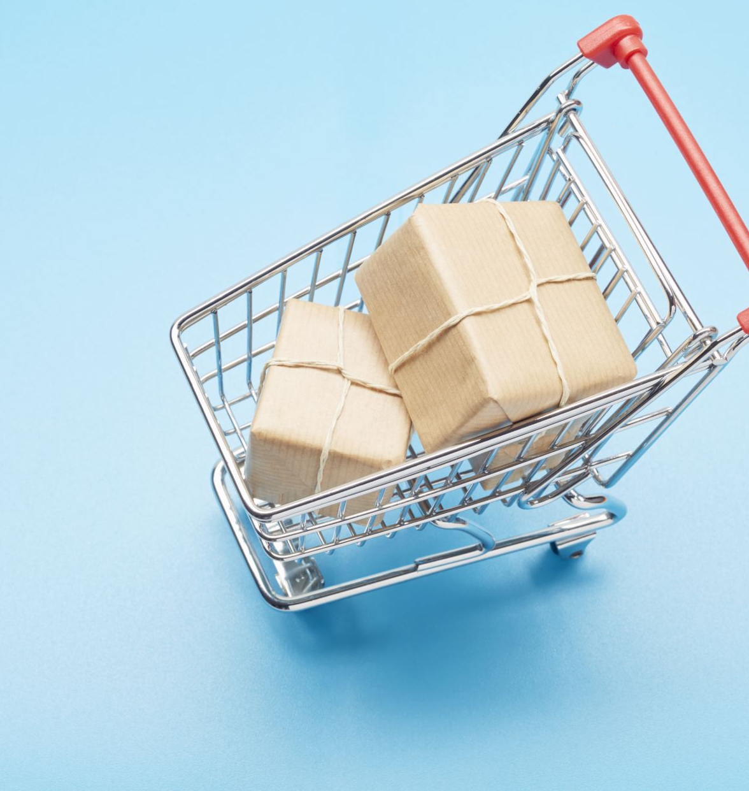
Task
Define the term information failure.
Define the term perfect knowledge.
Define the term asymmetric knowledge.
Explain why there is likely to be information failure amongst consumers at supermarkets.
Why don’t all economic agents have perfect knowledge regarding goods and services?
Explain why merit goods may be under provided.
For more help, please visit www.exampaperspractice.co.uk
© 2025 Exams Papers Practice. All Rights Reserved

Slide 19
Consequences of environmental change
Global economic growth has had a significant impact on the environment
High production levels have meant the extensive use of natural resources such as fossil fuels e.g. oil and coal and there has also been deforestation
Much of the production is unsustainable, using non-renewable resources
Social costs are not paid for by those creating the pollution
This has created negative externalities such as pollution and climate change
For more help, please visit www.exampaperspractice.co.uk
© 2025 Exams Papers Practice. All Rights Reserved

Slide 20
Plenary
Name one key term you’ve learnt.
Name one key term you need to revise.
Explain what is meant merit and demerit goods?
Explain what is meant by market failure?
For more help, please visit www.exampaperspractice.co.uk
© 2025 Exams Papers Practice. All Rights Reserved

