Slide 1
4.1.2 Barriers to Entry
For more help, please visit www.exampaperspractice.co.uk
© 2025 Exams Papers Practice. All Rights Reserved

Slide 2
Recall Task
What is a Monopoly?
What is a Duopoly?
What is an Oligopoly?
What is Monopolistic competition?
What is Perfect competition?
For more help, please visit www.exampaperspractice.co.uk
© 2025 Exams Papers Practice. All Rights Reserved

Slide 3
Starter
What makes it difficult for someone to start a new business selling paracetamol?
What do governments do to create these difficulties?
For more help, please visit www.exampaperspractice.co.uk
© 2025 Exams Papers Practice. All Rights Reserved

Slide 4
Lesson Objectives
Are you able to explain the barriers to entry for firms in different markets?
Are you able to analyse the impact of barriers to entry on market structures?
For more help, please visit www.exampaperspractice.co.uk
© 2025 Exams Papers Practice. All Rights Reserved

Slide 5
Contestable markets
A sunk cost is one that the firm cannot recover if it were to exit the market.
Freedom to enter or exit the market means that factors of production are perfectly mobile so no barriers to entry exist.
Perfect knowledge occurs when all producers and consumers in a market are fully aware of price, quantity available and other relevant information for all products when making buying decisions.
Hit and run competition occurs when firms enter the market to take advantage of short term supernormal profits.
For more help, please visit www.exampaperspractice.co.uk
© 2025 Exams Papers Practice. All Rights Reserved

Slide 6
Contestable markets
A contestable market is a type of market structure that is competitive because of a lack of barriers to entry. A perfectly contestable market exhibits the following characteristics:
Freedom to enter or exit the market
No sunk costs
Perfect knowledge
Price cannot be set above average cost as supernormal profits will attract hit and run competition to enter the market
In reality we look at the degree of contestability in the market as perfectly contestable markets do not exist
For more help, please visit www.exampaperspractice.co.uk
© 2025 Exams Papers Practice. All Rights Reserved

Slide 7
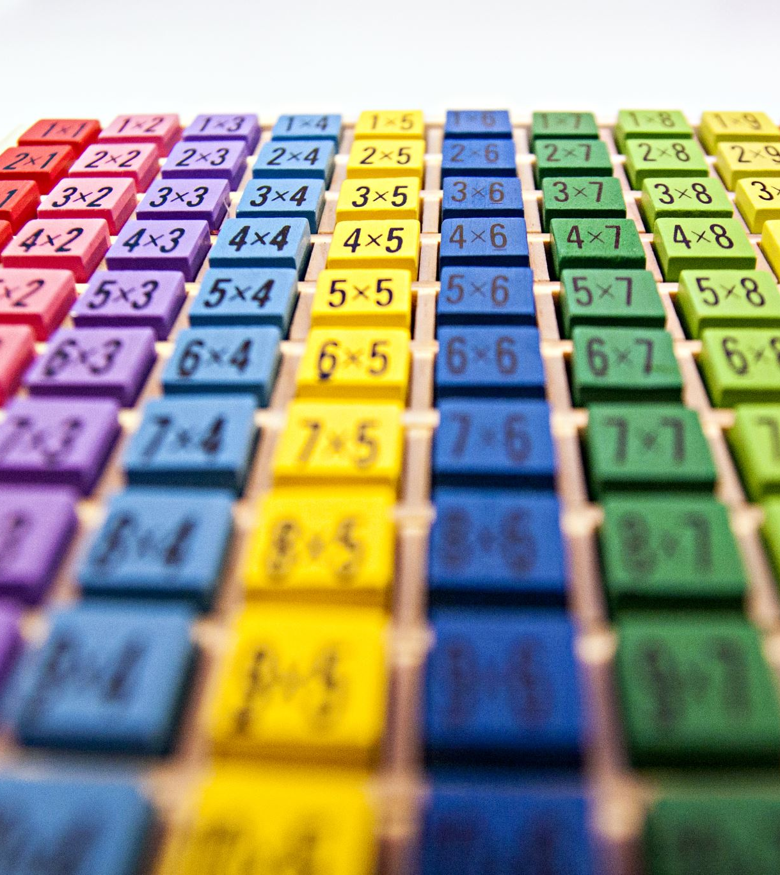
Contestable markets and perfect competition
Contestable markets differ to those in perfect competition as firms can:
Sell both homogenous (identical) or heterogeneous (different) products
Display elements of monopoly power e.g. by being a price leader in the market
Be small in number e.g. the market might be oligopolistic
The significance of contestable markets is that firms can easily enter or exit the market to access supernormal profits
This threat of potential entrants means that incumbent firms only make normal profits
For more help, please visit www.exampaperspractice.co.uk
© 2025 Exams Papers Practice. All Rights Reserved

Slide 8
Market contestability and the performance of an industry
Contestability will impact on efficiency in a market:
Productive efficiency will exist as firms operate at the lowest point on their average cost curve. If they didn’t new firms would enter the market with lower AC and could charge a lower price
Allocative efficiency occurs as firms:
only make normal profits (AR or P = AC)
operate at the lowest cost output (MC = AC)
thus, P = MC the criterion for allocative efficiency
Dynamic efficiency might occur as firms innovate production processes in order to lower AC. This is made easier as firms have greater access to industry wide technology
For more help, please visit www.exampaperspractice.co.uk
© 2025 Exams Papers Practice. All Rights Reserved

Slide 9
Activity 1
Explain the term contestability.
How will this impact on profit making firms?
For more help, please visit www.exampaperspractice.co.uk
© 2025 Exams Papers Practice. All Rights Reserved

Slide 10
Freedom to enter or exit the market
Freedom to enter or exit the market means that factors of production are perfectly mobile so no barriers to entry or exit exist
This means that all firms have access to the same technology
The average costs of all firms are likely to be the same for both new entrants and existing firms as firms are unable to exploit economies of scale
If firms in the market raise price and earn supernormal profits new entrants will take advantage and move into the market
If the original firms lower price and supernormal profits no longer exist the hit and run competition will leave the market
As there is free entry and exit the hit and run competitor does not have any substantial costs e.g. their machines can still be put to use for other purposes
This guarantees only normal profit in the long run
For more help, please visit www.exampaperspractice.co.uk
© 2025 Exams Papers Practice. All Rights Reserved

Slide 11
Product differentiation
Firms try to make their product different to the competition by adapting the actual product in some way or by distinguishing the product through advertising and branding
A business might have a product range selling a variety of goods or services to meet consumer needs
With high competition in most markets it is important that a business tries to differentiate itself from the competition in order to sell
A Unique Selling Point (USP) is something that distinguishes a firm’s product from those of its competitors and can allow a firm to charge a premium price
For more help, please visit www.exampaperspractice.co.uk
© 2025 Exams Papers Practice. All Rights Reserved

Slide 12
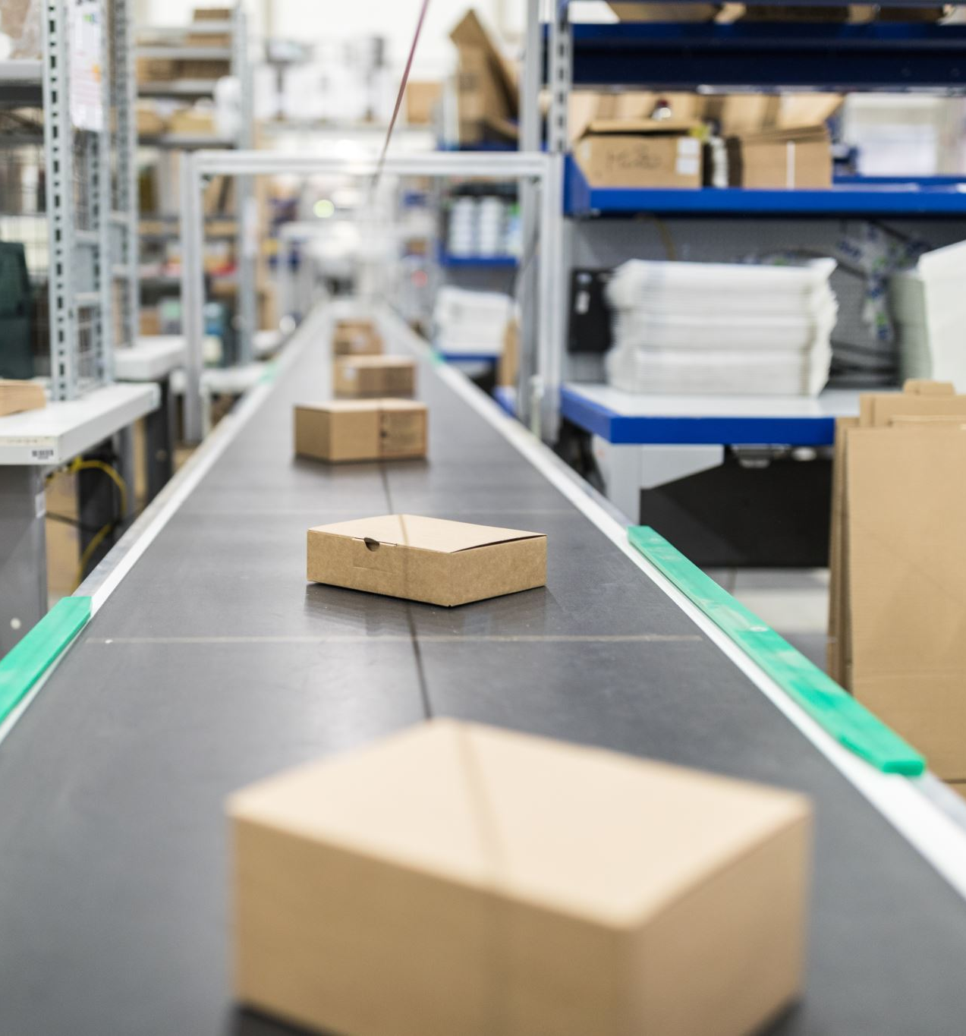
Activity 2
What is meant by the freedom to enter or exit the market?
How will this differ depending on the industry?
How do firms differentiate themselves without changing price?
For more help, please visit www.exampaperspractice.co.uk
© 2025 Exams Papers Practice. All Rights Reserved

Slide 13
Branding
A promotional method that involves the creation of an identity for the business that distinguishes that firm and its products from other firms
Branding can add value to a product allowing firms to charge higher prices
Ultimately leads to brand loyalty whereby customers will continue to buy products from that firm
Organisations spend enormous amounts of time and money branding their company and products
For more help, please visit www.exampaperspractice.co.uk
© 2025 Exams Papers Practice. All Rights Reserved

Slide 14
Start-up costs
Start-up costs or sunk costs are costs that the firm cannot recover if it were to exit the market
As these costs are irretrievable they will impede the free exit of firms from the industry
Sunk costs should not be taken into account when making future investment decisions
However, a firm will be aware that sunk costs will exist in a market
This will deter hit and run entrants into a market
Therefore, the market is less likely to be contestable
For more help, please visit www.exampaperspractice.co.uk
© 2025 Exams Papers Practice. All Rights Reserved

Slide 15
Intellectual property rights
Intellectual property rights create barriers to entry
These include legal barriers that stop other firms from using ideas:
Patents
Trademarks
Copyright
These restrict other firms from producing a good or service making it difficult for them to enter a market
For more help, please visit www.exampaperspractice.co.uk
© 2025 Exams Papers Practice. All Rights Reserved

Slide 16
R&D and technology change
Research and development creates barriers to entry as firms need to finance it
In fast moving industries where products change regularly this requires investment in product innovation
As technology changes firms need to invest heavily in process innovation
These restrict other firms from entering a market, creating a significant barrier to entry
For more help, please visit www.exampaperspractice.co.uk
© 2025 Exams Papers Practice. All Rights Reserved

Slide 17
Other types of barrier to entry and exit
Perfect knowledge occurs when all producers and consumers in a market are fully aware of price, quantity available and other relevant information for all products when making buying and production decisions
This means that all firms have access to the same technology and can use it at the same cost
If a firm has a competitive advantage due to better technology this will lower its average costs and impede the entry of new firms into the market
Therefore, the market is less likely to be contestable
For more help, please visit www.exampaperspractice.co.uk
© 2025 Exams Papers Practice. All Rights Reserved

Slide 18
The impact of barriers to entry on perfect competition
In perfect competition there are no barriers to entry or exit
This means firms are free to enter or exit the market if they wish to do so
Therefore, entry costs will be low or non-existent
Barriers to entry such as costs associated with capital expenditure, research and development and start-up of the business are low or non- existent
For more help, please visit www.exampaperspractice.co.uk
© 2025 Exams Papers Practice. All Rights Reserved

Slide 19
The impact of barriers to entry on imperfect markets
Barriers to entry exist in markets with monopoly power. These stop firms from entering the market
They include:
High costs to enter the market, especially high capital costs
Economies of scale experienced by large firms e.g. bulk buying
Intellectual property rights/legal barriers – patents, trademark and copyright restrict other firms from producing a good or service
Unfair competition e.g. predatory pricing – attempting to force competitors out of a market e.g. selling products below cost price for a time period
Government regulation – restricting firms from entering a market e.g. giving sole rights to one supplier
For more help, please visit www.exampaperspractice.co.uk
© 2025 Exams Papers Practice. All Rights Reserved

Slide 20
The impact of barriers to entry on imperfect markets
Firms might use limit pricing, deliberately keeping price low to deter new entrants into the market
This leads to normal profits being made in the industry
Sunk costs are costs that the firm cannot recover if it were to exit the market
As these costs are irretrievable they will impede the free exit of firms from the industry
For more help, please visit www.exampaperspractice.co.uk
© 2025 Exams Papers Practice. All Rights Reserved

Slide 21
Activity 3
Explain the impact of barriers to entry on imperfect markets.
How does this differ from perfect markets?
How do firms create barriers to entry within a market?
For more help, please visit www.exampaperspractice.co.uk
© 2025 Exams Papers Practice. All Rights Reserved

Slide 22
Economies of scale and their impact on cost and price
Purchasing economies provide discounts for bulk-buying
As the firm is buying a job lot they are able to secure lower prices per unit
Technical economies are the use of specialist, often expensive, capital e.g. machines
Large firms are able to spend more on bigger and more efficient machinery, spreading fixed costs over greater output. This helps to obtain lower costs per unit through this method
Managerial economies allow firms to employ specialist labour e.g. accountants, lawyers, technical
Division of labour allows staff to focus on particular areas
All of these allow firms to reduce costs and charge lower prices
For more help, please visit www.exampaperspractice.co.uk
© 2025 Exams Papers Practice. All Rights Reserved

Slide 23
Plenary
Name one key term you’ve learnt.
Name one key term you need to revise.
Explain what is meant by imperfect markets?
Explain what is meant by contestability?
For more help, please visit www.exampaperspractice.co.uk
© 2025 Exams Papers Practice. All Rights Reserved

