Slide 1
3.3.2 Demand-side factors in global markets 3.3 Globalisation
For more help, please visit www.exampaperspractice.co.uk
© 2025 Exams Papers Practice. All Rights Reserved

Slide 2
Recall Activity
What is glocalisation?
What is the marketing mix?
Explain the three different approaches to global markets
For more help, please visit www.exampaperspractice.co.uk
© 2025 Exams Papers Practice. All Rights Reserved

Slide 3
Starter
What do we mean by cultural differences?
Has globalisation caused there to be less cultural differences?
Research and discuss whether Chinese will become the global language for business.
For more help, please visit www.exampaperspractice.co.uk
© 2025 Exams Papers Practice. All Rights Reserved

Slide 4
Learning Objectives
Are you able to explain cultural and social factors that impact global markets?
Are you able to analyse how firms respond to demand side factors?
For more help, please visit www.exampaperspractice.co.uk
© 2025 Exams Papers Practice. All Rights Reserved

Slide 5
Cultural/social factors
Cultural/social factors are the lifestyle, customs and values of a group of people.
It is important for a business to recognise these factors when targeting markets. Without an insight and understanding it is likely that a business will fail to establish a significant presence in the market.
It is essential that a business understands the requirements of the target market, whilst at the same time ensuring that it does not use inappropriate marketing, very likely innocently, to upset them.
For more help, please visit www.exampaperspractice.co.uk
© 2025 Exams Papers Practice. All Rights Reserved

Slide 6
Cultural differences
Cultural differences occur because different types of people have different lifestyles, customs and values. Therefore, their perception of situations is different.
Language, behaviour and gestures are interpreted differently. This means that businesses must employ people that have an awareness of the cultures of the markets in which they are operating.

Slide 7
Cultural differences
This becomes more complex when dealing with a variety of cultures at the same time e.g. often seen in cosmopolitan centres such as London.
Understanding other people’s behaviour, whilst being able to put forward ones own views in a respectful way, are clearly important.
For more help, please visit www.exampaperspractice.co.uk
© 2025 Exams Papers Practice. All Rights Reserved

Slide 8
Different tastes
As part of these cultural differences it is apparent that people have different tastes. Taste is subjective and is dependent on the individual. However, upbringing and the environment in which one lives have had a significant impact on this.
This means that businesses can use their understanding of culture to help market their products. Promoting products based on ethnicity, for example, will ensure that a marketing budget is more likely to be spent effectively.
Again, having self-awareness and an understanding of where other people are coming from, ensures that the business is likely to be more successful.
For more help, please visit www.exampaperspractice.co.uk
© 2025 Exams Papers Practice. All Rights Reserved

Slide 9
Activity 1
Explain why it is important for companies to be aware of cultural differences
Explain what it means for people to have different tastes.
Name a cultural difference in another country and explain how a company could adapt to it.
For more help, please visit www.exampaperspractice.co.uk
© 2025 Exams Papers Practice. All Rights Reserved

Slide 10
Language
Language barriers can cause significant issues when doing business. Often, English is seen as the business language and it is clear that many business people are happy to negotiate using English.
However, with vast new markets, such as the BRICS countries, having opened up in the past two decades, being able to market products in other languages effectively is increasingly important.
This Photo by Unknown author is licensed under CC BY.

Slide 11
Language
It looks unprofessional and can compromise a deal if the marketing of a product is let down by poor language. A poor letter of application might mean not getting an interview. In the same way, poor advertising based on language can lose customers.
For more help, please visit www.exampaperspractice.co.uk
© 2025 Exams Papers Practice. All Rights Reserved

Slide 12
Unintended meanings
Unintended meanings occur when the message being portrayed by the business is taken to mean something else by the potential market.
01
Often this is based on factors such as gestures and hidden connotations.
02
Without appropriate insight into different cultures and societies this can cause significant problems for a business, even destroying its reputation.
03
This means that the business would have to redress the situation by increasing the marketing budget to restore its brand image.
04
For more help, please visit www.exampaperspractice.co.uk
© 2025 Exams Papers Practice. All Rights Reserved

Slide 13
Inappropriate/inaccurate translations
Inappropriate and inaccurate translations occur when the language being used to promote a product is not converted accurately.
This can cause significant embarrassment for a business and will impact on the brand name in the short term.
For more help, please visit www.exampaperspractice.co.uk
© 2025 Exams Papers Practice. All Rights Reserved

Slide 14
Inappropriate/inaccurate translations
There are numerous examples of businesses advertising their products through offensive terminology as the business hasn’t undertaken adequate research.
In a similar vein, an inaccurate translation, maybe only changing a single letter, can lead to the business having to quickly remedy an awkward situation.
For more help, please visit www.exampaperspractice.co.uk
© 2025 Exams Papers Practice. All Rights Reserved

Slide 15
Activity 2
Explain what we mean by a language barrier.
Explain why it is important for companies to be aware of language differences
Find an example of a time language barriers caused bad publicity for a company.
For more help, please visit www.exampaperspractice.co.uk
© 2025 Exams Papers Practice. All Rights Reserved

Slide 16
Activity 3
Identify how 3 information and communication factors may affect the activities of a business.
Information & communication factors | Effect on the activities of a business | Actions a business can take to reduce the threat
For more help, please visit www.exampaperspractice.co.uk
© 2025 Exams Papers Practice. All Rights Reserved

Slide 17
Adapting marketing strategies for niche markets
Global market niches are subcultures in world society. These share common interests and can be identified as market segments on a global scale.
Although a niche targets a smaller market, on a global scale this can be sizeable.
For more help, please visit www.exampaperspractice.co.uk
© 2025 Exams Papers Practice. All Rights Reserved

Slide 18
Adapting marketing strategies for niche markets
This is particularly profitable when we recognise that these are likely to be highly differentiated products rather than low cost.
This means that the world’s wealthiest consumers can be targeted, with the quality of the product being the most important factor.
For more help, please visit www.exampaperspractice.co.uk
© 2025 Exams Papers Practice. All Rights Reserved

Slide 19
Adapting marketing strategies for niche markets
Other common features of global niche markets include:
Require high levels of customer service as demanding customers pay for quality not quantity
Highly skilled employees with the expertise and, at times, the reputation required to create and sell the desired products
For more help, please visit www.exampaperspractice.co.uk
© 2025 Exams Papers Practice. All Rights Reserved

Slide 20
Activity 4
Explain what we mean by a global market niche.
01
Name some common features of global market niches.
02
Explain why it is still profitable to target niche markets, rather than the mass market.
03

Slide 21
Activity 5
Advantages | Disadvantages
Identify at least 3 advantages and 3 disadvantages of global niche markets.
For more help, please visit www.exampaperspractice.co.uk
© 2025 Exams Papers Practice. All Rights Reserved

Slide 22
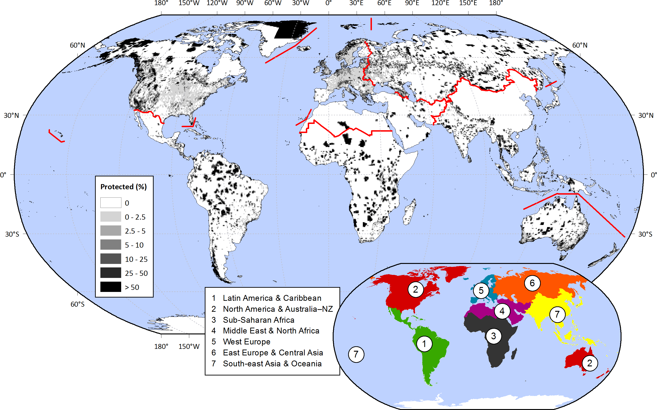
Adapting marketing strategies for niche markets
Product innovation is essential in order to produce the highly differentiated products that customers require
A high level of market research is required in order to understand the specific needs of the market on a global basis
This Photo by Unknown author is licensed under CC BY.
For more help, please visit www.exampaperspractice.co.uk
© 2025 Exams Papers Practice. All Rights Reserved

Slide 23
Adapting marketing strategies for niche markets
The marketing mix needs to be applied effectively to global niche markets in order to be of use to the business.
A business will have to invest in each element of the marketing mix numerous times in order to meet the requirements of the variety of consumers that they are targeting.
This will require expertise and insight into these specific markets.
For more help, please visit www.exampaperspractice.co.uk
© 2025 Exams Papers Practice. All Rights Reserved

Slide 24
Adapting marketing strategies for niche markets
Product will be the most important factor. The quality must be extremely high in order to target wealthier individuals on a global basis.
This means that businesses must undertake significant market research and research and development in order to meet customer requirements.
For more help, please visit www.exampaperspractice.co.uk
© 2025 Exams Papers Practice. All Rights Reserved

Slide 25
Adapting marketing strategies for niche markets
Businesses will be able to charge high prices as they are targeting the world’s wealthiest consumers. In essence, price is not an important factor to the consumer.
The high levels of disposable income that people have mean that, although sales volume is low, there is significant added value for each product sold.

Slide 26
Adapting marketing strategies for niche markets
Global promotion will be targeted through niche channels. This may be through specific social media as the target market are likely to be up to date with the very latest social media. However, it could be very carefully planned and specifically targeted, with one to one service provided to meet the needs of demanding clients.
Finally, place will be through carefully selected channels. It may well be that the business goes to the client, offering high quality individual customer service.

Slide 27
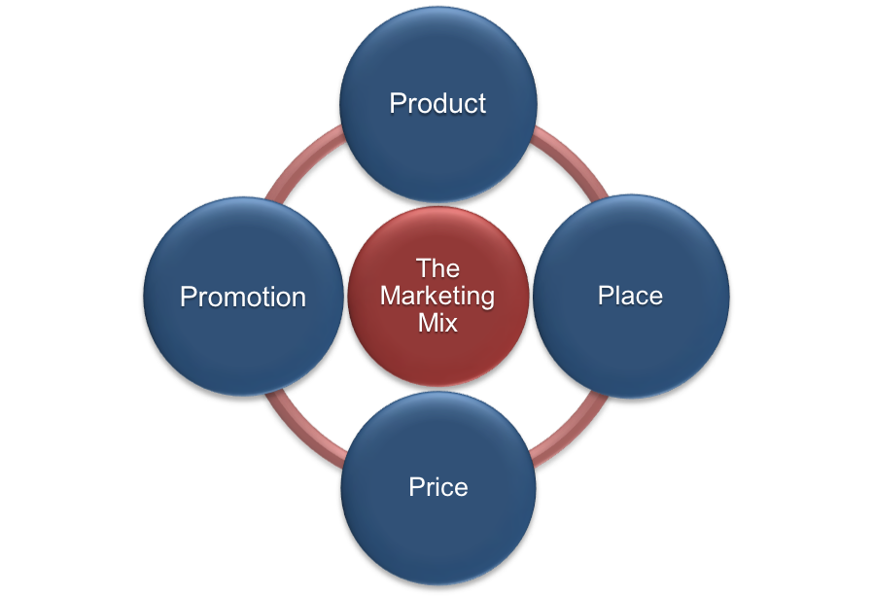
Activity 6
Explain how each part of the marketing mix is applied to a niche product.
Use a real life example of a niche product and explain how the marketing mix has been used.
For more help, please visit www.exampaperspractice.co.uk
© 2025 Exams Papers Practice. All Rights Reserved

Slide 28
Adapting marketing strategies for mass markets
A global mass market is when a business is trying to sell a largely homogenous product to a large market.
Modern marketing, whilst still targeting mass markets, has become increasingly personalised
Firms have adapted to changes in technology and to the influence of social media
Big data has allowed them to personalise their marketing to greater suit the needs of the target audience
As technology and the use of data gathered by firms improves so will the ability to cater for individual needs when mass marketing products
For more help, please visit www.exampaperspractice.co.uk
© 2025 Exams Papers Practice. All Rights Reserved

Slide 29
Activity 7
Explain what we mean by a mass market product.
01
Explain how marketing has changed for mass market products.
02
Discuss whether it is ethical for companies to use our data to target advertising.
03
For more help, please visit www.exampaperspractice.co.uk
© 2025 Exams Papers Practice. All Rights Reserved

Slide 30
Activity 8
Explain how each part of the marketing mix is applied to a mass market product.
Use a real life example of a mass market product and explain how the marketing mix has been used.
For more help, please visit www.exampaperspractice.co.uk
© 2025 Exams Papers Practice. All Rights Reserved

Slide 31
Presentation - Tesco strategy for success
How will you lead Tesco to global dominance?
What strategies will you use?
How ill you make it a success?
Pick which countries you will target – use data to support your strategy.
This needs to be written as a formal document.
Addressed to the CEO.
For more help, please visit www.exampaperspractice.co.uk
© 2025 Exams Papers Practice. All Rights Reserved

Slide 32
Home learning
Demand side questions
For more help, please visit www.exampaperspractice.co.uk
© 2025 Exams Papers Practice. All Rights Reserved

Slide 33
Plenary
Niche Markets | Mass Markets
Summarise how firms respond to demand side factors by adapting market strategies
Explain whether you would try to make a mass market product or a niche product.
For more help, please visit www.exampaperspractice.co.uk
© 2025 Exams Papers Practice. All Rights Reserved

