Slide 1




2.6.2 Policy instruments
For more help, please visit www.exampaperspractice.co.uk
© 2025 Exams Papers Practice. All Rights Reserved

Slide 2

Recall
What are the four macroeconomic objectives?
What are the two types of inflation we have learnt?
Why is inflation a good and bad thing for the economy?
For more help, please visit www.exampaperspractice.co.uk
© 2025 Exams Papers Practice. All Rights Reserved

Slide 3

Starter
List a number of government policies to boost economic growth.
Draw a diagram to show the impact of one of these policies.
What can the Bank of England do?
For more help, please visit www.exampaperspractice.co.uk
© 2025 Exams Papers Practice. All Rights Reserved

Slide 4
Learning Objectives
Are you able to explain the role of Fiscal policy?
Are you able to explain the role of Monetary policy?
Are you able to analyse Supply-side policies?
Are you able to evaluate exchange rate policy?
For more help, please visit www.exampaperspractice.co.uk
© 2025 Exams Papers Practice. All Rights Reserved

Slide 5
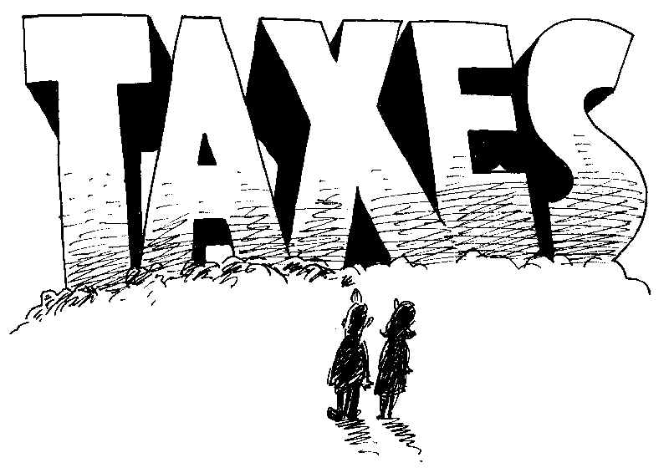
Fiscal Policy: A Definition
“The manipulation of government spending, taxation and government borrowing to influence the level of economic activity.”
Activity
List four different taxes the government collect.
Give a definition for each tax.
What is the impact of each on businesses and people.
For more help, please visit www.exampaperspractice.co.uk
© 2025 Exams Papers Practice. All Rights Reserved

Slide 6

Fiscal Policy can have both macroeconomic and microeconomic functions
  Fiscal policy is used to achieve a wide variety of objectives
    Keep inflation on target (2%)
    Stimulate economic growth and employment during times of recession
    Maintain a stable economic cycle that minimises “boom and bust”
    Activity
    Give an update on each of these targets for the UK economy now.
    What has happened over the last three years to each of these targets.
For more help, please visit www.exampaperspractice.co.uk
© 2025 Exams Papers Practice. All Rights Reserved

Slide 7
Types of Fiscal Policy (1)
Fiscal policy is said to be “expansionary” if the government is trying to positively stimulate economic activity.
Possible methods include:
Cutting taxes
  A cut in income tax may give consumers more disposable income, thus raising consumption
  A cut in corporation tax may increase available profits for firms which may stimulate investment
Raising government spending
  The government may increase its spending on core infrastructure projects or increase the pay of public sector workers
Increasing the budget deficit
  Another way of increasing spending if the government do not wish to raise taxation is to increase borrowing
  This can be spent on a variety of projects nationally
  However, this adds to the national debt, and must be repaid with interest
For more help, please visit www.exampaperspractice.co.uk
© 2025 Exams Papers Practice. All Rights Reserved

Slide 8
Activity
Draw a diagram to show expansionary fiscal policy.
Explain your diagram.
Analyse the impact on:
  Inflation
  Employment
  Government spending.
For more help, please visit www.exampaperspractice.co.uk
© 2025 Exams Papers Practice. All Rights Reserved

Slide 9
Types of Fiscal Policy (2)
Fiscal policy is said to be “contractionary” if the government is trying to constrain aggregate demand, reduce debt or control inflation.
Possible methods include:
Increasing taxes
  If income tax is raised this may discourage spending and reduce consumption
  This will reduce aggregate demand and may help to bring inflation under control
Cutting government spending
  The government may decide to reduce expenditure on public projects or cut key government budgets if it considers excessive government spending to be unaffordable or perhaps inflationary
Cutting the budget deficit
  The UK budget deficit is large and thus must be repaid with interest
  Cutting the governments long term borrowing commitments may help to stabilise economic growth as reduced debt repayments in future can be reinvested back into the economy
For more help, please visit www.exampaperspractice.co.uk
© 2025 Exams Papers Practice. All Rights Reserved

Slide 10
Activity
Draw a diagram to show expansionary fiscal policy.
1
Explain your diagram.
2
Analyse the impact on:
3
Inflation
Employment
Government spending.
For more help, please visit www.exampaperspractice.co.uk
© 2025 Exams Papers Practice. All Rights Reserved

Slide 11
Expansionary Fiscal Policy – Aggregate Demand
1) Assume the government would like to stimulate economic growth.
LRAS
2) It may decide to cut taxation, which will boost AD to AD1, as consumption rises.
Price Level
3) This has the effect of increasing real national output from Y to Y1.
4) There will also be the added benefit of creating employment.
P1
P
5) However, this has come at the expense of an increase in the price level to P1, which may hamper the inflation target.
AD1
AD
6) In addition, if additional consumption is spent on imports, then this will worsen the balance of payments on current account.
Y
Y1
FE
Real National Output
For more help, please visit www.exampaperspractice.co.uk
© 2025 Exams Papers Practice. All Rights Reserved

Slide 12
Expansionary Fiscal Policy – Aggregate supply
1) Imagine the government would like to stimulate the supply-side of the economy.
2) They may cut corporation tax in order to boost firms’ profits, which can then be reinvested in capital projects.
LRAS
LRAS1
Price Level
3) LRAS will shift to the right to LRAS1.
4) Productive capacity has now increased to FE1 and there has been a fall in the price level from P to P1, helping to soften inflationary pressure.
P
5) However, if AD remains unchanged, spare capacity has now increased in size from Y-FE to Y1-FE1, indicating a waste of economic resources.
P1
AD
Y
Y1
FE1
Real National Output
FE
For more help, please visit www.exampaperspractice.co.uk
© 2025 Exams Papers Practice. All Rights Reserved

Slide 13
Contractionary Fiscal Policy – Aggregate Demand
1) Assume the government would like to use fiscal policy to maintain its inflationary target of 2%, because the economy is running up against capacity constraints.
Price Level
LRAS
2) It may decide to increase taxation, which will cut AD to AD1, as consumption falls.
3) This has the effect of reducing inflationary pressure as the price level falls from P to P1.
P
4) There will also be the added benefit of improving the balance of payments on current account as less income is spent on imports.
P1
AD
5) However, this has come at the expense of a reduction in real national output from Y to Y1, which damages economic growth.
AD1
6) In addition, falling consumption and lower aggregate demand is likely to increase cyclical unemployment.
Y
Y1
FE
Real National Output
For more help, please visit www.exampaperspractice.co.uk
© 2025 Exams Papers Practice. All Rights Reserved

Slide 14

How government spending and taxation can affect the pattern of economic activity
Public expenditure entails government spending to pay for the needs of society such as health, education, infrastructure etc.
We can distinguish between:
    Current expenditure – short-term spending on day to day running of the country e.g. wages, consumables etc.
    Capital expenditure – long-term spending on assets e.g. hospitals, schools, roads, infrastructure etc.
    Transfer payments are a redistribution of income for which no good or service is provided in return e.g. benefit payments
For more help, please visit www.exampaperspractice.co.uk
© 2025 Exams Papers Practice. All Rights Reserved

Slide 15

How government spending and taxation can affect the pattern of economic activity
The government pay for their spending through a variety of taxes, borrowing, income received form the provision of goods and services and selling off state assets:
  Taxation includes income, corporation and value added
  The public sector net cash requirement is the finance required to pay for a budget deficit – the difference between expenditure and income
  Government provide a variety of goods and services that have to be paid for by the consumer e.g. prescriptions for drugs
  Governments sell off state assets and privatise businesses e.g. the Royal Mail
For more help, please visit www.exampaperspractice.co.uk
© 2025 Exams Papers Practice. All Rights Reserved

Slide 16

How government spending and taxation can affect the pattern of economic activity
  The role of the government has grown in many economies
  This has lead to increased public expenditure
  Spending tends to rise significantly as government transfer payments increase e.g. unemployment benefits
  The government may increase spending in time of a recession in order to kick-start the economy and increase demand, benefitting from the multiplier effect
  In periods of healthy growth the government will tend to reduce spending and repay borrowing
For more help, please visit www.exampaperspractice.co.uk
© 2025 Exams Papers Practice. All Rights Reserved

Slide 17
How government spending and taxation can affect the pattern of economic activity
  The type of government in power in different economies will have an impact on public expenditure:
    Left-leaning governments tend to increase public spending in order to look after the needs of society
    Right-leaning governments tend to reduce public spending and believe that markets should be left to fend for themselves
  The impact of the global recession has had a significant impact on forecast spending as many nations look to reduce debt and slim down the public sector
For more help, please visit www.exampaperspractice.co.uk
© 2025 Exams Papers Practice. All Rights Reserved

Slide 18
How government spending and taxation can affect the pattern of economic activity
As an economy grows the pattern of public expenditure will change:
  Government will seek to provide what are deemed to be necessities to society such as, education, health care and housing
  Transfer payments will increase as governments ensure that there is no absolute poverty within the economy
  Spending on infrastructure is deemed to be essential if firms and markets are to operate effectively
For more help, please visit www.exampaperspractice.co.uk
© 2025 Exams Papers Practice. All Rights Reserved

Slide 19

Direct and indirect taxation
  Direct tax is imposed on the income of individuals or profits of businesses
    This type of tax is paid directly to the government
        Examples include:
        Income tax
        Corporation tax
        Inheritance tax
        National Insurance contributions
  Indirect tax is imposed on goods or services
    This increases the price of that good or service
      Examples include:
        Value Added Tax
        Excise duty
        Customs duty
For more help, please visit www.exampaperspractice.co.uk
© 2025 Exams Papers Practice. All Rights Reserved

Slide 20

Government Budget (Fiscal) deficit and surplus
  A budget deficit occurs when a government receives less income through tax receipts and other government revenue than it spends
  This will lead to increased government debt that will have to paid off in future years
  A budget surplus occurs when a government receives more income through tax receipts and other government revenue than it has to pay out in its spending plans
  This will allow the government to reduce its debt burden and therefore reduce interest payments
  The national debt is the total amount of money owed by the government
For more help, please visit www.exampaperspractice.co.uk
© 2025 Exams Papers Practice. All Rights Reserved

Slide 21

A balanced government budget and the national debt
  A balanced government budget is one where government revenue is equal to government expenditure
  This means that there is not:
    A budget surplus, where revenue is greater than expenditure
    A budget deficit, where expenditure is greater than revenue
  A budget surplus will enable the government to pay off some of it’s debt, a budget deficit will increase it
  Governments will often borrow during the bad times e.g. the 2008 recession and pay back during the good times e.g. a boom
For more help, please visit www.exampaperspractice.co.uk
© 2025 Exams Papers Practice. All Rights Reserved

Slide 22

Question
Fiscal policy involves changes in both
the budget balance and the balance of payments
interest rates and the supply of credit
the money supply and the exchange rate
government spending and tax revenue
For more help, please visit www.exampaperspractice.co.uk
© 2025 Exams Papers Practice. All Rights Reserved

Slide 23

Question
Which one of the following is an example of expansionary fiscal policy?
A reduction in interest rates
An increase in the budget deficit
An increase in the money supply
An increase in tax rates
For more help, please visit www.exampaperspractice.co.uk
© 2025 Exams Papers Practice. All Rights Reserved

Slide 24
Question
All other things being equal, a substantial cut in the rate of income tax in the short run is most likely to reduce
inflation
unemployment
spending on imports
the government budget deficit
For more help, please visit www.exampaperspractice.co.uk
© 2025 Exams Papers Practice. All Rights Reserved

Slide 25
Question
Which one of the following is the best example of fiscal policy having a direct supply-side effect?
An increase in the money supply leading to greater output
A reduction in income tax boosting consumption and the supply of consumer credit from banks
A reduction in interest rates boosting investment and the productive potential of the economy
Government expenditure on retraining schemes increasing factor mobility
For more help, please visit www.exampaperspractice.co.uk
© 2025 Exams Papers Practice. All Rights Reserved

Slide 26

Monetary Policy: A Definition
“The manipulation of the rate of interest, the money supply and exchange rates to influence the level of economic activity.”
For more help, please visit www.exampaperspractice.co.uk
© 2025 Exams Papers Practice. All Rights Reserved

Slide 27
Monetary Policy Goals
  The primary target of monetary policy is to maintain a low rate of inflation
  Target = 2% (CPI) +/- 1%
  Monetary policy in the UK has been delegated to the Bank of England (BoE), who have responsibility for setting interest rates (also known as the base rate) and controlling the money supply
  In recent times the Bank has also assumed a degree of responsibility for assisting in stimulating economic growth and employment
For more help, please visit www.exampaperspractice.co.uk
© 2025 Exams Papers Practice. All Rights Reserved

Slide 28
How does Monetary Policy Work?
  The Bank, via the Monetary Policy Committee (MPC), meet every month to decide the level of interest rates and any other changes to policy strategy
  In order to make their decision, the MPC consider a wide range of macroeconomic variables including GDP, unemployment, exchange rates, house prices, the level of investment by firms and GDP growth in other countries
  The main tool they have at their disposal is interest rates, although they may also use other tools to influence the money supply, such as quantitative easing
  In theory, if inflation remains around the target level of 2%, then this will give confidence to
    Consumers – as regards to spending decisions
    Firms – as regards to investment decisions
    Workers – as regards to wage demands
For more help, please visit www.exampaperspractice.co.uk
© 2025 Exams Papers Practice. All Rights Reserved

Slide 29
The Monetary Policy Committee (MPC)
  Setting interest rates is the responsibility of the MPC
  MPC: 9 members (4 independent, 5 from within bank)
  Chaired by the Governor of the Bank of England Andrew Bailey
  The MPC meet monthly to assess the state of the economy and decide whether it is appropriate to increase, decrease or hold interest rates from their existing level
  It is independent from government, which should give it more credibility (free from political influence)
For more help, please visit www.exampaperspractice.co.uk
© 2025 Exams Papers Practice. All Rights Reserved

Slide 30
Interest Rates
Interest rates are best described as the “price of money”
Interest rates are the cost of borrowing and the reward for saving
 | Likely Impact On Consumer Saving | Likely Impact on Consumer Borrowing | Likely Impact on Investment | Likely Impact on House Prices
High Interest Rates | Increase/Decrease | Increase/Decrease | Increase/Decrease | Increase/Decrease
Low Interest Rates | Increase/Decrease | Increase/Decrease | Increase/Decrease | Increase/Decrease
For more help, please visit www.exampaperspractice.co.uk
© 2025 Exams Papers Practice. All Rights Reserved

Slide 31
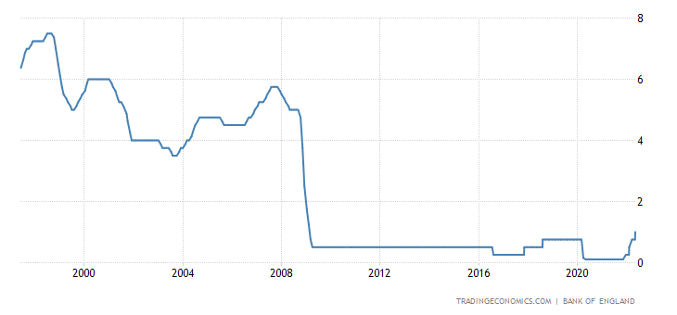
Interest Rates
For more help, please visit www.exampaperspractice.co.uk
© 2025 Exams Papers Practice. All Rights Reserved

Slide 32
Other Monetary Policy Tools (1)
Whilst interest rates are the Bank of England’s main tool, it has other options
The Money Supply
  If the BoE expand the supply of notes and coins in the economy, it should have the effect of encouraging spending
  However, this must be carefully managed
    If the supply and circulation of notes and coins increases this reduces their value, and hence creates inflationary pressure
Rules on bank lending and credit agreements
  These rules are quite complex, however if the BoE tighten the rules on how much credit and loan funds banks can make available, this will have the effect of constraining investment and consumption
  Equally, looser credit regulations will improve the availability of credit and it is likely that loans and general spending will rise
For more help, please visit www.exampaperspractice.co.uk
© 2025 Exams Papers Practice. All Rights Reserved

Slide 33
Other Monetary Policy Tools (2)
  Quantitative Easing (QE)
    When the recession began in the UK in 2008, the BoE would have been expected to cut interest rates in order to help stimulate economic activity
    However, with interest rates at 0.5%, they had very little downwards movement to manipulate the economy with
    In addition, banks were nervous about lending money to firms and individuals, so the BoE sought to boost the funds available for lending to businesses and firms
    In total, £375bn has been raised in QE
    How effective this has been is a matter of debate, but it could be argued that the recession may have been worse had the BoE not intervened in this manner
For more help, please visit www.exampaperspractice.co.uk
© 2025 Exams Papers Practice. All Rights Reserved

Slide 34
Monetary Policy and Aggregate Demand
Consumption
  Low interest rates = less incentive to save, more incentive to borrow and therefore higher consumption
  This affects general spending and consumer durables especially
  Higher interest rates = vice versa
Investment
  Low interest rates = investment projects become less costly/more profitable thus more attractive, so investment should rise
  High interest rates = vice versa
Net Exports
  Low interest rates = weaker £ as less attractive to currency investors
  Weak £ = Stronger Exports, fewer Imports
  High rates = vice versa
For more help, please visit www.exampaperspractice.co.uk
© 2025 Exams Papers Practice. All Rights Reserved

Slide 35
Other Monetary Policy Impacts
Wealth Effect
Falling interest rates → greater demand for housing through more affordable mortgages and increases in property prices
Homeowners can then borrow against the value of their home and increase consumption
It is also likely that rising house prices will improve consumer confidence and encourage further consumption
Savings Ratio
High interest rates = Higher savings ratio as a higher proportion of income likely to be saved and therefore less spent on consumption
Low interest rates = Lower savings ratio as there is less incentive to save and more incentive to spend on consumption given that the reward for saving is small
For more help, please visit www.exampaperspractice.co.uk
© 2025 Exams Papers Practice. All Rights Reserved

Slide 36
Expansionary Monetary Policy
1) If the Bank of England is concerned that slow economic growth is likely to feed through to lower inflation they may cut interest rates.
LRAS
Price Level
2) This reduces the savings ratio and makes borrowing more attractive so consumption rises.
3) This has the effect of increasing real national output from Y to Y1.
4) There will also be the added benefit of creating employment.
P1
P
AD1
AD
Y
Y1
FE
Real National Output
For more help, please visit www.exampaperspractice.co.uk
© 2025 Exams Papers Practice. All Rights Reserved

Slide 37
Contractionary Monetary Policy
1) If the Bank of England is concerned that inflation is running above the 2% target they may increase interest rates to reduce inflationary pressure.
LRAS
Price Level
P
2) This makes saving more attractive and will reduce consumption in addition to reducing investment from firms.
P1
3) This has the effect of reducing inflationary pressure as the price level falls from P to P1.
AD
4) However, this has come at the expense of a reduction in real national output to Y1, which damages economic growth and employment.
AD1
Y1
FE
Real National Output
For more help, please visit www.exampaperspractice.co.uk
© 2025 Exams Papers Practice. All Rights Reserved

Slide 38
The Supply Side Effects of Monetary Policy
1) Whilst monetary policy has numerous effects on AD, it can also influence LRAS.
LRAS
LRAS1
2) A cut in interest rates might stimulate businesses investment into capital process to improve their productivity and efficiency, which will shift LRAS to LRAS1.
Price Level
3) As Investment is a component of AD, AD will shift to AD1.
P
4) Productive capacity has now increased to FE1 and increases in AD can feed through to higher growth and employment. In this example, there has been no change in the price level.
AD1
AD
Y
Y1
FE
FE1
Real National Output
For more help, please visit www.exampaperspractice.co.uk
© 2025 Exams Papers Practice. All Rights Reserved

Slide 39

Supply-side policy: A Definition
“Policies that seek to improve the long run productive potential of the economy.”
For more help, please visit www.exampaperspractice.co.uk
© 2025 Exams Papers Practice. All Rights Reserved

Slide 40
Supply-Side Policy Options (1)
Deregulation
    Opening markets to freer competition and removing barriers to entry should help to drive productivity gains and boost supply
Privatisation
    Minimisation of state control which can often be inefficient
    This has been pursued by a number of (mainly Conservative) governments to privatise key areas of the economy in order to drive efficiency
Cutting Income Tax
    This should create incentives to work and expand the labour force
    In addition, it may influence the economically inactive to enter labour force and boost output
Cutting Corporation Tax
    Increases profit motive of firms which can be re-invested in capital
Modification of Welfare Payments
    Widen gap between benefits and wages to boost work incentives
For more help, please visit www.exampaperspractice.co.uk
© 2025 Exams Papers Practice. All Rights Reserved

Slide 41
Plenary
Which supply side policy option is the best in your opinion to grow business investment?
Explain the impact of this on the wider economy?
Analyse the drawbacks of this policy.
For more help, please visit www.exampaperspractice.co.uk
© 2025 Exams Papers Practice. All Rights Reserved

