Slide 1
2.6.1 Possible macroeconomic objectives
For more help, please visit www.exampaperspractice.co.uk
© 2025 Exams Papers Practice. All Rights Reserved

Slide 2
Recall
Name the four types of unemployment.
01
Explain why we aim for low unemployment and now full employment.
02
Give examples of unemployment types impacting on different industries.
03
For more help, please visit www.exampaperspractice.co.uk
© 2025 Exams Papers Practice. All Rights Reserved

Slide 3
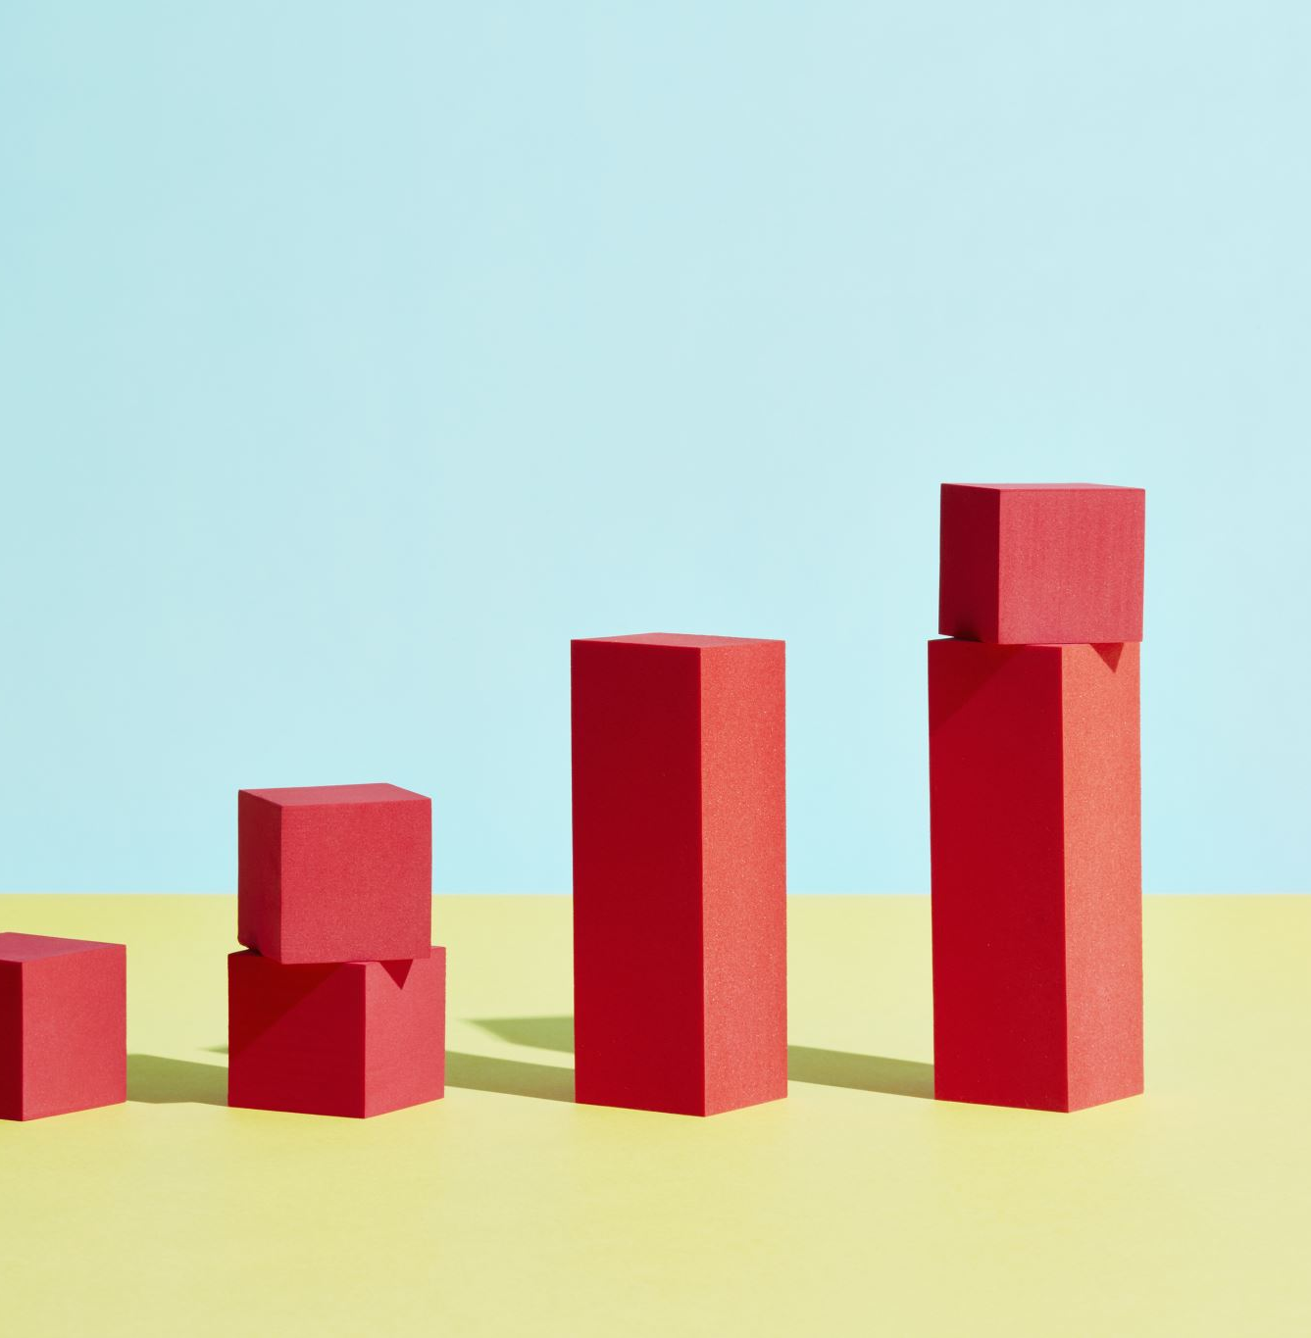
Starter
Which is the most important benefit of economic growth and why? Why is Economic Growth an Objective?
For more help, please visit www.exampaperspractice.co.uk
© 2025 Exams Papers Practice. All Rights Reserved

Slide 4
Learning Objectives
Are you able to explain the four macroeconomic objectives?
Are you able to compare the objectives and analyse them?
Are you able to analyse the benefits and drawbacks of the objectives?
For more help, please visit www.exampaperspractice.co.uk
© 2025 Exams Papers Practice. All Rights Reserved

Slide 5
Economic growth
This measures the “rate of change of a country’s output”
The key measure is GROSS DOMESTIC PRODUCT (GDP), which calculates the sum of a country’s output over 1 year
The pursuit of economic growth, both in terms of actual and potential productivity, is seen as a crucial goal of macroeconomic performance
For more help, please visit www.exampaperspractice.co.uk
© 2025 Exams Papers Practice. All Rights Reserved

Slide 6
Activity
Agree | Disagree
Unemployment is always a bad thing.
For more help, please visit www.exampaperspractice.co.uk
© 2025 Exams Papers Practice. All Rights Reserved

Slide 7
Unemployment
Unemployment is a major problem because it represents a waste of resources
High unemployment is generally an indicator of poor economic performance
Economies that have strong economic growth are likely to have low unemployment
Therefore, governments wish to pursue a policy of low unemployment
For more help, please visit www.exampaperspractice.co.uk
© 2025 Exams Papers Practice. All Rights Reserved

Slide 8
Activity
How will you reduce unemployment?
Create a five point plan to reduce unemployment.
1.
2.
3.
4.
5.
How will rising inflation reduce the chances of your plan succeeding?
For more help, please visit www.exampaperspractice.co.uk
© 2025 Exams Papers Practice. All Rights Reserved

Slide 9
Assessment
What is good about the plan and how will it work?
How will you develop the plan to make it more effective?
For more help, please visit www.exampaperspractice.co.uk
© 2025 Exams Papers Practice. All Rights Reserved

Slide 10
Benefits of Low Unemployment
Higher consumption and aggregate demand
Higher incomes
Improved standards of living
Higher tax revenue for government
Lower government spending on unemployment related welfare
Improved productivity of UK economy
Reduced poverty (absolute and relative)
Social benefits (reduced crime, improved wellbeing)
It is often assumed that full employment is not an achievable target as there will always be people moving between jobs or seeking work post education, so low unemployment becomes the default target. Although precisely what defines “low” is a matter of political debate.
For more help, please visit www.exampaperspractice.co.uk
© 2025 Exams Papers Practice. All Rights Reserved

Slide 11
Activity
How will you reduce inflation?
Create a five point plan to reduce inflation.
1.
2.
3.
4.
5.
How will a reducing in unemployment reduce the chances of your plan succeeding?
For more help, please visit www.exampaperspractice.co.uk
© 2025 Exams Papers Practice. All Rights Reserved

Slide 12
Inflation
Inflation is the “rate of change of average prices in an economy” as measured by the Consumer Price Index (CPI)
Inflation is important because it affects the value of £’s in your pocket, workers wage demands and consumer confidence
High, or rising inflation, damages the real value of money and erodes spending power
The inflation target has been made independent of the UK government in order to give a key component of macroeconomic policy more transparency and credibility following a number of periods of high inflation in the UK through the 1970’s and 1980’s
A target of 2% has been designated to the Bank of England
Within this, the target also includes price stability, and for inflation to be maintained within a range of +/- 1% of the target
For more help, please visit www.exampaperspractice.co.uk
© 2025 Exams Papers Practice. All Rights Reserved

Slide 13
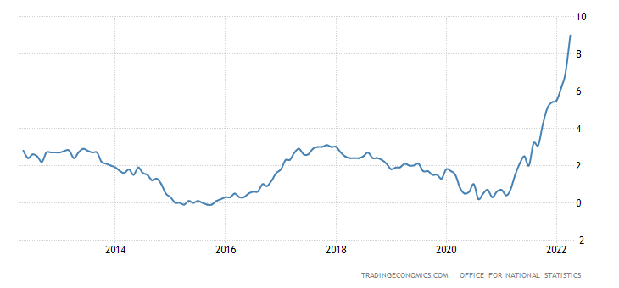
UK Inflation
For more help, please visit www.exampaperspractice.co.uk
© 2025 Exams Papers Practice. All Rights Reserved

Slide 14
Balance of Payments
This measures the UK’s record of economic activities with other countries
There are many components of the UK’s transactions with other countries, but we are principally concerned with the current account and our trade with other countries, in other words, imports and exports
If Exports > Imports = Surplus
If Imports > Exports = Deficit
Given that deficits have to be funded (often by borrowing) it is assumed that a surplus or equilibrium on the current account is the desired objective
For more help, please visit www.exampaperspractice.co.uk
© 2025 Exams Papers Practice. All Rights Reserved

Slide 15
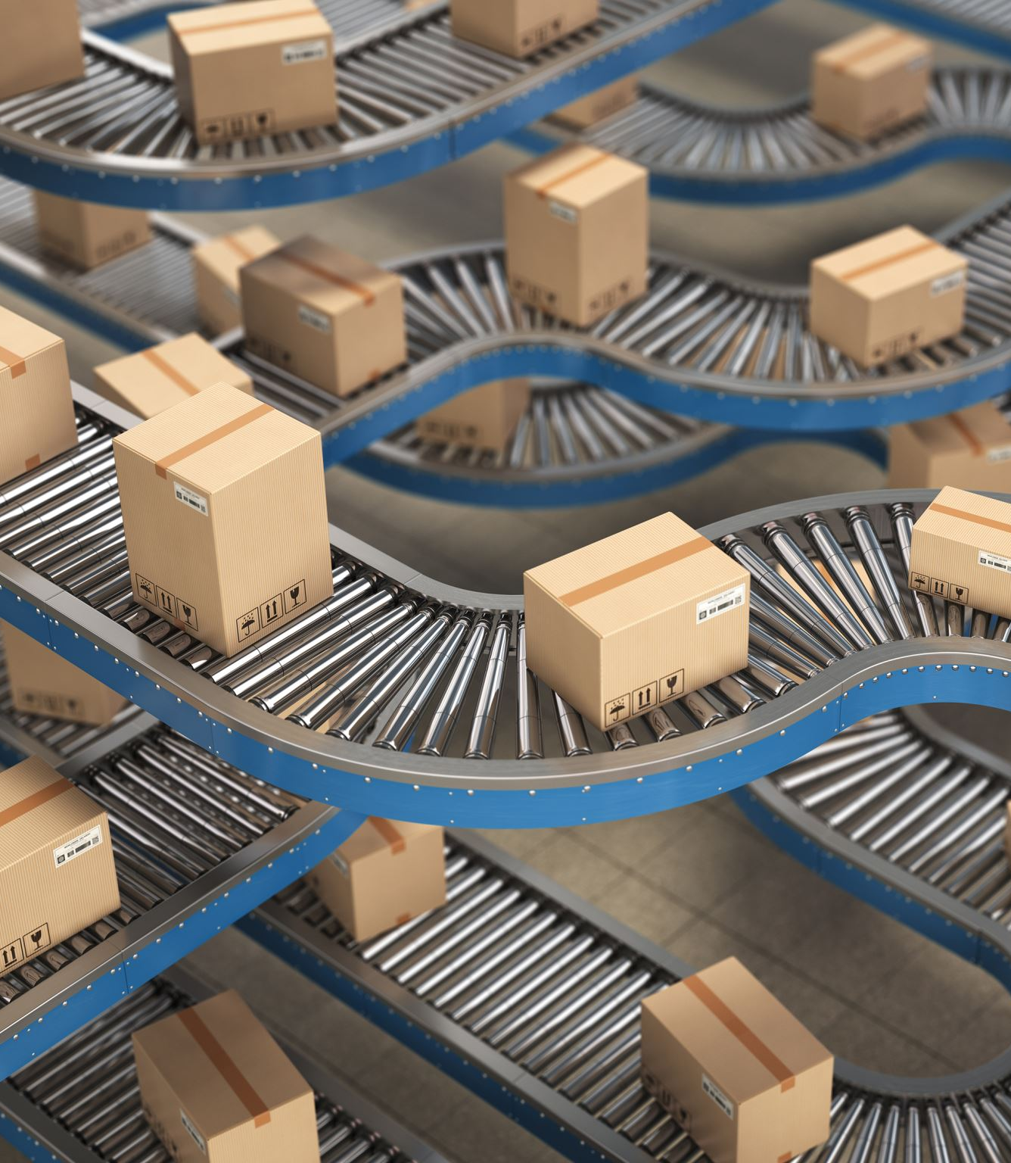
Activity
Do we want more imports or exports?
What can we find out from running a surplus or deficit?
Which countries run a surplus or deficit?
German runs a surplus, are they developed? What is the anomaly?
For more help, please visit www.exampaperspractice.co.uk
© 2025 Exams Papers Practice. All Rights Reserved

Slide 16
Balance of Payments – How much does it matter?
The UK has been running, for a sustained period, a significant deficit on the current account in terms of our trade in goods
This is offset to a degree by a surplus in our trade in services
Overall, the UK has had a sustained and persistent deficit on the Balance of Payments, and this has received relatively little attention from successive governments (in comparison to other targets)
The UK economy is heavily skewed towards the tertiary sector, which is a key driver of jobs and income
For more help, please visit www.exampaperspractice.co.uk
© 2025 Exams Papers Practice. All Rights Reserved

Slide 17
Balance of Payments – How much does it matter?
Whilst a high level of imported goods might be seen as a negative, it provides consumers with a wider choice of goods, which may be of higher quality and lower prices
All of this enhances consumers standards of living and welfare
Firms may also benefits from cheaper or higher quality imported components or raw materials, which may reduce costs, either enhancing profits or lowering prices further for customers
As a result, it is viewed by many economists that a deficit on the balance of trade overall, is not necessarily detrimental to the wider economy
For more help, please visit www.exampaperspractice.co.uk
© 2025 Exams Papers Practice. All Rights Reserved

Slide 18
Plenary
Which of the objectives is hardest to achieve?
Which objective would you focus on now?
Which objectives are related and why?
Economic Growth
Unemployment
Inflation
Balance of Payments
For more help, please visit www.exampaperspractice.co.uk
© 2025 Exams Papers Practice. All Rights Reserved

