Slide 1
Inflation (2)
For more help, please visit www.exampaperspractice.co.uk
© 2025 Exams Papers Practice. All Rights Reserved

Slide 2
Recall
Draw a diagram showing an increase in economic growth.
What are the components of Aggregate Demand?
Consumption
Investment
Government Spending
Exports
Imports
For more help, please visit www.exampaperspractice.co.uk
© 2025 Exams Papers Practice. All Rights Reserved

Slide 3
Starter
Draw a picture to show off your understanding of the term inflation.
How can you link this into wages that people earn?
Some keywords to think about:
Prices
Goods
Costs
People
For more help, please visit www.exampaperspractice.co.uk
© 2025 Exams Papers Practice. All Rights Reserved

Slide 4
Learning Objectives
Are you able to explain the causes of demand pull inflation?
Are you able to analyse the impact of demand pull inflation?
Are you resilient enough to make links between a number of diagrams?
For more help, please visit www.exampaperspractice.co.uk
© 2025 Exams Papers Practice. All Rights Reserved

Slide 5
Inflation
Definition
The rate of change in the average price level over time
Two primary causes of inflation
Demand-Pull
Cost-Push
For more help, please visit www.exampaperspractice.co.uk
© 2025 Exams Papers Practice. All Rights Reserved

Slide 6
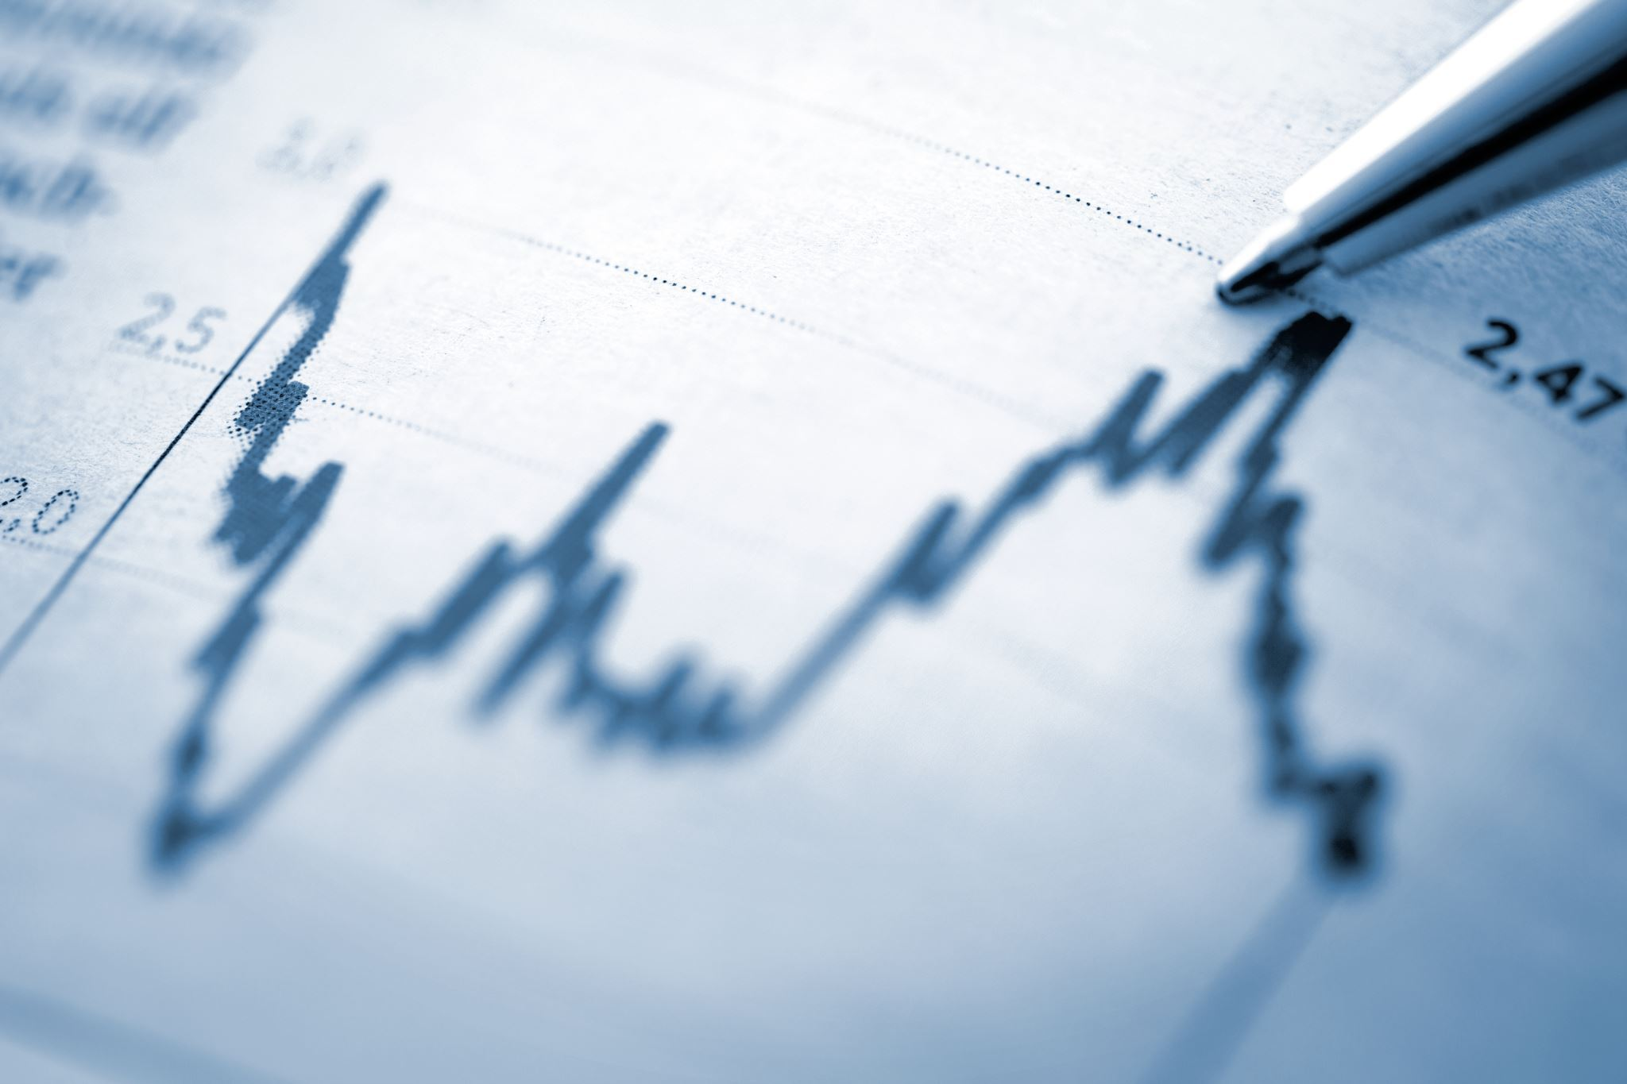
Activity 1
Draw a diagram that will show Demand Pull inflation.
How may Covid-19 have led to demand pull inflation?
What current steps are taking place to control this inflation?
For more help, please visit www.exampaperspractice.co.uk
© 2025 Exams Papers Practice. All Rights Reserved

Slide 7
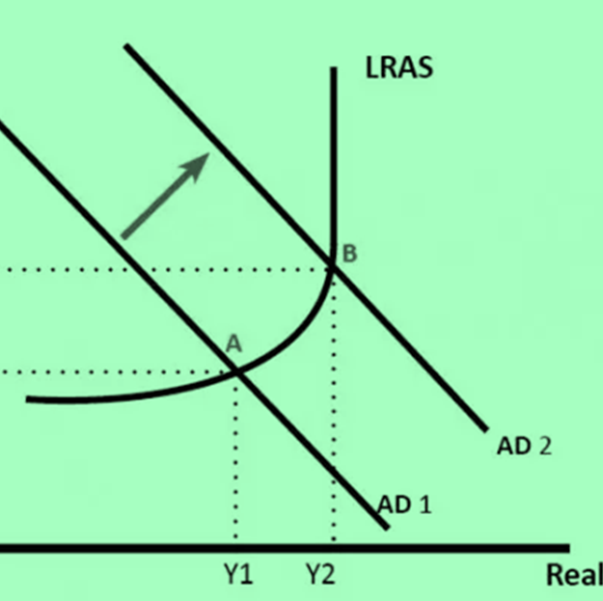
Causes of Demand-Pull Inflation
Reduced taxation
Increases disposable income
Lower interest rates
Makes borrowing more attractive and saving less rewarding
A weak exchange rate
Will boost export growth
General rise in confidence / expectations of future growth
May feed through to higher consumer spending and investment
For more help, please visit www.exampaperspractice.co.uk
© 2025 Exams Papers Practice. All Rights Reserved

Slide 8
Activity 2
Draw a diagram to show a depreciation in the exchange rate.
Explain the impact on imports and exports.
Analyse the impact on Economic growth (AD).
For more help, please visit www.exampaperspractice.co.uk
© 2025 Exams Papers Practice. All Rights Reserved

Slide 9
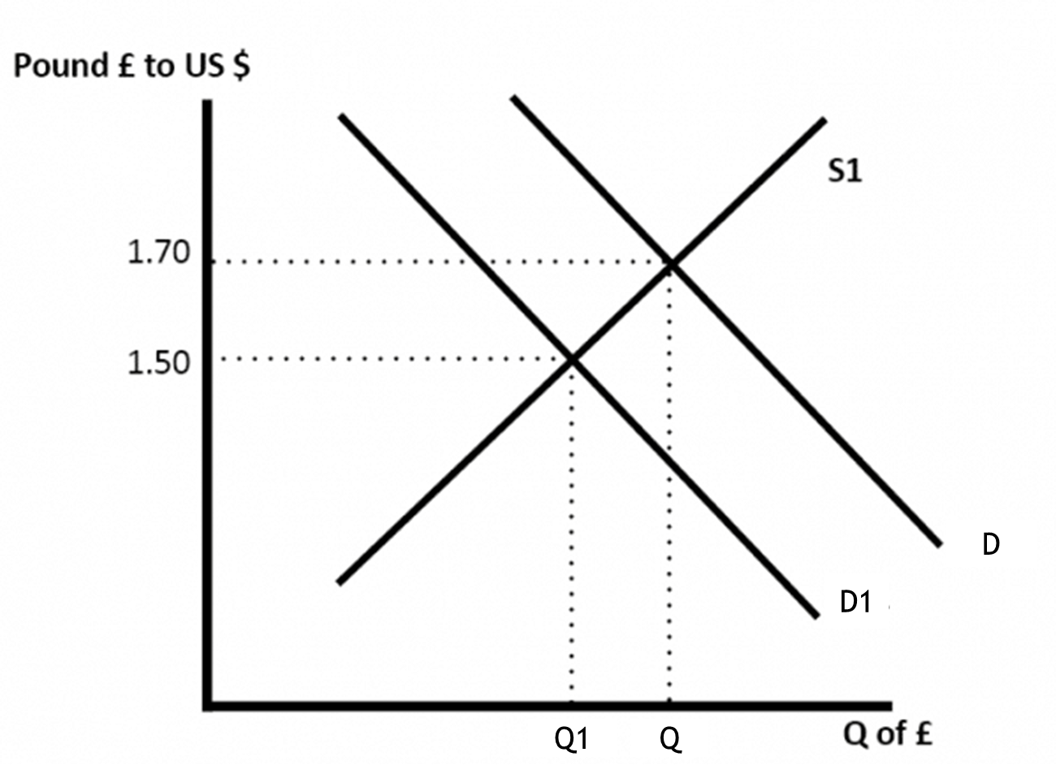
Depreciation of the Pound
Weak
Pound
Imports
Dearer
Exports
Cheaper
For more help, please visit www.exampaperspractice.co.uk
© 2025 Exams Papers Practice. All Rights Reserved

Slide 10
Peer Assessment
Give one area that could have been improved.
Give one area that was done really well.
Example
You showed a depreciation of the pound but did not correctly label the axis.
For more help, please visit www.exampaperspractice.co.uk
© 2025 Exams Papers Practice. All Rights Reserved

Slide 11
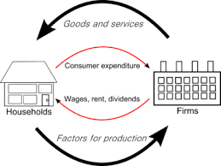
Activity 3
Link the circular flow of income to aggregate demand.
Explain where each component of AD links to the circular flow of income.
Explain the impacts of rising inflation on the economy.
Use a diagram
How can we reduce inflation and what would the steps be?
For more help, please visit www.exampaperspractice.co.uk
© 2025 Exams Papers Practice. All Rights Reserved

Slide 12
Peer Assessment
Give one area that could have been improved.
Give one area that was done really well.
Example
You need to explain how an interest rate will end up leading to prices going lower.
For more help, please visit www.exampaperspractice.co.uk
© 2025 Exams Papers Practice. All Rights Reserved

Slide 13
Home learning
You are tasked with two main objectives for the economy.
Low inflation at 2%
High economic growth.
Using a series of diagrams and explanation, please try to show how this is going to be extremely difficult to achieve both objectives.
Make a judgement on what is the most important objective and provide a five point plan on how you will achieve it.
The Bank of England have increased interest rates. Analyse the impact on unemployment. We will be focussing on unemployment in our next lesson.
For more help, please visit www.exampaperspractice.co.uk
© 2025 Exams Papers Practice. All Rights Reserved

Slide 14
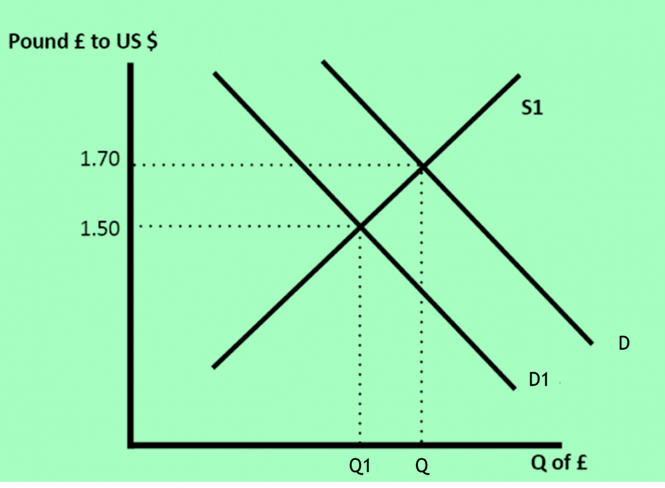
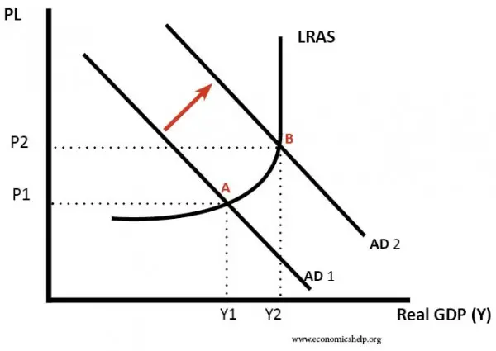
Plenary
Are you able to explain the causes of demand pull inflation?
Are you able to analyse the impact of demand pull inflation?
Are you resilient enough to make links between a number of diagrams?
AD = C + I + G + (X - M)
For more help, please visit www.exampaperspractice.co.uk
© 2025 Exams Papers Practice. All Rights Reserved

