Slide 1



2.5.3 Inflation
(1)
For more help, please visit www.exampaperspractice.co.uk
© 2025 Exams Papers Practice. All Rights Reserved

Slide 2


Recall
What is inflation?
What is disinflation?
What is deflation?
How do we measure inflation?
What is the current rate of inflation?
For more help, please visit www.exampaperspractice.co.uk
© 2025 Exams Papers Practice. All Rights Reserved

Slide 3

Starter
How has the economy been impacted over the last three years due to Covid-19?
How has the pandemic impacted on those who were employed throughout the pandemic?
What has happened to the disposable income as a result of Covid-19?
For more help, please visit www.exampaperspractice.co.uk
© 2025 Exams Papers Practice. All Rights Reserved

Slide 4

Lesson Objectives
Are you able to give the causes of demand pull and cost push inflation?
Are you able to explain the impact of inflation on consumers and firms?
For more help, please visit www.exampaperspractice.co.uk
© 2025 Exams Papers Practice. All Rights Reserved

Slide 5

Causes of Inflation
There are three primary causes of inflation
Demand-Pull
Cost-Push
Growth of the money supply
For more help, please visit www.exampaperspractice.co.uk
© 2025 Exams Papers Practice. All Rights Reserved

Slide 6
Demand-Pull Inflation
  Demand-pull inflation is caused by excessive demand in the economy for goods and services
      there is too much money chasing too few goods and services
  The best way to think about this is using the AD formula: C + I + G + (X-M)
  Remember, consumption is the largest component of AD, although any stimulant to AD will create some demand-pull inflationary pressure if supply remains unchanged
For more help, please visit www.exampaperspractice.co.uk
© 2025 Exams Papers Practice. All Rights Reserved

Slide 7

Activity
How has Covid-19 impacted on demand pull inflation?
What has happened to inflation over the last three years?
How has inflation changed in the last few months?
For more help, please visit www.exampaperspractice.co.uk
© 2025 Exams Papers Practice. All Rights Reserved

Slide 8

Causes of Demand-Pull Inflation
  Reduced taxation
    Increases disposable income
  Lower interest rates
    Makes borrowing more attractive and saving less rewarding
  A general rise in consumer spending
    Perhaps from higher incomes and consumer confidence
  Improved availability of credit
    Banks/Building Societies widen the availability of credit or make it more affordable
  A weak exchange rate
    Will boost export growth
  Fast growth in other countries
    May increase demand for UK exports
  General rise in confidence / expectations of future growth
    May feed through to higher consumer spending and investment
  Certainty
    Links to confidence and assists consumers and firms in their spending and investment decisions
For more help, please visit www.exampaperspractice.co.uk
© 2025 Exams Papers Practice. All Rights Reserved

Slide 9

Activity
Draw a diagram to show the impact of an increase in confidence in the economy on a supply and demand chart.
Explain how this will impact firms and consumers?
For more help, please visit www.exampaperspractice.co.uk
© 2025 Exams Papers Practice. All Rights Reserved

Slide 10
Demand-Pull Inflation Diagram
1) Begin with the equilibrium position.
Price Level
2) If there is a cut in interest rates, this makes borrowing on credit more attractive, and saving less rewarding so consumption may rise.
SRAS
P1
P
3) This leads to a rise in AD to AD1.
AD1
4) In the short-run, factor resources remain unchanged and if demand for goods and services rises faster than firms are able to provide additional supply, then prices will be ‘pulled’ upwards to P1.
AD
Y
Y1
Real National Output
For more help, please visit www.exampaperspractice.co.uk
© 2025 Exams Papers Practice. All Rights Reserved

Slide 11
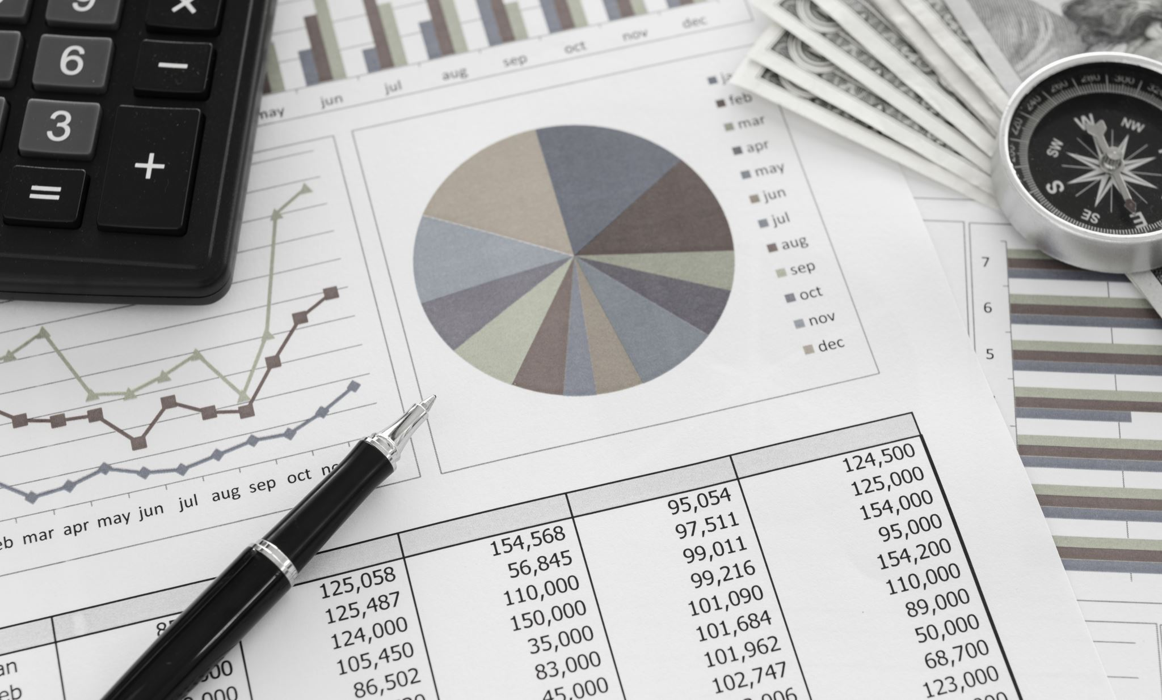
Cost-Push Inflation
  This occurs when firms respond to rising costs of production by increasing prices
  Firms will typically do this to protect profit margins
  That said, firms may be able to absorb some increases in their costs of production, but they will not be able to do this indefinitely, and so pass costs onto the consumer in the form of higher prices
For more help, please visit www.exampaperspractice.co.uk
© 2025 Exams Papers Practice. All Rights Reserved

Slide 12

Causes of Cost-Push Inflation
  Wage increases
    For many firms, wages is their largest single cost of production
    It is likely that if prices are rising, workers will demand higher wages in order to maintain their ‘real’ incomes
    If these higher wage costs are reflected in higher prices, then workers will continue to demand higher wages, leading to a wage-price spiral
  Higher raw material costs
    As primary raw materials become more scarce and in even greater demand, raw materials and associated components may rise in price
  Higher taxes
    The government may impose higher taxes on firms; for example, corporation tax, national insurance, or taxes on waste disposal
  Higher import prices
    A weaker exchange rate or rising prices abroad mean that imported components feed through to higher costs of production
  Natural disasters
    May temporarily or permanently reduce the supply of raw materials or disrupt the supply chain, adding to a firms costs
For more help, please visit www.exampaperspractice.co.uk
© 2025 Exams Papers Practice. All Rights Reserved

Slide 13

Activity
Draw a diagram to show the impact of an increase in wages on a supply and demand chart.
Explain how this will impact firms and consumers?
For more help, please visit www.exampaperspractice.co.uk
© 2025 Exams Papers Practice. All Rights Reserved

Slide 14
Cost-Push Inflation Diagram
1) Begin with the equilibrium position.
Price Level
2) If there is an increase in wage rates, this will increase a firms costs of production.
SRAS1
SRAS
3) This will reduce SRAS to SRAS1 because faced with higher costs of production, firms will reduce their supply, or may even leave the industry if they cannot maintain profit margins.
P1
P
4) As a result, rising costs have “pushed” up prices to P1.
AD
Y
Real National Output
Y1
For more help, please visit www.exampaperspractice.co.uk
© 2025 Exams Papers Practice. All Rights Reserved

Slide 15

The effects of inflation on firms
High inflation will lead to consumers purchasing goods and services today before prices rise further in the future thus increasing demand in the short run
Firms will pass costs on to the consumer which will further fuel higher prices and increases in inflation
Workers will bargain to increase their wages. Collective bargaining will take place with the union negotiating with employers to improve wage rates
This further increases costs for firms and there may be a wage-price spiral as higher wages lead to higher costs for firms, leading to calls for higher wages etc.
For more help, please visit www.exampaperspractice.co.uk
© 2025 Exams Papers Practice. All Rights Reserved

Slide 16

The effects of inflation on firms
Uncertainty arises as firms find it difficult to budget for the future as they are unsure of their future costs
High inflation rates cause particular problems as firms cannot invest with confidence as their budget forecasts are likely to be inaccurate
Loss of international competitiveness arises as higher prices make UK products less attractive leading to a fall in demand for UK goods and services
This is particularly the case if these products are price elastic making it easier for importers to look elsewhere as there are likely to be more substitutes
For more help, please visit www.exampaperspractice.co.uk
© 2025 Exams Papers Practice. All Rights Reserved

Slide 17

The impact of inflation on consumers
Over time, the price of goods and services tends to rise
If wages and earnings remain constant, then as prices rise, consumers are worse off in real terms, as their real income will buy less goods and services than previously
Therefore it is said that inflation erodes the value of money
At the same time the return of savers will be less in real terms as inflation eats into the value of their savings
However, borrowers are better off as they will be paying back less in real terms e.g. high inflation rates might be greater than the interest that they pay back
For more help, please visit www.exampaperspractice.co.uk
© 2025 Exams Papers Practice. All Rights Reserved

Slide 18

Activity
https://www.bbc.co.uk/news/business-61483175
https://www.bbc.co.uk/news/business-12196322
https://www.bbc.co.uk/news/business-61469532
What is the impact on the people/businesses within these news articles?
For more help, please visit www.exampaperspractice.co.uk
© 2025 Exams Papers Practice. All Rights Reserved

Slide 19

Plenary
What is the impact of inflation on the economy?
What are the causes of inflation?
What is demand pull and cost push inflation?
For more help, please visit www.exampaperspractice.co.uk
© 2025 Exams Papers Practice. All Rights Reserved

