Slide 1
Difference between SRAS and LRAS
For more help, please visit www.exampaperspractice.co.uk
© 2025 Exams Papers Practice. All Rights Reserved

Slide 2
Recall
Once upon a time there was something called Aggregate Demand. They were known as AD, they also had links to interest rates and exchange rates.
John was an American native and liked to buy British Tractors. Jayne was an English Butcher and liked to buy knife sets from America. The Pound in 2008 used to get $2.00, it now gets $1.25.
I want you to write the next paragraphs and explain how they were linked, with diagrams.
10 Minutes.
For more help, please visit www.exampaperspractice.co.uk
© 2025 Exams Papers Practice. All Rights Reserved

Slide 3
Starter
Long run and short run, what is the difference?
What are our factors of production?
Are any fixed?
For more help, please visit www.exampaperspractice.co.uk
© 2025 Exams Papers Practice. All Rights Reserved

Slide 4
Learning Objectives
Are you able to explain the difference between SRAS and the LRAS?
Are you able to illustrate the Keynesian LRAS and explain the shape of it?
Are you able to link AD and AS in the same diagram and analyse it?
For more help, please visit www.exampaperspractice.co.uk
© 2025 Exams Papers Practice. All Rights Reserved

Slide 5
Definition
Short run – where one factor of production (e.g. capital) is fixed. This is a time period of fewer than four-six months.
Long run – where all factors of production of a firm are variable (e.g. a firm can build a bigger factory) A time period of greater than four-six months/one year
For more help, please visit www.exampaperspractice.co.uk
© 2025 Exams Papers Practice. All Rights Reserved

Slide 6
Difference between SRAS and LRAS
Essentially, the SRAS assumes that the level of capital is fixed. (i.e. in the short run you can’t build a new factory)
However, in the short run you can increase the utilisation of existing factors of production, e.g. workers doing overtime.
In the short run, an increase in the price of goods encourages firms to take on more workers, pay slightly higher wages and produce more.
Thus the SRAS suggests an increase in prices leads to a temporary increase in output as firms employ more workers.
The short run aggregate supply is affected by costs of production. If there is an increase in raw material prices (e.g. higher oil prices), the SRAS will shift to the left. If there is an increase in wages, the SRAS will also shift to the left.
For more help, please visit www.exampaperspractice.co.uk
© 2025 Exams Papers Practice. All Rights Reserved

Slide 7
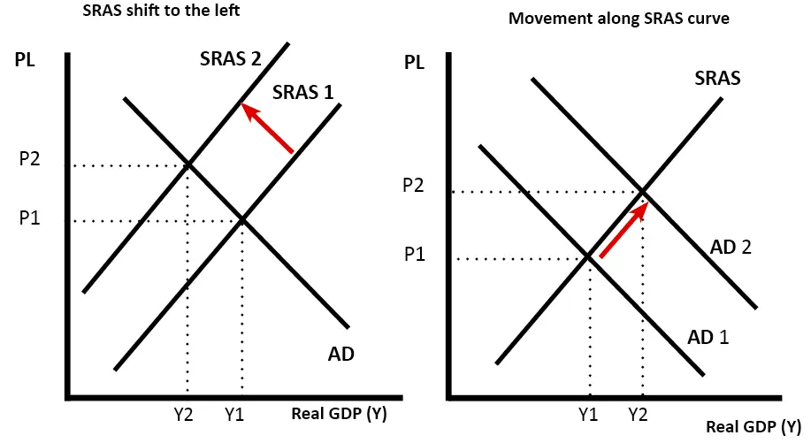
Difference between shift in SRAS and movement along SRAS
A shift in SRAS could be due to higher oil prices (left diagram)
A movement along SRAS could be due to higher AD, which leads to increase real GDP and PL.
For more help, please visit www.exampaperspractice.co.uk
© 2025 Exams Papers Practice. All Rights Reserved

Slide 8
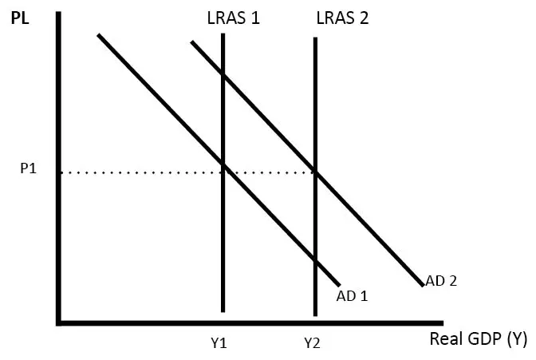
Long run aggregate supply (LRAS)
The long run aggregate supply curve (LRAS) is determined by all factors of production – size of the workforce, size of capital stock, levels of education and labour productivity.
If there was an increase in investment or growth in the size of the labour force this would shift the LRAS curve to the right.
This is the classical view of long run aggregate supply (LRAS). It states that aggregate supply is not determined by the price level or AD, but is determined by factors of production, – land, labour, capital and labour productivity.
For more help, please visit www.exampaperspractice.co.uk
© 2025 Exams Papers Practice. All Rights Reserved

Slide 9
Activity
Draw a diagram to show a middle ground of SRAS and LRAS.
How will the factors of production change over time?
Explain how increasing factors of production will impact the economy.
For more help, please visit www.exampaperspractice.co.uk
© 2025 Exams Papers Practice. All Rights Reserved

Slide 10
How to know which ones to use?
If showing a change in wage costs or oil prices, I would use a SRAS.
For showing long run economic growth, and an increase in capital stock and investment I would show a shift in LRAS.
For more help, please visit www.exampaperspractice.co.uk
© 2025 Exams Papers Practice. All Rights Reserved

Slide 11
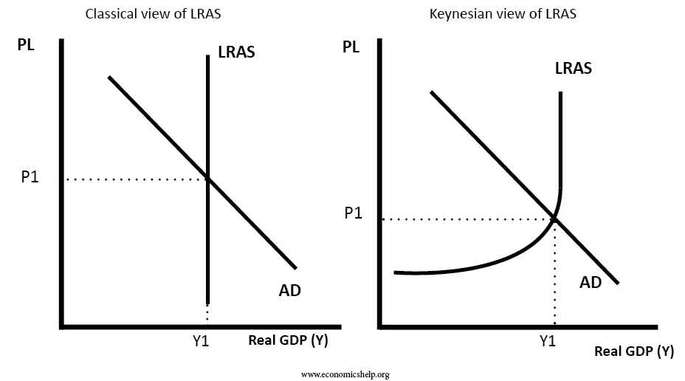
Keynesian view of LRAS
A further complication is that there are different views of the LRAS. The Classical view is an inelastic LRAS. The Keynesian view suggests it is elastic at a point up to inelastic. In a sense, the Keynesian view is a combination of the short run aggregate supply and long run. The Keynesian LRAS shows that there is a point in the economy of spare capacity where firms can use more. There also comes a point where full capacity is reached.
For more help, please visit www.exampaperspractice.co.uk
© 2025 Exams Papers Practice. All Rights Reserved
Notes:
Keynesians believe that at low levels of output and employment, there would be spare capacity in the economy which would enable firms to increase their output without increasing the cost per unit produced. Here the LRAS curve will be horizontal.

Slide 12
Plenary
Explain the reason the LRAS Keynesian curve bends.
How can we reduce inflation using the LRAS?
Draw a diagram to show the impact of increased immigration.
For more help, please visit www.exampaperspractice.co.uk
© 2025 Exams Papers Practice. All Rights Reserved

