Slide 1



2.5.2 Circular flow of income, expenditure and output
For more help, please visit www.exampaperspractice.co.uk
© 2025 Exams Papers Practice. All Rights Reserved

Slide 2
Recall
Show me a diagram showing demand pull inflation.
Explain how SPICED works.
For more help, please visit www.exampaperspractice.co.uk
© 2025 Exams Papers Practice. All Rights Reserved

Slide 3

Starter
What will influence the demand within an economy?
What impact can interest rates have on the economy?
For more help, please visit www.exampaperspractice.co.uk
© 2025 Exams Papers Practice. All Rights Reserved

Slide 4
Learning Objectives
Are you able to explain the difference between fiscal, monetary & supply side policies?
Are you able to explain what influences aggregate demand?
Are you able to analyse how effective using aggregate demand is?
For more help, please visit www.exampaperspractice.co.uk
© 2025 Exams Papers Practice. All Rights Reserved

Slide 5
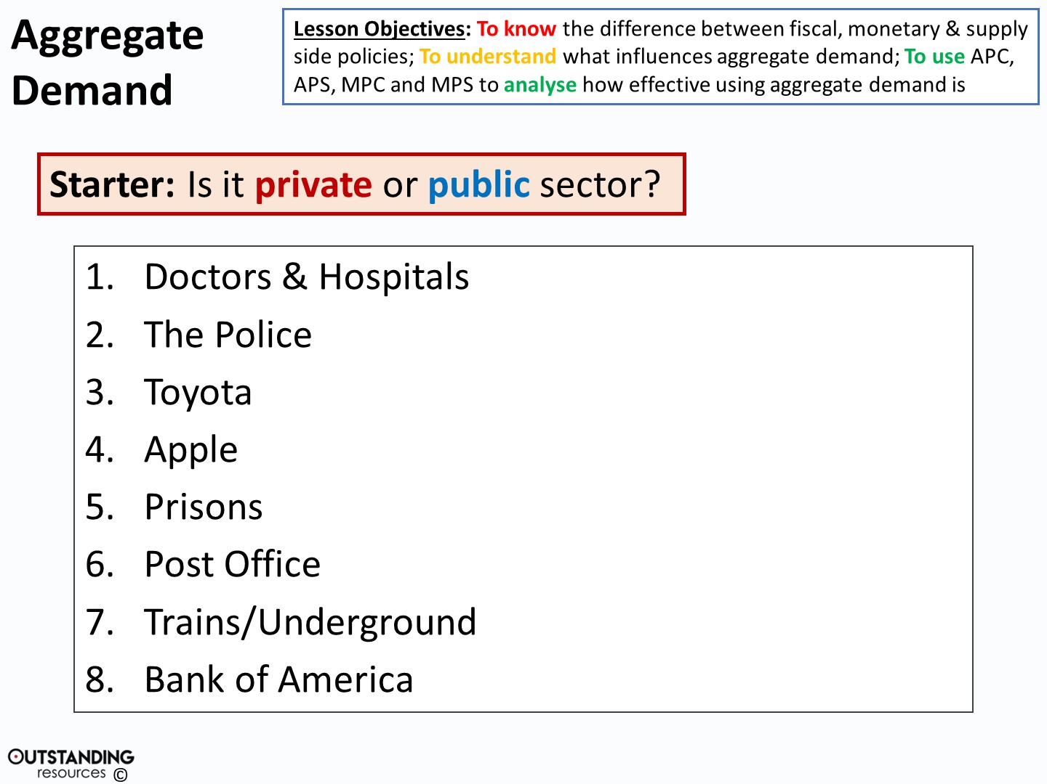

PRIVATE
PUBLIC
PUBLIC
PRIVATE
PRIVATE
PUBLIC
PUBLIC
PRIVATE
PUBLIC
PRIVATE
For more help, please visit www.exampaperspractice.co.uk
© 2025 Exams Papers Practice. All Rights Reserved

Slide 6
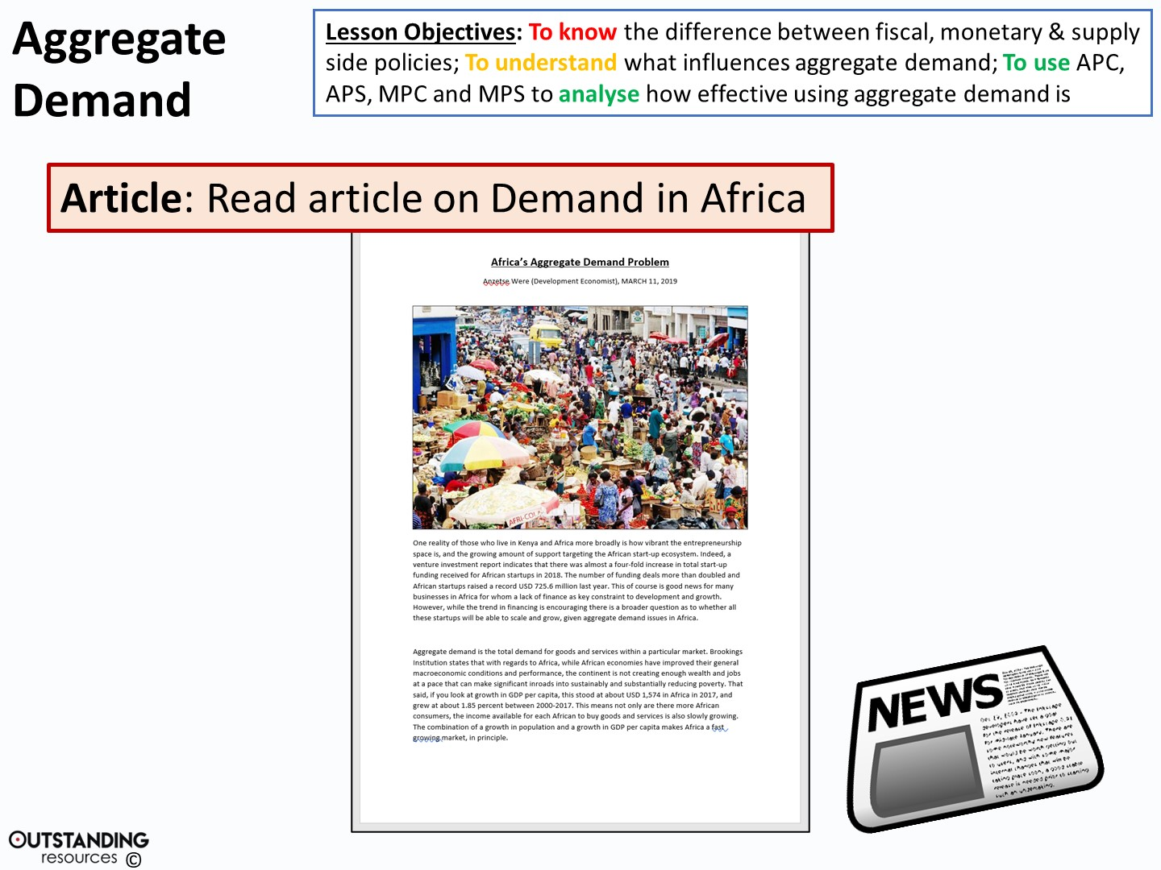
For more help, please visit www.exampaperspractice.co.uk
© 2025 Exams Papers Practice. All Rights Reserved
Notes:
Clipart Image: Newspaper – taken from: https://openclipart.org/detail/280414/newspaper-icon

Slide 7
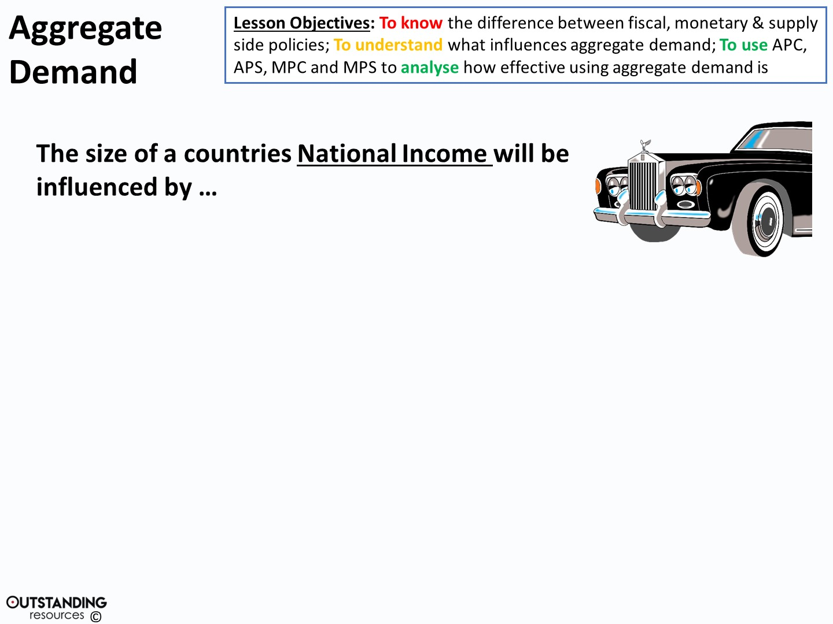
The NATURAL RESOURCES available
The SIZE and QUALITY of the WORKFORCE
The stock of CAPITAL
TECHNOLOGY or Technical knowledge
ENTREPRENEURSHIP
GOVERNMENT Action & Direction
For more help, please visit www.exampaperspractice.co.uk
© 2025 Exams Papers Practice. All Rights Reserved
Notes:
Clipart Image: Rolls Royce – taken from: https://openclipart.org/detail/284074/rolls-royce-shadow

Slide 8
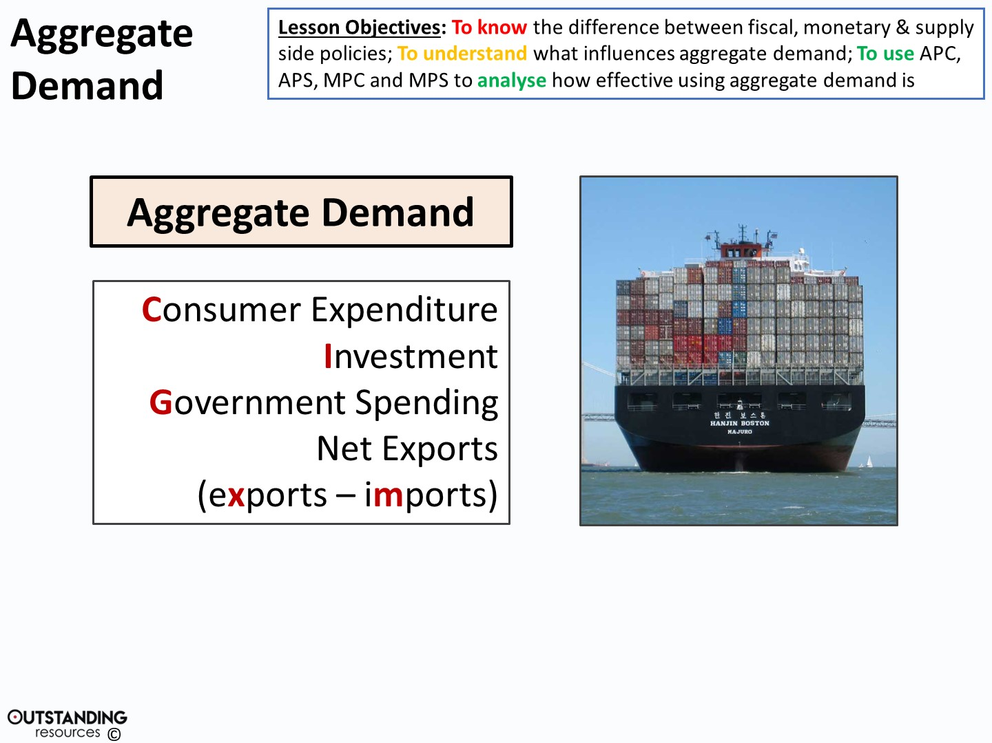
AD = C + I + G + (X-M)
For more help, please visit www.exampaperspractice.co.uk
© 2025 Exams Papers Practice. All Rights Reserved
Notes:
Shipping Container, By Mgunn at English Wikipedia - Transferred from en.wikipedia to Commons by NotFromUtrecht using CommonsHelper., Public Domain, https://commons.wikimedia.org/w/index.php?curid=19443898

Slide 9
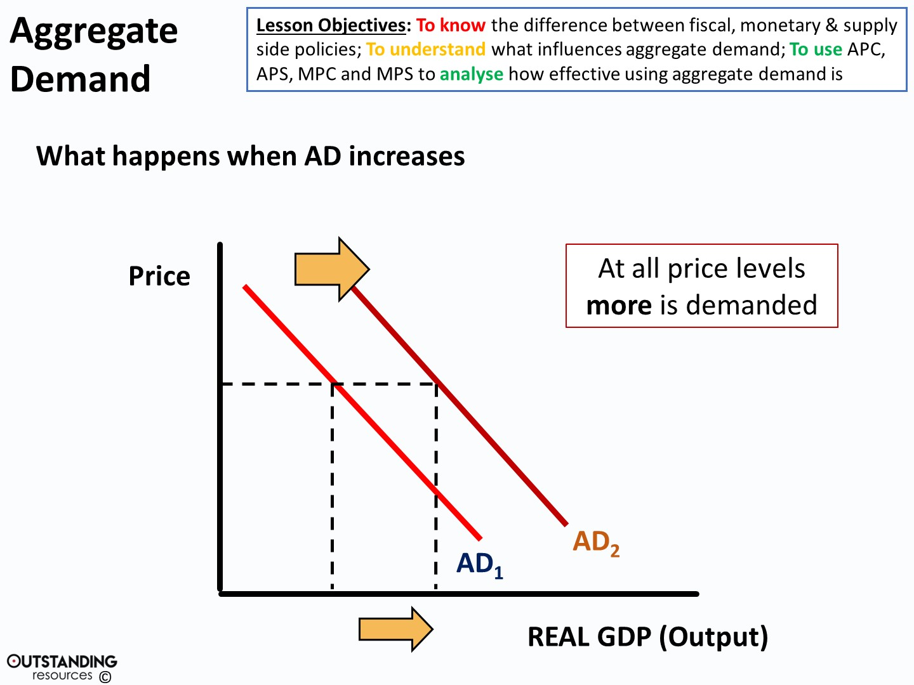
For more help, please visit www.exampaperspractice.co.uk
© 2025 Exams Papers Practice. All Rights Reserved

Slide 10
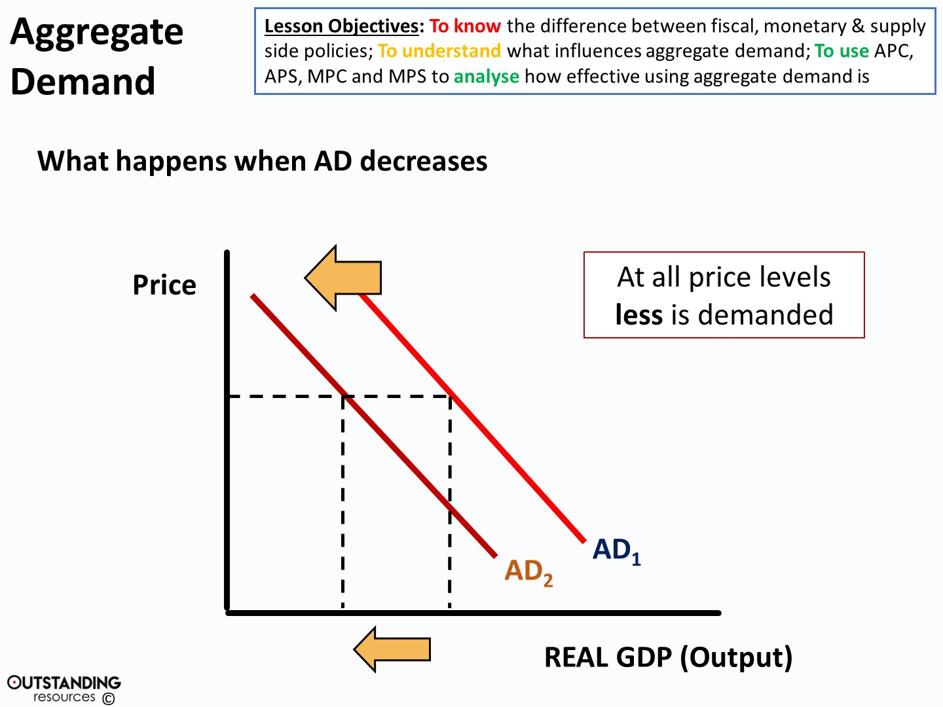
For more help, please visit www.exampaperspractice.co.uk
© 2025 Exams Papers Practice. All Rights Reserved

Slide 11
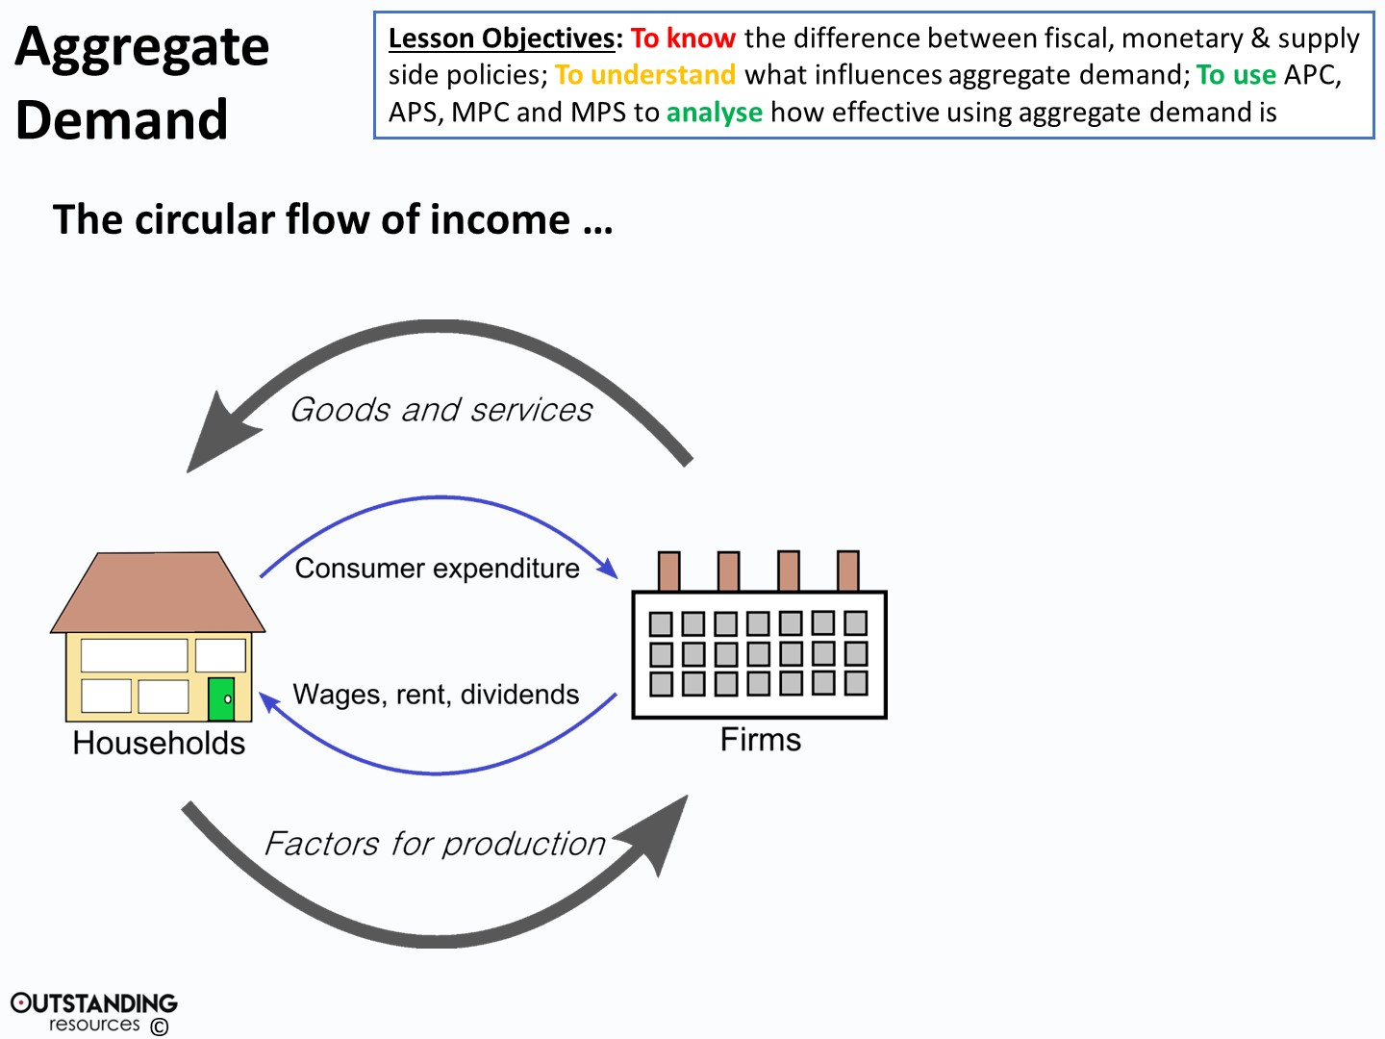



BANKS
Savings
Profits
Loans & Investments
Imports
ABROAD
Exports
Spending
TAX
Benefits & Pensions
GOVERNMENT
For more help, please visit www.exampaperspractice.co.uk
© 2025 Exams Papers Practice. All Rights Reserved
Notes:
Circular Flow diagram – taken from: By Irconomics, CC BY-SA 3.0, https://commons.wikimedia.org/w/index.php?curid=4638275
Clipart Image: Bank – taken from: https://openclipart.org/detail/231056/bank
Clipart Image: Gov Building – taken from: https://openclipart.org/detail/237168/ipoh-city-hall-building
Clipart Image: beach ball – taken from: https://openclipart.org/detail/3820/beach-ball

Slide 12
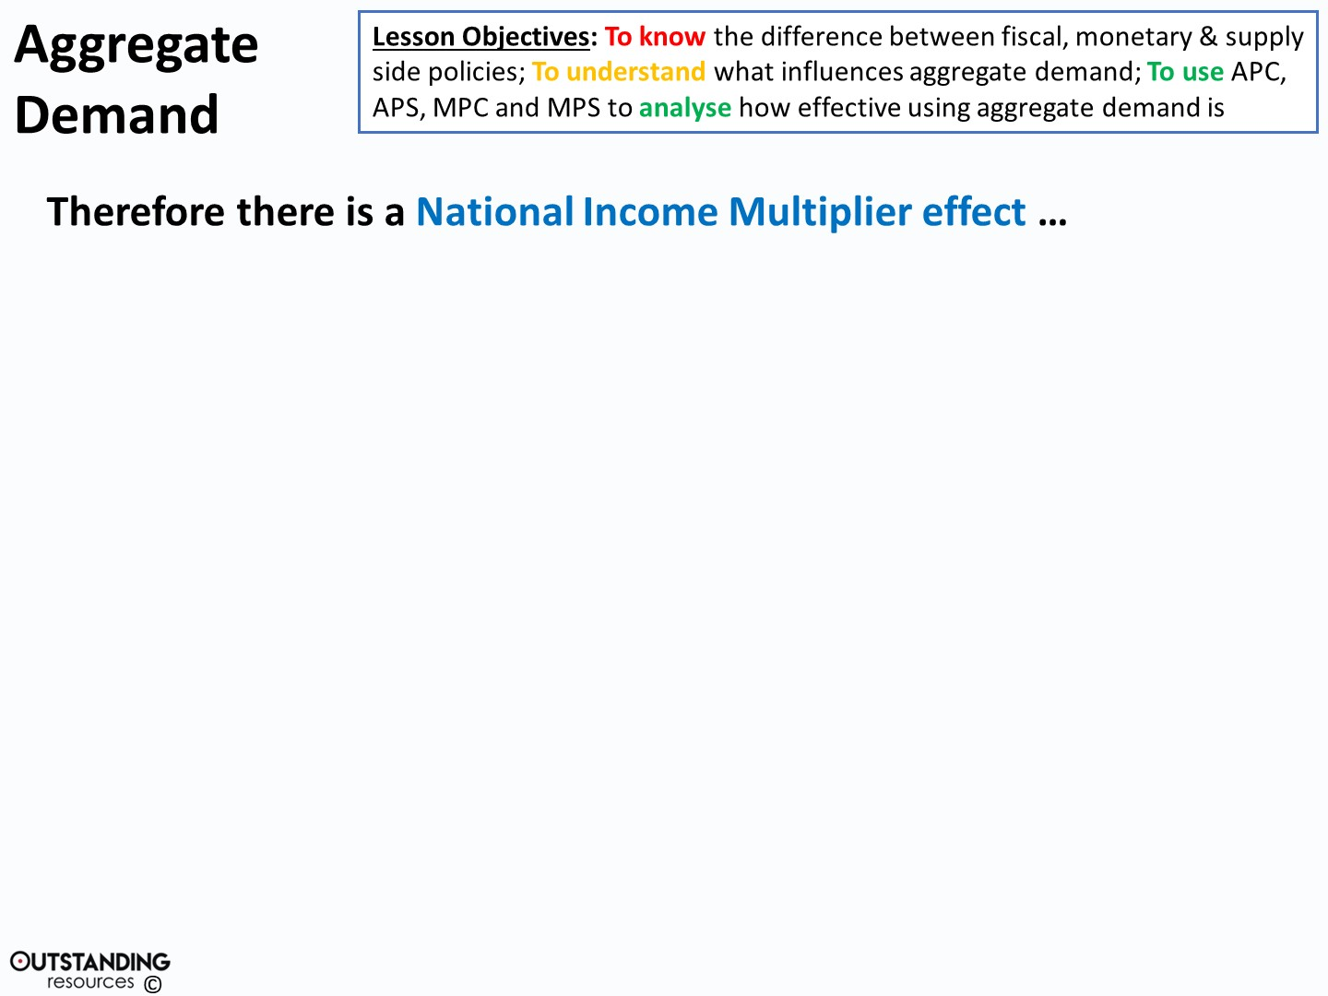
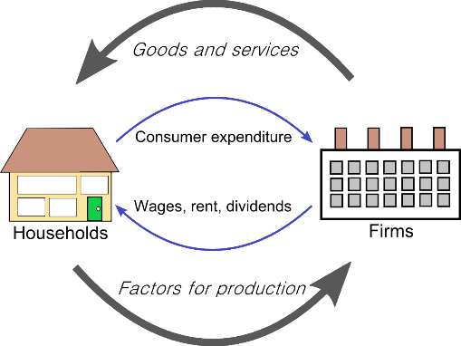
Spend an extra £10billion on the economy
(new roads etc.)
GOVERNMENT
Goes around and around and boosts
AD by an extra £25billion
(firms have more work, more jobs etc.)
This would mean the NI multiplier for the economy is 2.5
Multiplier = Change in NI / Initial change in AD
For more help, please visit www.exampaperspractice.co.uk
© 2025 Exams Papers Practice. All Rights Reserved

Slide 13
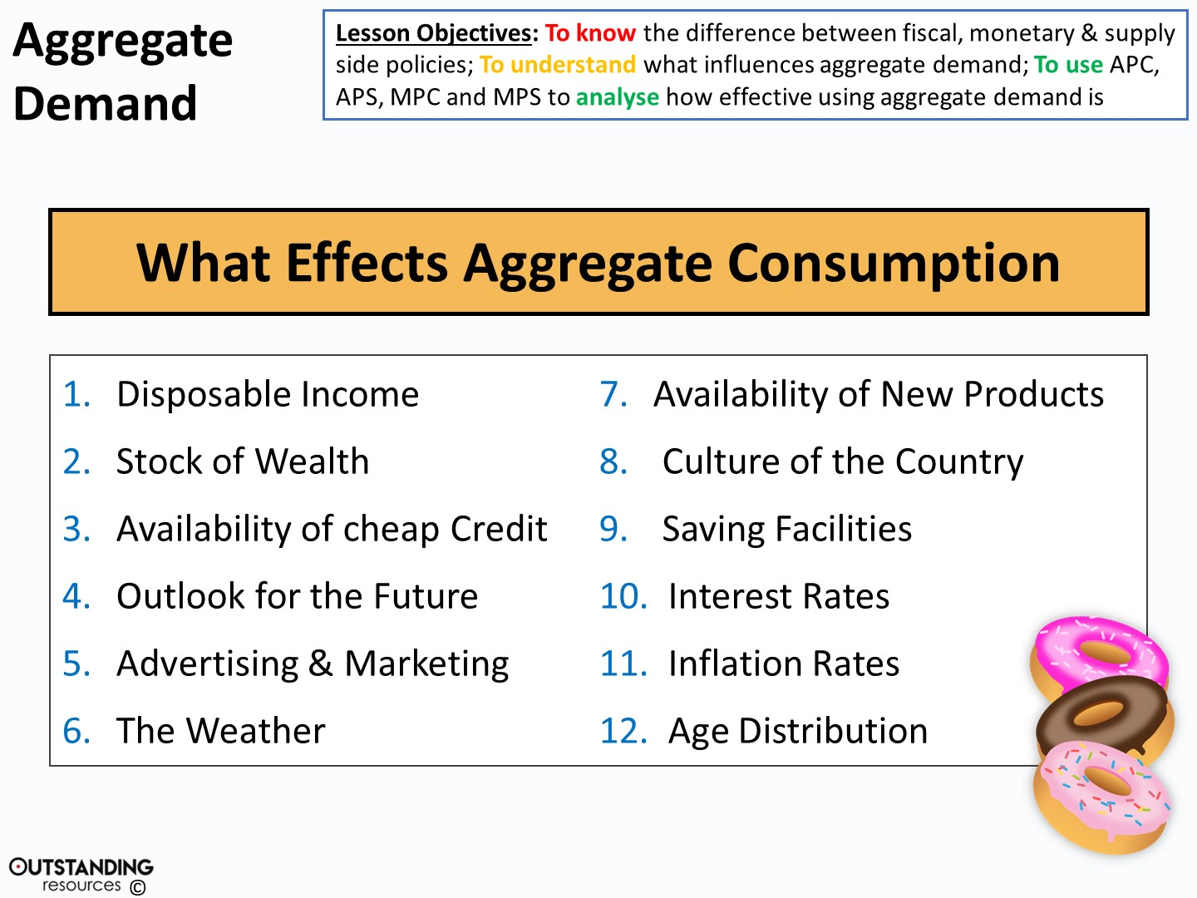
For more help, please visit www.exampaperspractice.co.uk
© 2025 Exams Papers Practice. All Rights Reserved
Notes:
Clipart Image: Donuts – taken from: https://openclipart.org/detail/279100/donoughts

Slide 14

Activity
For each of the following, how will they impact on AD?
  Disposable income.
  Availability of cheap credit.
  Outlook for the future
  The weather
  Availability of new products
  Interest rates
  Inflation rates
For more help, please visit www.exampaperspractice.co.uk
© 2025 Exams Papers Practice. All Rights Reserved

Slide 15
Green Pen
For each of the following, how will they impact on AD?
  Disposable income.
    This will lead to more spending → Increased marginal propensity to consume → Increased consumption (65% of AD) → Shift right in AD.
  Availability of cheap credit.
    Cheaper interest rates on business/personal loans → More businesses take on infrastructure projects → Increased investment → Shift right in AD.
  Cheaper interest rates on personal loans/credit → People more likely to spend using credit cards/other forms of credit → Increased consumption of goods → Shift right in AD.
  Outlook for the future
  The weather
  Availability of new products
  Interest rates
  Inflation rates

Slide 16

Activity
Worksheet
For more help, please visit www.exampaperspractice.co.uk
© 2025 Exams Papers Practice. All Rights Reserved

Slide 17

Green Pen
D
A
D
C
A
D
A
B
A
B
C
A
D
For more help, please visit www.exampaperspractice.co.uk
© 2025 Exams Papers Practice. All Rights Reserved

Slide 18
Activity
Assess the extent to which rising interest rates can control inflation. (10)
For more help, please visit www.exampaperspractice.co.uk
© 2025 Exams Papers Practice. All Rights Reserved

Slide 19

Home learning
Assess the extent to which net trade is the most important factor in the growth of the UK economy? (10)
For more help, please visit www.exampaperspractice.co.uk
© 2025 Exams Papers Practice. All Rights Reserved

Slide 20

Plenary
Name three things that impact AD.
Which is the most/least important.
Draw a diagram to show a fall in AD and an increase in AD.
For more help, please visit www.exampaperspractice.co.uk
© 2025 Exams Papers Practice. All Rights Reserved

