Slide 1
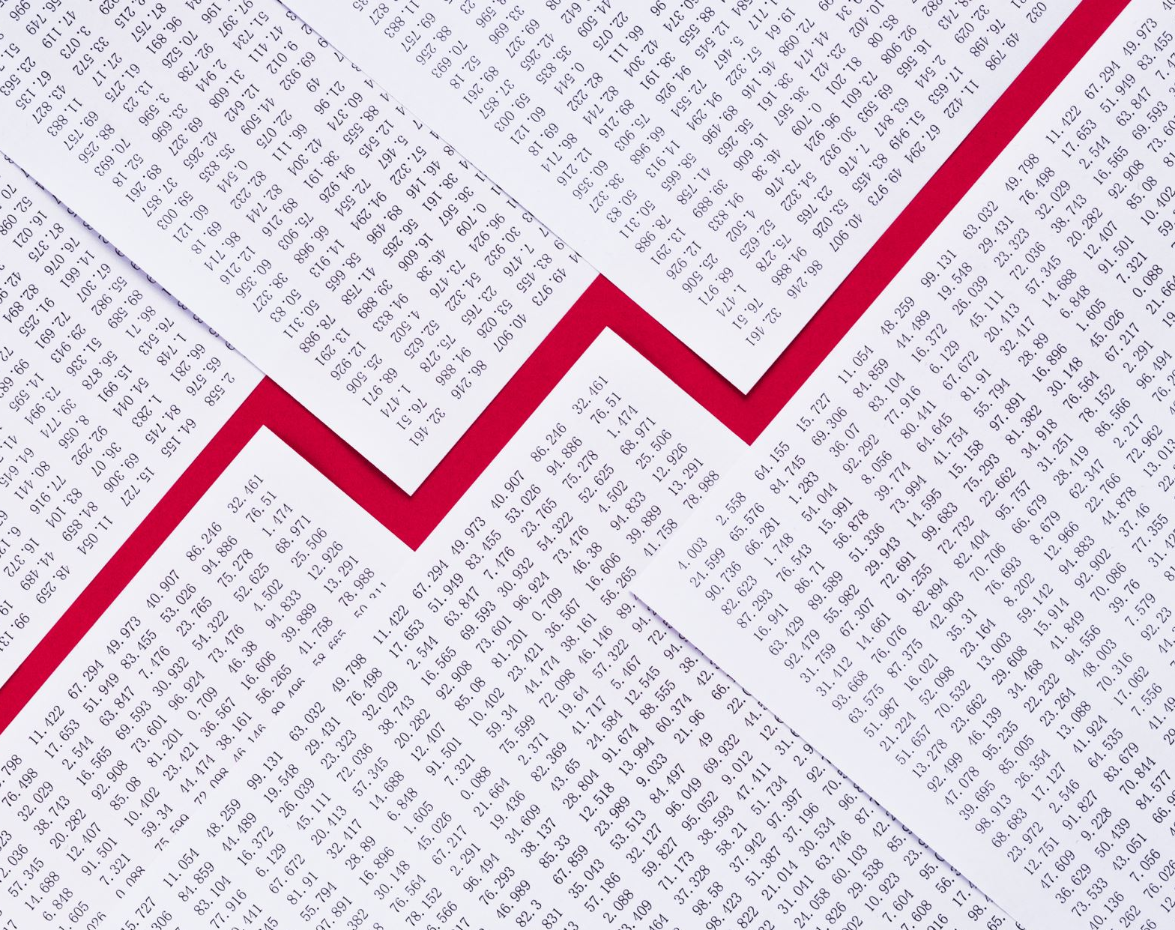


2.5.1 The economic cycle
For more help, please visit www.exampaperspractice.co.uk
© 2025 Exams Papers Practice. All Rights Reserved

Slide 2
Recall
What is a an appreciation and depreciation of a currency?
Draw a S&D diagram to show a appreciation of the currency
For more help, please visit www.exampaperspractice.co.uk
© 2025 Exams Papers Practice. All Rights Reserved

Slide 3
Starter
Draw a picture to explain what is currently going on with the UK Economy.
Using key terms we have learnt, explain what you have drawn.
For more help, please visit www.exampaperspractice.co.uk
© 2025 Exams Papers Practice. All Rights Reserved

Slide 4
Learning Objectives
Do you understand what aggregate demand is?
Are you able to show economic growth on a diagram?
Are you able to analyse the potential issues with economic growth?
For more help, please visit www.exampaperspractice.co.uk
© 2025 Exams Papers Practice. All Rights Reserved

Slide 5
Definition
We need to distinguish between short-run and long-run economic growth.
  Short-Run - “The actual annual percentage change in real national output”.
  Long-Run - “An increase in the potential productive capacity of the economy”.
For more help, please visit www.exampaperspractice.co.uk
© 2025 Exams Papers Practice. All Rights Reserved

Slide 6
How is it measured?
Short-Run - The annual percentage change in Real National Output or Gross Domestic Product (GDP)
Long-Run - The maximum potential output of the economy using all factor resources as illustrated on the Production Possibility Frontier.
For more help, please visit www.exampaperspractice.co.uk
© 2025 Exams Papers Practice. All Rights Reserved

Slide 7
Causes of Short-Run Economic Growth
In the short-run, the primary cause of an increase in economic growth is an increase in aggregate demand.
AD = C + I + G + (X-M)
Economic growth can also occur if there is an increase in short-run aggregate supply
Recap: SRAS will increase if there is a change in the costs of production (wages, price of raw materials, taxes/subsidies, exchange rates)
For more help, please visit www.exampaperspractice.co.uk
© 2025 Exams Papers Practice. All Rights Reserved

Slide 8
Short-Run Economic Growth Diagram
1) Begin with the equilibrium position.
Price Level
2) If there is an increase in AD to AD1, there will be economic growth from Y to Y1.
SRAS
SRAS1
P1
P
3) Or if there is an increase in SRAS to SRAS1, there will also be economic growth from Y to Y1.
P2
AD1
AD
4) If economic growth is caused by an increase in AD, this will lead to an increase in the price level to P1, but if caused by an increase in SRAS, will put downward pressure on prices to P2.
Y
Y1
Real National Output
For more help, please visit www.exampaperspractice.co.uk
© 2025 Exams Papers Practice. All Rights Reserved

Slide 9
Causes of Long-Run Economic Growth
For long-run economic growth to occur, there must be an increase in the productive capacity of the economy, that is to say an increase in long-run aggregate supply.
Increases in long-run aggregate supply can occur if there is a change in the quantity or quality of factors of production.
  Land
  Labour
  Capital
  Entrepreneurship
  Government Intervention
For more help, please visit www.exampaperspractice.co.uk
© 2025 Exams Papers Practice. All Rights Reserved

Slide 10
Evaluating Economic Growth
It is important that the government find a balance between short-run and long-run economic growth policies
Stimulating the demand-side of the economy is vital, but if supply-side of the economy remains constrained, high levels of inflation are likely to occur
Equally, focusing on improving the supply-side of the economy will have limited effect if the demand-side of the economy is suppressed. There will likely be significant spare capacity and unused resources
However, the enhancement of the supply-side of the economy has significant time-lags attached, and not all capital investment yields the desired improvements in productive efficiency
For more help, please visit www.exampaperspractice.co.uk
© 2025 Exams Papers Practice. All Rights Reserved

Slide 11
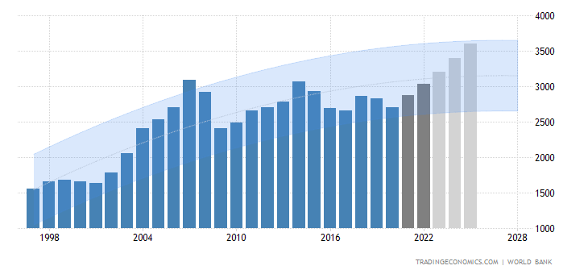
The Economic Cycle in the UK
For more help, please visit www.exampaperspractice.co.uk
© 2025 Exams Papers Practice. All Rights Reserved

Slide 12
GDP Definition
“The value of goods and services produced in the economy over a period of time.”
For more help, please visit www.exampaperspractice.co.uk
© 2025 Exams Papers Practice. All Rights Reserved

Slide 13
The Economic Cycle: A Diagram
The level of economic activity fluctuates over time, this pattern is referred to as the economic cycle
Economic activity is measured by GDP
GDP is the total value of a country’s output in a year
Real GDP takes into account inflation. If GDP growth is 5% and inflation 2% real GDP growth will be 3%
Trend rate of economic growth
Real GDP
Boom
Recession
Recovery
Slump
Time
For more help, please visit www.exampaperspractice.co.uk
© 2025 Exams Papers Practice. All Rights Reserved

Slide 14
Plenary
What is meant by aggregate demand?
What is the formula for AD?
How is AD and economic growth linked?
For more help, please visit www.exampaperspractice.co.uk
© 2025 Exams Papers Practice. All Rights Reserved

