Slide 1
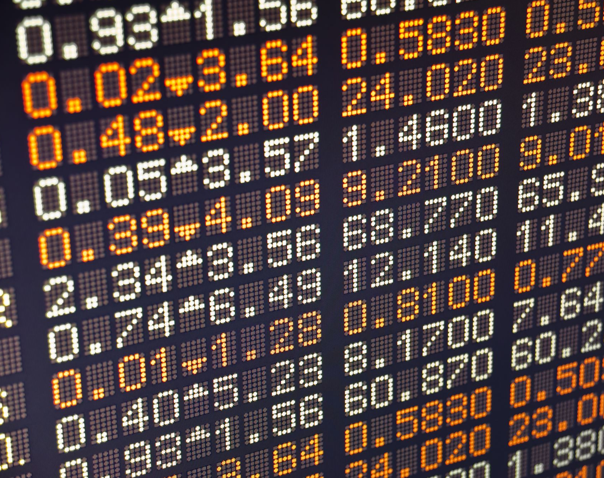
Exchange Rates
For more help, please visit www.exampaperspractice.co.uk
© 2025 Exams Papers Practice. All Rights Reserved
Notes:
0-2 Minutes
Let class settle
Introduce subject

Slide 2
Home Learning
Transactions demand
Demand for the currency derives from people wishing to buy goods and services from that country
For example, this may come about as companies produce products that are in high demand on the world stage e.g. petrol
Speculative demand
Higher interest rates attract speculators to UK banks in order to achieve a higher return
Foreign currency dealers will speculate whether a currency will appreciate or depreciate in the future
Task 1
Interest rates v Cost of living? Where is the balance? Write one page of notes.
Task 2:
How will Covid have impacted Transactional demand?

Slide 3
Learning Objectives
Are you able to draw supply and demand diagrams to show appreciation and depreciation of an exchange rate?
Are you able to analyse the impact of exchange rates on the economy?
Are you able to give investment advice based off sound economic arguments?
For more help, please visit www.exampaperspractice.co.uk
© 2025 Exams Papers Practice. All Rights Reserved

Slide 4
Recall
What is meant by appreciation of the exchange rate?
What is meant by a depreciation of the exchange rate?
Why do we have exchange rates?
For more help, please visit www.exampaperspractice.co.uk
© 2025 Exams Papers Practice. All Rights Reserved

Slide 5
Recall
What is meant by appreciation of the exchange rate?
An appreciation means an increase in the value of a currency against other foreign currency.
What is meant by a depreciation of the exchange rate?
Fall in value of exchange rate – exchange rate becomes weaker
Why do we have exchange rates?
Allows us to trade with other countries
For more help, please visit www.exampaperspractice.co.uk
© 2025 Exams Papers Practice. All Rights Reserved

Slide 6
Pound to Dollar
Task 1:
Draw a supply and demand diagram to show this diagram in action.
Task 2:
Using the terms appreciation and depreciation, explain your diagram in one paragraph.
Task 3:
Analyse the causes for this change in exchange rate.
Give two causes and analyse in one paragraph.
For more help, please visit www.exampaperspractice.co.uk
© 2025 Exams Papers Practice. All Rights Reserved

Slide 7
Self Assess
Task 1:
Draw a supply and demand diagram to show this diagram in action.
Price of £s in $
S
S1
P
P1
D
Task 2:
Using the terms appreciation and depreciation, explain your diagram in one paragraph.
Q
Q1
Quantity of £
As supply £s rises the exchange rate falls
e.g. £1 = $1.45 falls to £1 = $1.35
The pound has become weaker
Factors influencing supply:
Demand for imported products
Interest rates attracting or pushing away foreign investment
A fall in UK interest rates
Task 3:
Analyse the causes for this change in exchange rate.
Give two causes and analyse in one paragraph.
For more help, please visit www.exampaperspractice.co.uk
© 2025 Exams Papers Practice. All Rights Reserved

Slide 8
How are exchange rates determined?
Task 1:
Draw a supply and demand diagram to show this in action.
It’s as simple as Supply and demand…
As demand for £’s rises the exchange rate rises
e.g. £1 = $1.45 increases to £1 = $1.60
The pound has become stronger
Factors influencing demand:
Demand for UK products
Interest rates attracting or pushing away foreign investment
Rate of Foreign Direct Investment (FDI)
Task 2:
What is the impact on the economy?
Task 3:
How may this impact the cost of living?
For more help, please visit www.exampaperspractice.co.uk
© 2025 Exams Papers Practice. All Rights Reserved

Slide 9
How are exchange rates determined?
Self Assess
Task 1:
Draw a supply and demand diagram to show this in action.
£ v $
Supply of £s
$1.15
Task 2:
What is the impact on the economy?
$1.00
D1
D
Q
Q1
Quantity
Task 3:
How may this impact the cost of living?
An increase in exports to the US will increase the demand for the £ as Americans have to pay for these goods and services in £s. This will increase demand for the £ from D to D1. The price of the £ will rise from £1 = $1 to £1 = $1.15. This is called an appreciation of the £.
For more help, please visit www.exampaperspractice.co.uk
© 2025 Exams Papers Practice. All Rights Reserved

Slide 10
SPICED
Task 1:
Explain how SPICED can make the economy decline?
£ v $
Supply of £s
Task 2:
Explain how we can make our currency weaker? What will that lead to?
$1.15
$1.00
D1
D
Task 3:
Is it always a case of SPICED until we hit a recession? Discuss!
Q
Q1
Quantity
For more help, please visit www.exampaperspractice.co.uk
© 2025 Exams Papers Practice. All Rights Reserved

Slide 11
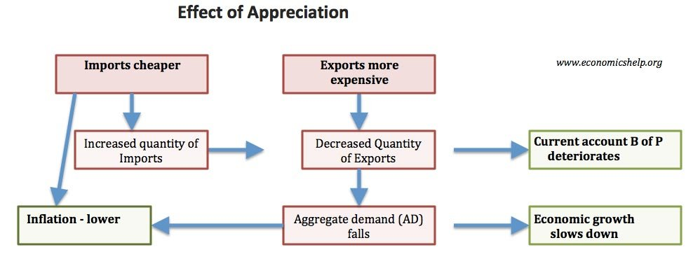
SPICED
Self Assess
Task 1:
Explain how SPICED can make the economy decline?
Task 2:
Explain how we can make our currency weaker? What will that lead to?
Task 3:
Is it always a case of SPICED until we hit a recession? Discuss!
For more help, please visit www.exampaperspractice.co.uk
© 2025 Exams Papers Practice. All Rights Reserved

Slide 12
Policy Analysts
Task 1:
As a policy analyst at Pieters PLC, you need to give advice to your investors on what may happen to the Russian currency over the next 6 months.
You must produce a diagram and explain your reasons for your diagram choice.
Task 2:
Please give advice on which country your investors should go to for a high return on their capital. The choices are, Venezuela, Japan and France. They would like to know why you advise against the other two countries.
For more help, please visit www.exampaperspractice.co.uk
© 2025 Exams Papers Practice. All Rights Reserved

Slide 13
Self Assess
Task 1:
As a policy analyst at Pieters PLC, you need to give advice to your investors on what may happen to the Russian currency over the next 6 months.
You must produce a diagram and explain your reasons for your diagram choice.
Price of £s in $
S
Russian investors will sell off assets.
Russian currency will increase in supply.
Reduced demand for Russian Ruble.
S1
P
P1
D
Q
Q1
Quantity of £
Task 2:
Please give advice on which country your investors should go to for a high return on their capital. The choices are, Venezuela, Japan and France. They would like to know why you advise against the other two countries.
Interest rates?
Money supply?
Inflation?
War?
For more help, please visit www.exampaperspractice.co.uk
© 2025 Exams Papers Practice. All Rights Reserved

Slide 14
Plenary
How is SPICED linked to interest rates?
How can we link the economic cycle to exchange rates?
Name one key term you want to revise.
For more help, please visit www.exampaperspractice.co.uk
© 2025 Exams Papers Practice. All Rights Reserved

