Slide 1


2.3.4 Impact on costs and sales revenue
2.3 Productive efficiency
For more help, please visit www.exampaperspractice.co.uk
© 2025 Exams Papers Practice. All Rights Reserved

Slide 2
Recap
Name two types of lean production.
Explain what they are.
Explain why they are used and how they will benefit a business.
Can you link these types of production to the impact on costs and sales revenue?
For more help, please visit www.exampaperspractice.co.uk
© 2025 Exams Papers Practice. All Rights Reserved

Slide 3
Starter Activity:
When writing an essay or completing a piece of homework which approach would be better, quality control or quality assurance?
Quality control- the process of inspecting products to ensure they meet the required quality standards.
Quality Assurance - The processes that ensure production quality meets the requirements of customers.
For more help, please visit www.exampaperspractice.co.uk
© 2025 Exams Papers Practice. All Rights Reserved

Slide 4
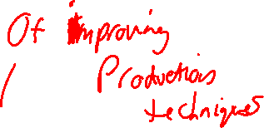
Learning Objectives
Can you analysis the impact on average costs?
Are you able to offer recommendations on how a business can minimising waste of resources?
Competitive advantage of short product development lead times
For more help, please visit www.exampaperspractice.co.uk
© 2025 Exams Papers Practice. All Rights Reserved

Slide 5
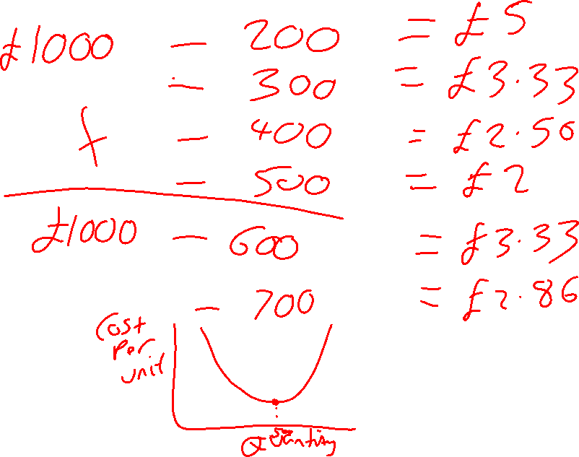
For more help, please visit www.exampaperspractice.co.uk
© 2025 Exams Papers Practice. All Rights Reserved

Slide 6
Productive efficiency
Productive efficiency occurs when an economy uses the minimum inputs to produce the maximum output at the lowest possible cost.
This can be shown using an average total cost diagram
Average Total Total Cost
Cost: Output
=
For more help, please visit www.exampaperspractice.co.uk
© 2025 Exams Papers Practice. All Rights Reserved
Notes:
http://www.theguardian.com/business/2015/feb/24/oecd-warns-uk-must-fix-productivity-problem-to-raise-living-standards

Slide 7
Productive efficiency
As output increases costs per unit fall. This occurs because fixed costs (e.g. rent) are spread over the higher output.
Productive efficiency occurs at output Q where average total costs are at their minimum.
Productive efficiency can be shown using an average cost curve diagram
Food for thought:
Which facts could cause the cost of production per unit to increase?
What would happen as a result of a decrease in the quantity of output produced?
What could a business do to ensure their average cost continues to decrease?
Costs of production
Average Total Cost
Q
Output
For more help, please visit www.exampaperspractice.co.uk
© 2025 Exams Papers Practice. All Rights Reserved

Slide 8
Productive efficiency
Student Task:
What is meant by the term opportunity cost?
Label the diagram to show the opportunity cost of moving from point A to point B.
Good Y
D
Any point on the PPF is said to be productively efficient e.g. point A or point B. On the curve we are producing at maximum production i.e. we cannot produce any more. At point C we can produce more goods (under production). Point D is unobtainable given our current factor inputs.
The PPC also shows the trade-off between two variables, here good X and good Y. There is an opportunity cost as producing more of good X means producing less of good Y.
A
C
B
Good X
Production-possible frontier (PPF) – is a curve that illustrates the possible quantities that can be produced of two products if both depend on the same finite resources for their manufacturer.
For more help, please visit www.exampaperspractice.co.uk
© 2025 Exams Papers Practice. All Rights Reserved
Notes:
Point A
Point B
Point C
Point D

Slide 9
Student Activity
Can you explain the difference between productive and allocative efficiency?
Illustrate how diseconomies of scale will be represented on the PPF curve?
Explain how a business could possible become productive inefficient. Provide some industry examples.
Challenge: What impact could competitors have on a business’ productive efficiency levels?
For more help, please visit www.exampaperspractice.co.uk
© 2025 Exams Papers Practice. All Rights Reserved

Slide 10
Minimising waste of resources
Economies of scale occur as unit costs fall as the scale of production increases.
The decisions of individuals, producers and government can, under certain circumstances, improve resource allocation
Through economies of scale we can see that productive efficiency is created when:
  Purchasing economies lead to a reduction in costs
  Specialisation can lead to a more efficient use of inputs
  Better management can lead to increased output with the same factor inputs
For more help, please visit www.exampaperspractice.co.uk
© 2025 Exams Papers Practice. All Rights Reserved
Notes:
http://www.bbc.co.uk/news/business-19981498

Slide 11
Minimising waste of resources
Diseconomies of scale occur as unit costs rise as the scale of production increases.
Bureaucracy occurs when large organisations, particularly government, have overly complex administrative procedures. This increases costs.
The decisions of individuals, producers and government can lead to a misallocation of resources
Through diseconomies of scale we can see that productive inefficiency is created where resources are misallocated:
  Lack of communication between employees
  Lack of coordination by management
  Bureaucracy, particularly in large organisations
For more help, please visit www.exampaperspractice.co.uk
© 2025 Exams Papers Practice. All Rights Reserved

Slide 12
Competitive advantage of short product development lead times
Time Based Management is the effective management of resources to ensure that unproductive time is eliminated from the production process
This will involve the use of a variety of operations management systems including Just In Time and CAD/CAM
Flexibility is crucial so that firms can alter the production process to meet changes in demand. If successful then firms will have:
  Reduced lead times and faster response to changes in the market meaning short product development lead times
  Less wastage through increased efficiency
  Faster development time for new products
This will create a competitive advantage meaning that the firm has first mover advantage and can get the product to market quicker than the competition
For more help, please visit www.exampaperspractice.co.uk
© 2025 Exams Papers Practice. All Rights Reserved

Slide 13
Test yourself
Write a definition of each of the following terms:
  Opportunity cost
  Productive efficiency
  Just in time
  Time based management
  Economies of scale
  Diseconomies of scale
  Average costs
For more help, please visit www.exampaperspractice.co.uk
© 2025 Exams Papers Practice. All Rights Reserved

