Slide 1
2.3.1 Productivity 2.3 Productive efficiency
For more help, please visit www.exampaperspractice.co.uk
© 2025 Exams Papers Practice. All Rights Reserved

Slide 2
Recall
Deptford Ltd currently employs 652 staff. The business has a current output of 50 700 units per year.
Calculate the current labour productivity output level.
If Deptford Ltd, wanted to produce 75,000 units but lose 10% of staff. What will the impact be on staff?
Calculate the new predicted labour productivity output level.
What would this change in output mean for the economy?
For more help, please visit www.exampaperspractice.co.uk
© 2025 Exams Papers Practice. All Rights Reserved

Slide 3
Exam practice
For more help, please visit www.exampaperspractice.co.uk
© 2025 Exams Papers Practice. All Rights Reserved

Slide 4
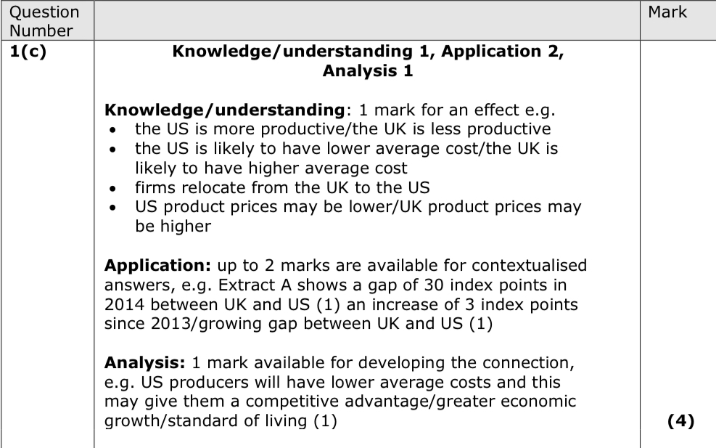
For more help, please visit www.exampaperspractice.co.uk
© 2025 Exams Papers Practice. All Rights Reserved

Slide 5
Learning Objectives
Are you able to make a distinction between labour and capital intensive production?
Can you evaluate the impact of productivity gap between two opposing countries?
Can you offer recommendations of the best way a business in a niche market can adapt to make intensive production work in their favour?
For more help, please visit www.exampaperspractice.co.uk
© 2025 Exams Papers Practice. All Rights Reserved

Slide 6
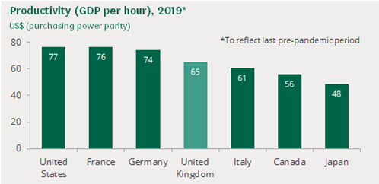
International comparisons
For more help, please visit www.exampaperspractice.co.uk
© 2025 Exams Papers Practice. All Rights Reserved

Slide 7
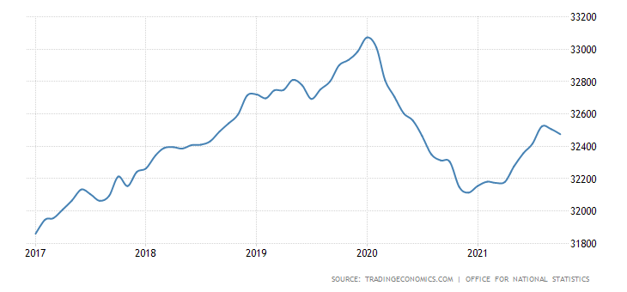
Employed Persons
For more help, please visit www.exampaperspractice.co.uk
© 2025 Exams Papers Practice. All Rights Reserved
Notes:
Although there were redundancies and other job losses as a result of the global pandemic. Why did we see an increase in the number employed people in the beginning of 2020?

Slide 8
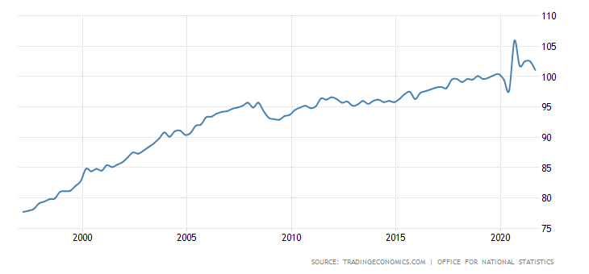
Productivity
For more help, please visit www.exampaperspractice.co.uk
© 2025 Exams Papers Practice. All Rights Reserved

Slide 9
Productivity and economic growth
Productive efficiency occurs anywhere along the PPC e.g. point A or point B.
Producing at point C shows an inefficiency as not all resources are being used.
Point D is unobtainable as there are not enough resources to produce this level of output.
Manufacturing
D
By operating on the PPC, society is using its resources efficiently. If it operated within the PPC, at point C, it could produce more whilst it is unable to operate outside the PPC, at point D.
Therefore, it is productively efficient anywhere on the PPC, such as at point A or B.
A
C
B
Services
For more help, please visit www.exampaperspractice.co.uk
© 2025 Exams Papers Practice. All Rights Reserved
Notes:
Answers:
Productive efficiency occurs anywhere along the PPC e.g. point A or point B.
Producing at point C shows an inefficiency as not all resources are being used.
Point D is unobtainable as there are not enough resources to produce this level of output.

Slide 10
Productivity and economic growth
Economic growth caused by an increase in factors of production available in an economy can cause the PPF to shift outwards to the right.
This will result in an increase in the productive capacity of the economy from PPF to PPF1 i.e. greater output can be produced.
Good Y
B
Economic growth is the percentage change in the total output (GDP) of a country.
An increase in economic growth can be caused by an increase in factor inputs e.g. immigration will see a growth of labour as an input so that we can produce more; increased production of investment goods will allow us to produce more goods and services in the future.
A
PPF
PPF1
Good X
For more help, please visit www.exampaperspractice.co.uk
© 2025 Exams Papers Practice. All Rights Reserved

Slide 11
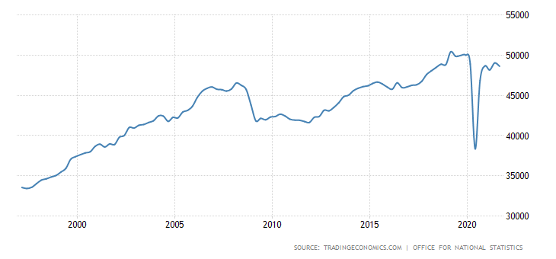
GDP From Manufacturing
For more help, please visit www.exampaperspractice.co.uk
© 2025 Exams Papers Practice. All Rights Reserved

Slide 12
Student Activity
In pairs, one person will be the student and the other will be the teacher.
Between the two of you, you will research and teach your partner on one of the following topics:
GDP growth rate
GDP and manufacturing.
Consider how these factors will influence GDP and the economy.
Can you link the GDP to unemployment rates. What happens to unemployment if the GDP increases or decreases?
For more help, please visit www.exampaperspractice.co.uk
© 2025 Exams Papers Practice. All Rights Reserved
Notes:
Student as teacher – Students will take it in turns to

Slide 13
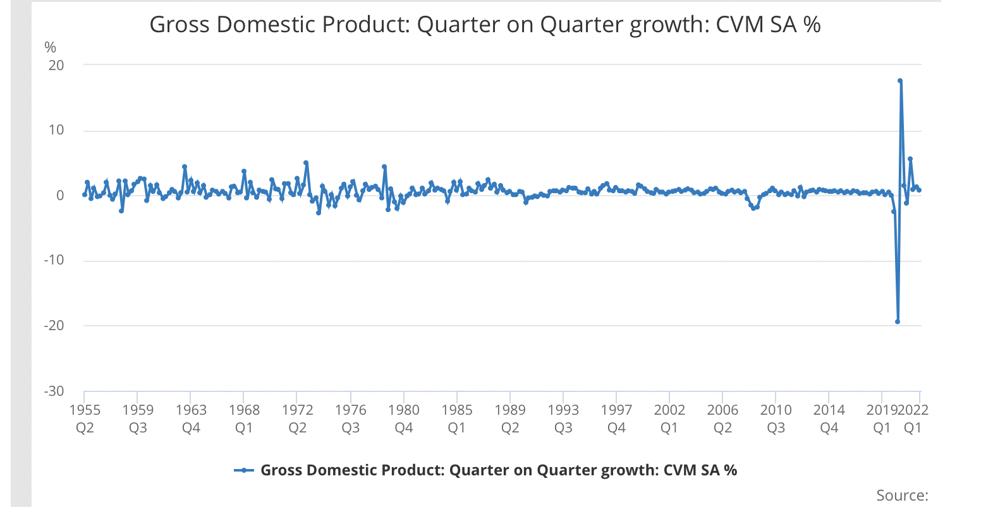
GDP Growth Rate
Mini task:
Can you provide reasoning as to how Covid caused a great spike?
Thinking of the next 5 years, illustrate and justify your prediction of how you expect the GDP growth rate to be. Will it continue to be fairly stable or will there be a decline in the rate?
For more help, please visit www.exampaperspractice.co.uk
© 2025 Exams Papers Practice. All Rights Reserved

Slide 14
Labour and Capital intensive production
The mix of resources can be:
Capital intensive which uses a relatively high proportion of capital such as machinery in the production of a good or service
This tends to occur in the secondary sector of the economy i.e. manufacturing
Labour intensive which uses a relatively high proportion of labour i.e. workers in the production of a good or service
This tends to occur in the tertiary sector of the economy i.e. services
For more help, please visit www.exampaperspractice.co.uk
© 2025 Exams Papers Practice. All Rights Reserved
Notes:
http://www.bbc.co.uk/news/magazine-29941354
Head to head: Potter versus 3D printer

Slide 15
Student Activity
Class split
Research the advantages and disadvantages of:
Capital intensive production
Labour intensive production
Aim to find some interesting information about the type of production.
Challenge: How will capital and labour intensive production impact a mass and niche market differently
For more help, please visit www.exampaperspractice.co.uk
© 2025 Exams Papers Practice. All Rights Reserved

Slide 16
Capital intensive
Advantages | Disadvantages
Increased productivity Improved quality and speed Reduced labour costs Greater opportunities for economies of scale (the benefits to a business of producing on a large scale that lead to a fall in unit costs) | High investment outlay Lack of human initiative Greater resistance to change by workforce e.g. retraining to use new equipment
For more help, please visit www.exampaperspractice.co.uk
© 2025 Exams Papers Practice. All Rights Reserved
Notes:
Answers

Slide 17
Labour intensive
Advantages | Disadvantages
Often cheaper, especially when produced in low wage locations Workforce can easily adapt to change, especially if multi-skilled Continuous improvement through workforce can benefit the firm e.g. new ideas Government funding often available to protect jobs in the economy | Industrial relations can be a problem e.g. strikes Lack of skilled workers in some industries HRM costs can be very high e.g. recruitment, selection and training
For more help, please visit www.exampaperspractice.co.uk
© 2025 Exams Papers Practice. All Rights Reserved
Notes:
Asnwers

Slide 18
In pairs
Complete the table below to show examples of capital and labour intensive industries operating in both mass and niche markets
 | Capital intensive | Labour intensive
Mass market
Niche market
For more help, please visit www.exampaperspractice.co.uk
© 2025 Exams Papers Practice. All Rights Reserved

Slide 19
Create a guide to staff/equipment on labour v Capital intensive
When should each be used?
People and equipment – ads/dis?
How do you calculate productivity?
How can we increase productivity?
When should we increase it?
For more help, please visit www.exampaperspractice.co.uk
© 2025 Exams Papers Practice. All Rights Reserved

Slide 20
Check your knowledge
The firm also manufacturer’s tables and its production possibility curve using all available resources is shown on the right.
Illustrate the effect of the improvement in the productivity of chairs if the productivity of tables remains unchanged. /2 marks
2. How does a business the sector of a business operate in (primary, secondary or tertiary) impact the productivity of the business?
For more help, please visit www.exampaperspractice.co.uk
© 2025 Exams Papers Practice. All Rights Reserved

