Slide 1
Edexcel A2 Business
1.2.5 Income Elasticity of Demand (YED)
Revisionstation
For more help, please visit www.exampaperspractice.co.uk
© 2025 Exams Papers Practice. All Rights Reserved

Slide 2
Theme 1 Retrieval Challenge Matrix
1 point | 2 points | 3 points
Define the term ‘supply’ | Compare advertising and branding | Explain the significance of PED in terms of pricing
What does ‘demand’ mean in a business context? | Describe how innovation drive dynamic markets | Explain the impact of external shocks on commodities
Give an example of a ‘subsidy’ | Give 2 uses of demographics data to a business | Explain the relationship between PED and total revenue
For more help, please visit www.exampaperspractice.co.uk
© 2025 Exams Papers Practice. All Rights Reserved

Slide 3
Calculators will be needed for this topic
For more help, please visit www.exampaperspractice.co.uk
© 2025 Exams Papers Practice. All Rights Reserved

Slide 4
A ruler and coloured pens are needed for this topic
For more help, please visit www.exampaperspractice.co.uk
© 2025 Exams Papers Practice. All Rights Reserved

Slide 5
You will need worksheet 1.2.5 for this lesson
For more help, please visit www.exampaperspractice.co.uk
© 2025 Exams Papers Practice. All Rights Reserved

Slide 6
From Edexcel
a) Calculation of income elasticity of demand
b) Interpretation of numerical values of income elasticity of demand
c) The factors influencing income elasticity of demand
d) The significance of income elasticity of demand to businesses
For more help, please visit www.exampaperspractice.co.uk
© 2025 Exams Papers Practice. All Rights Reserved

Slide 7
Starter
Here are three statements:
We know that an inferior good is products or services where demand decreases when consumer income increases
We also know that a normal good (necessity good) is products or services for which demand increases when income increases
We also know that a luxury good is products or services for which demand increases more than proportionally as income rises
Now you know this try the question on the next slide
For more help, please visit www.exampaperspractice.co.uk
© 2025 Exams Papers Practice. All Rights Reserved

Slide 8
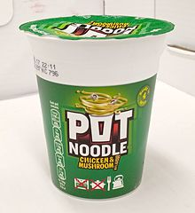
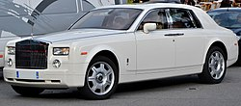
Starter – which product is inferior?
For more help, please visit www.exampaperspractice.co.uk
© 2025 Exams Papers Practice. All Rights Reserved
Notes:
Pot noodle – as your income rises you choose to buy a better quality dinner

Slide 9
YED
YED stands for Income Elasticity of Demand
We can’t use the letter “I” as that is reserved for the word Investment
So we use “Y” instead
For more help, please visit www.exampaperspractice.co.uk
© 2025 Exams Papers Practice. All Rights Reserved

Slide 10
Definition: Income Elasticity of Demand
Income Elasticity of Demand is also known as YED for short
It is a calculation used, by business, to estimate how demand will change given changes in income
As consumer incomes change (up or down) so do demands
So a business can measure how much demand for a product or service will be affected by a change in consumers income
For more help, please visit www.exampaperspractice.co.uk
© 2025 Exams Papers Practice. All Rights Reserved

Slide 11
YED in a nutshell
A
B
C
You have a part-time job which gives you a steady income. What do you have for lunch?
You are broke, what do you have for lunch?
You have a successful online business, what do you have for lunch?
For more help, please visit www.exampaperspractice.co.uk
© 2025 Exams Papers Practice. All Rights Reserved
Notes:
A – pot noodle
B – Mc Ds or a meal deal
C – meal out, steak anything posh nosh

Slide 12
Calculation of income elasticity of demand
For more help, please visit www.exampaperspractice.co.uk
© 2025 Exams Papers Practice. All Rights Reserved

Slide 13
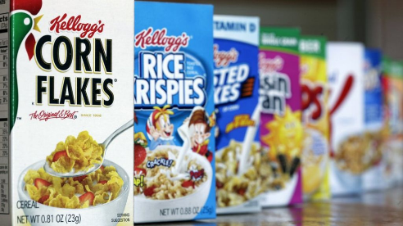
Normal (necessity) goods
Normal goods are those for which consumer demand increases when income increases
A good is normal when consumers demand more as their incomes increase
YED value would be >0 (a positive value)
For example the YED value for Kellogg’s cornflakes might be 0.4
For more help, please visit www.exampaperspractice.co.uk
© 2025 Exams Papers Practice. All Rights Reserved

Slide 14
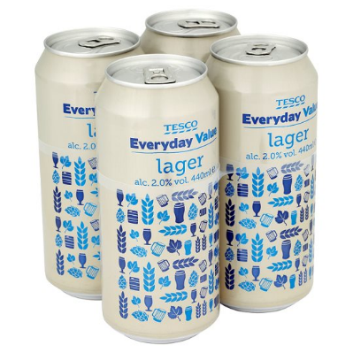
Inferior goods
Inferior goods are products where demand decreases as income increases
YED value for an inferior good will be <0 ( a negative value)
For example charity shop clothes might have a YED of -1.5
Leo is earning more money now he has been promoted, so he wants to buy less inferior goods. This means that he can now afford Champagne and doesn’t have to drink Tesco Value larger
For more help, please visit www.exampaperspractice.co.uk
© 2025 Exams Papers Practice. All Rights Reserved

Slide 15
Luxury goods
A luxury good is when an increase in income causes a larger increase in demand (it’s all about proportion)
YED value for luxury goods will be >1 positive
For example you buy a game with extra online downloadable content levels because you have had a 10% increase in income but your demand increases 25%. This gives a YED value of 2.5
For more help, please visit www.exampaperspractice.co.uk
© 2025 Exams Papers Practice. All Rights Reserved

Slide 16
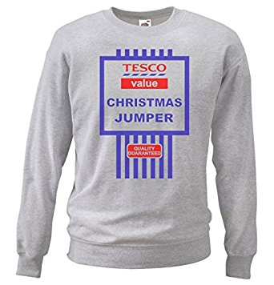
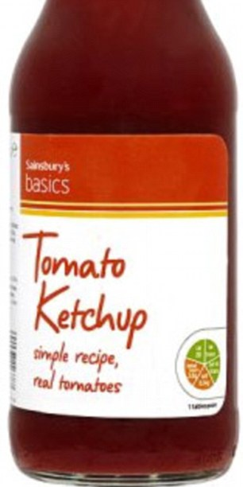
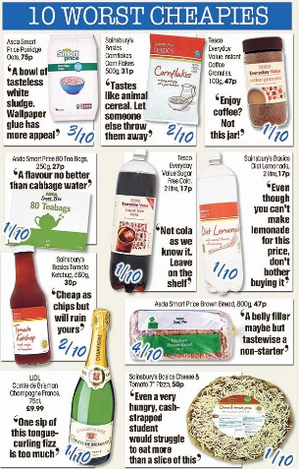
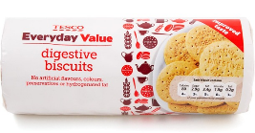
Suggested activity - Can you create your own collages of inferior / normal and luxury goods?
For more help, please visit www.exampaperspractice.co.uk
© 2025 Exams Papers Practice. All Rights Reserved

Slide 17
Interpretation of numerical values of income elasticity of demand
For more help, please visit www.exampaperspractice.co.uk
© 2025 Exams Papers Practice. All Rights Reserved

Slide 18
YED formula
This is the main formula
For more help, please visit www.exampaperspractice.co.uk
© 2025 Exams Papers Practice. All Rights Reserved

Slide 19
% change in price or quantity demanded formula
Price new – Price old
Price old x 100
You will need both formulas to calculate YED
Note: This is also used to calculate PED.
For more help, please visit www.exampaperspractice.co.uk
© 2025 Exams Papers Practice. All Rights Reserved

Slide 20
Example YED Calculations
Question 1: Calculate YED if demand has increased from 20,000 units to 25,000 units following an average income increase of 15%.
Question 2: Calculate YED if demand has increased from 52,476 units to 702,003 units following an average income increase of 4%.
Question 3: Calculate YED if demand has increased from 6,438 units to 6,489 units following an average income increase of 12%.
Use both formulas!
Round up and down and show results to 2 decimal places
For more help, please visit www.exampaperspractice.co.uk
© 2025 Exams Papers Practice. All Rights Reserved

Slide 21
Answers to example YED calculations
Question 1: 25,000 – 20,000 / 20,000 x 100 / 15% = 1.67
Question 2: 702,003 – 52,476 / 52,476 x 100 / 4% = 309.44
Question 3: 6489-6438/6438 x 100 / 12% = 0.066
Wrong result? Check you are rounding down (1-4) and up (5+)
For more help, please visit www.exampaperspractice.co.uk
© 2025 Exams Papers Practice. All Rights Reserved

Slide 22
Interpretation of numerical values
YED measures the responsiveness of demand to a change in income
Inferior | Normal | Luxury
YED value is <0 negative | YED value is between 0 and 1 positive | YED value is >1 positive
Ian increase in income means a decrease in demand | An increase in income means a small increase in demand | An increase in income means a higher increase in demand
For more help, please visit www.exampaperspractice.co.uk
© 2025 Exams Papers Practice. All Rights Reserved

Slide 23
Comment on your results
Look at your answers from questions 1, 2 and 3
Comment if the YED value is negative or positive
Comment if the YED value is for an inferior or normal good
 | Question 1 | Question 2 | Question 3
Your answers
YED negative or positive?
Inferior or normal good?
For more help, please visit www.exampaperspractice.co.uk
© 2025 Exams Papers Practice. All Rights Reserved

Slide 24
Comment on your results - answers
 | Question 1 | Question 2 | Question 3
Your answers | 1.67 | 309.44 | 0.065
YED negative or positive? | positive | positive | Positive
Inferior or normal good? | Luxury | Luxury | Normal
For more help, please visit www.exampaperspractice.co.uk
© 2025 Exams Papers Practice. All Rights Reserved

Slide 25
The factors influencing income elasticity of demand
For more help, please visit www.exampaperspractice.co.uk
© 2025 Exams Papers Practice. All Rights Reserved

Slide 26
Factors influencing YED = luxury goods
An increase in income will mean an increase in the demand for luxury goods
Scott has had a pay rise and now he is considering purchasing a luxury watch
For more help, please visit www.exampaperspractice.co.uk
© 2025 Exams Papers Practice. All Rights Reserved

Slide 27
Factors influencing YED = normal goods
An increase in income will lead to an increase in demand
Kathryn is earning more because the minimum wage has increased this year, so she will buy more of the products that she needs
For more help, please visit www.exampaperspractice.co.uk
© 2025 Exams Papers Practice. All Rights Reserved

Slide 28
Factors influencing YED = Inferior goods
An increase in income will lead to a fall in demand for inferior goods
Chazz earns more money, he no longer wants to buy ASDA Smartprice food and is treating himself to a tin on Heinz branded beans
For more help, please visit www.exampaperspractice.co.uk
© 2025 Exams Papers Practice. All Rights Reserved

Slide 29
Expectations of changes income
Incomes will fall if employees lose their job and end up claiming jobseekers allowance
Incomes will rise if an employee is promoted within a business, this may come with a pay rise
Incomes may fall in times of recession – businesses may need to cut costs (staff wages)
Incomes may rise in times of economic growth – businesses may want to keep key staff with a pay rise
For more help, please visit www.exampaperspractice.co.uk
© 2025 Exams Papers Practice. All Rights Reserved

Slide 30
The significance of income elasticity of demand to businesses
For more help, please visit www.exampaperspractice.co.uk
© 2025 Exams Papers Practice. All Rights Reserved

Slide 31
YED example - Poundland
Poundland specialises in inferior goods
Poundland specialises in negative YED products
Poundland will thrive and have more sales when incomes are falling in a recession
What will happen in economic growth when incomes start to rise?
YED is used by business to help them decide what products and services they should offer in order to increase sales
For more help, please visit www.exampaperspractice.co.uk
© 2025 Exams Papers Practice. All Rights Reserved
Notes:
When incomes start to rise customers will demand better less inferior goods and the revenue and demand for Poundland products will decrease.

Slide 32
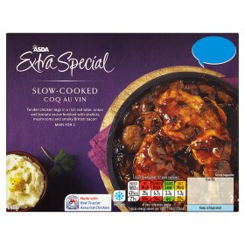
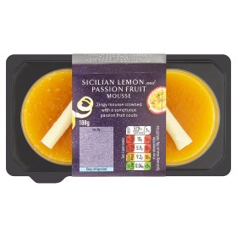
YED example ASDA
When incomes start to rise, in a period of economic growth, ASDA may need to diversify into premium products and extra special ranges
For more help, please visit www.exampaperspractice.co.uk
© 2025 Exams Papers Practice. All Rights Reserved

Slide 33
Plenary Quiz
Incomes fell in 2021 by 2.2%
Weekly orders at XYZ have increased from 2,000 a week to 3,500
Calculate the YED for company XYZ in 2021
You have 4 minutes
Use both formulas
For more help, please visit www.exampaperspractice.co.uk
© 2025 Exams Papers Practice. All Rights Reserved

Slide 34
Plenary Quiz Answers
Calculate % change in quantity demanded
= (3500-2000)/2000 x 100
= 75%
Calculate YED
= 75%/-2.2%
= -34.09
For more help, please visit www.exampaperspractice.co.uk
© 2025 Exams Papers Practice. All Rights Reserved

Slide 35
Sample Edexcel A2 questions
For more help, please visit www.exampaperspractice.co.uk
© 2025 Exams Papers Practice. All Rights Reserved

Slide 36
Case study for question 3
For more help, please visit www.exampaperspractice.co.uk
© 2025 Exams Papers Practice. All Rights Reserved

Slide 37
Sample question 3
Knowledge 1
Application 3
For more help, please visit www.exampaperspractice.co.uk
© 2025 Exams Papers Practice. All Rights Reserved

Slide 38
Answer sample question 3
For more help, please visit www.exampaperspractice.co.uk
© 2025 Exams Papers Practice. All Rights Reserved

Slide 39
New terms
Income elastic demand; how much demand changes when the consumer has a change in income
YED; income elastic demand (we use Y because the letter I is reserved for the word investment)
For more help, please visit www.exampaperspractice.co.uk
© 2025 Exams Papers Practice. All Rights Reserved

Slide 40
For more help, please visit www.exampaperspractice.co.uk
© 2025 Exams Papers Practice. All Rights Reserved

