Slide 1
2.2.4 Income elasticity of demand
For more help, please visit www.exampaperspractice.co.uk
© 2025 Exams Papers Practice. All Rights Reserved

Slide 2
Recall
Name three different pricing strategies.
Explain which strategy you would use for a new product.
Assess the most likely pricing strategy for a new firm entering the minicab market.
For more help, please visit www.exampaperspractice.co.uk
© 2025 Exams Papers Practice. All Rights Reserved

Slide 3
Starter
What products do you buy if you are relatively poor/rich?
Which products demand wouldn’t change if your income changes?
Explain which product you think is least likely to change and why.
For more help, please visit www.exampaperspractice.co.uk
© 2025 Exams Papers Practice. All Rights Reserved

Slide 4
Lesson Objectives
Are you able to explain Income elasticity of demand?
Are you able to analyse the impacts of income elasticity on normal and inferior goods?
Can you work out the income elasticity for different goods?
For more help, please visit www.exampaperspractice.co.uk
© 2025 Exams Papers Practice. All Rights Reserved

Slide 5
Definition
Income elasticity of demand (Yed) measures the relationship between a change in quantity demanded and a change in real income
or
The responsiveness of demand to a change in real income
For more help, please visit www.exampaperspractice.co.uk
© 2025 Exams Papers Practice. All Rights Reserved

Slide 6
Formula
YED = % change in demand
% change in income
For more help, please visit www.exampaperspractice.co.uk
© 2025 Exams Papers Practice. All Rights Reserved

Slide 7
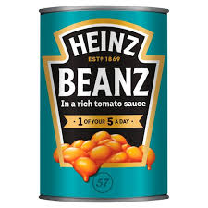
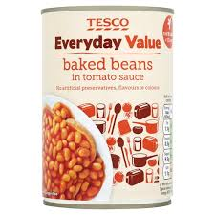
Income Elasticity of Demand:
Normal Good – demand rises as income rises and vice versa
Inferior Good – demand falls as income rises and vice versa
Why does this happen?
For more help, please visit www.exampaperspractice.co.uk
© 2025 Exams Papers Practice. All Rights Reserved

Slide 8
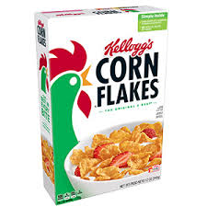
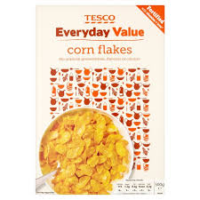
Look out for the sign…!
A positive sign (+) denotes a normal good
A negative sign (-) denotes an inferior good
For more help, please visit www.exampaperspractice.co.uk
© 2025 Exams Papers Practice. All Rights Reserved

Slide 9
The basic details you need to know
Luxury Goods
Have a positive income elasticity of demand > +1:
Demand rises more than proportionate to a change in income
Sometimes called superior goods
Normal Goods
Have a positive income elasticity of demand:
As consumers’ income rises, so more is demanded at each price level
Normal goods have an income elasticity of demand of between 0 and +1
Inferior goods
Have a negative income elasticity of demand:
Demand falls as income rises
For more help, please visit www.exampaperspractice.co.uk
© 2025 Exams Papers Practice. All Rights Reserved

Slide 10
Positive Income Elasticity
A rise in income will cause a rise in demand
A fall in income will cause a fall in demand
Coffee example…. A 10% increase in income will result in a 2.3% increase in demand for coffee.
What’s the YED?
What will this look like on a diagram?
For more help, please visit www.exampaperspractice.co.uk
© 2025 Exams Papers Practice. All Rights Reserved

Slide 11
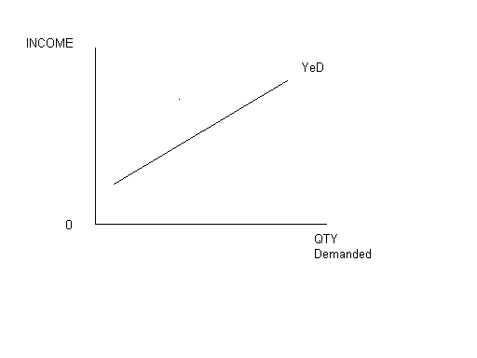
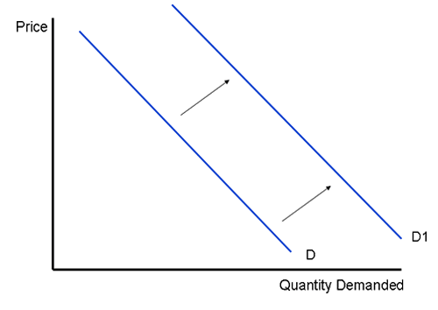
Positive Income Elastic Demand
Two ways of showing YED on a graph
For more help, please visit www.exampaperspractice.co.uk
© 2025 Exams Papers Practice. All Rights Reserved

Slide 12
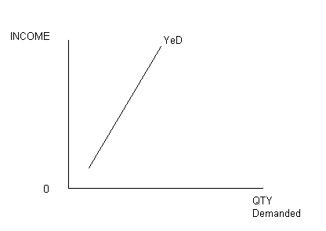
Elastic or Inelastic +YeD?
Elastic goods – are seen as LUXURIES OR SUPERIOR
Inelastic goods – are seen as NORMAL or NECESSITIES
For more help, please visit www.exampaperspractice.co.uk
© 2025 Exams Papers Practice. All Rights Reserved

Slide 13
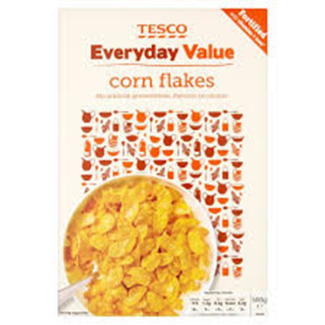
Negative Income Elasticity
An increase in income will result in a decrease in demand.
A decrease in income will result in a rise in demand.
ALSO known as INFERIOR GOODS
For more help, please visit www.exampaperspractice.co.uk
© 2025 Exams Papers Practice. All Rights Reserved

Slide 14
Negative Income Elasticity
Potatoes are seen as a inferior product
Potatoes have a YED of -0.48
So a 10% rise in incomes will result in????
What would this look like on a D&S diagram?
For more help, please visit www.exampaperspractice.co.uk
© 2025 Exams Papers Practice. All Rights Reserved

Slide 15
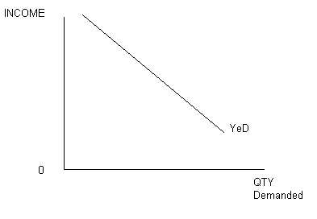
Negative YeD Diagram = Inferior goods
Note the different axes labels
Income on the Y axis
How else could you show this?
For more help, please visit www.exampaperspractice.co.uk
© 2025 Exams Papers Practice. All Rights Reserved

Slide 16
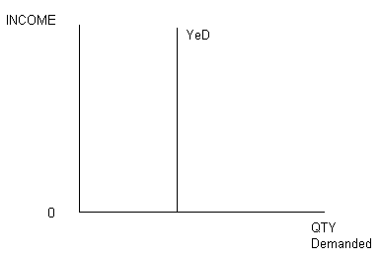
Zero Income Elasticity
This occurs when a change in income has NO effect on the demand for goods.
A rise of 5% income in a rich country will leave the demand for toothpaste unchanged!
These goods are called “sticky” goods
For more help, please visit www.exampaperspractice.co.uk
© 2025 Exams Papers Practice. All Rights Reserved

Slide 17
To summarise
For more help, please visit www.exampaperspractice.co.uk
© 2025 Exams Papers Practice. All Rights Reserved

Slide 18
Look for the signs!
NORMAL GOODS
LUXURY GOODS
+
+
BETWEEN 0 & 1
+0.5 +0.9 + 0.1
GREATER THAN 1
+2 +5 +27
-
INFERIOR GOODS
CAN BE A DECIMAL OR A VALUE LESS THAN -1
For more help, please visit www.exampaperspractice.co.uk
© 2025 Exams Papers Practice. All Rights Reserved

Slide 19
For example:
Yed = - 0.6:
Good is an inferior good
a rise in income of 10% would lead to demand falling by 6%
Yed = + 0.4:
Good is a normal good but inelastic
a rise in incomes of 10% would lead to demand rising by 4%
Yed = + 1.6:
Good is a normal good and elastic SO LUXURY
a rise in incomes of 10% would lead to demand rising by 16%
Yed = - 2.1:
Good is an inferior good and elastic
a rise in incomes of 10% would lead to a fall in demand of 21%
For more help, please visit www.exampaperspractice.co.uk
© 2025 Exams Papers Practice. All Rights Reserved

Slide 20
Income elasticity questions
Define YeD
What is the formula?
What type of YED would you expect a luxury good should have?
Identify the different types of YED in the table…
Product | YED
Luxury choc | +2.4
Whisky | +4.1
Digestive Biscuits | +0.6
Apples | +0.2
Own brand baked beans | -0.4
For more help, please visit www.exampaperspractice.co.uk
© 2025 Exams Papers Practice. All Rights Reserved

Slide 21
Income elasticity questions
Calculate the effect a 5% fall in income would have on each product.
For each product, calculate the change in income required for a 15% increase in demand.
Product | YED
Luxury choc | +2.4
Whisky | +4.1
Digestive Biscuits | +0.6
Apples | +0.2
Own brand baked beans | -0.4
For more help, please visit www.exampaperspractice.co.uk
© 2025 Exams Papers Practice. All Rights Reserved

Slide 22
High Income Elasticity
Demand is sensitive to changes in real incomes
Demand is therefore cyclical – in an economic expansion, demand will grow strongly. In a recession demand may fall sharply
Can be difficult for businesses to accurately forecast demand and make capital investment decisions
Potential rewards are greater in the long run (as incomes trend upwards over time)
For more help, please visit www.exampaperspractice.co.uk
© 2025 Exams Papers Practice. All Rights Reserved

Slide 23
Low Income Elasticity
Demand is more stable during fluctuations in the economic cycle
More predictable outcomes for firms that produce/invest in low elasticity products
For more help, please visit www.exampaperspractice.co.uk
© 2025 Exams Papers Practice. All Rights Reserved

Slide 24
Uses of YED
Investment planning – which investments will give us the best future sales based on predicted incomes?
Production planning – do we need to increase capacity for example if incomes are expected to rise
Product switching – some firms are able to switch products e.g. in a recession they will produce inferior goods
Managers at supermarkets know they will have to stock more budget (negative YED) products in a recession
For more help, please visit www.exampaperspractice.co.uk
© 2025 Exams Papers Practice. All Rights Reserved

Slide 25
Limitations
YED is an only an estimate and people’s buying habits change all the time
Income is only one of a range of factors that affects demand – for some products income is the most important determinant, for others it might be the price of substitutes or the price of the product itself
For more help, please visit www.exampaperspractice.co.uk
© 2025 Exams Papers Practice. All Rights Reserved

