Slide 1


2.2.3 Types of non-price competition
2.2 Firms, consumers and elasticities of demand
For more help, please visit www.exampaperspractice.co.uk
© 2025 Exams Papers Practice. All Rights Reserved

Slide 2
Recall
What is direct marketing?
Which form of marketing is best suited to supermarkets and window cleaners?
Why is important that businesses market their products in the most effective way?
For more help, please visit www.exampaperspractice.co.uk
© 2025 Exams Papers Practice. All Rights Reserved

Slide 3

Starter
For more help, please visit www.exampaperspractice.co.uk
© 2025 Exams Papers Practice. All Rights Reserved
Notes:
Students will be asked questions pertaining to their thoughts on the image. They should arrive at the though of distributing goods etc.
Their thoughts and ideas will be jotted around the image

Slide 4
Learning Objective
Are you able to identify and explain the three distribution channels?
Are you able to analyse the importance of relationship between competitors and advertising?
Can you evaluate the how a business can adapt their distribution route to work in their long-term favour?
For more help, please visit www.exampaperspractice.co.uk
© 2025 Exams Papers Practice. All Rights Reserved

Slide 5
Different forms of promotion and how they influence demand
The nature of the market
The type of market that a business operates in will affect its use of the promotional mix
Local v National
  As a firm grows, moving from local to national markets, the type of promotion will differ. Advertising is more effective in meeting national markets than direct marketing
Physical v Electronic
  Through growing use of technology businesses are finding it easier to directly target individual consumers through electronic mail
For more help, please visit www.exampaperspractice.co.uk
© 2025 Exams Papers Practice. All Rights Reserved

Slide 6
Different forms of promotion and how they influence demand
The nature of the product
The type of product that a business sells will affect its use of the promotional mix
Business To Consumers (B2C) – where firms sell to the general public the type of media used to promote the product will reflect this. Television, radio and newspapers might be used by an expanding business targeting the whole country
Business To Business (B2B) – where firms sell between each other we are more like to see direct marketing with businesses targeting other businesses with specialist information giving greater insight and detail of the product being sold. There will be greater use of informative, rather than persuasive, advertising.
For more help, please visit www.exampaperspractice.co.uk
© 2025 Exams Papers Practice. All Rights Reserved

Slide 7
Student Activity
In the supermarket industry, competition is reaching high levels. Supermarkets are continually promoting their goods. These supermarkets tend to be heavily influenced by the actions of one another.
Why is it important for a business to monitor the activities of their competitors? Which risks could the business possibly face if they fail to react to these actions?
Challenge: Focusing on a specific supermarket of your choice, in which other ways could the business affected through non-price factors?
For more help, please visit www.exampaperspractice.co.uk
© 2025 Exams Papers Practice. All Rights Reserved

Slide 8
Distribution methods
Distribution is the process of getting the firm’s product to the market
Distribution channels are the routes to market that a product takes from producers to the final customer
There are a number of distribution channels available to firms:
  Short distribution channels are where the producer sells either directly to the customer or through a retailer
  Long distribution channels are where there are more than one intermediary (middle person) between the producer and the customer
For more help, please visit www.exampaperspractice.co.uk
© 2025 Exams Papers Practice. All Rights Reserved

Slide 9
Types of distribution channels
Producers can use direct selling whereby they sell directly to the final consumer
Often, producers use retailers who sell products on to the general public
Wholesalers buy large quantities of supplies from producers and sell them on in smaller quantities. For example, a corner shop might go to a wholesaler to buy their products
Increasingly, firms are using e-commerce benefiting from the power of the internet to sell on their products
Multi-channel distribution is when a firm chooses to use a combination of methods
For more help, please visit www.exampaperspractice.co.uk
© 2025 Exams Papers Practice. All Rights Reserved

Slide 10
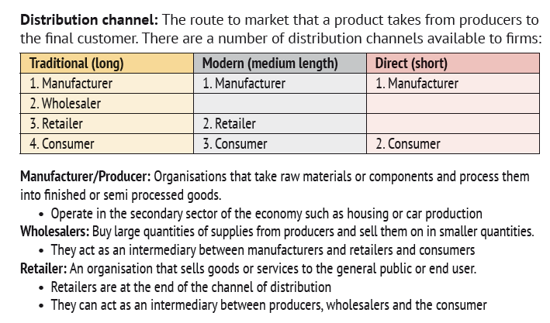
Types of distribution channels
For more help, please visit www.exampaperspractice.co.uk
© 2025 Exams Papers Practice. All Rights Reserved

Slide 11
Student Activity
Explain the different distribution channels.
Analyse the benefits and drawbacks for each type of distribution channels.
Challenge: Do you think that within the next 5 years there may be a decrease in the number of businesses utilising traditional distribution channels? Explain your reasoning.
For more help, please visit www.exampaperspractice.co.uk
© 2025 Exams Papers Practice. All Rights Reserved

Slide 12
Distribution decisions
Distribution decisions will be affected by a number of factors including:
  Type of Product
    The characteristics of the product need to be taken into account. For example Coca Cola do not ship their product to the UK from the USA. Instead, they ship over the syrup and the actual product is then made in the UK using British water
  Market
    It is important that the customers being targeted can access the product. High streets are accessible by public transport so that all customers can shop, not just those with cars
    Is the businesses targeting a local, national or global market?
  Quantity and frequency
For more help, please visit www.exampaperspractice.co.uk
© 2025 Exams Papers Practice. All Rights Reserved

Slide 13
Distribution decisions
Distribution decisions will be affected by a number of factors including:
  Geographical location
    How far is the target market from the firm? The firm will have to take into account the nearness of the market. Regional markets are far more accessible than international markets
  Cost
    This is very important for a firm. An expensive distribution method will reduce the contribution being made to a firm’s profit. Therefore, the firm must ensure that the method is cost effective
  Degree of control
    Businesses may want to protect their brand by limiting the spread of the product and keeping tight control of where it is available and at what price
For more help, please visit www.exampaperspractice.co.uk
© 2025 Exams Papers Practice. All Rights Reserved

Slide 14
Devising appropriate marketing approaches
Non-price competition means that firms must devise appropriate marketing strategies to be successful. These include:
Product differentiation in terms of higher quality product and customer service
A high degree of spending on advertising to inform and persuade customers to buy the product
A high level of spending on sponsorship to create awareness of the brand and build a relationship with stakeholders
Sales promotions to attract customers e.g. buy one get one free (BOGOF)
Loyalty schemes to attract repeat custom e.g. loyalty cards
For more help, please visit www.exampaperspractice.co.uk
© 2025 Exams Papers Practice. All Rights Reserved

Slide 15
Student Activity
In pairs, research advantages and disadvantages of each distribution decisions businesses must consider. Offer examples of businesses that use each one.
Why must a business consider frequency and quantity when considering which is most appropriate for a business.
Challenge: Research what Tesco did to make their distribution channel more manageable and sustainable for the business.
For more help, please visit www.exampaperspractice.co.uk
© 2025 Exams Papers Practice. All Rights Reserved

Slide 16
Plenary
Name one key term you’ve learnt.
Name one key term you need to revise.
Explain the different distribution channels?
What factors impact the success of a distribution network?
For more help, please visit www.exampaperspractice.co.uk
© 2025 Exams Papers Practice. All Rights Reserved

