Slide 1
Edexcel A2 Business
1.2.4 Price Elasticity of Demand
Revisionstation
For more help, please visit www.exampaperspractice.co.uk
© 2025 Exams Papers Practice. All Rights Reserved

Slide 2
Theme 1 Retrieval Challenge Matrix
1 point | 2 points | 3 points
Where would you find ‘market clearing’? | Compare the terms risk and uncertainty | Explain the limitations of market research
What does ‘added value’ mean? | Compare consumer needs and wants | Explain the purpose of product differentiation
Define the term ‘seasonality’ | Gove two ways to add value to fish products | Explain the characteristics of mass markets
For more help, please visit www.exampaperspractice.co.uk
© 2025 Exams Papers Practice. All Rights Reserved

Slide 3
Calculators will be needed for this topic
For more help, please visit www.exampaperspractice.co.uk
© 2025 Exams Papers Practice. All Rights Reserved

Slide 4
A ruler and coloured pens are needed for this topic

Slide 5
You will need worksheet 1.2.4 for this lesson
For more help, please visit www.exampaperspractice.co.uk
© 2025 Exams Papers Practice. All Rights Reserved

Slide 6
From Edexcel
a) Calculation of price elasticity of demand
b) Interpretation of numerical values of price elasticity of demand
c) The factors influencing price elasticity of demand
d) The significance of price elasticity of demand to businesses in terms of implications for pricing
e) Calculation and interpretation of the relationship between price elasticity of demand and total revenue
For more help, please visit www.exampaperspractice.co.uk
© 2025 Exams Papers Practice. All Rights Reserved

Slide 7
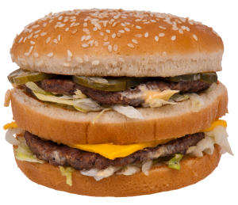
Starter
If the price of a Big Mac goes up to £10 will there be an impact on demand? Will customers still buy Big Macs?
For more help, please visit www.exampaperspractice.co.uk
© 2025 Exams Papers Practice. All Rights Reserved
Notes:
Yes, £10 is too much for a big mac, you could argue that some gastro pubs charge this for a burger but that they add value though other methods such as ambience or live jazz music. How does McD find just the right price to charge for the burgers?

Slide 8
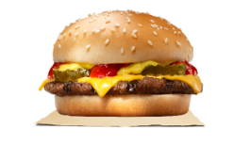
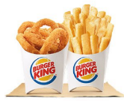
The link between demand and price
When prices go up, customers demand less. That statement makes logical sense and all businesses know this, so they try to avoid putting prices up.
If the business costs rise they try and absorb the costs so that the customers do not have to pay more, because this will affect demand for their product.
For example if McDonald’s put up the price of a Big Mac to £10 customer demand will decrease, sales revenue for that product will decrease and profits will decrease.
There is another argument that customers may switch to an available substitute, and it may be McDonald’s Chicken Nuggets or the customer may switch to Burger King.
For more help, please visit www.exampaperspractice.co.uk
© 2025 Exams Papers Practice. All Rights Reserved

Slide 9
Definition: PED
PED stands for price elasticity of demand
PED measures the responsiveness of demand to a change in price
PED can be either elastic or inelastic
PED values can be calculated so that you can work out if a product or service has elastic or inelastic demand
PED values are always a minus
For more help, please visit www.exampaperspractice.co.uk
© 2025 Exams Papers Practice. All Rights Reserved

Slide 10
Calculation of price elasticity of demand
For more help, please visit www.exampaperspractice.co.uk
© 2025 Exams Papers Practice. All Rights Reserved

Slide 11
PED calculations Top Tips
PED calculations always come out as a negative number e.g. -0.23
This is because there is a relationship between price and demand
As price increases demand decreases (causing a negative demand figure)
As price decreases demand increases (causing a negative price figure)
In either case the PED value would be a negative.
You need to make sure that you understand this concept before you move on.
For more help, please visit www.exampaperspractice.co.uk
© 2025 Exams Papers Practice. All Rights Reserved

Slide 12
PED formula
To calculate the price elasticity of demand (PED) we use a formula:
% change in Quantity demanded
__________________________________
% change in Price
This is not as simple as it first appears, we need to make a another calculation to find the % change in price or % change in quantity demanded – see next slide
For more help, please visit www.exampaperspractice.co.uk
© 2025 Exams Papers Practice. All Rights Reserved

Slide 13
% change in price formula
Price new – Price old
Price old x 100
Example: A price changes from £5 to £7. You could say that it has increased by £2, but you need to calculate the % change increase
Apply the formula: New is £7, Old is £5
What is the % change, show your answer to two decimal places
You can now use this answer in your PED formula
For more help, please visit www.exampaperspractice.co.uk
© 2025 Exams Papers Practice. All Rights Reserved
Notes:
5-7 = 2/5 = 0.4
0.4*100 = 40% change in price

Slide 14
Example calculations % change
 | Product A | Product B | Product C | Product D
Old Price | £300 | £55 | £70 | £60
New price | £290 | £29 | £77 | £65
% Change
Price new – Price old
Price old x 100
For more help, please visit www.exampaperspractice.co.uk
© 2025 Exams Papers Practice. All Rights Reserved

Slide 15
Example calculations % change - answers
 | Product A | Product B | Product C | Product D
Old Price | £300 | £55 | £70 | £60
New price | £290 | £29 | £77 | £65
% Change | 3.33% | 47.27% | 10% | 8.33%
Price new – Price old
Price old x 100
For more help, please visit www.exampaperspractice.co.uk
© 2025 Exams Papers Practice. All Rights Reserved

Slide 16
Example PED Calculation: sunglasses shop
Sam owns a sunglasses business. She wants to know how elastic the demand for some of her products is.
This will help her to decide if she should put her prices up or not.
If she puts up her prices of her best selling sunglasses from £35 to £55 then she sells 45% less.
Calculate PED and comment on the elasticity of demand.
For more help, please visit www.exampaperspractice.co.uk
© 2025 Exams Papers Practice. All Rights Reserved

Slide 17
Example PED calculation steps
Step 1 – Find the % change in price
55-35 / 35 *100 = -57.14% (a minus because the price has decreased)
Step 2 – Take the % change in quantity and divide it by the % change in price
45% / 57.14% = PED -0.79 (rounded to 2 decimal places)
For more help, please visit www.exampaperspractice.co.uk
© 2025 Exams Papers Practice. All Rights Reserved

Slide 18
How to interpret your PED value
Elastic demand (Demand for the product is sensitive to a change in price)
Inelastic demand (Very little change in demand with a change in price)
Value will be more than 1
Examples:
-1.75
-2.45
-8.00
Values will be between 0 and 1
Examples
-0.1
-0.005
-0.98
For more help, please visit www.exampaperspractice.co.uk
© 2025 Exams Papers Practice. All Rights Reserved
Notes:
-0.79 is between 0 and 1 so is inelastic.

Slide 19
Answer to the example PED calculation: sunglasses shop
The PED value for Sam’s Sunglasses business is -0.79
The PED value is between 0 and 1
This means the price is inelastic
This means that her customers will continue to buy if she puts her prices up
Sam can use this for decision making about price changes
For more help, please visit www.exampaperspractice.co.uk
© 2025 Exams Papers Practice. All Rights Reserved

Slide 20
Interpretation of numerical values of price elasticity of demand
For more help, please visit www.exampaperspractice.co.uk
© 2025 Exams Papers Practice. All Rights Reserved

Slide 21
Elastic Demand
Can you explain why burgers and fast food have elastic demand?
Products and services that have elastic demand are responsive to a change in price
This means if the business puts prices up, then demand will decrease
If prices decrease then demand will increase. It stands to reason that if you make a product cheaper that more customers will want to buy it.
What happens if prices rise too high?
For more help, please visit www.exampaperspractice.co.uk
© 2025 Exams Papers Practice. All Rights Reserved
Notes:
Burgers have elastic demand because there are lots of substitutes if prices rise too high customers will go elsewhere.

Slide 22
Elastic Demand and calculations
If your PED calculation is more than 1 then this will mean that the product or service has elastic demand
For the business this means that they need to be careful when setting prices, too high and they will lose their customers, too low and they may not have enough supply to meet demand
Generally products with lots of substitutes have elastic demand
Examples -1.27, -1.4, -6,
For more help, please visit www.exampaperspractice.co.uk
© 2025 Exams Papers Practice. All Rights Reserved

Slide 23
Inelastic Demand
Inelastic demand is for goods means if the price is changed the demand stays the same
With inelastic demand there are few substitutes (e.g. insulin, petrol)
Generally addictive products have inelastic demand – can you explain why?
For more help, please visit www.exampaperspractice.co.uk
© 2025 Exams Papers Practice. All Rights Reserved
Notes:
Addictive products – customers will buy them no matter what the price.

Slide 24
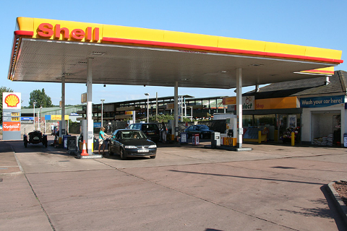
Inelastic demand explained
You are in your car, you are running very low on petrol, but at last you see a garage and pull in
What choice of products do you have?
Are there any substitutes for petrol that you could put in your car?
Can you drive away if you are unhappy with the price of petrol?
Can you explain why demand remains unchanged even when the price of petrol increases?
For more help, please visit www.exampaperspractice.co.uk
© 2025 Exams Papers Practice. All Rights Reserved
Notes:
1) Petrol / diesel /
2) No
3) No you can’t drive away as you don’t have any petrol
Explanation – there are NO substitutes so demand will remain almost constant

Slide 25
Inelastic demand and calculations
When you calculate PED using the formula: If the result is between 0 and -1 this means that demand is inelastic
Examples
-0.2 = inelastic demand
-0.45 = inelastic demand
-0.006 = inelastic demand
For more help, please visit www.exampaperspractice.co.uk
© 2025 Exams Papers Practice. All Rights Reserved

Slide 26
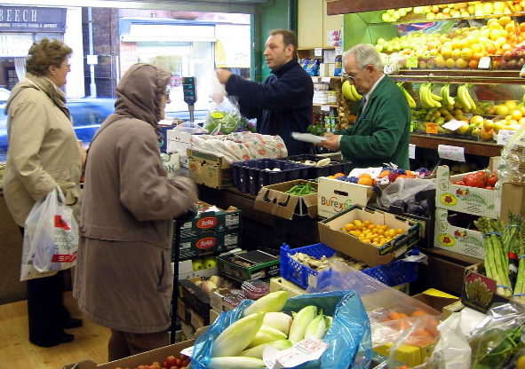
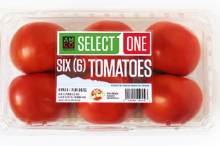
Example PED calculation 1
John runs a greengrocers in a high street. He decides to increase the price of a pack of tomatoes from £1.50 to £1.75 and he knows that demand will fall 25% - calculate and comment on the PED value of the tomatoes
For more help, please visit www.exampaperspractice.co.uk
© 2025 Exams Papers Practice. All Rights Reserved
Notes:
Change in P = 0.25/1.50 *100 = 16.67% (rounded up)
Change in Q = -25%
-25/ 16.67 = -1.50 (rounded up)
PED value is above -1 therefore demand for his tomatoes is elastic, if he puts prices up too high, customers may buy from the supermarket instead

Slide 27
Example PED calculation 1 answer
% change in price = 0.25/1.50 *100 = 16.67% (rounded up)
% change in quantity demanded was given in the question = -25%
-25/ 16.67 = -1.50 (rounded up)
Comment:
The PED value of the tomatoes is -1.50 which is above -1 therefore demand is elastic
If John puts prices up too high, customers may buy from the supermarket instead because there are lots of substitutes for this product and for John’s greengrocers shop.
For more help, please visit www.exampaperspractice.co.uk
© 2025 Exams Papers Practice. All Rights Reserved

Slide 28
Example PED calculation 2
Kathryn makes scarves, they are not selling very well, there is lots of competition in the high street.
She has decided to reduce the price of her scarves from £15 each to £8 each. She expects to see a rise in demand of 80%.
Calculate the PED value of the scarves and comment on her decision
For more help, please visit www.exampaperspractice.co.uk
© 2025 Exams Papers Practice. All Rights Reserved

Slide 29
Example PED calculation 2 - answer
% Change in Price = -7/15 *100 = 46.67% (rounded up)
% Change in Quantity demanded, which you are given in the question = 80%
PED calculation is therefore
80/-46.67 = -1.71
Comment:
The PED value is -1.71 which is above -1, this means the scarves are elastic products, therefore if she reduces the prices of her scarves then demand will increase
For more help, please visit www.exampaperspractice.co.uk
© 2025 Exams Papers Practice. All Rights Reserved

Slide 30
Example PED calculation 3
Gurpal owns a sandwich bar, he sells soups and sandwiches. They are selling well, but he would like to make more revenue, but he is worried if he puts his prices up that his customers will go elsewhere.
So, he thinks he might increase the price from £5 to £9 for a soup and sandwich combo meal and he estimates that demand may decrease by just 10%
Calculate the PED value of one of his combo meals and comment on his decision
For more help, please visit www.exampaperspractice.co.uk
© 2025 Exams Papers Practice. All Rights Reserved

Slide 31
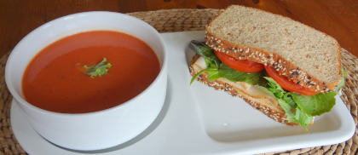
Example PED calculation 3 - answer
% Change in Price 4/5 *100 = 80%
% Change in Quantity Demanded which is given in the question
= -10%
PED value -10/80 = -0.13 rounded up
Comment:
The PED value of the soup and sandwich combo meal is -0.13 which is below -1 which suggests that Gurpal’s customers are loyal and demand will not change if he puts his prices up
For more help, please visit www.exampaperspractice.co.uk
© 2025 Exams Papers Practice. All Rights Reserved

Slide 32
The factors influencing price elasticity of demand
For more help, please visit www.exampaperspractice.co.uk
© 2025 Exams Papers Practice. All Rights Reserved

Slide 33
Availability of substitutes
Example
PED
-1.82
When a market has a large number of available substitutes, then the more sensitive demand will be to price
Lots of substitutes
Means
Demand for products is more sensitive to price
Means
Product is more price elastic
Example, beach shops often all sell the same goods
For more help, please visit www.exampaperspractice.co.uk
© 2025 Exams Papers Practice. All Rights Reserved

Slide 34
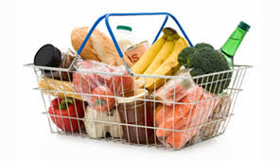
Frequency of purchase
Example
PED
-3.4
Products that are bought frequently by consumers tend to be very elastic (sensitive to price)
Frequent purchase
Means
Consumers sensitive to changes in price
Means
Products are price elastic
For more help, please visit www.exampaperspractice.co.uk
© 2025 Exams Papers Practice. All Rights Reserved

Slide 35
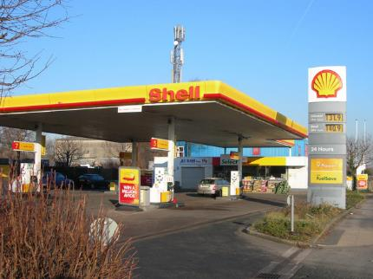
Necessities (staple goods)
Example
PED
-0.021
Necessities have lower price elasticises as consumers must purchase the product despite price changes
Petrol is a necessity
Means
Consumers need to keep buying petrol even if price increases
Means
Product is very price inelastic
For more help, please visit www.exampaperspractice.co.uk
© 2025 Exams Papers Practice. All Rights Reserved
Notes:
The more necessary a good is, the lower the price elasticity of demand

Slide 36
Luxury goods
Example
PED
- 1.96
Luxury goods tend to be very expensive, these are a very large percentage of consumer’s incomes
The high cost will cause consumers to pay attention to the price
Luxury goods
Means
Large investment so consumers very sensitive to price change
Means
Product is price elastic
For more help, please visit www.exampaperspractice.co.uk
© 2025 Exams Papers Practice. All Rights Reserved
Notes:
The higher the percentage of a consumer's income used to pay for the product, the higher the elasticity tends to be.

Slide 37
The significance of price elasticity of demand to businesses in terms of implications for pricing
For more help, please visit www.exampaperspractice.co.uk
© 2025 Exams Papers Practice. All Rights Reserved

Slide 38
Competitive pricing
Some products or services are priced very similar to close competitors
This is used by a business which sells products that have very close substitutes
This means that customers will have to judge a product or service on “non-price” methods such as; quality of service, speed, extras etc.
Have you tried searching for car insurance on price comparison sites? Do you get similar prices?
For more help, please visit www.exampaperspractice.co.uk
© 2025 Exams Papers Practice. All Rights Reserved

Slide 39
Skimming pricing
Products that are unique or first to market can have a high price can be charged at introduction or launch
This is so that the business can maximise revenue and profits before substitutes appear on the market
High demand when the product is first launched at it will have a Unique Selling Point (USP)
The business will need to set high prices to recoup research and development (R&D) costs
For more help, please visit www.exampaperspractice.co.uk
© 2025 Exams Papers Practice. All Rights Reserved

Slide 40
Calculation and interpretation of the relationship between price elasticity of demand and total revenue
For more help, please visit www.exampaperspractice.co.uk
© 2025 Exams Papers Practice. All Rights Reserved

Slide 41
PED and total revenue
There is a relationship between PED and Total Revenue
Total revenue is calculated by: TR = Quantity x Price
Total revenue is a measure of how much can be made from selling products / services (before costs have been taken off)
A business will have an objective of maximising profits, to do this it will need to increase total revenue
Total revenue can be increased by increasing price
This is why business managers will need to know PED – they need to know how sensitive their customers are to a change in price
For more help, please visit www.exampaperspractice.co.uk
© 2025 Exams Papers Practice. All Rights Reserved

Slide 42
Plenary Quiz
Product XYZ is £20 and the price has increased to £23
PED for a product XYZ is -0.8
Calculate the % change in quantity demanded for product XYZ
Use the two formulas you have learnt
You have 4 minutes
For more help, please visit www.exampaperspractice.co.uk
© 2025 Exams Papers Practice. All Rights Reserved

Slide 43
Plenary Quiz Answers
PED is -0.8
Price new is £23
Price old is £20
3/20 x 100 = 15%
-0.8 x 15% = -12%
Change in quantity demanded is -12%
For more help, please visit www.exampaperspractice.co.uk
© 2025 Exams Papers Practice. All Rights Reserved

Slide 44
Summary of formulae to learn
PED:
% change in Quantity demanded
__________________________________
% change in Price
% Change in price
Price new – Price old
Price old x 100
For more help, please visit www.exampaperspractice.co.uk
© 2025 Exams Papers Practice. All Rights Reserved

Slide 45
Sample Edexcel A2 questions
For more help, please visit www.exampaperspractice.co.uk
© 2025 Exams Papers Practice. All Rights Reserved

Slide 46
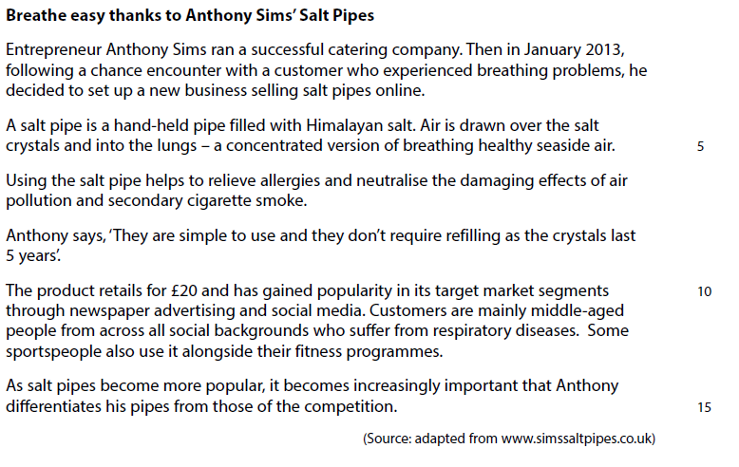
Case Study for sample question 1
For more help, please visit www.exampaperspractice.co.uk
© 2025 Exams Papers Practice. All Rights Reserved

Slide 47
Sample question 1
Knowledge 1
Application 3
For more help, please visit www.exampaperspractice.co.uk
© 2025 Exams Papers Practice. All Rights Reserved

Slide 48
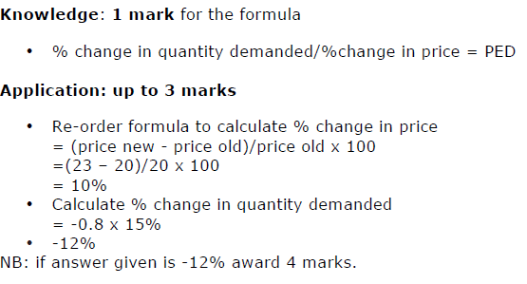
Answer to sample question 1
For more help, please visit www.exampaperspractice.co.uk
© 2025 Exams Papers Practice. All Rights Reserved

Slide 49
Case study for question 2
For more help, please visit www.exampaperspractice.co.uk
© 2025 Exams Papers Practice. All Rights Reserved

Slide 50
Sample question 2
Knowledge 2
Application 2
Analysis
4
Evaluation
4
For more help, please visit www.exampaperspractice.co.uk
© 2025 Exams Papers Practice. All Rights Reserved

Slide 51
Answer sample question 2
For more help, please visit www.exampaperspractice.co.uk
© 2025 Exams Papers Practice. All Rights Reserved

Slide 52
Peer / self marking grid for 12 mark question
Mark
1-2 marks | Limited knowledge and some recall of business theory, answer may not be in context What went well: You used business terms correctly Even better if: You had discussed the business context given in the case study
3-4 marks | Comments are in context, and chains of reason are present but very basic. Unbalanced argument, only discusses one side. What went well: You were able to give chains of reason in context in your answer Even better if: You had given both sides of the argument
5-8 marks | Chains of reason are complete and argument shows both sides. Answer is in context, an attempt at a assessment using numerical data given in the case study. What went well: Your analysis was shown in your chains of reason Even better if: You had reached a supported judgement
9-12marks | Accurate understanding and knowledge. Logical chains of reason, balanced argument, in context leading to a supported judgement What went well: You had logical chains of reason showing cause and effect which led to a supported judgement Even better if: You had used more numerical data from the case study to support your arguments
For more help, please visit www.exampaperspractice.co.uk
© 2025 Exams Papers Practice. All Rights Reserved

Slide 53
For more help, please visit www.exampaperspractice.co.uk
© 2025 Exams Papers Practice. All Rights Reserved

