Slide 1


2.1.3 Research and development (R&D) and innovation
2.1 Business growth and competitive advantage
For more help, please visit www.exampaperspractice.co.uk
© 2025 Exams Papers Practice. All Rights Reserved

Slide 2
Recall Task
Type of Integration | Real business example | Advantages | Disadvantages
Horizontal
Forward Vertical
Backward Vertical
Diversification
For more help, please visit www.exampaperspractice.co.uk
© 2025 Exams Papers Practice. All Rights Reserved

Slide 3
Starter
Write down three products that you consider to be creative.
Explain the process of products that led to one of your products.
Challenge:
  Explain what is meant by the term creative destruction.
For more help, please visit www.exampaperspractice.co.uk
© 2025 Exams Papers Practice. All Rights Reserved

Slide 4
Lesson Objectives
Are you able to identify the difference between product and process innovation?
Can you analyse the product life cycle and analyse the potential extension strategies?
For more help, please visit www.exampaperspractice.co.uk
© 2025 Exams Papers Practice. All Rights Reserved

Slide 5
Innovation and competitive advantage
Innovation is the development of an idea into a new product or process. Businesses invest time and money in order to make a profit. Product innovation occurs through adapting a product that already exists.
An innovation is likely to have a patent as the business looks to recoup the cost of research and development by stopping other firms from copying their product. Often, a small business will sell out to a larger one.
For more help, please visit www.exampaperspractice.co.uk
© 2025 Exams Papers Practice. All Rights Reserved

Slide 6
Innovation and competitive advantage
PURPOSE
Firms cannot afford to stand still in competitive markets – today’s innovations are tomorrow’s stars and cash cows
A firm that comes up with the right innovation can guarantee future income if it is protected by a patent
Although expensive, the alternative of losing future markets might be worse
RISKS INVOLVED
Firms can make substantial losses if innovation fails
Other companies are likely to react with their own innovations
Legal implications often arise with other firms questioning whether the product/process is really an innovation
For more help, please visit www.exampaperspractice.co.uk
© 2025 Exams Papers Practice. All Rights Reserved

Slide 7
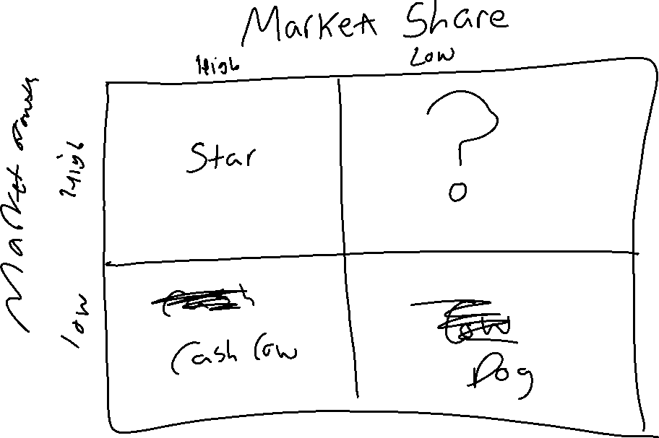
For more help, please visit www.exampaperspractice.co.uk
© 2025 Exams Papers Practice. All Rights Reserved

Slide 8
Innovation and competitive advantage
BENEFITS
Creates a USP for the product
Less competition due to patent
More efficient and cost effective production process
Likely to be a premium product with high prices
COSTS
Can be very costly in R&D stage and therefore a drain on resources
For all innovations there is an opportunity cost
Few innovations see the light of day so the firm is effectively financing waste
For more help, please visit www.exampaperspractice.co.uk
© 2025 Exams Papers Practice. All Rights Reserved

Slide 9
Activity 1
Explain the difference between competitive and comparative advantage.
Using a PEEL paragraph, explain the benefits of competitive advantage.
Challenge:
  Are high costs of R&D inevitable for a successful business?
For more help, please visit www.exampaperspractice.co.uk
© 2025 Exams Papers Practice. All Rights Reserved

Slide 11
Incentive to increase market power
Investment in R&D is expensive
High fixed costs:
  Lead to a requirement to produce significant output in some industries in order to recoup start-up and R&D costs
  Require increased scale of production
  Thus creating barriers to entry and a tendency towards less competition in the market
  This increases the market power of the firm
For more help, please visit www.exampaperspractice.co.uk
© 2025 Exams Papers Practice. All Rights Reserved

Slide 12
Incentive to increase market power
Through R&D a firm can differentiate its product leading to success in either a mass or niche market
Differentiation means being able to offer a product or service that stands out from the competition
  Product – has to appear better than the competition, USP, patents
  Promotion – create desire, exclusivity, brand loyalty
  Operational objectives will focus on R&D and innovation
This will lead to increased market power
For more help, please visit www.exampaperspractice.co.uk
© 2025 Exams Papers Practice. All Rights Reserved

Slide 13
Product and process innovation
Product innovation - changing a product that already exists or developing an invention into a brand new product
Process innovation - changing a process of production that already exists or putting into practise a brand new production process
An innovation is likely to have a patent as the firm looks to recoup the cost of research and development by stopping other firms from copying their product or process.

Slide 14
Activity 2
Explain the possible routed to increasing market power.
Challenge:
  What will a patent offer to the owner?
For more help, please visit www.exampaperspractice.co.uk
© 2025 Exams Papers Practice. All Rights Reserved

Slide 15
Role of state funding
The state will often provide funding for firms that are innovative
The government will funds innovation in a number of areas including science, technology and engineering
This will help high-tech industries to grow, creating highly differentiated UK industries in the future
For more help, please visit www.exampaperspractice.co.uk
© 2025 Exams Papers Practice. All Rights Reserved

Slide 16
Activity 3
What makes these products innovative?
What was the role of R&D in designing the robot vacuum cleaners?
How will the launch of this product have affected other functional areas?
Challenge:
  What will a patent offer to the owner?
For more help, please visit www.exampaperspractice.co.uk
© 2025 Exams Papers Practice. All Rights Reserved

Slide 17
Product life cycle
Product life cycle is a technique used to track the stages a product goes through during its life
It tracks sales over time from the development stage of a product through launch and until it is removed from the market
Although a product life cycle relates to just one product business will want to have products at different stages
For example the revenue from a product that has reached maturity could be used to help develop a new product
For more help, please visit www.exampaperspractice.co.uk
© 2025 Exams Papers Practice. All Rights Reserved

Slide 18
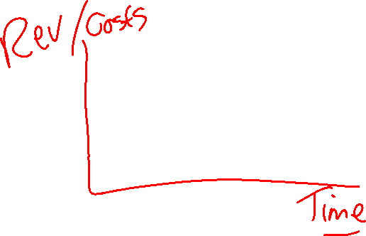
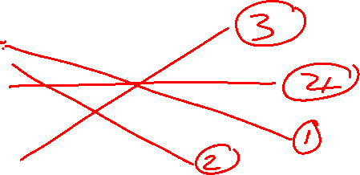
Product Life Cycle
The stages that a product will go through in its lifetime are:
Development – negative cash flow due to market research and Research and Development (R&D). No sales revenue before launch
Introduction – production and promotion costs can be high
Growth – sales revenue increases but as more units are sold production costs also increase. However, there will be economies of scale
Maturity – sales stabilise and the product acts as a cash cow
Decline – at some point the product will start to lose sales.
Extension strategies - many products are adapted and given a new lease of life this can be by:
  Changing the product e.g. new flavours or new features
  Increasing promotion or changing promotional methods e.g. repackaging, targeting a new market, viral marketing

Slide 19
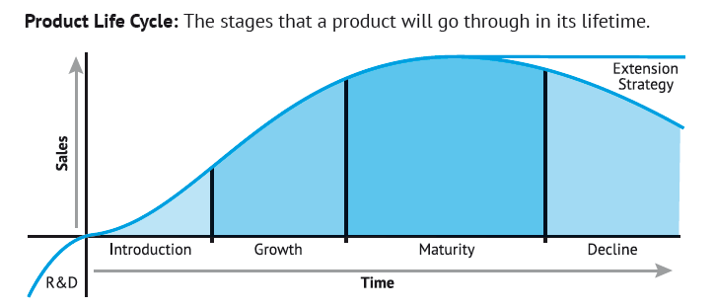
Product Life Cycle
For more help, please visit www.exampaperspractice.co.uk
© 2025 Exams Papers Practice. All Rights Reserved

Slide 20
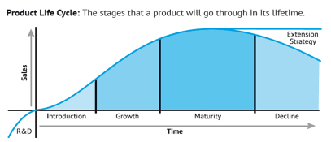

Activity 4
Analyse the product life cycle using Nokia mobile phones.
How can a business manage the product life cycle using a number of products?
For more help, please visit www.exampaperspractice.co.uk
© 2025 Exams Papers Practice. All Rights Reserved

Slide 21
Plenary
Name one key term you’ve learnt.
Name one key term you need to revise.
How do we achieve process innovation?
Explain the terms decline and maturity?
What is meant by gaining a competitive advantage?

Slide 22
Home Learning
https://businesscasestudies.co.uk/creating-a-competitive-advantage-through-rd-2/
For more help, please visit www.exampaperspractice.co.uk
© 2025 Exams Papers Practice. All Rights Reserved

