Slide 1


2.1.1 Growth
2.1 Business growth and competitive advantage
For more help, please visit www.exampaperspractice.co.uk
© 2025 Exams Papers Practice. All Rights Reserved

Slide 2
Recall
Name the different types of internal economies of scale.
Explain what is meant by two of them.
What is the difference between internal and external economies of scale?
For more help, please visit www.exampaperspractice.co.uk
© 2025 Exams Papers Practice. All Rights Reserved

Slide 3
Starter
Using Nike as an example.
Task 1: What makes you buy their products?
Task 2: Explain the benefits of Nike putting their logo on their products.
Task 3: Name a company where you don’t believe they have a good brand and explain why.
For more help, please visit www.exampaperspractice.co.uk
© 2025 Exams Papers Practice. All Rights Reserved

Slide 4
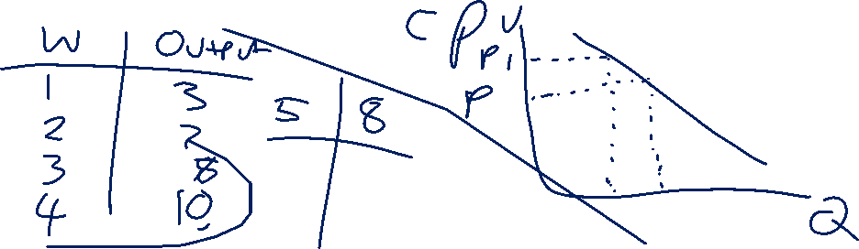
Lesson Objectives
Are you able to explain the concept of diseconomies of scale?
Can you explain how market power impacts customers and suppliers?
Are you able to explain the benefits of branding and how it impacts businesses?
For more help, please visit www.exampaperspractice.co.uk
© 2025 Exams Papers Practice. All Rights Reserved

Slide 5
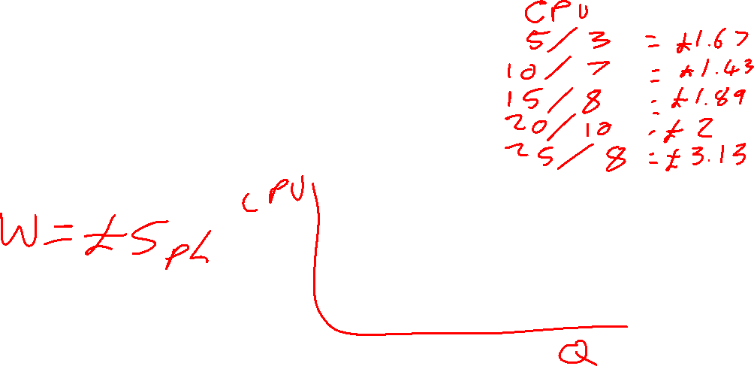
Worker/Output
Workers | Output
1 | 3
2 | 7
3 | 8
4 | 10
5 | 8
For more help, please visit www.exampaperspractice.co.uk
© 2025 Exams Papers Practice. All Rights Reserved

Slide 6

Diseconomies of scale
Diseconomies of scale occur when there is an increase in average total cost as the scale of production increases
Diseconomies of scale take a variety of forms, including:
  Internal communication
    Larger firms find it more difficult to communicate efficiently within the organisation
    There will be an increased cost for communication methods within the firm
    The manager of a small firm will be able to communicate effectively with all members of the workforce
  Coordination
    Larger firms find it more difficult to manage the increased number of personnel and customers
    It might become increasingly difficult to delegate to and motivate workers
For more help, please visit www.exampaperspractice.co.uk
© 2025 Exams Papers Practice. All Rights Reserved

Slide 7
Higher average costs discourage the growth of firms
Larger firms are disadvantaged by higher average costs
This discourages them from growing as this could lead to a fall in profits or a move into loss
The firm will have to weigh up the benefits involved e.g. greater market share against the costs involved e.g. overtrading where the firm takes on too many orders
For more help, please visit www.exampaperspractice.co.uk
© 2025 Exams Papers Practice. All Rights Reserved

Slide 8
Economies and diseconomies of scale
Economies and diseconomies of scale operate at the same time.
At first unit costs fall due to economies of scale. At this point economies outweigh diseconomies.
The optimum output occurs when unit costs are at a minimum (productive efficiency).
After this unit costs rise and diseconomies outweigh economies.
Therefore, we can see a relationship between economies of scale, diseconomies of scale and the long-run average cost curve.
Costs
Economies of scale
LRAC
Diseconomies of scale
Productive efficiency
Output
For more help, please visit www.exampaperspractice.co.uk
© 2025 Exams Papers Practice. All Rights Reserved

Slide 9
Activity
Task 1:
Draw a graph to show:
  Economies of scale
  Diseconomies of scale
  Productive efficiency
Task 2:
Explain the reasons why a firm may be at productive efficiency?
Challenge:
  Are you able to write one sentence to explain how a firm achieves economies of scale?
For more help, please visit www.exampaperspractice.co.uk
© 2025 Exams Papers Practice. All Rights Reserved

Slide 10
Market power over consumers and suppliers
By growing in size a firm is able to increase market power leading to higher prices and supernormal profits
A monopoly exists where there is only one firm in the market. However, the Government refer to any company that has at least 25% market share as having monopoly powers
Larger firms can exploit consumers by charging high prices due to less competition
Therefore, they are likely to be regulated in order to protect the consumer
For more help, please visit www.exampaperspractice.co.uk
© 2025 Exams Papers Practice. All Rights Reserved

Slide 11
market power over consumers and suppliers
Larger firms have a greater degree of buying power
They can force suppliers to lower prices by threatening to cancel contracts
Suppliers are less likely to argue with larger customers so are more likely to agree to lower prices or risk losing significant trade
A larger firm is more likely to have an inelastic price elasticity of demand allowing it to set higher prices
There are fewer substitutes when a firm begins to increase market share so consumers have less choice in where they buy from
The greater the degree of competition the less likely is a firm to have monopoly power
For more help, please visit www.exampaperspractice.co.uk
© 2025 Exams Papers Practice. All Rights Reserved

Slide 12
Increased market share
There are a number of benefits in increasing market share including:
Lack of competition can help them to:
    Develop and maintain customer loyalty
    Restrict output and charge higher prices
Economies of scale such as:
    Bulk buying, reducing unit costs
    Advertising, helping to develop brand image
Use its financial resources to maintain its position:
    Predator pricing, selling at a loss to price new firms out of the market
    Research and Development, to produce new products
For more help, please visit www.exampaperspractice.co.uk
© 2025 Exams Papers Practice. All Rights Reserved

Slide 13
Activity 3
Explain what is meant by the terms market power, monopoly and market share?
  The supermarket industry is worth £4 billion. Tesco sales revenue in 2020 was £1.3 billion. Sainsbury's revenue was £900 million. Asda = £9500 million. Morrison's = £450 million.
Work out the market share for each company.
Analyse how building market share can be to the detriment of other business objectives.
For more help, please visit www.exampaperspractice.co.uk
© 2025 Exams Papers Practice. All Rights Reserved

Slide 14
Brand recognition
Branding is a promotional method that involves the creation of an identity for the business that distinguishes that firm and its products from other firms
Brand recognition can add value to a product allowing firms to charge higher prices
Ultimately leads to brand loyalty whereby customers will continue to buy products from that firm
Organisations spend enormous amounts of time and money branding their company and products
For more help, please visit www.exampaperspractice.co.uk
© 2025 Exams Papers Practice. All Rights Reserved

Slide 15
Types of branding
Brand recognition comes in many forms including colour, logo, strap line and shape
Branding is traditional in businesses associated with giving a unique recognisable characteristic to a product or corporate image e.g. Toblerone’s unique shape or Heinz’s shade of green
This is corporate branding – it attaches a perception and promise to the goods and services associated with that brand e.g. quality, customer service, corporate culture
Other types of brand include:
  Personal – when a person brands themselves e.g. a sports personality or pop star
  Geographical brand – when a region, city, county or country creates a brand that epitomises the people and the lifestyle of that country, often used in tourism
For more help, please visit www.exampaperspractice.co.uk
© 2025 Exams Papers Practice. All Rights Reserved

Slide 16
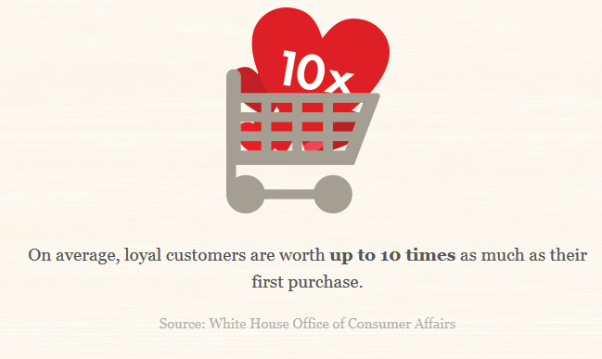
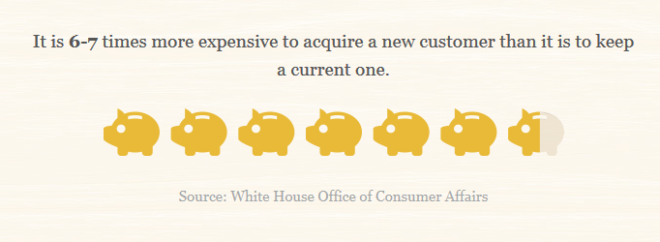
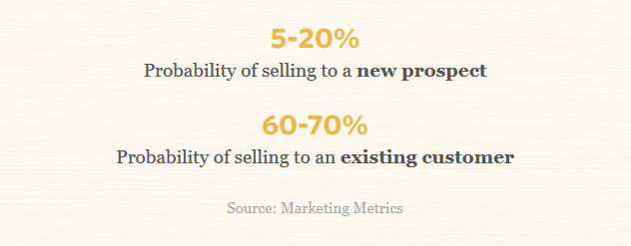
Benefits of a strong brand
Brand loyalty exists when customers keep returning to buy a recognised brand
Branding is a promotional method that involves the creation of an identity for a business that distinguishes it and its products from competitors
For more help, please visit www.exampaperspractice.co.uk
© 2025 Exams Papers Practice. All Rights Reserved

Slide 17
The benefits of a strong brand
Added value
Ability to charge premium prices
Reduced price elasticity of demand
Challenge:
All three of these are inter linked. Can you write a paragraph about the benefits of a strong brand, with reference to a company or product of your choice that links all three concepts
For more help, please visit www.exampaperspractice.co.uk
© 2025 Exams Papers Practice. All Rights Reserved

Slide 18
Building brand recognition
Sponsorship
  Associating a brand name with an event to raise its profile in the public eye, a business pays to sponsor an event in return for visual coverage of the brand e.g. around a stadium, on literature on sport kits etc.
The use of social media
  Use of targeted newsfeeds e.g. Facebook newsfeeds based on searches on other webpages
  Viral marketing e.g. Evian rollerblading babies
For more help, please visit www.exampaperspractice.co.uk
© 2025 Exams Papers Practice. All Rights Reserved

Slide 19
Activity 4
Identify a top brand in each of the following markets:
  Ice cream
  Teenage fashion
  Sportswear
  Frozen food
  Technology
Explain how one of the brands communicates with the target market, what is the brand message?
Analyse the impact of targeting only one section of a market, for example targeting 18-25 year olds for a clothing business.
For more help, please visit www.exampaperspractice.co.uk
© 2025 Exams Papers Practice. All Rights Reserved

Slide 20
Increased profitability
By growing in size a firm can increase profitability:
  Reduced costs due to economies of scale mean that profit margins are likely to increase as the firm is able to use its size to be more efficient
  Larger size implies greater sales revenue. This is likely to lead to higher profits
  However, it might not lead to higher profitability as many large firms work on lower profit margins
  Although sales and profits are higher this does not mean that profitability will increase
For more help, please visit www.exampaperspractice.co.uk
© 2025 Exams Papers Practice. All Rights Reserved

Slide 21
Potential skills shortages
Large firms might struggle to find enough skilled workers
Labour immobility can occur as a result of:
  Geographical immobility – where workers in an economy find it difficult to move from one region to another
  This may occur due to:
    The cost of moving e.g. housing costs in London
    Imperfect information e.g. not being aware of jobs
    Not wanting to move away from family and friends
  Occupational immobility - workers are not equipped for different types of work e.g. a coal miner cannot easily transfer to become an accountant
For more help, please visit www.exampaperspractice.co.uk
© 2025 Exams Papers Practice. All Rights Reserved

Slide 22
The role of corporate culture
As a firm grows it is likely that the corporate culture will change
This might lead to resistance to change and a period of adjustment
The organisational structure will change and a more formal hierarchy is likely to exist
This may impact on decision making in terms of:
  Speed
  Level of involvement
For more help, please visit www.exampaperspractice.co.uk
© 2025 Exams Papers Practice. All Rights Reserved

Slide 23
Plenary
Name one key term you’ve learnt.
Name one key term you need to revise.
How do we achieve economies of scale?
Explain are diseconomies of scale caused?
What is meant by the stakeholder conflict?
For more help, please visit www.exampaperspractice.co.uk
© 2025 Exams Papers Practice. All Rights Reserved

Slide 24
Home Learning
Retrieval Practice
  Page 1-3 in Booklet.
Find three examples of businesses that have suffered from diseconomies of scale and explain what happened in a PEEL paragraph.
Wider Reading – Make notes on the following.
  https://www.tutor2u.net/business/reference/aims-and-objectives-of-a-business
  https://www.frog-dog.com/magazine/companies-set-growth-primary-business-objective#:~:text=Growth%20can%20be%20a%20strategic,service%20offerings%20than%20a%20competitor.
  https://www.bbc.co.uk/bitesize/guides/z9gcd2p/revision/3
  https://www.clearpointstrategy.com/56-strategic-objective-examples-for-your-company-to-copy/
  https://www.bbc.co.uk/bitesize/guides/z6wc7nb/revision/2
For more help, please visit www.exampaperspractice.co.uk
© 2025 Exams Papers Practice. All Rights Reserved

