Slide 1
2.1.1 Growth
2.1 Business growth and competitive advantage
For more help, please visit www.exampaperspractice.co.uk
© 2025 Exams Papers Practice. All Rights Reserved

Slide 2
Recall
Name three businesses that have grown in recent years?
How did they grow? New markets? New products?
Challenge: Name a business that has decreased its operations and explain why.
For more help, please visit www.exampaperspractice.co.uk
© 2025 Exams Papers Practice. All Rights Reserved

Slide 3
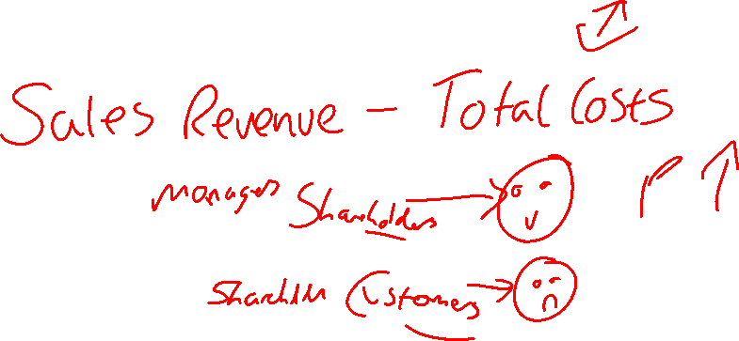
Starter
Write down three reasons why businesses want to grow?
For one of these reasons, How can different stakeholders have conflict over this reason?
For more help, please visit www.exampaperspractice.co.uk
© 2025 Exams Papers Practice. All Rights Reserved

Slide 4
For more help, please visit www.exampaperspractice.co.uk
© 2025 Exams Papers Practice. All Rights Reserved

Slide 5
Lesson Objectives
Are you able to identify the different objectives of growth?
Can you analyse the problems arising from growth?
Are you able to explain stakeholder conflict with the use of real world examples.
For more help, please visit www.exampaperspractice.co.uk
© 2025 Exams Papers Practice. All Rights Reserved

Slide 6
Economies of scale
Economies of scale occur when there is a fall in average total cost as the scale of production increases
Internal economies of scale occur due to an increase in the scale of production of a firm
External economies of scale occur due to an increase in the scale of production within the industry in which the firm operates
For more help, please visit www.exampaperspractice.co.uk
© 2025 Exams Papers Practice. All Rights Reserved

Slide 7
Activity
Task 1: Draw a diagram to show falling average costs per unit.
Task 2: Explain the impact of falling average costs on a business.
Challenge: How will consumers benefit from average falling costs for businesses.
For more help, please visit www.exampaperspractice.co.uk
© 2025 Exams Papers Practice. All Rights Reserved

Slide 8
Internal economies of scale
Economies of scale take a variety of forms, including:
Purchasing economies
Discounts for bulk-buying
Technical economies
The use of specialist, often expensive, capital e.g. machines
Managerial economies
Specialist labour e.g. accountants, lawyers, technical etc.
Financial economies
Better credit ratings as large firms are seen to be less likely to fail and can borrow money at lower interest rates
For more help, please visit www.exampaperspractice.co.uk
© 2025 Exams Papers Practice. All Rights Reserved

Slide 9
Purchasing economies of scale
Discounts for bulk-buying
As the firm is buying a job lot they are able to secure lower prices per unit
For more help, please visit www.exampaperspractice.co.uk
© 2025 Exams Papers Practice. All Rights Reserved

Slide 10
Technical economies of scale
The use of specialist, often expensive, capital e.g. machines
Large firms are able to spend more on bigger and more efficient machinery
They are able to spread fixed costs over greater output
They are likely to obtain lower costs per unit through this method
This increases competitiveness
Large firms can also spend more money on scientific Research and technical Development (R&D)
For more help, please visit www.exampaperspractice.co.uk
© 2025 Exams Papers Practice. All Rights Reserved

Slide 11
Managerial economies of scale
Employing specialist labour e.g. accountants, lawyers, technical etc.
Division of labour allows staff to focus on particular areas
As the employee is allowed to concentrate on a specific job they are likely to be:
better qualified
more experienced
more efficient
The manager of a small firm will often do the accounts, marketing and look after
human resource management issues i.e. a ‘Jack of all trades’
In larger firms we might see a highly qualified accountant working in finance or a
personnel department dealing with recruitment and selection
For more help, please visit www.exampaperspractice.co.uk
© 2025 Exams Papers Practice. All Rights Reserved

Slide 12
External economies of scale
A fall in average total cost due to factors outside of the control of the firm
They will impact on firms within the same industry or geographical region
They will create positive externalities
Examples include:
Improved transport infrastructure
A pool of skilled workers
More advanced communication systems
These will benefit all firms within an industry or region
For more help, please visit www.exampaperspractice.co.uk
© 2025 Exams Papers Practice. All Rights Reserved

Slide 13
Activity
Give one example of an internal economy of scale and one example of an external economy of scale.
Using a PEEL paragraph, how will purchasing economies benefit businesses?
Challenge: For managerial economies of scale, how can this be a benefit to the company?
For more help, please visit www.exampaperspractice.co.uk
© 2025 Exams Papers Practice. All Rights Reserved

Slide 14
Activity
Pedal power offer cycling holidays in the UK. Peggy Legget, has asked you to provide her with the following information:
Fixed costs per year (expenses) - £280,000
Variable / direct costs per holiday - £105.00
Average selling price - £210.00
She has prepared some projected sales figures for the forthcoming summer season as provided below.
Good weather – high demand expected of 3,500 bookings
Fair weather – demand expected to run at 3,200 bookings
Unpredictable weather – demand expected of 2,900 bookings
Washout summer – demand expected of 2,500 bookings
As a budding entrepreneur, she has approached you to calculate some profit forecasts for her. Using the figures provided she has asked that you calculate the answers to the following questions:
Task 1: Calculate the number of sales needed for the business to break even
Task 2: Calculate the average cost of each holiday at each level of demand
Challenge: Calculate the expected profit at each demand level.
For more help, please visit www.exampaperspractice.co.uk
© 2025 Exams Papers Practice. All Rights Reserved

Slide 15
Plenary
Explain two types of economies of scale.
Draw a diagram to show economies of scale.
How can a government create external economies of scale?
For more help, please visit www.exampaperspractice.co.uk
© 2025 Exams Papers Practice. All Rights Reserved

