Slide 1

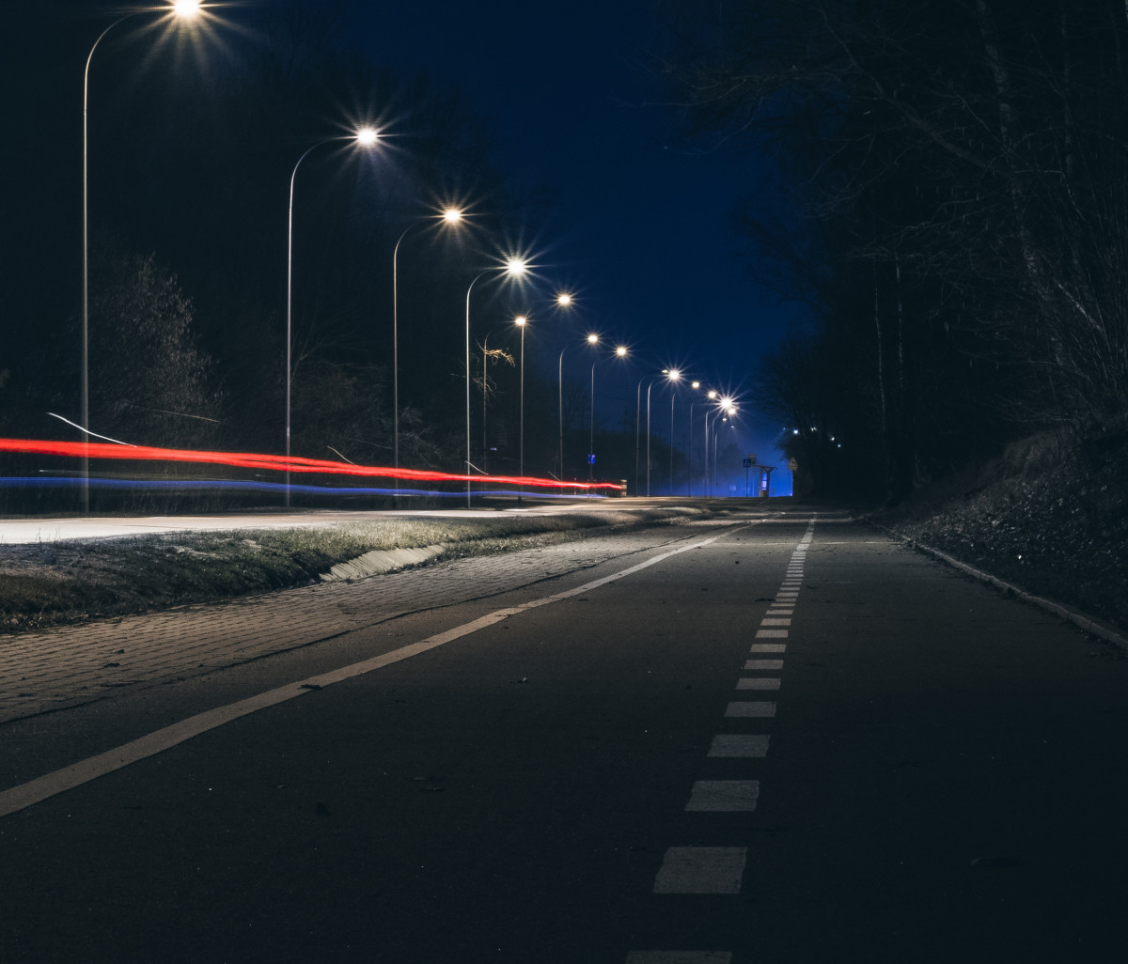


Public Goods
For more help, please visit www.exampaperspractice.co.uk
© 2025 Exams Papers Practice. All Rights Reserved

Slide 2

Recall
Give an example of a positive and a negative externality
Illustrate a negative externality on a diagram
For more help, please visit www.exampaperspractice.co.uk
© 2025 Exams Papers Practice. All Rights Reserved

Slide 3
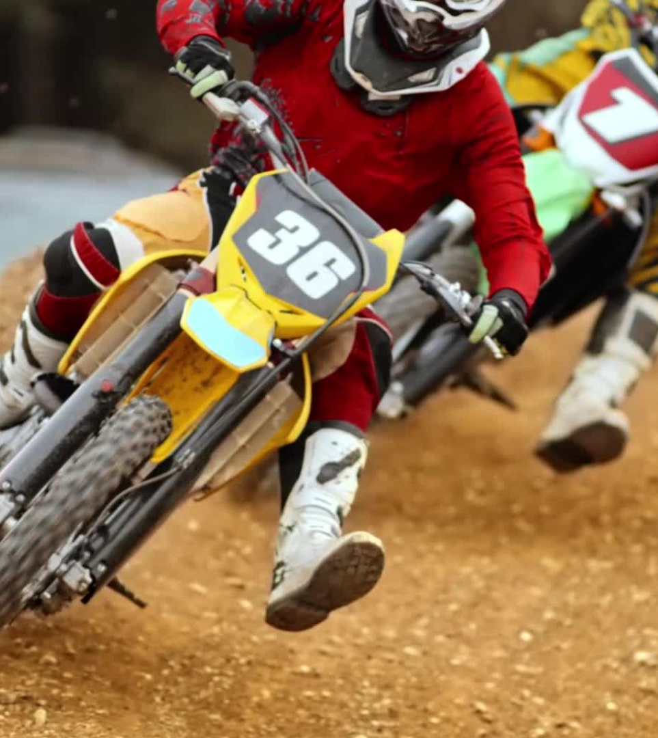
Learning Objectives
Are you able to distinguish between public and private goods?
Are you able to Explain the free rider problem?
For more help, please visit www.exampaperspractice.co.uk
© 2025 Exams Papers Practice. All Rights Reserved

Slide 4

Activity
The free market ignores ________ & _______ externalities
Define the term private costs and give examples
Define the term social costs and give examples
Define the term private benefits and give examples
Define the term social benefits and give examples
For more help, please visit www.exampaperspractice.co.uk
© 2025 Exams Papers Practice. All Rights Reserved

Slide 5

Green Pen
The free market ignores positive and negative externalities.
Social cost is the total cost to society. It includes both private costs plus any external costs.
Private costs that are incurred when an individual or business either produces or consumes something.
Private benefit is the benefit derived by an individual or firm directly involved in a transaction as either buyer or seller.
Social benefit is the total benefit to society from producing or consuming a good / service. Social benefit includes all the private benefits plus any external benefits of production / consumption.
For more help, please visit www.exampaperspractice.co.uk
© 2025 Exams Papers Practice. All Rights Reserved

Slide 6

Definition
Public goods are not provided by the market e.g. Street lights, road signs, beaches
Due to the free rider problem
For more help, please visit www.exampaperspractice.co.uk
© 2025 Exams Papers Practice. All Rights Reserved

Slide 7
Public goods are:
Non rival
i.e. Quality of good doesn’t diminish after consumption
Non excludable
i.e. The benefit of consuming can’t be confined to one individual
Therefore no price can be charged
For more help, please visit www.exampaperspractice.co.uk
© 2025 Exams Papers Practice. All Rights Reserved

Slide 8
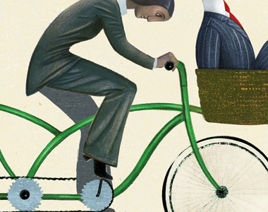
Free rider problem
Consumers wait for others to pay and then benefit
This is why the private (profit driven) sector cannot provide this good and the govt has to
For more help, please visit www.exampaperspractice.co.uk
© 2025 Exams Papers Practice. All Rights Reserved

Slide 9
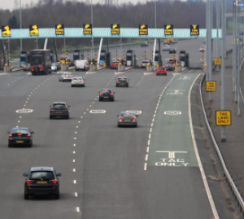
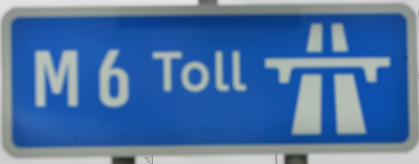
Quasi public goods
Quasi (non-pure) public goods have characteristics of both public and private goods
Partially provided by the free market. For example, roads such as M6 toll, only if you pay you can drive on it.
Congestion charge in London £15 a day
Jumeirah private beach (only if pay for hotel)
For more help, please visit www.exampaperspractice.co.uk
© 2025 Exams Papers Practice. All Rights Reserved

Slide 10
Plenary – Pick a box
1
2
3
DFGDFGDFGDFG | Ask someone a question based on today’s lesson | Lucky box You get to choose someone else to pick a box
Identify three public goods | Two features of public goods | What are quasi public goods
Very lucky box You get to choose someone else to pick a box and you can’t be picked again | Do you free ride? | Explain the free rider problem?
4
5
6
7
8
9
For more help, please visit www.exampaperspractice.co.uk
© 2025 Exams Papers Practice. All Rights Reserved

Slide 11

Information Gaps
For more help, please visit www.exampaperspractice.co.uk
© 2025 Exams Papers Practice. All Rights Reserved

