Slide 1
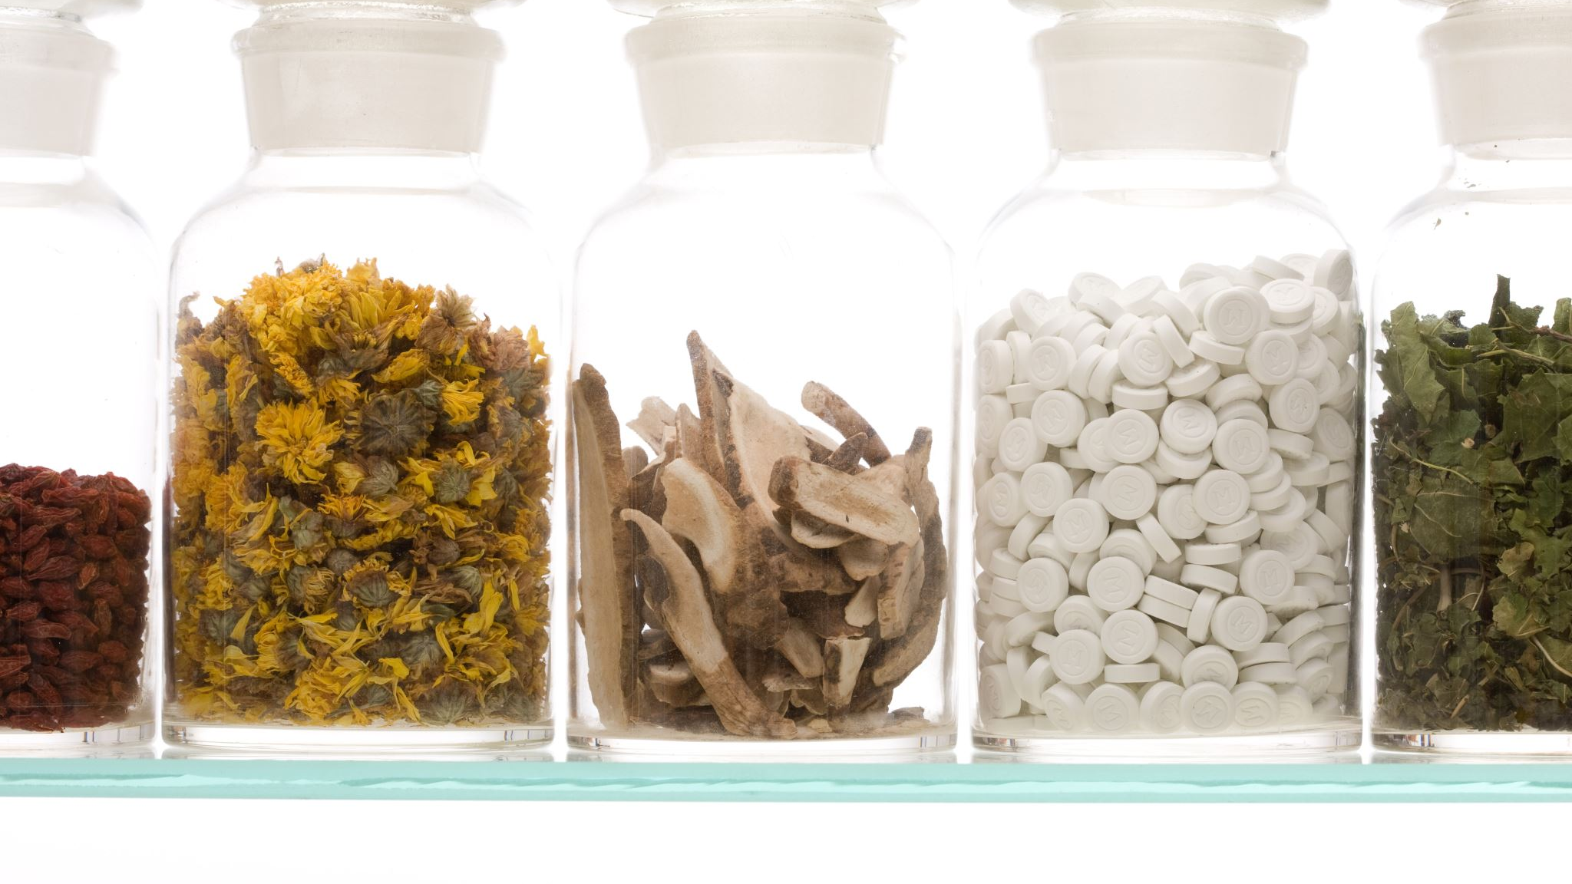
Negative externalities
For more help, please visit www.exampaperspractice.co.uk
© 2025 Exams Papers Practice. All Rights Reserved

Slide 2
Recall
What are the three types of market failure.
Explain each of them
For more help, please visit www.exampaperspractice.co.uk
© 2025 Exams Papers Practice. All Rights Reserved

Slide 3
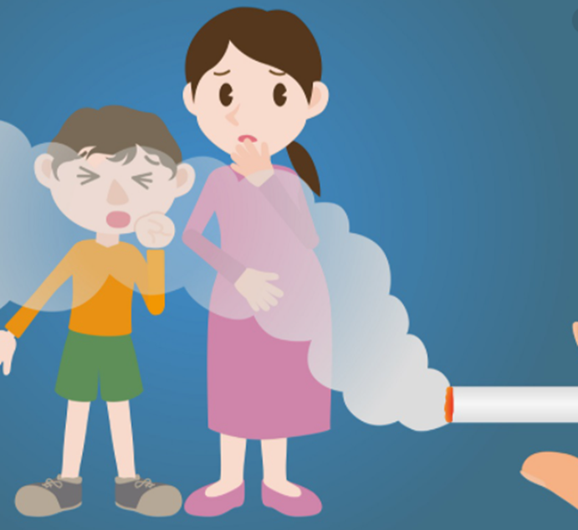
Starter
Why might Economists be interested in this picture?
For more help, please visit www.exampaperspractice.co.uk
© 2025 Exams Papers Practice. All Rights Reserved

Slide 4
Learning Objectives
• Are you able to distinguish between private, external, social costs/benefits?
• Are you able to illustrate on a diagram the different costs?
• Can you analyse the impact of externalities?
For more help, please visit www.exampaperspractice.co.uk
© 2025 Exams Papers Practice. All Rights Reserved

Slide 5
Negative externalities examples
For more help, please visit www.exampaperspractice.co.uk
© 2025 Exams Papers Practice. All Rights Reserved

Slide 6
Externalities explanation
https://www.youtube.com/watch?v=yC5R9WPId0s
For more help, please visit www.exampaperspractice.co.uk
© 2025 Exams Papers Practice. All Rights Reserved

Slide 7
Definition
Externality is the cost or benefit a third party receives from an economic transaction.
In other words, it is the spill over effect of the production or consumption of a good or service.
Externalities can be: Positive (external benefits) Or Negative (external costs)
For more help, please visit www.exampaperspractice.co.uk
© 2025 Exams Papers Practice. All Rights Reserved

Slide 8
Private costs/benefits
•Private costs are the costs to producers or consumers involved directly in an economic transaction.
•Producers are concerned with private costs of production. For example, the rent, the cost of machinery and labour.
•For consumers, it is the market price which the consumer pays for the good.
•Private benefits are the benefits derived from consuming a good i.e. The satisfaction of eating a chocolate.
•For producers, it is the revenue from selling goods.
For more help, please visit www.exampaperspractice.co.uk
© 2025 Exams Papers Practice. All Rights Reserved

Slide 9
Social costs/benefits
•This is private costs + external costs
•External costs are costs to others i.e. If you smoke, someone else breathes it is, NHS has to pay to fix them
•Social costs are costs to society as a whole PC+EC
•This is private benefits + external benefits
•External benefits are benefits to others i.e. If you get training/qualifications, others will benefit from when you work, govt get tax from you too.
•Social benefits are benefits to society as a whole PB+EB
For more help, please visit www.exampaperspractice.co.uk
© 2025 Exams Papers Practice. All Rights Reserved

Slide 10
Note:
•MSB – marginal social benefit
•M just stands for marginal, as in for each unit
For more help, please visit www.exampaperspractice.co.uk
© 2025 Exams Papers Practice. All Rights Reserved

Slide 11
nOTE
When social costs meet social benefits, this is the point of maximum welfare, socially optimum
For more help, please visit www.exampaperspractice.co.uk
© 2025 Exams Papers Practice. All Rights Reserved

Slide 12
Welfare diagram, not D and S
For more help, please visit www.exampaperspractice.co.uk
© 2025 Exams Papers Practice. All Rights Reserved

Slide 13
Welfare diagram, not D and S
For more help, please visit www.exampaperspractice.co.uk
© 2025 Exams Papers Practice. All Rights Reserved

Slide 14
cONTINUED
For more help, please visit www.exampaperspractice.co.uk
© 2025 Exams Papers Practice. All Rights Reserved

Slide 15
Note
•Red area is a misallocation of resources
•Q* is what society would look to be produced, but Q1 is what the market produces
•Overproduction
For more help, please visit www.exampaperspractice.co.uk
© 2025 Exams Papers Practice. All Rights Reserved

Slide 16
Activity
•That was a negative externality for consumption
•Draw a diagram illustrating a negative externality for production (Benefits line stays same, Costs line shifts left)
For more help, please visit www.exampaperspractice.co.uk
© 2025 Exams Papers Practice. All Rights Reserved

Slide 17
https://www.youtube.com/watch?v=sYTQ3o5ZJPI&list=PLWeicFreBUYCOFC2A0SlKrpEYgwaSF63t&index=24 from 2:00 Negative externality diagram
For more help, please visit www.exampaperspractice.co.uk
© 2025 Exams Papers Practice. All Rights Reserved

Slide 18
Govt. Policy for negative externalities
Indirect taxes: to reduce the quantity of demerit goods consumed.
This increases the price of the good. If the tax is equal to the external cost of each unit, then the supply curve becomes MSC rather than MPC, so the free market equilibrium becomes the socially optimum equilibrium.
This internalises the externality. In other words, the polluter pays for the damage.
BUT how we do give the MSC a money value?
For more help, please visit www.exampaperspractice.co.uk
© 2025 Exams Papers Practice. All Rights Reserved

Slide 19
Govt. Policy for negative externalities
•Subsidies: encourage the consumption of merit goods
•Regulation: to enforce less consumption of a good.
•For example, the minimum school leaving age. If there was a compulsory recycling scheme, it would be difficult to police and there could be high administrative costs.
For more help, please visit www.exampaperspractice.co.uk
© 2025 Exams Papers Practice. All Rights Reserved

Slide 20
Govt. Policy for negative externalities
•Provide the good directly: The government could provide public goods which are underprovided in the free market, such as with education.
•Provide information: so there is no information failure, and consumers and firms can make informed economic decisions.
•Personal carbon allowances: They could be tradeable, so firms and consumers can pollute up to a certain amount, and trade what they do not use.
For more help, please visit www.exampaperspractice.co.uk
© 2025 Exams Papers Practice. All Rights Reserved

Slide 21
Plenary
What is a negative externality?
Draw the diagrams.
How can a government deal with market failure?
For more help, please visit www.exampaperspractice.co.uk
© 2025 Exams Papers Practice. All Rights Reserved

