Slide 1
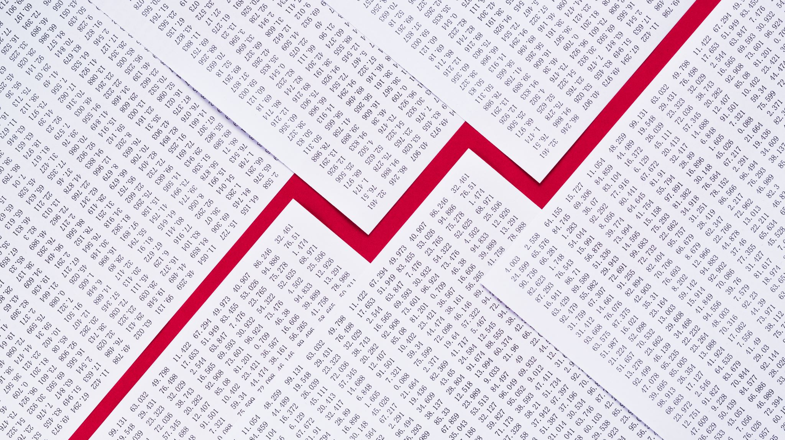
Types of market failure
For more help, please visit www.exampaperspractice.co.uk
© 2025 Exams Papers Practice. All Rights Reserved

Slide 2
Recall
Type
For more help, please visit www.exampaperspractice.co.uk
© 2025 Exams Papers Practice. All Rights Reserved

Slide 3
Starter
What might market failure mean?
How may this impact the economy?
For more help, please visit www.exampaperspractice.co.uk
© 2025 Exams Papers Practice. All Rights Reserved

Slide 4
Learning Objectives
Are you able to recall the types of market failure?
Are you able to explain the different types of market failure?
Are you able to explain what allocative efficiency is?
For more help, please visit www.exampaperspractice.co.uk
© 2025 Exams Papers Practice. All Rights Reserved

Slide 5
Market failure
so there is an inefficient allocation of scarce resources
Market failure occurs when the free market fails to allocate resources to the best interests of society
For more help, please visit www.exampaperspractice.co.uk
© 2025 Exams Papers Practice. All Rights Reserved

Slide 6
Externalities
Refers to the cost or benefit received from an economic transaction i.e, it is the spillover effect of the production or consumption of a good or service
For more help, please visit www.exampaperspractice.co.uk
© 2025 Exams Papers Practice. All Rights Reserved

Slide 7
2. Under provision of public goods
Public goods are non-excludable and non-rival, and they are underprovided in a free market because of the free-rider problem
For more help, please visit www.exampaperspractice.co.uk
© 2025 Exams Papers Practice. All Rights Reserved

Slide 8
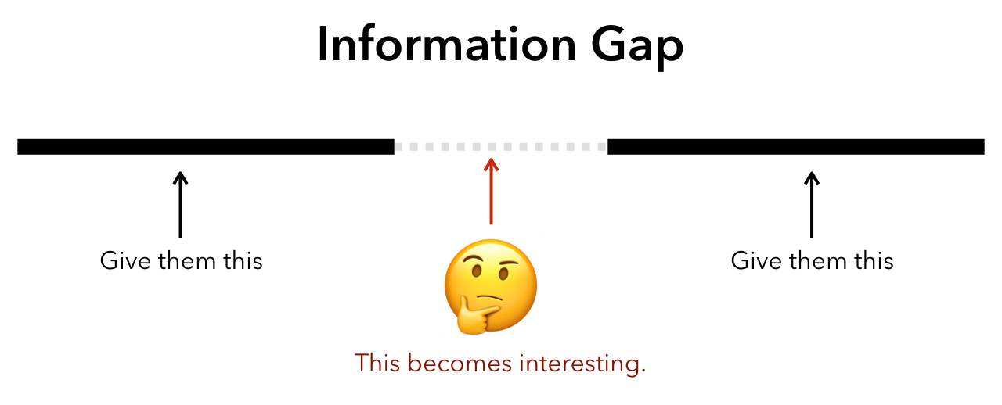
3) Information gaps
We might assume that individuals and firms have perfect information when making economic decisions. However, we don’t always have all the information needed to make a rational decision which leads to a misallocation of resources.
For more help, please visit www.exampaperspractice.co.uk
© 2025 Exams Papers Practice. All Rights Reserved

Slide 9
Allocative efficiency
Resources are allocated as efficiently as possible, at the social optimum
Watch these before next lesson (Econplusdal)
https://www.youtube.com/watch?v=L1u1mnQ1aE0&list=PLWeicFreBUYCOFC2A0SlKrpEYgwaSF63t&index=22
https://www.youtube.com/watch?v=2HU2ZLRGyOM&list=PLWeicFreBUYCOFC2A0SlKrpEYgwaSF63t&index=23
Different labels to the D & S for this as it is a welfare diagram we are looking at now
For more help, please visit www.exampaperspractice.co.uk
© 2025 Exams Papers Practice. All Rights Reserved

Slide 10
Plenary – Pick a box
What is allocative efficiency? | Ask someone a question based on today’s lesson | Lucky box You get to choose someone else to pick a box
What is MSB | One reason why markets fail? | Something you’re not sure about?
Very lucky box You get to choose someone else to pick a box and you can’t be picked again | One reason why markets fail? | One reason why markets fail?
1
2
3
4
5
6
7
8
9
For more help, please visit www.exampaperspractice.co.uk
© 2025 Exams Papers Practice. All Rights Reserved

