Slide 1
1.4.2 Risk and Liability
For more help, please visit www.exampaperspractice.co.uk
© 2025 Exams Papers Practice. All Rights Reserved

Slide 2
Learning Objectives
Are you able to describe and explain the different forms of business?
Are you able to explain the meaning of risk?
Are you able to analyse the implications of limited and unlimited liability?
For more help, please visit www.exampaperspractice.co.uk
© 2025 Exams Papers Practice. All Rights Reserved

Slide 3
Recall
For more help, please visit www.exampaperspractice.co.uk
© 2025 Exams Papers Practice. All Rights Reserved

Slide 4
Starter
What would a bank consider before lending money?
What must a government consider before spending taxpayers' money?
What must you consider before deciding to start your own business?
For more help, please visit www.exampaperspractice.co.uk
© 2025 Exams Papers Practice. All Rights Reserved

Slide 5
Definition: Business forms
A business form is the legal structure that it takes (in the UK). It could be a sole trader, a partnership, a private limited company (Ltd) or a public limited company (PLC).
Most (but not all) businesses in the UK are a Ltd – this is so that they can sell shares to friends and family to raise money to expand AND they get the benefit of limited liability (next slide)
For more help, please visit www.exampaperspractice.co.uk
© 2025 Exams Papers Practice. All Rights Reserved

Slide 6
Definition: Limited liability
Limited liability means that the owner of the business has no personal liability for business debts. The owner has a separate legal identity from the business and is NOT liable for payment of the debts from their own personal funds.
For more help, please visit www.exampaperspractice.co.uk
© 2025 Exams Papers Practice. All Rights Reserved

Slide 7
Unlimited liability
If a business gains debts, goes bust or is sued this could be a problem for the owner​
If there is no money in the business then the owner would need to pay using their own savings, and finances, they may even have to remortage their home or even sell their car to pay the debts​
This is unlimited liability​
Watch the video can you now explain limited and unlimited liability?
For more help, please visit www.exampaperspractice.co.uk
© 2025 Exams Papers Practice. All Rights Reserved

Slide 8
Sole trader
Business owned by one owner, but they can take on staff
Also known as a sole proprietor
Can employ people but they will not be involved in control of business
Tend to be small businesses
Has unlimited liability
Examples include; small shops, accountants that work from home, online traders, plumbers etc.
For more help, please visit www.exampaperspractice.co.uk
© 2025 Exams Papers Practice. All Rights Reserved

Slide 9
Activity - Sole trader
Make a list of possible sole trader jobs and professions
Share these with another pair until you build up a large list
How many of these types of businesses would be in trouble if they remained a limited liability company? To answer this consider if they are likely to accrue large debts or be sued.
For more help, please visit www.exampaperspractice.co.uk
© 2025 Exams Papers Practice. All Rights Reserved

Slide 10
Pros and cons of sole traders
Advantages
Easy to set up – no complicated forms
Make decisions quickly
Less capital needed
All profits kept by the owner
Can offer personal attention to customers
Don’t have to make any information about the company public
They are their own boss
Disadvantages
Unlimited liability, this means that if the business has financial difficulties the sole trader could lose their own assets like their savings, house or car
Difficult to raise money – seen as a risk
Don’t have economies of scale (buying in bulk)
No one to take over for ill-health or holidays
For more help, please visit www.exampaperspractice.co.uk
© 2025 Exams Papers Practice. All Rights Reserved

Slide 11
Partnerships
2 to 20* partners share the risks, costs and responsibilities of being in business
The profits and gains of the partnership are shared among the partners, unless the partnership agreement states otherwise
Each partner is personally responsible for paying tax on their share of the profits and gains
Partners raise finance for the business out of their own assets, cash or with loans
The partners themselves usually manage the business, although they can delegate certain responsibilities to employees
It is possible to have 'sleeping' partners who contribute capital investment to the business but are not involved in running the business
For more help, please visit www.exampaperspractice.co.uk
© 2025 Exams Papers Practice. All Rights Reserved
Notes:
Adapted from: https://www.nibusinessinfo.co.uk/content/business-partnerships
*UK might be different in other countries

Slide 12
Activity - Partnerships
Partnerships tend to be groups of experts who can all work in a practice together
For example a dentists practice may be a group of dentists who have started the business as a partnership
Carry out some research and create a list of likely partnership professions
Also find out what an LLP is - it is outside the scope of you’re a Level but important to know
For more help, please visit www.exampaperspractice.co.uk
© 2025 Exams Papers Practice. All Rights Reserved

Slide 13
Pros and cons of partnerships
Advantages
Easier than a sole trader to raise extra capital, as partners all have their own sources of finance e.g. savings
Profits go to the partners, which is very motivating
Smaller business means good working relationships
No need to make public any information
Partners contribute with range of skills
Shared problems and decisions
Disadvantages
Unlimited liability
Partners may have disagreements about;
Control of business
Sharing of profits
Withdrawal from the partnership
Inviting new partners into the business
For more help, please visit www.exampaperspractice.co.uk
© 2025 Exams Papers Practice. All Rights Reserved

Slide 14
Private limited company (ltd)
LTDs can expand and grow by selling more shares, giving the business more capital​
Friends and family can buy shares in the business, this will make them part owners​
Shares cannot be bought by the public​
LTDs owners have full control of who buys the shares​
LTDs have the benefit of limited liability, those that own or buy shares in the business can only lose their original investment, their private assets remain safe​
For more help, please visit www.exampaperspractice.co.uk
© 2025 Exams Papers Practice. All Rights Reserved

Slide 15
Activity - Private Limited Companies
Limited companies tend to be businesses where having limited liability is critical.
For example a scaffolding company could be worried about a pole falling on the head of someone underneath and being sued. Limited liability gives the owners some protection over their personal finances
Carry out some research and find 9 limited liability businesses in your local area. Use check-a-trade and yell.com websites
For more help, please visit www.exampaperspractice.co.uk
© 2025 Exams Papers Practice. All Rights Reserved

Slide 16
Pros and cons of private limited companies (ltd)
Advantages
Limited liability
Can raise extra capital by selling more shares, to friends and family, making it easier to expand
Can employ managers to run the business if the owners don’t want to do it themselves
Has its own legal status, separate from the shareholders
Disadvantages
Accounts of the company cannot be kept private, they have to be available for the public to see
More complex and expensive to set up - more administration
Cannot sell shares on stock exchange, which limits the amount of capital that it can raise
For more help, please visit www.exampaperspractice.co.uk
© 2025 Exams Papers Practice. All Rights Reserved

Slide 17
Franchising introduction
An entrepreneur may choose to set up with an established business name and buy a franchise
For example an entrepreneur may wish to open their own sandwich bar and call it “Bob’s sandwiches” or they could buy the Subway franchise
There is less business risk by buying a well known brand
For more help, please visit www.exampaperspractice.co.uk
© 2025 Exams Papers Practice. All Rights Reserved

Slide 18
What is a franchise?
Imagine a company has a great and successful business. It wants to expand but it doesn’t want the problems and expense of opening more stores, so it sells the business idea
If an entrepreneur buys a franchise it is a “business in a box”, as well as signage and training they will get support of a national company and a brand that customers already know
For more help, please visit www.exampaperspractice.co.uk
© 2025 Exams Papers Practice. All Rights Reserved

Slide 19
Franchising vocab
Franchisee; This is the business owner who is buying the rights e.g. Gurdeep
Franchisor; this is the business that is selling the rights e.g. Subway
For more help, please visit www.exampaperspractice.co.uk
© 2025 Exams Papers Practice. All Rights Reserved

Slide 20
Cost of a franchise
When a business person decides to buy a franchise they will need to take into consideration the costs:
Cost of buying the franchise rights at the start
Monthly royalty payment to the franchisor
Have a look at the McDonald’s website for franchising
For more help, please visit www.exampaperspractice.co.uk
© 2025 Exams Papers Practice. All Rights Reserved

Slide 21
Activity - Franchising
Have a look at the franchising websites on the Internet
Choose a franchise and find out how much it would cost to start up
Include any yearly royalties and the cost of premises and staff
Present your franchise to the rest of the group and explain how much revenue you expect to earn in the first year
For more help, please visit www.exampaperspractice.co.uk
© 2025 Exams Papers Practice. All Rights Reserved

Slide 22
Franchising pros and cons
Advantages
The franchisor chooses the franchisees carefully, they know what characteristics that make a successful franchisee
The franchisor decides how much money the franchisee must invest in the business
The franchisor provides support, management advice and training
Disadvantages
Franchisees do not have freedom of running their own business
Franchisee bound by rules cannot vary the price or products sold
Franchisee pays percentage of profits in royalties to the franchisor
Franchisee will never own the business outright
For more help, please visit www.exampaperspractice.co.uk
© 2025 Exams Papers Practice. All Rights Reserved

Slide 23
Growth to plc
Once a limited (Ltd) company has grown in size and needs further investment, which it cannot get from its current pool of owners, it may consider becoming a PLC
If it intends to float shares on the stock market, so they can be bought by anyone, it will need to first issue a prospectus where potential investors are invited to purchase share before flotation (called an IPO)
Going public is expensive
Lawyers to draw up legal paperwork
Publications
Advertising and admin
Company must have £50,000 in share capital
For more help, please visit www.exampaperspractice.co.uk
© 2025 Exams Papers Practice. All Rights Reserved

Slide 24
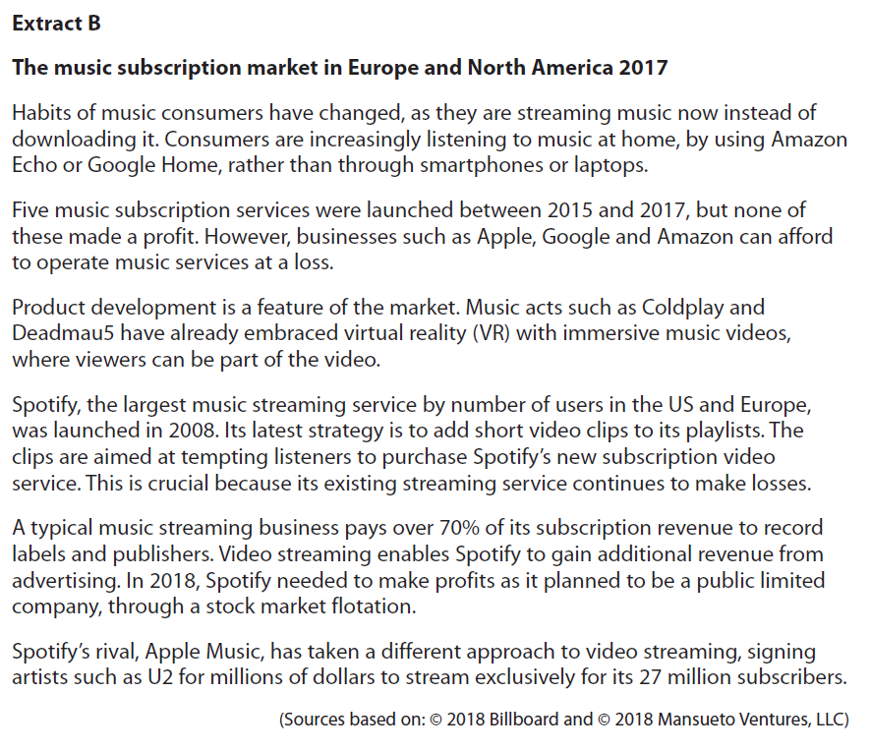
Activity
For more help, please visit www.exampaperspractice.co.uk
© 2025 Exams Papers Practice. All Rights Reserved

Slide 25
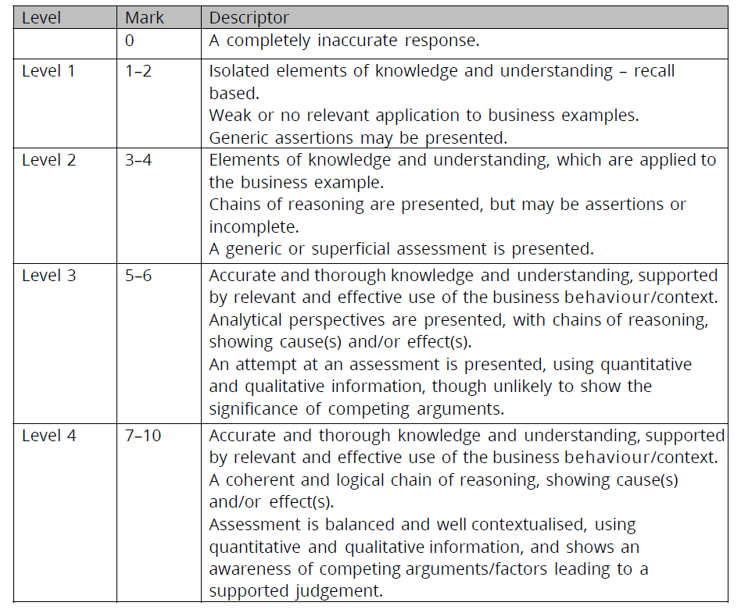
Sample Answer
For more help, please visit www.exampaperspractice.co.uk
© 2025 Exams Papers Practice. All Rights Reserved

Slide 26
Key terms
Sole trader; a person who sets up business on their own, they can have employees but there is only one owner
Partnership; two to 20 people who set up a business together as joint owners e.g. vets, solicitors, dentists
PLC; stands for public limited company, shares are floated on the stock market and can be bought by anyone
LTD; stands for private limited company, shares can only be sold to friends and family
Franchise; a business idea which is sold to other owners who run it under a licence and pay royalties, in return they get branding and marketing support e.g. Subway
Franchisor; the person who sells the franchise
Franchisee; the person who buys the franchise
For more help, please visit www.exampaperspractice.co.uk
© 2025 Exams Papers Practice. All Rights Reserved

Slide 27
Risk and uncertainty
Both risk and uncertainty deal with unknowns
Risks
It is possible to add a probability to quantify the degree of risk
It is measurable
Uncertainties
It is not possible to add a quantifiable probability as the outcome is too unpredictable
It is not measurable
Business decision making involves both risk and uncertainties
For more help, please visit www.exampaperspractice.co.uk
© 2025 Exams Papers Practice. All Rights Reserved

Slide 28
Risk
Examples of risk in business include:
An entrepreneur takes a risk when setting up in business
May have given up paid employment
Investing personal savings into a venture that may not work
Personal esteem and reputation
Family home and possessions may be at risk
Research three entrepreneurs and discuss the trade-offs.
For more help, please visit www.exampaperspractice.co.uk
© 2025 Exams Papers Practice. All Rights Reserved

Slide 29
Risk
List the factors, which would need to be considered when evaluating risks of a financial institution when lending money
Will it be paid back?
When will it be paid back?
Can the repayments be made?
What is the interest rate?
Is it secured against an asset?
What will happen if the business fails?
For more help, please visit www.exampaperspractice.co.uk
© 2025 Exams Papers Practice. All Rights Reserved

Slide 30
Risk
Examples of risk in business include:
A supplier providing goods or services on credit i.e. supply now but give the customer time to pay
Will the supplier get paid?
If not how much have they lost?
How serious will this loss be to their own business?
For more help, please visit www.exampaperspractice.co.uk
© 2025 Exams Papers Practice. All Rights Reserved

Slide 31
Plenary Quiz
Identify the form of business from the definition
___________ this is a form of business that has floated its shares on the stock market to sell to the general public
____________is a simple business structure where there is only one owner. They are liable for all losses but can keep any profits that they make
_____________is a form of business where the owners have limited responsibility for debts and shares can be sold to friends and family
__________ is a form a business where 2- 10 people will own a business and jointly share responsibility for it

Slide 32
Plenary Quiz Answers
Public Limited Company or PLC this is a form of business that has floated its shares on the stock market to sell to the general public
Sole Trader is a simple business structure where there is only one owner. They are liable for all losses but can keep any profits that they make
Private Limited Company or Ltd is a form of business where the owners have limited responsibility for debts and shares can be sold to friends and family
Partnership is a form a business where 2- 20 people will own a business and jointly share responsibility for it
For more help, please visit www.exampaperspractice.co.uk
© 2025 Exams Papers Practice. All Rights Reserved

