Slide 1
1.3.5 Understanding the customer
Theme 1: Markets, consumers and firms
Primary and secondary market research data (quantitative and qualitative) used to quantify likely demand and gain insight into consumer behaviour
For more help, please visit www.exampaperspractice.co.uk
© 2025 Exams Papers Practice. All Rights Reserved

Slide 2
Recall
Define the following terms
Explain why the price mechanism tends to lead to firms reallocating resources to markets with potential growth
Price Mechanism
Rationing Funding
Incentives Function
Signalling Function
For more help, please visit www.exampaperspractice.co.uk
© 2025 Exams Papers Practice. All Rights Reserved

Slide 3
Learning aims
Identify the importance of market research
List the features of the types of market research
Evaluate how market research can influence business decision making
For more help, please visit www.exampaperspractice.co.uk
© 2025 Exams Papers Practice. All Rights Reserved

Slide 4
Market research
Market research is the collection and analysis of data and information to inform a business about its market
Data collected and analysed is used to:
identify and anticipate customer needs and wants
quantify likely demand
gain insight into consumer behaviour
Primary market research (field research) involves the collection of first hand data that did not exist before and therefore it is original data
Secondary market research (desk research) is research that has already been undertaken by another organisation and therefore already exists
For more help, please visit www.exampaperspractice.co.uk
© 2025 Exams Papers Practice. All Rights Reserved

Slide 5
Primary market research
Examples of primary market research include:
Surveys and questionnaire
Postal
Telephone
Face–to-face
On-line
In depth interviews
Focus groups
Observations
Activity
1) List the benefits of collecting primary research
2) Evaluate how this information could be helpful to a firm, provide a real life example
3) List the drawbacks of collecting primary data
4) Evaluate how this data could be unhelpful to a firm, explain with an example.
For more help, please visit www.exampaperspractice.co.uk
© 2025 Exams Papers Practice. All Rights Reserved

Slide 6
Secondary market research
Activity
1) List the benefits of collecting primary research
2) Evaluate how this information could be helpful to a firm, provide a real life example
3) List the drawbacks of collecting primary data
4) Evaluate how this data could be unhelpful to a firm, explain with an example.
Examples of secondary market research include:
National and Local Government e.g. Office for National Statistics
Market Research organisations e.g. MORI, MINTEL
Professional bodies e.g. ACCA
Trade unions and Confederation of British Industry (CBI)
International bodies e.g. EU, OECD
Academic organisations e.g. universities
Newspapers and magazines
The Internet
For more help, please visit www.exampaperspractice.co.uk
© 2025 Exams Papers Practice. All Rights Reserved

Slide 7
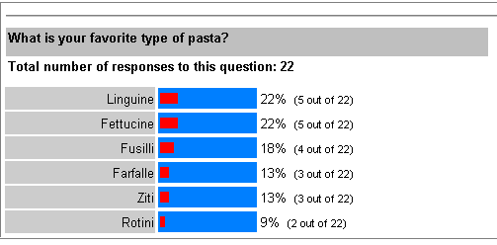
Qualitative and quantitative data
Qualitative research is the gathering of non-statistical information that gives a company in depth insight into the reasons for human behaviour
Quantitative research is the gathering of statistical data to inform the company about people’s behaviour but does not identify the reasons
For more help, please visit www.exampaperspractice.co.uk
© 2025 Exams Papers Practice. All Rights Reserved

Slide 8
In pairs
 | Primary | Secondary
Quantitative
Qualitative
How can each type of research data be used by businesses, for example can primary quantitative data from a questionnaire identify and anticipate needs and wants?
Identify and anticipate customer needs and wants
Quantify likely demand
Gain insight into
For more help, please visit www.exampaperspractice.co.uk
© 2025 Exams Papers Practice. All Rights Reserved

Slide 9
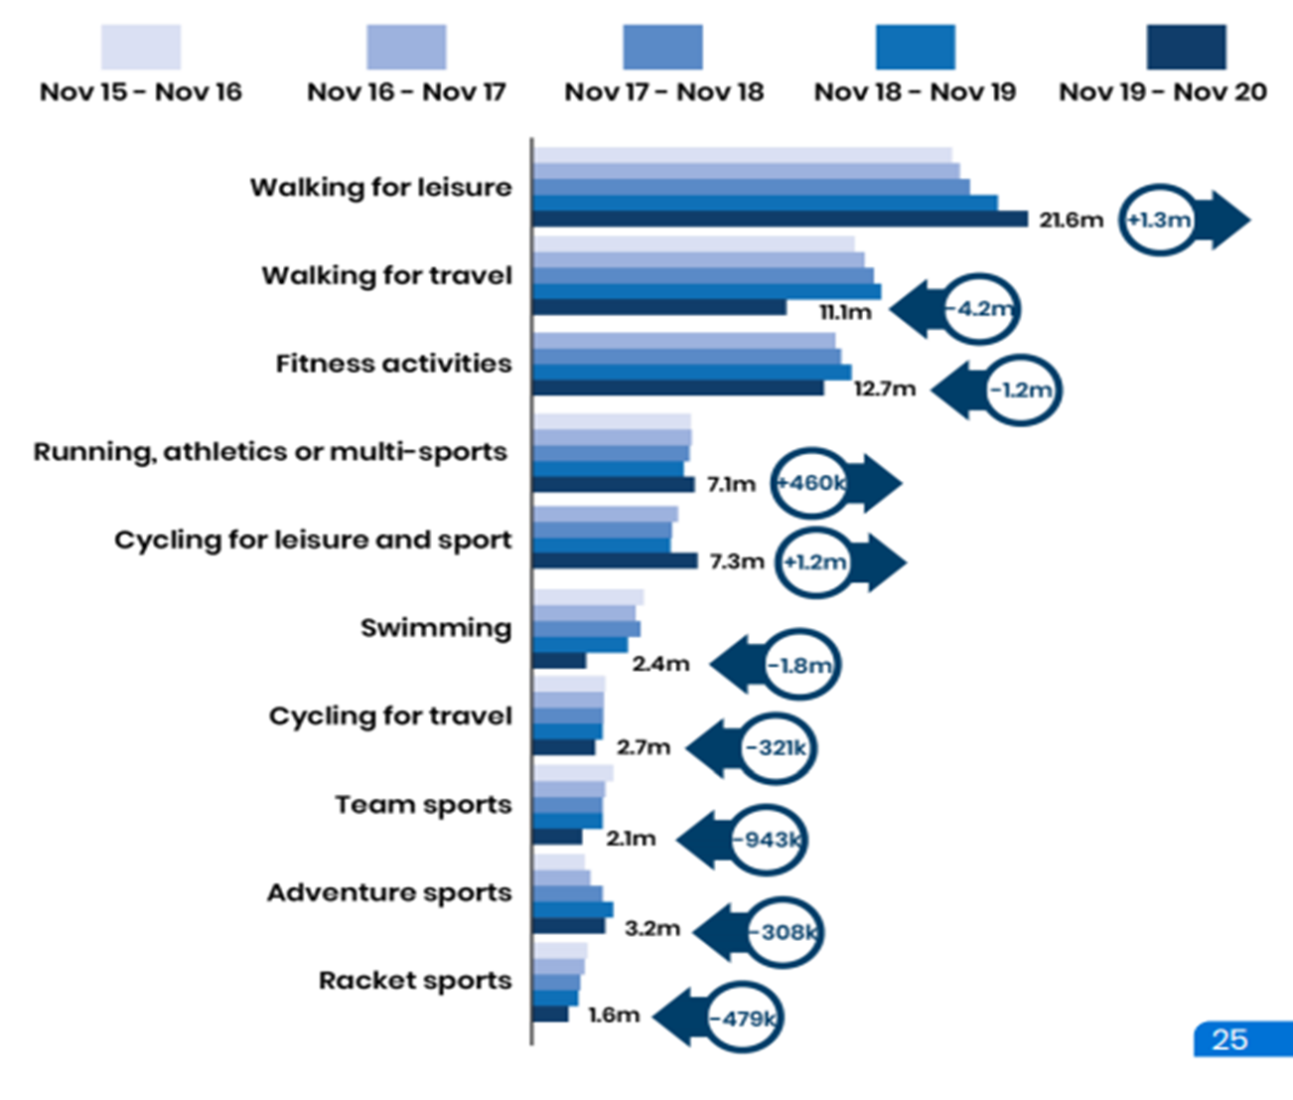
The data shows the growth or decline of sports over a five year period. Examine the secondary data
Explain the key findings
Explore how this relates to demand
For more help, please visit www.exampaperspractice.co.uk
© 2025 Exams Papers Practice. All Rights Reserved

Slide 10
Census data
Explain the purpose of collecting this information
How do the government and external agencies use this information
How can this data be used to help support the economy.
For more help, please visit www.exampaperspractice.co.uk
© 2025 Exams Papers Practice. All Rights Reserved

Slide 11
Check my learning
Explain the purpose of market research.
Evaluate how market research can contribute to the success of a firm.
Identify the types of data which can be collected.
For more help, please visit www.exampaperspractice.co.uk
© 2025 Exams Papers Practice. All Rights Reserved

