Slide 1


1.3.3 Price Determination
Theme 1: Markets, consumers and firms
1.3 Introducing the market
For more help, please visit www.exampaperspractice.co.uk
© 2025 Exams Papers Practice. All Rights Reserved

Slide 2

What we need to cover
Equilibrium price and quantity and how they are determined
The use of supply and demand diagrams to depict excess supply and excess demand
The operation of market forces to eliminate excess demand and excess supply
The use of the supply and demand model to show how shifts in demand and supply curves cause the equilibrium price and quantity to change in real-world situations
The limitations of the supply and demand model and its predictions
For more help, please visit www.exampaperspractice.co.uk
© 2025 Exams Papers Practice. All Rights Reserved

Slide 3
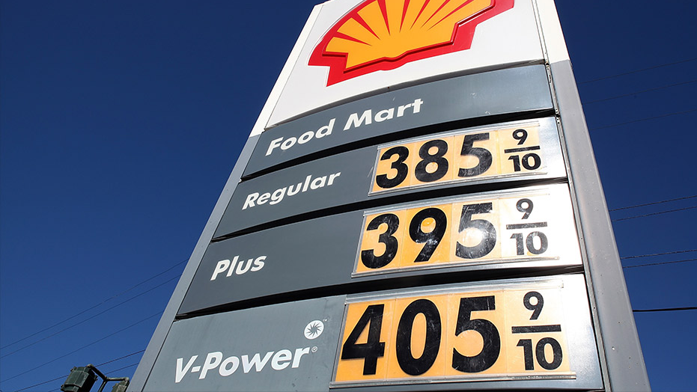
Price determination
Price is dependent on the interaction between demand and supply components of a market
In a free market, the forces of demand and supply determine the prices
For more help, please visit www.exampaperspractice.co.uk
© 2025 Exams Papers Practice. All Rights Reserved

Slide 4
Determination of equilibrium price and quantity in a market
Market equilibrium is that point at which demand is equal to supply
This is known as the market clearing price as all products will be sold at this price
  all buyers can get the exact amount that they want to buy at this price and all sellers provide exactly the amount that they want to sell at this price
  therefore, there is nothing left over – the market has cleared
Any change in demand or supply will lead to a new equilibrium price
For more help, please visit www.exampaperspractice.co.uk
© 2025 Exams Papers Practice. All Rights Reserved

Slide 5
Determination of equilibrium price and quantity in a market
At a price of P quantity demanded (qd) is equal to quantity supplied (qs). All products are sold and no products are left over – the market has cleared.
At this price all products that have been offered for sale by suppliers have been bought by buyers all supply has had an equal demand.
S
Price
P
D
Q
Quantity
For more help, please visit www.exampaperspractice.co.uk
© 2025 Exams Papers Practice. All Rights Reserved

Slide 6
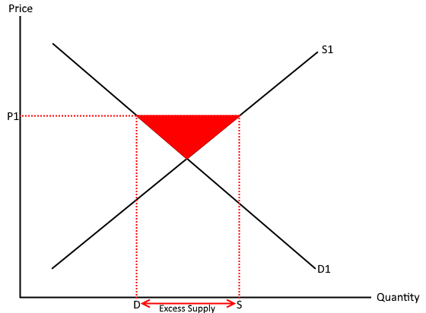
If the price of the good is above the market equilibrium then there will be an excess in supply.
On the other hand, if the price of the good is below the market equilibrium price then there will be an excess of demand. In either case, the market will not be operating at equilibrium and therefore won’t clear.
There area between demand and supply and underneath/below the equilibrium point represents the excess supply/demand
For more help, please visit www.exampaperspractice.co.uk
© 2025 Exams Papers Practice. All Rights Reserved

Slide 7
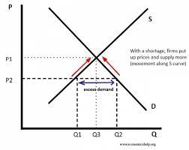
Market forces
When there is excess demand, the impact is a shortage. The marking is failing to clear because the current price at P1 is below equilibrium.
For more help, please visit www.exampaperspractice.co.uk
© 2025 Exams Papers Practice. All Rights Reserved

Slide 8
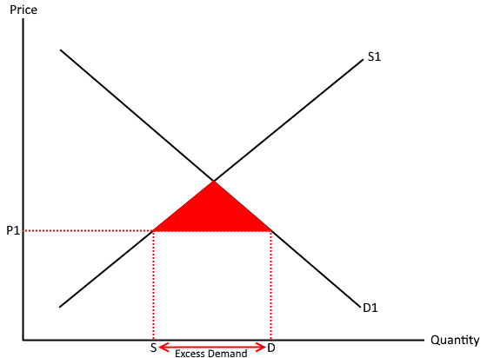
Excess supply and demand
For more help, please visit www.exampaperspractice.co.uk
© 2025 Exams Papers Practice. All Rights Reserved

Slide 9
Excess supply and demand
Excess demand occurs when the quantity demanded outstrips the quantity supplied. The price is too low for the market to clear
Excess supply occurs when the quantity supplied is greater than the quantity demanded. The price is too high for the market.
For more help, please visit www.exampaperspractice.co.uk
© 2025 Exams Papers Practice. All Rights Reserved

Slide 10
Determination of equilibrium price and quantity in a market
Excess Supply:
If price were to rise to P1 we would have a position of excess supply. Buyers would demand less (Q1) at the higher price but firms would wish to supply more (Q2) at this price. This would lead to a situation of too much supply (Q2 – Q1) in the market.
To solve this problem firms would need to lower price to get rid of excess products.
Price
S
P1
P
D
Q1
Q
Q2
Quantity
For more help, please visit www.exampaperspractice.co.uk
© 2025 Exams Papers Practice. All Rights Reserved

Slide 11
Determination of equilibrium price and quantity in a market
If price were to fall to P2 we would have a position of excess demand.
Buyers would demand more (Q2) at the lower price but firms would wish to supply less (Q1) at this price. This would lead to a situation of too much demand (Q2 – Q1) in the market.
To improve profitability firms could raise price, thus reducing the excess demand.
Price
S
P
P2
D
Q1
Q
Q2
Quantity
For more help, please visit www.exampaperspractice.co.uk
© 2025 Exams Papers Practice. All Rights Reserved

Slide 12
Determination of equilibrium price and quantity in a market
Market forces are always pushing prices towards market equilibrium – the price at which demand equals supply and there are no products left over in the market. Too much supply leads to lower prices, too much demand to higher prices.
Where demand is equal to supply we have the market equilibrium price.
Price
S
P1
P
Market equilibrium
P2
D
Q1
Q
Q2
Quantity
For more help, please visit www.exampaperspractice.co.uk
© 2025 Exams Papers Practice. All Rights Reserved

Slide 13
Test Yourself
Which of the following statements best defines market equilibrium?
  Prices are kept low leading to consumer satisfaction
  Quantity demanded in the market matches supply
  The market is saturated by cheap supplies
  More suppliers can enter the market to maximise profits
For more help, please visit www.exampaperspractice.co.uk
© 2025 Exams Papers Practice. All Rights Reserved

Slide 14
Determination of equilibrium price and quantity in a market
As shown on the diagram opposite price has fallen from P to P1. Which of the following statements is correct?
The market is in equilibrium
The market has excess demand of Q1 - Q2
The market has excess supply of Q1 – Q2
The market has excess supply and demand of Q1 – Q2
Price
S
P
P1
D
Q1
Q
Q2
Quantity
For more help, please visit www.exampaperspractice.co.uk
© 2025 Exams Papers Practice. All Rights Reserved

Slide 15
A change in price, shown by the red line, has led to excess supply within the textiles market. Which of the following diagrams shows this?
b)
S
a)
D
D
S
S
c)
d)
D
S
D
For more help, please visit www.exampaperspractice.co.uk
© 2025 Exams Papers Practice. All Rights Reserved

Slide 16
The impact of changes in demand and supply on equilibrium
A shift in the demand curve will occur due to changes in: | A shift in the supply curve will occur due to changes in:
Consumer income Prices of other goods and services Consumer tastes and fashion Other factors e.g. advertising | The impact of changing costs of production Technological progress Prices of other goods and services Government policy e.g. taxes and subsidies Other factors e.g. expectations
It is important to remember that:
  a change in price will lead to a movement along the supply or demand curve
However:
  a change in any other factor will lead to a shift in the demand or supply curve
For more help, please visit www.exampaperspractice.co.uk
© 2025 Exams Papers Practice. All Rights Reserved

Slide 17
The impact of changes in demand and supply on equilibrium
A change in price will cause either:
  A movement along the demand curve
Or
  A movement along the supply curve
Disequilibrium occurs when there is an imbalance in the quantity demanded and quantity supplied of a product i.e. there is excess demand or excess supply.
For more help, please visit www.exampaperspractice.co.uk
© 2025 Exams Papers Practice. All Rights Reserved

Slide 18
The impact of changes in demand and supply on equilibrium
An increase in demand will see the demand curve shift upwards and towards the right from D to D1. This will cause price to rise to P1 and quantity demanded to Q1.
At this point we have a new market equilibrium (P1 Q1).
The shift in demand has led to a movement along the supply curve.
Price
S
P1
P
D
Q
Q1
Quantity
For more help, please visit www.exampaperspractice.co.uk
© 2025 Exams Papers Practice. All Rights Reserved

Slide 19
The impact of changes in demand and supply on equilibrium
An increase in supply will see the supply curve shift downwards and towards the right from S to S1. This will cause price to fall to P1 and quantity supplied to rise to Q1.
At this point we have a new market equilibrium (P1 Q1).
The shift in supply has led to a movement along the demand curve.
Price
S
S1
P
P1
D
Q
Q1
Quantity
For more help, please visit www.exampaperspractice.co.uk
© 2025 Exams Papers Practice. All Rights Reserved

Slide 20
The impact of changes in demand and supply on equilibrium
Price
S2
S
On the diagram show what will happen when there is a decrease in supply.
Explain what has happened.
P2
P
D
Q2
Q
Quantity
A decrease in supply will see the supply curve shift upwards and towards the left from S to S2. This will cause price to rise to P2 and quantity supplied to fall to Q2. At this point we have a new market equilibrium (P2 Q2). The shift in supply has led to a movement along the demand curve.
For more help, please visit www.exampaperspractice.co.uk
© 2025 Exams Papers Practice. All Rights Reserved

Slide 21
The limitations of the supply and demand model and its predictions
Although widely used in economic research the supply and demand model is limited due to:
  Supply and demand looks at competitive markets. In the real world the degree of competition in the market varies
  The ceteris paribus principle – in the real world other variables change in a dynamic economy
  Extrapolating microeconomic information to look at goods and services that have large markets means that more variables can cause change
  Information tends to be asymmetric so that consumers do not have full information regarding products. This leads to decision making that does not maximise consumer satisfaction
For more help, please visit www.exampaperspractice.co.uk
© 2025 Exams Papers Practice. All Rights Reserved

